Slide 1
SCIENCE
Reflections: Which surface reflects more light?

Slide 2
WHICH SURFACE REFLECTS MORE LIGHT?
1
Introduction
2
Setting up the experiment
3
Data collection
SCIENCES
4
Data analysis
5
Questions
6
Activity summary

Slide 3
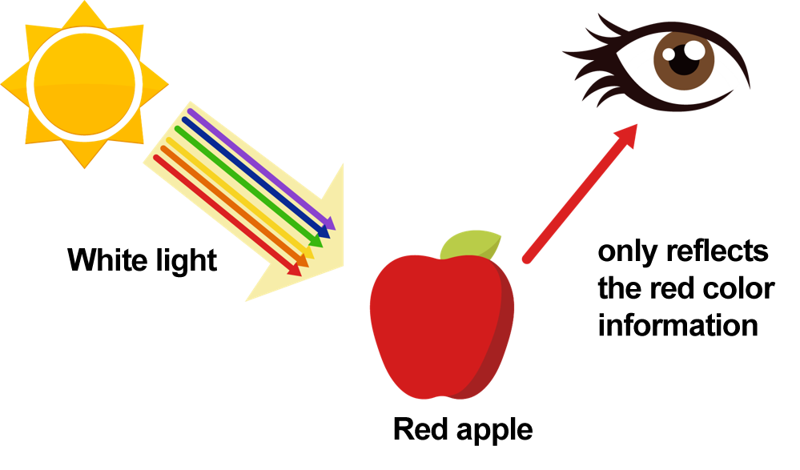
Introduction
1
Have you ever wondered why we perceive objects in different colors? This occurs because white light contains all colors combined. When it hits an object, that object absorbs all colors except for the one we see, which is reflected towards our eyes. For instance, a red apple absorbs all colors except red, which it reflects, allowing us to see it as red.
From the text above we can deduce that not all objects reflect light in the same way, so in this lesson you are going to compare how much light is reflected by 3 different surfaces using the Xploris light sensor.
The question you will answer will be:
Which of the following materials reflects more light and which reflects less: white paper, black paper, or aluminum foil?

Slide 4
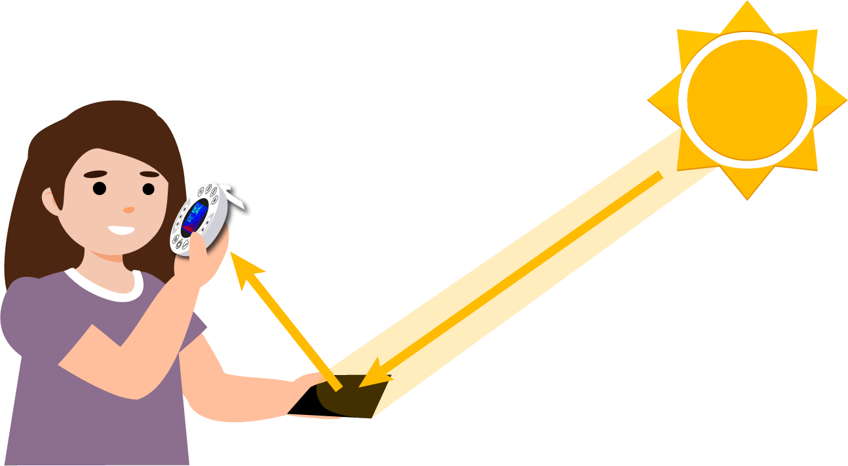
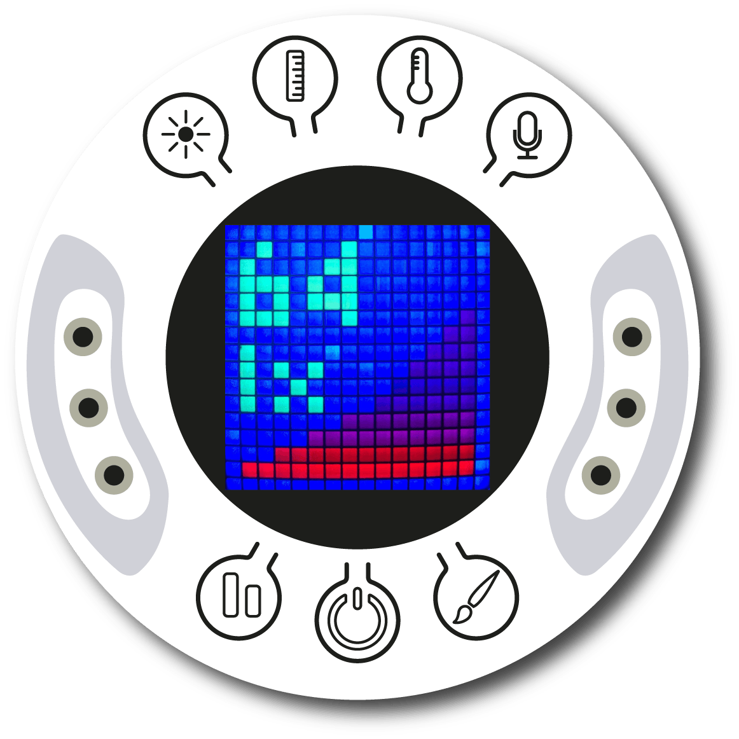
Setting up the experiment
2
You will expose 3 surfaces directly to the sun and measure how much light they reflect using the Xploris light sensor. The surfaces you will use are: a sheet of white paper, aluminum foil and a sheet of black paper.
To take a measurement, we suggest looking carefully at the Xploris screen until the light intensity stabilizes and then taking the measurement.

Slide 5
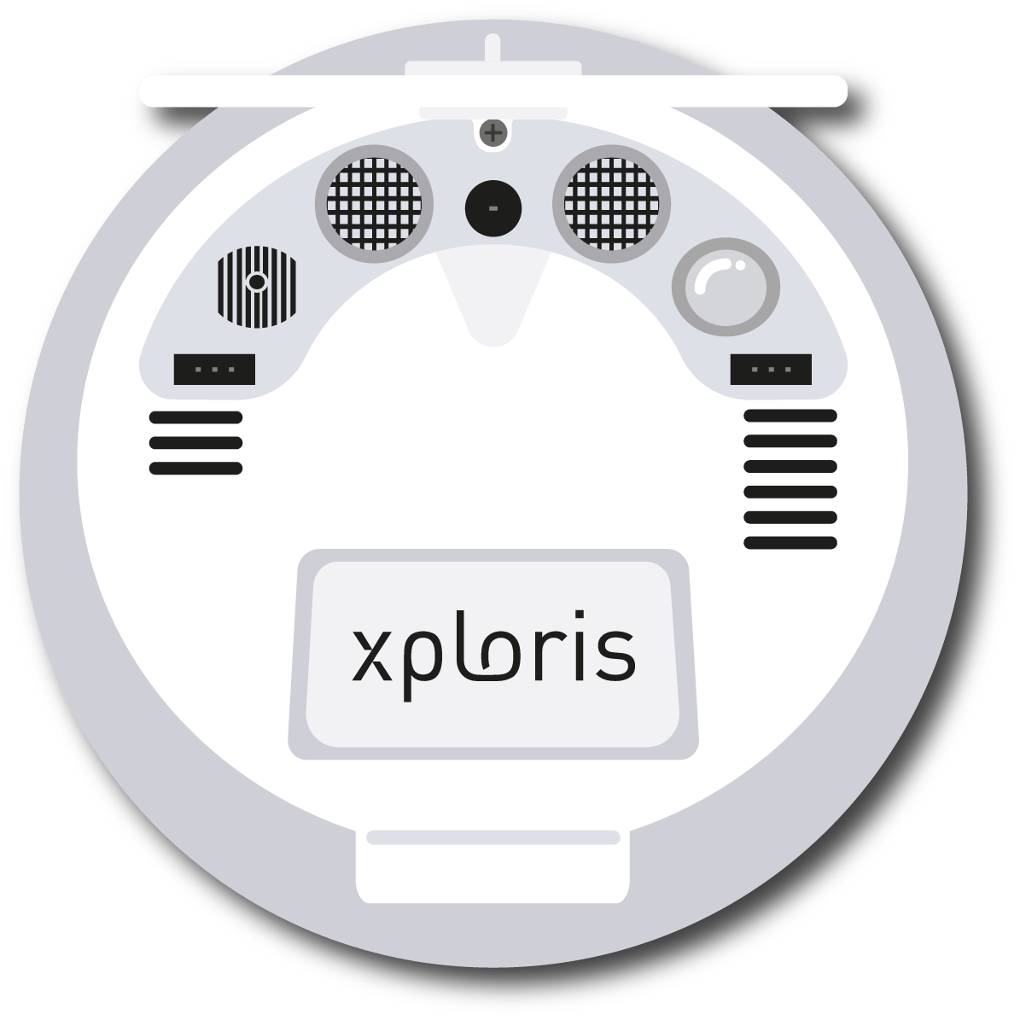
Setting up the experiment
2
The “light” sensor is located at the back of the Xploris, make sure it is uncovered as shown in the picture.

Slide 6
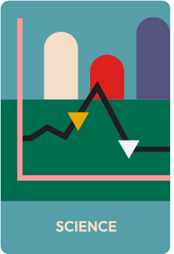
Setting up the experiment
2
Turn on your Xploris and connect it to your computer or tablet.
Open the XploriLab software on your computer or tablet.
Once inside XploriLab, select the icon to connect the device via cable or bluetooth as applicable.
Go to the SCIENCE section and then to DATA LOGGER.

Slide 7
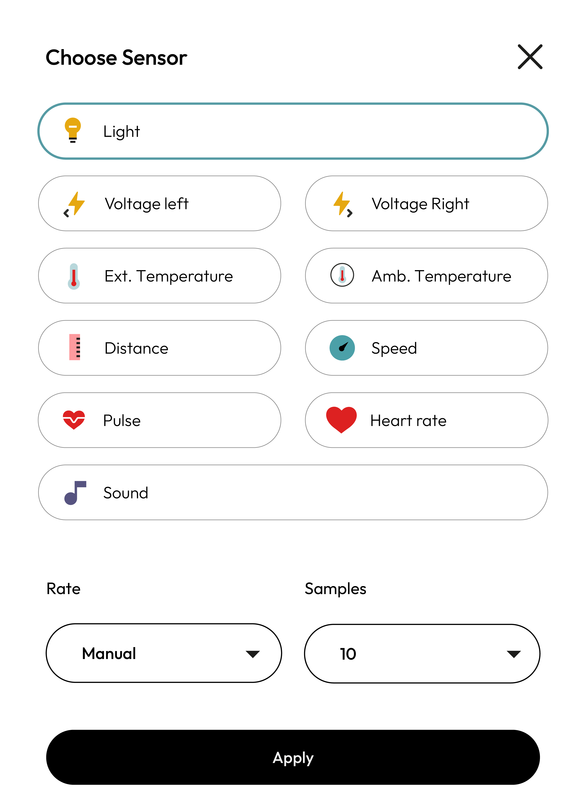
XploriLab software configuration
Setting up the experiment
2
1
To start any configuration related to the sensors, please select the “setup” icon.
The sensor you will use for this activity is the light sensor and you will configure it to take manual measurements with a total of 10 samples.
Once the configuration has been completed, select “Apply” to save it.

Slide 8
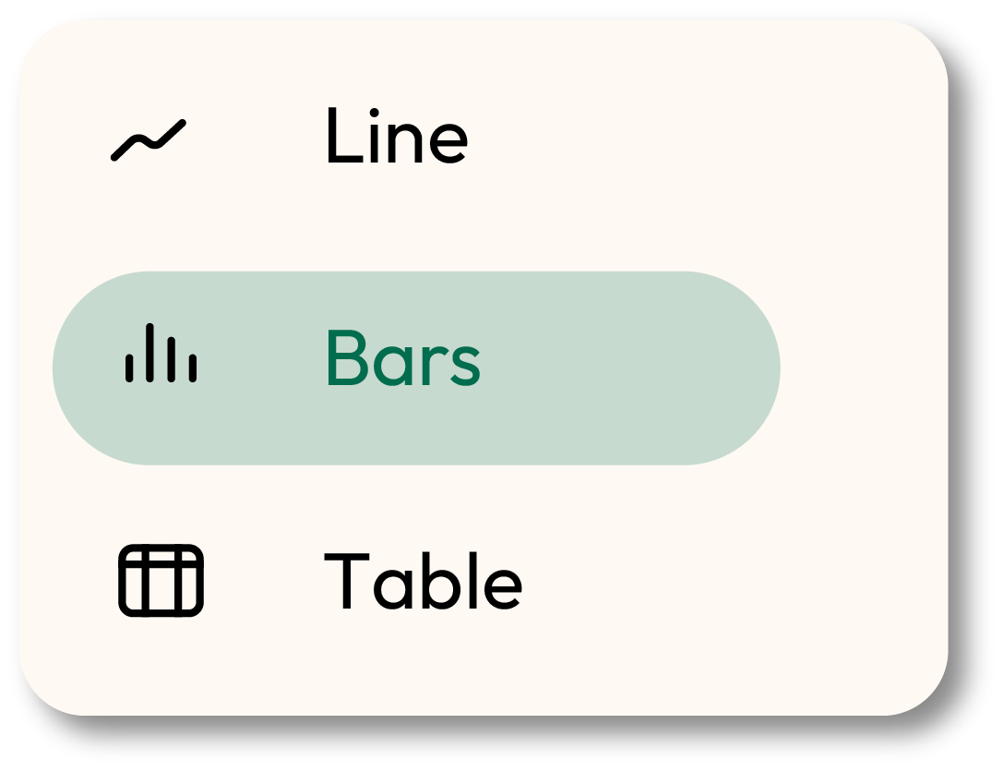
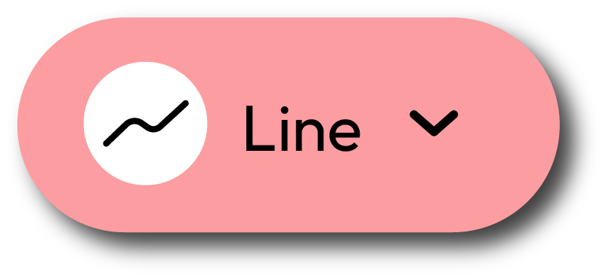
XploriLab software configuration
Setting up the experiment
2
2
Click the “line” icon on display and select the “bars” option.
3
Click the PLAY icon to start recording. Then, when you want to collect a new measurement - press the Light key on the Xploris.

Slide 9
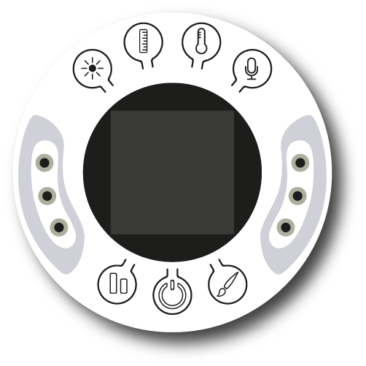
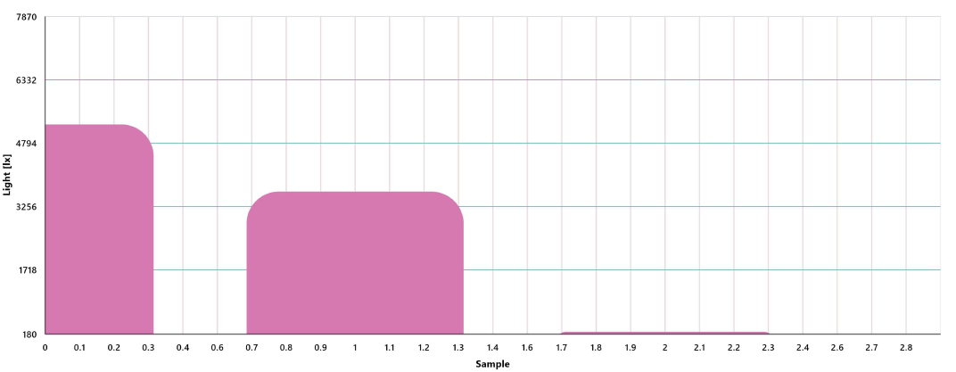
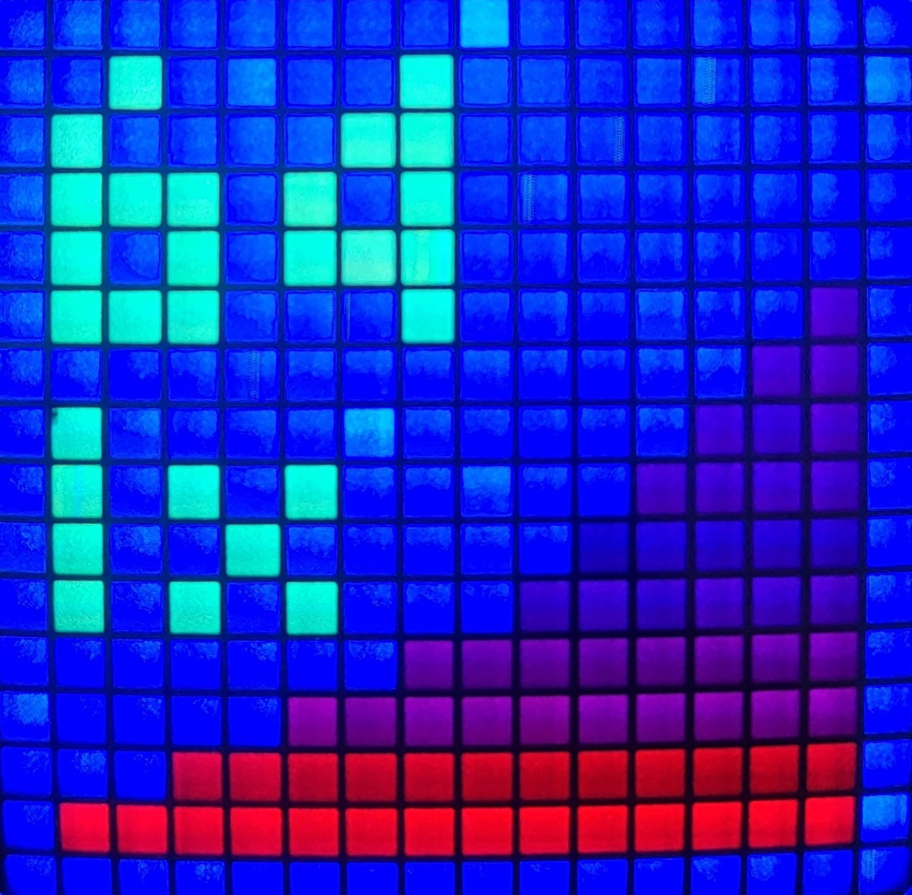
Data collection
3
Carefully watch the Xploris screen to take measurements manually. Wait for the data to stabilize before recording them.
Take a sample for each of the surfaces, so you will get 3 bars, as in the graph below.
LIGHT REFLECTION GRAPH

Slide 10
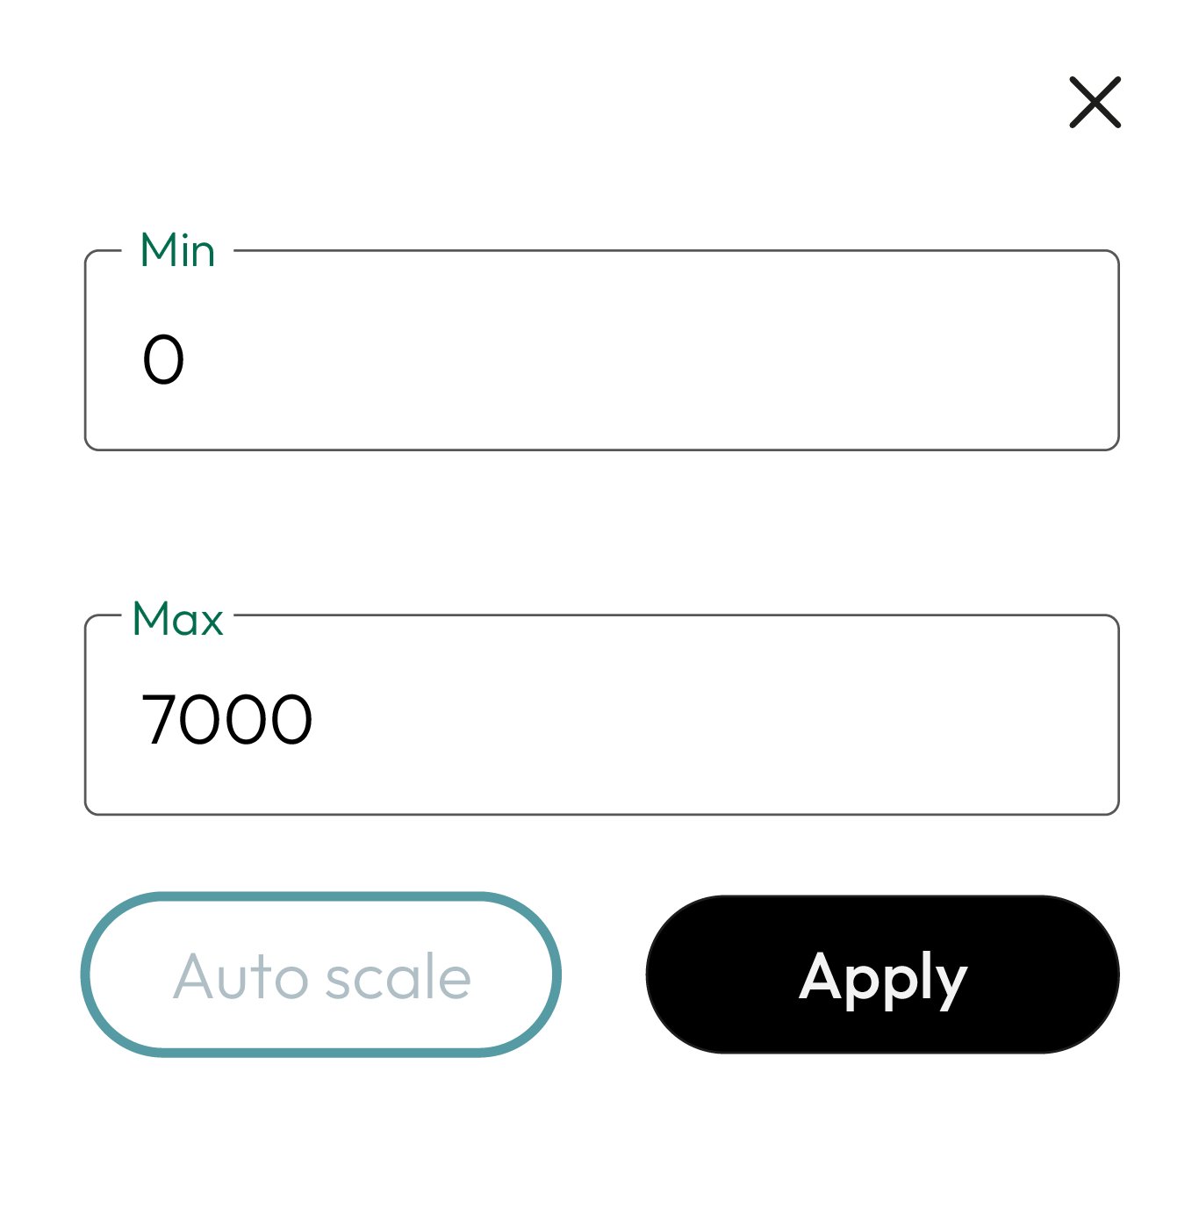
2
Data analysis
4
1
To change the Y-axis values of a graph you must do the following:
Double click on the Y-axis name.
A dialog box will open in which you will have to enter the maximum and minimum values.
Once you have entered the values, click on “Apply”.

Slide 11
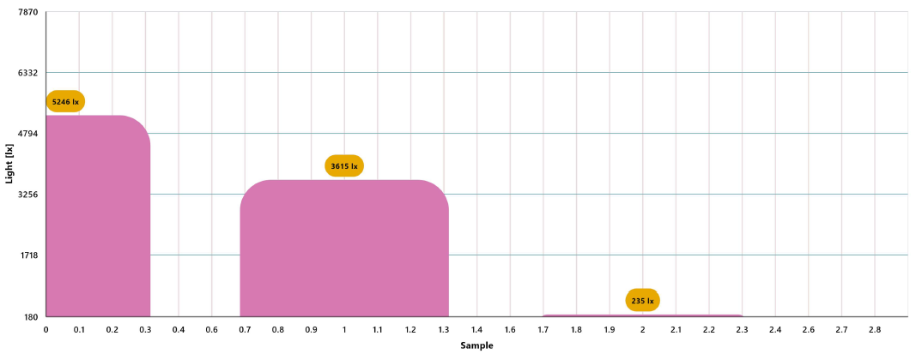
Data analysis
4
2
Use markers to add labels to the graph columns. To do this you must select the “Marker” icon:
GRAPH WITH MARKERS

Slide 12
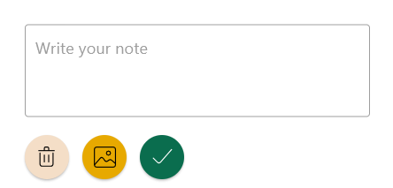
2
Data analysis
4
3
To add photos to the notes within a graph you must do the following:
Select the note icon.
Click on the bar where you want to add a note.
A dialog box will open and allow you to add the note with text and images.
Take a picture of the surface used in the activity and select it for the note image.

Slide 13
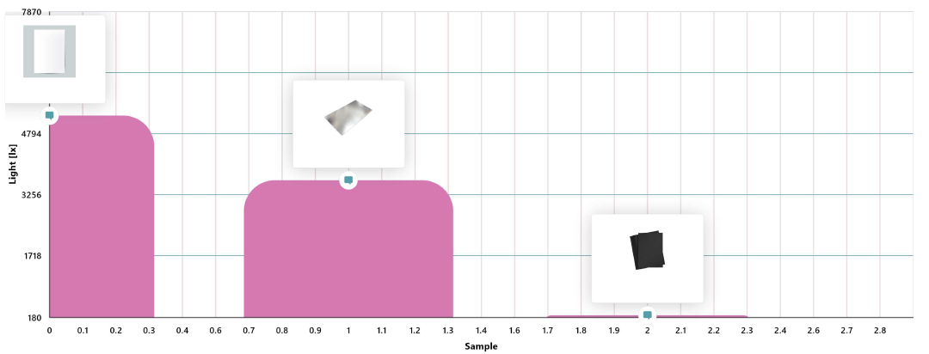
Data analysis
4
4
GRAPH WITH NOTES

Slide 14
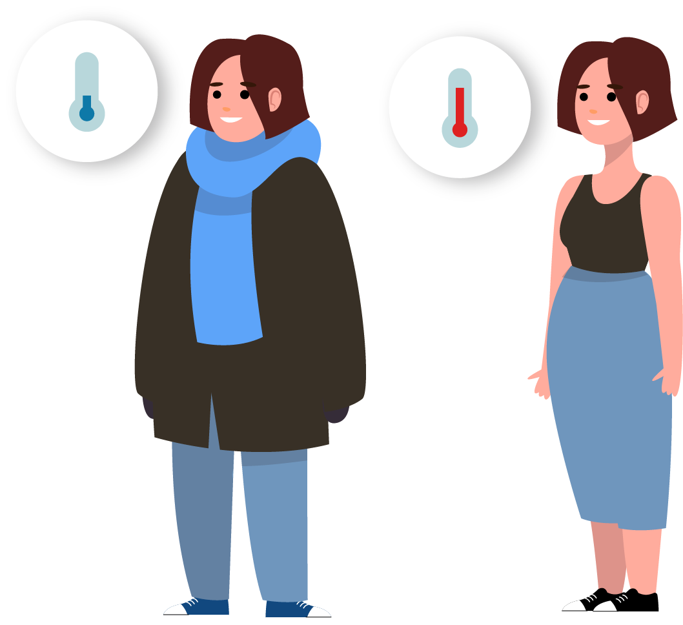
Questions
5
1
Let's take a look at the graph
4
Let's keep experimenting!
Which of the surfaces reflected more light and which reflected less?
What do you think the light reflection will be like on other colored surfaces? Formulate your hypothesis and experiment using the Xploris sensor by measuring the light on different colored leaves.
2
Let's take a look at the graph
Which of the surfaces absorbed more light and which absorbed less? Did your answers to questions 1 and 2 match what you expected before doing the experiment?
3
Let's relate the data
It is said that on hot days you should avoid black clothing and go for light colors. In what way do you think heat can be related to the light absorbed by the fabric of clothing?

Slide 15
Activity summary
6
We used the Xploris light sensor to measure the light reflected by 3 surfaces: a sheet of white paper, a sheet of black paper and aluminum foil when exposed to direct sunlight.
We created a bar graph and analyzed the data to establish which surface reflected more light and which reflected less and compared the data obtained with what we thought before doing the experiment.
We reflected on light absorption and the suitability of certain clothing for use on warm days. In addition, we experimented again by varying the colors of the leaves used in the procedure.

Slide 16
SCIENCES
Reflections: Which surface reflects more light?

