Slide 1
SCIENCE
Our heart: How do my heartbeats change?

Slide 2
HOW DO MY HAERT BEAT CHANGE?
1
Introduction
2
Setting up the experiment
3
Data collection
SCIENCES
4
Data analysis
5
Questions
6
Activity summary

Slide 3
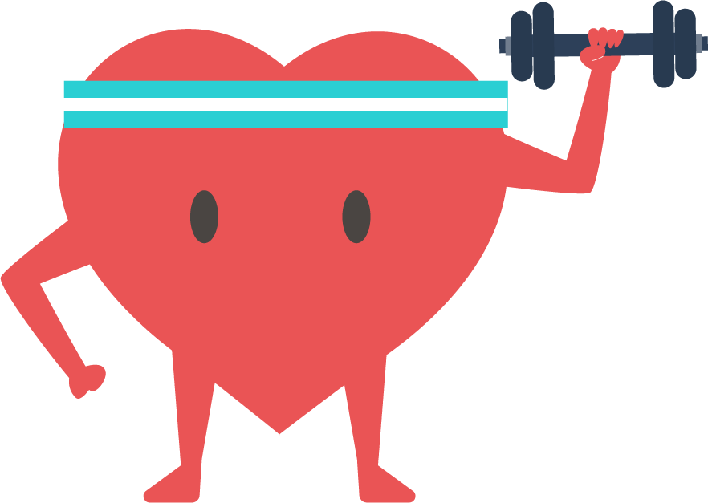
Introduction
1
Has it ever happened to you that you have done a lot of exercise and you feel how your heart beats faster and with a lot of force? That happens because the heart pumps blood with oxygen and nutrients to the body in order to function, so when you exercise your muscles must receive more blood to keep working.
In this activity, you will study how your body changes after exercise, using the Xploris heart rate and pulse sensors.
The question you will answer will be:
How will my pulse and heart rate change after exercise?

Slide 4
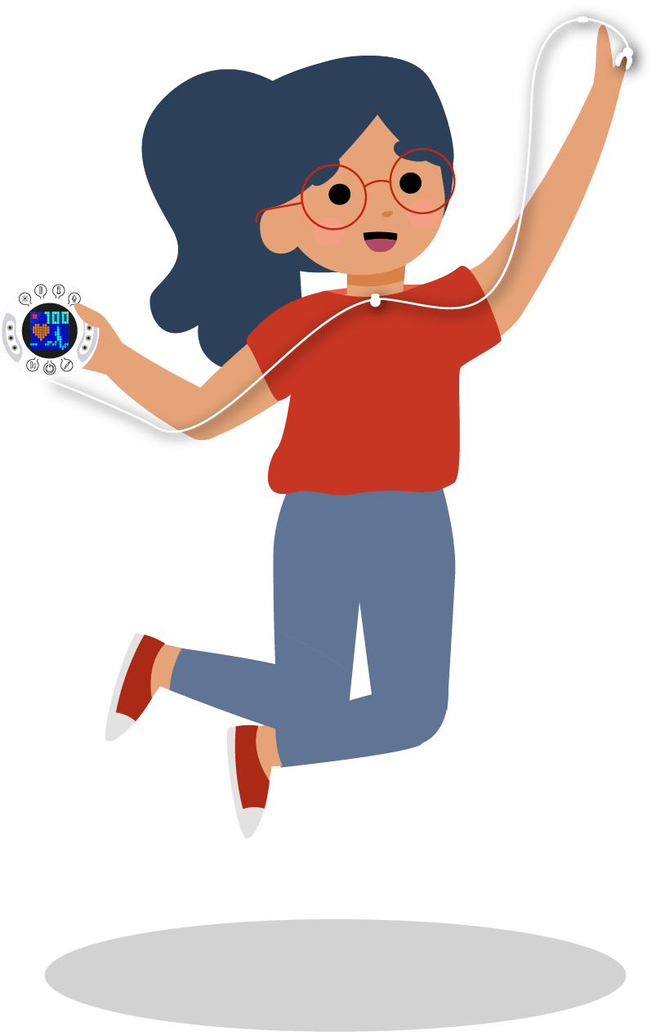
Setting up the experiment
2
You will sit on a chair and measure your resting heart rate and pulse using the Xploris sensor. Then, you will jump for 1 minute and, afterwards, you will sit down and measure the same parameters again until you return to the resting state.
Remember that to make these measurements you will need to attach the heart rate probe to the Xploris and to your left index finger.

Slide 5
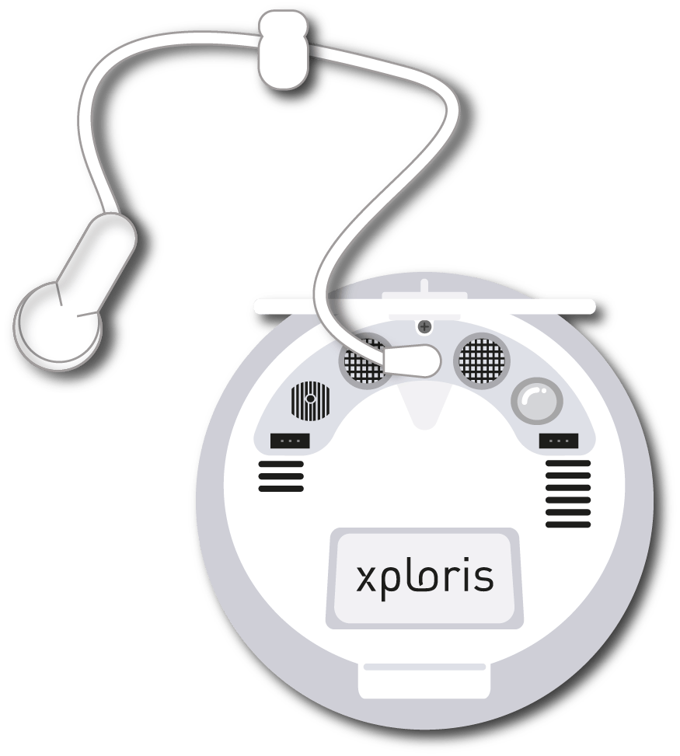
Setting up the experiment
2
Connect the Heart rate clip to the Xploris back input.

Slide 6
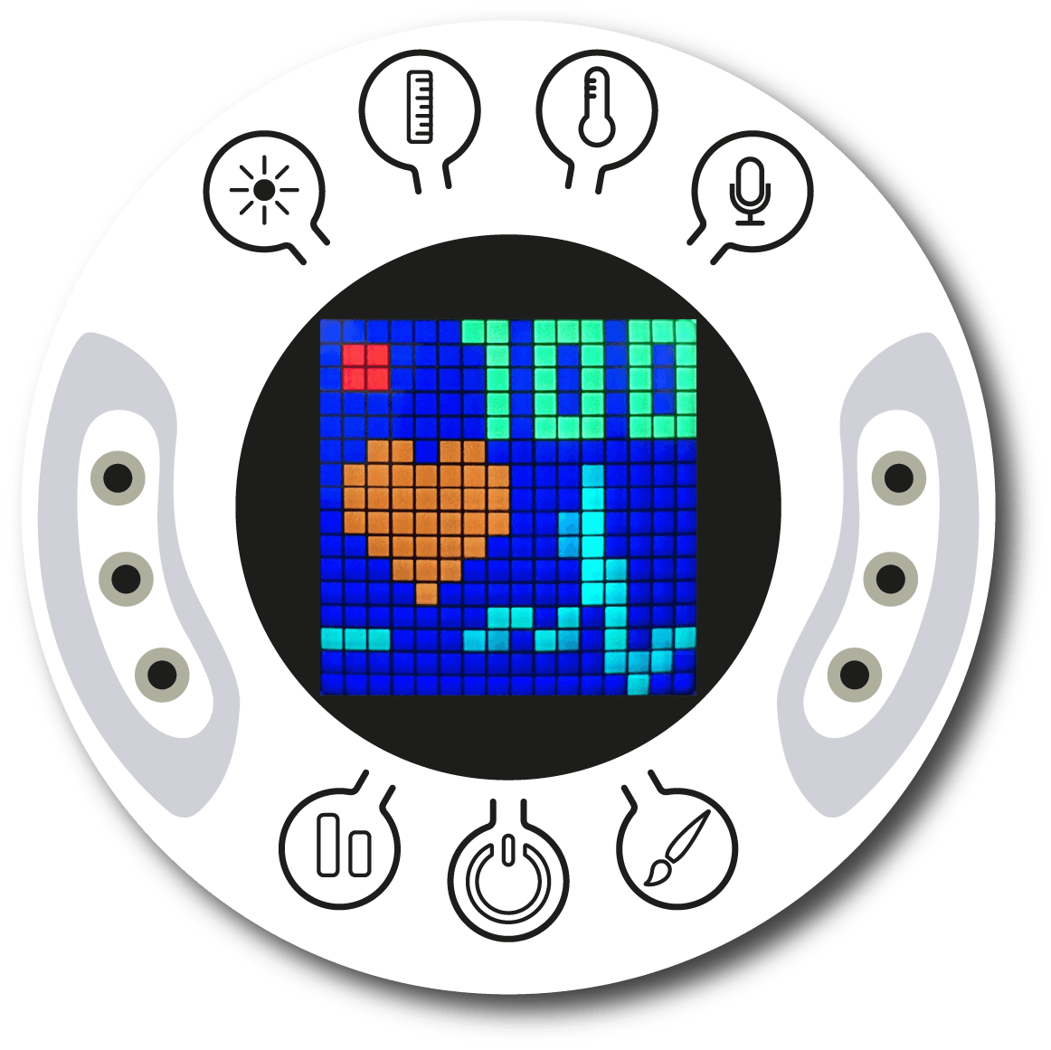
Setting up the experiment
2
Turn on your Xploris and connect it to your computer or tablet.
Open the XploriLab software on your computer or tablet.
Once inside XploriLab, select the icon to connect the device by cable or bluetooth as applicable.
Go to the SCIENCE section and then to DATA LOGGER.

Slide 7
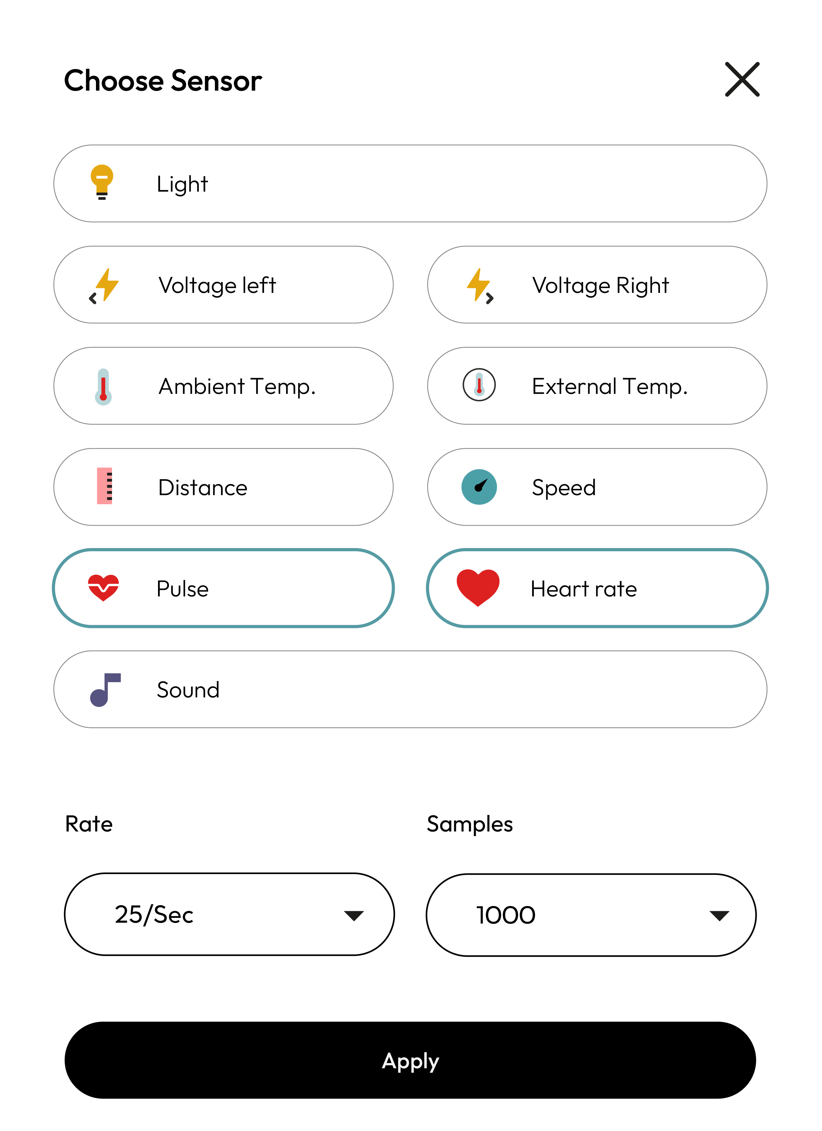
XploriLab software configuration
Setting up the experiment
2
1
To start any configuration related to the sensors, please select the “setup” icon.
The sensors you will use for this activity are the pulse and heart rate sensors. You will set them to take 25 samples per second (25/sec) for a total of 1000 samples.
Once the configuration has been completed, select “Apply” to save it.

Slide 8
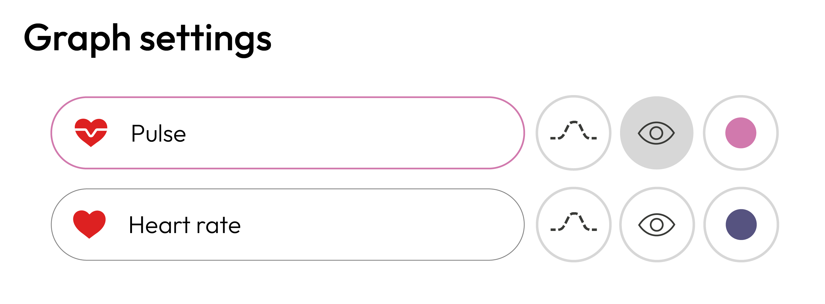
Setting up the experiment
2
2
You may change the color of one of the sensors to make it clearer to read
Go to the "Graph setting" and select one of the sensors.
Then, select the color to use for the graph.
3

Slide 9
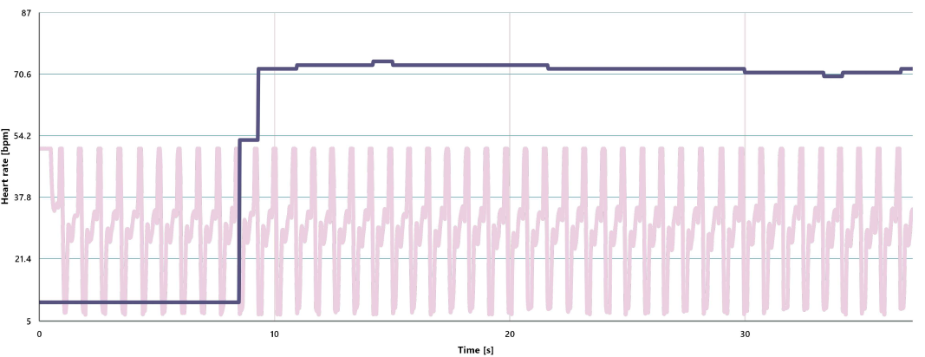
Data collection
3
Make a graph by recording the resting pulse and heart rate measurements for 20 seconds, and then save the graph.
RESTING GRAPH

Slide 10
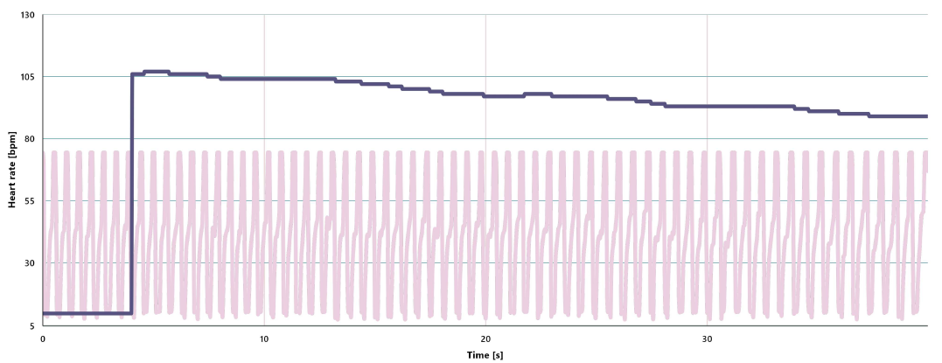
Data collection
3
Then, disconnect the probe from the index finger and start jumping for 30 seconds. Measure your pulse and heart rate again immediately after exercising and save this second graph.
GRAPH AFTER EXERCISE

Slide 11
Data analysis
4
1
Use markers on the graph to:
Learn the heart rate at the end of the measurements before and after exercise by adding labels to the graph points using markers. To do this, select the “Maker” icon.
2
To lock the marker, select it and press the lock icon to lock it..

Slide 12
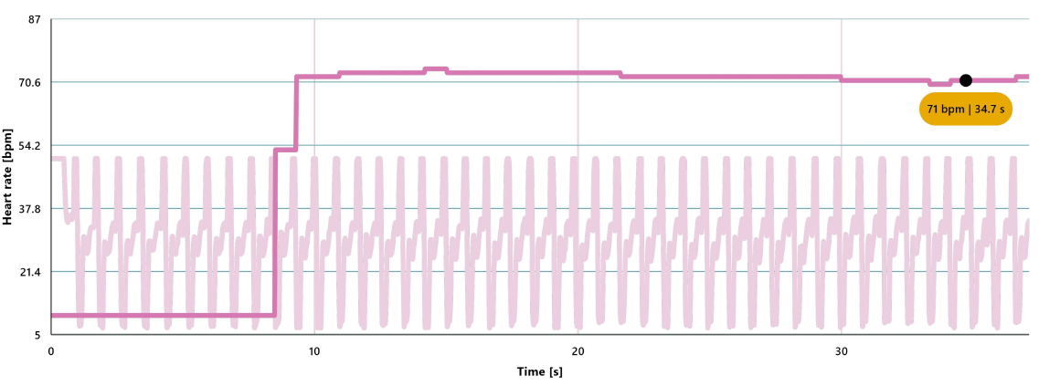
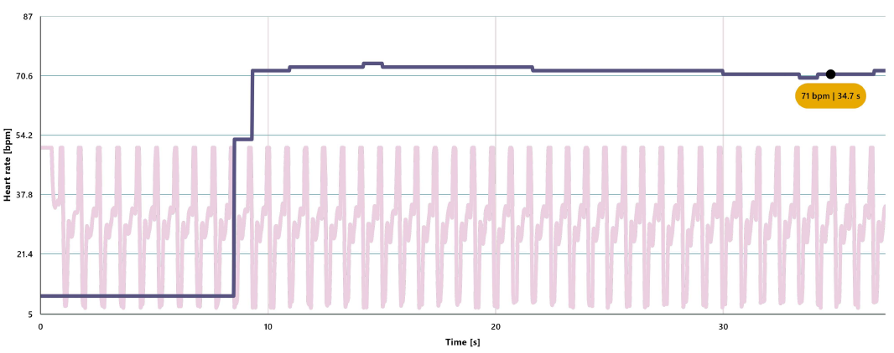
Data analysis
4
3
REST GRAPHIC WITH MARKER

Slide 13
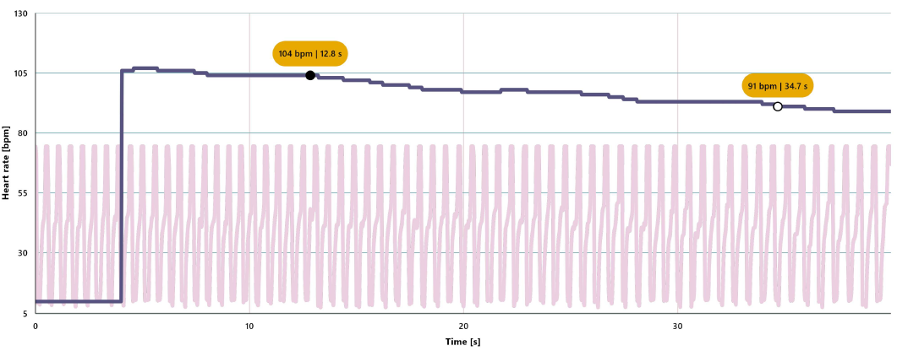
Data analysis
4
4
GRAPH AFTER EXERCISE WITH MARKER

Slide 14
Questions
5
1
Let's take a look at the pulse graph
4
Looking at your pulse measurements, what is your approximate resting pulse?
Let's compare results!
Compare your measurements with those of other classmates and calculate the average resting heart rate of the class.
2
Let's take a look at the pulse graph
How long did it take you to return to your resting pulse after exercising?
3
Let's take a look at the heart rate graph
When you compare your heart rate before and after exercise, what can you conclude?

Slide 15
Activity summary
6
We used Xploris heart rate and pulse sensors to measure these two parameters before and after exercise. We also built line graphs showing the recorded measurements.
We analyzed the data to establish what our pulse and heart rate values were before and after exercise. We also established how long it took us to return to a resting state after physical activity.
Finally, we compared the data obtained with those of other classmates and calculated the resting heart rate value of the class.

Slide 16
SCIENCES
Our heart: How do my heartbeats change?

