Slide 1
SCIENCE
Matching the graph: Drawing with distance

Slide 2
DRAWING WITH DISTANCES
1
Introduction
2
Setting up the experiment
3
Data collection
SCIENCES
4
Data analysis
5
Questions
6
Activity summary

Slide 3
Introduction
1
Have you ever ridden a roller coaster? If your answer is yes, you probably remember the feeling that came over your body when the carts changed the way they moved, but usually we are not aware of how we are moving, we are just doing it.
In this class we invite you to analyze your own movement using the Xploris distance sensor.
The question you will answer will be:
What should I change in my movement to achieve a defined pattern?

Slide 4
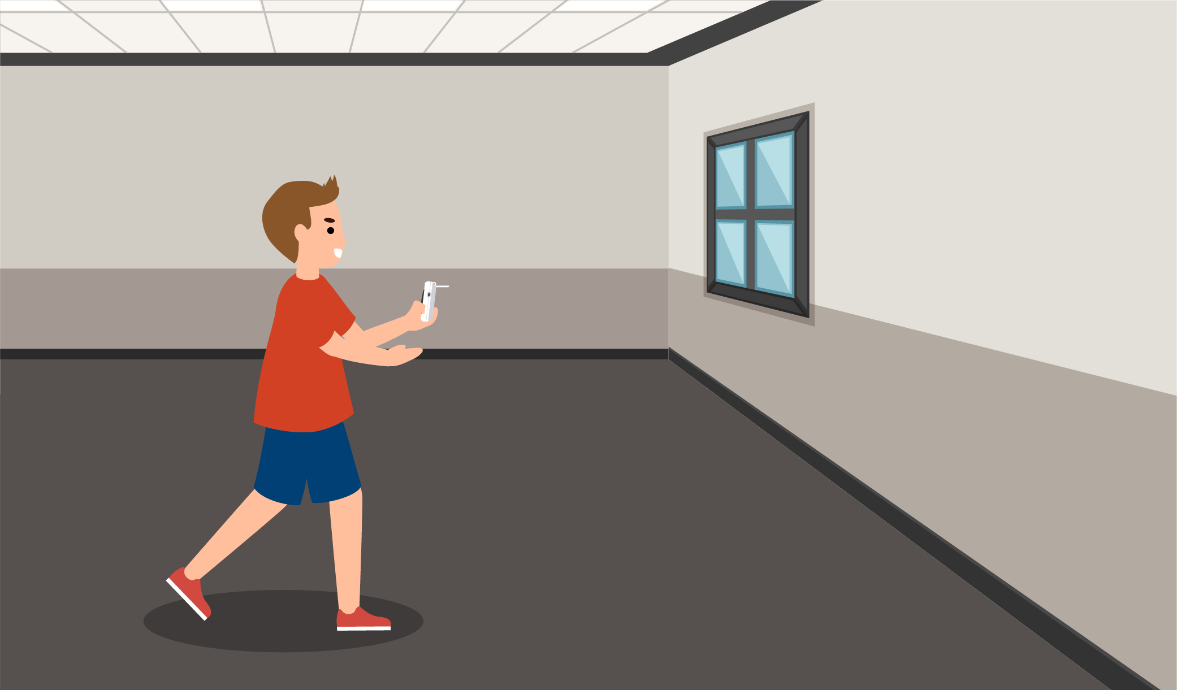
Setting up the experiment
2
You will be presented with a specific graph and you will have to mimic that graph as best you can by measuring your movement using the Xploris distance sensor.

Slide 5
Setting up the experiment
2
The "distance" sensor is located on the back of the Xploris, make sure it is uncovered as shown in the picture

Slide 6
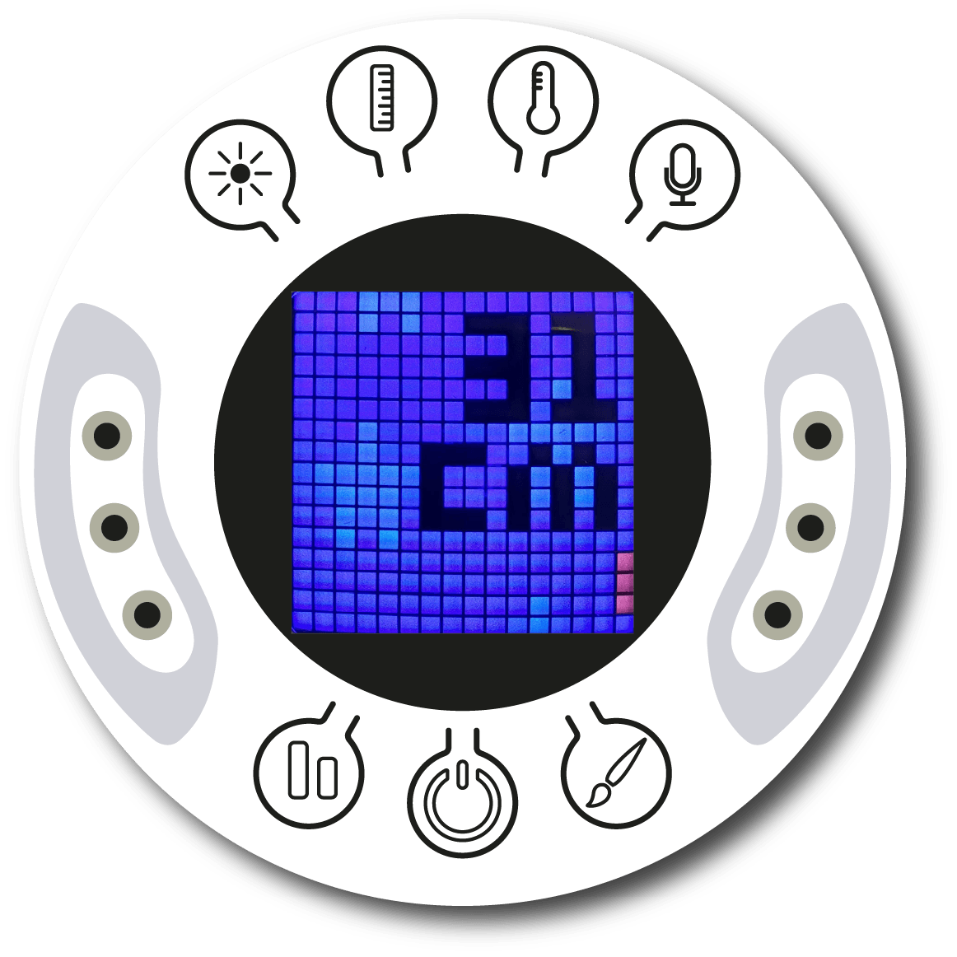
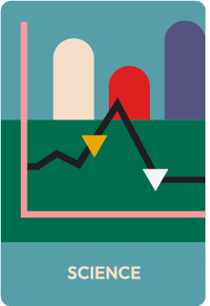
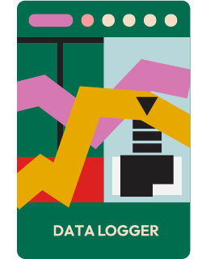
Setting up the experiment
2
Turn on your Xploris and connect it to your computer or tablet.
Open the XploriLab software on your computer or tablet.
Once inside XploriLab, select the icon to connect the device by cable or bluetooth as applicable.
Go to the SCIENCE section and then to DATA LOGGER.

Slide 7
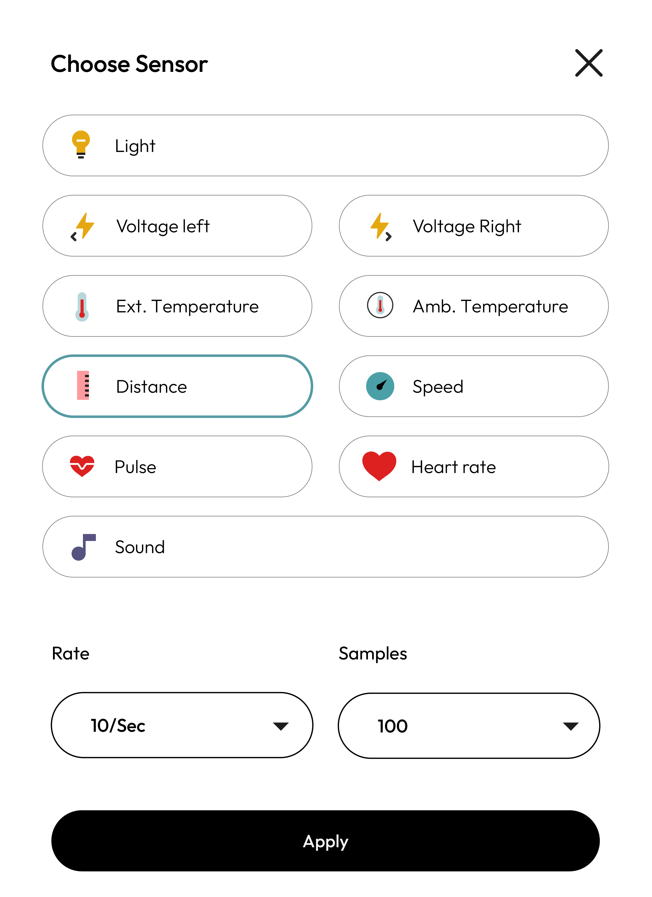
XploriLab software configuration
Setting up the experiment
2
1
Select the configuration icon to start any configuration related to the sensors.
The sensor you will use for this activity is the distance sensor and you will set it to take 100 samples per second (10/sec) for a total of 1000 samples.
Once the configuration has been completed, select "Apply" to save it.

Slide 8
Setting up the experiment
2
2
How to create a predictive graph?
Select the icon to activate the prediction tool.
Then, draw a predicted motion graph using the mouse or your finger depending on your device.

Slide 9
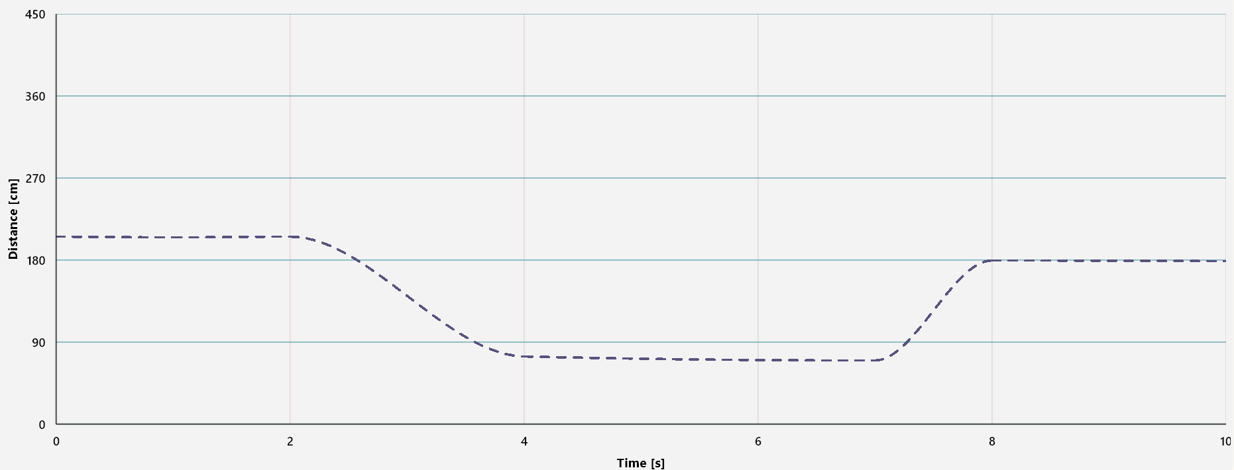
Data collection
3
Take a close look at the distance-time graph below. Now, you should measure your distance from a wall and try to create a graph as similar as possible by moving away from or towards the wall, as required.
PREDICTIVE GRAPH

Slide 10
Data analysis
4
1
2
Let's use markers in the graph to:
Explain what you had to do to obtain each part of the graph.
Example: Running fast towards the wall, walking slowly, moving closer, moving away, etc.
Use markers to add labels to the graph columns. To do this you must select the icon:

Slide 11
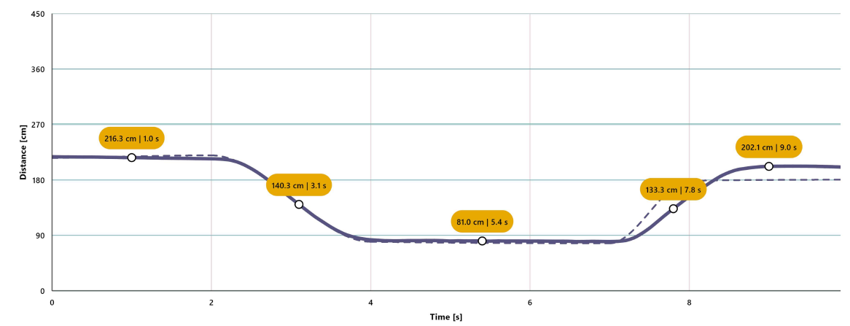
Data analysis
4
3
GRAPH WITH MARKERS

Slide 12
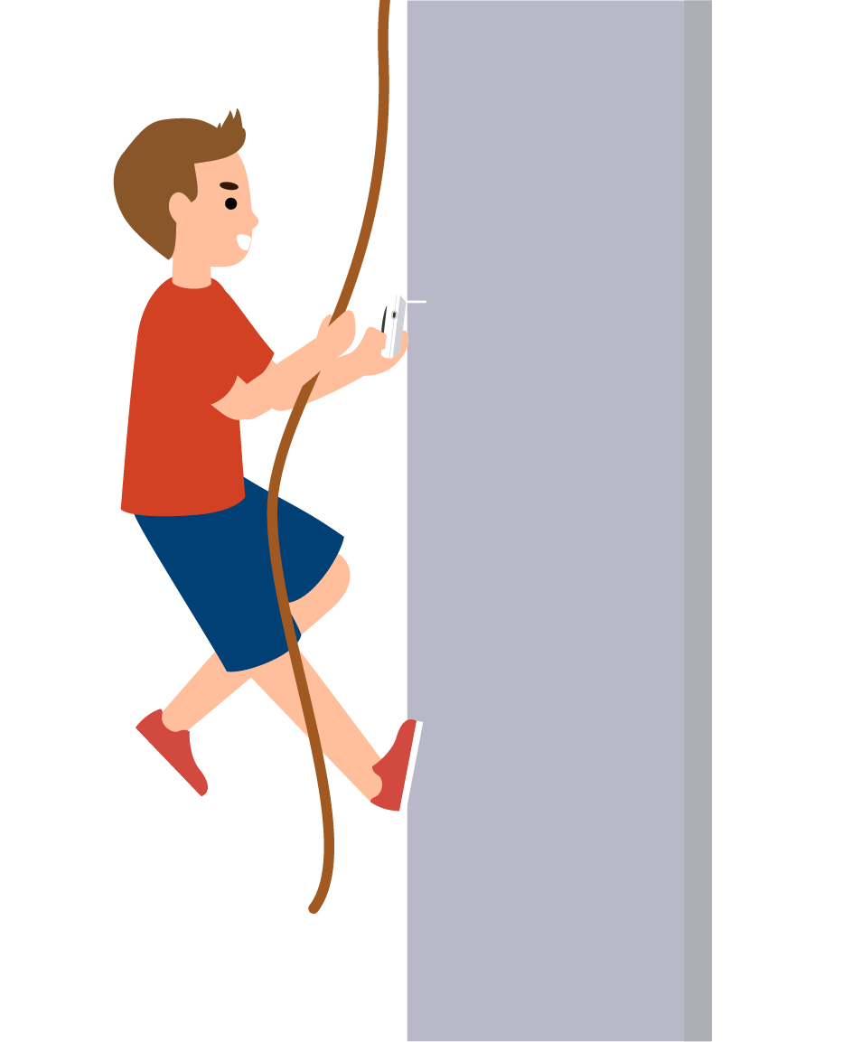
Questions
5
1
Let's take a look at the graph
What variables did you have to take care of to make your graph look like the one presented in this class?
2
Let's evaluate the data
What was the biggest difficulty you faced in creating your graph?
3
Let's keep experimenting!
Do you think the measurements would change if they were taken vertically instead of horizontally to the wall?

Slide 13
Activity summary
6
We used the Xploris distance sensor to create a distance-time graph that followed a given pattern.
We analyzed the data to establish what we had to do in each of the parts of the graph (walking, running, moving away from or approaching the wall).
We answered questions by analyzing our own movement, establishing what we had to do to achieve a graph similar to the one presented in the activity, what difficulties were encountered, as well as evaluating whether the graph changes when climbing instead of walking.

Slide 14
SCIENCES
Matching the graph: Analyzing my movement

