Slide 1
SCIENCE
Light reflection: How does light bounce off a surface?

Slide 2
HOW DOES LIGHT BOUNCE OFF A SURFACE?
1
Introduction
2
Setting up the experiment
3
Data collection
SCIENCES
4
Data analysis
5
Questions
6
Activity summary

Slide 3
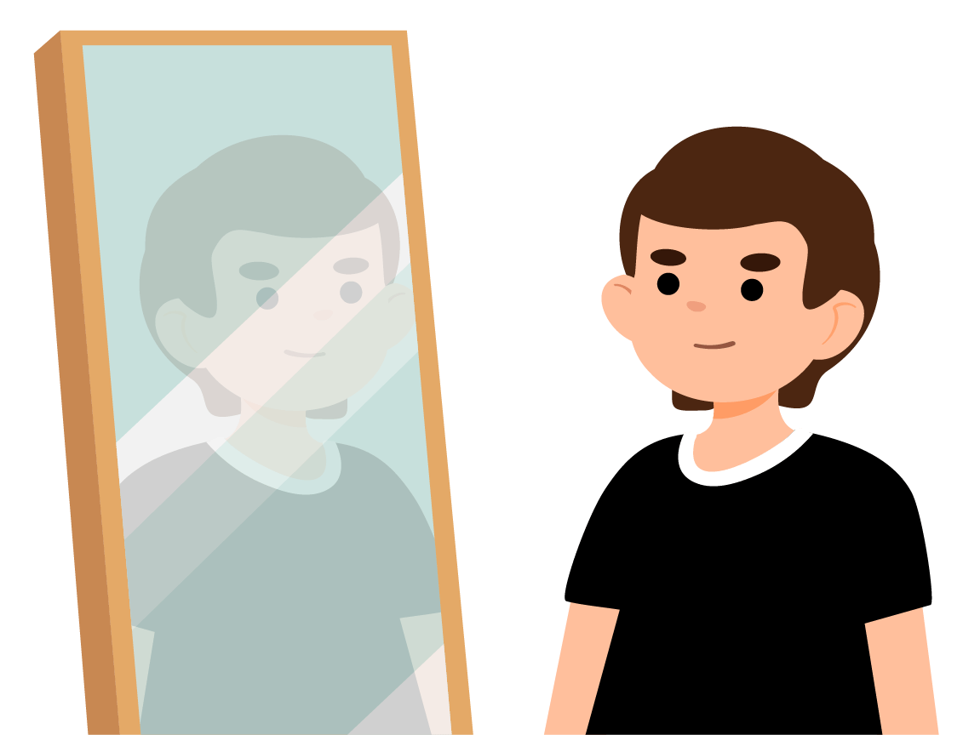
Introduction
1
Have you ever wondered why you can see yourself in a mirror? Mirrors work because the light that hits their surface bounces off and reaches your eyes, allowing you to see your reflection. This property of light to “bounce” when it hits some surfaces is called reflection.
In this activity, you will learn about how different surfaces reflect light using the Xploris sensor.
The question you will answer will be:
How does light reflect from different surfaces?

Slide 4
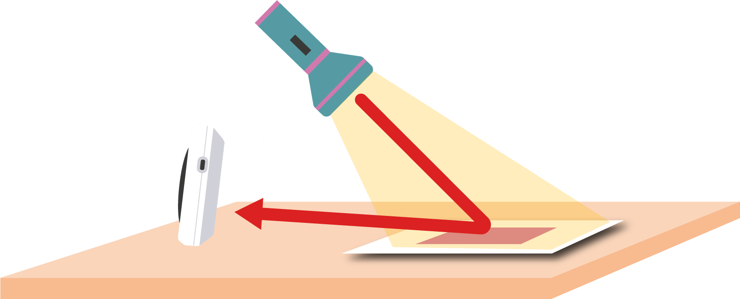
Setting up the experiment
2
Shine a flashlight on a surface and measure the intensity of the reflected light. Do this on 5 different surfaces and compare the different results.

Slide 5
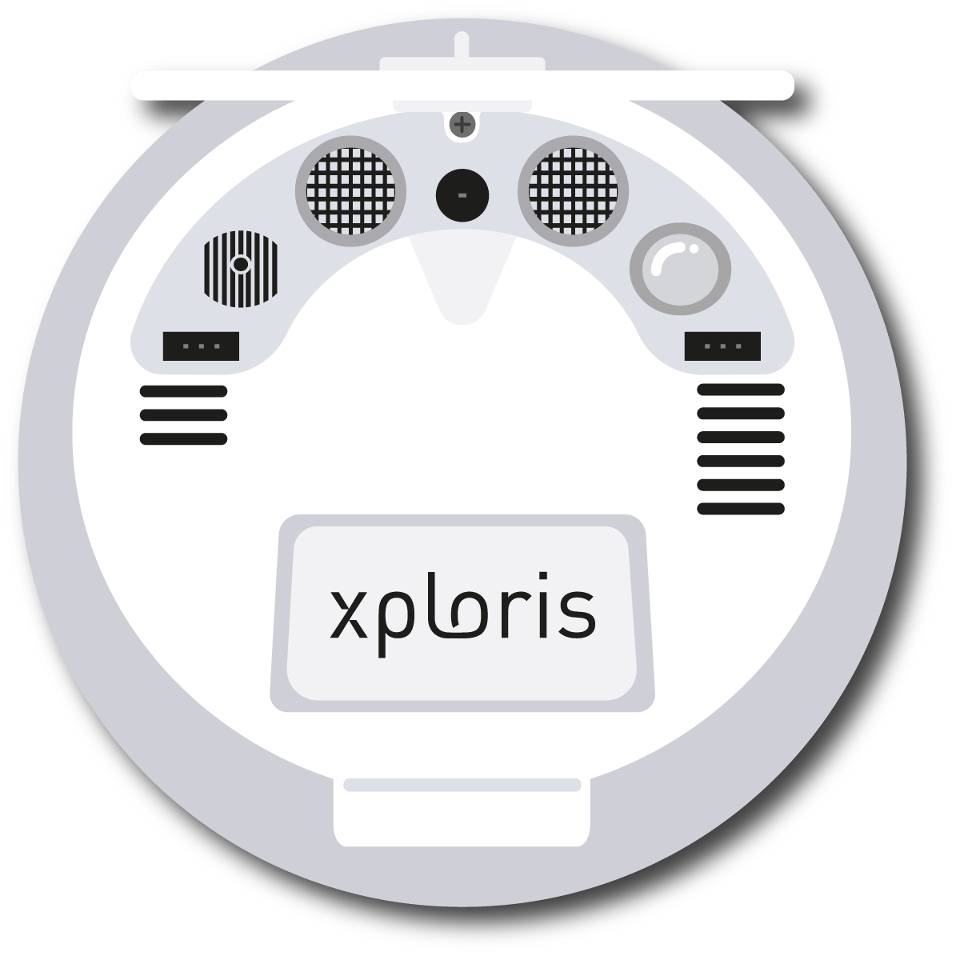
Setting up the experiment
2
The “light” sensor is located at the back of the Xploris, make sure it is uncovered as shown in the picture.

Slide 6
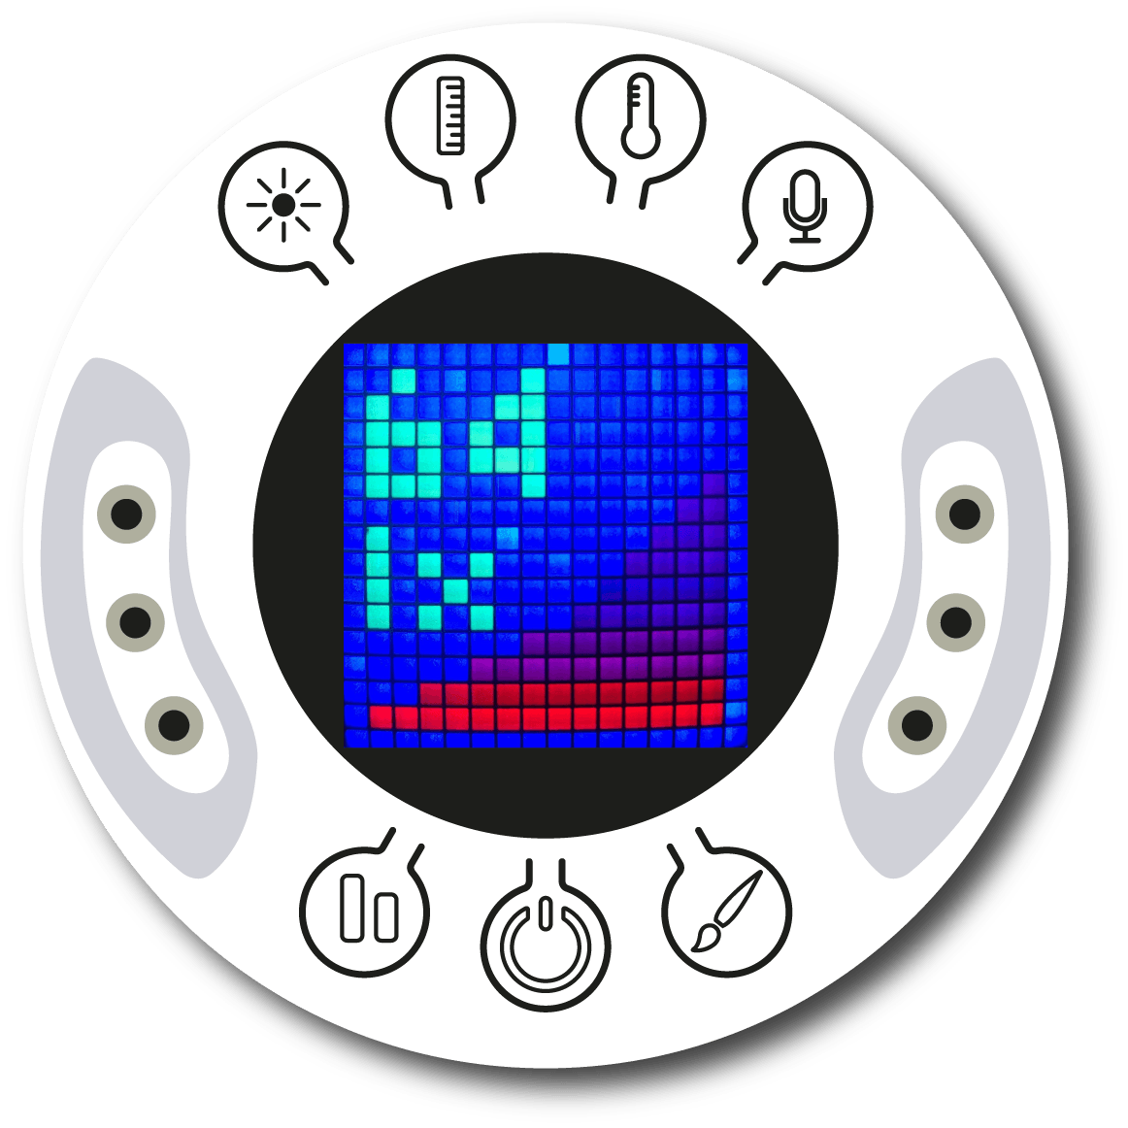
Setting up the experiment
2
Turn on your Xploris and connect it to your computer or tablet.
Open the XploriLab software on your computer or tablet.
Once inside XploriLab, select the icon to connect the device by cable or bluetooth as applicable.
Go to the SCIENCE section and then to DATA LOGGER.

Slide 7
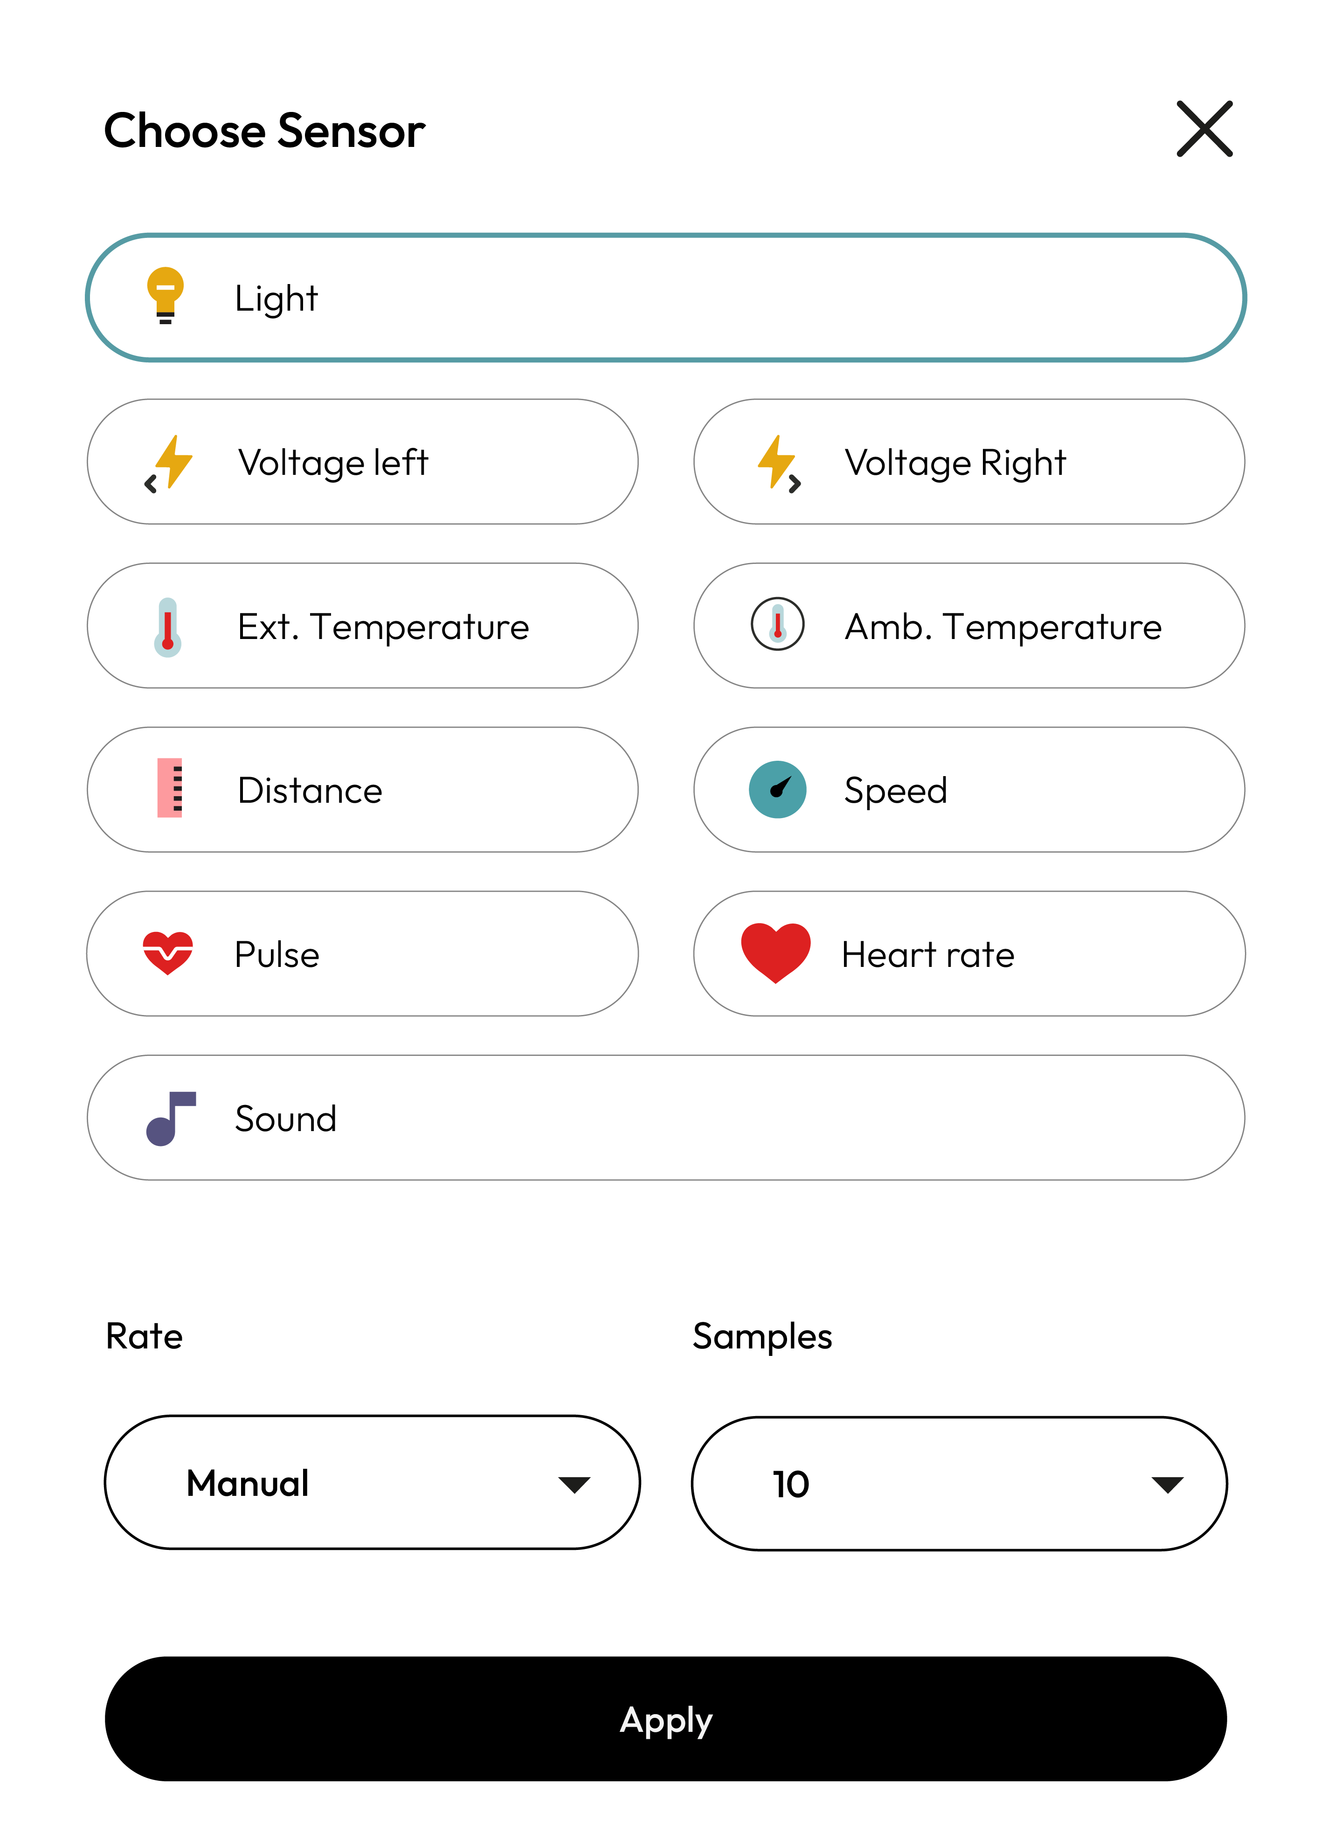
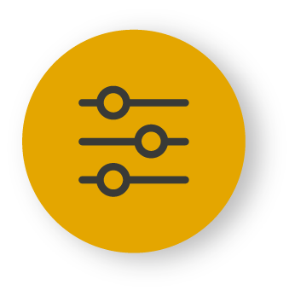
XploriLab software configuration
Setting up the experiment
2
1
To start any configuration related to the sensors, please select the “setup” icon.
The sensor you will use for this activity is the light sensor and you will configure it to take manual measurements with a total of 10 samples (2 for each surface).
Once the configuration has been completed, select “Apply” to save it.

Slide 8
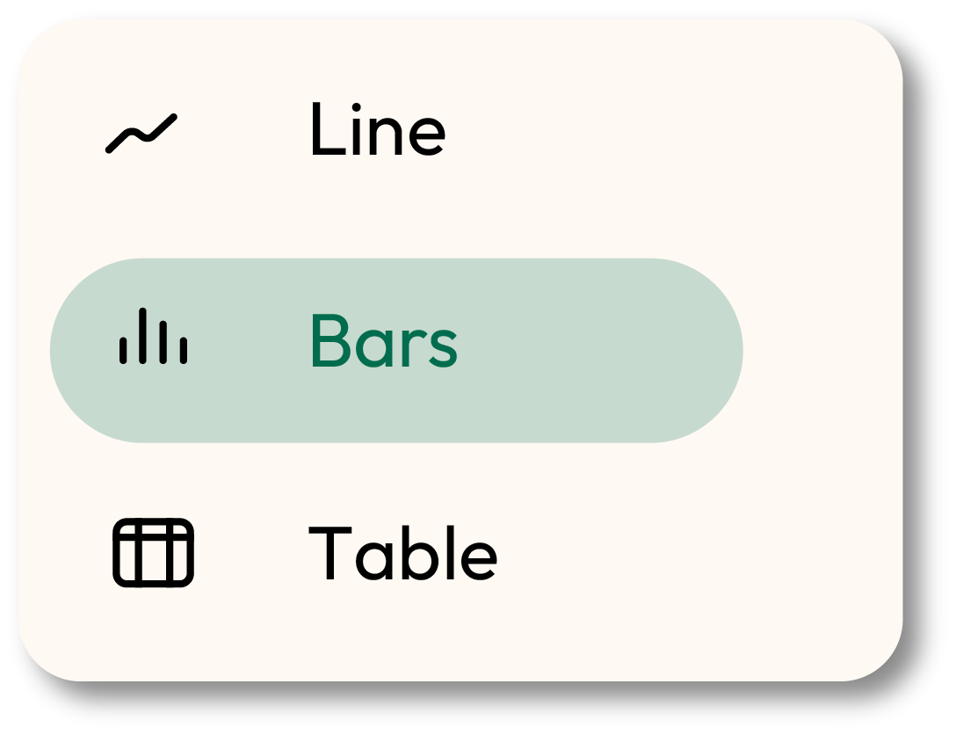
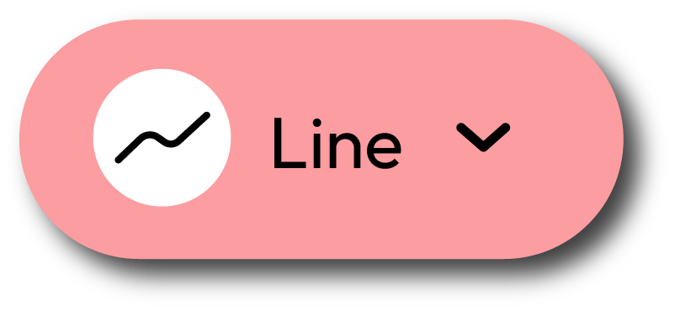
XploriLab software configuration
Setting up the experiment
2
1
To use the graph you must click on the “line” icon and select the “bars” option.
2
To take manual measurements, in addition to configuring the sensor from the XploriLab, you will have to press the button of the sensor being used (in this case, the light sensor) on the Xploris to take each sample.

Slide 9
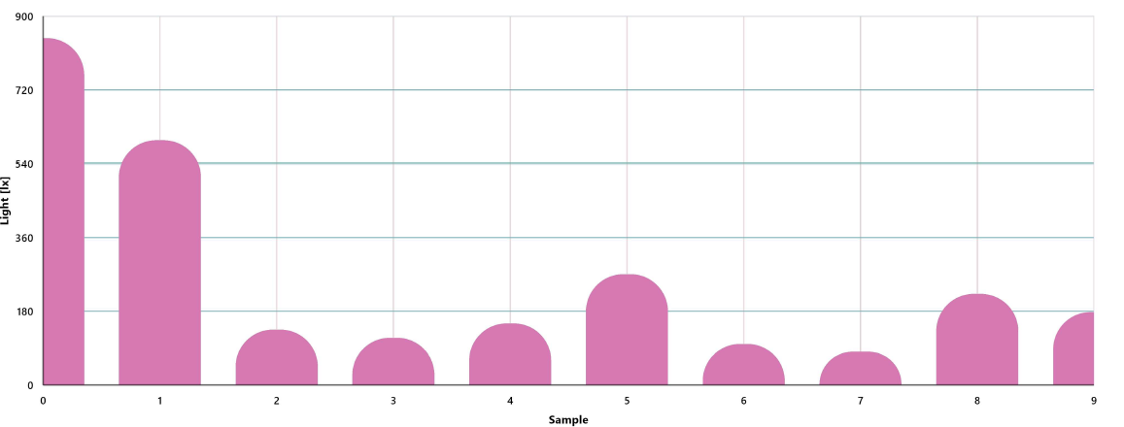
Data collection
3
Manually record two light measurements for each of the surfaces to be studied.
LIGHT GRAPH

Slide 10
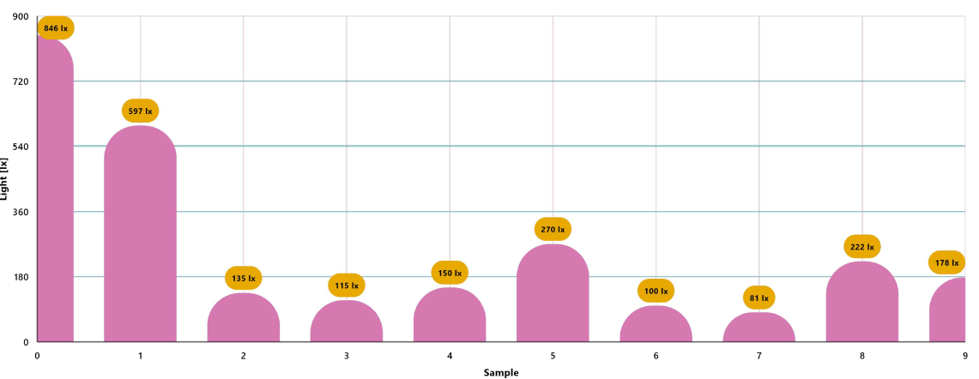
Data analysis
4
1
Use markers to add labels to the graph columns. To do this you must select the icon:
GRAPH WITH MARKERS

Slide 11
2
Data analysis
4
2
To add photos to the “Annotations” within a chart you must do the following:
Select the “Annotation” icon.
Click on the bar where you want to add your note.
A dialog box will open and allow you to add notes with text and images.
Take a photo of the surface used for reflection and select it for the annotation image.

Slide 12
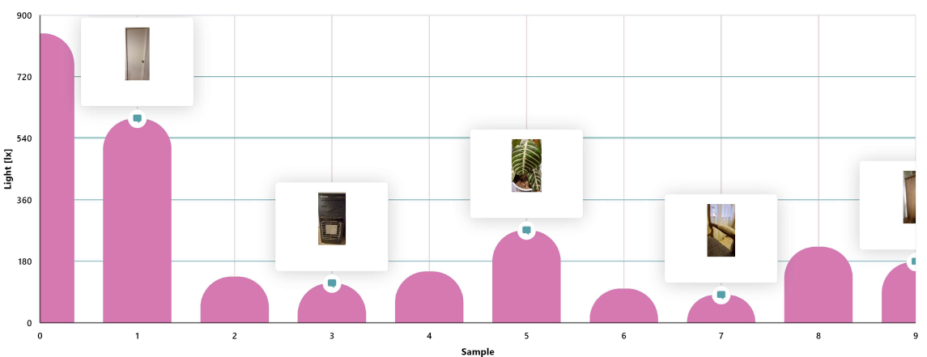
Data analysis
4
3
GRAPH WITH ANNOTATIONS

Slide 13
Questions
5
1
Let's take a look at the graph
Looking at your measurements, which surface reflected the most and which reflected the least light?
2
Let's evaluate the data
What relationship can be made between the color of the surface and its ability to reflect light?
3
Let's keep experimenting!
Do you think the reflection of light on a surface will change if it is smooth or wrinkled? Create your hypothesis and test it using the Xploris light sensor.

Slide 14
Activity summary
6
We used the Xploris light sensor to measure the ability of certain surfaces to reflect light and built a bar graph showing the different measurements.
We analyzed the data to establish which surface reflected the most light and which reflected the least.
We answered questions by analyzing the relationship between light reflection and some characteristics of surfaces, such as their color or whether they are smooth or rough.

Slide 15
SCIENCES
Light reflection: How does light bounce off a surface?

