Slide 1
SCIENCE
Light and shade: Where is it cooler?

Slide 2
WHERE IS IT COOLER?
1
Introduction
2
Setting up the experiment
3
Data collection
SCIENCES
4
Questions
5
Activity summary

Slide 3
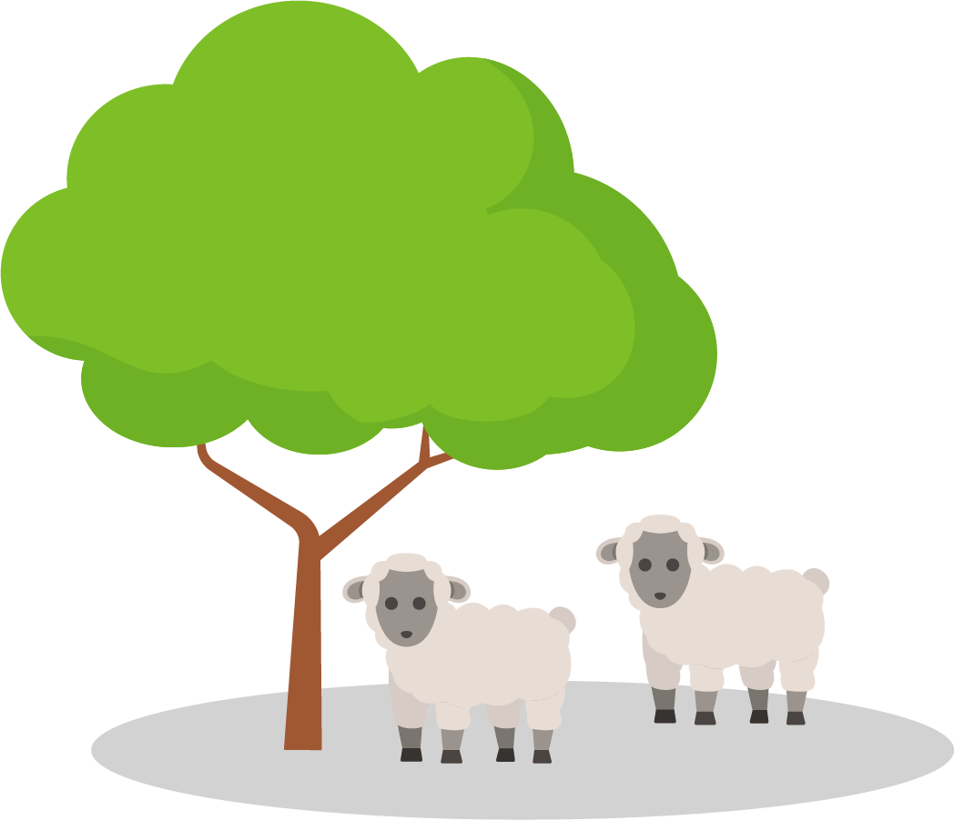
Introduction
1
Have you ever seen several animals taking refuge under the shade of a tree on a hot day? This happens because we living beings must maintain our body temperature and, to do so, it is necessary to take shelter when environmental conditions are challenging.
That is why in this class you will analyze the temperature in different areas of your school to find the coolest areas using the Xploris temperature sensor.
The question you will answer will be:
Which areas of my school have the lowest temperatures?

Slide 4
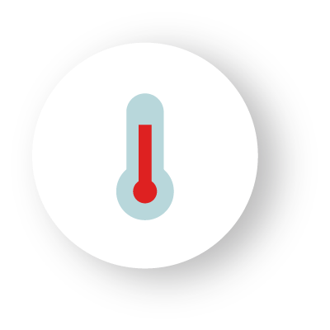
Setting up the experiment
2
Walk around your school looking for the coolest area. Use the external temperature sensor on your Xploris and observe the values on the sensor's display. Position yourself in different areas: an open and sunny area, a shady area, a humid area, a hallway or room inside the school, an area with vegetation, among others. You can make notes if necessary to record the different temperatures.

Slide 5
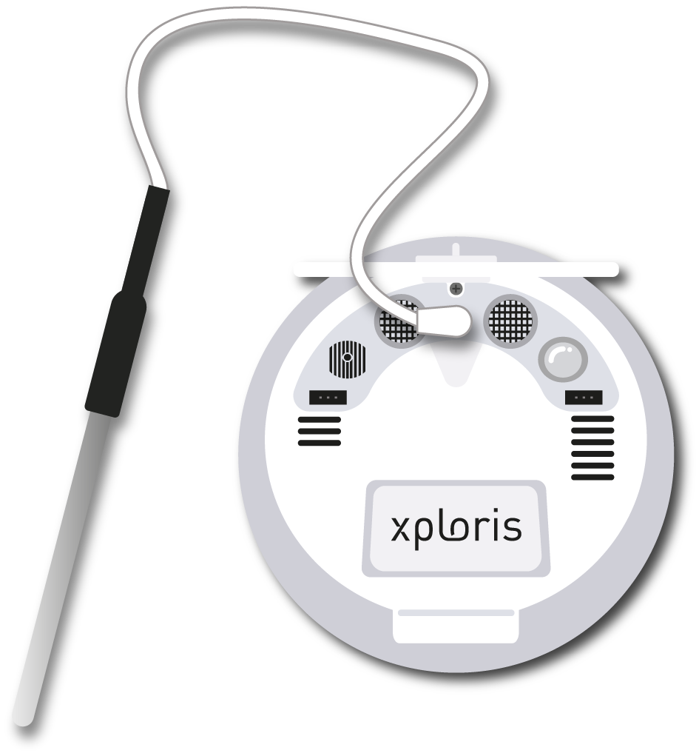
Setting up the experiment
2
Remember that in order to use the external temperature sensor you must connect the probe to the Xploris sensor.

Slide 6
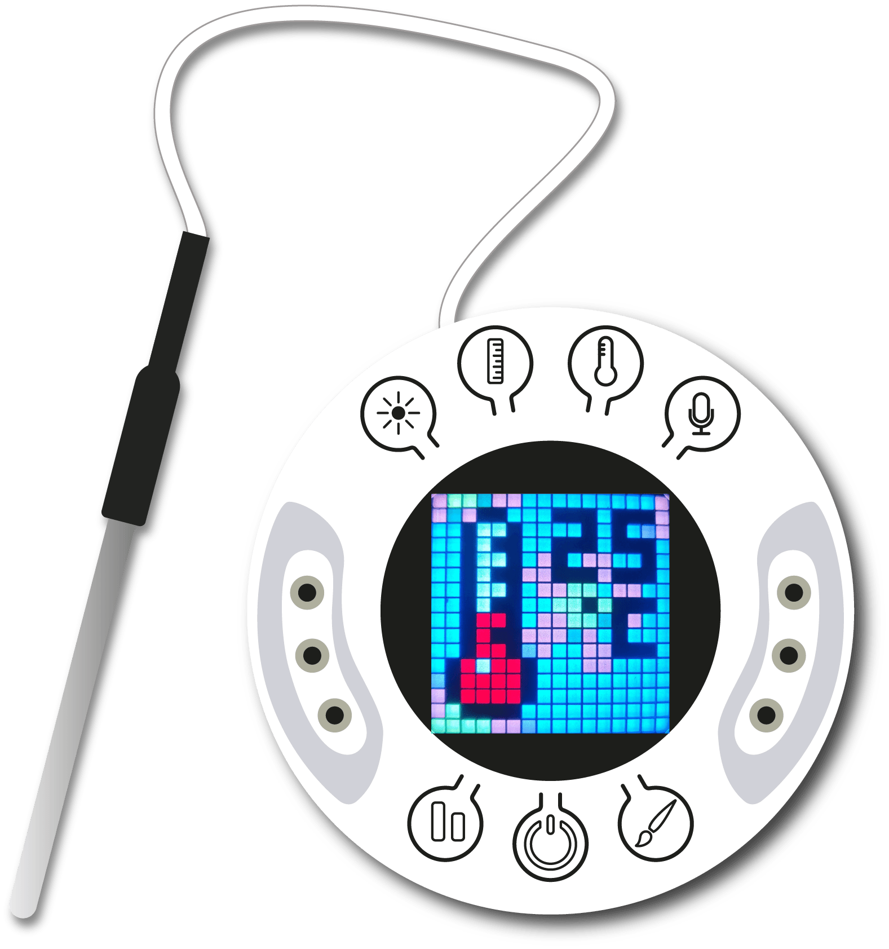
Data collection
3
Connect the external temperature probe to the Xploris and wait 2 minutes for the measurements to stabilize, then walk around your school looking for the coolest area. Don't forget to look carefully at the Xploris sensor screen so as not to miss any data and complete a table like the one shown here!
No. | Name of the area | Ambient temperature
1
2
3
4
…
* You can also take measurements with the ambient temperature sensor that is built into the Xploris, but it takes up to 20 minutes to stabilize.

Slide 7
Questions
4
1
Let's look at the table
What was the coolest and warmest area in your school? Was there anyone who detected a similar area?
2
Let's evaluate the data
What was the temperature difference between the coldest and warmest area of your school?
3
Let's analyze
Which areas do you think would be the most suitable to be in the opposite season of the year to the current one, for example, if you are in winter now, which area do you think would be more pleasant in summer?

Slide 8
Activity summary
5
We walked through different areas of the school and used the Xploris ambient temperature sensor to record the coolest and warmest areas.
We analyzed the data to establish the temperature difference between the different areas of the school.
We compared our data with those obtained by other classmates to establish the coolest and warmest areas of the school. In addition, we analyzed the data to establish which areas would be more pleasant in the opposite season of the year to the current one.

Slide 9
SCIENCES
Light and shade: Where is it cooler?

