Slide 1
SCIENCE
Light absorbance: Which sunglasses are the most effective?

Slide 2
¿WHICH SUNGLASSES ARE THE MOST EFFECTIVE?
1
Introduction
2
Setting up the experiment
3
Data collection
SCIENCES
4
Data analysis
5
Questions
6
Activity summary

Slide 3
Introduction
1
Have you ever been dazzled? This happens when a light source appears in our field of vision that is brighter than the surroundings, causing the eye to become overstimulated and leading to dark spots. To avoid being dazzled, we can use sunglasses, among other things, to reduce the amount of light entering our eyes.
In this lesson we invite you to compare the effectiveness of different sunglasses in filtering light using the Xploris light sensor.
The question you will answer will be:
Which sunglasses are the most effective at filtering light?

Slide 4
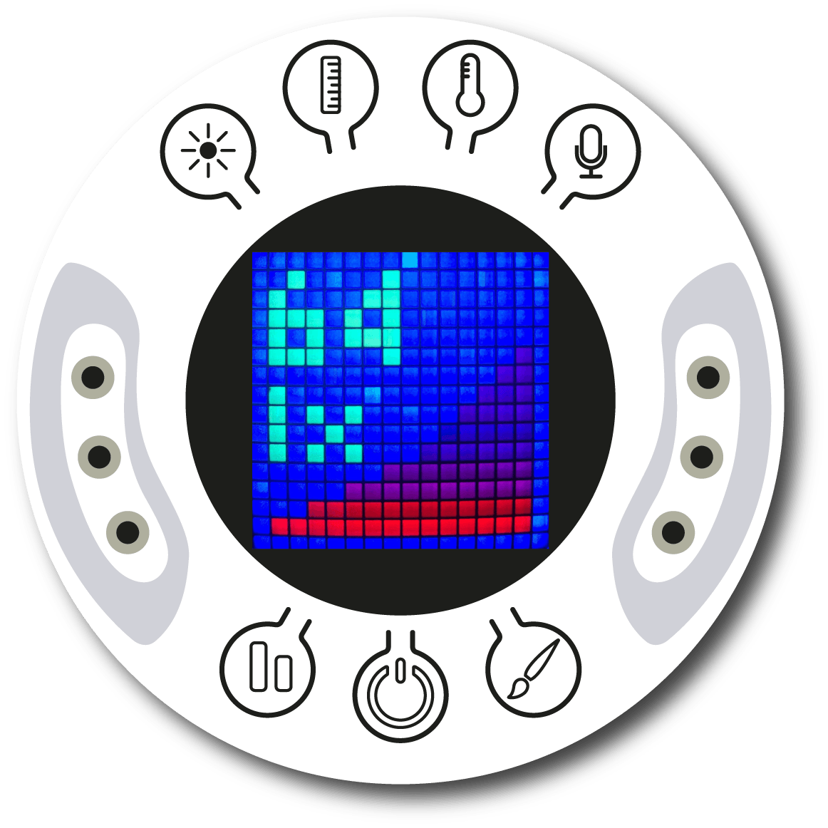
Setting up the experiment
2
You will use the light sensor to manually measure how much light manages to pass through different sunglasses. To do this, you will illuminate the sensor with a flashlight located 20 centimeters away and place a filter (sunglasses) between the flashlight and the sensor.
To take a measurement, we suggest looking carefully at the Xploris screen until the light intensity stabilizes and then taking the measurement.

Slide 5
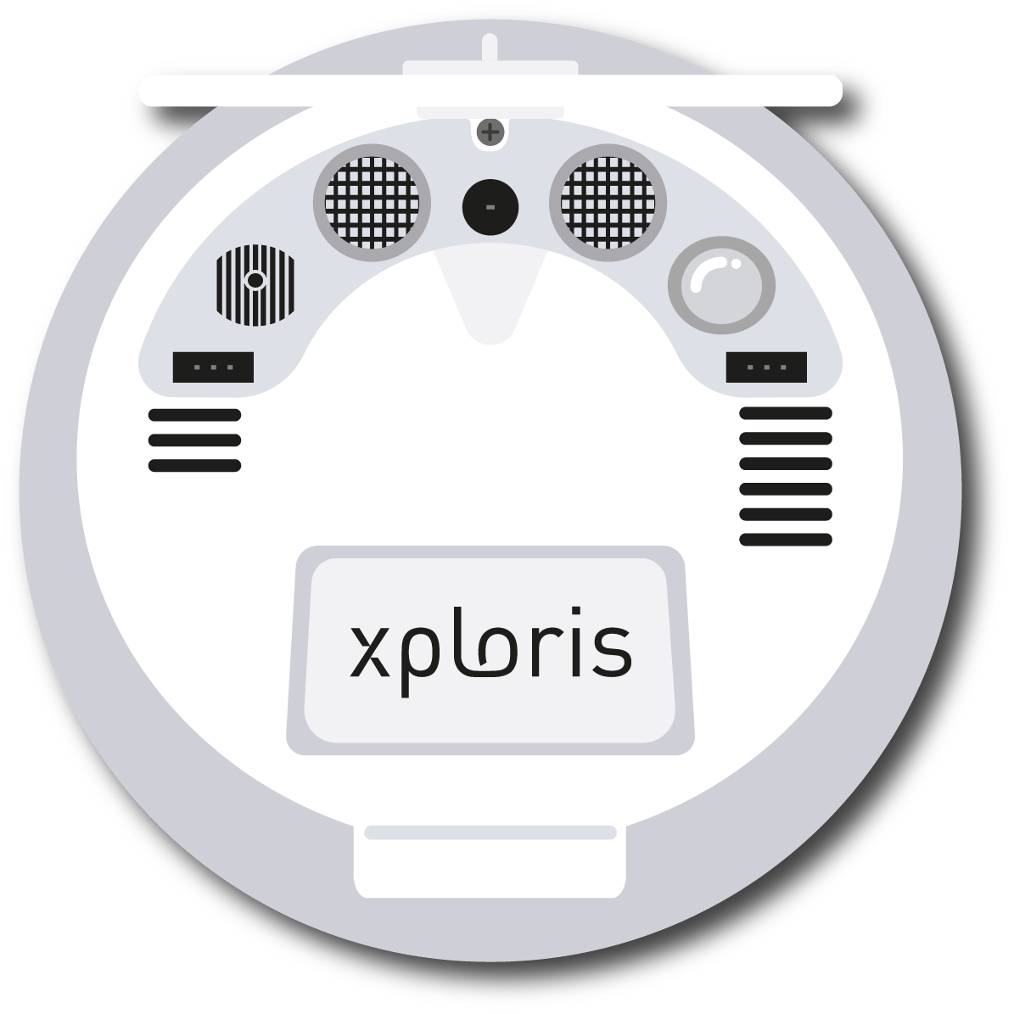
Setting up the experiment
2
The “light” sensor is located at the back of the Xploris, make sure it is uncovered as shown in the picture.

Slide 6
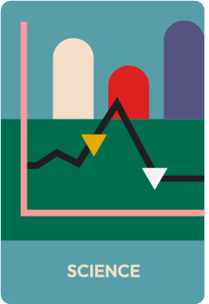
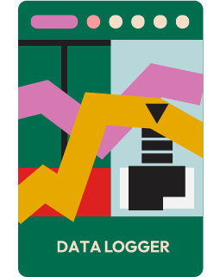
Setting up the experiment
2
Turn on your Xploris and connect it to your computer or tablet.
Open the XploriLab software on your computer or tablet.
Once inside XploriLab, select the icon to connect the device via cable or bluetooth as applicable.
Go to the SCIENCE section and then to DATA LOGGER.

Slide 7
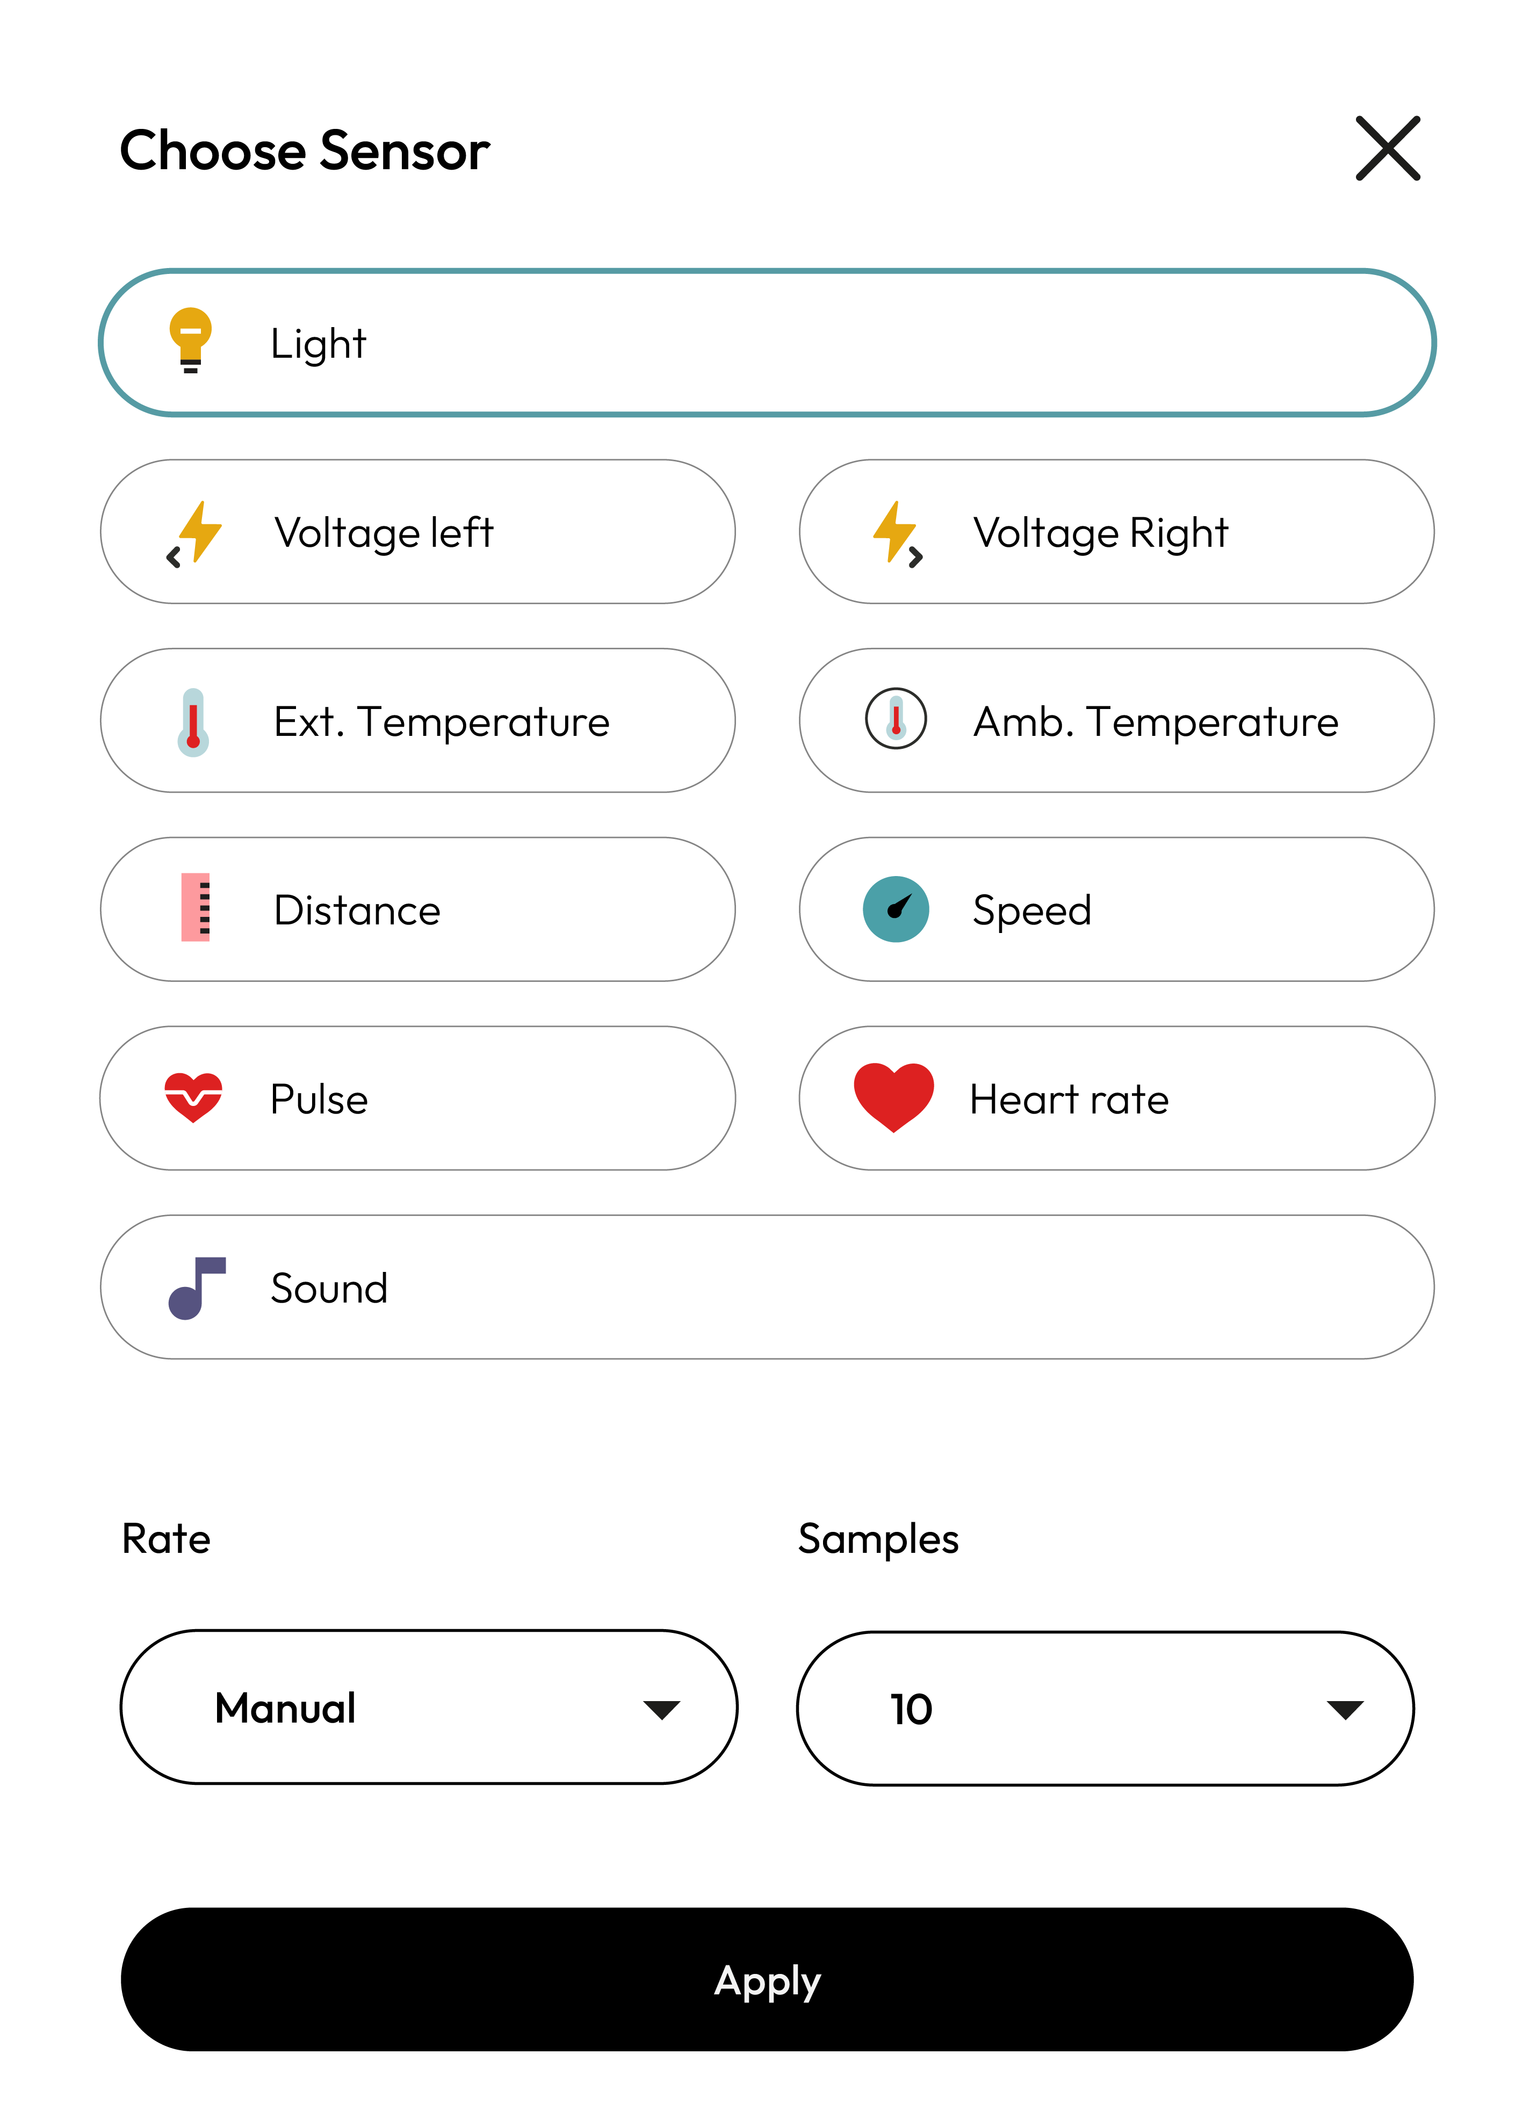
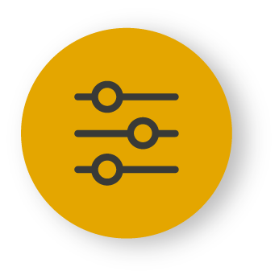
XploriLab software configuration
Setting up the experiment
2
1
To start any configuration related to the sensors, you will select the “setup” icon.
The sensor you will use for this activity is the light sensor and you will configure it to take manual measurements with a total of 10 samples.
Once the configuration has been completed, select “Apply” to save it.

Slide 8
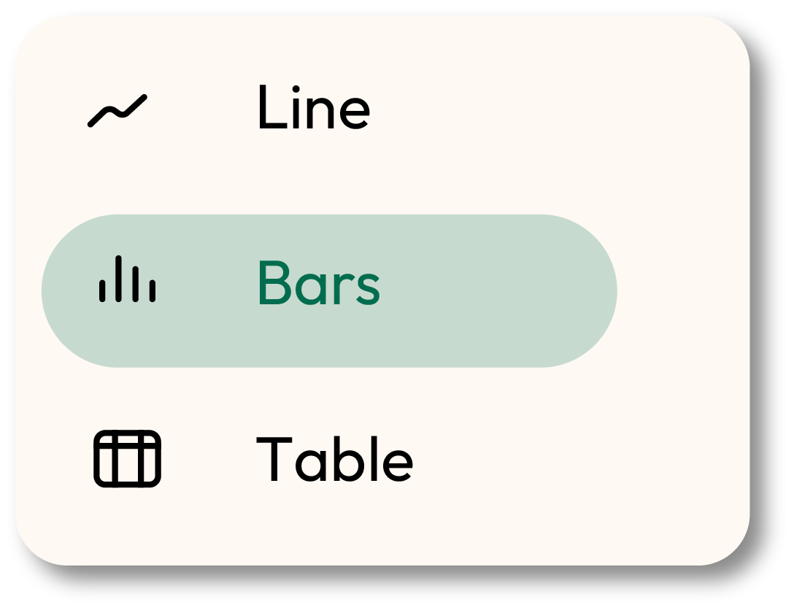
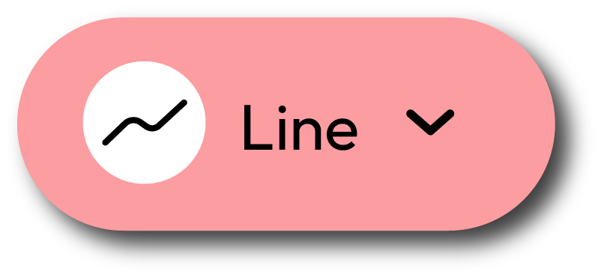
XploriLab software configuration
Setting up the experiment
2
1
Click the “line” icon on display and select the “bars” option.
2
Click the PLAY icon to start recording. Then, when you want to collect a new measurement - press the Light key on the Xploris.

Slide 9
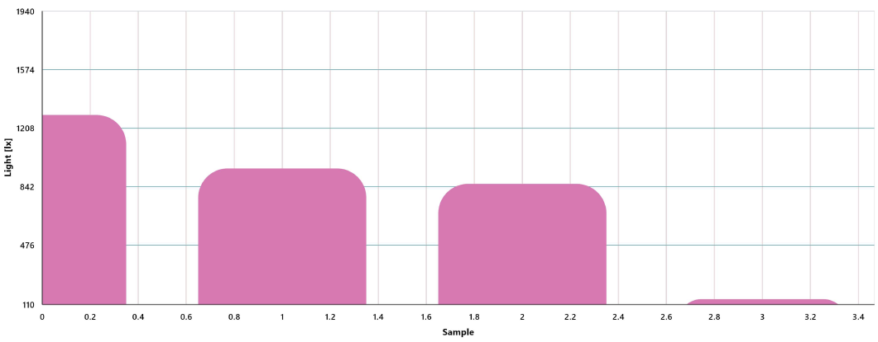
Data collection
3
Use 3 sunglasses to filter the light entering the sensor and record a manual measurement for each one. Also, add a fourth pair of glasses that is transparent, so that you have a control sample for comparison.
In the graph shown in this lesson, sunglasses with yellow, orange and black filters were used.
COMPARISON GRAPH OF DIFFERENT SUNGLASSES

Slide 10
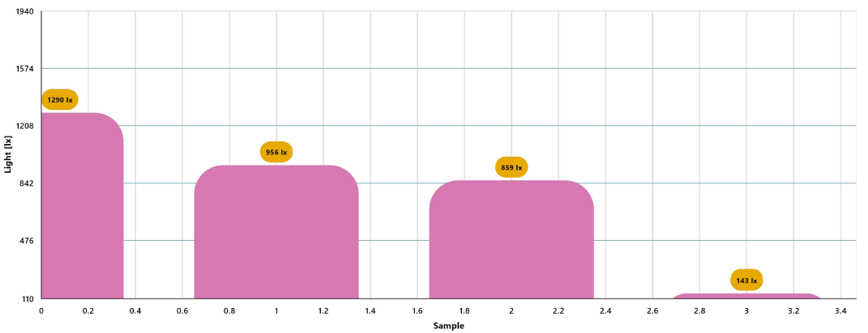
Data analysis
4
1
Use markers to add labels to the graph columns. To do this you must select the “Marker” icon:
GRAPH WITH MARKERS

Slide 11
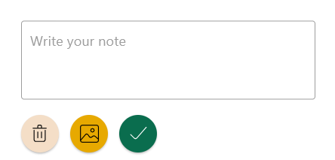
2
Data analysis
4
2
To add photos to the notes within a graph you must do the following:
Select the note icon.
Click on the bar where you want to add a note.
A dialog box will open and allow you to add the note with text and images.
Take a picture of the pair of sunglasses used for the measurement and select it for the note image.

Slide 12
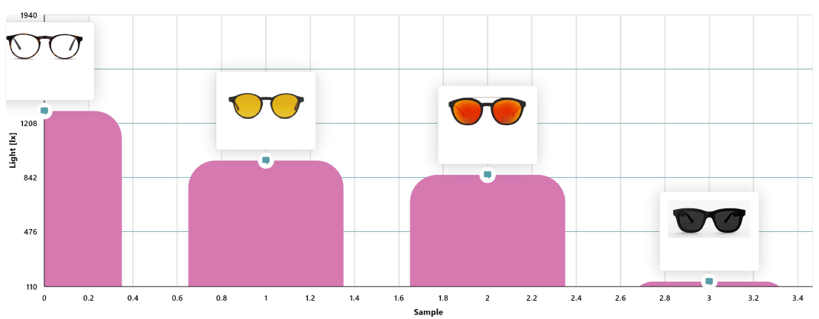
Data analysis
4
3
GRAPH WITH NOTES

Slide 13
Questions
5
1
Let's take a look at the graph
4
Let's investigate!
Which of the sunglasses let the most light through to the sensor and which filtered the most?
What other characteristics, besides the color of the lenses, are important in choosing sunglasses that really protect your eyes?
2
Let's take a look at the graph
5
Let's keep experimenting!
What do you think is the relationship between the color of sunglasses lenses and their ability to filter light?
Do you think that if you change the color of the flashlight, the ability of the lens to filter the light will change? Formulate your hypothesis and experiment with your classmates using the Xploris sensor.
3
Let's evaluate the data
Which of the sunglasses you tested in this class could best protect your eyes from being dazzled?

Slide 14
Activity summary
6
We used the Xploris light sensor to compare the ability of different sunglasses to filter the light coming from a flashlight.
We created a bar graph and analyzed the data to establish which lens filtered the light best and which lens let the most light through to the sensor.
We answered questions by analyzing our data and related the color of the sunglasses to their ability to filter light. In addition, we investigated other characteristics of sunglasses that allow us to protect ourselves from the sun and experimented again by changing the color of the light source to assess whether our results varied.

Slide 15
SCIENCES
Light absorbance: Which sunglasses are the most effective?

