Slide 1
SCIENCE
How loud: I can't hear you!

Slide 2
I CAN'T HEAR YOU!
1
Introduction
2
Setting up the experiment
3
Data collection
SCIENCES
4
Data analysis
5
Questions
6
Activity summary

Slide 3
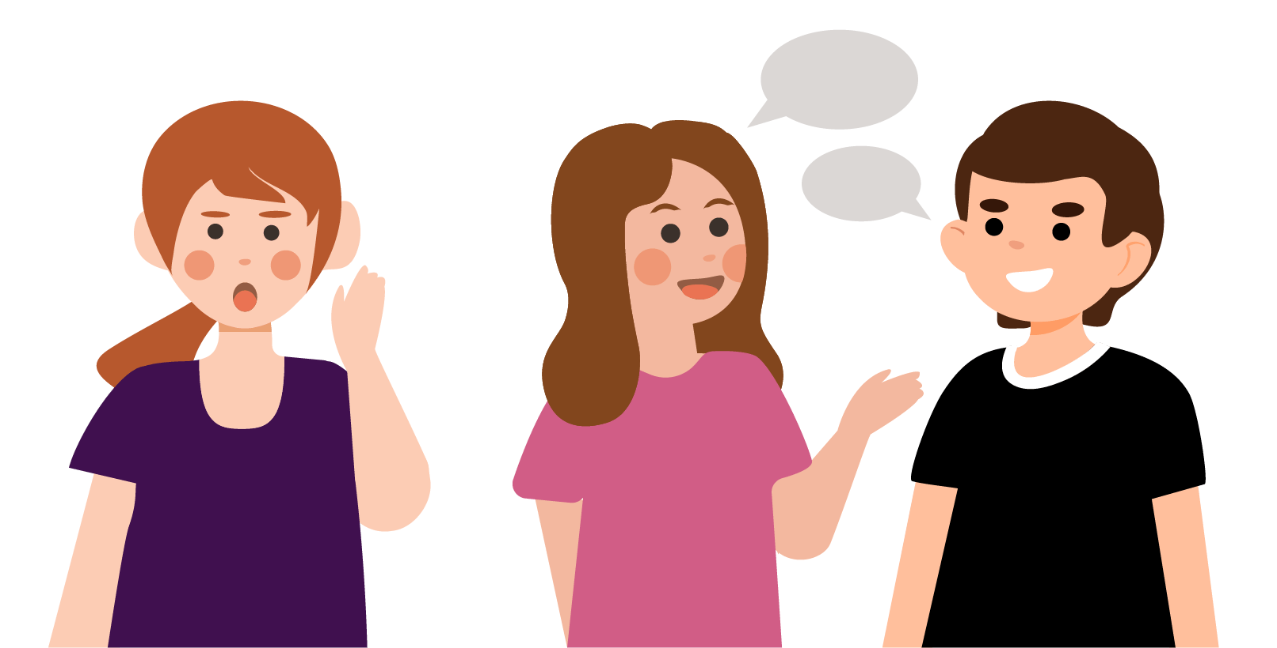
Introduction
1
Have you ever seen two people talking to each other and wanted to hear what they were saying, but couldn't? Either because they are talking too quietly or because they are too far away, sometimes we simply can't hear the sound.
In this lesson you will study the relationship between sound and distance, using the Xploris microphone sensor.
The question you will answer will be:
How does the sound change as I get closer to the source?

Slide 4
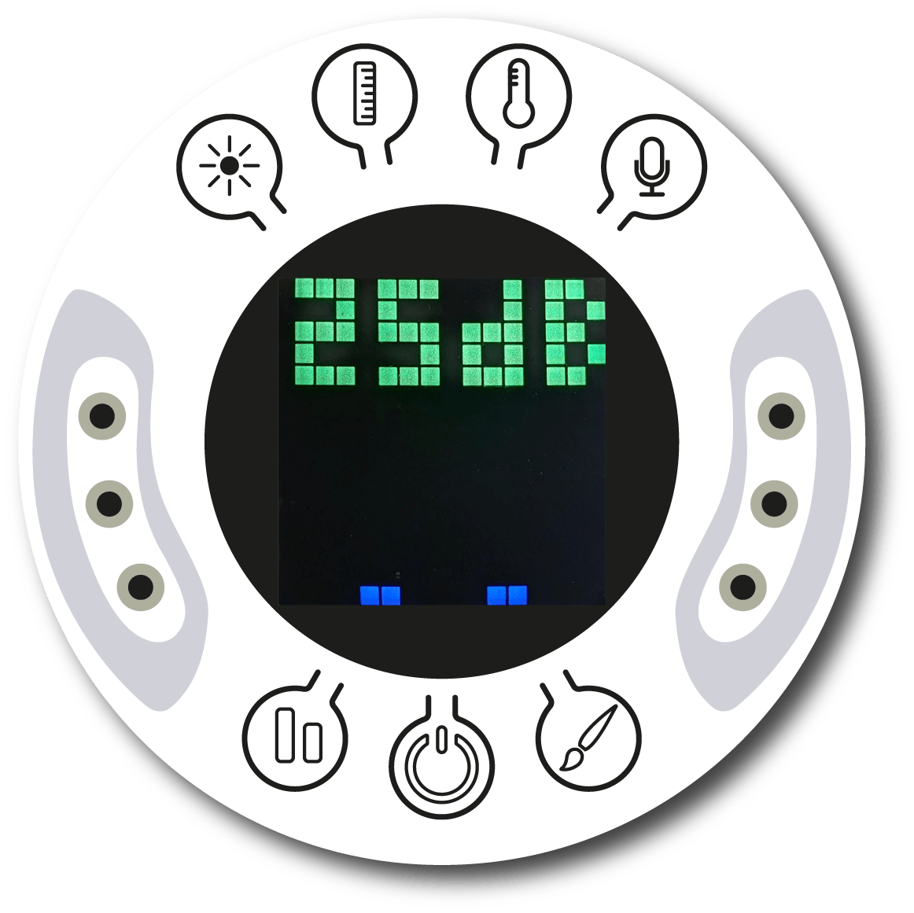
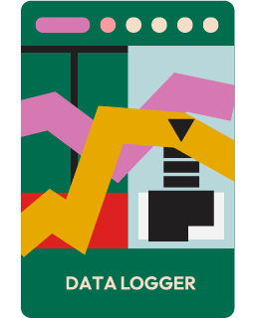
Setting up the experiment
2
Turn on your Xploris and connect it to your computer or tablet.
Open the XploriLab software on your computer or tablet.
Once inside XploriLab, select the icon to connect the device via cable or bluetooth as applicable.
Go to the SCIENCE section and then to DATA LOGGER.

Slide 5
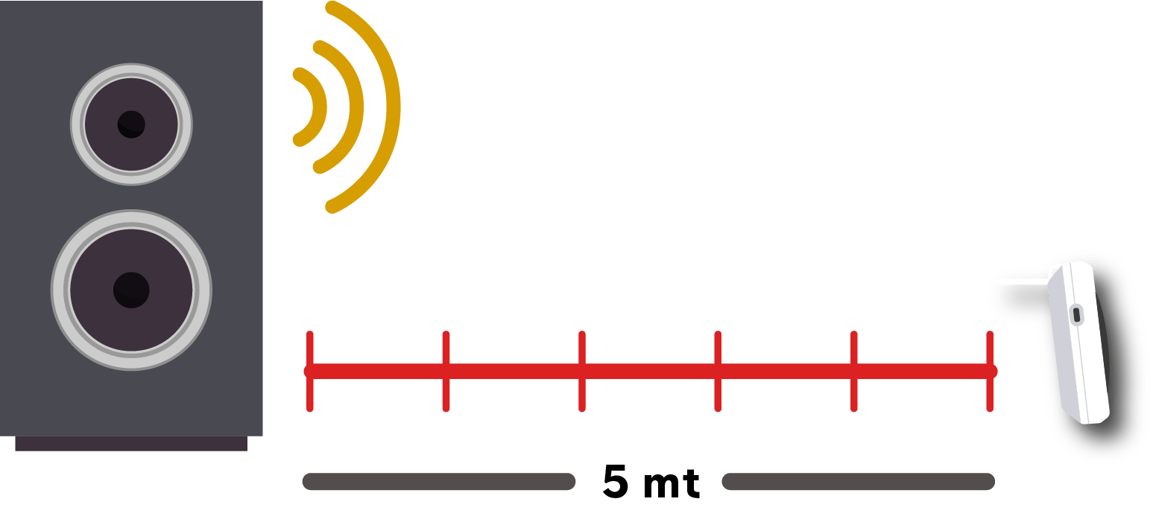
Setting up the experiment
2
Find a quiet hallway in your school. Place a speaker at one end and move away from it by marking distances on the floor separated by one meter until you reach 5 meters. Then, one person should turn on the speaker at high volume and you should register the sound with the Xploris sensor as you get closer to the speaker.
It is necessary for the speaker to produce a clear single frequency sound.
To do this, use any online tone generator and select a frequency close to 1000 Hz.

Slide 6
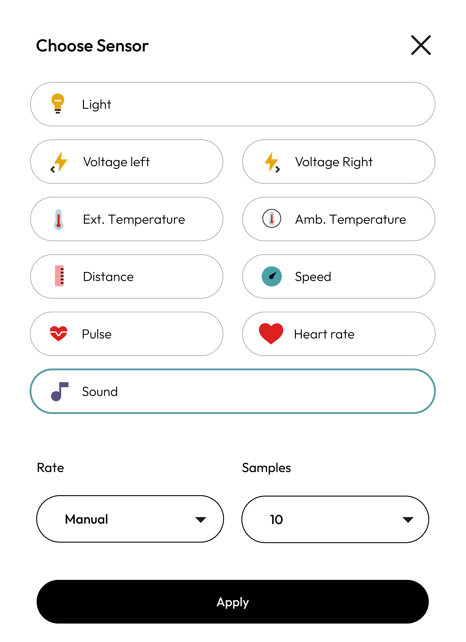
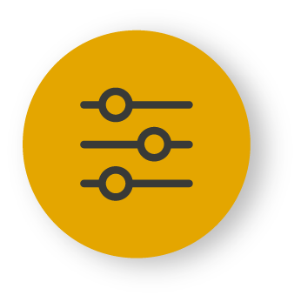
XploriLab software configuration
Setting up the experiment
2
1
To start any configuration related to the sensors, please select the “setup” icon.
The sensor you will use for this activity is the sound sensor and you will configure it to take manual measurements with a total of 10 samples.
Once the configuration has been completed, select “Apply” to save it.

Slide 7
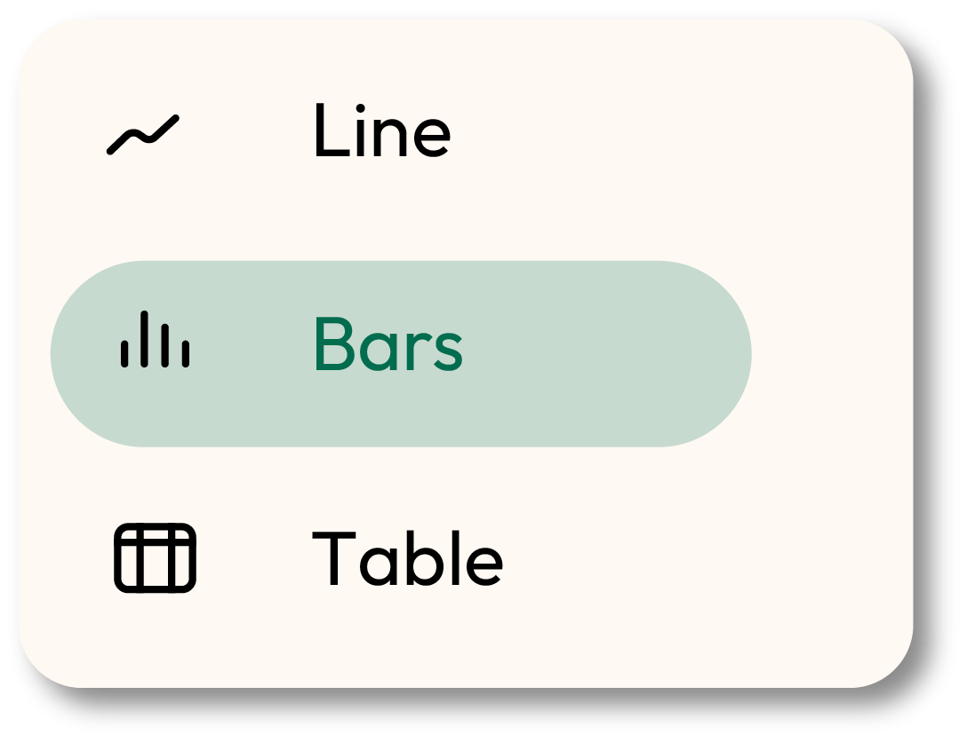
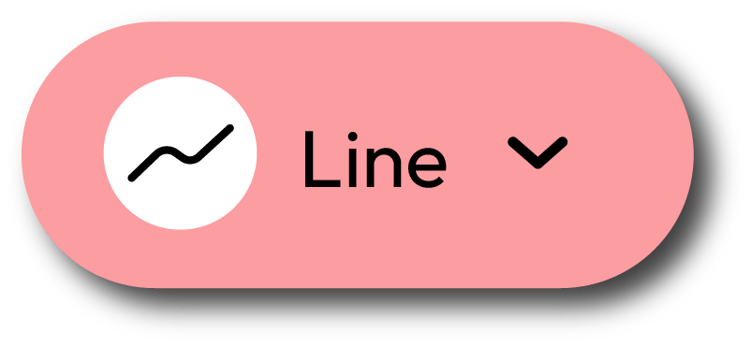
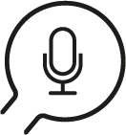
XploriLab software configuration
Setting up the experiment
2
1
Click the “line” icon on display and select the “bars” option.
2
Click the PLAY icon to start recording. Then, when you want to collect a new measurement - press the Sound key on the Xploris.

Slide 8
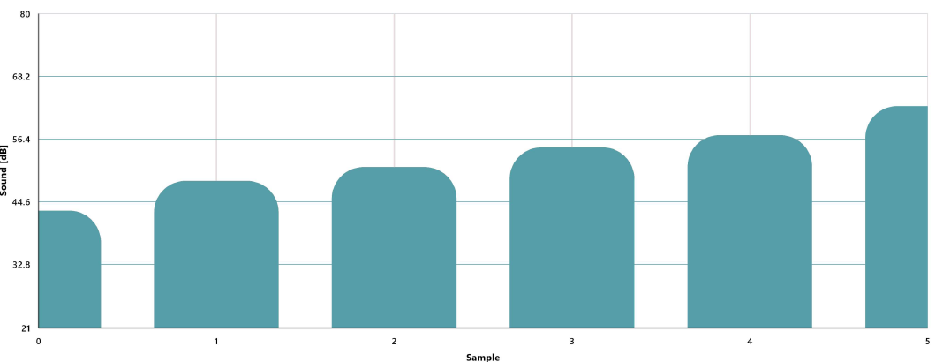
Data collection
3
Once you have made the marks on the floor every one meter, turn on the speaker as loud as possible and measure the sound manually as you get closer to the speaker. Remember to make sure that the place is as quiet as possible so as not to interfere with the measurements.
SOUND GRAPH
1 mt
2 mt
3 mt
4 mt
5 mt

Slide 9
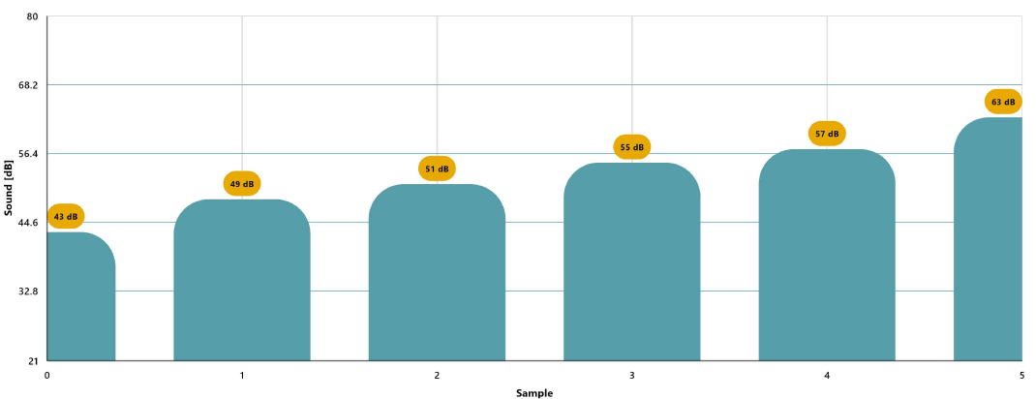
Data analysis
4
1
Use markers to add labels to the columns of the graph. To do this you must select the “Marker” icon:
GRAPH WITH MARKERS

Slide 10
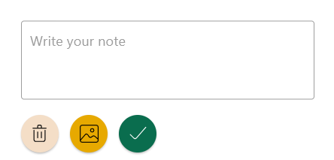
2
Data analysis
4
2
You can add photos to the notes within a graph by doing the following:
Select the note icon.
Click on the bar where you want to add a note.
A dialog box will open and allow you to add the note with text and images.

Slide 11
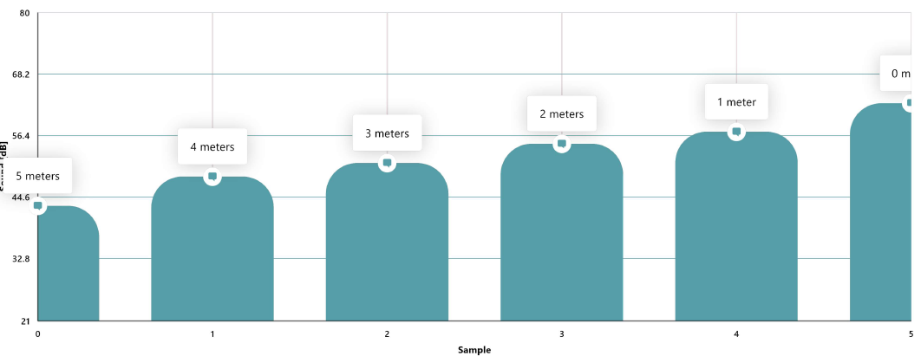
Data analysis
4
3
GRAPH WITH NOTES

Slide 12
Questions
5
1
Let's take a look at the graph
4
Let's keep experimenting!
What was the highest sound intensity detected and what was the lowest?
What do you think would happen to the measurements if instead of having the speaker at moderate volume we use it at very high volume? Formulate your hypothesis and test it using the Xploris microphone sensor.
2
Let's evaluate the data
What relationship can be made between sound intensity and distance from the speaker?
3
Let's investigate!
Look up in books or on the internet how we can hear and what happens to the ears when we are exposed to very loud sounds.

Slide 13
Activity summary
6
We use the Xploris sound sensor to study the sound intensity produced by a speaker.
We analyzed the data to establish the relationship between distance from the speaker and sound intensity.
We answered questions by analyzing the values obtained, as well as investigating how hearing occurs and what happens when we are exposed to loud sounds. Finally, we changed the volume of the speaker and repeated the experiment to see if there were any differences.

Slide 14
SCIENCES
How loud: I can't hear you!

