Slide 1
SCIENCE
How fast: Who wins the race?

Slide 2
WHO WINS THE RACE?
1
Introduction
2
Setting up the experiment
3
Data collection
SCIENCES
4
Data analysis
5
Questions
6
Activity summary

Slide 3
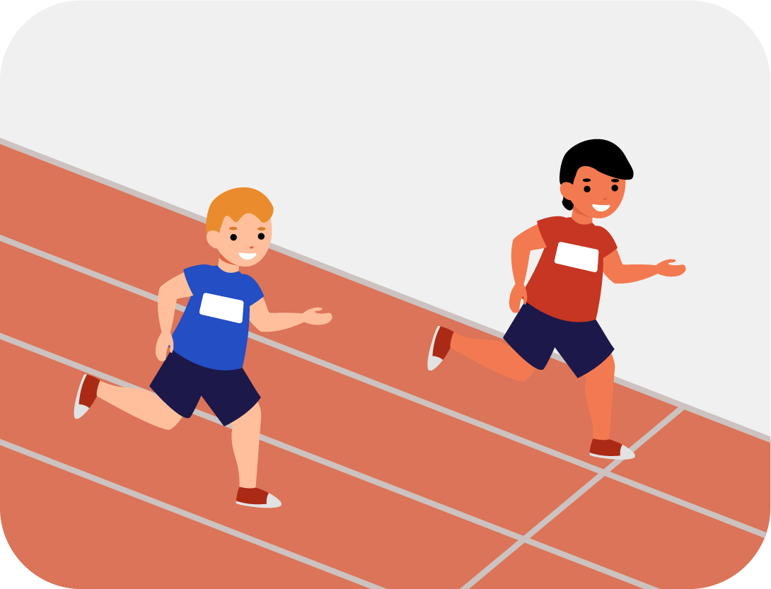
Introduction
1
You've likely raced against your friends numerous times and might even know someone who runs marathons or aspires to be a professional athlete. But have you ever considered what your maximum speed might be?
In this lesson, you will sprint at your maximum speed and use the Xploris distance sensor to determine your highest achievable acceleration.
The question you will answer will be:
What is the maximum acceleration that my classmates and I can achieve?

Slide 4
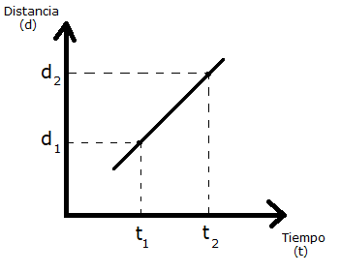
2
Introduction
1
1
SPEED
Velocity (V) refers to the change in position or distance (d) experienced by an object over a specific period of time (t) It can be expressed using the following equation:
$$\text{Velocity}\text{ (}\text{V}\text{)} \text{= }\frac{\text{∆ }\text{Distance}}{\text{∆ }\text{Time}}\text{=}\frac{{\text{d}}_{\text{2}}\text{ −}{\text{d}}_{\text{1}}}{{\text{t}}_{\text{2}}\text{ −}{\text{t}}_{\text{1}}}$$
Distance
(d)
The slope of this distance versus time graph corresponds to the velocity.
Time
(t)

Slide 5
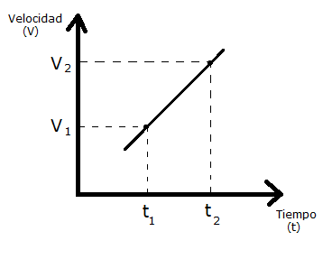
2
Introduction
1
2
ACCELERATION
On the other hand, acceleration (a) measures the rate at which speed changes over time for an object. It can be expressed using the following equation:
$$\text{A}\text{cceleration}\text{= }\frac{\text{∆ }\text{Speed}}{\text{∆ }\text{Time}}\text{=}\frac{{\text{V}}_{\text{2}}\text{ −}{\text{V}}_{\text{1}}}{{\text{t}}_{\text{2}}\text{ −}{\text{t}}_{\text{1}}}$$
Velocity
(v)
The slope of this speed versus time graph corresponds to the acceleration.
Time
(t)

Slide 6
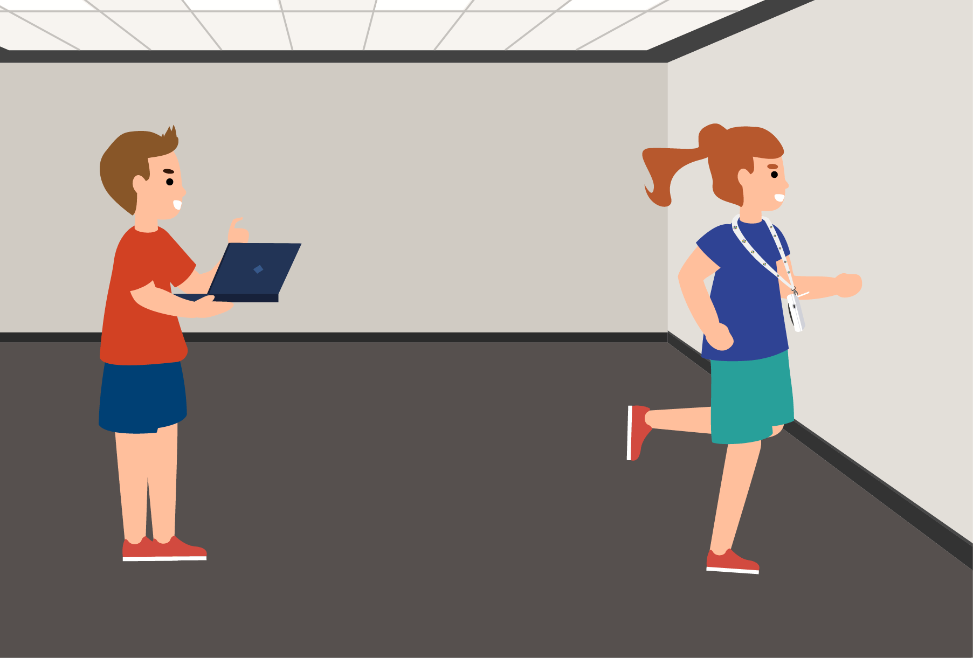
Setting up the experiment
2
This activity will require the participation of several people and their velocity will be measured. To do this, they will have to stand in a line 4 meters away from a wall.
The first person in line should wear the Xploris around their neck using the designated accessory, ensuring the distance sensor is facing the wall. Meanwhile, another participant will launch the measurements in the Xplorilab software. After a 3-second countdown, they will instruct the person with the sensor to run toward the wall. Once they reach a distance of 40 to 50 centimeters from the wall, they should stop the measurements, save the graph, and then repeat the procedure with the next participant.
¡IMPORTANT!
Measurements should be recorded for each participant, and a graph should be saved for each individual’s data analysis.

Slide 7
Setting up the experiment
2
For this activity, it is recommended to use the Xploris lanyard to ensure a safer experience.
The “distance” sensor is located on the back of the Xploris, make sure it is uncovered as shown in the picture.

Slide 8
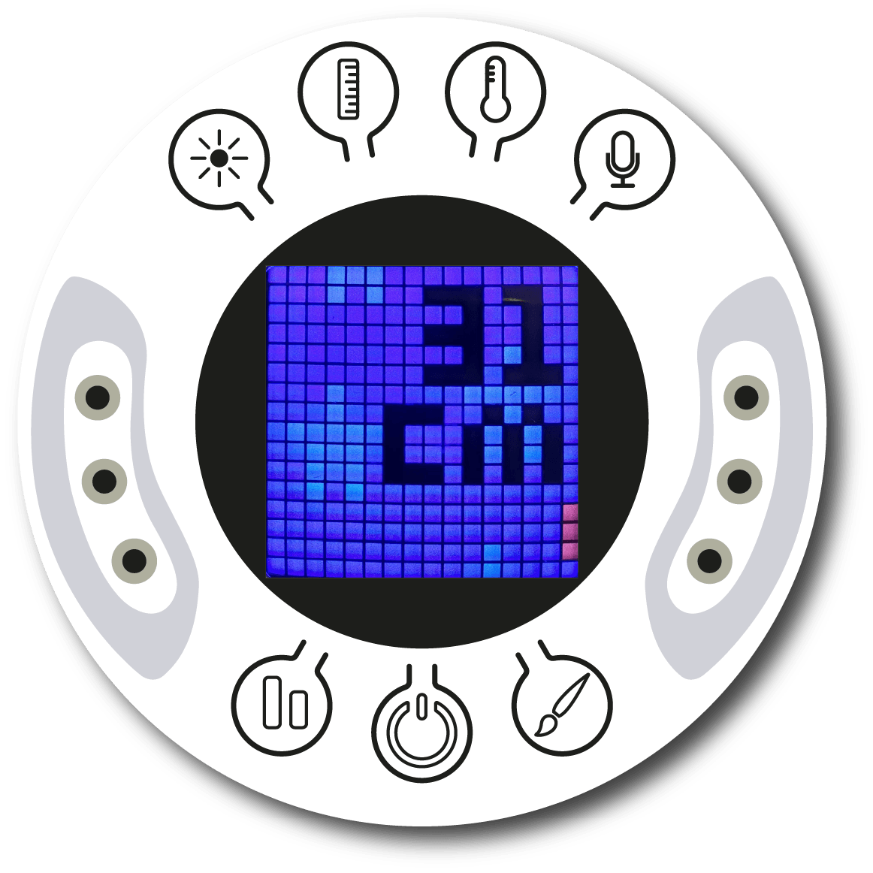
Setting up the experiment
2
Turn on your Xploris and connect it to your computer or tablet.
Open the XploriLab software on your computer or tablet.
Once inside XploriLab, select the icon to connect the device via cable or bluetooth as applicable.
Go to the SCIENCE section and then to DATA LOGGER.

Slide 9
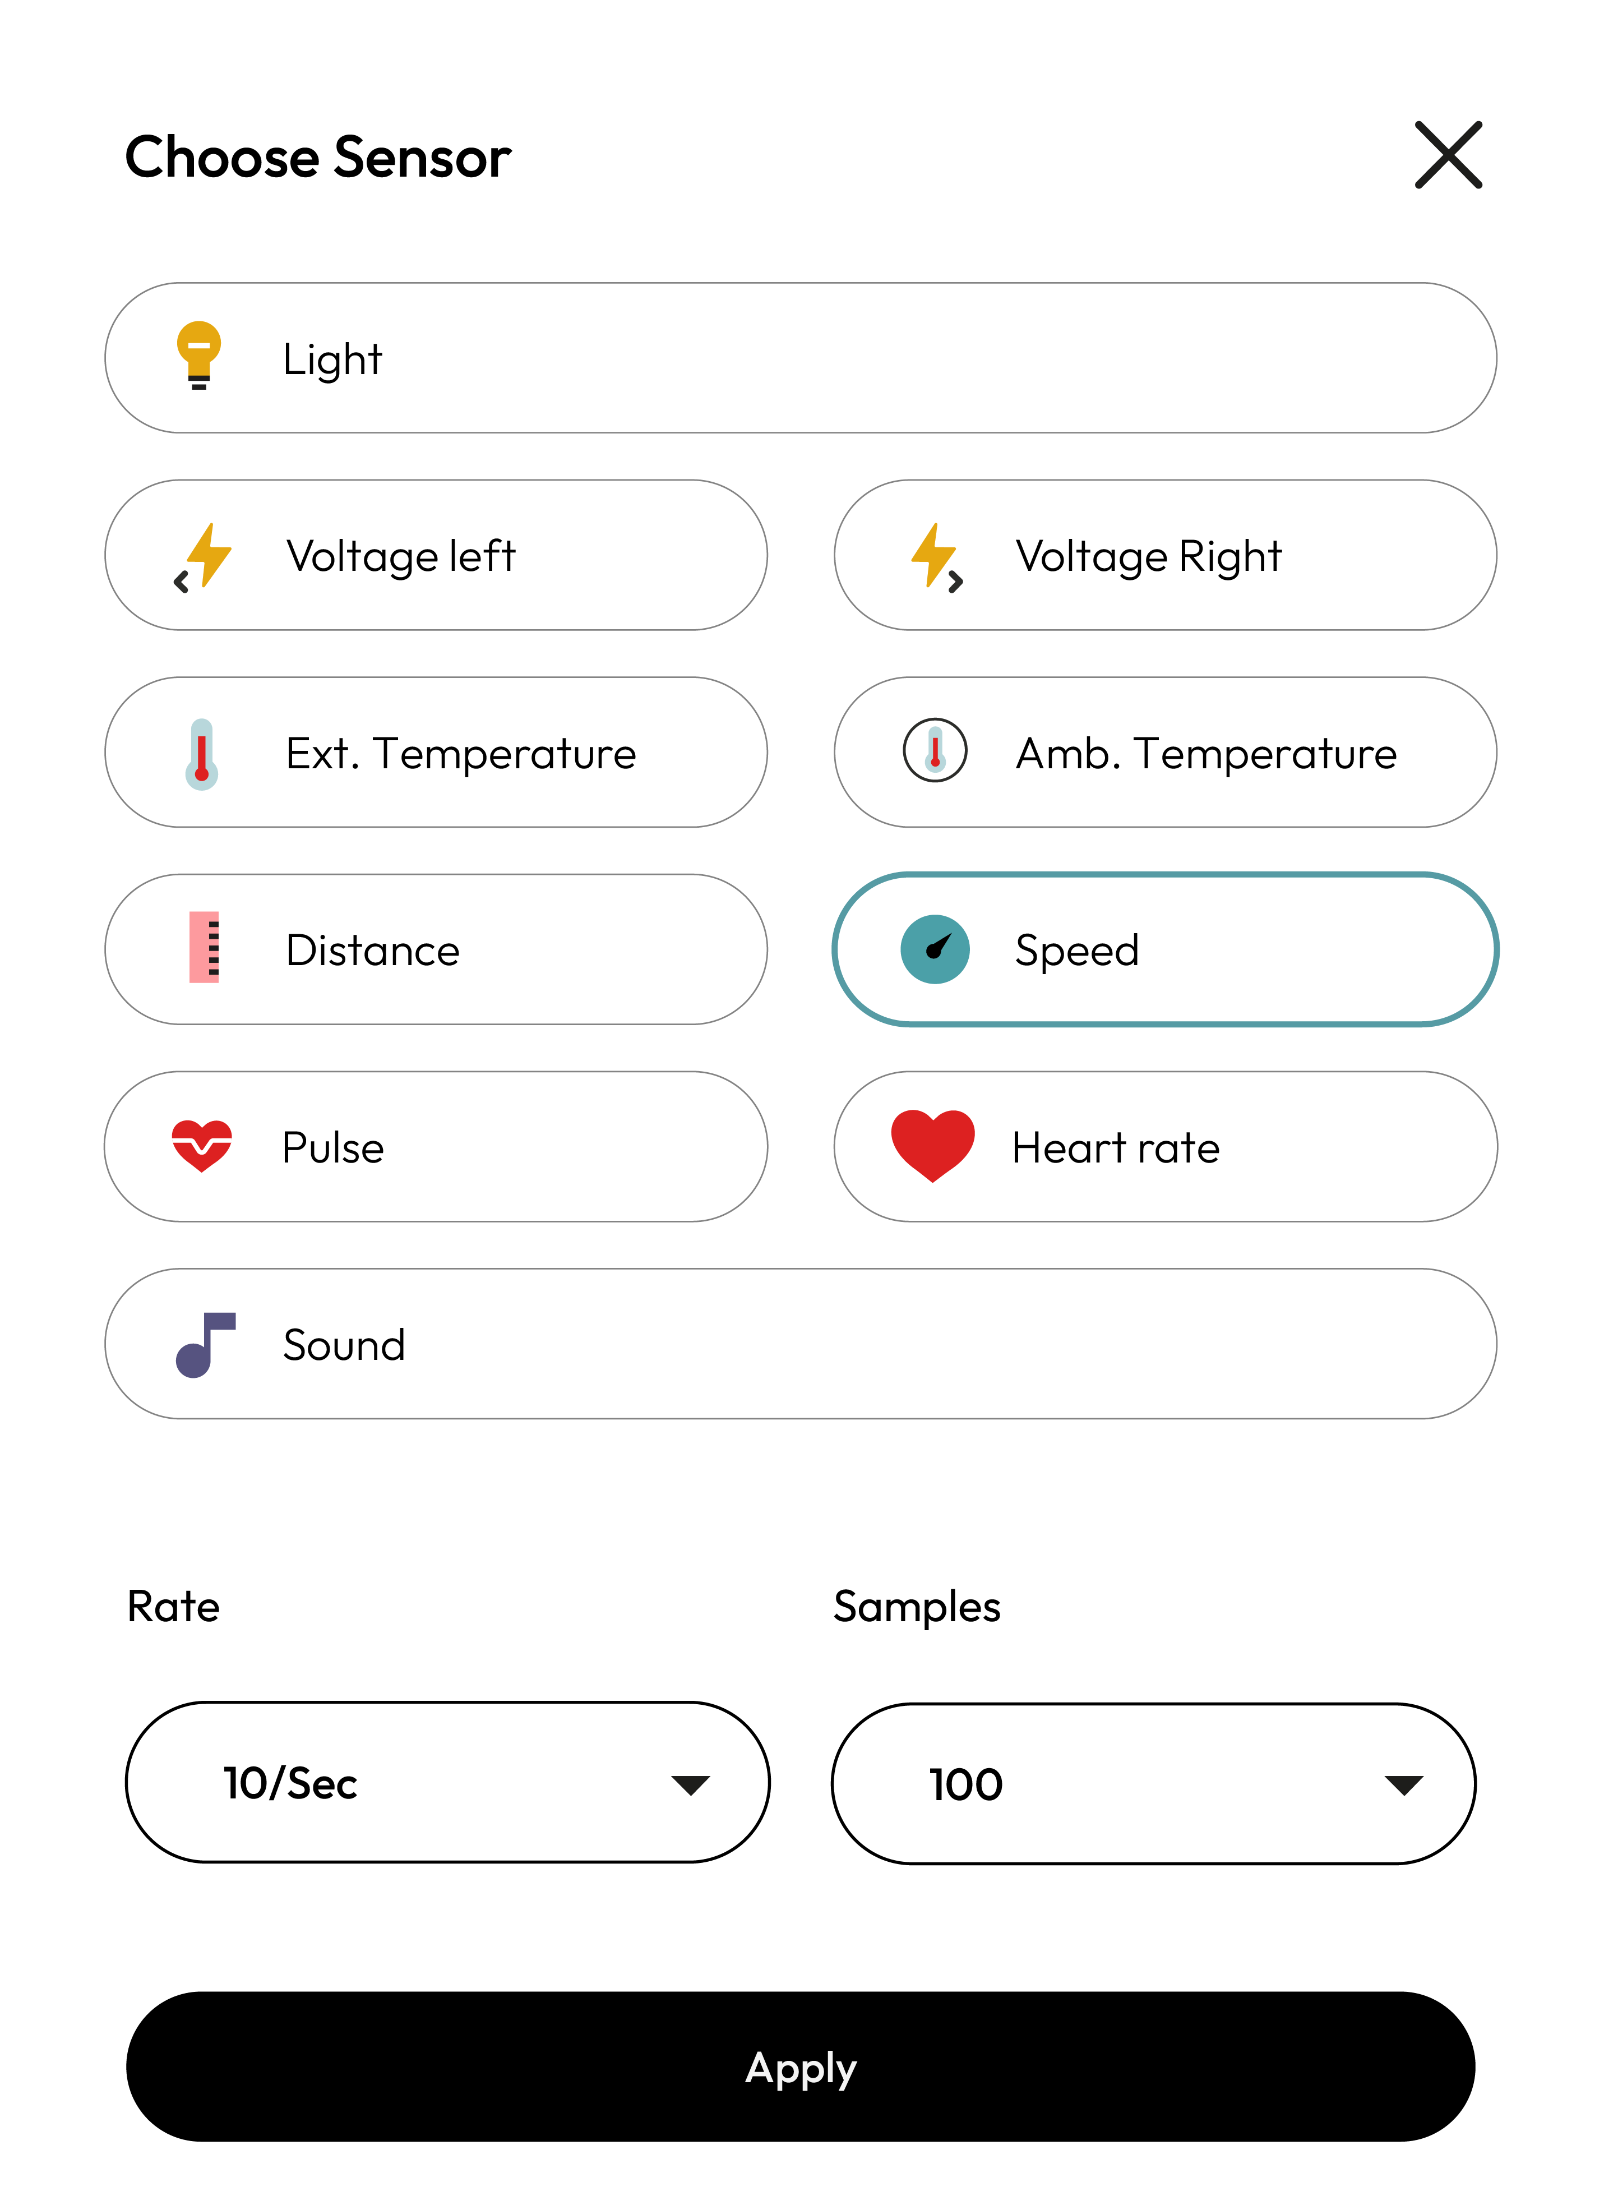
XploriLab software configuration
Setting up the experiment
2
1
To start any configuration related to the sensors, you will select the “setup” icon.
The sensors you will use for this activity are the distance and speed sensors and you will set them to take 10 samples per second (10/sec) for a total of 100 samples.
Once the configuration has been completed, select “Apply” to save it.

Slide 10
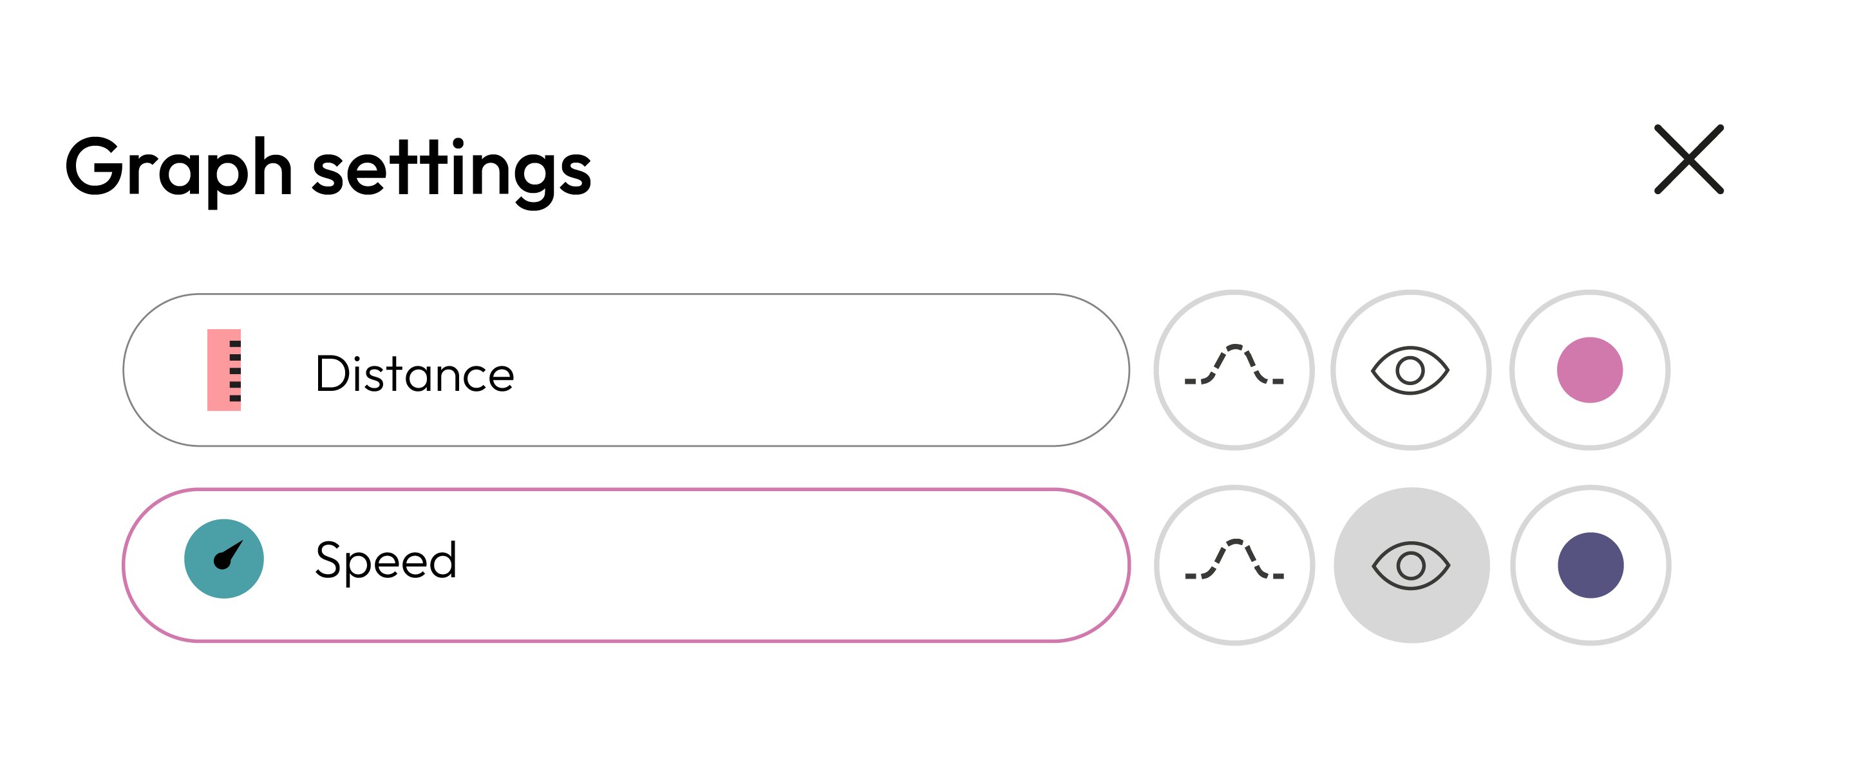
Setting up the experiment
2
2
Set the Speed graph to show sampling dots rather than a line graph:
Go to the "Graph setting" and select “Speed” sensor.
Then select the icon to activate the dot display.

Slide 11
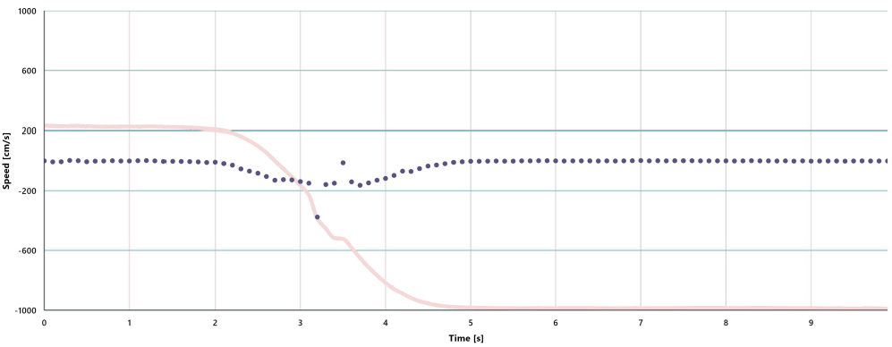
Data collection
3
Start measuring the velocity at which each of the participants is approaching the wall. Remember to get a graph of speed versus time for each of the people running towards the wall.
VELOCITY GRAPH STUDENT 1

Slide 12
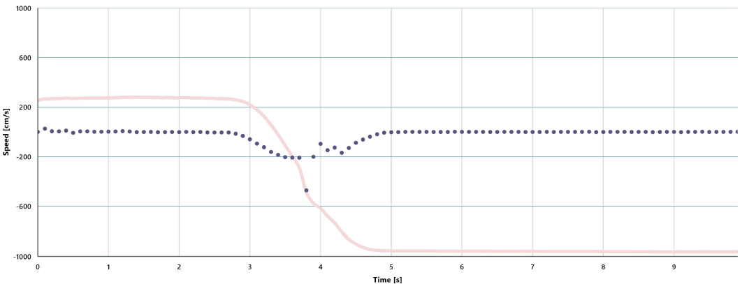
Data collection
3
VELOCITY GRAPH STUDENT 2

Slide 13
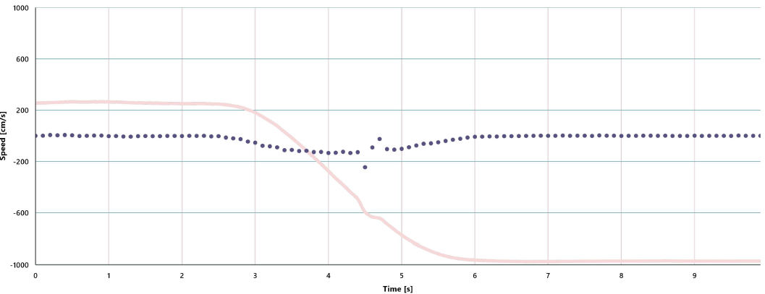
Data collection
3
VELOCITY GRAPH STUDENT 3

Slide 14
2
Data analysis
4
1
The linear regression tool allows us to find the line that best fits the measurement graph. The linear regression tool will also display the best line equation.
The equation can be expressed in the following form:
Where m is the slope of the line. In a graph of velocity versus time, the slope represents the acceleration.
Therefore, by obtaining the equation describing the motion of each person in the experiment, we can know and compare their accelerations.
y = mx + b

Slide 15
2
Data analysis
4
2
To obtain the acceleration from the measurements, you will use the linear regression tool of XploriLab.
Look at the graph to see what range of measurements register the person's movement towards the wall.
Then click on the “Marker” icon:
Use two markers to indicate the range of measurements to be analyzed, i.e. place one marker where the relevant data starts and another marker where it ends.
Use the data cropping tool by clicking the “Crop” button to isolate and retain only the section of the graph you wish to analyze on the graph.
Finally, select the linear regression tool by clicking on:

Slide 16
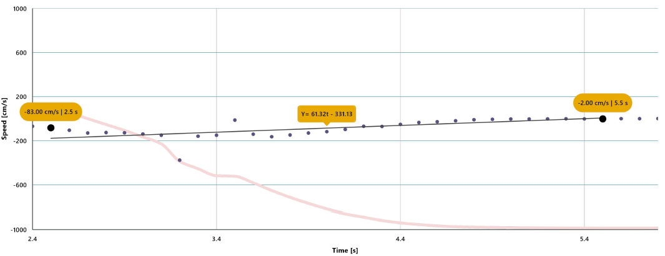
Data analysis
4
3
GRAPH WITH CROP AND LINEAR REGRESSION STUDENT 1

Slide 17
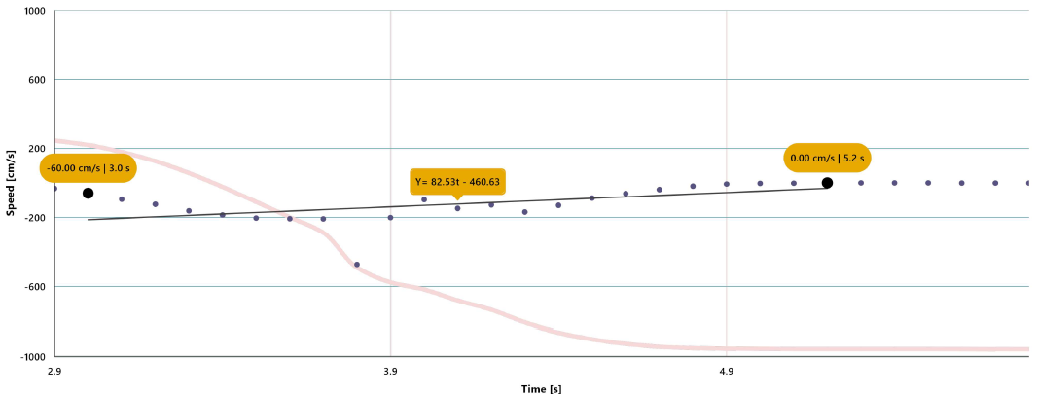
Data analysis
4
4
GRAPH WITH CROP AND LINEAR REGRESSION STUDENT 2

Slide 18
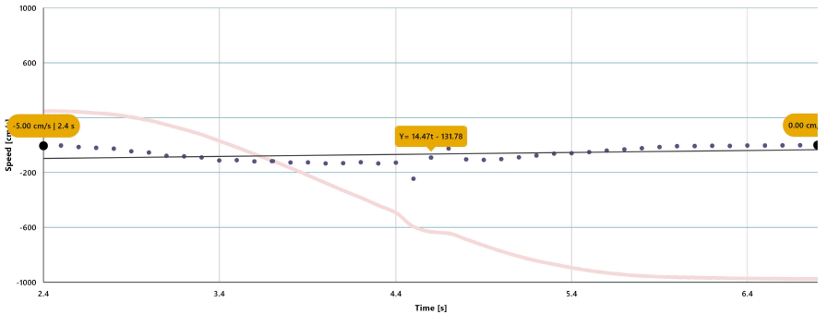
Data analysis
4
5
GRAPH WITH CROP AND LINEAR REGRESSION STUDENT 3

Slide 19
Questions
5
1
Let's take a look at the graph
4
Let's relate variables!
Which participant managed to run the fastest and what was their acceleration value?
In this experiment, the Xploris speed sensor was used to determine which participant achieved the highest acceleration. What variables influence the acceleration that a person can achieve?
2
Let's evaluate the data
Looking at the equations of each participant's line, what do you think the positive or negative symbol that the slope value indicates?
5
Let's keep experimenting!
Do you think they would reach a higher speed if they jumped instead of running away from the Xploris sensor? Test your answer by repeating the experiment, while jumping instead of running.
3
Let's evaluate the data
If these measurements were considered in a race, how would each participant rank?

Slide 20
Activity summary
6
We used the Xploris distance sensor to find out the maximum speed that different people could reach while running.
We analyzed the data and used mathematical tools (linear regression) to determine the acceleration of each participant based on the distance versus time graphs recorded.
We answered questions by analyzing our data based on the acceleration value and whether it was positive or negative. We also modified the experiment and repeated it by jumping instead of running, to see if there were variations.

Slide 21
SCIENCES
How fast: Who wins the race?

