Slide 1
SCIENCE
Greenhouse: What is a greenhouse?

Slide 2
WHAT IS A GREENHOUSE?
1
Introduction
2
Setting up the experiment
3
Data collection
SCIENCES
4
Data analysis
5
Questions
6
Activity summary

Slide 3
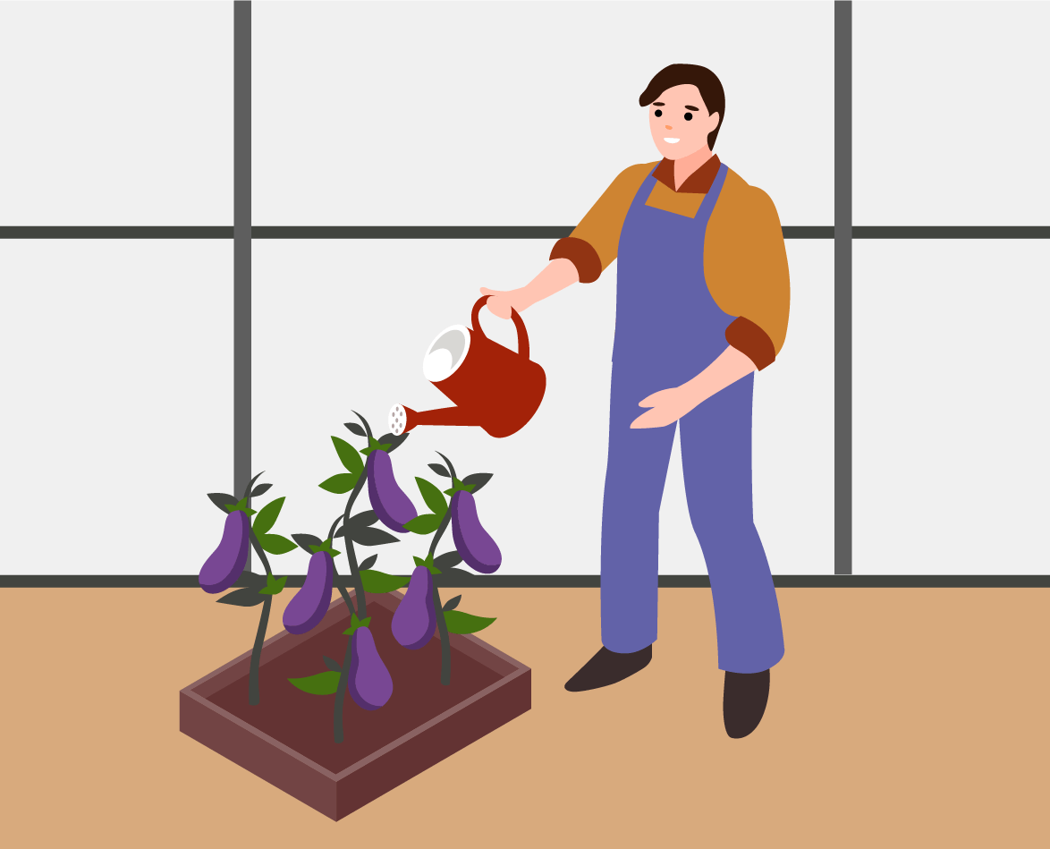
Introduction
1
Grocery stores offer a wide variety of fruits and vegetables, but you might notice that some are out of season or originate from distant regions. Surprisingly, many of these crops can still be grown locally. How is this possible? One key factor is the use of greenhouses. These controlled environments create optimal conditions for plant growth, allowing for the cultivation of diverse species year-round. Greenhouses provide protection from harsh weather and pests, enabling farmers to produce fresh, high-quality produce regardless of the season.
In this lesson, you will explore the environmental changes that take place inside a greenhouse, utilizing Xploris temperature sensors to gather and analyze data.
The question you will answer will be:
How does the temperature inside a greenhouse compare to the temperature outside?

Slide 4
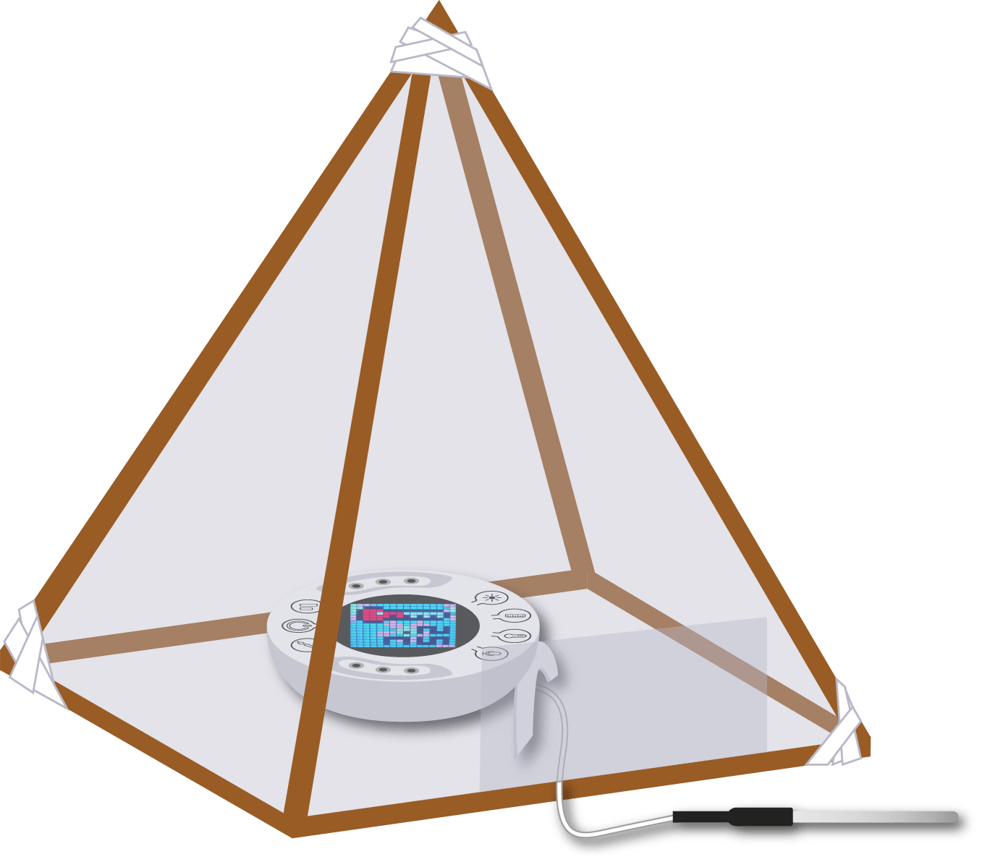
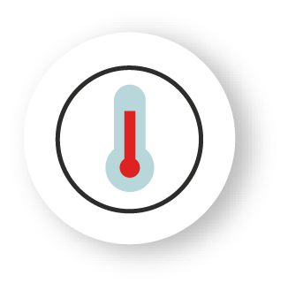
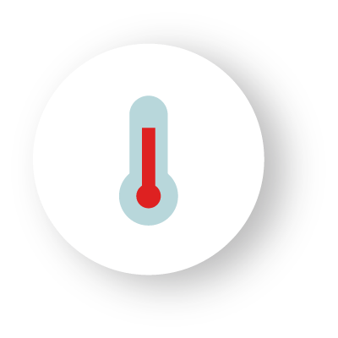
Setting up the experiment
2
Before starting the experiment, you need to build a small greenhouse for the Xploris sensor. If your school already has a greenhouse, that's even better!
You will measure the temperature inside the greenhouse using the ambient temperature sensor, and the outside temperature will be measured by connecting the external temperature probe. This way you will make simultaneous measurements and can compare the changes.

Slide 5
Setting up the experiment
2
1
2
3
To build your greenhouse, you can create a pyramid with a square base using 5x5 mm modeling sticks or a similar material.
All the sticks that make up the pyramid should be of the same length, about 25 cm approximately, and you can join them together using silicone, clear tape or paper tape.
Once the pyramid is assembled, line all its sides with thick transparent nylon, leaving an opening to insert the sensor and remove the temperature probe.

Slide 6
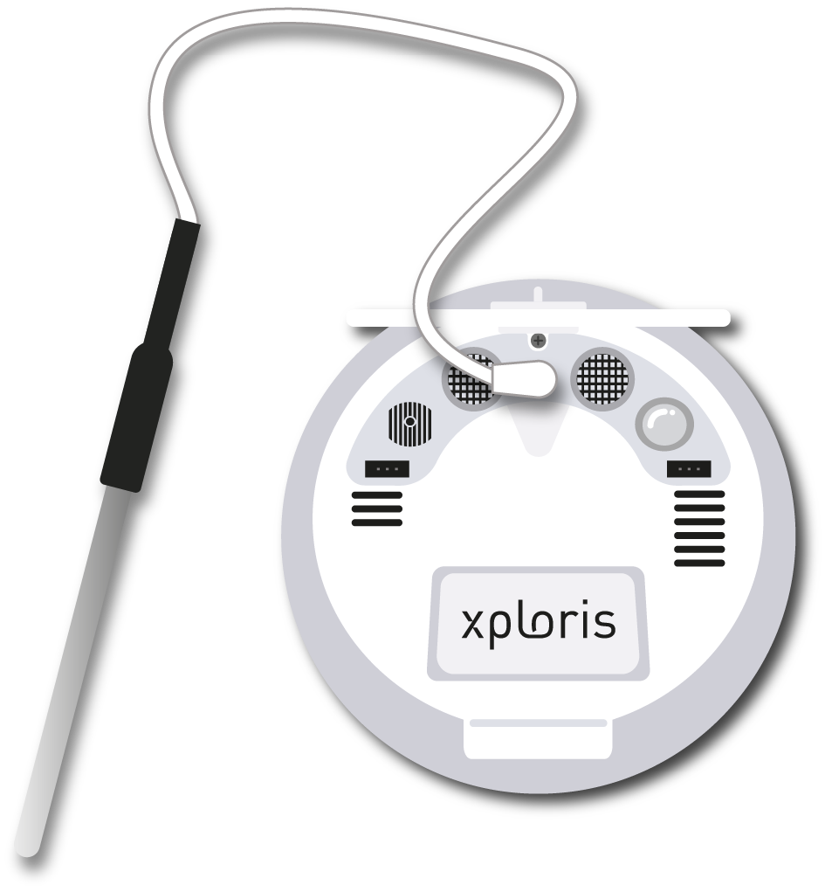
Setting up the experiment
2
Connect the external Temperature probe to the
Xploris back input.

Slide 7
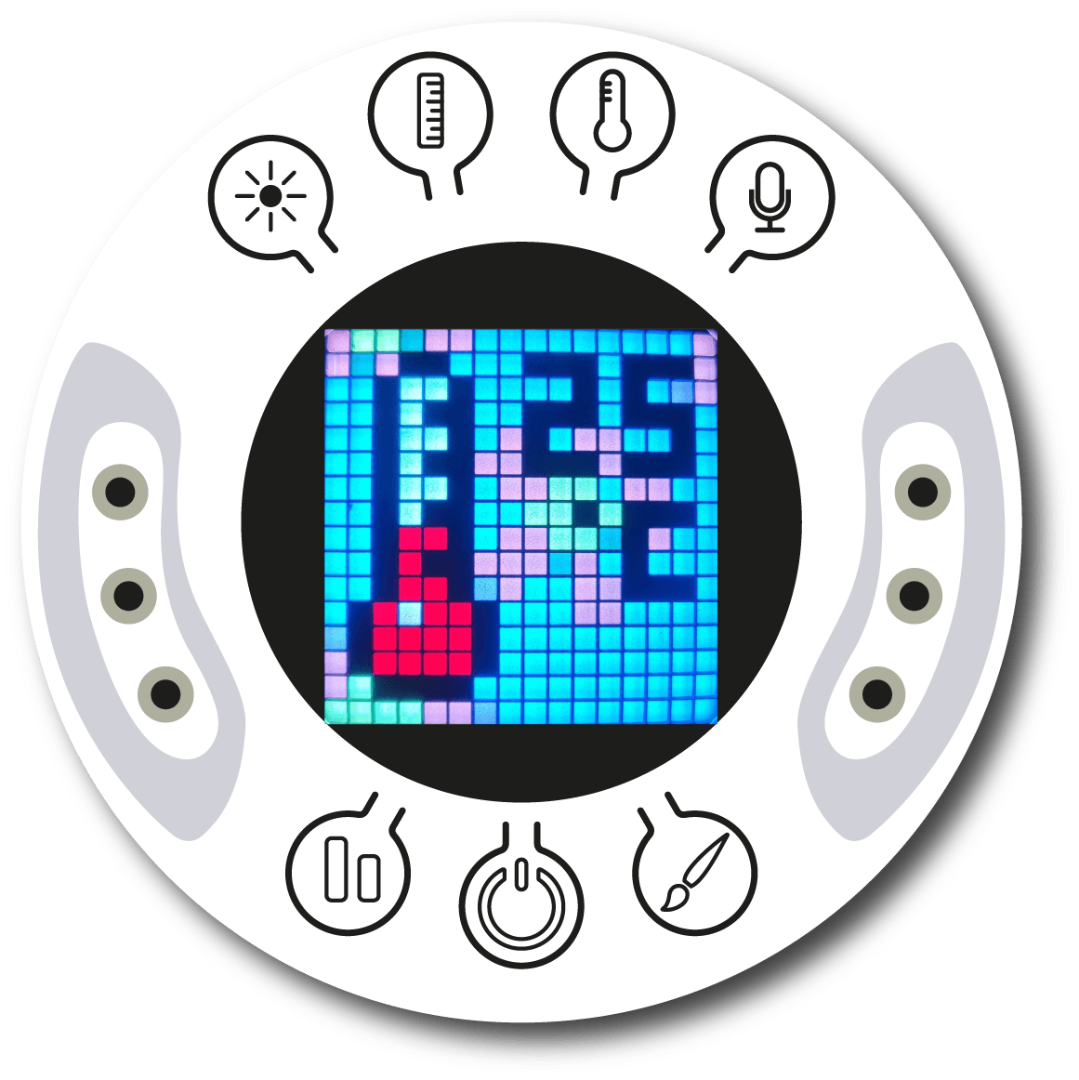
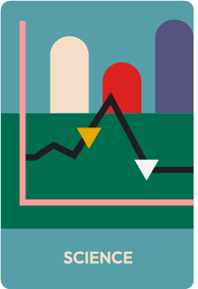
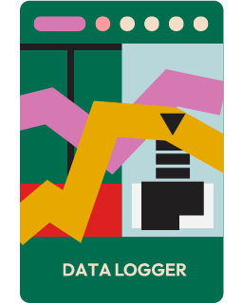
Setting up the experiment
2
Turn on your Xploris and connect it to your computer or tablet.
Open the XploriLab software on your computer or tablet.
Once inside XploriLab, select the icon to connect the device via cable or bluetooth as applicable.
Go to the SCIENCE section and then to DATA LOGGER.

Slide 8
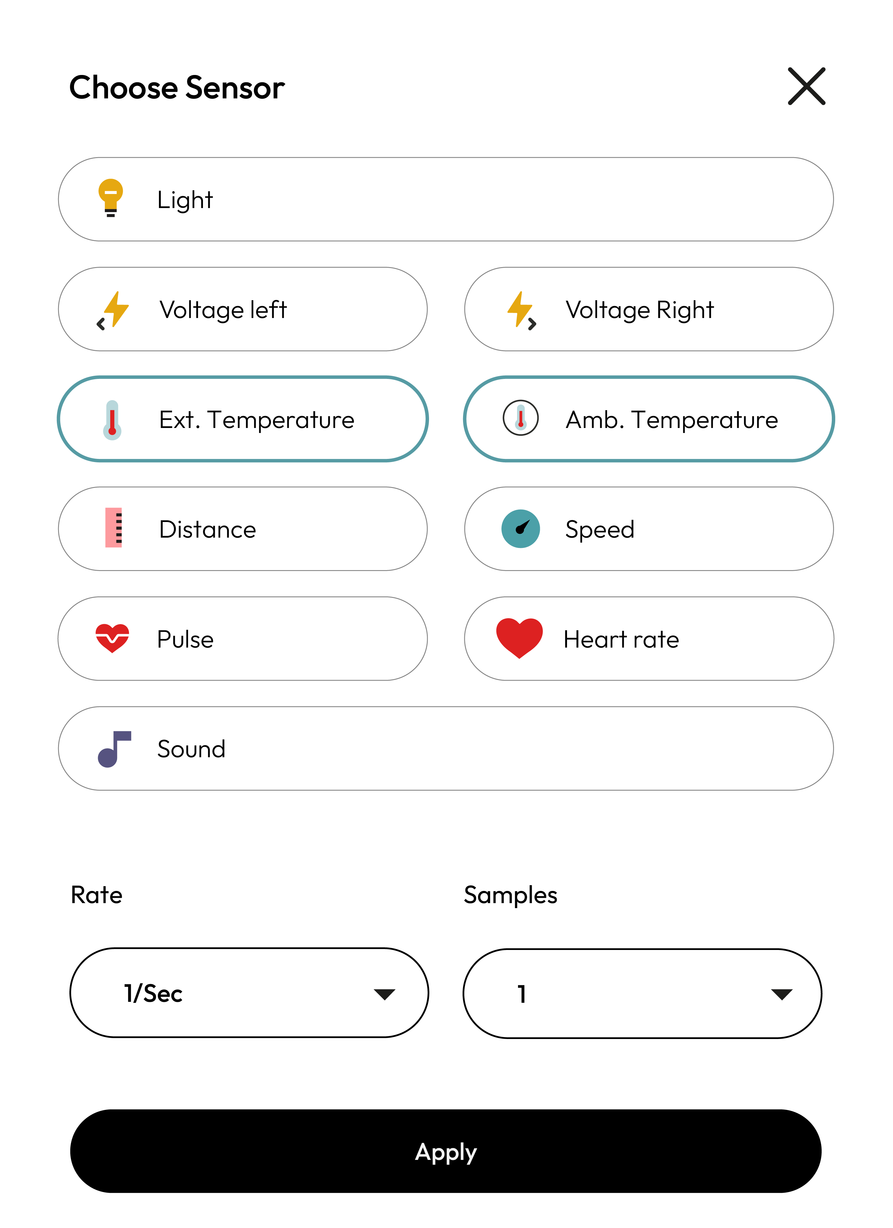
Configuration of the XploriLab software
Setting up the experiment
2
1
To start any configuration related to the sensors, you will select the “setup” icon.
The sensor you will use for this activity is the external temperature sensor and the
ambient temperature sensor and you will set them to take 1 sample per second (1/sec) for a total of 10000 samples.
Once the configuration has been completed, select “Apply” to save it.

Slide 9
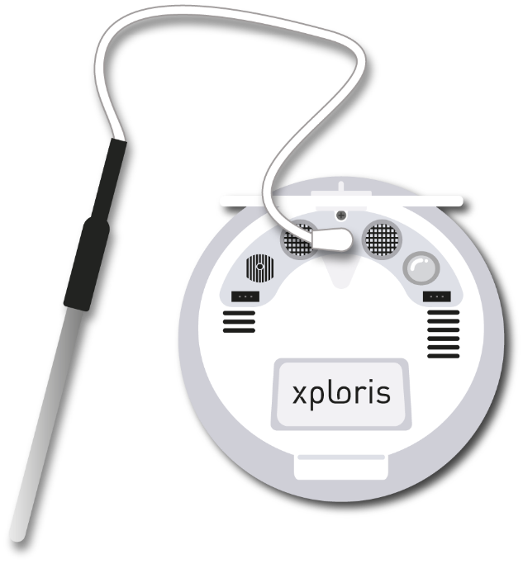
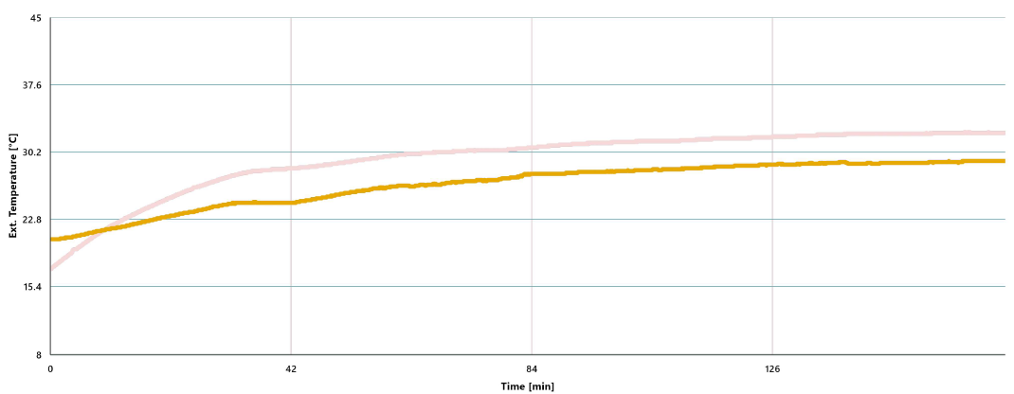
Data collection
3
Place the greenhouse directly in the sun and start measuring the temperature inside and outside the greenhouse using the ambient and outside temperature sensors, respectively.
It is used for the outside T° of the greenhouse.
INDOOR AND OUTDOOR GREENHOUSE TEMPERATURE GRAPH
It is used for the T° inside the greenhouse.

Slide 10
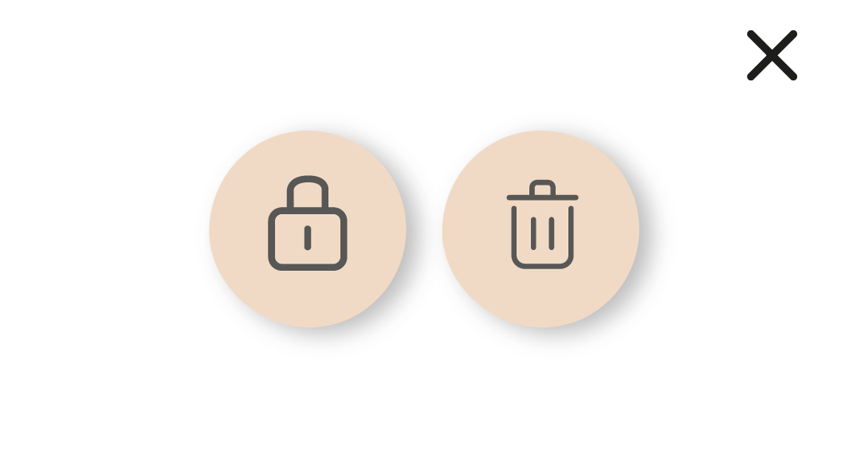
Data analysis
4
1
Use markers on the graph to:
Mark the final temperature within the greenhouse.
Mark the final temperature outside the greenhouse.
2
Use markers to add labels to the points on the graph. To do this you must select the “Marker” icon:
To lock the marker, select it and press the lock icon to lock it.

Slide 11
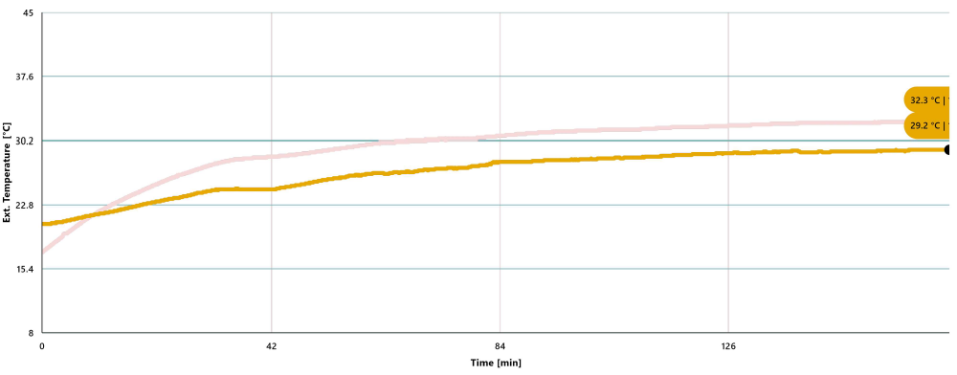
Data analysis
4
3
GRAPH WITH TEMPERATURE MARKERS

Slide 12
Questions
5
1
Let's take a look at the graph
4
Let's keep experimenting!
Did the maximum and minimum temperatures differ between the inside and outside of the greenhouse? If so, by how many degrees?
What other sensors could you use to conduct research in a greenhouse? Propose your study and incorporate the Xploris sensor to carry it out.
2
Let's evaluate the data
5
Let's investigate!
Based on the temperature measurements, which area do you believe exhibited greater temperature stability?
Have you ever heard of the greenhouse effect? This is a phenomenon that occurs on Earth and allows life on our planet. Research the greenhouse effect and compare it to what you learned about greenhouses during this experiment.
3
Let's analyze the experiment!
Where do you think plants are more likely to thrive—inside or outside the greenhouse? Justify your answer based on the results you’ve gathered.

Slide 13
Activity summary
6
We used the external and ambient temperature sensors of the Xploris to simultaneously measure the temperature inside and outside the greenhouse.
We analyzed the data to determine the temperature differences between the inside and outside of the greenhouse and to assess whether conditions varied between the two areas.
We answered questions by analyzing our data. In addition, we established new variables and factors that could change in a greenhouse. Finally, we researched the greenhouse effect and its similarities to what we studied in this lesson.

Slide 14
SCIENCES
Greenhouse: What is a greenhouse?

