Slide 1
SCIENCE
Equilibrium: Temperature equilibrium

Slide 2
TEMPERATURE EQUILIBRIUM
1
Introduction
2
Setting up the experiment
3
Data collection
SCIENCES
4
Data analysis
5
Questions
6
Activity summary

Slide 3
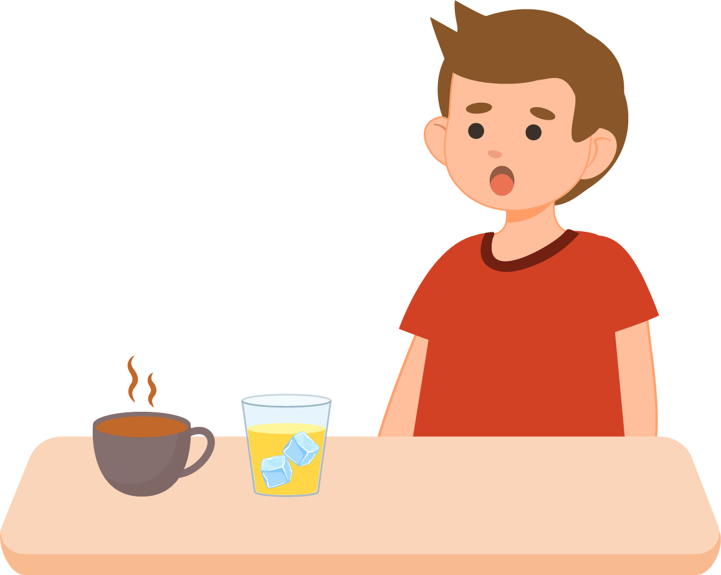
Introduction
1
Imagine it is a summer day and you decide to prepare two drinks for you and your friends: a lemonade with lots of ice and a cup of hot chocolate. You leave both drinks on the table while you play outside. When you return, you notice that the lemonade is no longer as cold and the hot chocolate does not burn when you touch it. Why do you think this happened? This phenomenon occurs because both the lemonade and the hot chocolate are trying to match the room temperature, a process called "temperature equilibrium".
In this activity, we will investigate how the temperature of a glass of cold water and a glass of hot water change when they are left outdoors. We will use a temperature sensor to measure these changes over time.
The question you will answer will be:
How does the temperature of hot and cold water change when exposed to open air?

Slide 4
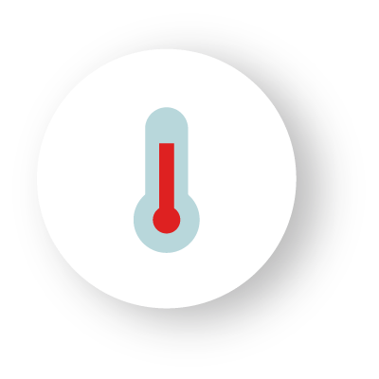
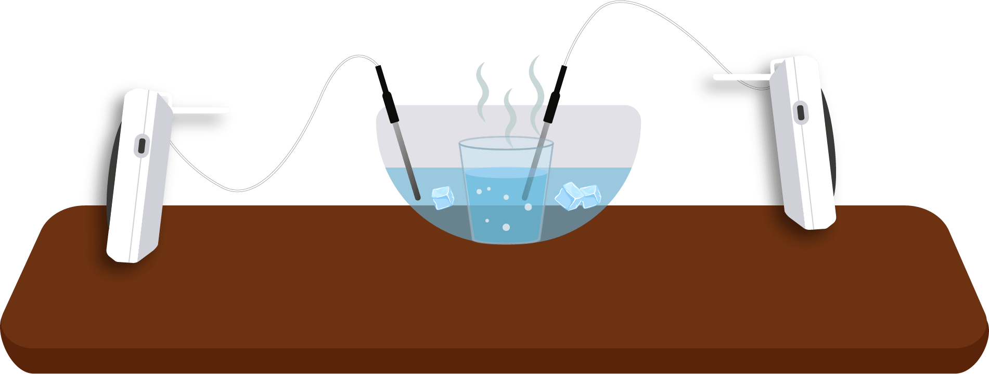
Setting up the experiment
2
In this lesson you will use two Xploris sensors with their external temperature probes to measure the water temperature. To begin, you will need to place a container of cold water on a table and then place a smaller container of hot water inside this container. Measure the temperature of each container until they stabilize using the external temperature probes, as shown in the picture.
At the end of the experiment, save the two graphs.
Xploris 1
Xploris 2
Save data

Slide 5
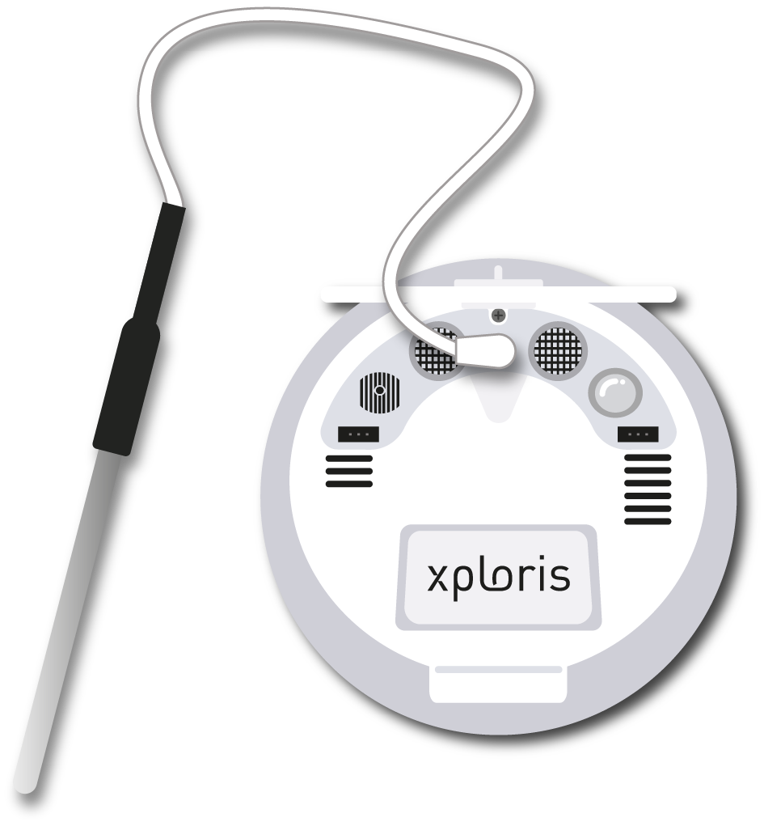
Setting up the experiment
2
For this experiment use the Xploris Temperature probe and connect it to the Xploris back input

Slide 6
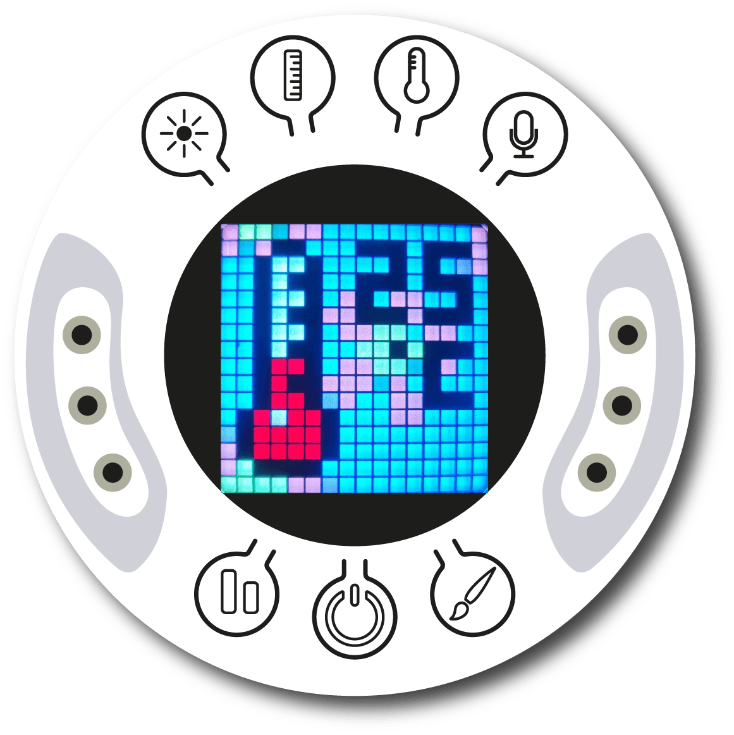
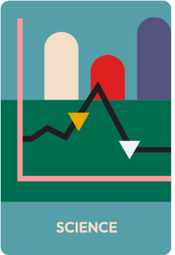
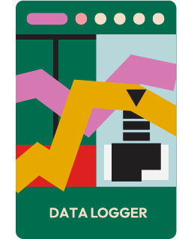
Setting up the experiment
2
Turn on your Xploris and connect it to your computer or tablet.
Open the XploriLab software on your computer or tablet.
Once inside XploriLab, select the icon to connect the device via cable or bluetooth as applicable.
Go to the SCIENCE section and then to DATA LOGGER.

Slide 7
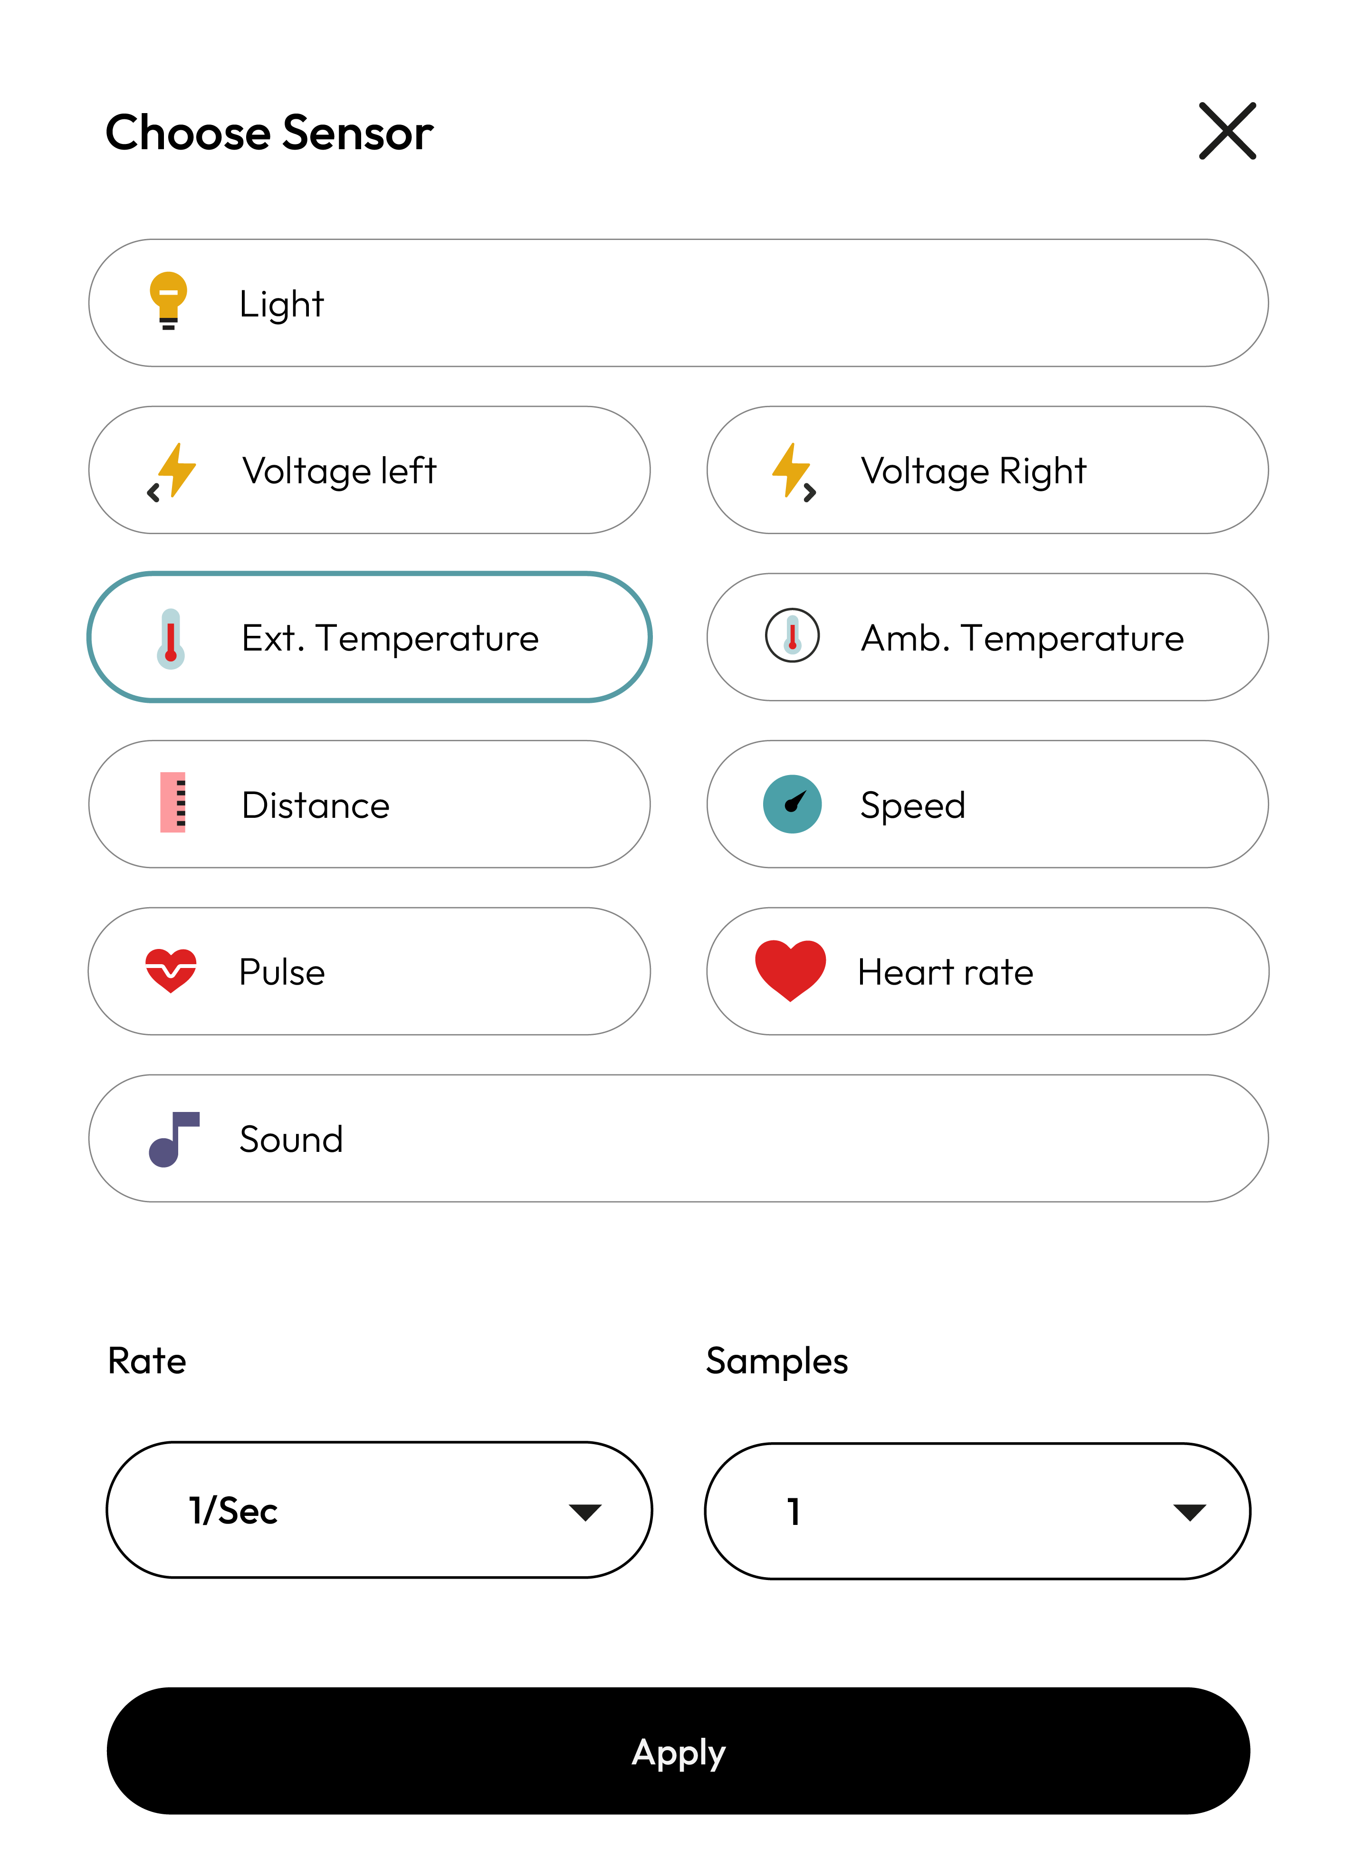
XploriLab software configuration
Setting up the experiment
2
1
To start any configuration related to the sensors, you will select the “setup” icon.
The sensor you will use for this activity is the external temperature sensor and you will set it to take 1 sample per second (1/sec) for a total of 10000 samples.
Once the configuration has been completed, select “Apply” to save it.
10000

Slide 8
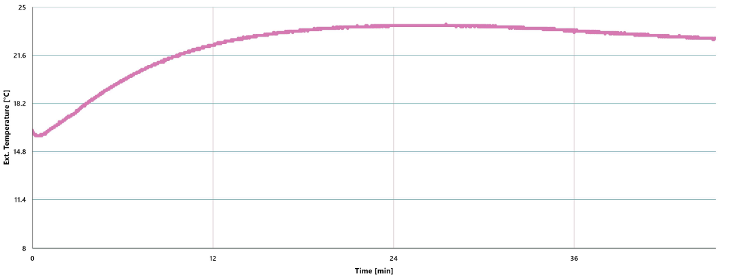
Data collection
3
Use two temperature probes. Place one in the cold water container and the other in the hot water container. Now insert the hot water container into the cold water container and wait till both temperature stabilizes.
TEMPERATURE GRAPH WITH INITIAL COLD WATER
Xploris 1

Slide 9
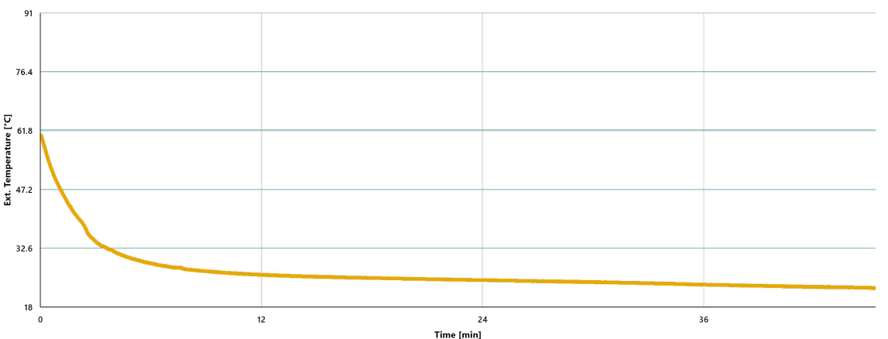
Data collection
3
TEMPERATURE GRAPH WITH INITIAL HOT WATER
Xploris 2

Slide 10
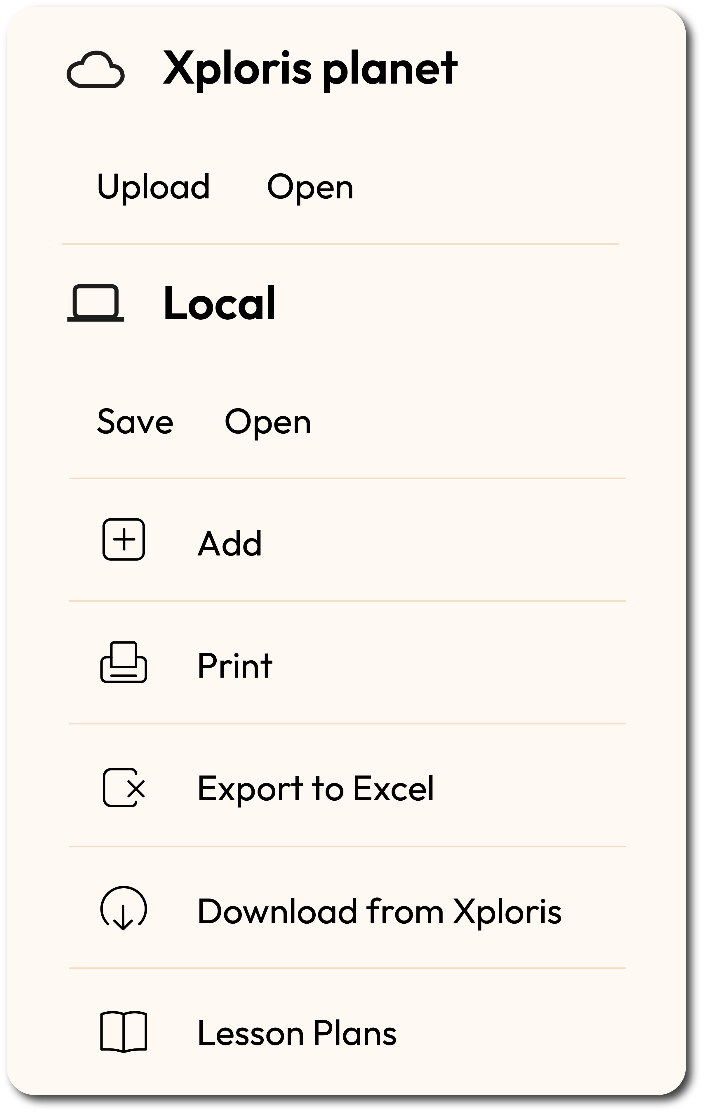
Data collection
3
Finally, combine both graphs using the “add graph” function of Xplorilab.
1
To save a graph
Click on the “files” icon.
Click on “save”.
Name your graph.
Click on “save”.
* Remember to do this with the two temperature graphs in order to combine them.

Slide 11
Data collection
3
2
To combine graphs do the following:
Open one of the two graphs.
Click on the “files” icon.
Select the “Add” option.
Click on the name of the graph you want to add and select “open”.
After a few seconds, the two graphs should appear as one.

Slide 12
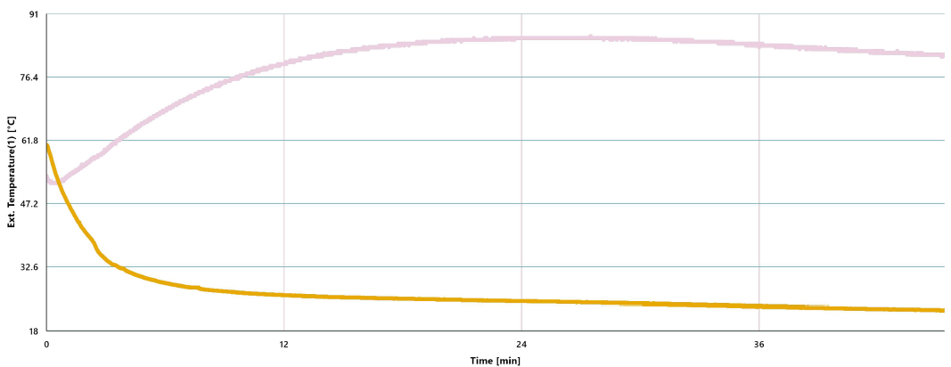
Data collection
3
3
TEMPERATURE GRAPH WITH INITIAL
HOT AND COLD WATER

Slide 13
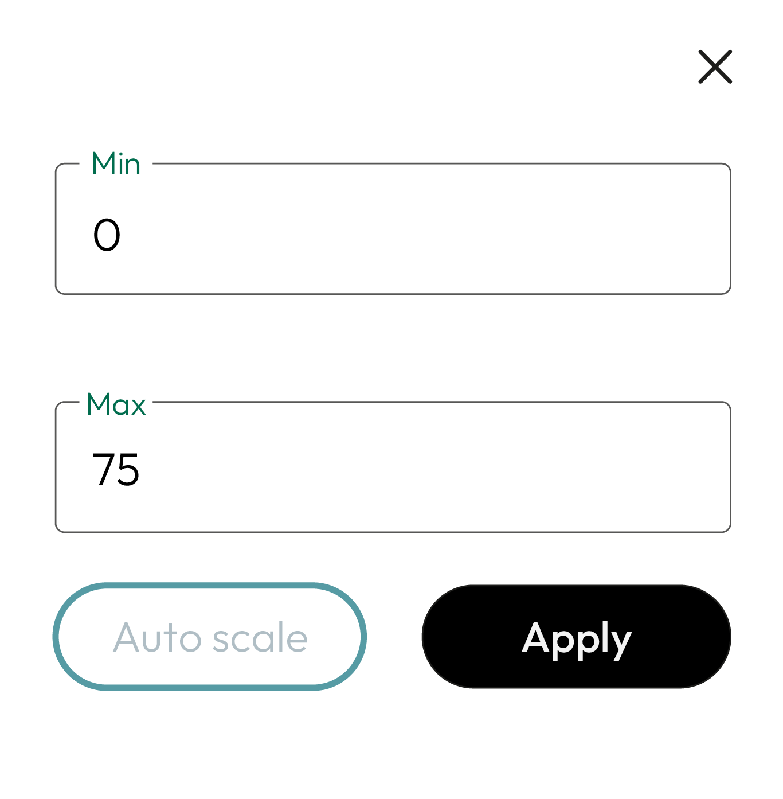
Data analysis
4
We need to analyze the graph, for which we will make the following adjustments:
1
To change the values of the “Y-axis” in a graph we must do the following:
Double click on the Y-axis name.
A dialog box will open in which you enter the maximum and minimum values.
Once you have entered the values, click on “Apply”.
Set both graphs to have the same scale
* It is recommended that the maximum value be set slightly above the initial temperature of the hot water, while the minimum value should be set at 0.

Slide 14
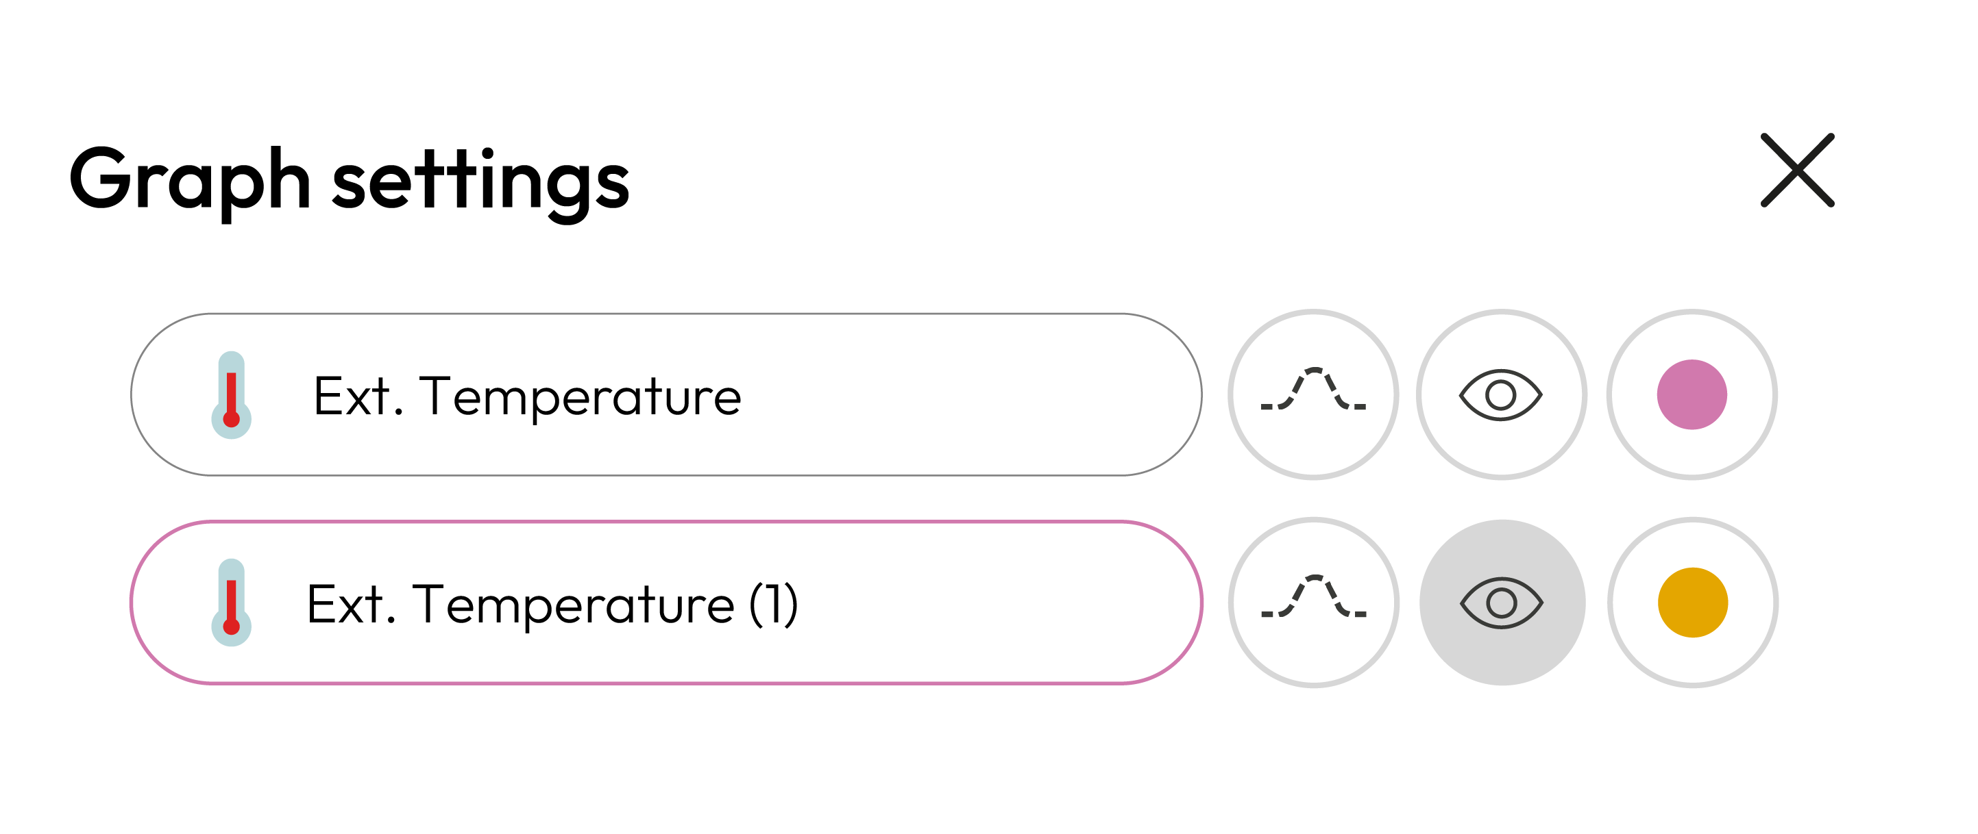
Data analysis
4
2
To change the colors of the graph do the following:
In the lower left corner, click on the name of the sensor.
The “Graph settings” dialog box will open.
Click on the button that shows the graph color and select the color of your choice.

Slide 15
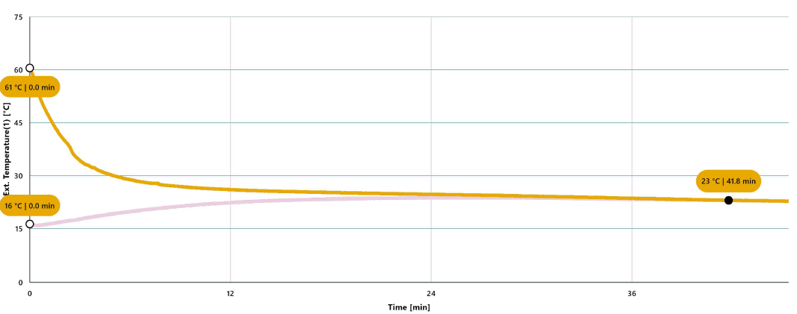
Data analysis
4
2
Use a marker to add a label to a point on the graph. To do this, select the “Marker” icon:
GRAPH WITH MARKERS

Slide 16
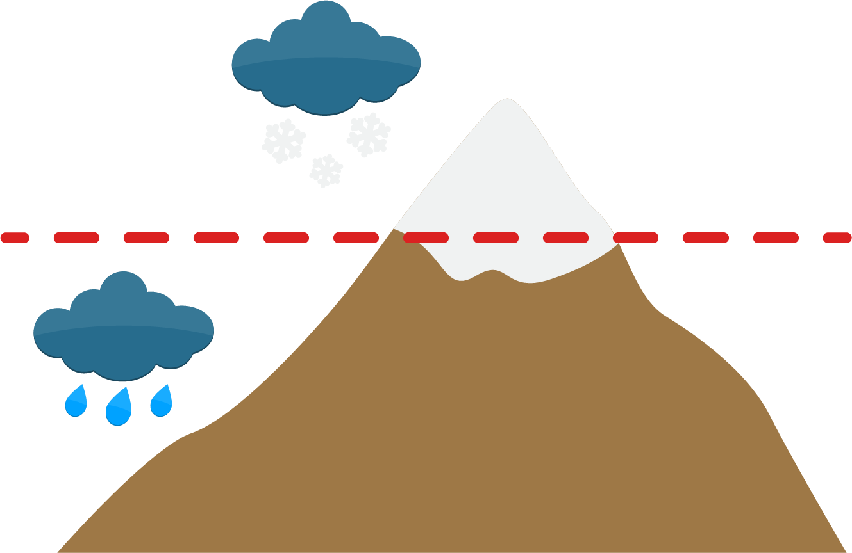
Questions
5
1
Let's take a look at the graphs
4
Let's keep experimenting!
What were the temperature values reached when equilibrium was achieved?
How do you think the water temperature will change when measuring the heating of cold water in a kitchen? Formulate your hypothesis and conduct the experiment again using the Xploris external temperature sensor.
2
Let's take a look at the graphs
When comparing both temperature graphs, what are the similarities and differences? Do you notice any trends in the graphs?
5
Let's investigate!
The image shows the concept of “Zero-degree isotherm” which is widely used to evaluate climates where there is snow. Have you ever heard of this concept, do you know what it refers to? If you don't know it, search the internet to find out what it is and what it is used for.
Less than 0°C
3
Let's analyze the experiment!
Zero isotherm
What relationship do you anticipate will exist between the equilibrium temperatures of the water left in open air and the ambient temperature?
Greater than 0°C

Slide 17
Activity summary
6
We used two Xploris external temperature sensors to measure how the temperature of a container filled with hot water changed while submerged in a container of cold water.
We combined both graphs and analyzed the data to establish their similarities and differences.
We addressed our questions by analyzing the data on the equilibrium temperatures reached in both scenarios and their relationship to the ambient temperature. Additionally, we formed hypotheses about the heating of water and explored the concept of the "zero-degree isotherm".

Slide 18
SCIENCES
Equilibrium: Temperature equilibrium

