Slide 1
SCIENCE
Build your own battery

Slide 2
BUILD YOUR OWN BATTERY
1
Introduction
2
Setting up the experiment
3
Data collection
SCIENCES
4
Data analysis
5
Questions
6
Activity summary

Slide 3
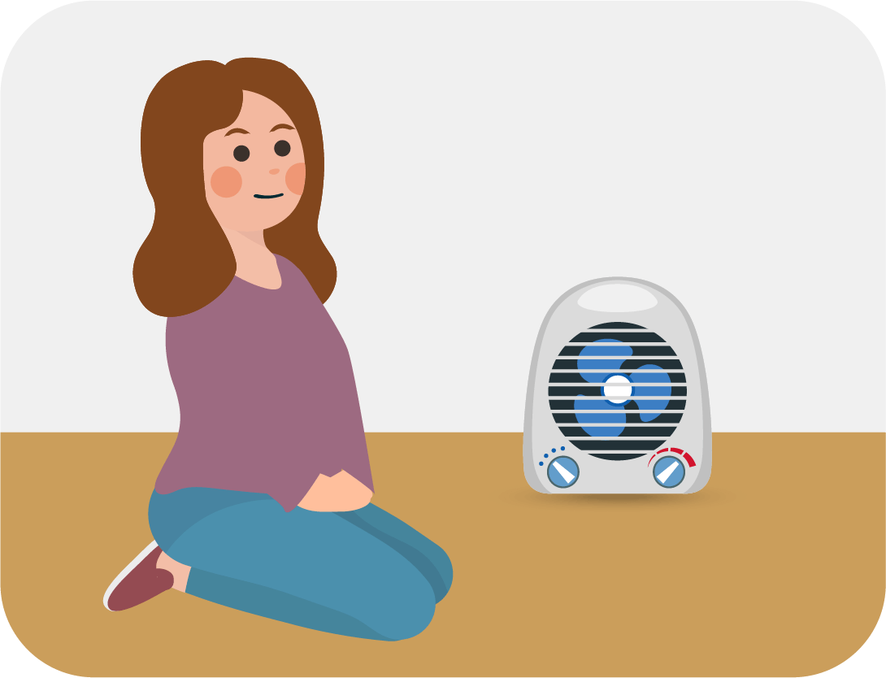
Introduction
1
Did you know that energy can be transformed from one form to another? For example, when you use a heater, electrical energy is transformed into heat energy. And there are many more examples like this one: fans, stoves and even the operation of a battery-operated toy transform energy.
In this activity you will learn how the energy contained in food (called chemical energy) can be transformed into electrical energy using the Xploris voltage sensor.
The question you will answer will be:
How much energy can be obtained from a potato or a lemon?

Slide 4
Setting up the experiment
2
You will measure the voltage produced by three energy sources—a AAA battery, a lemon, and a potato—using the Xploris voltage sensor. This experiment will explore whether it’s possible to generate electrical energy from these unconventional sources and how their output compares to that of a standard battery.
MATERIALES
Xploris
Voltage cables
red and black
Battery
Lemon
Potato
2 Galvanized screws
2 Pieces of copper

Slide 5
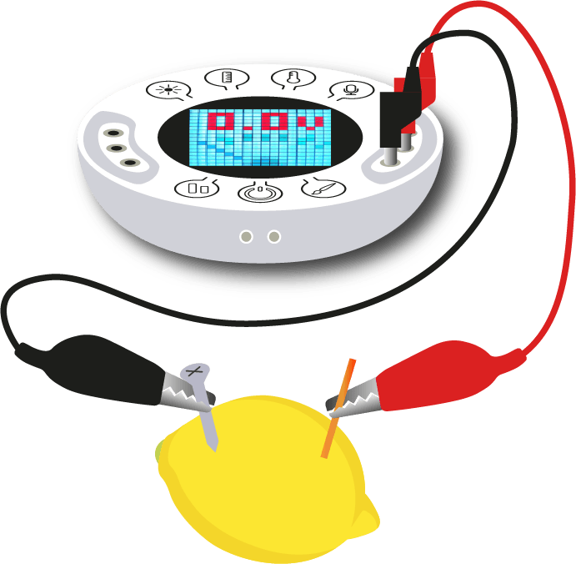
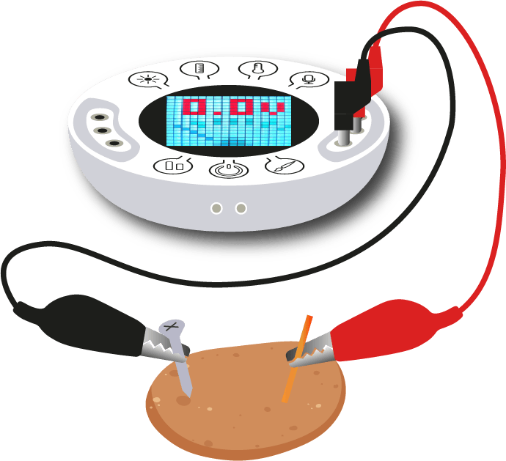
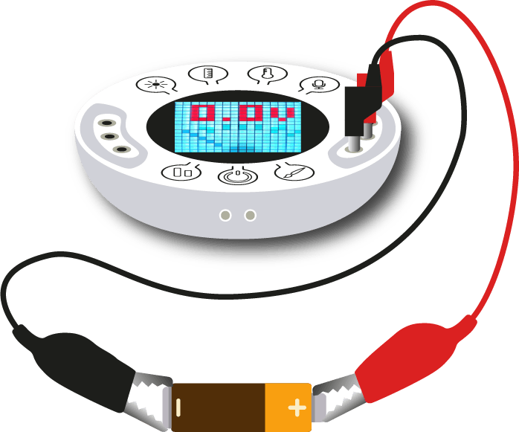
Setting up the experiment
2
ASSEMBLY 1
ASSEMBLY 2
ASSEMBLY 3
You will connect a AAA battery to the voltage sensor, as shown in the picture.
You will insert a galvanized zinc screw and a piece of copper into a lemon. Then, you will connect the Xploris voltage sensor using alligator to banana cables, as shown in the picture.
This assembly is identical to the previous one, but the lemon is replaced by a potato, as shown in the image.

Slide 6
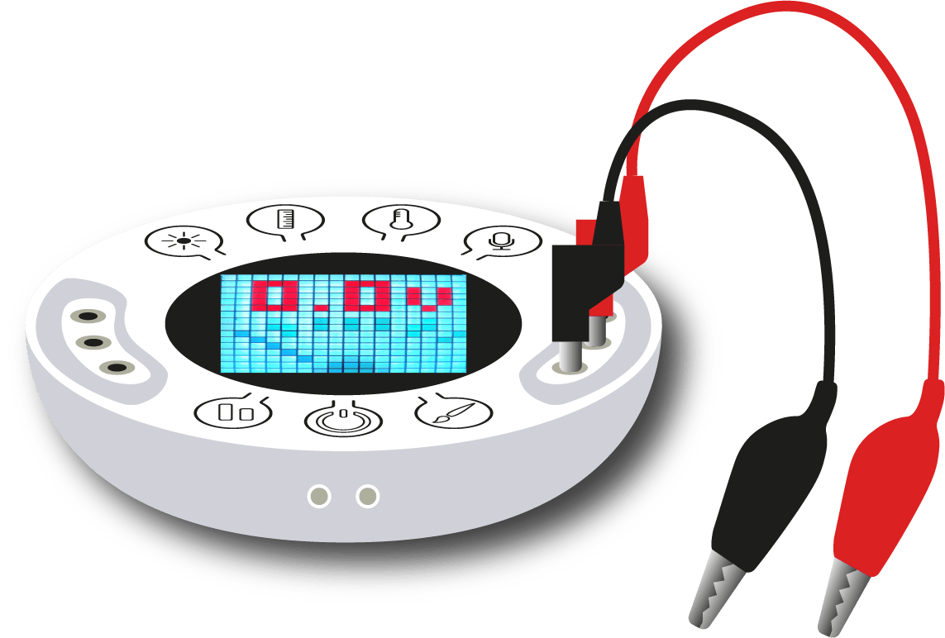
Setting up the experiment
2
The red and black voltage cables are inserted on the same side of the Xploris, as shown in the picture.

Slide 7
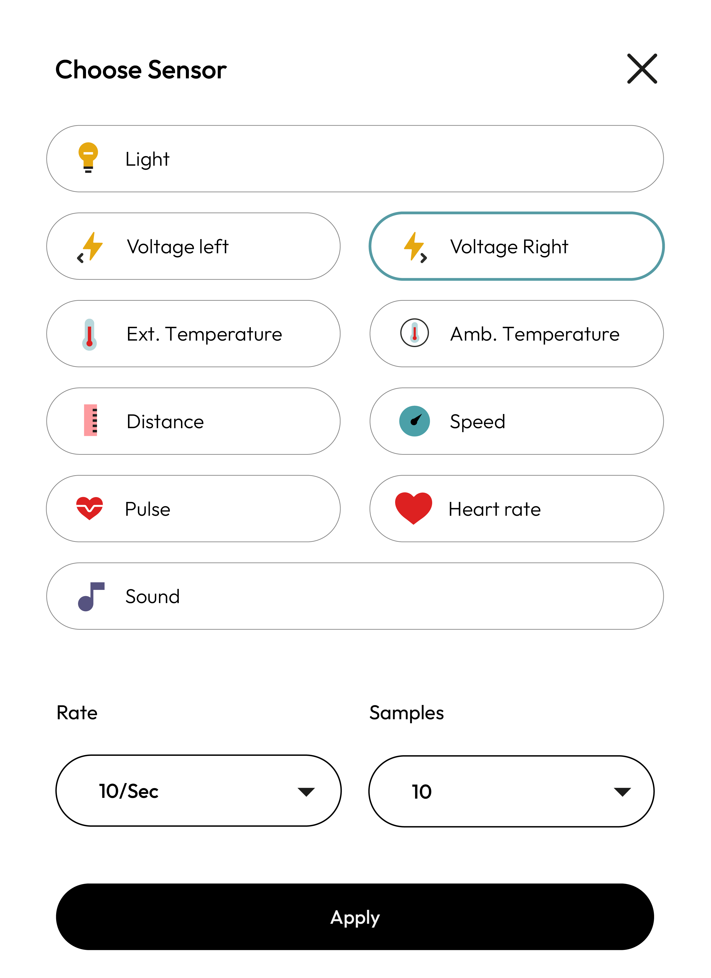
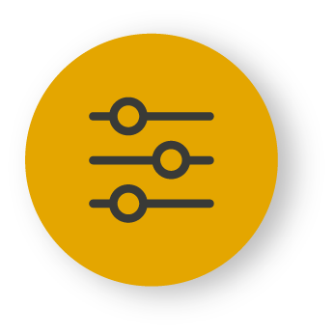
XploriLab software configuration
Setting up the experiment
2
1
To start any configuration related to the sensors, you will select the “setup” icon.
The sensor you will use for this activity is the voltage sensor and you will set it to take 10 samples per second (10/sec)
for a total of 1000 samples.
Once the configuration has been completed, select “Apply” to save it.

Slide 8
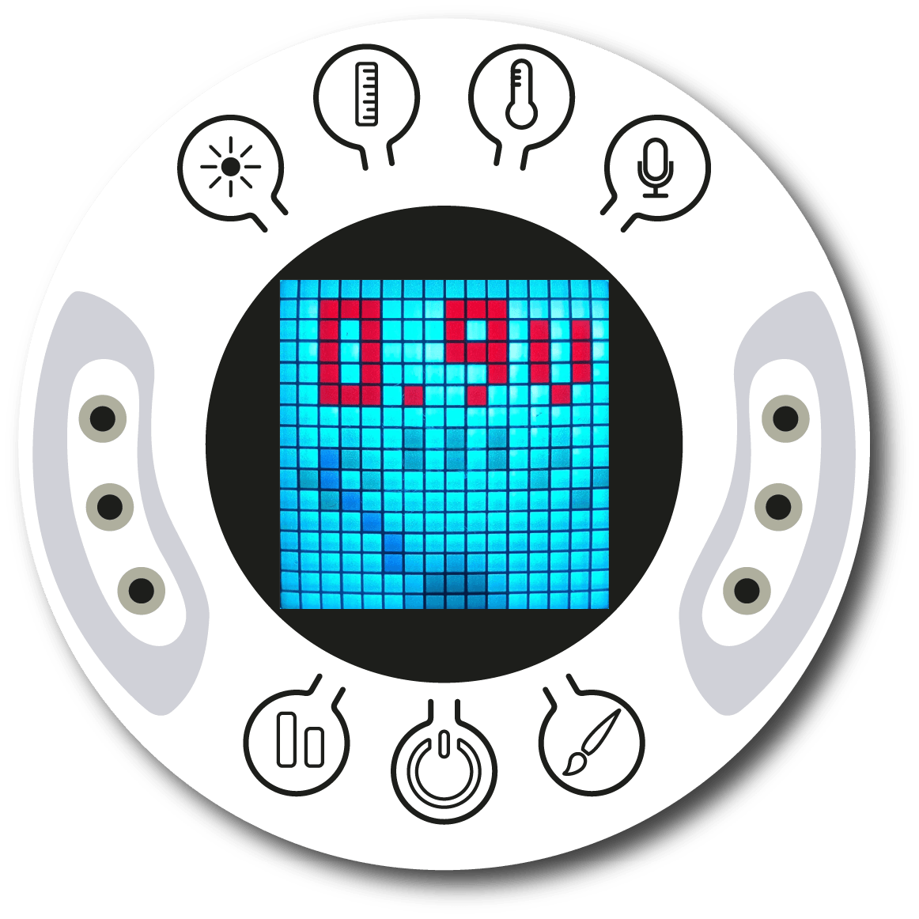
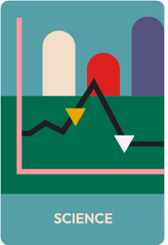
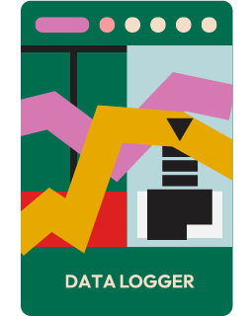
Setting up the experiment
2
Turn on your Xploris and connect it to your computer or tablet.
Open the XploriLab software on your computer or tablet.
Once inside XploriLab, select the icon to connect the device via cable or bluetooth as applicable.
Go to the SCIENCE section and then to DATA LOGGER.

Slide 9
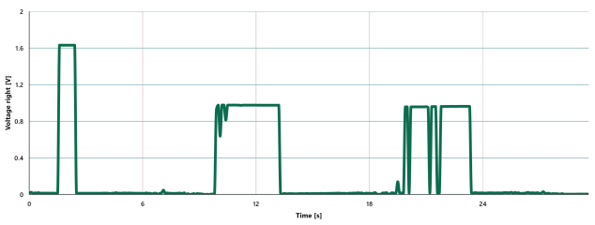
Data collection
3
Build the 3 assemblies shown above, connect the Xploris voltage sensor and record the voltage of each of them for a few seconds.

Slide 10
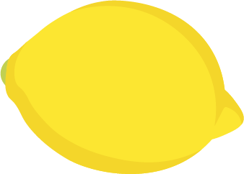
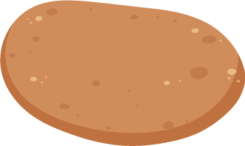
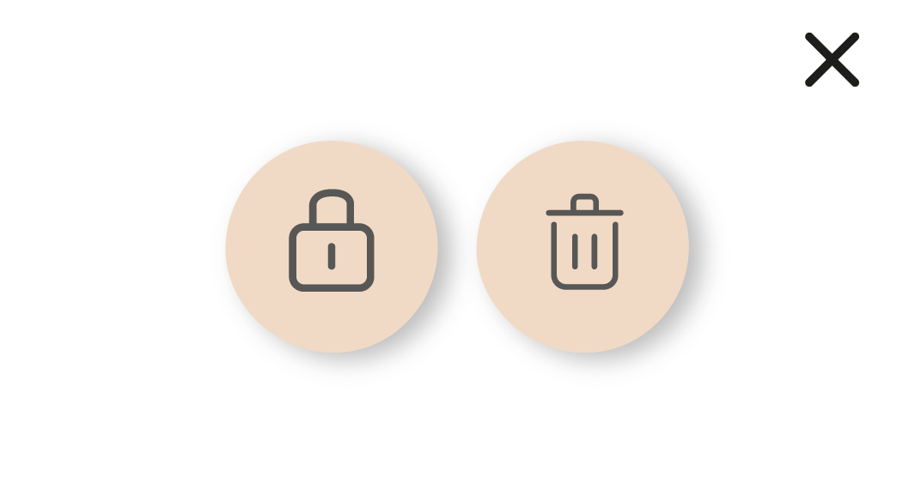
Data analysis
4
1
Use markers on the graph to indicate the voltage reached by the battery, lemon, and potato.
2
Use markers to add labels to the points on the graph. To do this you must select the “Marker” icon:
To keep the marker fixed, select it and press the lock icon.

Slide 11
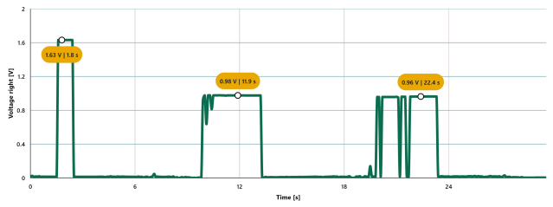
Data analysis
4
3
GRAPH WITH VOLTAGE MARKERS

Slide 12
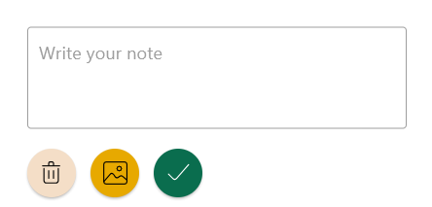
2
Data analysis
4
4
To add photos to the notes within a graph you must do the following:
Select the note icon.
Click on the point where you want to add a note.
A dialog box will open and allow you to add the note with text and images.
Take a picture of the objects used for the measurement and select it for the note image.

Slide 13
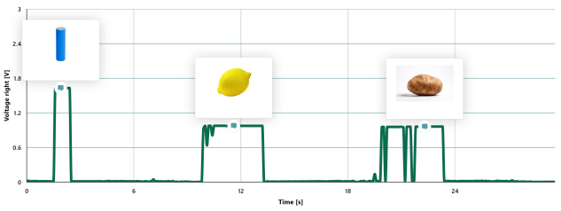
Data analysis
4
5
GRAPH WITH NOTES

Slide 14
Questions
5
1
Let's take a look at the graph
4
Let's imagine
After reviewing the measurements from the three circuits, which one produced the highest amount of electrical energy?
What environmental or social consequences do you think the use of electricity produced from food would have?
2
Let's take a look at the graph
Based on the voltage measurements, do you believe it’s possible to generate electrical energy from food?
5
Let's keep experimenting!
Do you think the voltage of your circuit will change if you add more power sources, for example, more potatoes or more lemons? Experiment by modifying your circuits, measuring their voltages and comparing your results with those obtained during the activity.
3
Let's imagine
What do you think the energy produced by this type of circuits could be used for?

Slide 15
Activity summary
6
We utilized the Xploris voltage sensor to investigate whether electrical energy can be produced from food. We compared the energy generated by three different sources and created a line graph to display our findings.
We analyzed the data to establish the maximum and minimum voltage produced in the circuit and the differences in electrical power production between the 3 circuits.
We answered questions to conclude whether electrical energy can be obtained from food, what uses can be given to that energy and the consequences that the production of energy from food could have. Finally, we modified the electric circuit to show whether adding more energy sources varied the voltage or not.

Slide 16
SCIENCES
Build your own battery

