Slide 1
SCIENCE
Body temperature: How does my skin temperature change?

Slide 2
HOW DOES MY SKIN TEMPERATURE CHANGE?
1
Introduction
2
Setting up the experiment
3
Data collection
SCIENCES
4
Data analysis
5
Questions
6
Activity summary

Slide 3
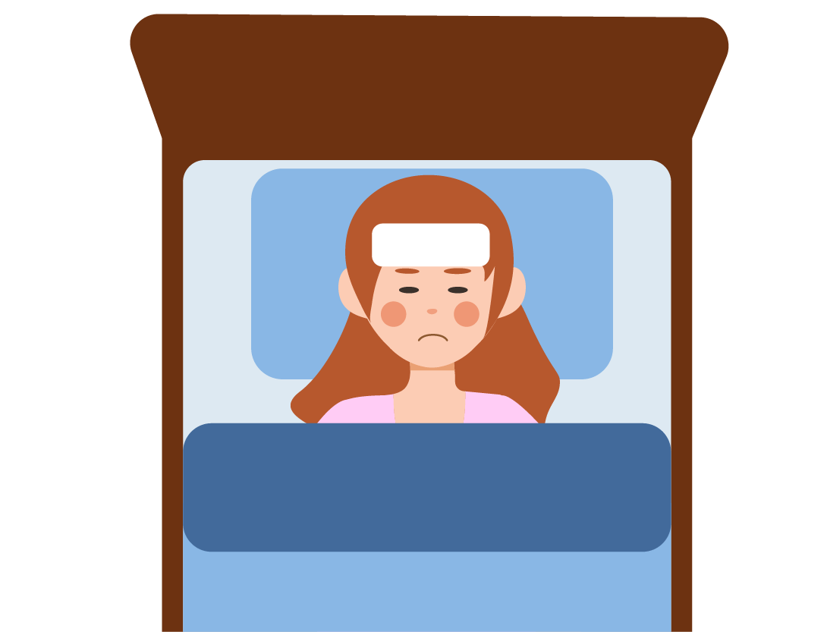
Introduction
1
Have you ever had a fever? A fever is an increase in body temperature as a response to certain threats, such as bacteria, that can make us sick. However, our bodies cannot tolerate a fever for too long, as it disrupts the internal balance of the organism.
The above situation shows that temperature is a key factor in the body and in this lesson you will analyze how your skin temperature changes using the Xploris external temperature sensor.
The question you will answer will be:
How does my skin temperature change when I get cold or hot?

Slide 4
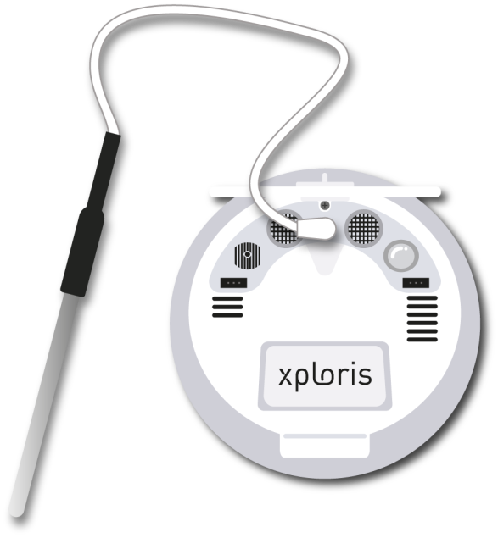
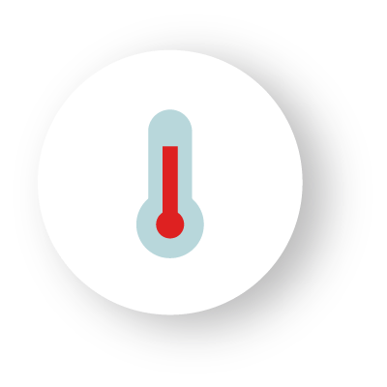
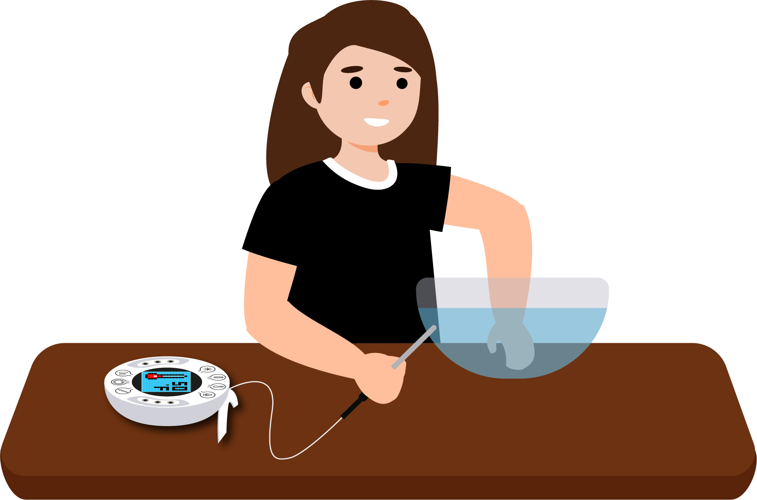
Setting up the experiment
2
You will use the Xploris external temperature sensor to manually measure the temperature of your hands in various situations. For instance, check your hand temperature when they are dry at room temperature, after rubbing them for 20 seconds, and after wetting them with cold and warm water or holding ice, among other scenarios. When measuring, be sure to closely observe the Xploris screen and wait for the temperature reading to stabilize before taking your measurement.

Slide 5
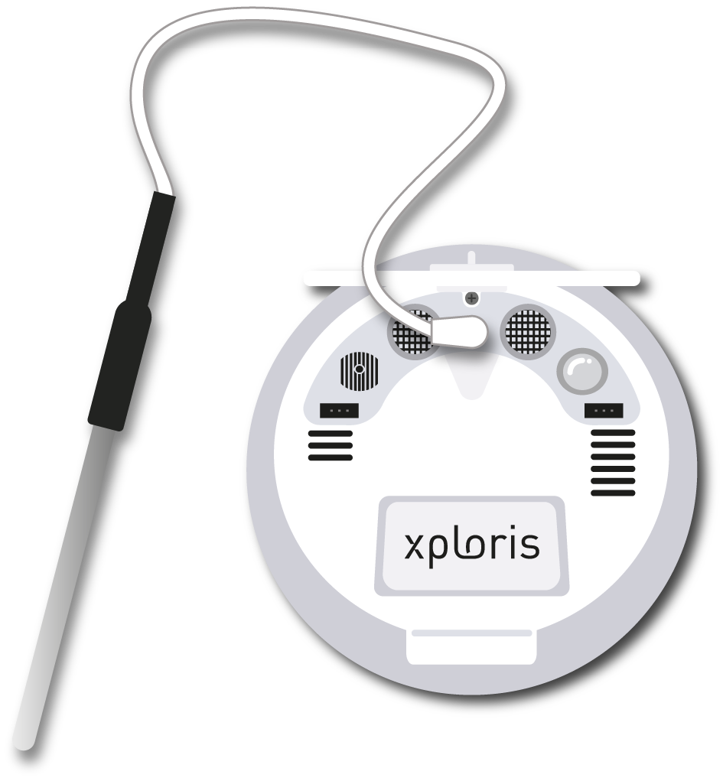
Setting up the experiment
2
Connect the external Temperature probe to the Xploris back input.

Slide 6
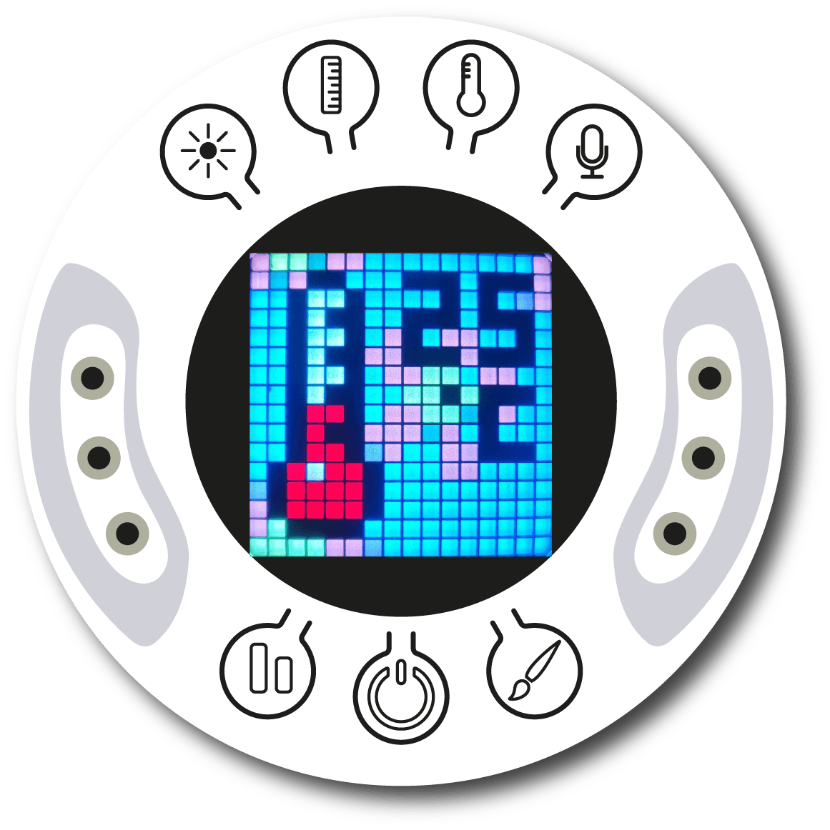
Setting up the experiment
2
Turn on your Xploris and connect it to your computer or tablet.
Open the XploriLab software on your computer or tablet.
Once inside XploriLab, select the icon to connect the device via cable or bluetooth as applicable.
Go to the SCIENCE section and then to DATA LOGGER.

Slide 7
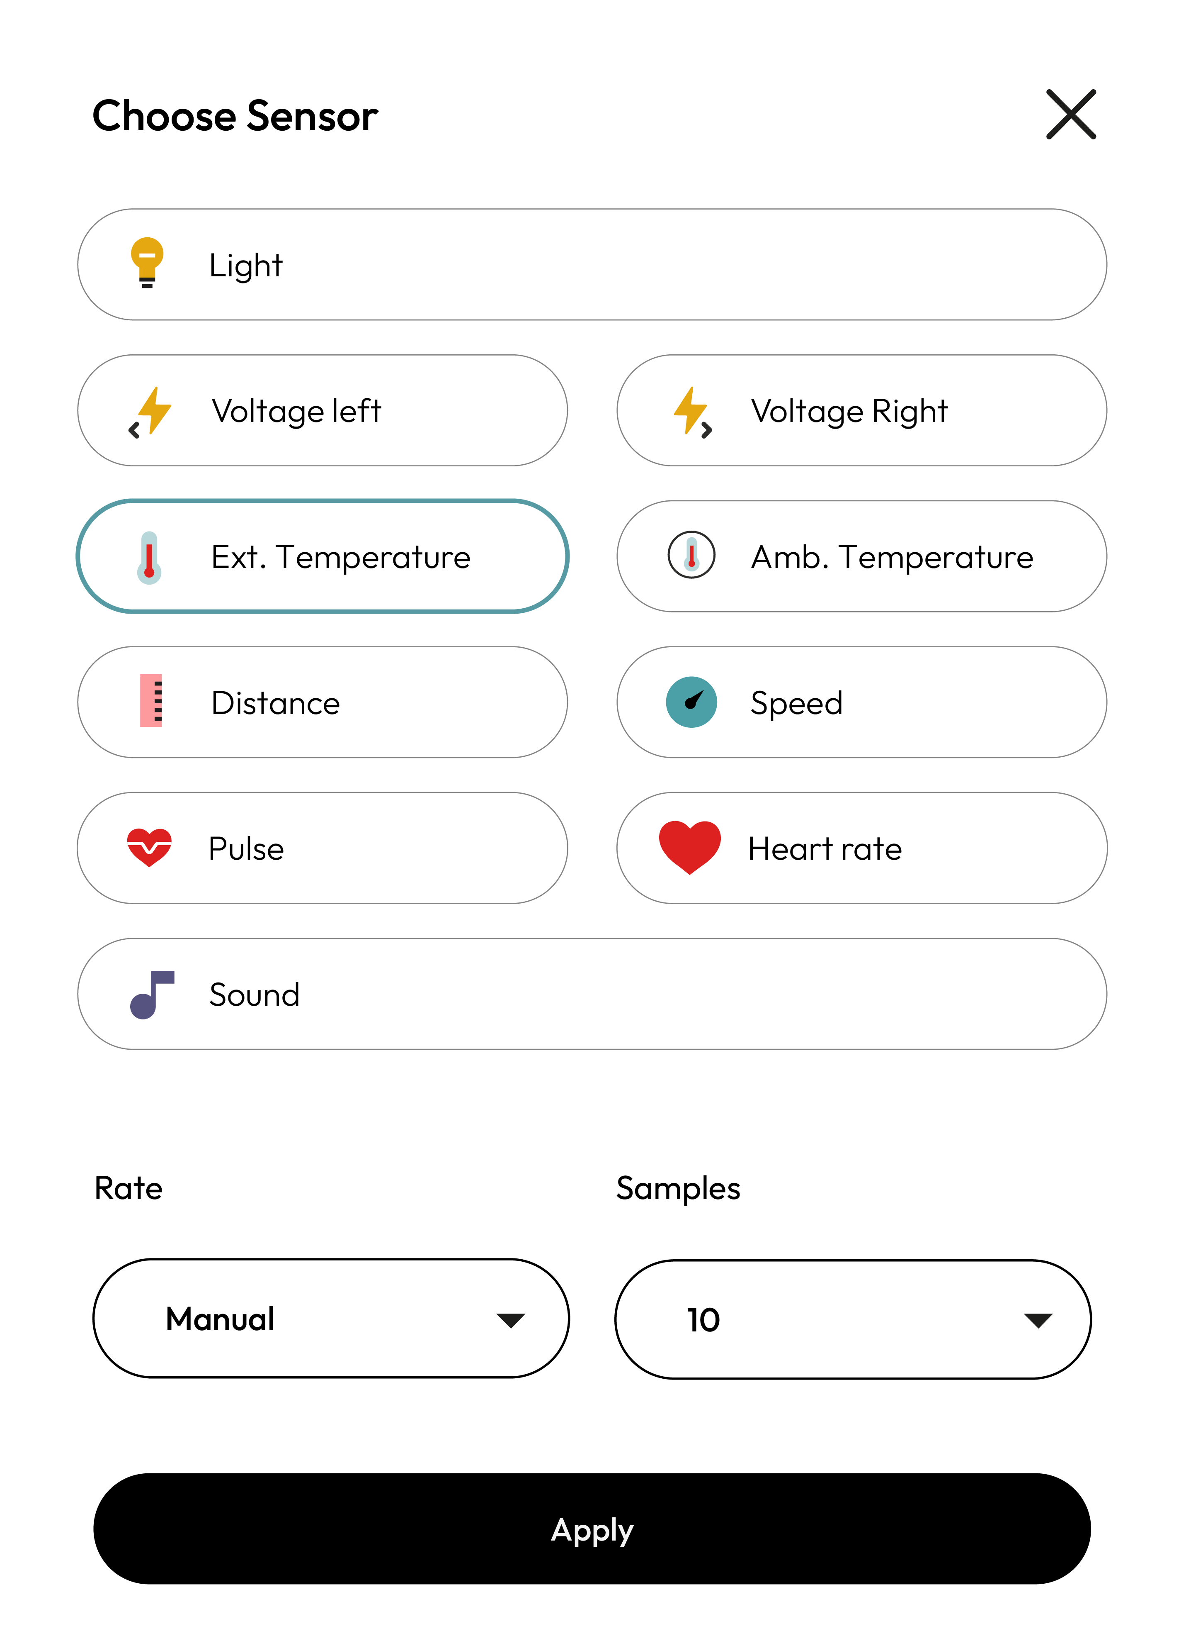
XploriLab software configuration
Setting up the experiment
2
1
To start any configuration related to the sensors, please select the “setup” icon.
The sensor you will use for this activity is the external temperatura sensor and you will configure it to take manual measurements with a total of 10 sample.
Once the configuration has been completed, select “Apply” to save it.

Slide 8
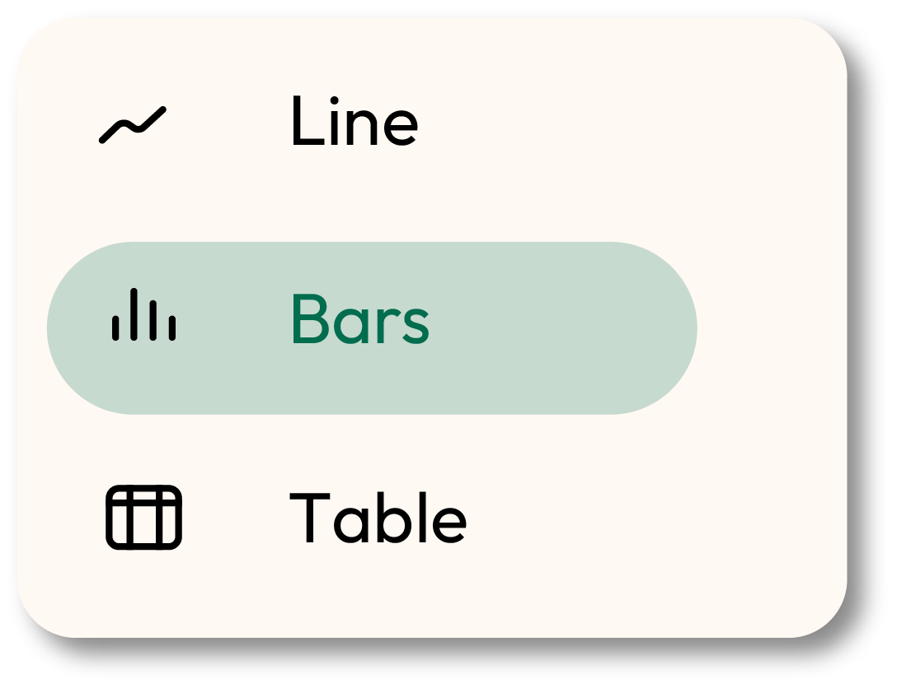
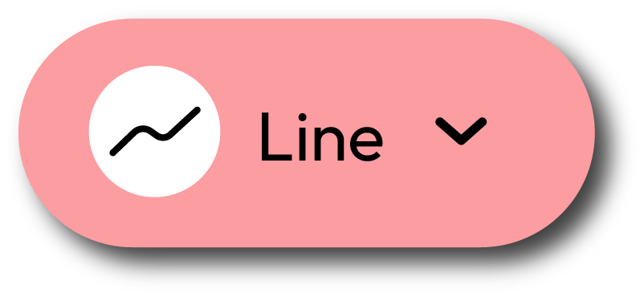
XploriLab software configuration
Setting up the experiment
2
2
Click the “line” icon on display and select the “bars” option.
3
Click the PLAY icon to start recording. Then, when you want to collect a new measurement - press the Temperature key on the Xploris.

Slide 9
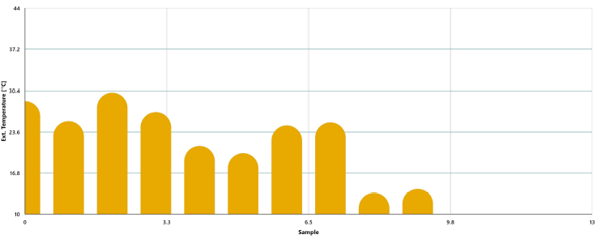
Data collection
3
Take a close look at the temperature graph you recorded under different conditions, and analyze how your hand temperature changed in each situation, as well as how it varied among your classmates. In the example provided, two measurements were taken for each situation using the same student to ensure the accuracy of the data.
TEMPERATURE GRAPH

Slide 10
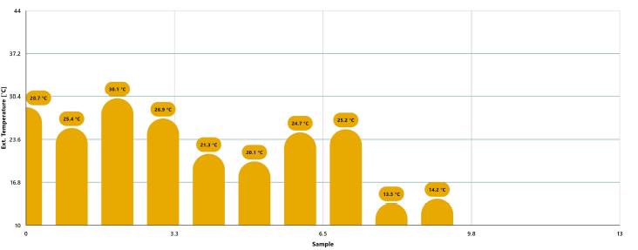
Data analysis
4
1
Use markers to add labels to the graph columns. To do this you must select the “Marker” icon:
GRAPH WITH MARKERS

Slide 11
2
Data analysis
4
2
You can add photos to the notes within a graph by doing the following:
Select the note icon.
Click on the bar where you want to add a note.
A dialog box will open and allow you to add the note with text and images.
Add text to explain each of the measurements

Slide 12
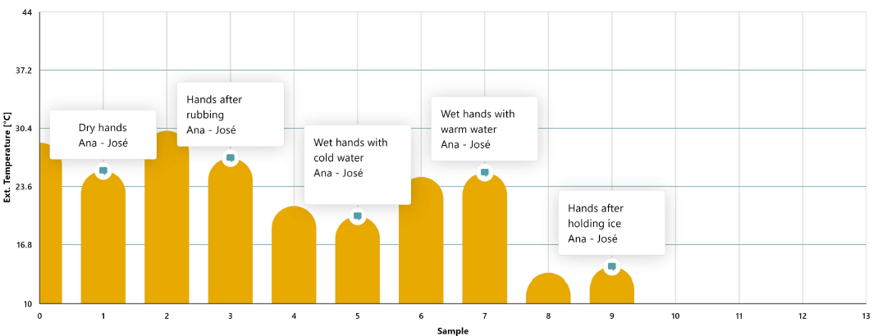
Data analysis
4
3
GRAPH WITH NOTES

Slide 13
Questions
5
1
Let's take a look at the graph
4
Let's investigate!
Who had the lowest temperature and in what situation, and who had the highest temperature and in what situation?
Inuit are people who inhabit the extremely cold regions of the northern Earth. Do you think their body temperature differs significantly from yours? Share your thoughts, and then take some time to research this topic online.
2
Let's evaluate the data
How many degrees difference is there between the highest and lowest temperature recorded for the same person?
5
Let's keep experimenting!
Do you think the temperature of your hands would differ if measured in another area of the body, like behind the knees? Formulate your hypothesis, then conduct an experiment with your classmates using the Xploris sensor to find out!
3
Let's evaluate the data
Do you think the temperatures recorded in the same person changed a lot or a little? Why do you think this happens?

Slide 14
Activity summary
6
We used the external Xploris temperature sensor to measure the temperature of hands in different situations (dry hands, after rubbing, after contact with cold water and with hot water).
We created a bar graph and analyzed the data to establish who had higher and lower temperatures and in what situations. In addition, we looked at the temperature variations for the same person.
We answered questions by analyzing our data and the temperature variation recorded. In addition, we compared the values between students and experimented again by changing the location on the body where we measured the temperature to see if the results were the same or different.

Slide 15
SCIENCES
Body temperature: How does my skin temperature change?

