Slide 1
CONTROL
The Sonar

Slide 2
DETECTING DISTANCES
1
Introduction
2
Activity setup
3
Control diagram
CONTROL
4
Questions
5
Activity summary

Slide 3
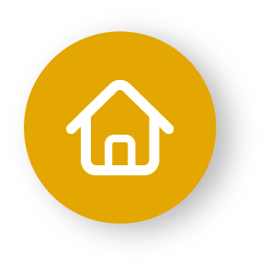
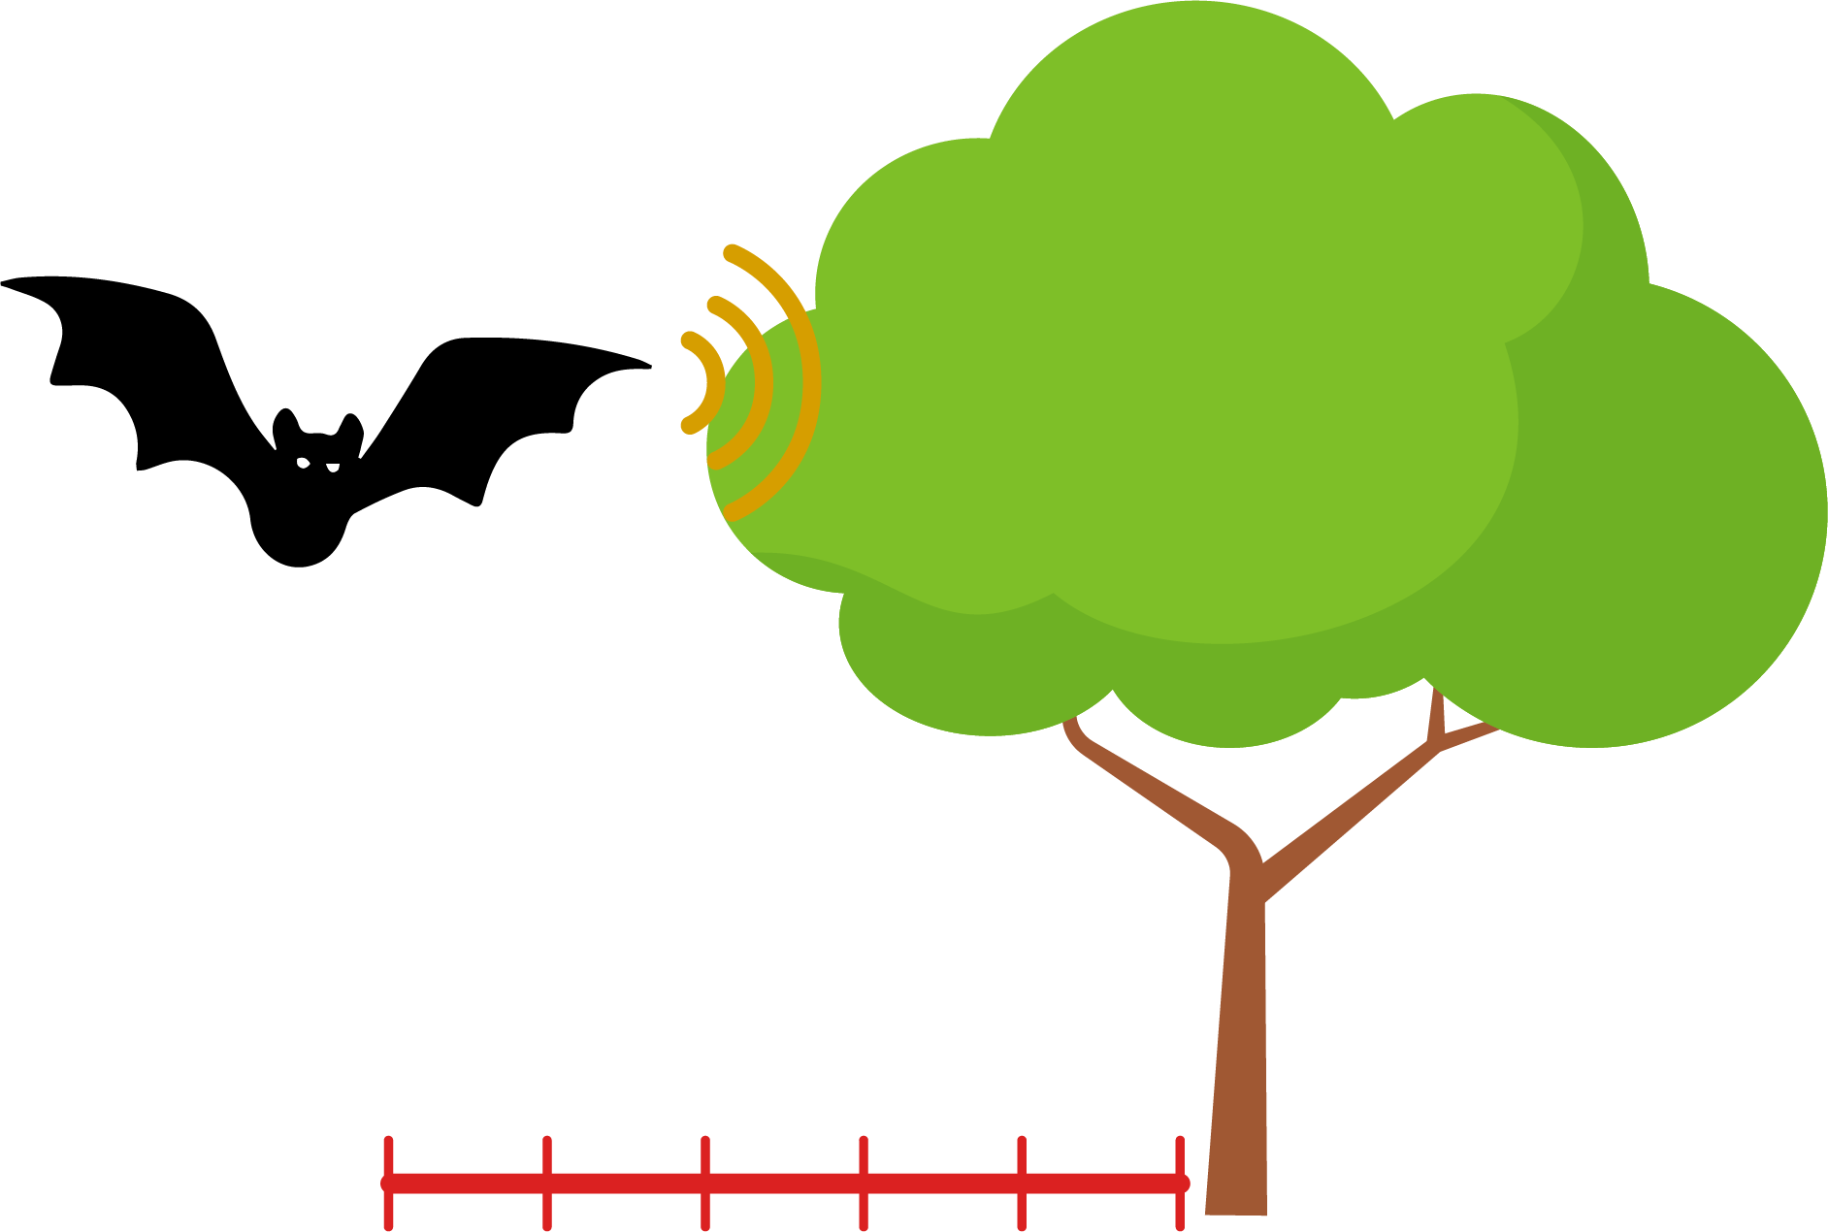
Introduction
1
Ultrasound refers to high-frequency sound waves that are undetected by the human ear. This phenomenon is commonly found in nature and widely used in technology for detecting objects and measuring distances.
For example, bats emit ultrasound to fly and hunt in the dark, and submarines use sonar systems to navigate and map the ocean floor.
In this lesson, you will use an ultrasonic distance sensor along with the Xploris to create a sonar system.
The question you will answer will be:
How does a sonar system display the information detected by the distance sensor?

Slide 4
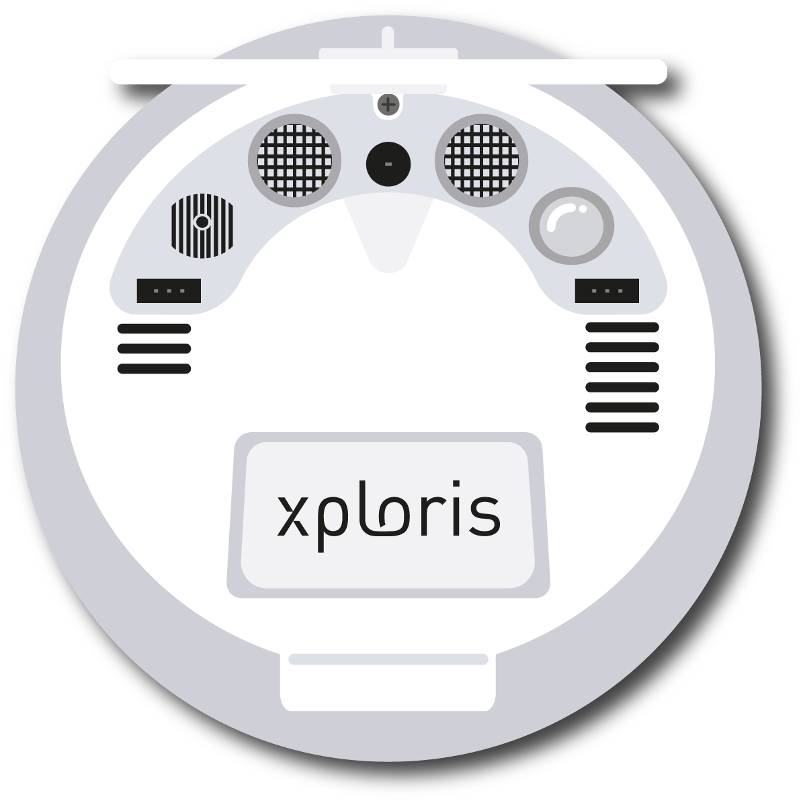
Activity setup
2
The “distance” sensor is located on the back of the Xploris, make sure it is uncovered as shown in the picture.

Slide 5
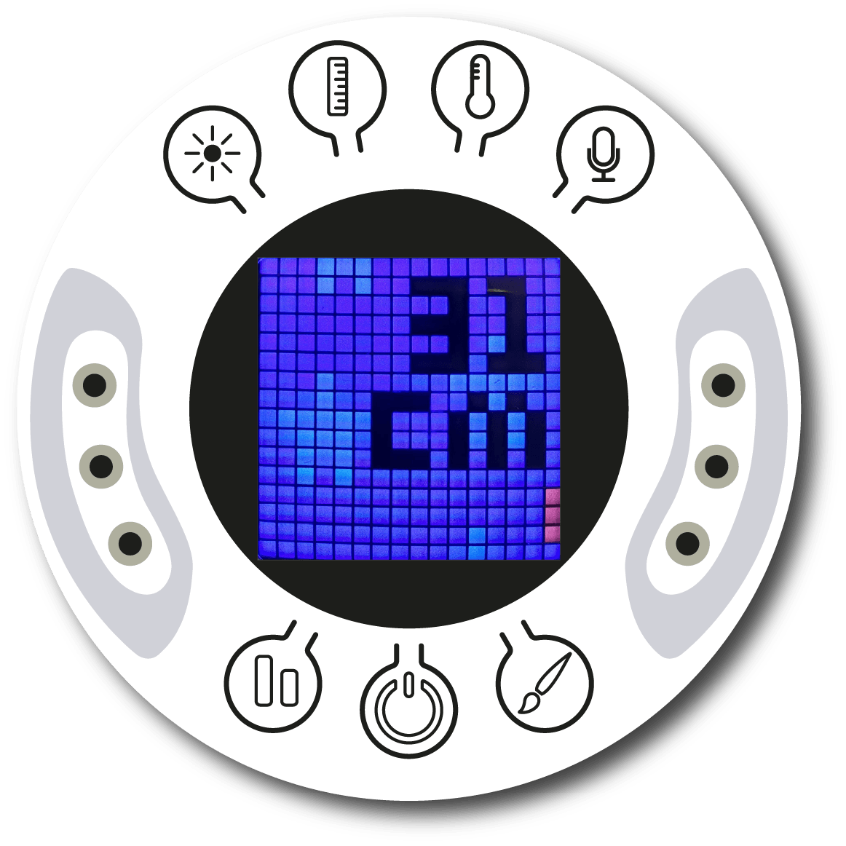
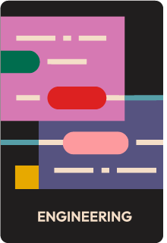
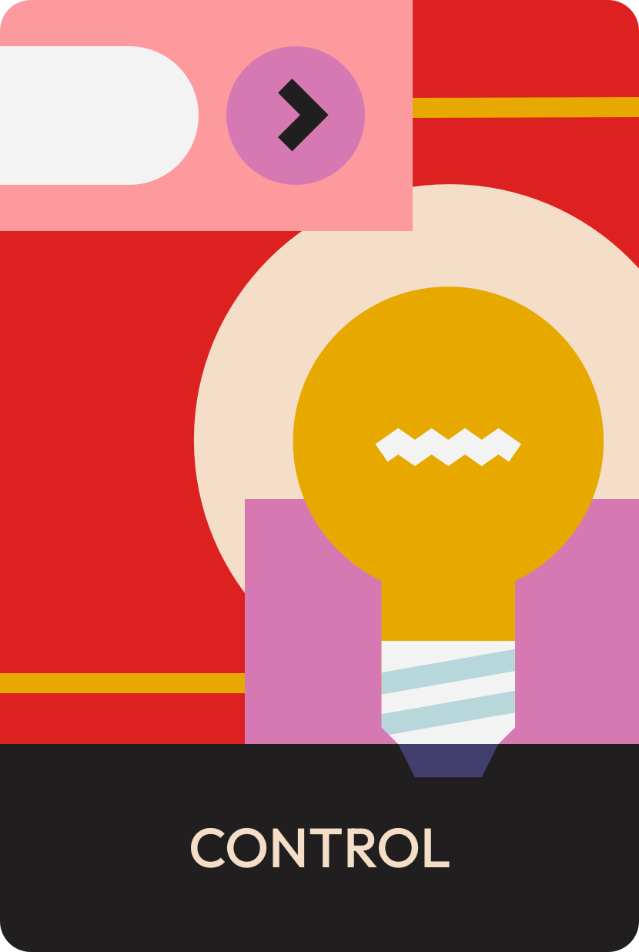
Activity setup
2
Turn on your Xploris and connect it to your computer or tablet.
Open the XploriLab software on your computer or tablet.
Once inside XploriLab, select the icon to connect the device via cable or Bluetooth as applicable.
Enter the ENGINEERING section and then CONTROL.

Slide 6
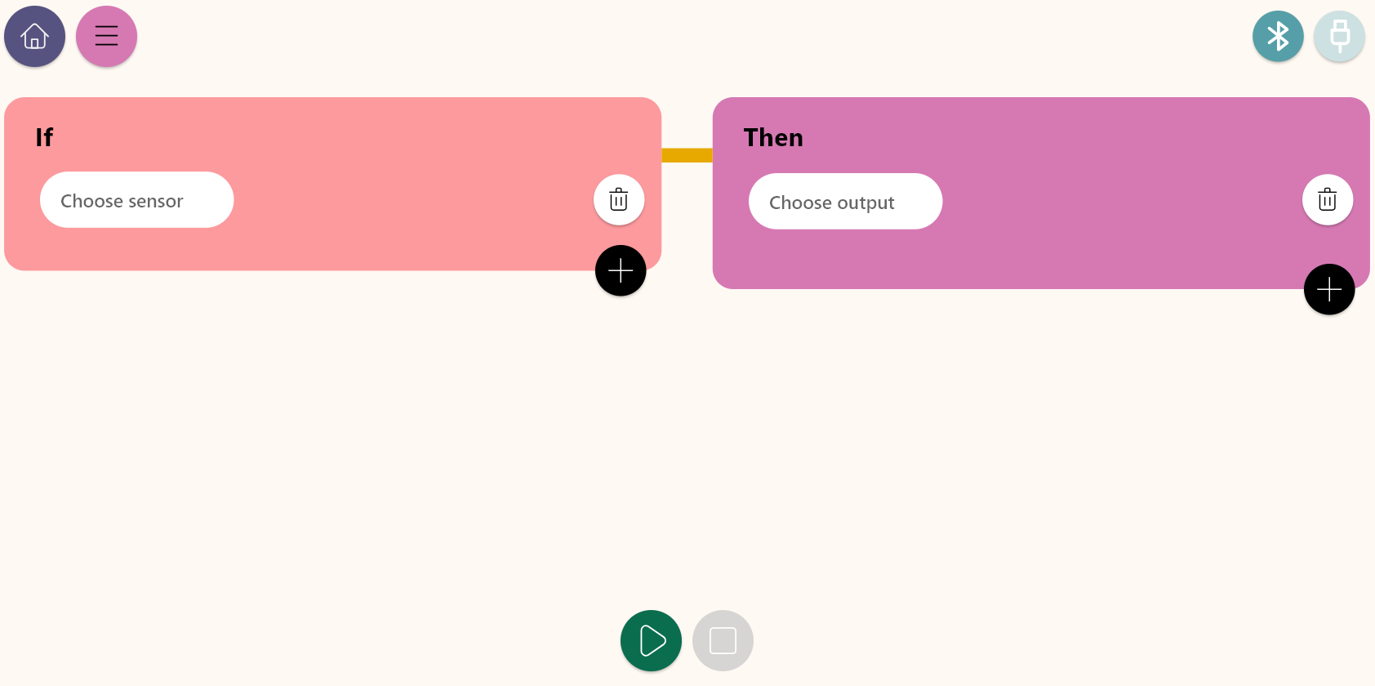
Control diagram
3
Inside the main window you will find several sections with the necessary tools to make a control diagram.
Connection keys
Control conditions
Control actions
Play or stop keys

Slide 7
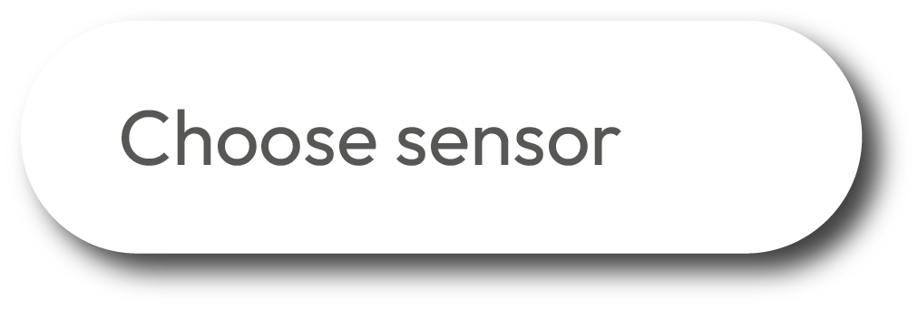
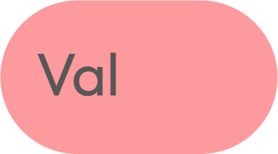
Control diagram
3
The Control window is divided to two sections: Condition and Action. Below we describe the varies conditions.
Control conditions
Work block for setting sensors, conditions and control logics.
Key to set a condition when detecting a High to Low change crossing a predefined level of the selected sensor.
Key to select and display the list of sensors to be used in the control diagram.
A cell for setting the sensor value in the condition.
Key to set “greater than” condition for a defined sensor level.
When using 2 conditions, this OR operand indicates that if one of the condition is fulfilled - the Xploris will execute the Control action.
Key to set “less than” condition for a defined sensor level.
When using 2 conditions, this AND operand indicates that ALL conditions must fulfill - in order for the Xploris to execute the Control action.
Key to set a condition within a range of values of a the defined sensor.
Key to add another control condition.
Key to set a condition when detecting a Low to High change, crossing a predefined level of the selected sensor.
Key to clear a Control condition

Slide 8
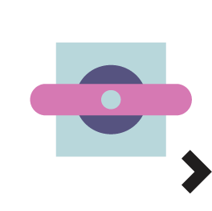
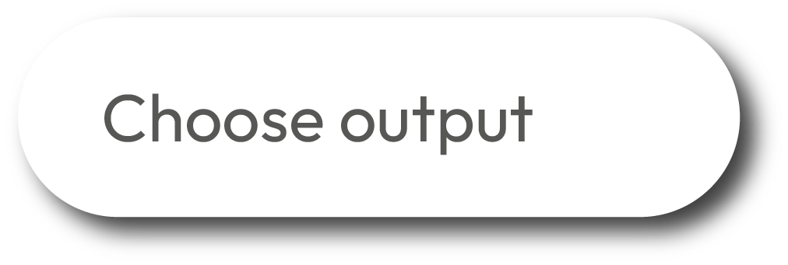
Control diagram
3
The Control window is divided to two sections: Condition and Action. Below we describe the varies actions.
Control actions
Work block for setting the Xploris outputs.
Key to select the right servo motor port control the servo angle and speed.
Key to select and display the list of Xploris outputs for the control diagram.
Key to select the Xploris speaker, produce sound tones and control the sound volume.
Key to select the left contact of the Xploris that can be configured to be opened or closed.
Key to deliver a 5V voltage activation to the left port of the Xploris.
Key to select the right contact of the Xploris that can be configured to be opened or closed.
Key to deliver a 5V voltage activation to the right port of the Xploris.
Key to set the Xploris “Display” to control animations frames and speed.
Key to add another control action.
Key to select the left servo motor port and control the servo angle and speed.
Key to delete a control action.

Slide 9
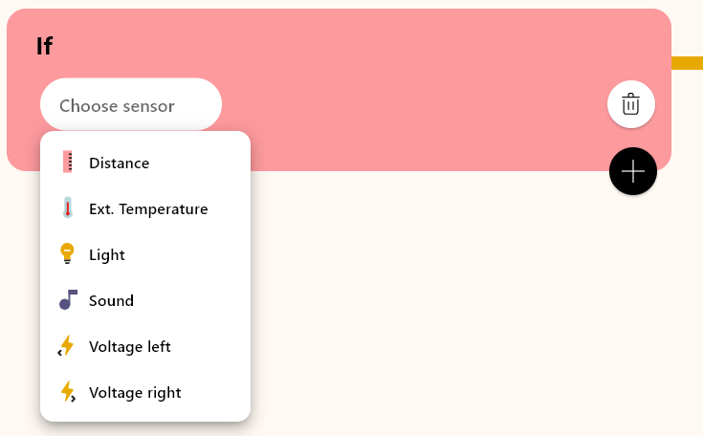
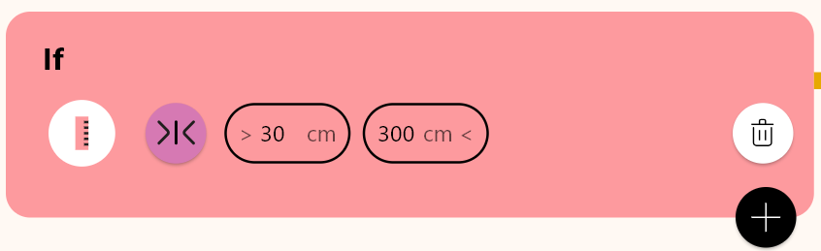
Control diagram
3
1
2
In this activity we will use the distance sensor. To do this simply use the “Choose sensor” key to select the Distance.
Then, in the conditions control bar, we will select the range option. Afterwards, we set the corresponding distance values for the operation of the sonar, which in this case will be from 30 cm to 300 cm.

Slide 10
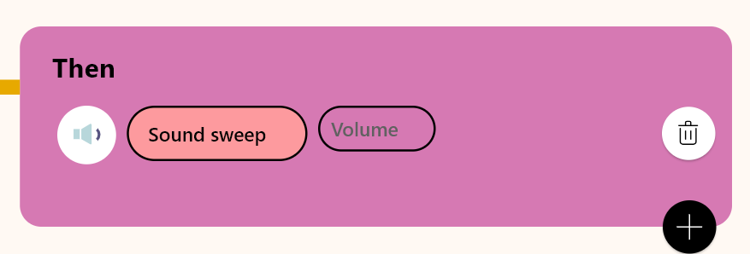
Control diagram
3
3
4
In the control actions area, select the “Choose output” key, then to choose the Xploris speaker, select the “Sound” option.
Next, in the “Condition” key, we select the “Sound sweep” option. This option will generate all 16 Xploris tones when the Distance sensor is between the 30-300cm range.

Slide 11
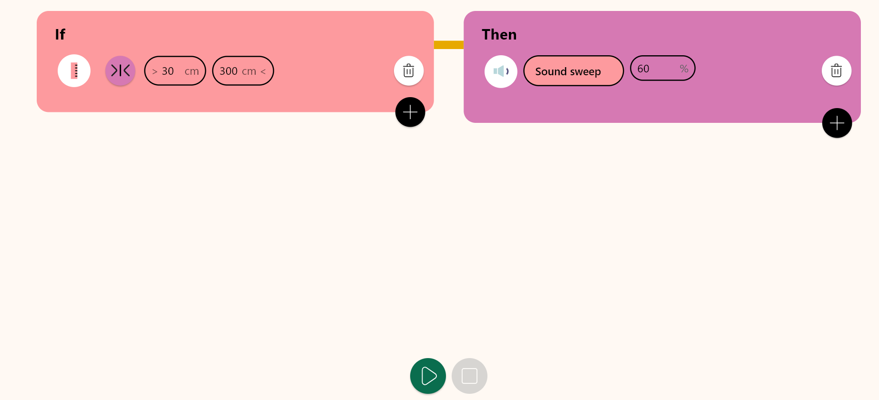
Control diagram
3
5
The 'Volume' field specifies the speaker volume level. In this case we have selected 60%, you may choose any volume level for this activity.

Slide 12
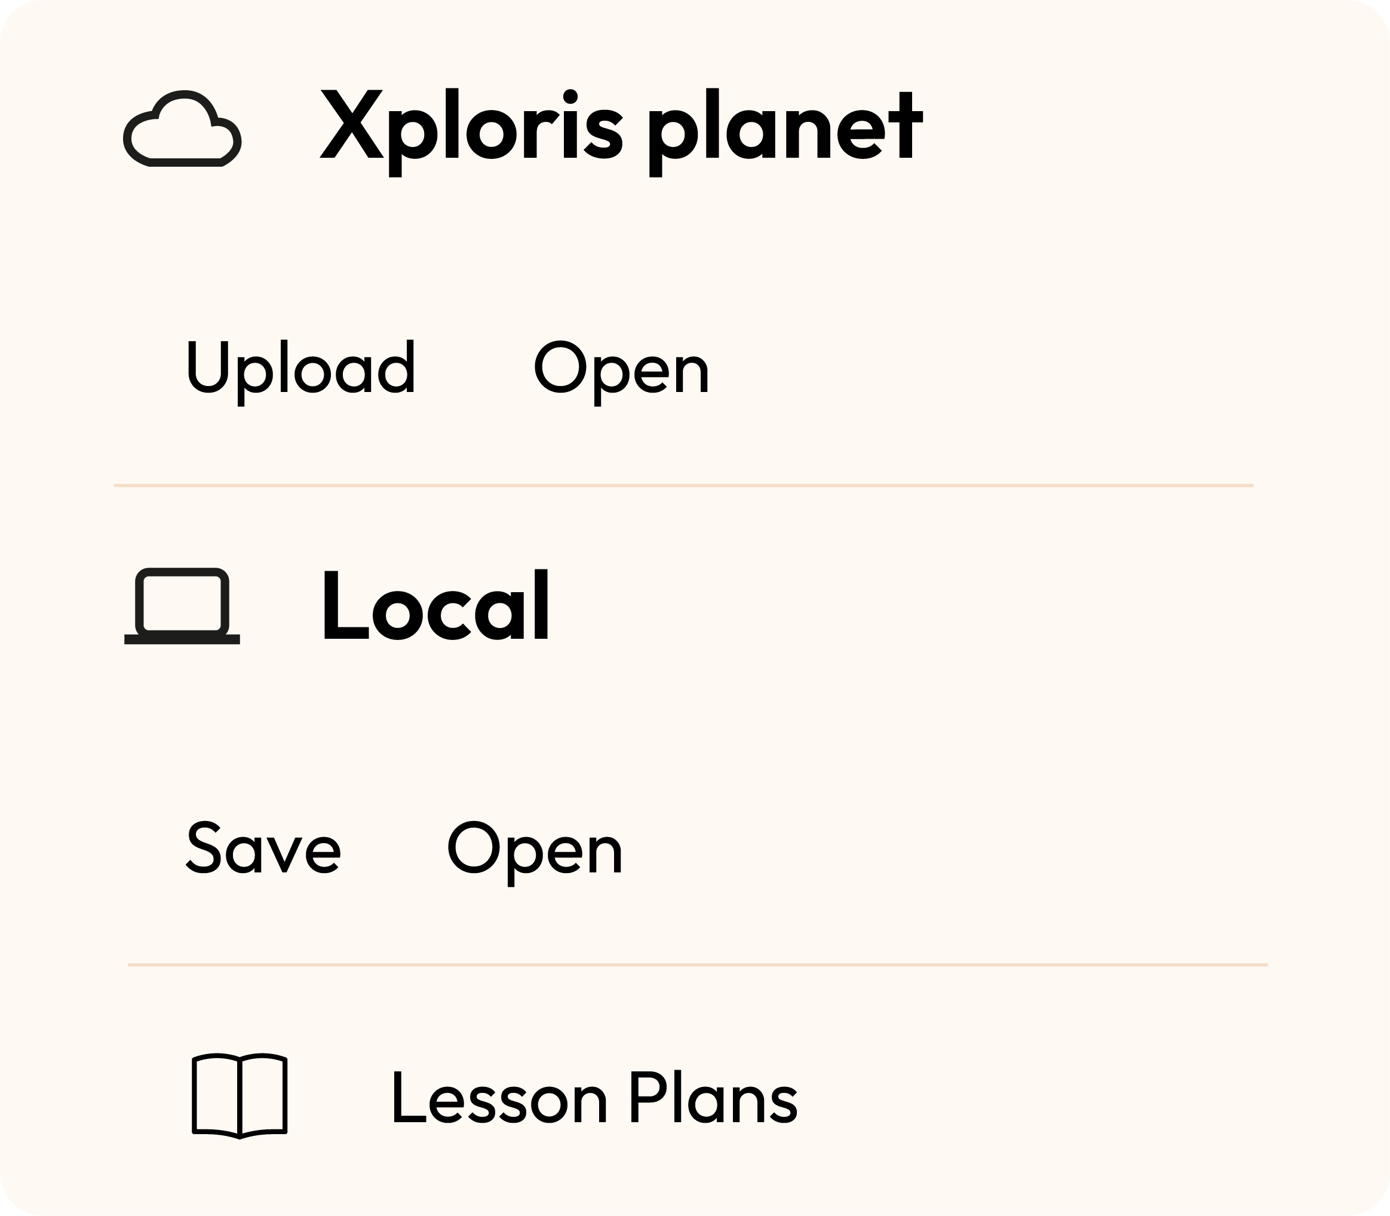
Control diagram
3
Once you have finished your control diagram, save and run it on your Xploris.
Click on the three-bar icon at the top of the screen.
First, save your diagram by clicking “Save” and give it a name.
Once saved, press the “Play” icon at the bottom of the screen. Listen to the tones produced by the Xploris, while you are walking towards and away from the class wall.

Slide 13
Questions
4
1
Sciences
What principles enable the ultrasonic sensor to detect distances?
2
Engineering
In what everyday situations do you think this type of control or functionality might be used? I encourage you to explore and find out.
3
Let's keep experimenting!
Could you illustrate the change in distances with an animation?

Slide 14
Activity summary
5
We used the Xploris software to create a control a “sonar”.
We used the distance sensor to establish a control condition.
We selected the “Sound sweep” function of the Xploris device to create a distance detector.

Slide 15
CONTROL
Detecting distances

