Slide 1
CONTROL
Molecules in motion

Slide 2
MOLECULES IN MOTION
1
Introduction
2
Activity setup
3
Control diagram
CONTROL
4
Questions
5
Activity summary

Slide 3
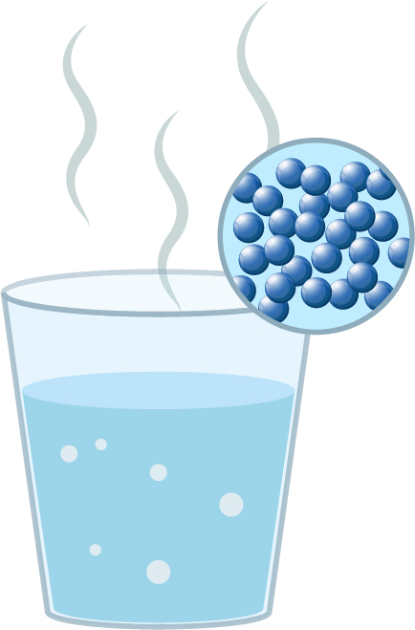
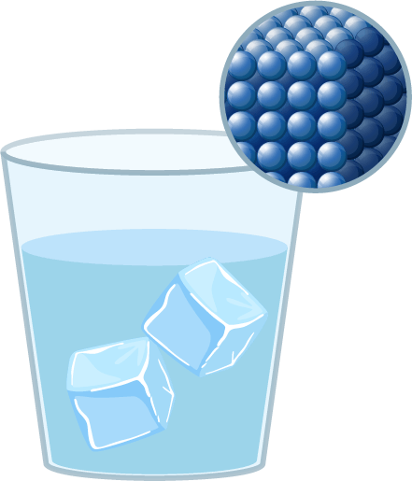
Introducción
1
Molecules, the tiny building blocks of everything around us, behave in fascinating ways depending on temperature. When an object heats up, its molecules move more rapidly and vibrate vigorously, almost as if they’re bursting with energy. Conversely, as something cools down, the molecules slow their movement significantly, coming close to a standstill.
In this lesson, you will build a control diagram with Xploris that will allow us to visually represent this phenomenon.
The question you will answer will be:
How do you think molecules would look as the temperature changes?

Slide 4
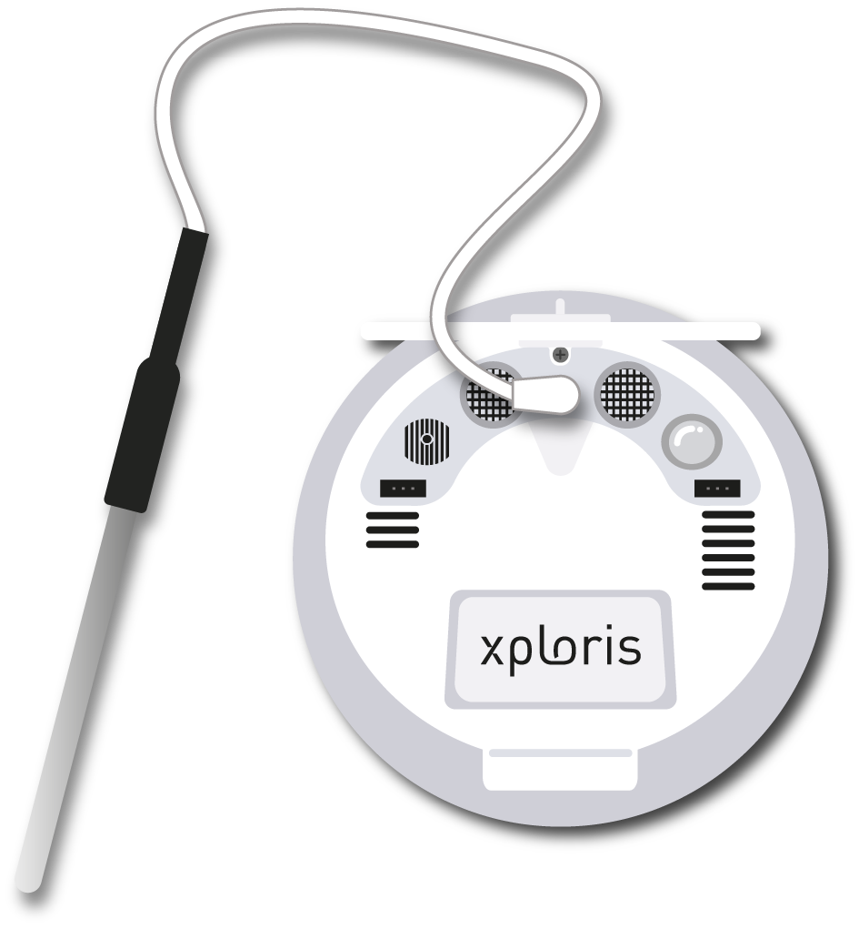
Activity setup
2
Connect the external temperature probe to the rear of the Xploris as shown in the picture.

Slide 5
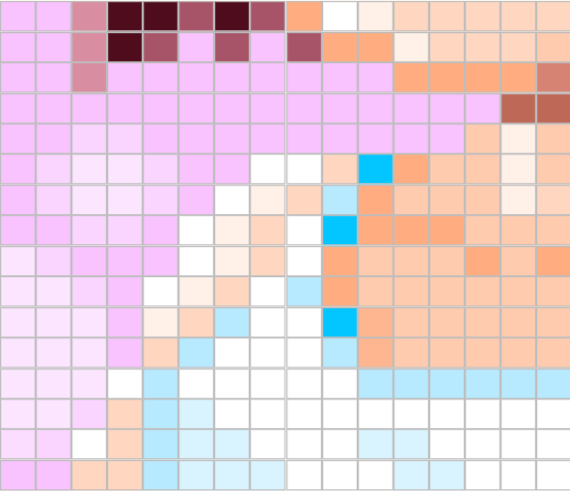
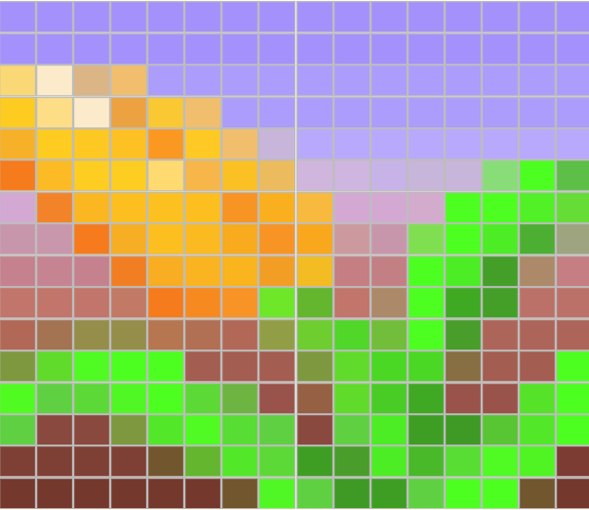
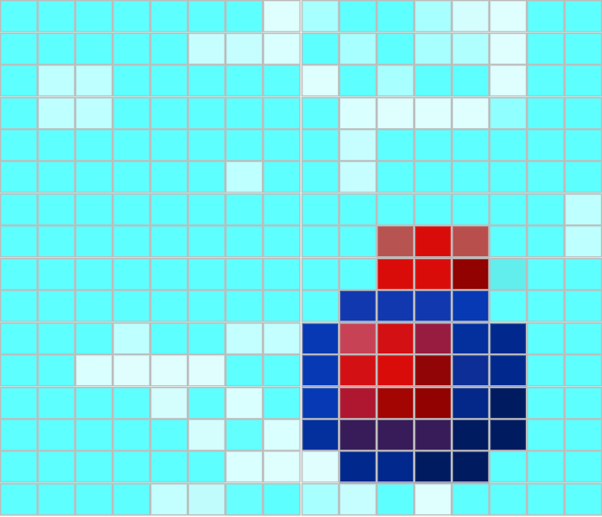
Activity setup
2
Xploris comes with presorted animations.
These animations are stored on the device under the following names and locations
Animation name:
Girl.json
Animation number: 1
Animation name : Flower.json
Animation number: 2
Animation name:
Note.json
Animation number: 3
Animation name:
Molecule.json
Animation number: 4
Animation name:
Bear.json
Animation number: 5
*Remember to check the location of any new animation you have saved in Xploris.

Slide 6
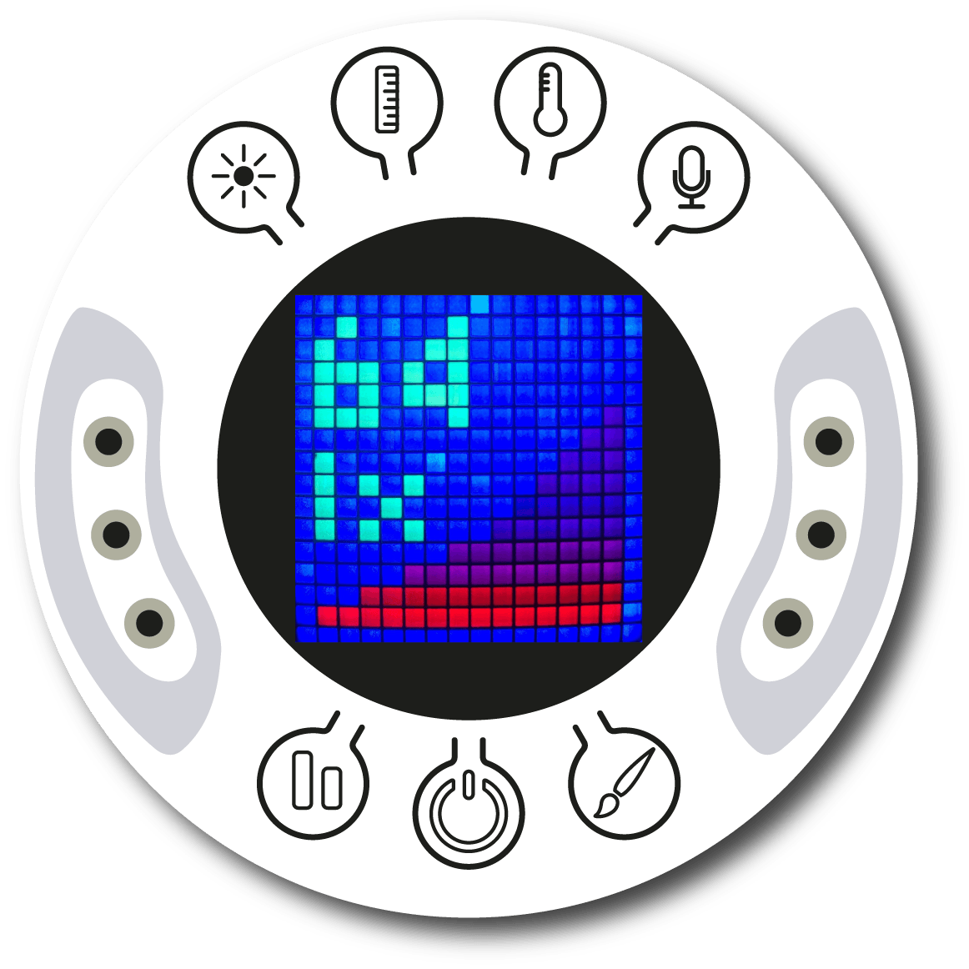
Activity setup
2
Turn on your Xploris and connect it to your computer or tablet.
Open the XploriLab software on your computer or tablet.
Once inside XploriLab, select the icon to connect the device via cable or Bluetooth as applicable.
Enter the ENGINEERING section and then CONTROL.

Slide 7
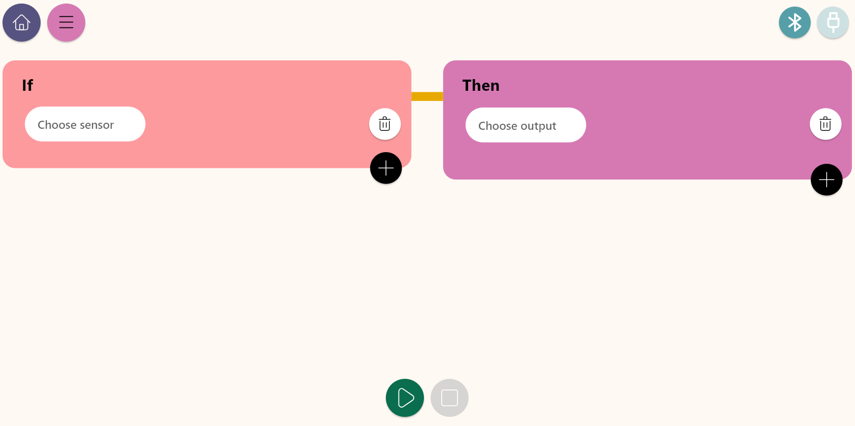
Control diagram
3
Inside the main window you will find several sections with the necessary tools to make a control diagram.
Connection keys
Control conditions
Control actions
Play or stop keys

Slide 8
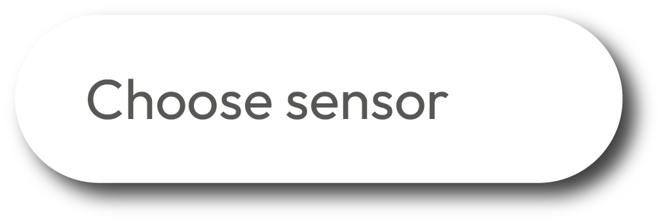
Control diagram
3
The Control window is divided to two sections: Condition and Action. Below we describe the varies conditions.
Control conditions
Work block for setting sensors, conditions and control logics.
Key to set a condition when detecting a High to Low change crossing a predefined level of the selected sensor.
Key to select and display the list of sensors to be used in the control diagram.
A cell for setting the sensor value in the condition.
Key to set “greater than” condition for a defined sensor level.
When using 2 conditions, this OR operand indicates that if one of the condition is fulfilled - the Xploris will execute the Control action.
Key to set “less than” condition for a defined sensor level.
When using 2 conditions, this AND operand indicates that ALL conditions must fulfill - in order for the Xploris to execute the Control action.
Key to set a condition within a range of values of a the defined sensor.
Key to add another control condition.
Key to set a condition when detecting a Low to High change, crossing a predefined level of the selected sensor.
Key to clear a Control condition

Slide 9
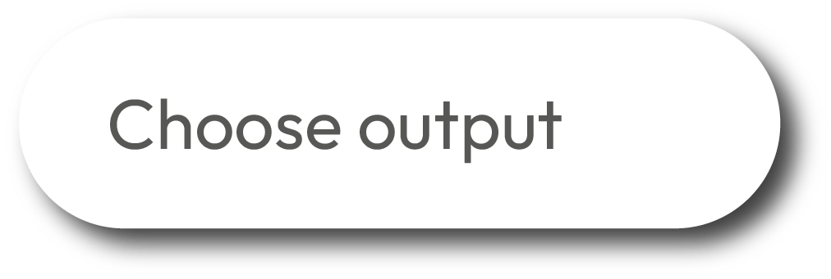
Control diagram
3
The Control window is divided to two sections: Condition and Action. Below we describe the varies actions.
Control actions
Work block for setting the Xploris outputs.
Key to select the right servo motor port control the servo angle and speed.
Key to select and display the list of Xploris outputs for the control diagram.
Key to select the Xploris speaker, produce sound tones and control the sound volume.
Key to select the left contact of the Xploris that can be configured to be opened or closed.
Key to deliver a 5V voltage activation to the left port of the Xploris.
Key to select the right contact of the Xploris that can be configured to be opened or closed.
Key to deliver a 5V voltage activation to the right port of the Xploris.
Key to set the Xploris “Display” to control animations frames and speed.
Key to add another control action.
Key to select the left servo motor port and control the servo angle and speed.
Key to delete a control action.

Slide 10
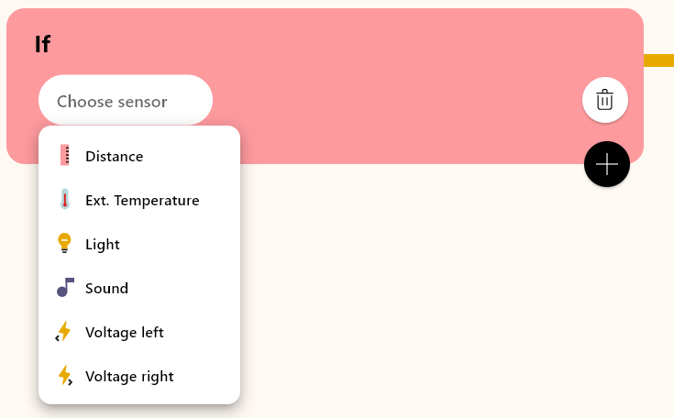
Control diagram
3
1
2
In this activity we will use the external temperature sensor. To do this simply use the Choose sensor key to select the External Temperature.
Then, in the conditions control bar, we will select he range option. Afterwards, we set the corresponding temperature values, which in this case will be from “0°” to 30°.

Slide 11
Control diagram
3
3
4
In the control actions area, select the “Choose output” key. To use the Xploris screen, select the “display” option.
Next, in the “Condition” key, we select the “Animation speed” option, to control the frames changing speed of one of Xploris saved animation.

Slide 12
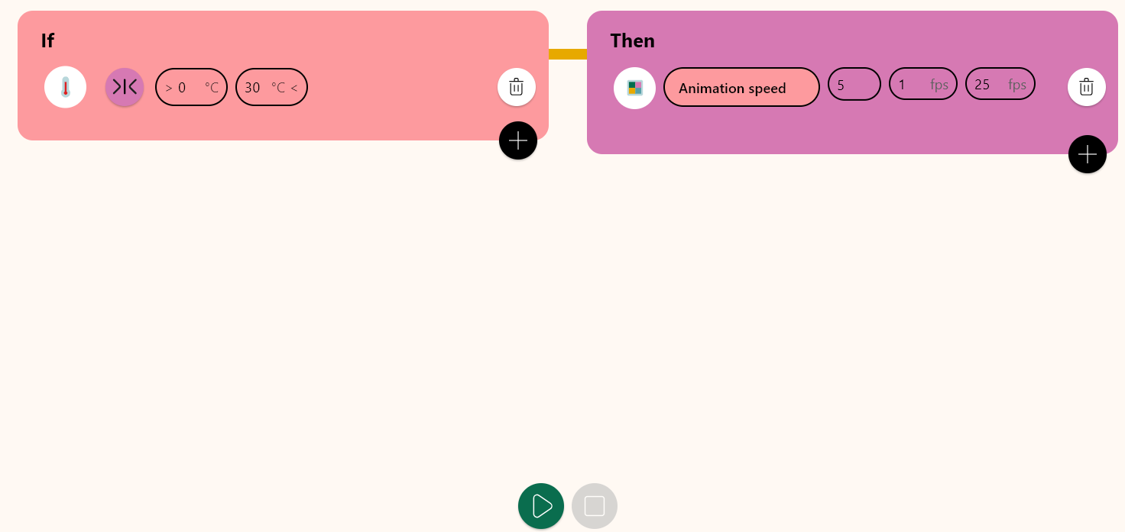
Control diagram
3
5
For this activity we will use the animation “molecule.json”. You must indicate “4” as value in the “num” field to select this animation.
4
The "Min" and "Max" fields indicate the minimum and maximum speed of advancing the animation frames. In this example we will use Min=1, and Maximum=25 FPS.

Slide 13
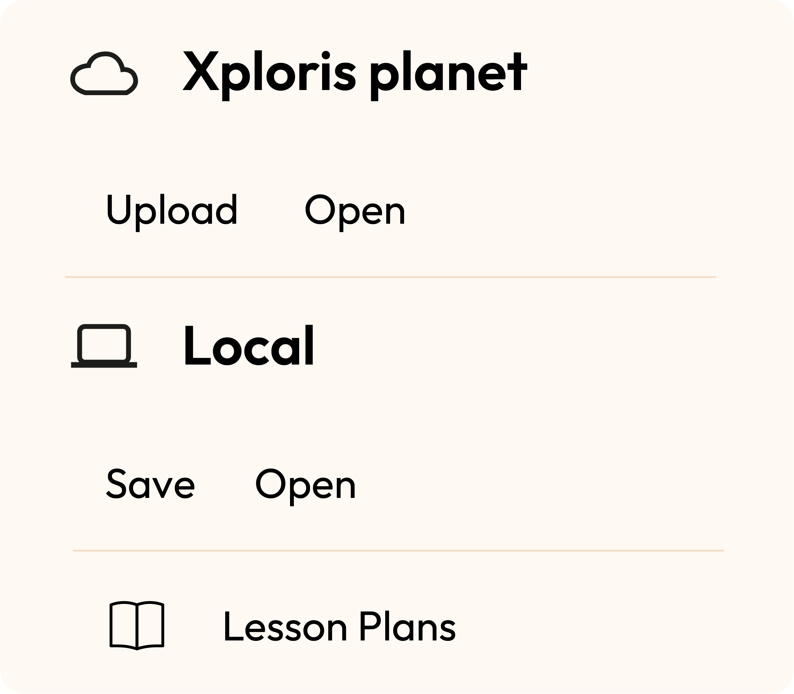
Control diagram
3
Once you have finished your control diagram, save and run it on your Xploris.
Click on the three-bar icon at the top of the screen.
First, save your diagram by clicking “Save” and give it a name.
Once saved, click the “play” icon at the bottom of the screen. Observe the Molecule animation changing its motion speed according to the measured temperature.

Slide 14
Questions
4
1
Sciences
How do you think the movement of atoms will affect the physical properties of materials?
2
Arts
Do you know what FPS stands for? These letters appeared when you were changing the speed of our animation. Find out what this acronym stands for.
3
Let's keep experimenting!
Could you represent the change of state of water with a new animation using the external temperature sensor?

Slide 15
Activity summary
5
We used the Xploris software to create a control diagram that replicates the motion of the molecules in relation to the surrounding temperature.
We used the external temperature sensor to establish a control condition.
We selected an animation of the Xploris device to illustrate the scientific principle.

Slide 16
CONTROL
Molecules in motion

