Slide 1
CONTROL
Flower opens in the sun

Slide 2
FLOWER OPENS IN THE SUN
1
Introduction
2
Activity setup
3
Control diagram
CONTROL
4
Questions
5
Activity summary

Slide 3
Introduction
1
Plants rely on sunlight to fuel photosynthesis, their method of producing food. During the day, they open their leaves and flowers wide to soak up as much light as possible, promoting healthy growth. At night, however, they close their leaves and flowers to rest and conserve energy, much like a peaceful slumber!
In this activity, you'll step into the role of a scientific explorer with the Xploris light sensor. Together, we’ll create a control diagram that lets you visualize this phenomenon unfolding right before your eyes—like witnessing nature from an exciting new perspective!
The question you are going to answer will be:
What happens to plants when the amount of light in their environment changes?

Slide 4
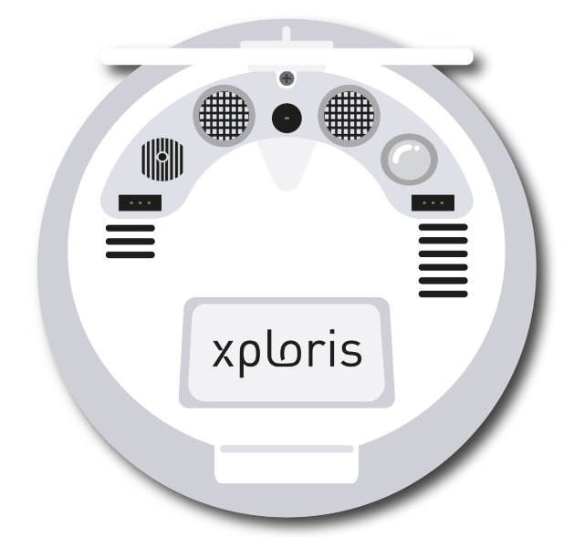
Setting up the experiment
2
The “light” sensor is located at the back of the Xploris, make sure it is uncovered, as shown in the picture.

Slide 5
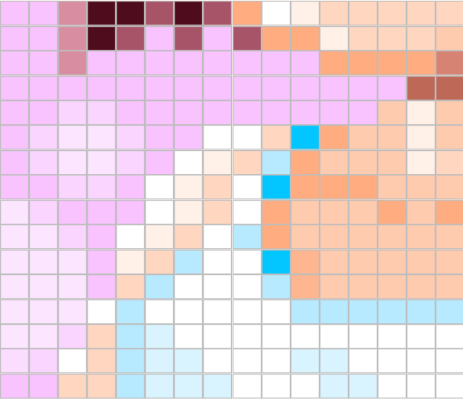
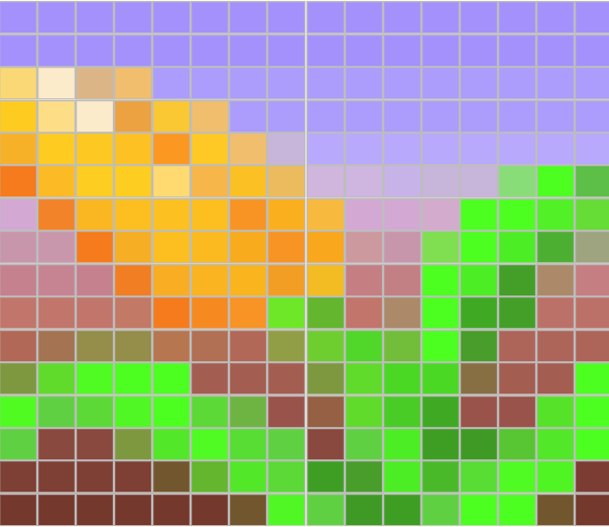
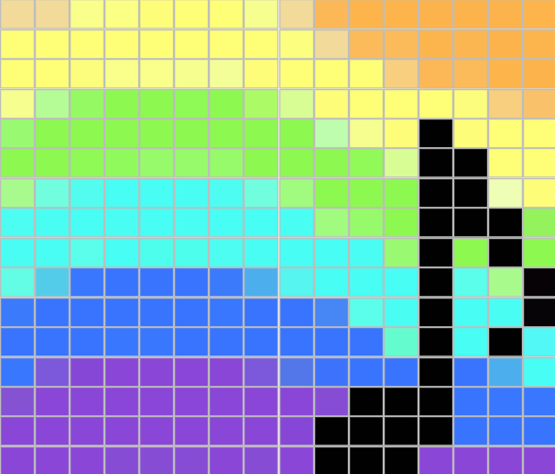
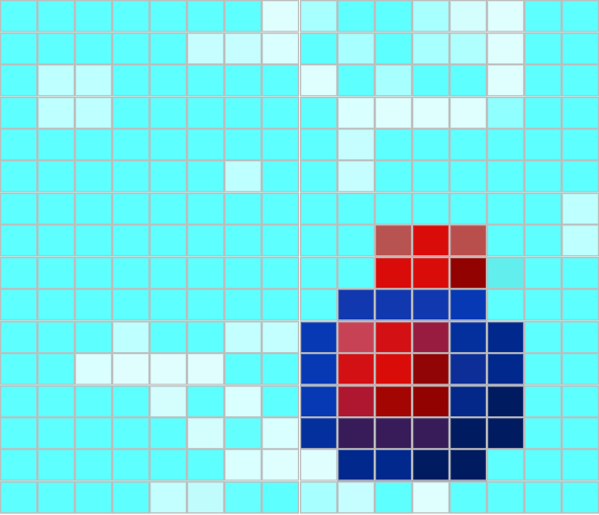
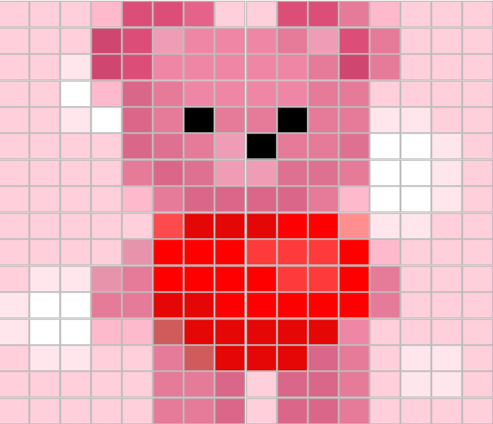
Activity setup
2
Xploris comes with presorted animations.
These animations are stored on the device under the following names and locations
Animation name:
Girl.json
Animation number: 1
Animation name : Flower.json
Animation number: 2
Animation name:
Note.json
Animation number: 3
Animation name:
Molecule.json
Animation number: 4
Animation name:
Bear.json
Animation number: 5
*Remember to check the location of any new animation you have saved in Xploris.

Slide 6
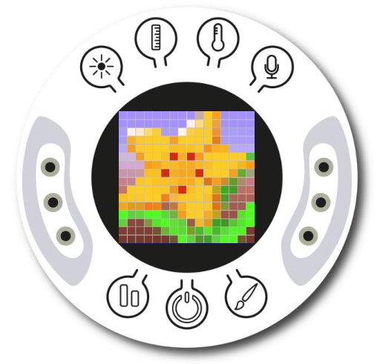
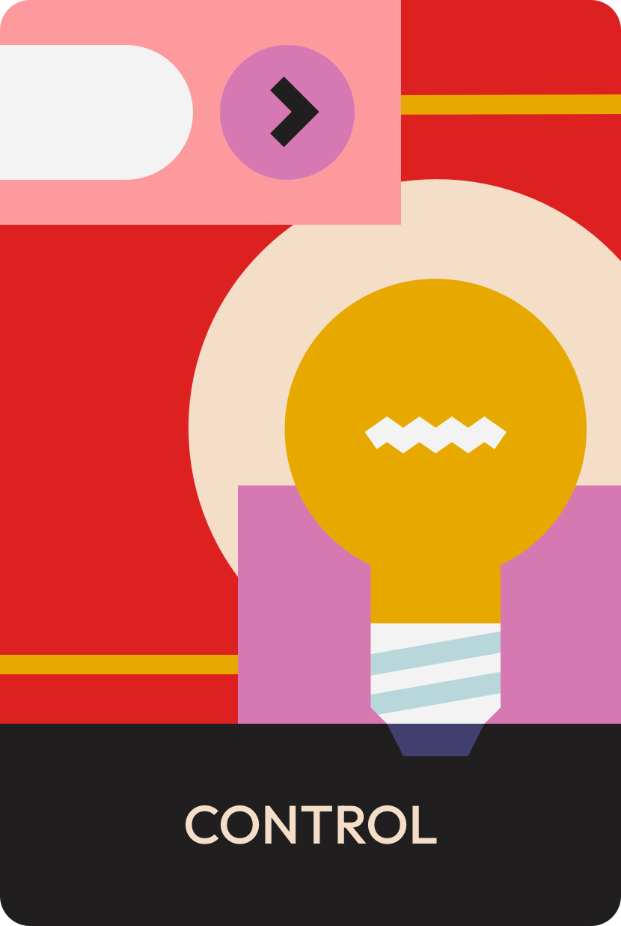
Activity setup
2
Turn on your Xploris and connect it to your computer or tablet.
Open the XploriLab software on your computer or tablet.
Once inside XploriLab, select the icon to connect the device via cable or Bluetooth as applicable.
Enter the ENGINEERING section and then CONTROL.

Slide 7
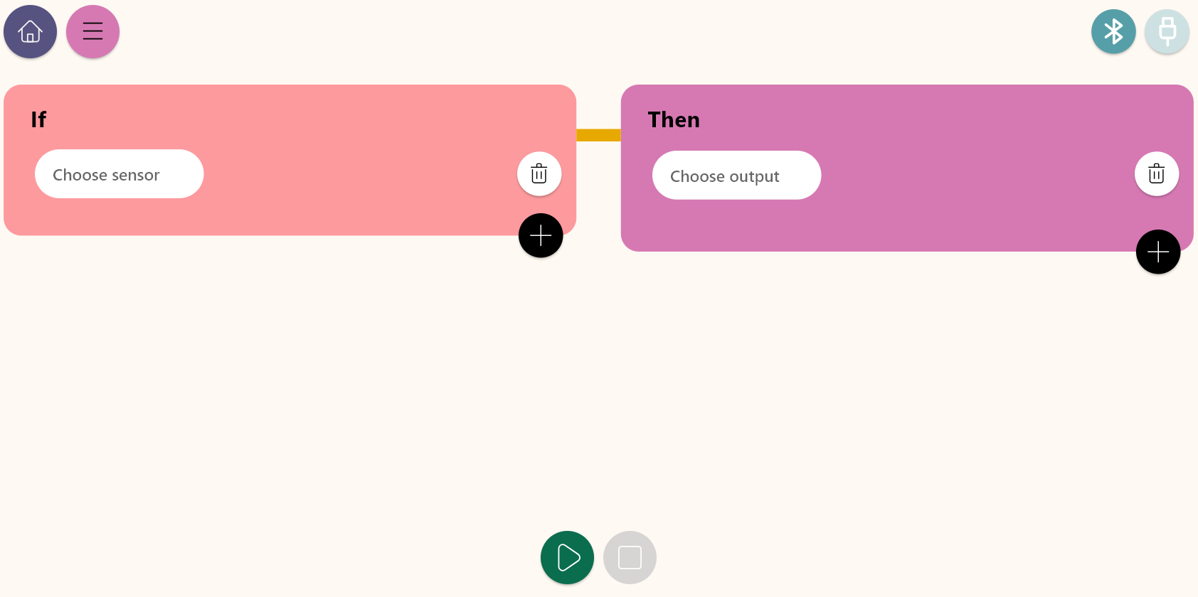
Control diagram
3
Inside the main window you will find several sections with the necessary tools to make a control diagram.
Connection keys
Control conditions
Control actions
Play or stop keys

Slide 8
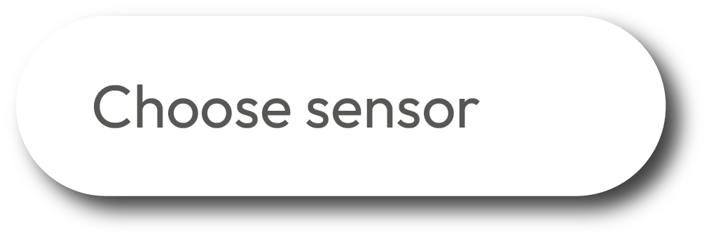
Control diagram
3
The Control window is divided to two sections: Condition and Action. Below we describe the varies conditions.
Control conditions
Work block for setting sensors, conditions and control logics.
Key to set a condition when detecting a High to Low change crossing a predefined level of the selected sensor.
Key to select and display the list of sensors to be used in the control diagram.
A cell for setting the sensor value in the condition.
Key to set “greater than” condition for a defined sensor level.
When using 2 conditions, this OR operand indicates that if one of the condition is fulfilled - the Xploris will execute the Control action.
Key to set “less than” condition for a defined sensor level.
When using 2 conditions, this AND operand indicates that ALL conditions must fulfill - in order for the Xploris to execute the Control action.
Key to set a condition within a range of values of a the defined sensor.
Key to add another control condition.
Key to set a condition when detecting a Low to High change, crossing a predefined level of the selected sensor.
Key to clear a Control condition

Slide 9
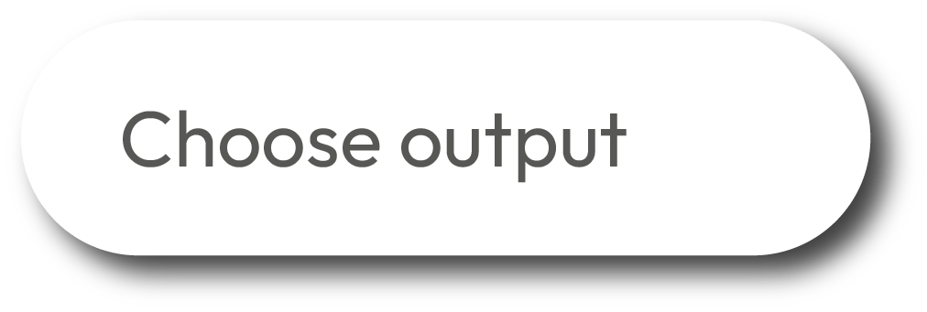
Control diagram
3
The Control window is divided to two sections: Condition and Action. Below we describe the varies actions.
Control actions
Work block for setting the Xploris outputs.
Key to select the right servo motor port control the servo angle and speed.
Key to select and display the list of Xploris outputs for the control diagram.
Key to select the Xploris speaker, produce sound tones and control the sound volume.
Key to select the left contact of the Xploris that can be configured to be opened or closed.
Key to deliver a 5V voltage activation to the left port of the Xploris.
Key to select the right contact of the Xploris that can be configured to be opened or closed.
Key to deliver a 5V voltage activation to the right port of the Xploris.
Key to set the Xploris “Display” to control animations frames and speed.
Key to add another control action.
Key to select the left servo motor port and control the servo angle and speed.
Key to delete a control action.

Slide 10
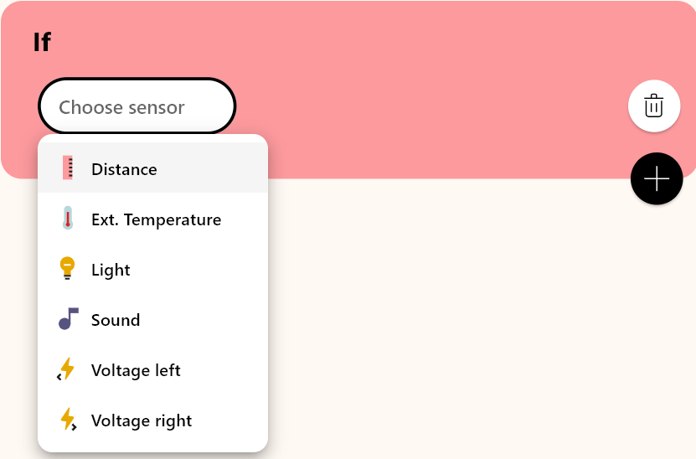
Control diagram
3
1
2
In this activity we will use the light sensor. Click sensor using the “Choose sensor” and select the Light sensor.
Then, in the conditions control bar, we will select the range option. Now we will set the corresponding brightness values, which in this case will be from 0 to 300 lx. This may vary depending on ambient light intensity where you are.

Slide 11
Control diagram
3
3
4
In the control actions area, click “Choose output” and select the “Display” option.
Next, in the “Condition” select the “Animation frame” option, which will allow us to display a specific frame of a saved animation.

Slide 12
Control diagram
3
5
For this activity we will use the animation “flower.json”. Simply indicate “2” as value in the “Num” field to select the Flower animation.
In the “Start” field, indicate the value of the start frame we will use, and in “End”, set the frame of our animation where the Flower is fully open. This will be the middle frame of the animation.
Our flower is animated by 16 frames, so make sure it blooms progressively by selecting End frame = 8.
8

Slide 13
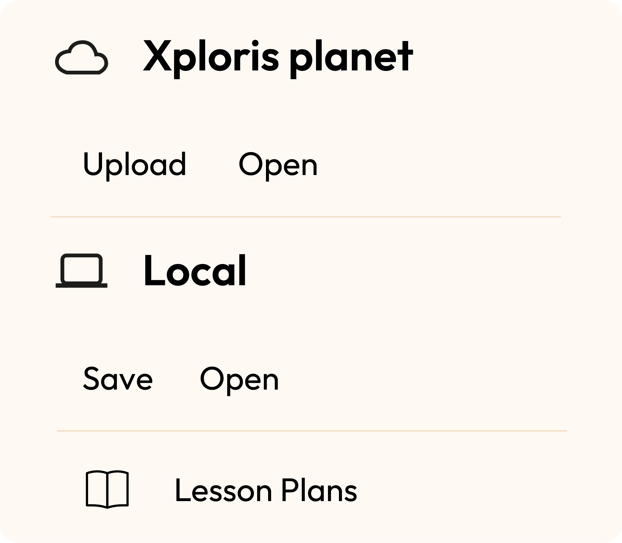
Control diagram
3
Once you have finished your control diagram, save and run it on your Xploris.
Click on the three-bar icon at the top of the screen.
First, save your diagram by clicking “Save” and give it a name.
Once saved, click the “Play” icon at the bottom of the screen, watch the flower open when more light is projected on the Xploris Light sensor.

Slide 14
Questions
4
1
Sciences
From the results, which light source did you prefer to make the animation bloom?
2
Control
If we change the control action, how do you think the phenomenon could be represented using a servomotor?
3
Let's keep experimenting!
Do you think the amount of light required for flowers to bloom varies among different types? Explore which plants thrive in bright sunlight and which prefer less light.

Slide 15
Activity summary
5
We learned how to display a specific frame of an animation.
We analyzed different light sources, choosing the one that made the activity easier to control.
We learned about the importance of light for plant growth by observing how a flower could open with the light sensor, controlled through the Xploris device and software.

Slide 16
CONTROL
Flower opens in the sun

