Slide 1
ARTS
Walking figure: Character creation

Slide 2
CHARACTER CREATION
1
Introduction
2
Design
ARTS
3
Questions
4
Activity summary

Slide 3
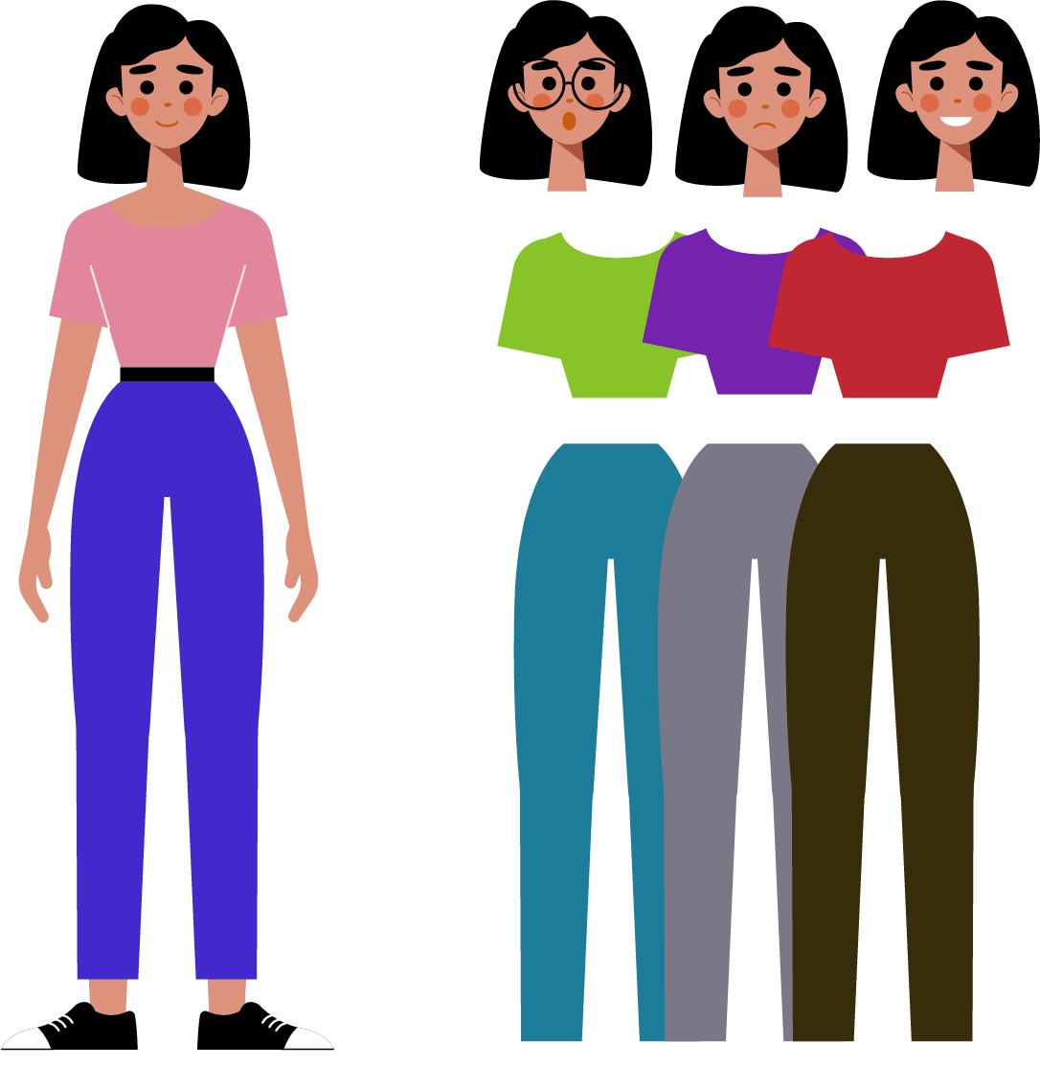
Introduction
1
There are many ways to create unique characters and bring them to life through 2D or 3D animation. Have you ever seen a character and already knew what their personality would be like, just by looking at their clothes and expressions?
Thanks to the art of character design, drawings can be given complex personalities by simply modifying their gestures, clothes, hairstyles or accessories.
In this lesson you will create and animate your own character with the Xploris software.
The question you will answer will be:
Can we create, customize and animate our own character?

Slide 4
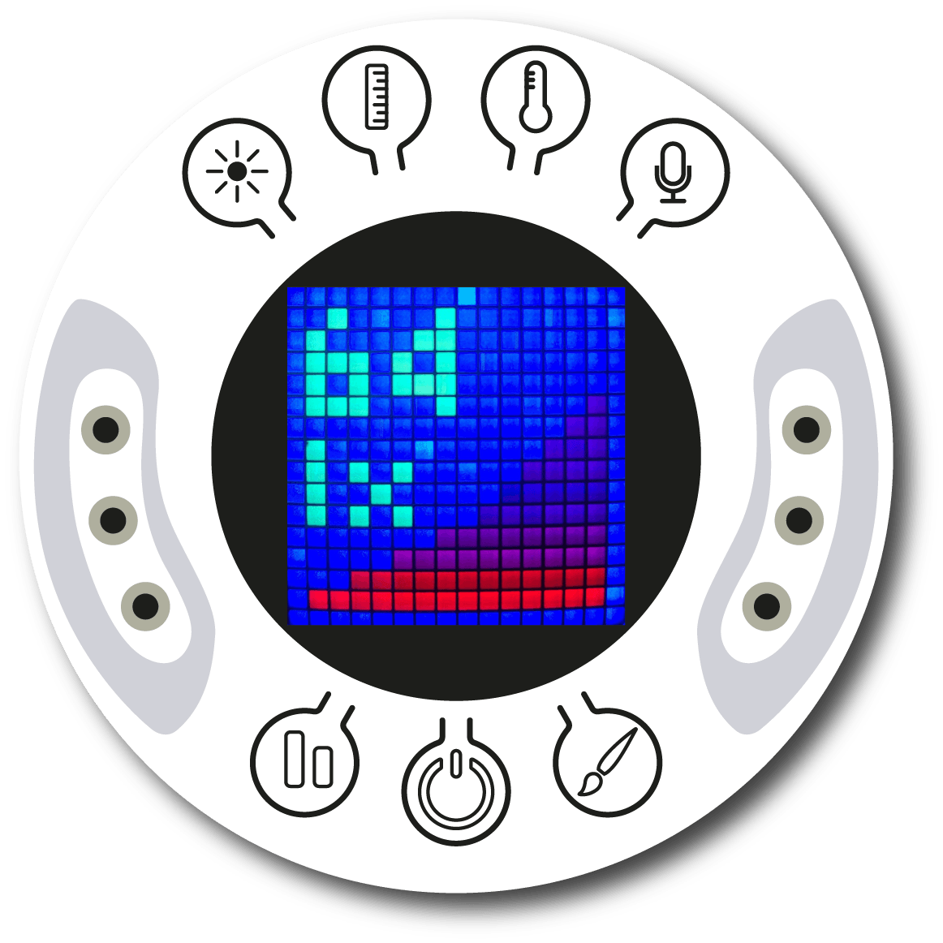
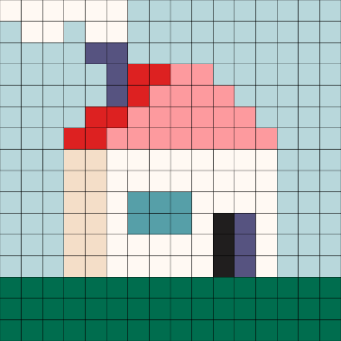
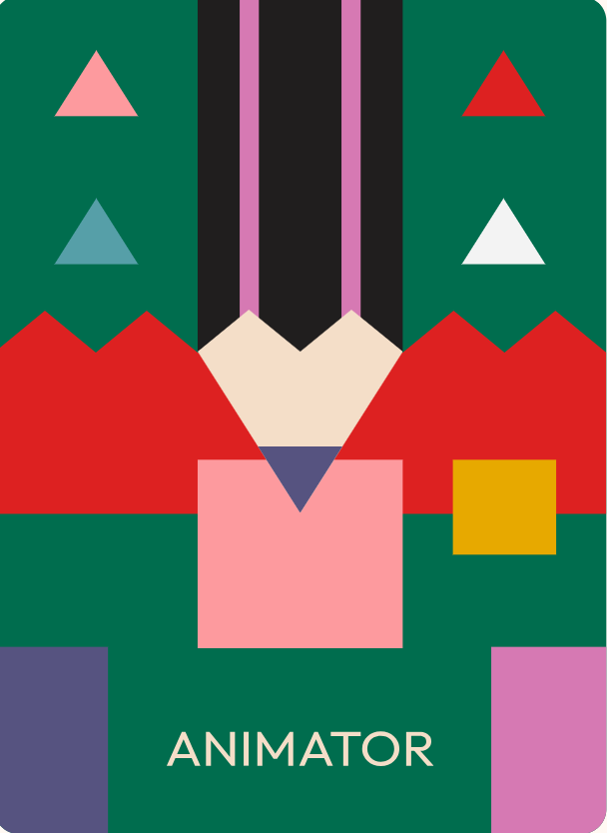
Design
2
Turn on your Xploris and connect it to your computer or tablet.
Open the XploriLab software on your computer or tablet.
Once inside XploriLab, select the icon to connect the device via cable or bluetooth as applicable.
Enter the art section (ART) and then to ANIMATOR.

Slide 5
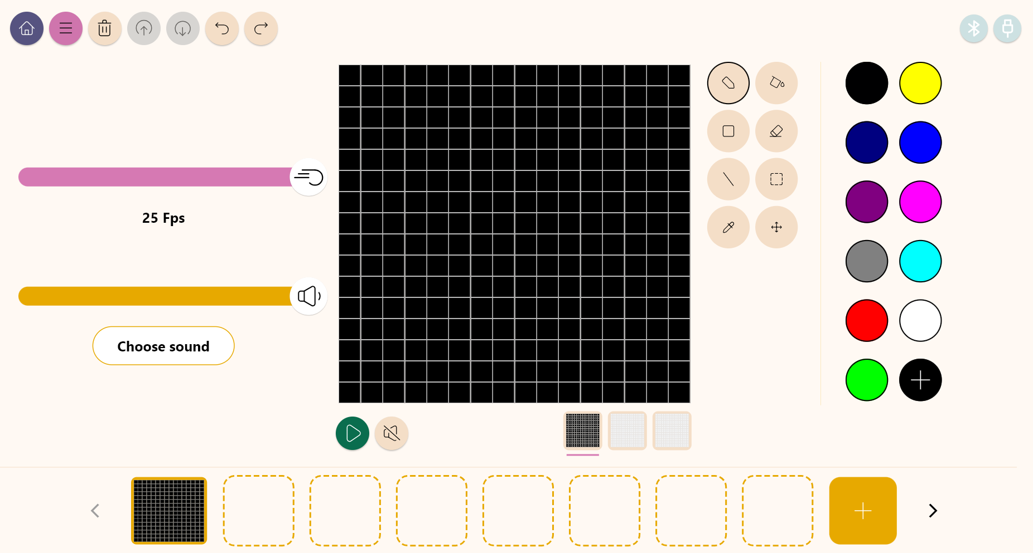
Design
2
Inside the main window you will find several sections with the necessary tools to make a digital artwork.
Tools
Color palette
Configuration
Drawing area
Layers
Frames

Slide 6
Design
2
Use the different Xploris tools to animate a walking character. You can copy the reference character, but remember that the main goal is for you to create the look you like best.
Tools
Pencil: Adds color to a pixel.
Eyedropper: Copies the color of a pixel.
Bucket: Fills the inside of a closed shape with color.
Move: Move the selected pixels.
Rectangle: Creates a rectangle on the screen.
More: Change the selected color in your palette.
Eraser: Erases a single pixel.
Undo: Deletes your last action.
Selection: Select a section of the frame to copy, paste and move.
Redo: Redo an action you have deleted.
Line: Creates a straight line.
Upload: Upload your drawing or animation to the Xploris device.

Slide 7
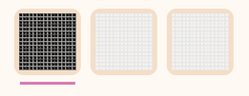
Design
2
1
2
Below the drawing area are the layers. The first one, black, is the background and the other two are the character. This time all the layers will be animated.
In the first layer you will draw the background with clouds, in the second layer the head and body of the character and in the third layer the hands and feet of the character.

Slide 8
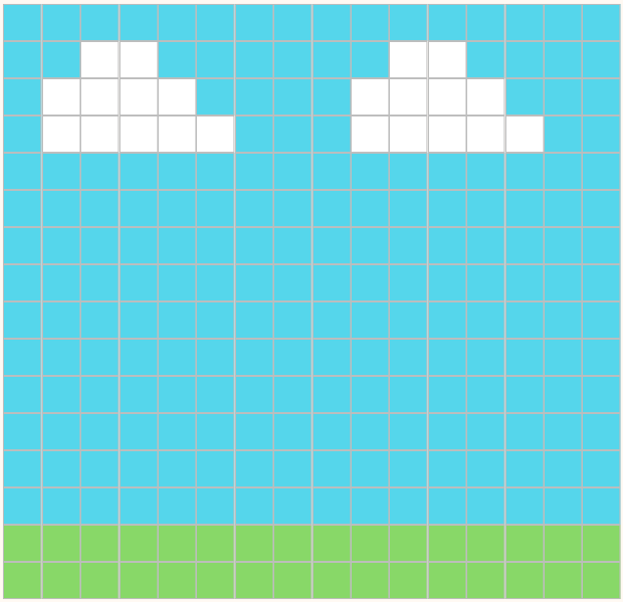
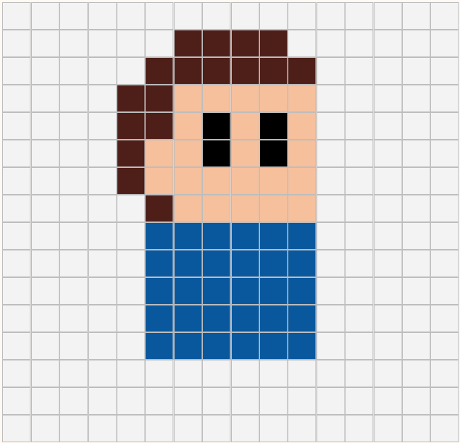
Design
2
2
3
4
In the first layer, with the help of the pencil and rectangle tools draw the sky, the clouds and the grass.
On the second layer, draw the head and body of your character. Here you can change the color of the clothes, skin, eyes or modify the hair. Let your imagination run wild!

Slide 9
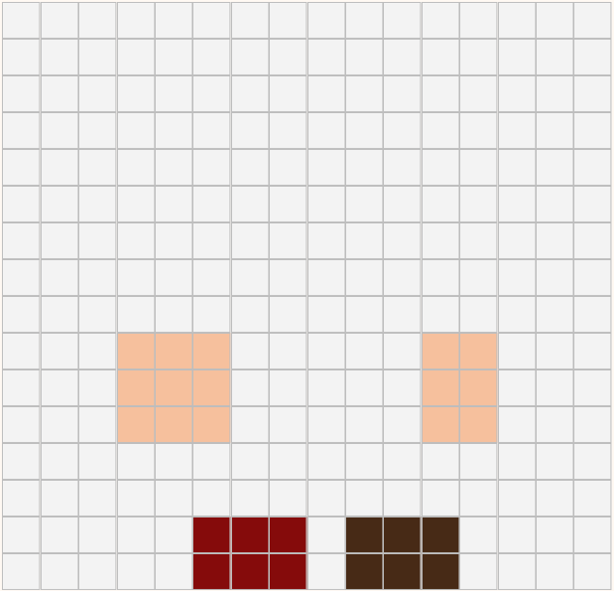
Design
2
5
6
A
B
C
D
E
On the third layer, with the help of the pencil draw the hands and feet of the character. You can change the color of the shoes or the skin.
Right click on the first frame.
Duplicate the frame 4 more times.
Modify the frames according to the instructions below.

Slide 10
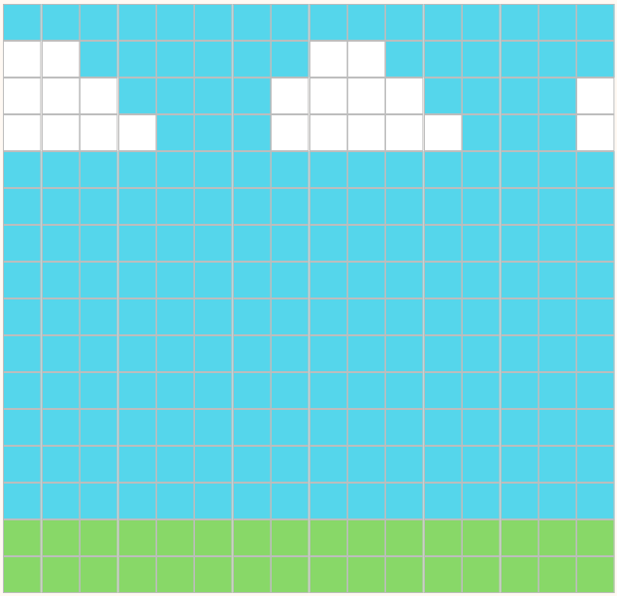
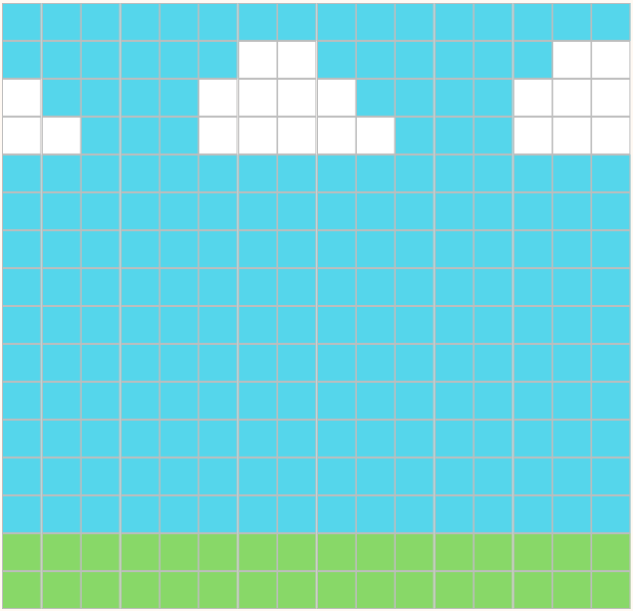
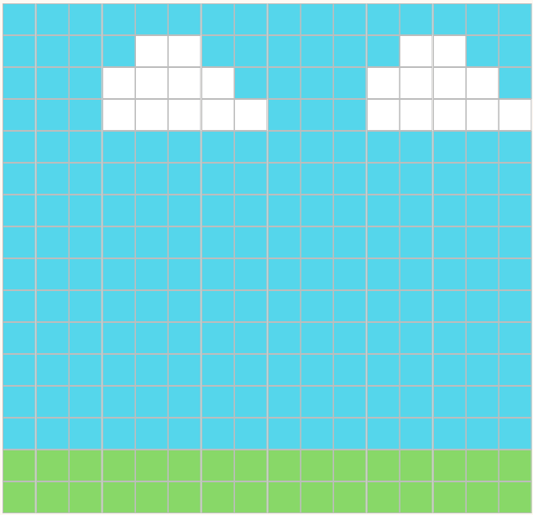
Design
2
2 px
4 px
7
A
B
C
6 px
8 px
D
E
In each frame, use the “move” tool to move the first layer 2 pixels to the left.
With this we are going to simulate the character walking.

Slide 11
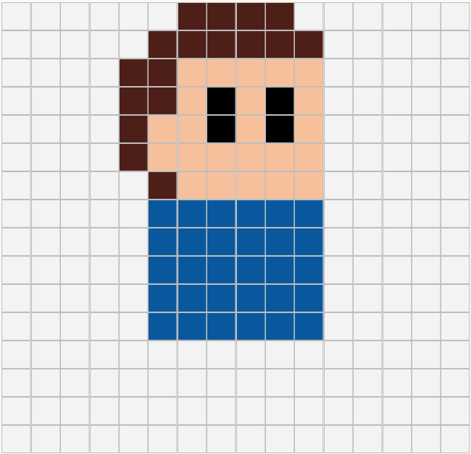
Design
2
1 px
8
A
B
C
1 px
In frame B and D, work on the second layer. With the “move” tool move the character 1 pixel up.
With this we will simulate that the character moves while walking.
D
E

Slide 12
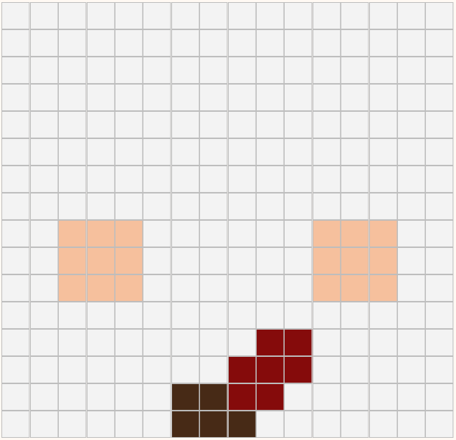
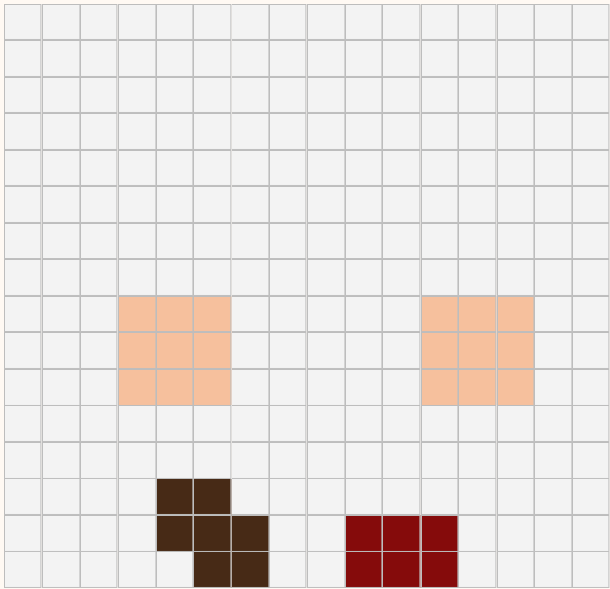
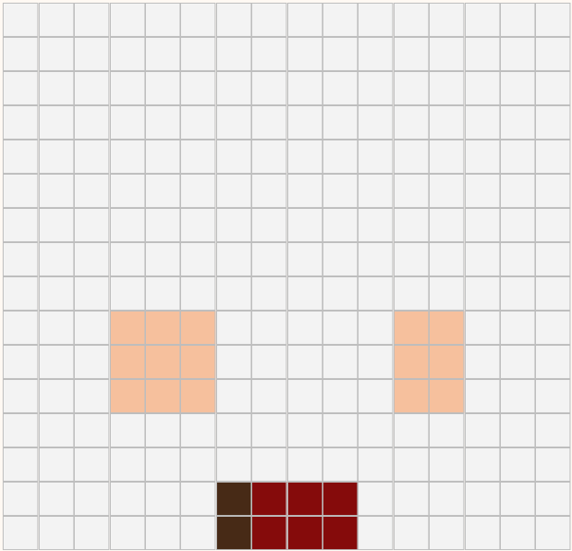
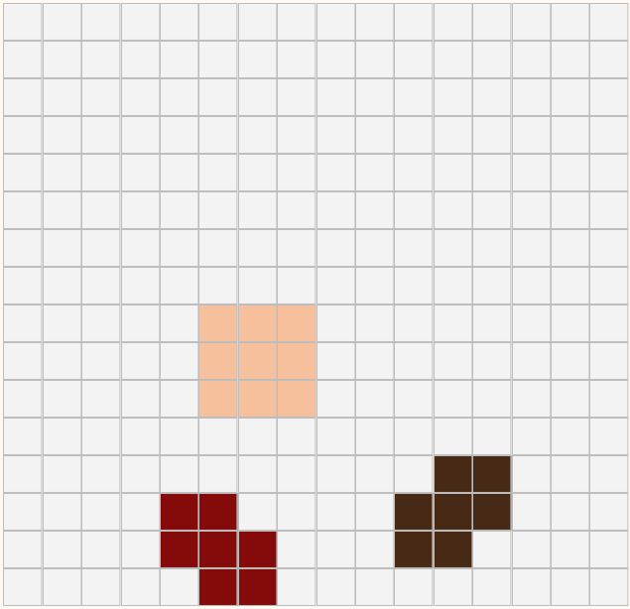
Design
2
9
A
B
C
In each frame, modify the third layer with the help of a pencil and eraser as shown here.
With this we will simulate the movement of hands and feet as when a person walks.
D
E

Slide 13
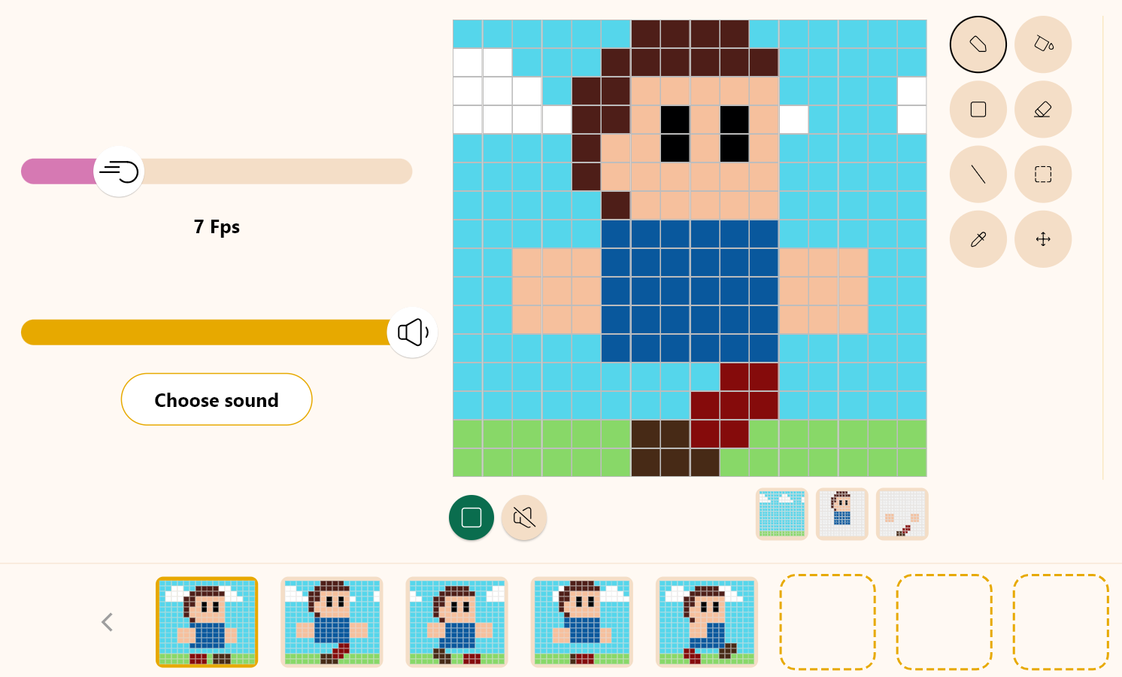
Design
2
10
Click the “Play” button to start your animation and see it in motion.
The Fps are the frames per second. Modify the frame bar to give more or less speed to the animation.
We recommend leaving it at 7 Fps for a smooth look.

Slide 14
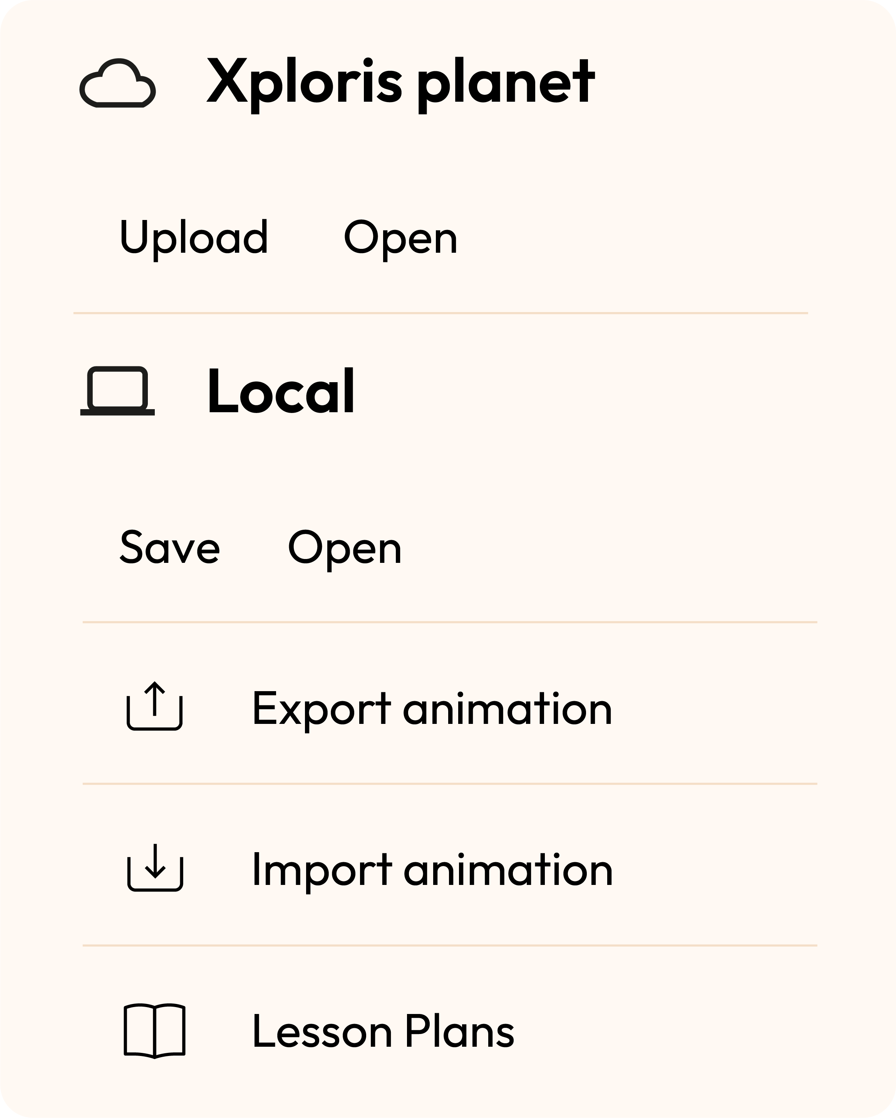
Design
2
Once you have finished your drawing, save and upload it to your Xploris screen.
Press the three-bar icon at the top of the screen.
First, save your drawing by pressing “Save” and give it a name.
Once saved, click on the “Upload” icon at the top of the screen, wait for it to load and watch your drawing appear in Xploris.

Slide 15
Questions
3
1
Arts
Do you think certain colors represent feelings like joy, sadness, or love? Also, do you believe that the colors we wear can indicate our personality types?
2
Technology
Have you ever played video games where you have to create a character and edit its appearance, what colors do you usually use?
3
Let's keep experimenting!
Do you think you can make another character with your Xploris? Try to create a character that is totally different from the one we already animated.

Slide 16
Activity summary
4
We used the Xploris software to create a walking person.
We gave personality to the character by editing his clothes, hair and accessories.
We uploaded a moving image to the Xploris device.

Slide 17
ARTS
Walking figure: Character creation

