Slide 1
ARTS
Let's draw an animation of a bird!

Slide 2
LET'S DRAW AN ANIMATION OF A BIRD!
1
Introduction
2
Design
ARTS
3
Questions
4
Activity summary

Slide 3
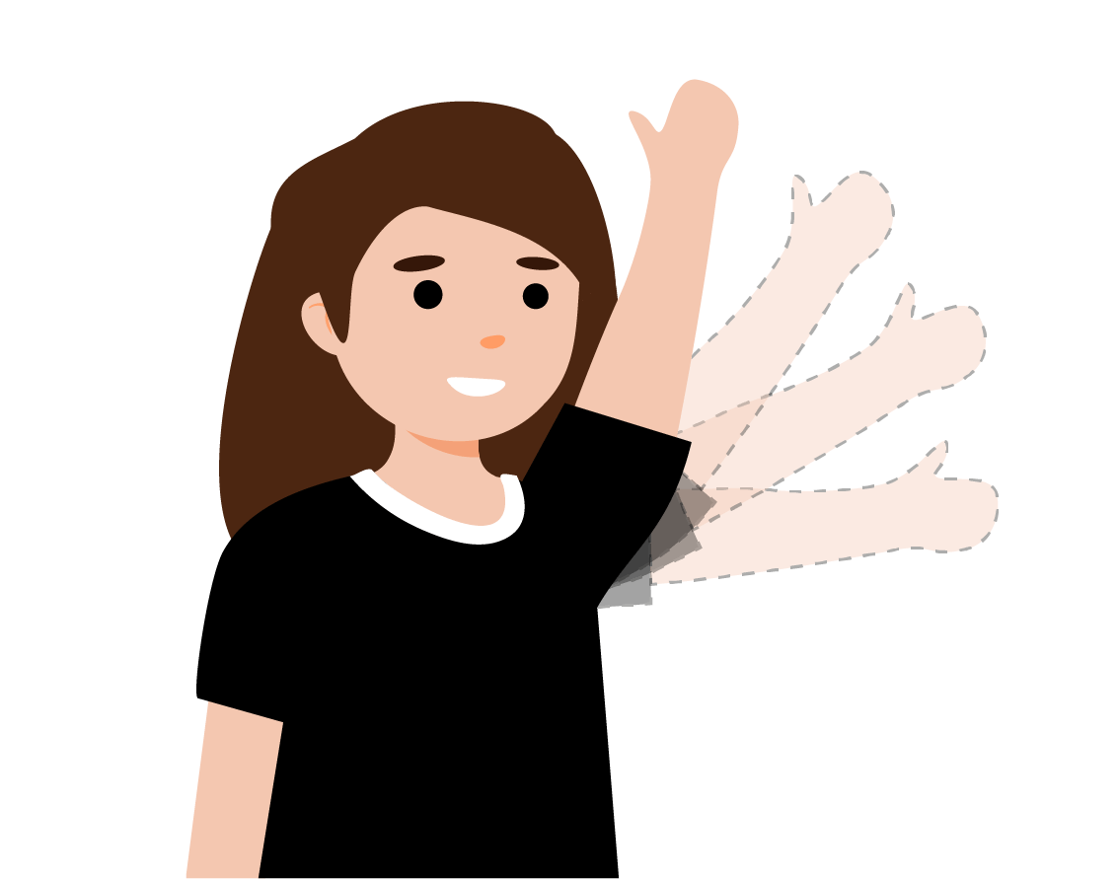
Introduction
1
Did you know that animators create numerous similar drawings to produce cartoons? When these drawings are sequenced together, they create the illusion of movement. For instance, if a character raises their hand to wave, the animator must illustrate multiple versions of that same image, capturing each hand position from the starting point to the top.
In this lesson you will create your own animation using the Xploris software.
The question you will answer will be:
Can we animate an image of a bird flying through the sky?

Slide 4
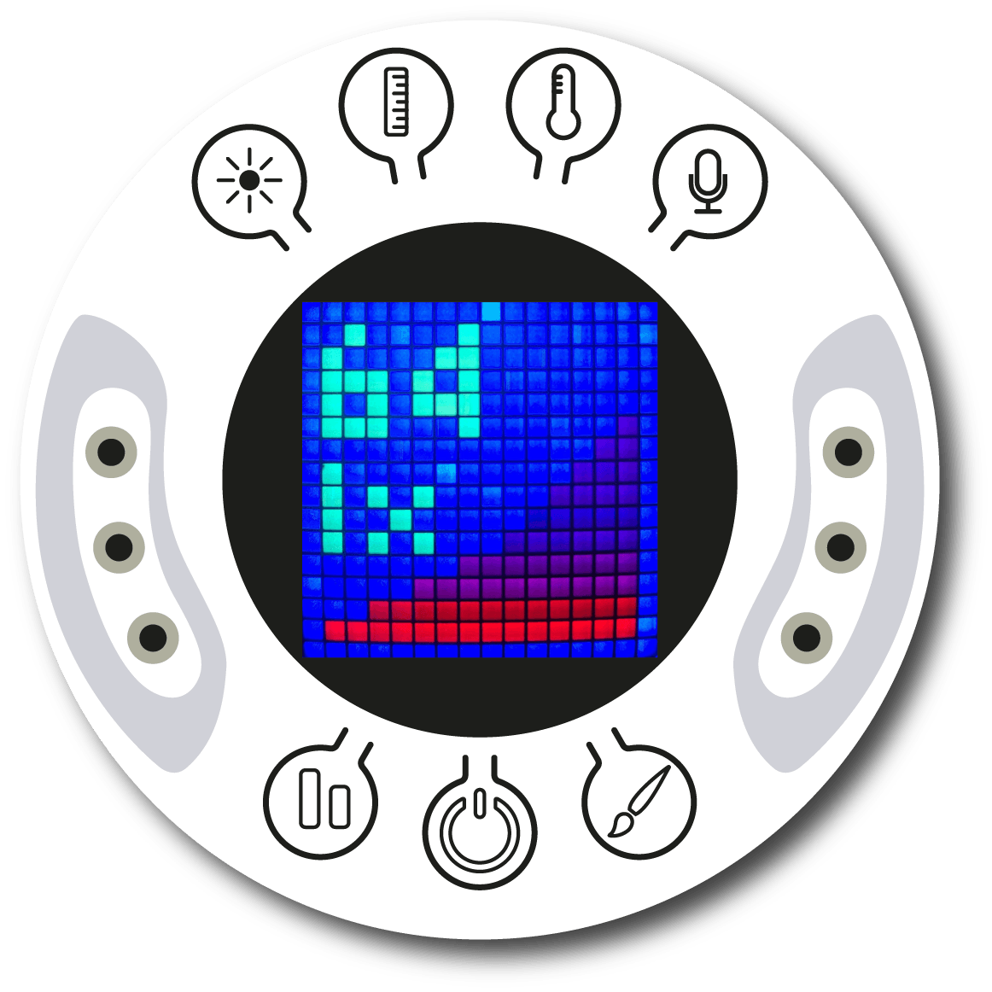
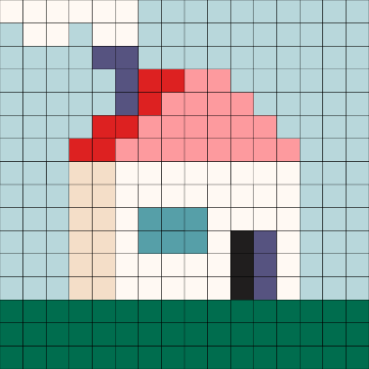
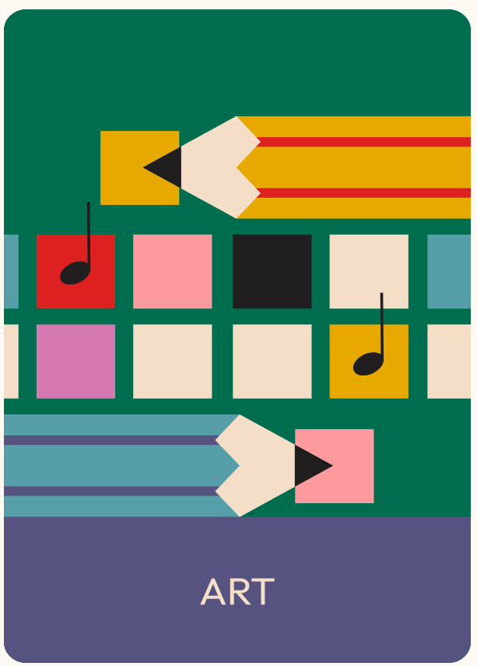
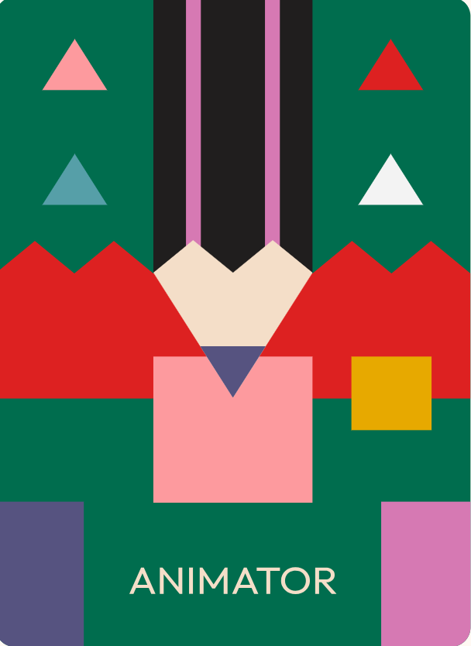
Design
2
Turn on your Xploris and connect it to your computer or tablet.
Open the XploriLab software on your computer or tablet.
Once inside XploriLab, select the icon to connect the device via cable or bluetooth as applicable.
Enter the art section (ART) and then to ANIMATOR

Slide 5
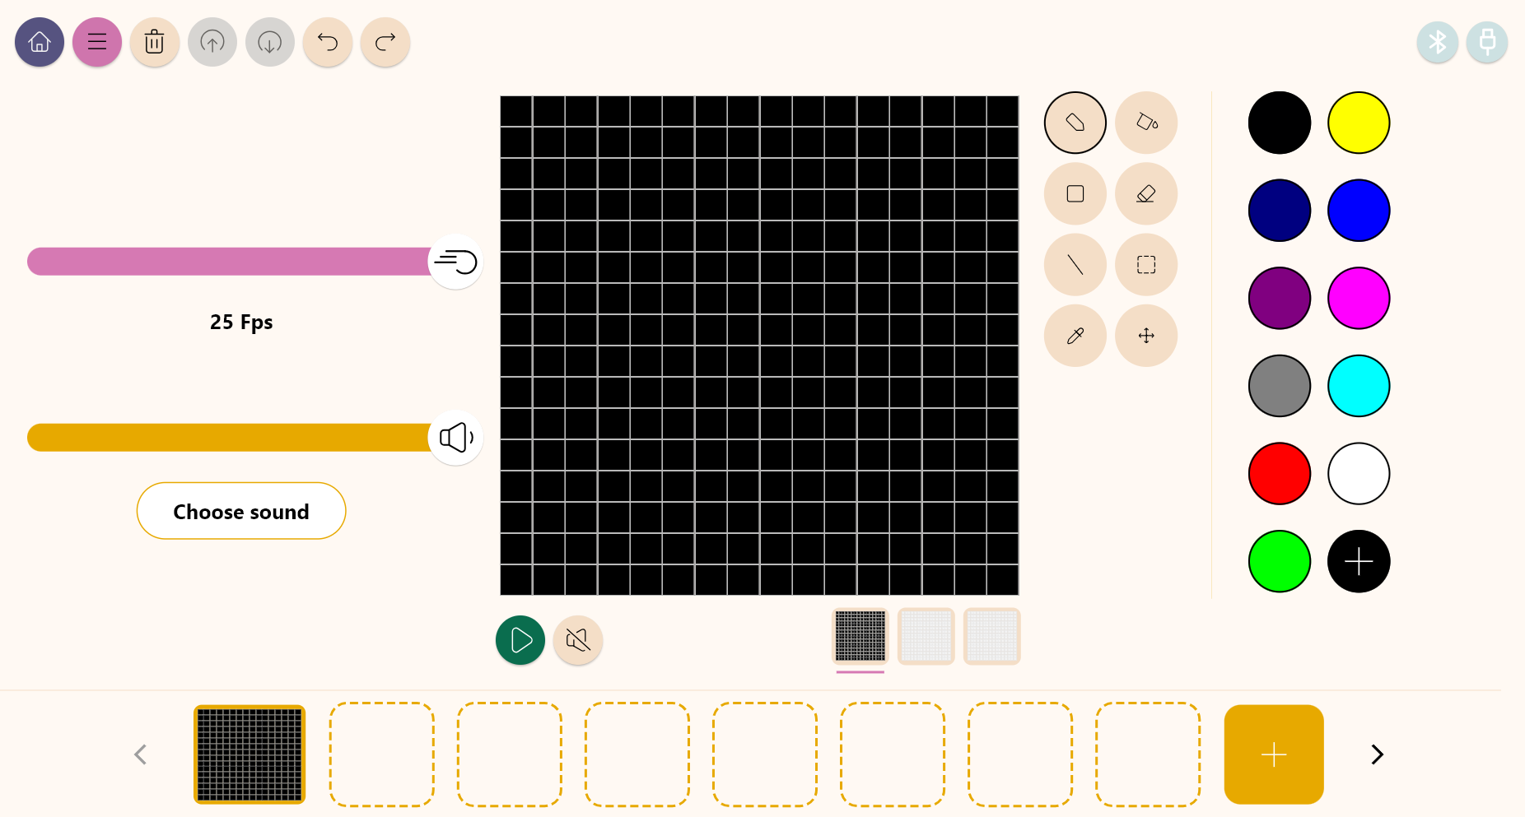
Design
2
Inside the main window you will find several sections with the necessary tools to make a digital artwork.
Tools
Color palette
Configuration
Drawing area
Layers
Frames

Slide 6
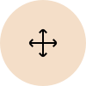
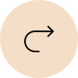
Design
2
Use the different Xploris tools to animate a bird flying through the sky.
Tools
Pencil: Adds color to a pixel.
Eyedropper: Copy the color of a pixel.
Bucket: Fills the inside of a closed shape with color.
Move: Move the selected pixels.
Rectangle: Creates a rectangle on the screen.
More: Change the selected color in your palette.
Eraser: Erases a single pixel.
Undo: Deletes your last action.
Selection: Select a section of the frame to copy, paste and move.
Redo: Redo an action you have deleted.
Line: Creates a straight line.
Upload: Upload your drawing or animation to the Xploris device.

Slide 7
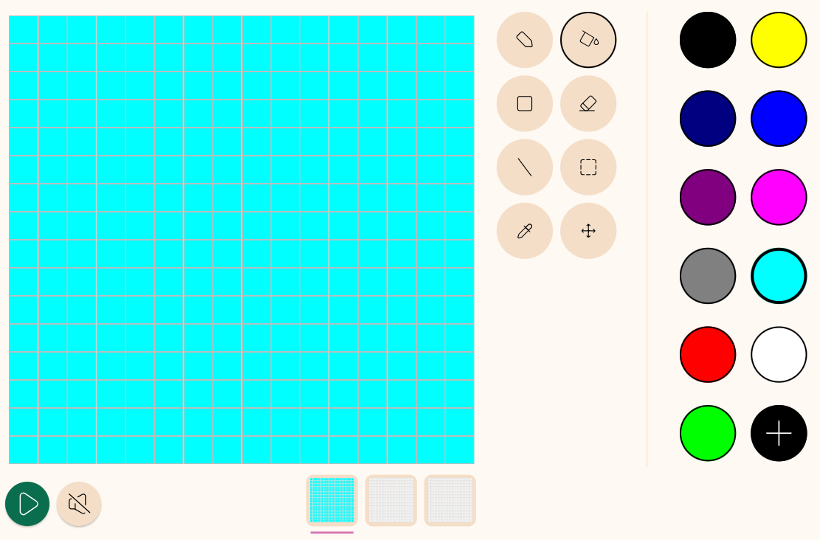
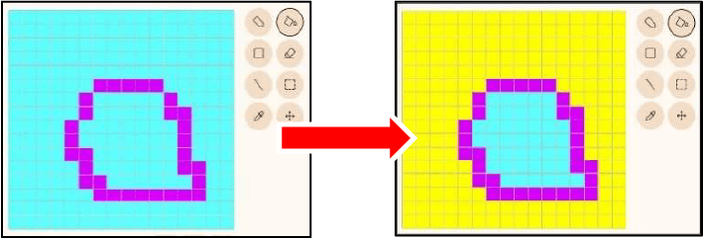
Design
2
1
On the right, select light blue from the color palette. Then select “Paint Bucket” and fill the drawing area with light blue.
NOTE: The “Bucket” tool fills areas that are connected in a sequence of the same color. It does not fill areas separated by other colors.

Slide 8
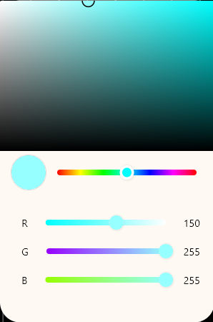
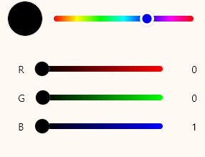
Design
2
2
NOTE: The “R,G,B” at the bottom indicates the intensity of red, green and blue light, respectively. You can also change the color by directly manipulating these sliders (RGB=0,0,0 looks like “black” but works as “transparent”. If you want to draw black, RGB=0,0,1 is recommended).
With the light blue color selected on the right side of the palette, click the “+” button in the lower right corner to open the “Change Color” window. Adjust the color to a slightly brighter light blue (RGB = 150.255.255) than the original shade.

Slide 9
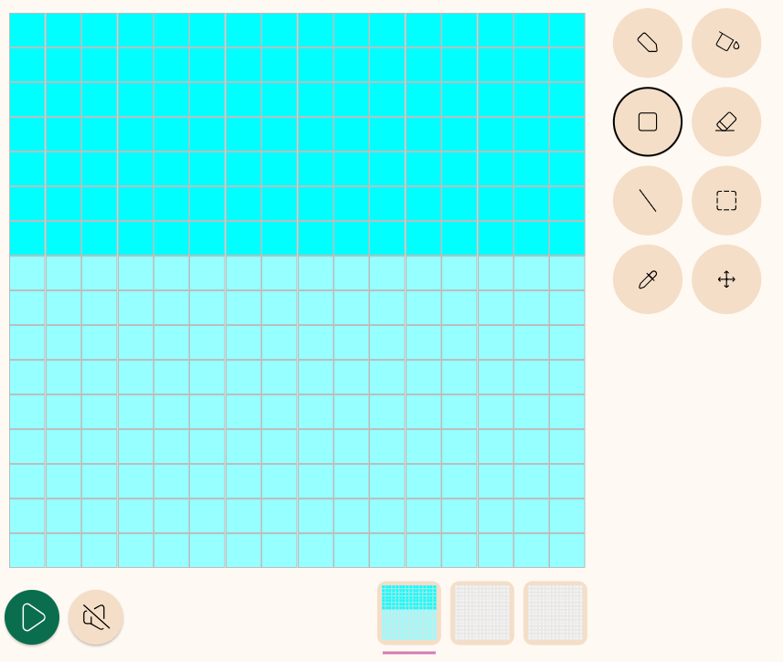
Design
2
3
Let's try using “draw a rectangle”. While the previous “Bucket” tool painted a series of areas of the same color, “Rectangle” is a tool that fills a rectangular shape (be careful not to confuse it with the “selection tool” which has a similar shape).
Referring to the screen below, use your mouse to drag from the eighth point from the left in the drawing area to the eighth point from the top (noted as “coordinate (0,8)”). Then, continue dragging to the bottom right corner of the drawing area at coordinate (15,15).
The lower two-thirds of the drawing area is now filled with a light blue slightly lighter than the first light blue.
(0,8)
(15,15)

Slide 10
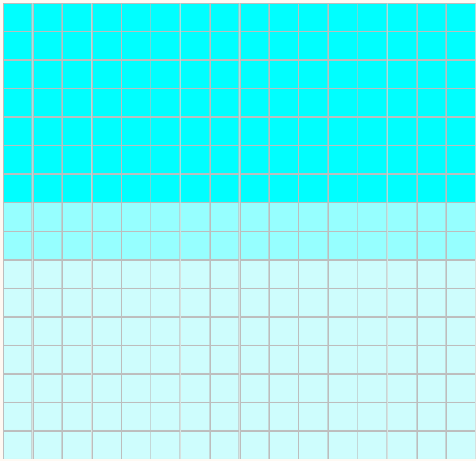
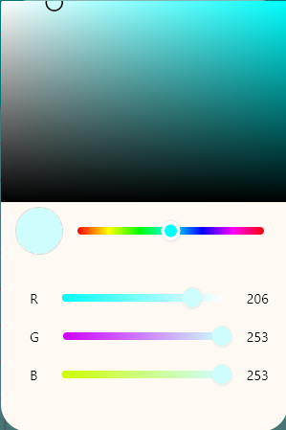
Design
2
4
NOTE: If you think "I messed up!“
“Undo” in the upper left corner of the screen allows you to undo the last operation. Next to it, with “Redo” you can redo the undone work.
Similar to the previous steps, with a brighter light blue (RGB = 206,253,253) complete the coordinates (0,10) to (15,15).
A three-step “sky gradient” has been created.

Slide 11
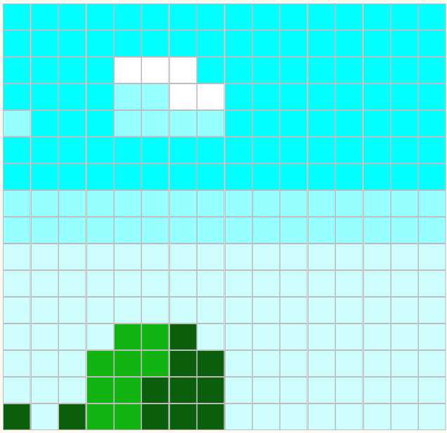
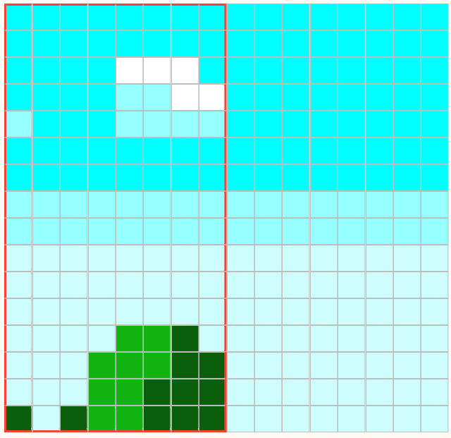
Design
2
5
6
Draw mountains and clouds using this diagram as a guide. However (for reasons I will explain later), make sure that they fit in the left half of the screen and that the “left edge of the screen” and the “eighth point from the left” are connected.
Once the left half is drawn, copy it to the right side.
To do this use the “Selection Tool” and select around the coordinates (0,0)-(8,15).

Slide 12
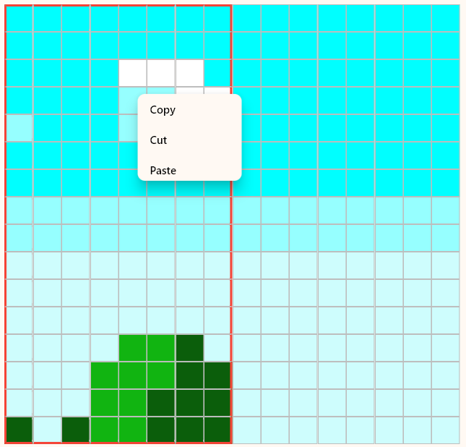
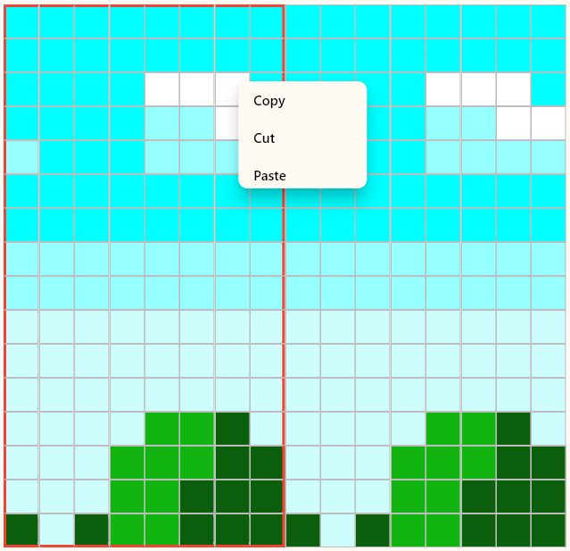
Design
2
7
8
Right click on the attached frame, the “Copy”, “Cut” and “Paste” menu will appear. Select “Copy”, nothing changes on the screen, but the computer has stored the image in the frame.
Next, right click on the coordinates (9,0) and the same “Copy”, “Cut” and “Paste” menus will appear. Now select “Paste”.

Slide 13
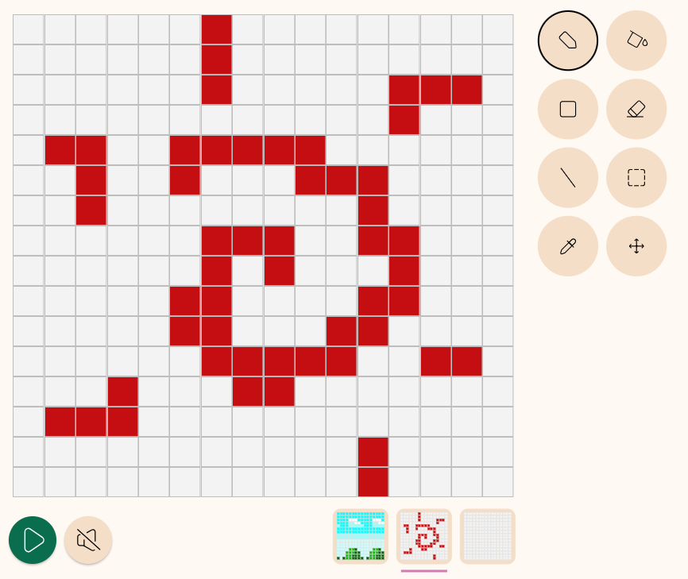
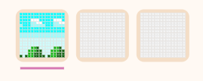
Design
2
9
10
Now, choose "Layer 2" in the middle. What's wrong, my drawing has disappeared? Don't worry, it's still there. If you select “Layer 1” on the leftmost layer, it will reappear.
Now, let's change the color and doodle something on Layer 2 with the “Pencil”. Layer 2” in the center shows the doodle you just drew and the lower left side of the screen shows the image created by merging three layers. Layers 1, 2 and 3 are independent of each other and what you draw on any one layer does not affect the others. Now, use “Eraser” to erase the graffiti you drew.
There are three squares in the lower right corner of the drawing area whose background has just been drawn. These are the “layers”.
A “layer” is like a “transparent glass canvas”. In Xploris, an image is composed of three overlapping layers (Layer 1 + Layer 2 + Layer 3).
The sky and mountains you have painted so far are on the leftmost “Layer 1”.

Slide 14
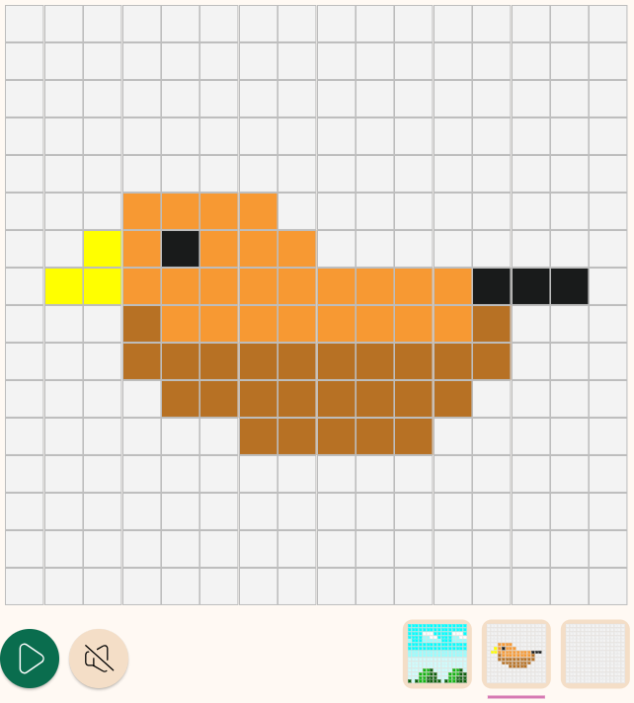
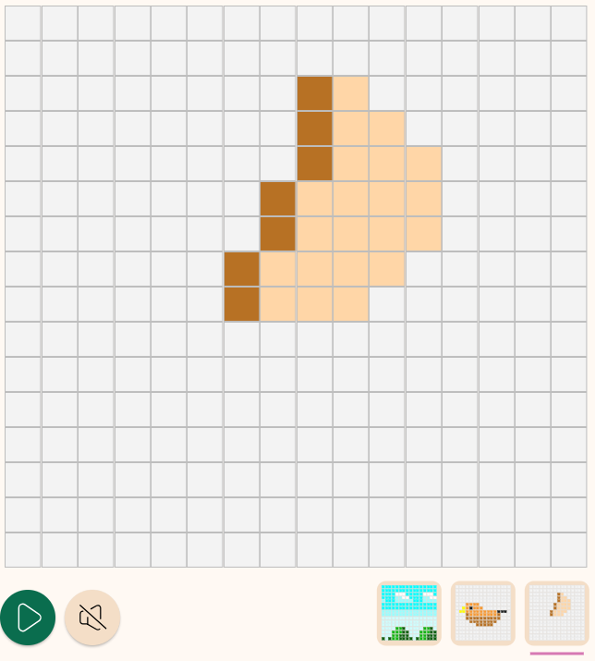
Design
2
11
12
As in the reference image draw the bird's body on Layer 2.
Draw the wings of the bird on Layer 3. Use the “Erase a pixel color” option to erase areas you want to make transparent.

Slide 15
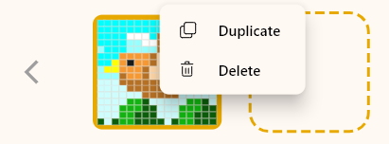
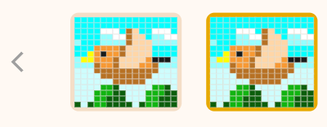
Design
2
13
14
Right-click on the first frame and select “Duplicate.” This action will create a copy of the bird painting, splitting it into two parts.
Let's redraw the bird's wings in the second frame to create a flapping pattern. Make sure the correct bird is selected (framed), then select “Layer 3”.

Slide 16
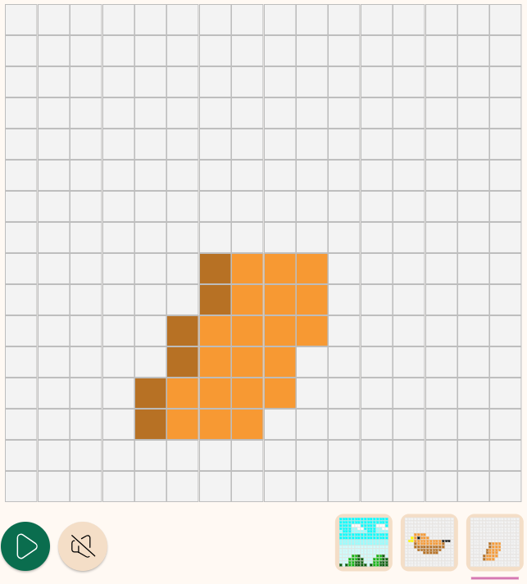
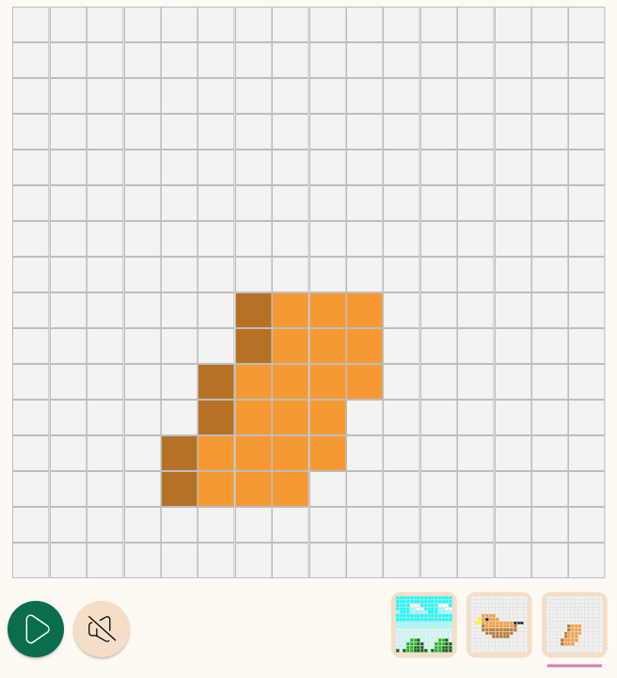
Design
2
15
16
Use the “Erase” option to erase areas you want to make transparent and as in the reference image draw the bird's wing downwards.
Now that we have drawn the two flapping images, let's animate them to test them. Press the “Play” button in the lower left corner of the drawing area, the two images will repeat alternately and the bird will flap its wings.

Slide 17
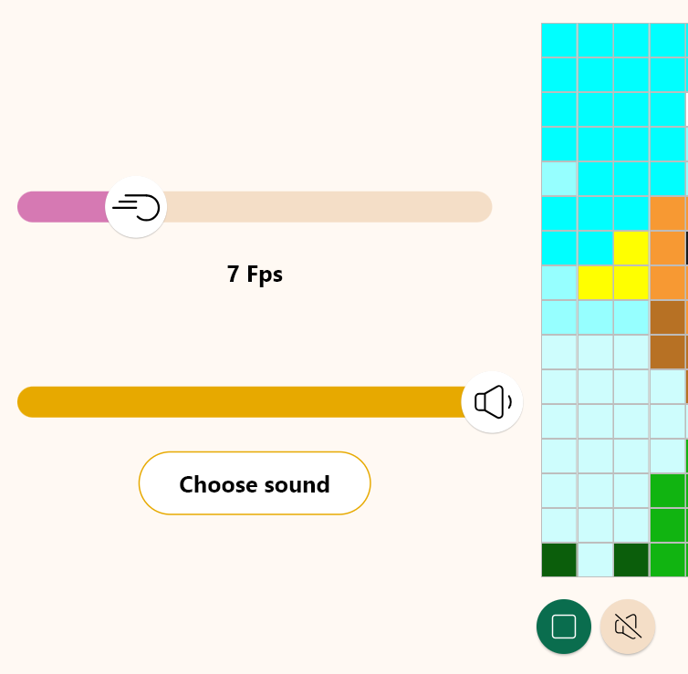
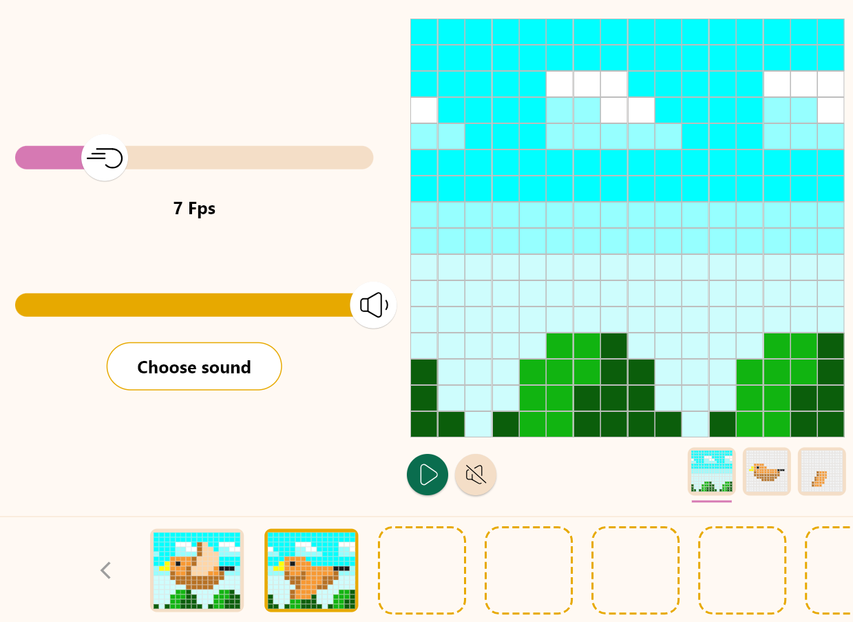
Design
2
1 px
17
18
You can adjust the playback speed using the slider, with a suggested setting of 7 frames per second. However, it still doesn't quite capture the sensation of “flying.” We’ll add a few more elements to enhance that feeling. When you're ready, press the play button again to finish the animation.
Let's make the background scroll! Go to Layer 1 (background) of the second frame. Then select “Move” and slowly drag to the right on the background. As the background scrolls, move it one pixel to the right from the initial state (don't move it up or down, just one pixel to the right).

Slide 18
Design
2
19
1 px
1 px
1 px
1 px
1 px
1 px
Then right-click on the second frame to duplicate it. Slide the new “third background” to the right one pixel at a time, just as before. Repeat the “duplicate” and “slide the background one pixel to the right” process to create a total of eight images.
* If you replay the animation as a test, you will see that when the eighth pattern is displayed and then returns to the first pattern, the background motion is smoothly connected. This is the reason why the left half and the right half are the same.

Slide 19
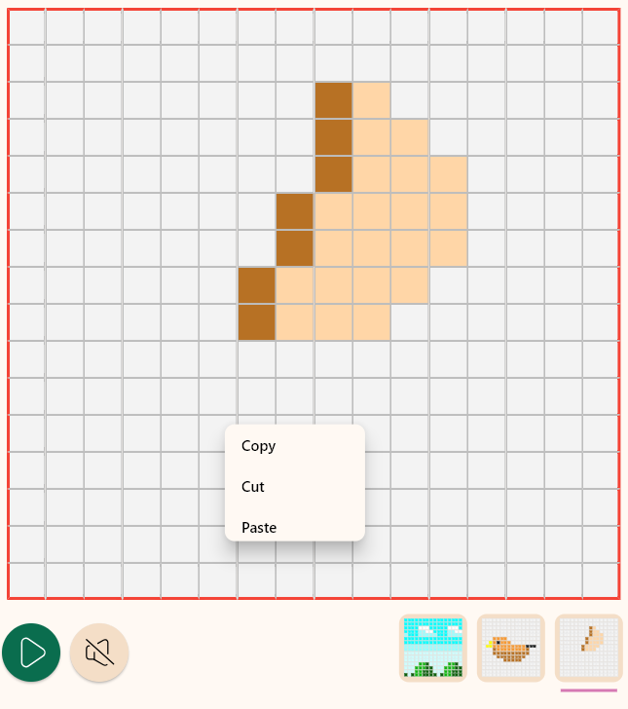
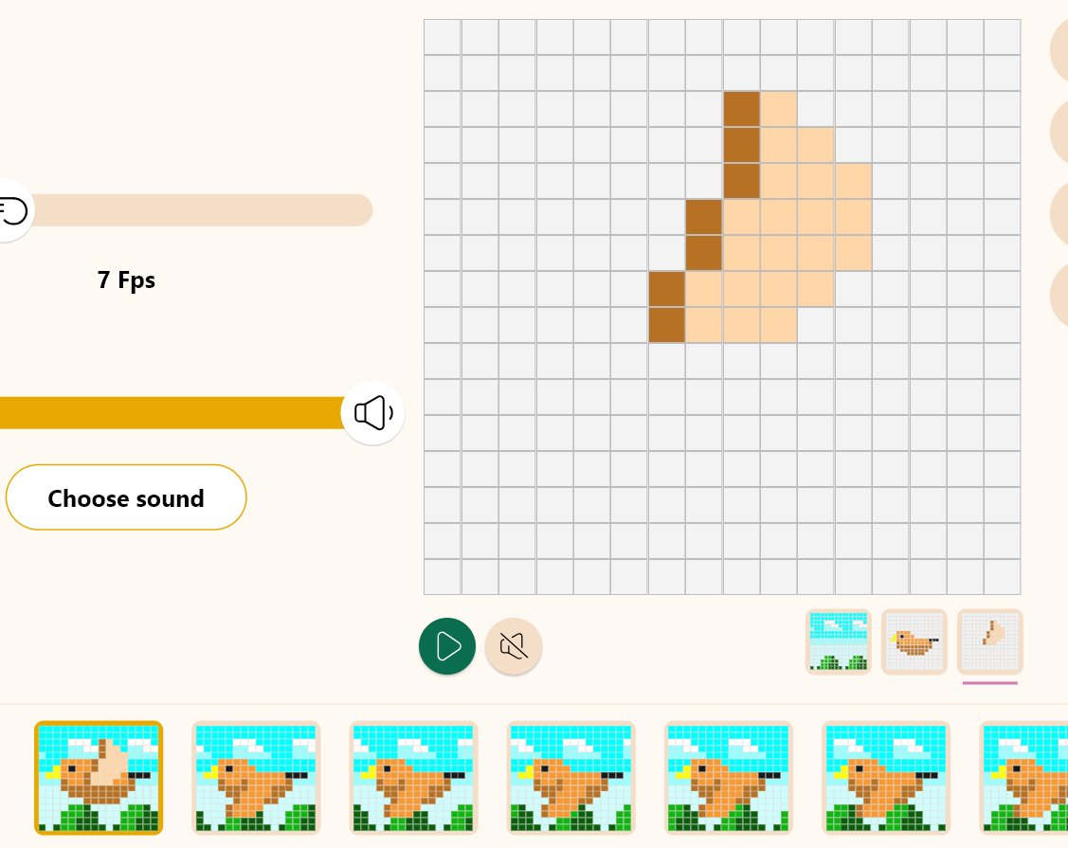
Design
2
20
21
Now the bird flaps its wings for the first time, but its feathers haven't moved much since then, so we'll correct that. Let the birds take flight.
Go to layer 3 (feathers) of the first frame.
Then, with the “Selection tool”, select the coordinates (0,0)-(15,15).
Right click and then click “Copy”.

Slide 20
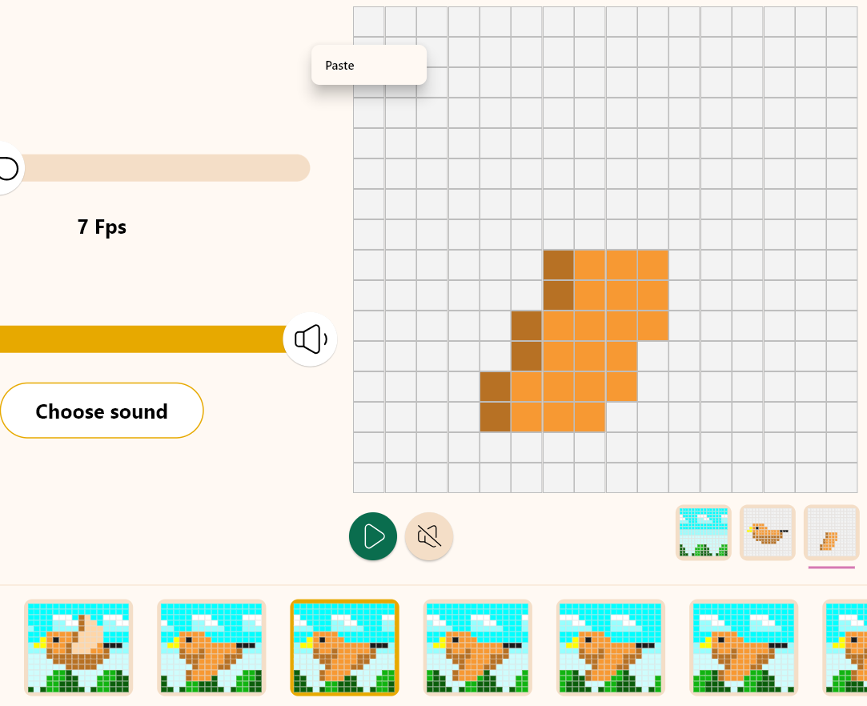
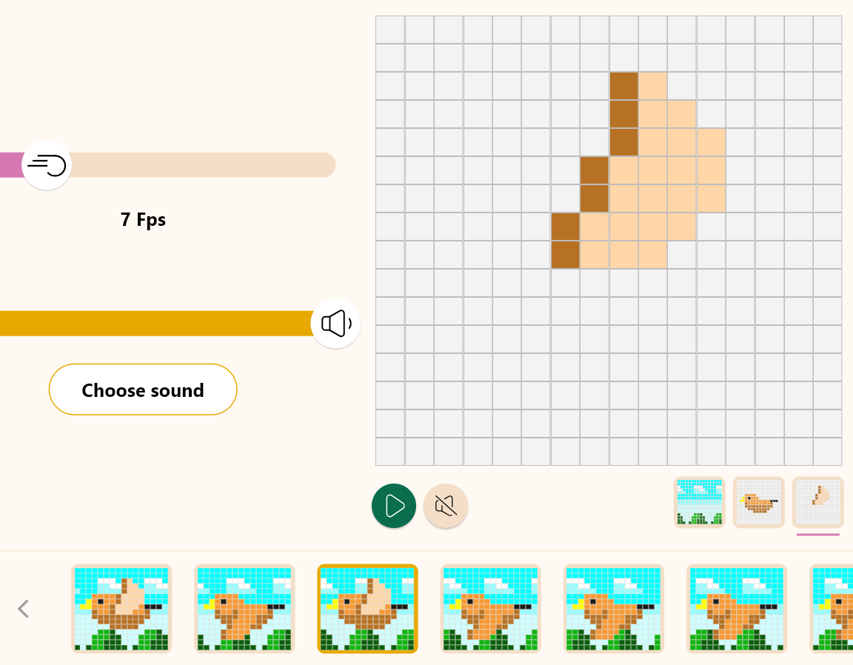
Design
2
22
(0,0)
23
The computer has memorized the “feather up” image. Go to layer 3 of the third frame and right click on the coordinates (0,0). A frame will pop up, click on the "Paste" option.
The feather in the third frame now rotates upwards.

Slide 21
Design
2
24
1
2
3
4
5
6
7
8
In the same way, the feathers of the fifth and seventh frames should also be shifted upwards. (The computer remembers the last "copy", so you can continue pasting without having to make a new copy).
Let's replay the animation. The bird now flaps its wings and the background moves.
This could be seen as complete, but let’s add a touch of creativity to make it even better!

Slide 22
Design
2
25
1
2
3
4
5
6
7
8
1 px
1 px
1 px
1 px
One last stroke of genius: let's move the bird up and down!
Do you remember the “Move” tool we used to move the background? This tool allows you to slide the entire layer with the mouse.
Use it to swing the bird up and down. In frames 2, 4, 6 and 8, move layer 2 (the bird's body) up one pixel and layer 3 (the feathers) up one pixel. As mentioned before, each layer is independent, so if you move only the body, the feathers will not follow. Move both the body layer and the feather layer.

Slide 23
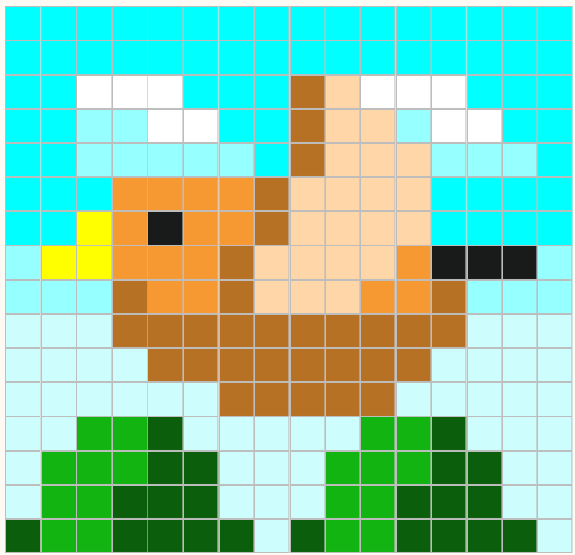
Design
2
26
About the Xploris Animation Specification
Some full-featured animation creation tools allow you to specify the order and duration of the visualization as if it were a program. While it is possible to create large-scale works, the operation can be quite complex.
Xploris is easy to use so that anyone can easily create animations.
Similar to the “flip book” we’ve all sketched in the corners of our notebooks at some point, the specification states that “all patterns are displayed in sequence at the same speed.” If you want to create a slowdown effect in the middle of an animation, simply repeat the same image in succession.
Once you have moved the bird one pixel up in all four frames, play the animation. The bird now flaps its wings and moves up and down, you have now completed the bird animation!
You can increase the amount of animation patterns, so try to create your own unique and wonderful works of art.

Slide 24
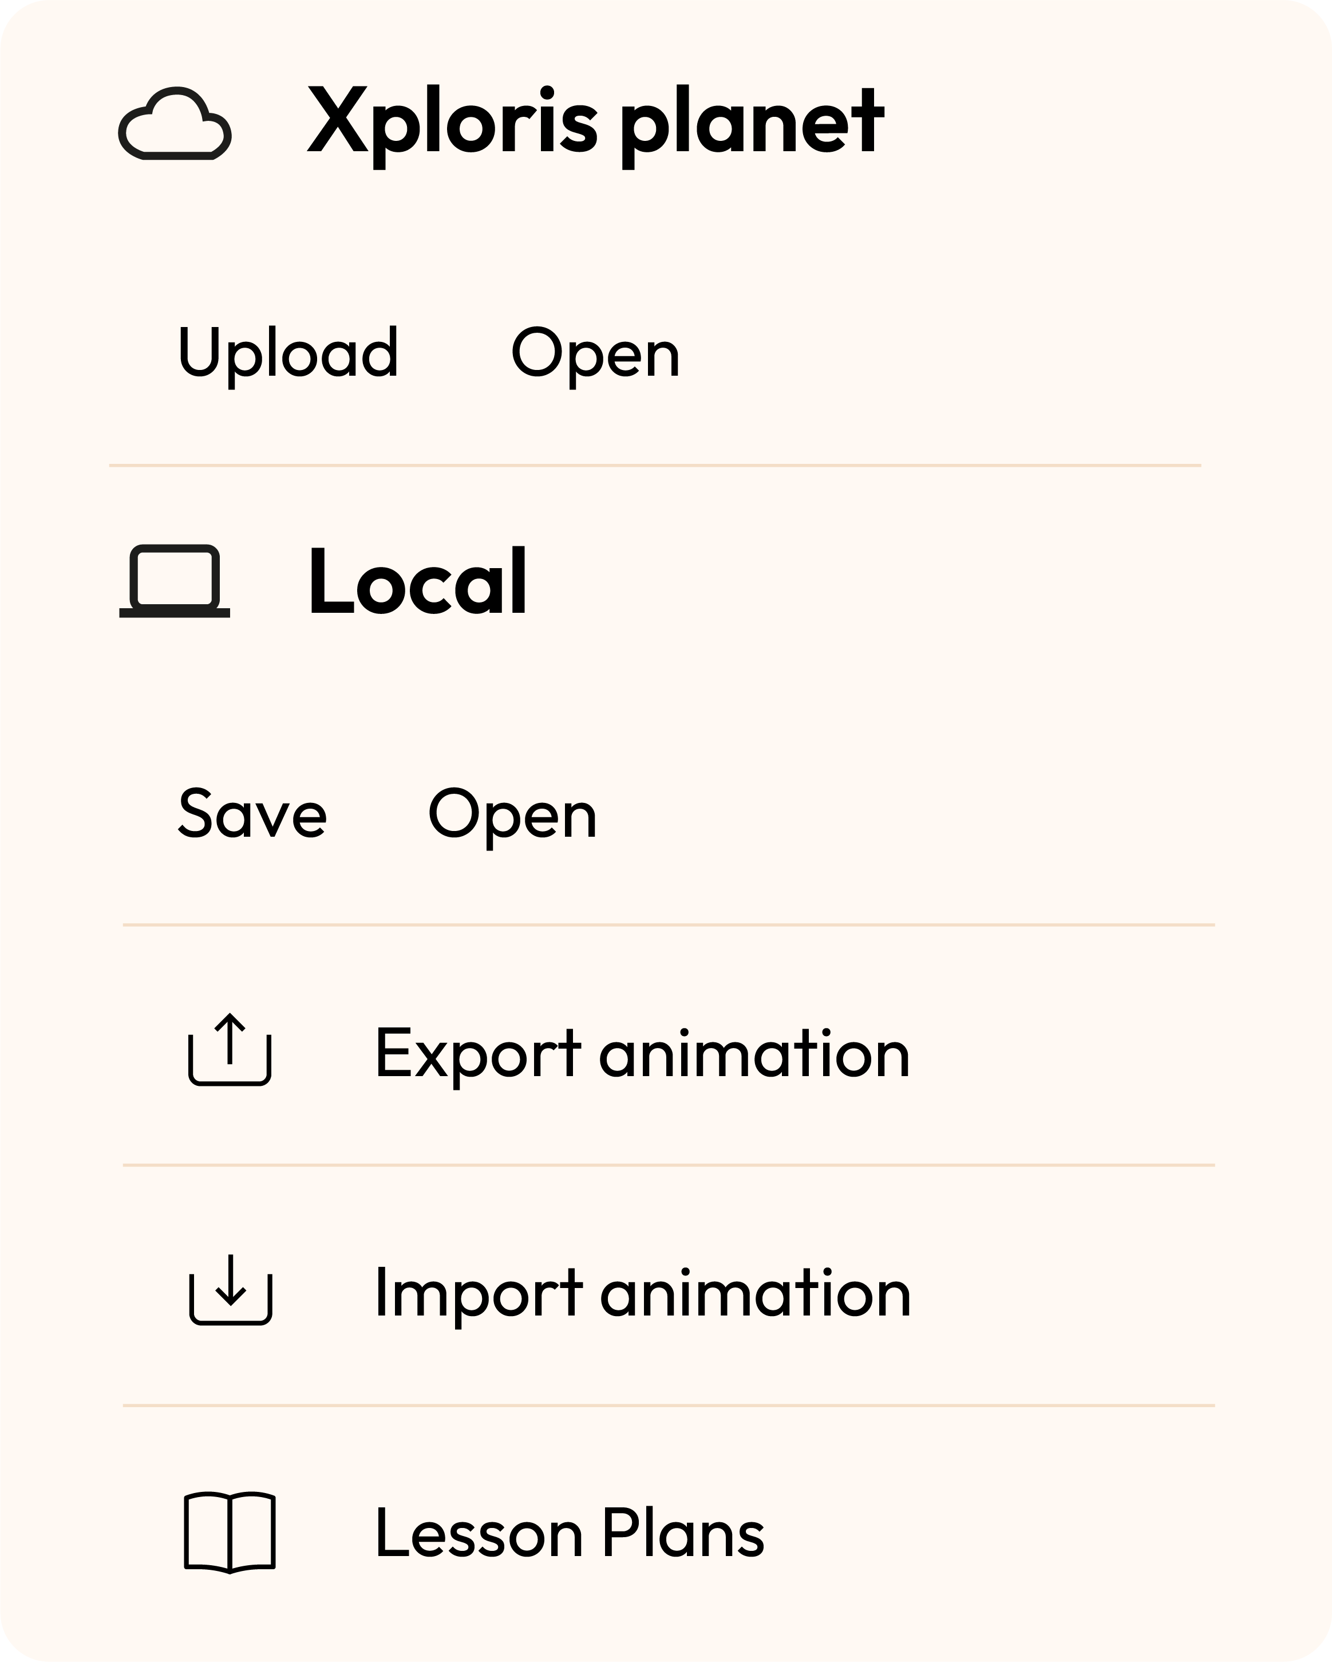
Design
2
Once you have finished your drawing, save and upload it to your Xploris screen.
Press the three-bar icon at the top of the screen.
First, save your drawing by pressing “Save” and give it a name.
Once saved, click on the “Upload” icon at the top of the screen, wait for it to load and watch your drawing appear in Xploris.

Slide 25
Questions
3
1
Arts
Not only can you make animations with drawings, you can also do something similar with photographs. Do you know the technique called stop motion?
2
Technology
Did you know the concept of FPS (Frames per second)?
Where have you heard of it?
3
Let's keep experimenting!
Do you think you can make other animations on your Xploris?
Try creating an animation of your favorite animal.

Slide 26
Activity summary
4
We used the Xploris software to create a bird flapping in the sky.
We combined several Xploris tools to create a complex animation.
We uploaded a moving image to the Xploris device.

Slide 27
ARTS
Let's draw an animation of a bird!

