Slide 1
ARTS
Layering: A boat on the river

Slide 2
A BOAT ON THE RIVER
1
Introduction
2
Design
ARTS
3
Questions
4
Activity summary

Slide 3
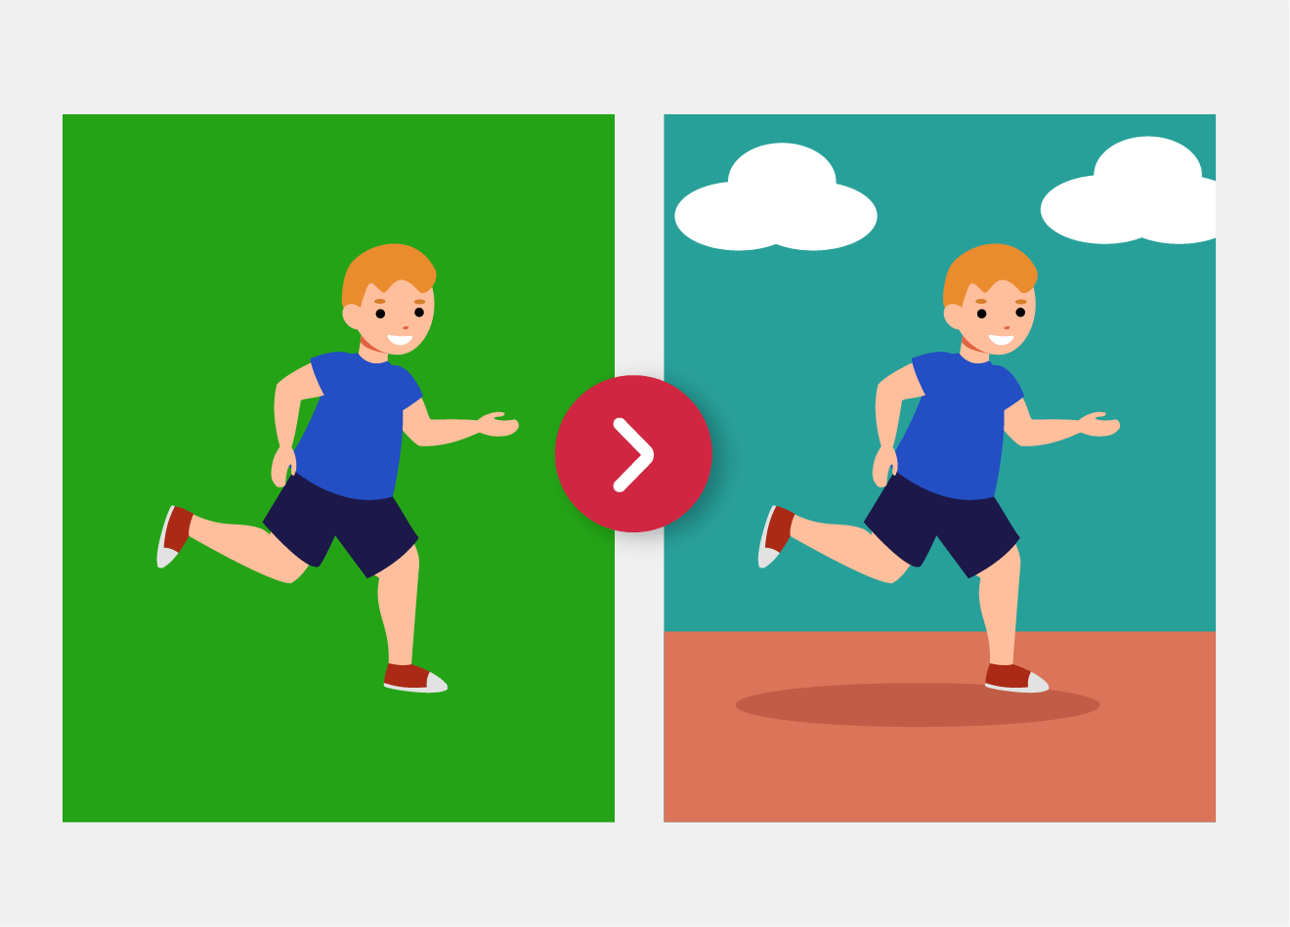
Introduction
1
Did you know that many movies are shot in closed studios and the backgrounds are applied afterwards? In other words, we often see landscapes that are not real. This happens thanks to green screens, a technique that allows us to create layers of the things we see. The main layer is for the actors and the background layer is the green screen, which is then replaced with an image or special effects.
In this lesson you will create your own layered animation using the Xploris software.
The question you will answer will be:
Can we use layers to animate a boat on the river?

Slide 4
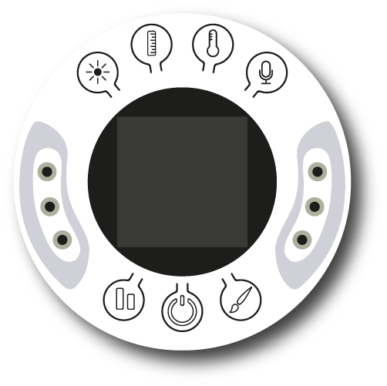
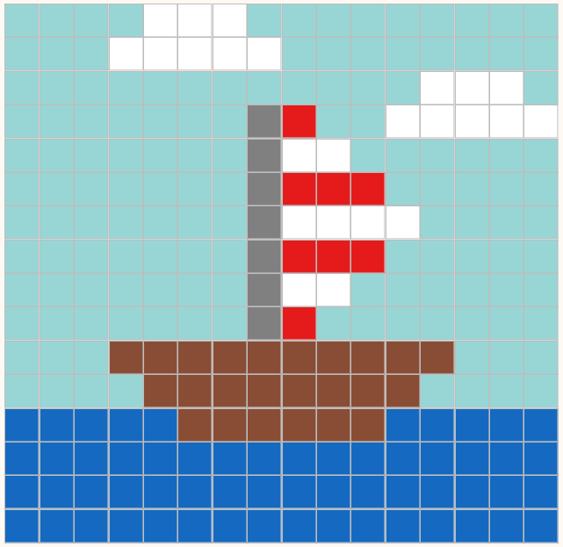
Design
2
Turn on your Xploris and connect it to your computer or tablet.
Open the XploriLab software on your computer or tablet.
Once inside XploriLab, select the icon to connect the device via cable or bluetooth as applicable.
Enter the art section (ART) and then to ANIMATOR.

Slide 5
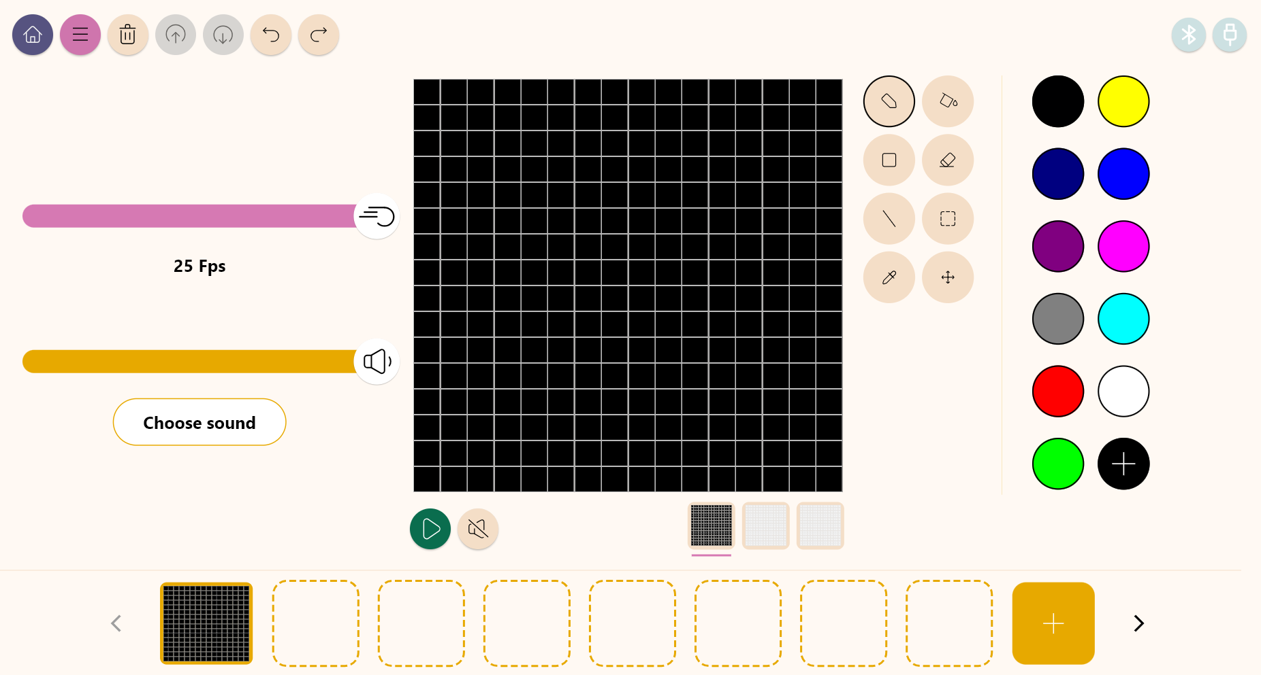
Design
2
Inside the main window you will find several sections with the necessary tools to make a digital artwork.
Tools
Color palette
Configuration
Drawing area
Layers
Frames

Slide 6
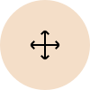
Design
2
Use the different Xploris tools to create a moving image of a boat.
Tools
Pencil: Adds color to a pixel.
Eyedropper: Copies the color of a pixel.
Bucket: Fills the inside of a closed shape with color.
Move: Move the selected pixels.
Rectangle: Creates a rectangle on the screen.
More: Change the selected color in your palette.
Eraser: Erases a single pixel.
Undo: Deletes your last action.
Selection: Select a section of the frame to copy, paste and move.
Redo: Redo an action you have deleted.
Line: Creates a straight line.
Upload: Upload your drawing or animation to the Xploris device.

Slide 7
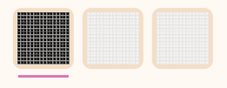
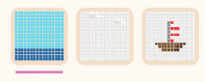
Design
2
1
2
Under the drawing area are the layers. The first, in black, corresponds to the background, and the other two correspond to the elements that are above it.
In the first layer you will draw the background, in the second the clouds and in the third the boat.

Slide 8
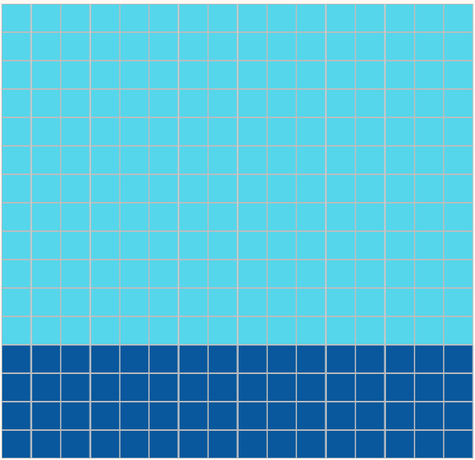
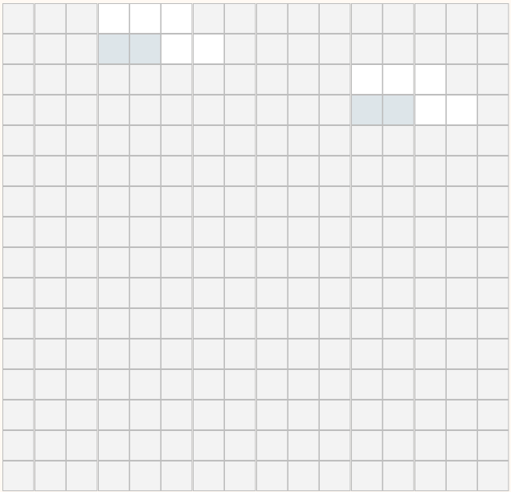
Design
2
3
4
On the first layer, use the rectangle tool to draw the sky and the sea.
On the second layer, draw 2 white clouds with the pencil.

Slide 9
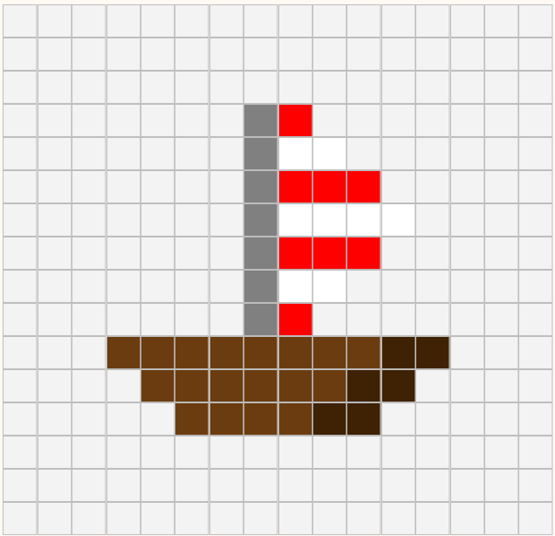
Design
2
5
6
On the third layer, use the pencil to draw a boat. Follow the one in the image.
Right click on the first frame.
Duplicate the frame.
Select the second frame and work on it.

Slide 10
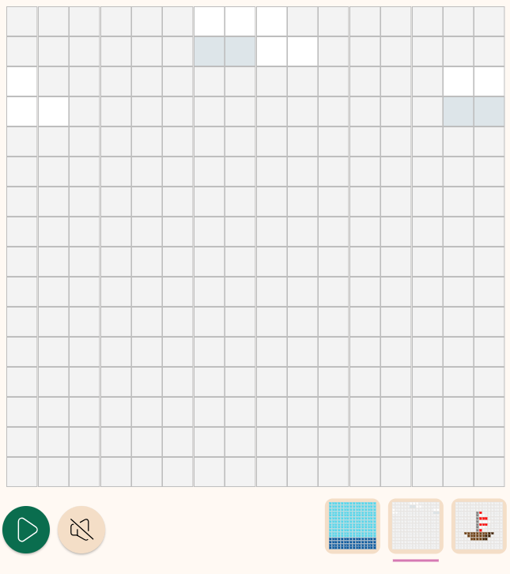
Design
2
7
8
3 px
From the second frame we will simulate that the clouds are moving in the sky. Select the second layer (clouds), and with the help of the move tool move them 3 pixels to the right.
Duplicate the frame we were working on and shift the clouds 3 pixels to the right again.

Slide 11
Design
2
3 px
3 px
3 px
3 px
3 px
9
Repeat the action of copying and shifting 3 pixels to the right until the clouds return to their original position.
1 px
1 px
1 px
To simulate that the boat is floating let's move it up and down. To do this in frames 2, 4 and 6, select the third layer (boat) and with the help of the move tool move the boat 1 pixel down.

Slide 12
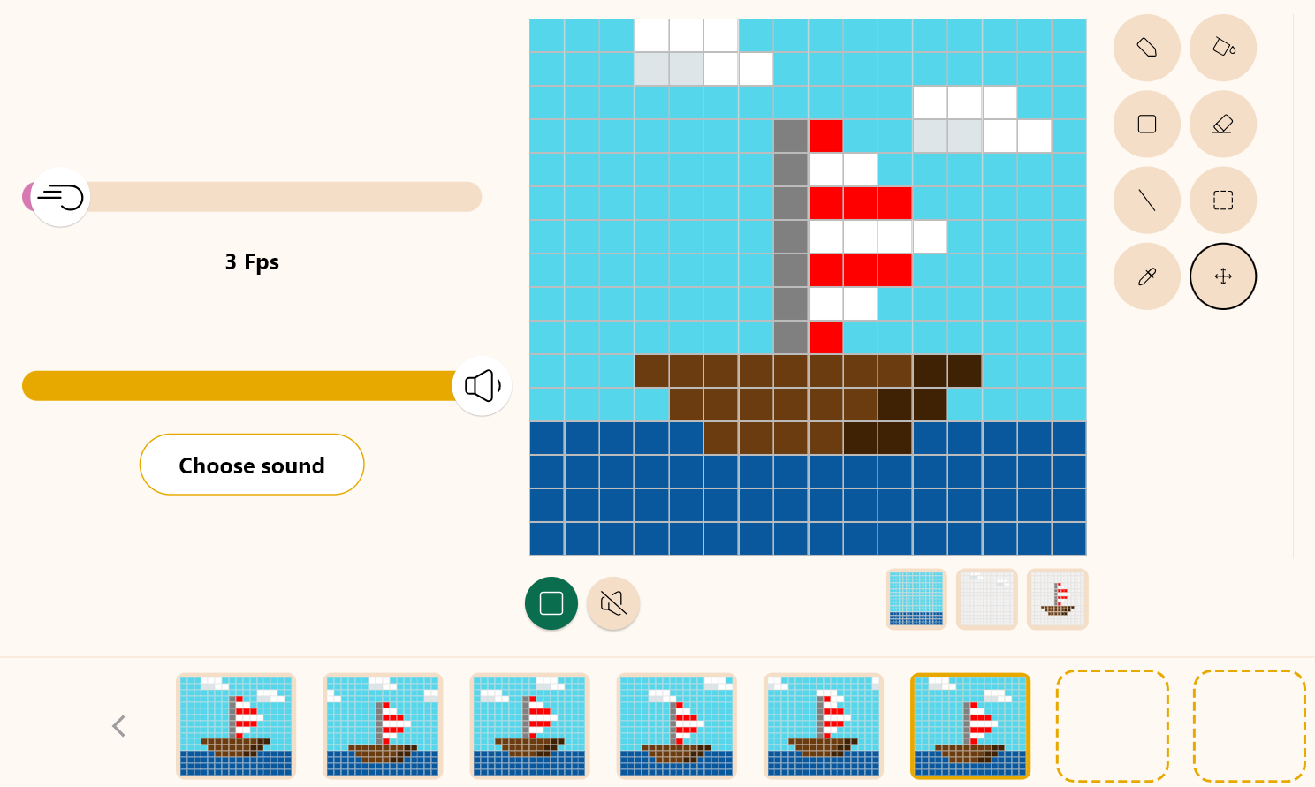
Design
2
10
Press the “Play” button to start your animation and see it in motion.
The Fps are the frames per second. Modify the frame bar to give more or less speed to the animation.
We recommend leaving it at 3 Fps for a smooth look.

Slide 13
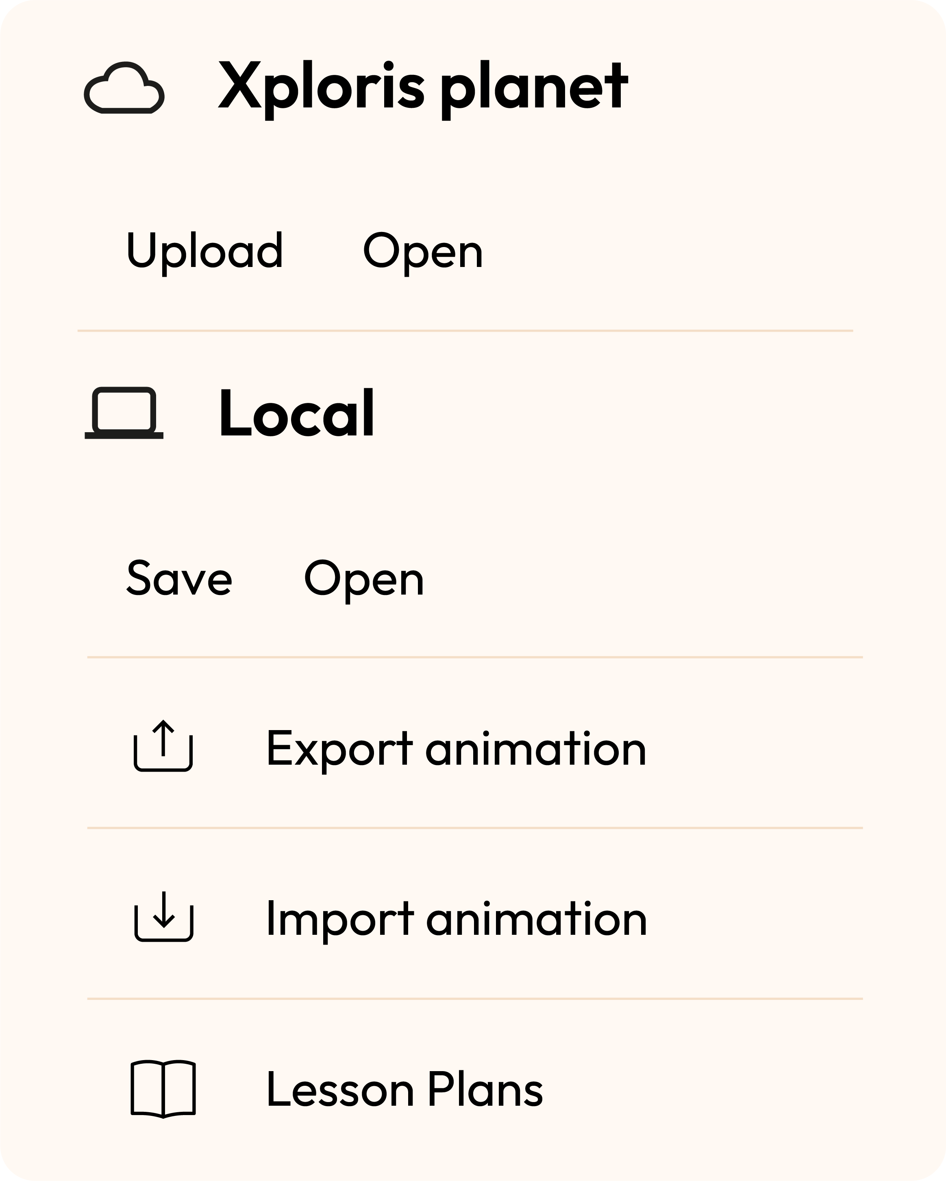
Design
2
Once you have finished your drawing, save and upload it to your Xploris screen.
Press the three-bar icon at the top of the screen.
First, save your drawing by pressing “Save” and give it a name.
Once saved, press the “Upload” icon at the top of the screen, wait for it to load and watch your drawing appear in Xploris.

Slide 14
Questions
3
1
Arts
When you make a drawing on paper, do you draw the background first and then the objects? Do you think that drawing by hand is similar to working with layers?
2
Technology
Have you ever worked with layers in another digital drawing program?
3
Let's keep experimenting!
Do you think you can make another layered animation in your Xploris? Try to create a different means of transportation and a different landscape.

Slide 15
Activity summary
4
We used the Xploris software to create a boat with movement.
We understood the concept of layers and applied it in our animation.
We uploaded an animation to the Xploris device.

Slide 16
ARTS
Layering: A boat on the river

