Slide 1
ARTS
Hearts in motion

Slide 2
HEARTS IN MOTION
1
Introduction
2
Design
ARTS
3
Questions
4
Activity summary

Slide 3
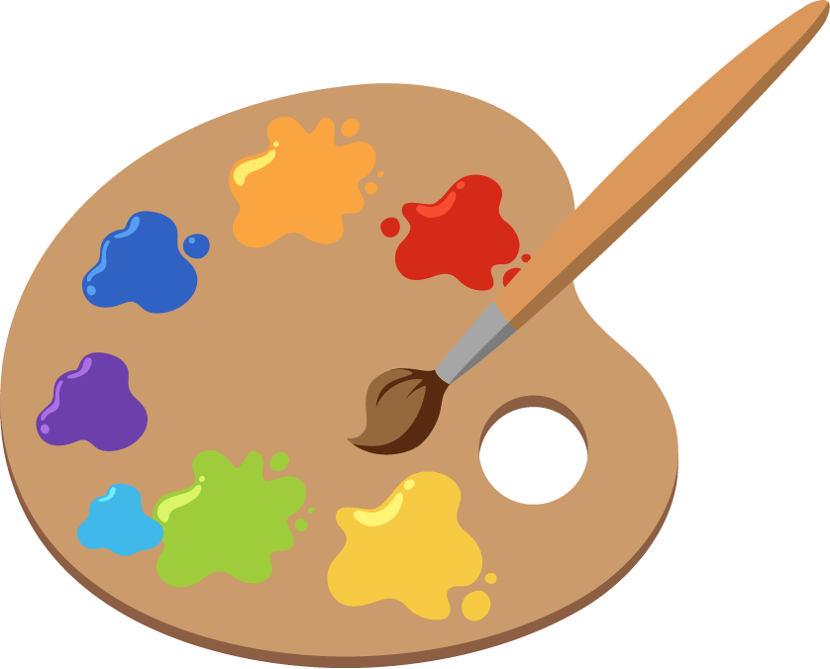
Introduction
1
Have you ever used a painter's palette like the one in the picture? Painters like to have all the colors in sight because it makes the painting experience more complete. A palette is the set of colors that a person will use in a graphic design, in it you can put and visualize the colors you are going to use at the moment.
In this lesson you will create your own animation by changing the colors of two hearts with the Xploris software.
The question you will answer will be:
Can we animate and change the colors of two hearts?

Slide 4
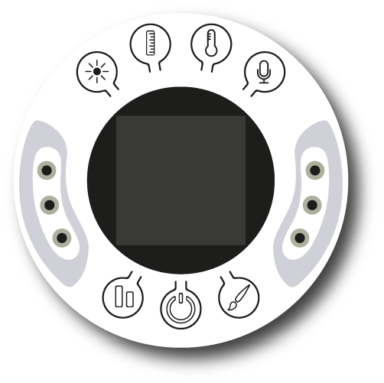
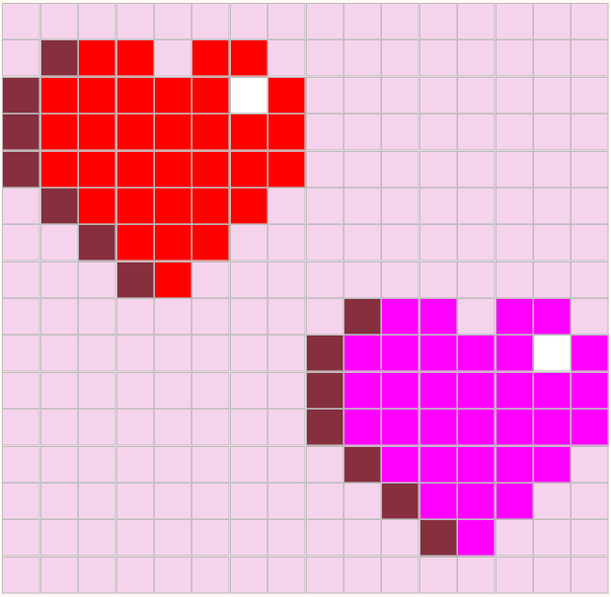
Design
2
Turn on your Xploris and connect it to your computer or tablet.
Open the XploriLab software on your computer or tablet.
Once inside XploriLab, select the icon to connect the device via cable or bluetooth as applicable.
Enter the art section (ART) and then to ANIMATOR.

Slide 5
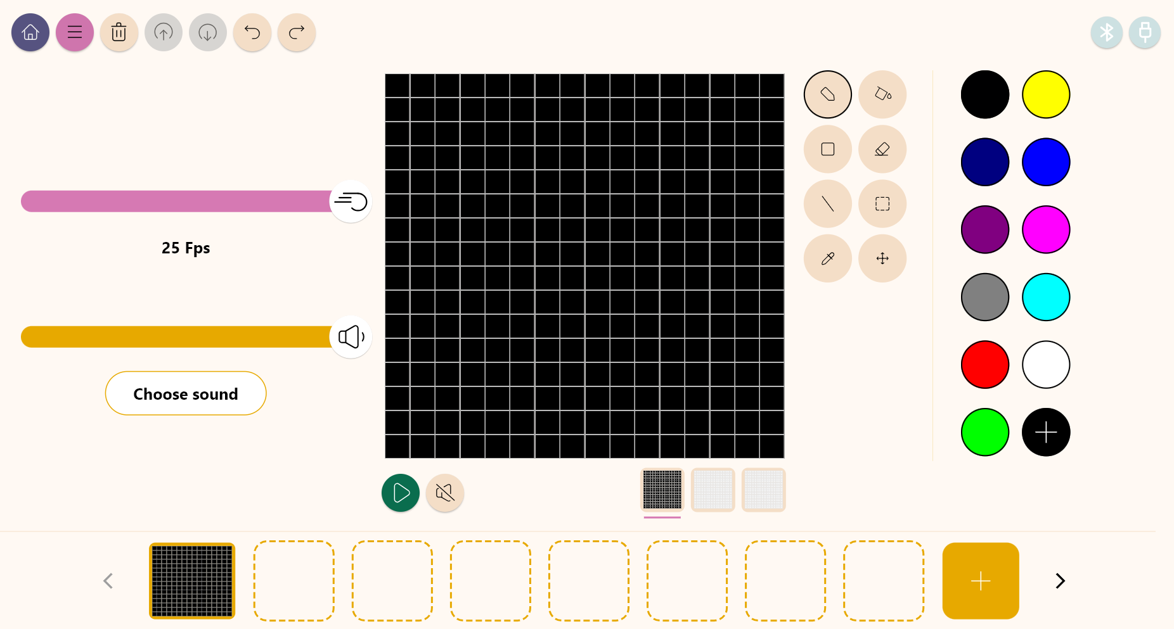
Design
2
Inside the main window you will find several sections with the necessary tools to make a digital artwork.
Tools
Color palette
Configuration
Drawing area
Layers
Frames

Slide 6
Design
2
Use the different Xploris tools to create a moving image of two hearts.
Tools
Pencil: Adds color to a pixel.
Eyedropper: Copies the color of a pixel.
Bucket: Fills the inside of a closed shape with color.
Move: Move the selected pixels.
Rectangle: Creates a rectangle on the screen.
More: Change the selected color in your palette.
Eraser: Erases a single pixel.
Undo: Deletes your last action.
Selection: Select a section of the frame to copy, paste and move.
Redo: Redo an action you have deleted.
Line: Creates a straight line.
Upload: Upload your drawing or animation to the Xploris device.

Slide 7
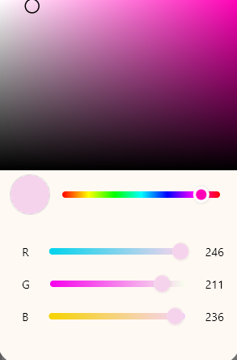
Design
2
1
2
For this activity we will use 5 main colors.
Light pink (background)
Red (heart 1)
Fuchsia (heart 2)
Dark red (shadow of the hearts)
White (glow of the hearts)
Select any of the colors in the palette and then change it using the “+” icon at the bottom.
When you click the “+” icon, this window will pop up allowing you to select a new color. To exit this configuration just click anywhere outside the window.

Slide 8
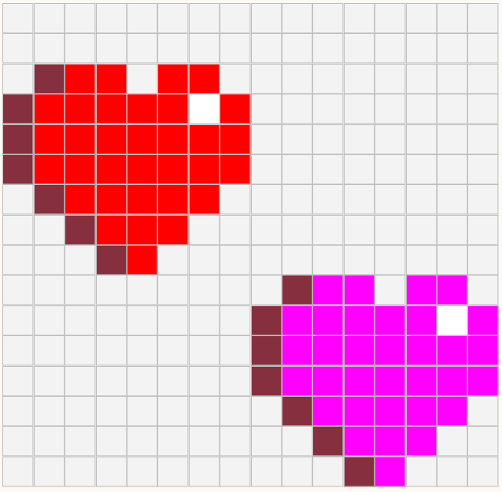
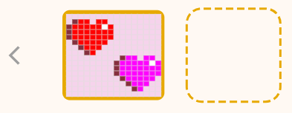
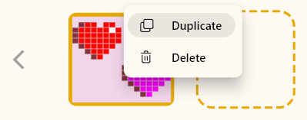
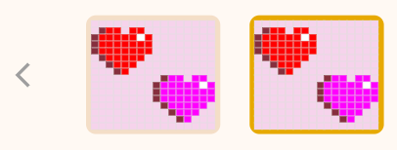
Design
2
3
4
Use the pencil to copy the drawing of the hearts shown here.
Right click on the first frame.
Duplicate the frame once.
Select the second frame and work on it.

Slide 9
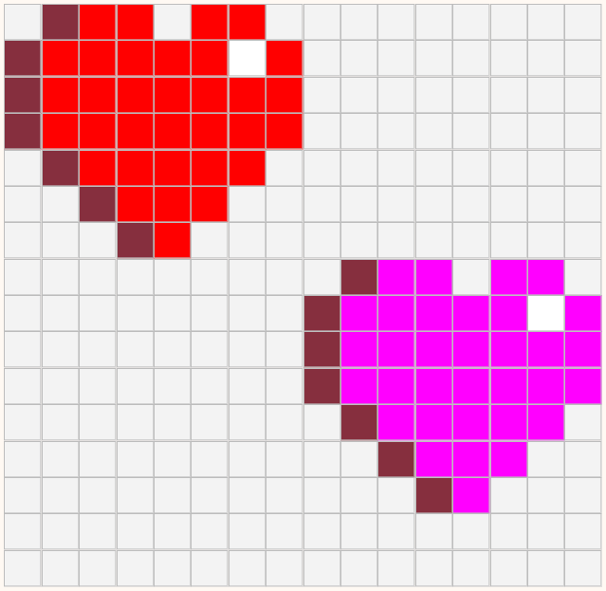
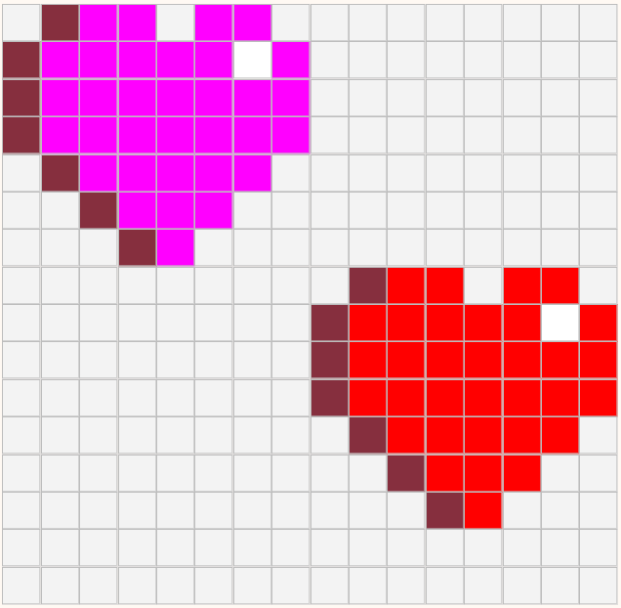
Design
2
5
6
2 px
Select the hearts, and with the help of the move tool move everything 2 pixels up. The idea is to simulate that the heart jumps.
In this same picture, with the paint bucket, invert the color of the hearts, so they look like they change color with each jump. The red becomes fuchsia and the fuchsia becomes red.

Slide 10
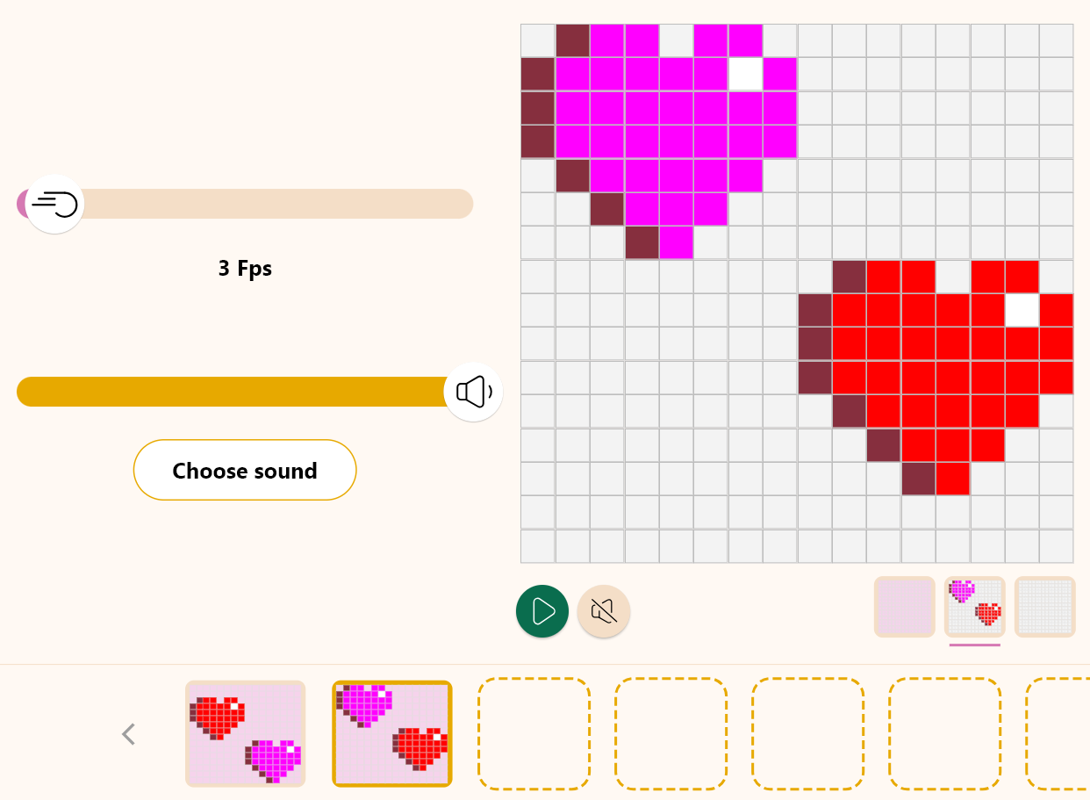
Design
2
7
Press the “Play” button to run your animation and see it in motion.
The Fps are the frames per second. Modify the frame bar to give more or less speed to the animation.
We recommend leaving it at 3 Fps for a smooth look.

Slide 11
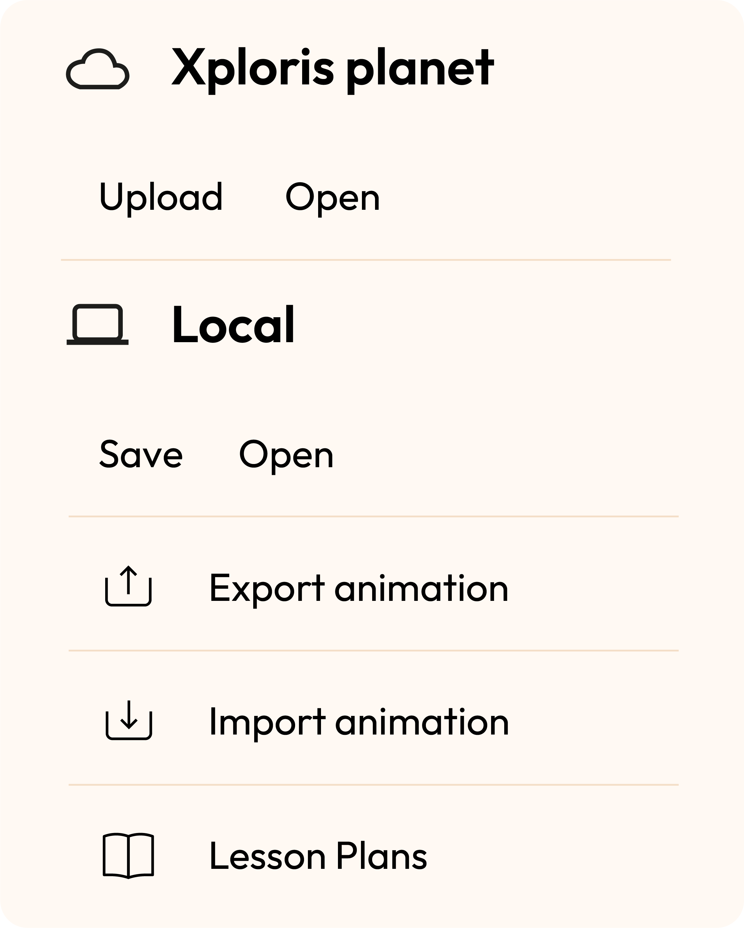
Design
2
Once you have finished your drawing, save and upload it to your Xploris screen.
Press the three-bar icon at the top of the screen.
First, save your drawing by pressing “Save” and give it a name.
Once saved, click on the “Upload” icon at the top of the screen, wait for it to load and watch your drawing appear in Xploris.

Slide 12
Questions
3
1
Arts
How is a painter's palette similar to and different from the color palette we see on the computer?
2
Technology
Do you know what RGB means? These letters appeared when you were changing the colors in the palette. Find out what this acronym stands for.
3
Let's keep experimenting!
Do you think you can make other shapes that move and change color? Try creating other animations.

Slide 13
Activity summary
4
We use the Xploris software to create moving hearts.
We apply colors to the different frames of the animation.
We load a moving image to the Xploris device.

Slide 14
ARTS
Hearts in motion

