Slide 1
ARTS
Creating a Still Image: Let's Draw an Elephant

Slide 2
LET'S DRAW AN ELEPHANT
1
Introduction
2
Design
ARTS
3
Questions
4
Activity summary

Slide 3
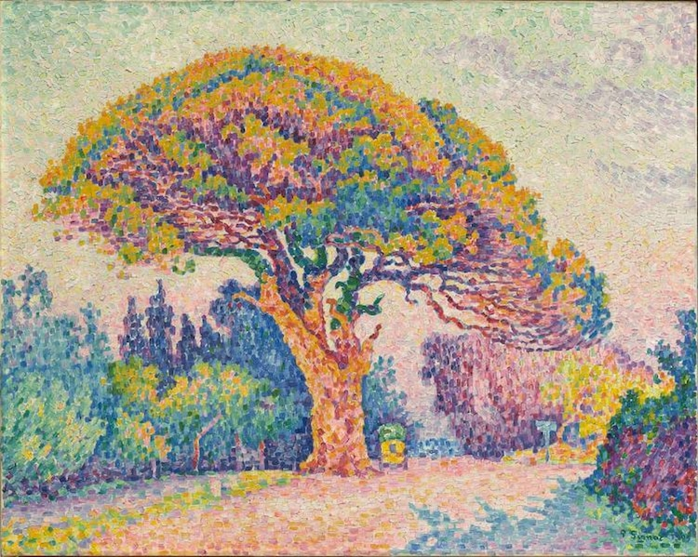
Introduction
1
There are paintings that, when viewed up close, seem like mere splotches of color. However, if you step back or slightly squint, you can begin to see a shape or a landscape.
Our brain is able to organize and create shapes with just a few visual elements. The same happens with pixels on a screen, if you put several pixels together you get a complete image.
In this lesson you will create your own pixel artwork using the Xploris software.
The question you will answer will be:
“El pino en Saint Tropez” de Paul Signac, 1909.
Can we draw an elephant with pixels?

Slide 4
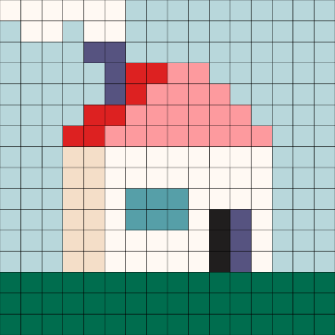
Design
2
Turn on your Xploris and connect it to your computer or tablet.
Open the XploriLab software on your computer or tablet.
Once inside XploriLab, select the icon to connect the device via cable or bluetooth as applicable.
Enter the art section (ART) and then to ANIMATOR.

Slide 5
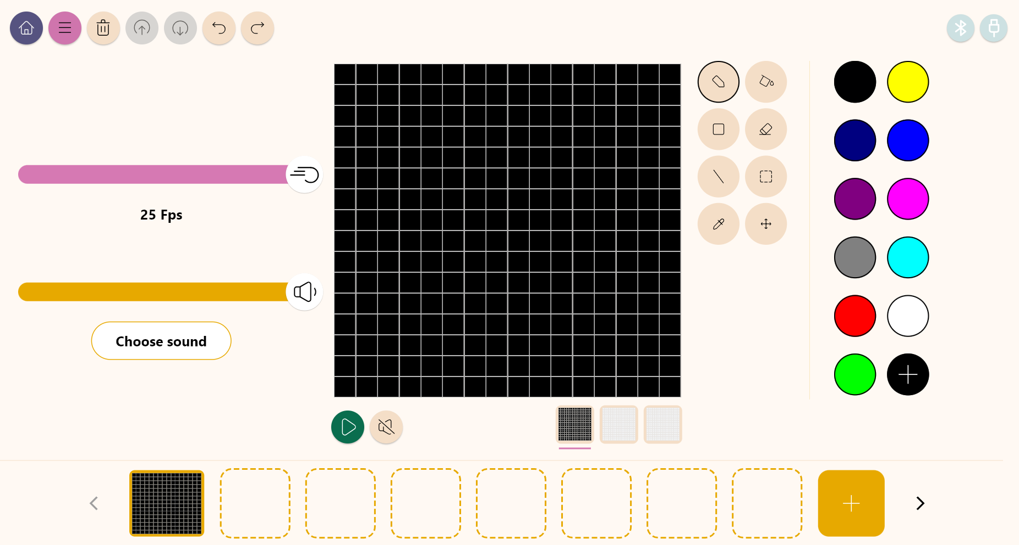
Design
2
Inside the main window you will find several sections with the necessary tools to make a digital artwork.
Tools
Color palette
Configuration
Drawing area
Layers
Frames

Slide 6
Design
2
Use the different Xploris tools to create a still image of an elephant.
Tools
Pencil: Adds color to a pixel.
Eyedropper: Copies the color of a pixel.
Bucket: Fills the inside of a closed shape with color.
Move: Move the selected pixels.
Rectangle: Creates a rectangle on the screen.
More: Change the selected color in your palette.
Eraser: Erases a single pixel.
Undo: Deletes your last action.
Selection: Select a section of the frame to copy, paste and move.
Redo: Redo an action you have deleted.
Line: Creates a straight line.
Upload: Upload your drawing or animation to the Xploris device.

Slide 7
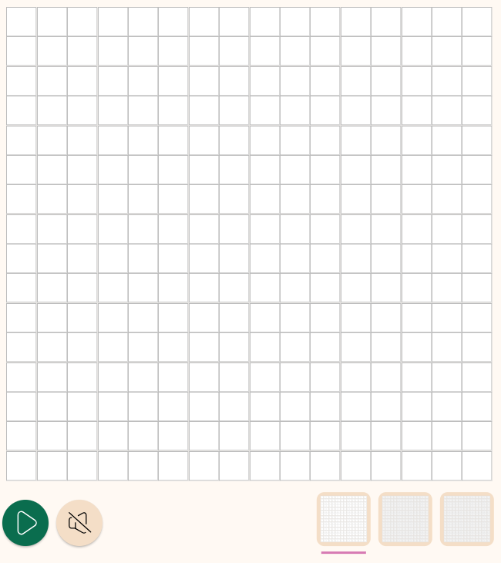
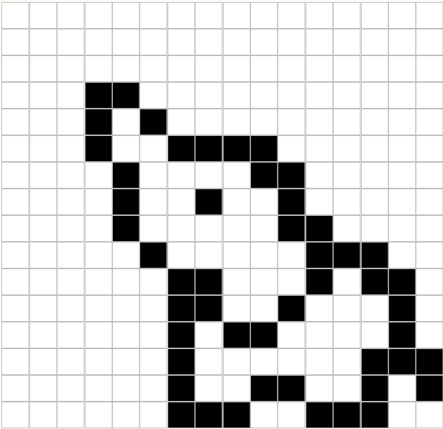
Design
2
1
2
Draw the elephant with the black pencil.
Start by painting the background white. You can do it with the paint bucket or by creating a rectangle.
If you make a mistake you can erase it.

Slide 8
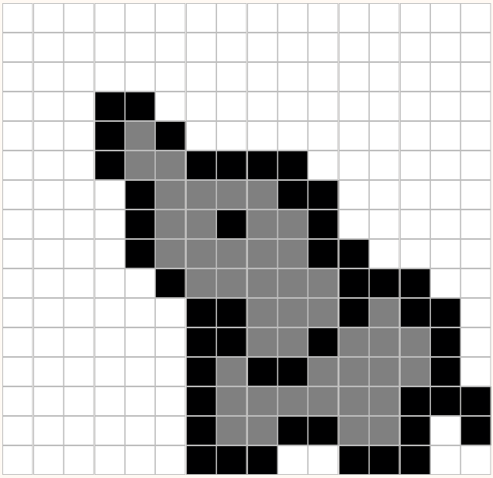
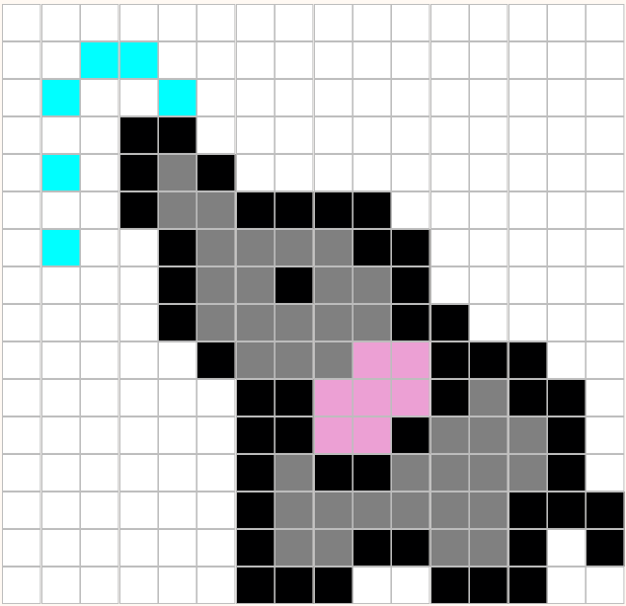
Design
2
3
4
Add gray to your color palette.
Add pink and light blue to your color palette.
Paint the elephant with the paint bucket.
Draw the pixels the ear and the water.

Slide 9
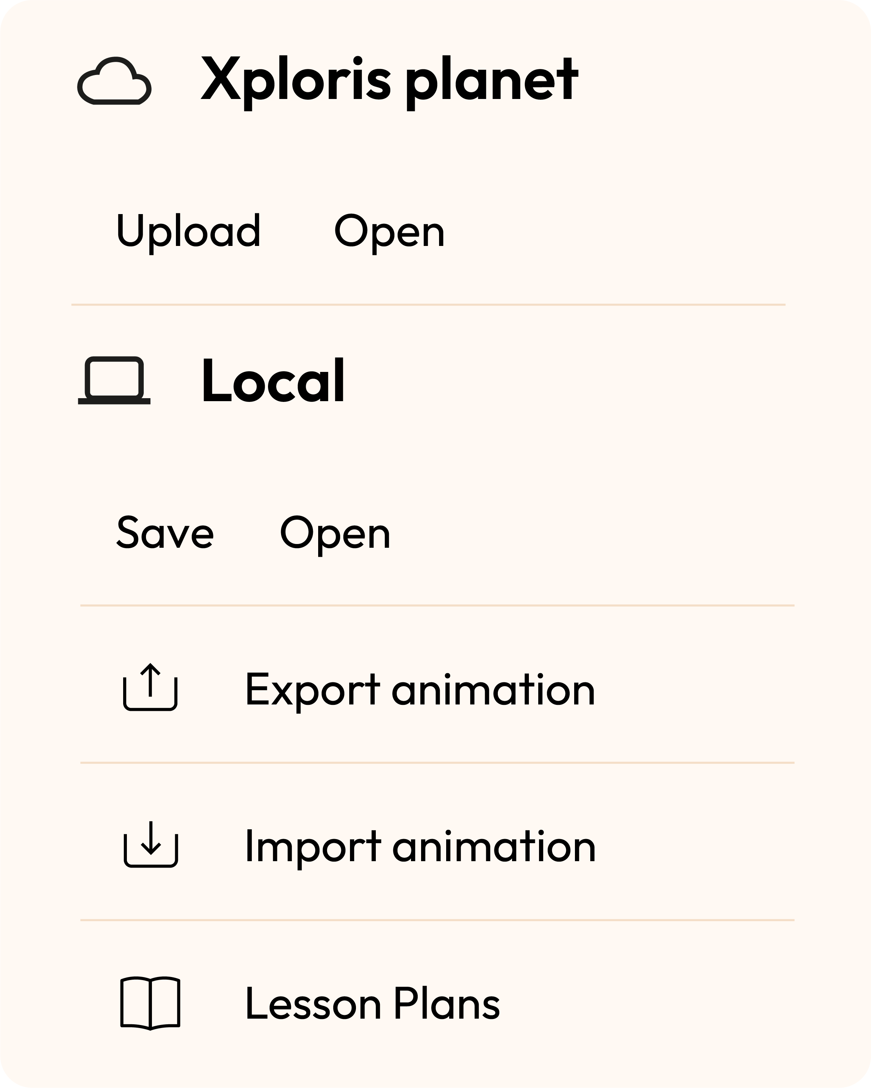
Design
2
Once you have finished your drawing, save and upload it to your Xploris screen.
Press the three-bar icon at the top of the screen.
First, save your drawing by pressing “Save” and give it a name.
Once saved, click on the “Upload” icon at the top of the screen, wait for it to load and watch your drawing appear in Xploris.

Slide 10
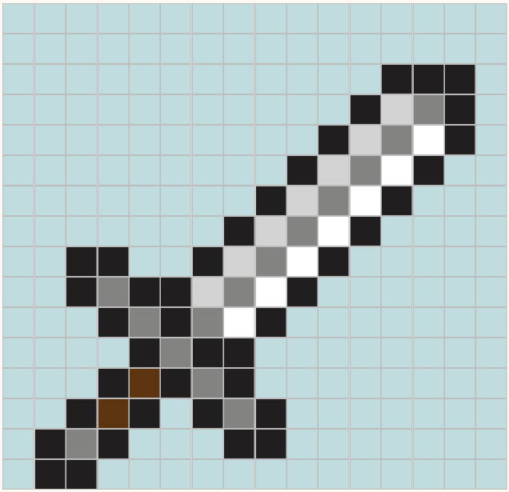
Questions
3
1
Arts
Do you know artists who work with similar techniques?
2
Technology
Have you ever played a video game that used pixel art?
3
Let's keep experimenting!
Do you think you can make other animals in your Xploris?
Try creating pixel art of your favorite animal.

Slide 11
Activity summary
4
We used the Xploris software to create an elephant with the pixel art technique.
We learned about different digital drawing tools: pencil, paint bucket, color palette, etc.
We uploaded an image to the Xploris device.

Slide 12
ARTS
Creating a Still Image: Let's Draw an Elephant

