Slide 1


Electricity and magnetism
Verifying the Lenz Law by measuring the electric current flowing through a coil created by an external magnetic field

Slide 2

Electricity and magnetism
Verifying the Lenz Law by measuring the electric current
flowing through a coil created by an external magnetic field
^{Objective}
The purpose of this activity is to study the relationship between
an electric current inside a conductor and an external magnetic
field. The electric current will be measured by the Labdisc’s
electric current sensor.

Slide 3

Electricity and magnetism
Verifying the Lenz Law by measuring the electric current
flowing through a coil created by an external magnetic field
^{Introduction and theory}
The aim of the introduction is to focus students on the lesson subject by
refreshing acquired knowledge and asking questions which encourage
research development. Key concepts from the theoretical framework applied
by the students during the lesson are taught.
^{Introduction}
Magnetic fields and electric current are closely connected. We can use
an electric current flowing inside a motor coil to rotate the motor and
convert electricity into a mechanical rotation; while on the other hand in a
generator we rotate a coil inside a magnetic field to create electricity and
produce current that will flow from the generator coil.

Slide 4
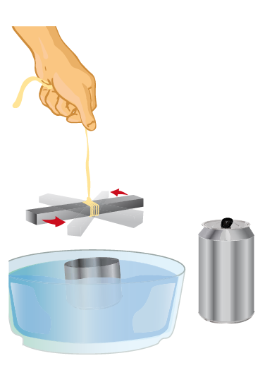
Electricity and magnetism
Verifying the Lenz Law by measuring the electric current
flowing through a coil created by an external magnetic field
^{Introduction and theory}
TRY THIS!
Carefully cut a fizzy drink can approximately 5 cm from the base to obtain a
small metal container. Place it on a deep plate full of water. Fix a large magnet
to the end of a rope. Spin the magnet over the center of the can without
touching the sides… What happens to the can?

Slide 5

Electricity and magnetism
Verifying the Lenz Law by measuring the electric current
flowing through a coil created by an external magnetic field
^{Introduction and theory}
At the end of this class you will be able to answer following questions and investigate!
What do you think the magnets on the inside of headphones or loudspeakers are
for? Explain
In what situations have you used magnets or experimented with magnetism?
Carry out the experiment activity with your class so that at the end you’ll be able to
answer the following question.
Can we induce an electric current using a magnet?

Slide 6
Electricity and magnetism
Verifying the Lenz Law by measuring the electric current
flowing through a coil created by an external magnetic field
^{Introduction and theory}
^{Theoretical}
In physics, electric current is a flow of charge through a given point of space, in
a specific time period. The point of space is determined by an arbitrary reference
point. Historically, electric current was first studied by investigating how electric
charge transfers between two objects. The object where charged using friction or
induction methods.
In 1800 the Italian, Alessandro Volta built the first electric battery. The Dane,
Christian Oersted, used Volta´s battery when he discovered by accident in 1820
that there is a relationship between electric current and magnetism. He observed
how the needle in a compass moved when it was close to a conductor cable where
electricity was passing through.

Slide 7
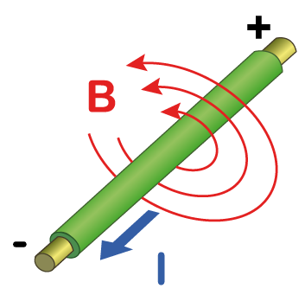
Electricity and magnetism
Verifying the Lenz Law by measuring the electric current
flowing through a coil created by an external magnetic field
^{Introduction and theory}
This accident moved him to write that “all electric current or flow of charge
causes a magnetic field around the path of the conductor, whose magnitude
is inversely proportional to the distance between the observer and the electric
current”. Furthermore, the effect of a magnetic field can be amplified and
transmitted through a ferromagnetic material (a material that can turn into a
magnet if it is exposed to a magnetic field). Some examples of ferromagnetic
elements are iron (Fe), cobalt (Co) and nickel (Ni).

Slide 8
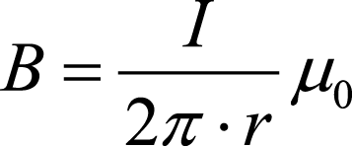

Electricity and magnetism
Verifying the Lenz Law by measuring the electric current
flowing through a coil created by an external magnetic field
^{Introduction and theory}
The expression for a magnetic field B caused by an electric current is:
Where:
B = magnetic field
I = electric current
r = radial distance to the observer
= magnetic permeability in free space
Staring from previous discoveries, in 1831 the Englishman, Michael Faraday made
a new discovery. He found out that in the same way that charges in motion cause
an electric field, a variation in the magnetic field also induces a force on the free
charges inside a conductor. This force is called electromotive force or EMF, and
drives the electric current to pass through the conductor. Therefore, electric current
may be induced by the movement of a magnet in a certain time period.

Slide 9
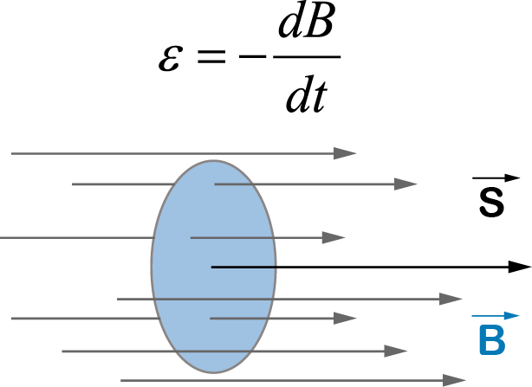
Electricity and magnetism
Verifying the Lenz Law by measuring the electric current
flowing through a coil created by an external magnetic field
^{Introduction and theory}
Two years later, the German, Heinrich Lenz proved that “electromotive force gives
rise to a flow of charges whose magnetic field opposes its original cause, i.e. it
opposes the original change in magnetic flux”. This may be expressed in Faraday’s
Law of Induction:

Slide 10
Electricity and magnetism
Verifying the Lenz Law by measuring the electric current
flowing through a coil created by an external magnetic field
^{Introduction and theory}
Where:
= electromotive force (EMF)
t = time
B = magnitude of the magnetic field
S = area of the surface where the magnetic flux passes through (defined by the
conductor wire)
= angle between the magnetic field and the surface normal to S
Faraday´s Law means that the electromotive force ( ) is proportional to the change
in magnetic flux in a given time period. The change of magnetic flux opposes the
direction of the original magnetic field.

Slide 11
Electricity and magnetism
Verifying the Lenz Law by measuring the electric current
flowing through a coil created by an external magnetic field
^{Introduction and theory}
Now students are encouraged to raise a hypothesis which must be tested with an experiment.
What will happen inside a copper coil if you move a magnet relative to the coil?

Slide 12

Electricity and magnetism
Verifying the Lenz Law by measuring the electric current
flowing through a coil created by an external magnetic field
^{Activity description}
Students will make a copper coil by coiling up a copper wire in their hands. They will then move a magnet several times relative to the coil to prove the Faraday and Lenz Laws
Warning!
Move all electronic devices away from the magnet to prevent them from being
adversely affected by the magnetic field.
At the end of the class, students will build an electromagnet and observe how the magnetic field affects the orientation of a compass needle.

Slide 13
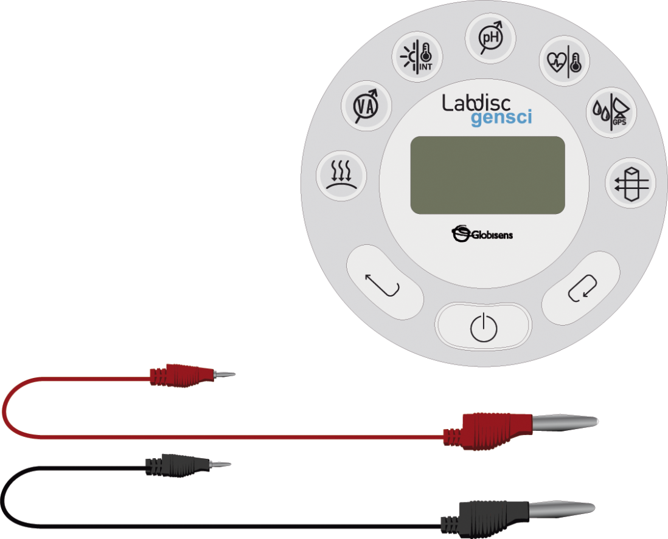
Electricity and magnetism
Verifying the Lenz Law by measuring the electric current
flowing through a coil created by an external magnetic field
^{Resources and materials}
Labdisc
Red and black banana to banana connector cables
Ten meters of 1 mm copper wire
A neodymium magnet with at least 4000 gauss
rating

Slide 14
Electricity and magnetism
Verifying the Lenz Law by measuring the electric current
flowing through a coil created by an external magnetic field
^{Using the Labdisc}
^{a. Using the Labdisc}
To collect measurements with the electric current sensor, the Labdisc must be set
up by following these steps:
Open the GlobiLab software and turn on the Labdisc.
Click the Bluetooth icon in the bottom right corner of the GlobiLab screen.
Select the Labdisc you are using currently. Once the Labdisc has been
recognized by the software the icon will change from a grey to blue color.

Slide 15
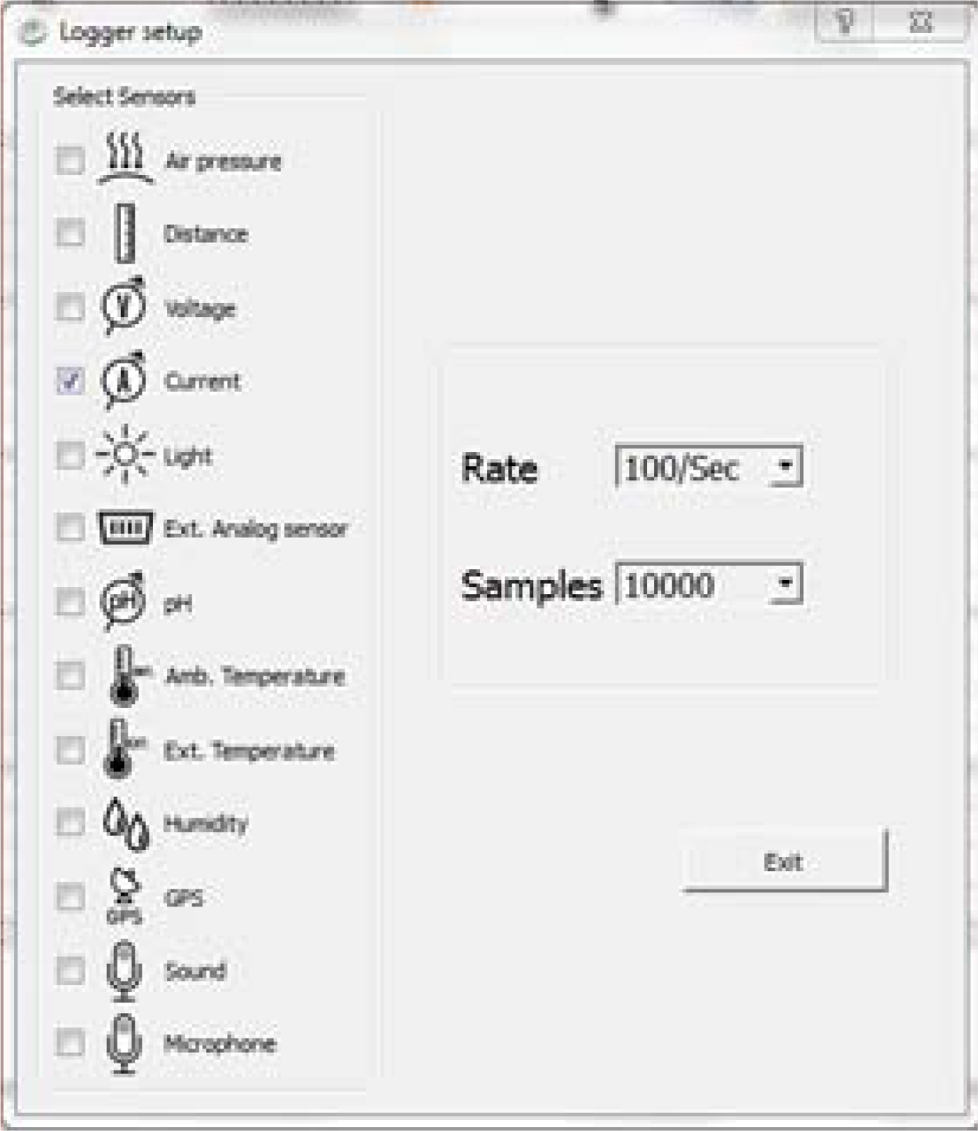
Electricity and magnetism
Verifying the Lenz Law by measuring the electric current
flowing through a coil created by an external magnetic field
^{Using the Labdisc}
Click on the button to configure the Labdisc. Select the current sensor in
the “Logger Setup” window. Enter “100/sec” for the sampling rate and
“10000” for the number of samples.

Slide 16


Electricity and magnetism
Verifying the Lenz Law by measuring the electric current
flowing through a coil created by an external magnetic field
^{Using the Labdisc}
Once you have finished the sensor configuration start measuring by clicking
Once you have finished measuring stop the Labdisc by clicking

Slide 17
Electricity and magnetism
Verifying the Lenz Law by measuring the electric current
flowing through a coil created by an external magnetic field
^{Experiment}
The following steps explain how to perform the experiment:
Take the copper wire and coil it around your hand, leaving about 10 cm of wire at
both ends free. Make sure the wire doesn’t unwind by fixing it with masking tape.
Connect the banana to banana cable to the Labdisc and to the ends of the copper
wire as shown in the figure below.
In the GlobiLab software click the RUN icon and observe the graph build on the
screen.

Slide 18
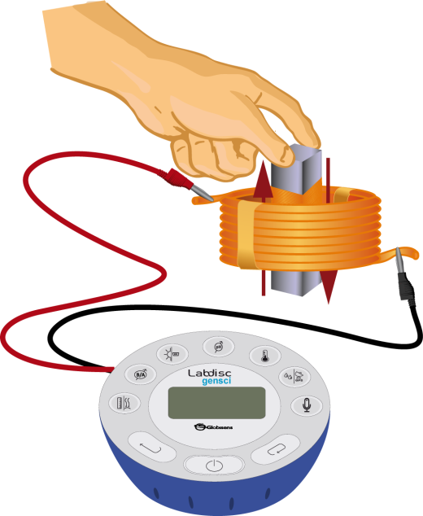
Electricity and magnetism
Verifying the Lenz Law by measuring the electric current
flowing through a coil created by an external magnetic field
^{Experiment}
Start measuring, move the magnet two times inside and outside the coil. For the
first time do it slowly, moving the magnet more quickly on the second time.
Stop measuring.

Slide 19


Electricity and magnetism
Verifying the Lenz Law by measuring the electric current
flowing through a coil created by an external magnetic field
^{Results and analysis}
The following steps explain how to analyze the experiment results:
Observe the chart that appears on the screen once you have finished measuring.
Identify the section of the graph where variations in the electric current were
recorded. Once you have found them, press to select the two points on the
graph representing the beginning and end of the current pulses section.
Press and then press OK. The graph was trimmed to show only the
“interesting section” of the current pulses.

Slide 20

Electricity and magnetism
Verifying the Lenz Law by measuring the electric current
flowing through a coil created by an external magnetic field
^{Results and analysis}
Fit the scale to observe the variations in electric current displayed. To do this register
the maximum and minimum vales using the button, and enter rounded values
in the “Set Range” window by right-clicking the y axis on the chart.
Press and write notes on the graph specifying when the magnet was inside and
outside the wire coil.

Slide 21

Electricity and magnetism
Verifying the Lenz Law by measuring the electric current
flowing through a coil created by an external magnetic field
^{Results and analysis}
How do the results relate to your initial hypothesis? Explain.
How would you explain the variations in electric current?

Slide 22
Electricity and magnetism
Verifying the Lenz Law by measuring the electric current
flowing through a coil created by an external magnetic field
^{Results and analysis}
What differences did you find between the electric current when the magnet
was moving inside the coil and the electric current when the magnet was moving outside the coil?
When did you observe a larger current pulse – when the magnet was moving
slowly or when it was moving faster? Explain.

Slide 23
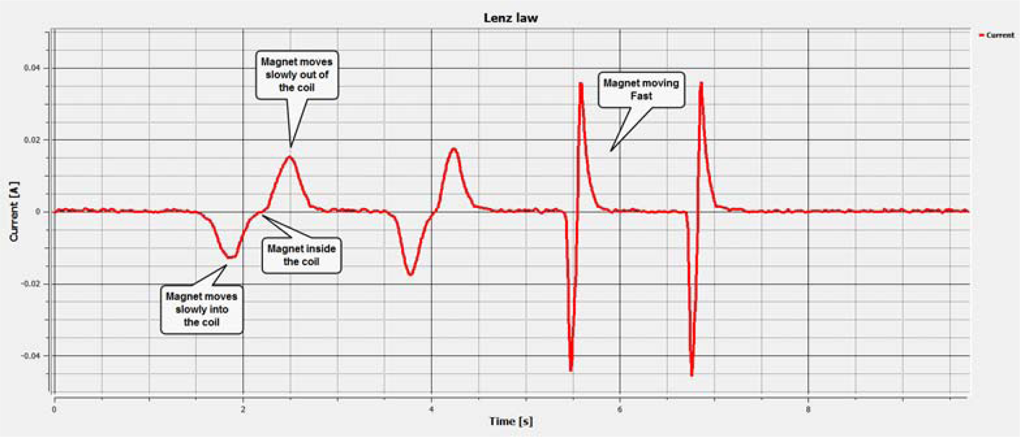
Electricity and magnetism
Verifying the Lenz Law by measuring the electric current
flowing through a coil created by an external magnetic field
^{Results and analysis}
The graph below should be similar to the one the students came up with.

Slide 24

Electricity and magnetism
Verifying the Lenz Law by measuring the electric current
flowing through a coil created by an external magnetic field
^{Conclusions}
Following are some questions and answers which should be developed by the students in order to elaborate their conclusions.
How does the magnetic field inside the coil relate to the current recorded in the
coil? Explain.
Students should identify that the electric current is proportional to the CHANGE in the
magnetic field. Thus when the magnet is moving fast in and out of the coil - the graph
registers a higher pulse compared to a slow magnet movement. When the magnet
doesn’t move, even when it is inside the coil creating a high magnetic field, there will be no electric current.
What does the negative and positive sign of the electric current mean?
Students should point out that the sign represents the electrons’ direction of flow and is independent of the current’s magnitude.

Slide 25
Electricity and magnetism
Verifying the Lenz Law by measuring the electric current
flowing through a coil created by an external magnetic field
^{Conclusions}
How is the sign of the current inside the copper wire related to the magnetic field of the magnet? Explain.
Students should explain that according to the Lenz Law the electric current in the coil is opposite to the magnetic field creating it. Thus from the above recorded graph, students can clearly observe that when we insert the magnet into the coil, increasing the magnetic field, the current will be negative. Similarly, when the magnet is pulled out of the coil (magnetic field is decreased) the current will be positive.

Slide 26

Electricity and magnetism
Verifying the Lenz Law by measuring the electric current
flowing through a coil created by an external magnetic field
Activities for further application
The aim of this section is that the students can extrapolate the acquired knowledge during this class through the application of it in different contexts and situations. Furthermore, it is intended that students wonder and present possible explanations to the experimentally observed phenomena.
Further questions:
How would you explain the phenomenon observed during the first activity called “TRY THIS!”?
Students should infer that the motion of the fizzy drink can is caused because of the action of a magnetic field on the fixed charges of the metal. Therefore the metal will move in an opposite direction than the current induced by the magnetic flux.

Slide 27
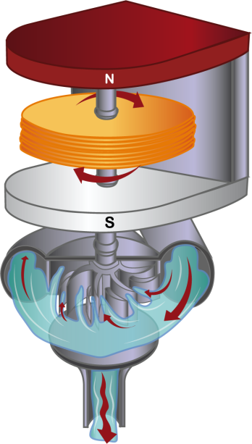
Electricity and magnetism
Verifying the Lenz Law by measuring the electric current
flowing through a coil created by an external magnetic field
Activities for further application
How could you use the Faraday and Lenz Law to produce energy in a hydroelectric
power plant? If you aren´t familiar with the process, investigate it.
Students should point out that the Faraday and Lenz Law may be used in a hydroelectric power plant to produce energy because the movement of a magnet inside a copper coil (dynamo) induces electric current. Water that falls on sails produces a circular movement of the magnet.

Slide 28
Electricity and magnetism
Verifying the Lenz Law by measuring the electric current
flowing through a coil created by an external magnetic field
Activities for further application
Could you build an electromagnet with a copper wire, a battery and a piece of iron?
Try it using the materials of the experiment.
Students should deduce that if they coil the copper wire around the piece of iron
and connect the wire to a power supply, a magnetic field will appear. Since iron is a
ferromagnetic material, the magnetic field will amplify and reach a high magnitude,
depending on the electric current that passes through the conductor.
How do you think the orientation of a compass would be affected if you exposed it to an electromagnet? Prove your theory with the electromagnet you built to answer the previous question.
Students should point out that the compass orientates according to the north pole of the
natural magnetic field on our planet. If we expose the compass to a magnetic field
other than that of Earth, its orientation will change. We can prove this by coiling
a copper wire around a piece of iron and connecting the end to a battery. Next we
place the compass in front of the electromagnet and try connecting and disconnecting the wire to the battery. The orientation of the needle inside the compass will change depending on if it is orientated by the magnetic field of the planet or by the magnetic field of the electromagnet.

Slide 29
Electricity and magnetism
Verifying the Lenz Law by measuring the electric current
flowing through a coil created by an external magnetic field
Activities for further application
What will happen to the direction of the needle if you switch the cables connected to the battery?
Students should point out that the direction of the needle’s movement will change
due to the change in the battery’s polarity which then causes a change in the direction of the electric flow.

Slide 30


