Slide 1
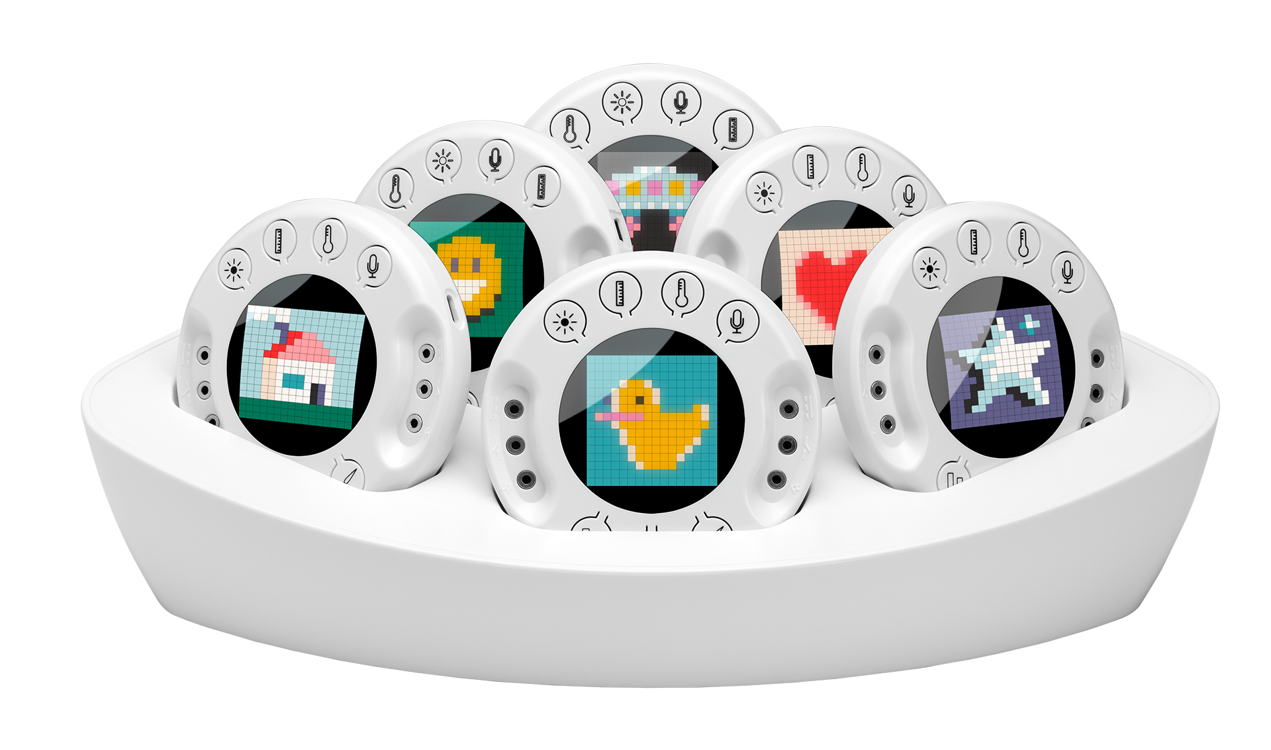
Xploris
One stop shop for k-6 STEAM

Slide 2
Unique STEAM solution
Xplrois does it all: An orchestra of STEAM learning in a compact, hand-held disc
Engineering
Science & Math
Coding
Art
By producing various control outputs.
Experimentation with Xploris 5 built in sensors.
Through Blockly and Python languages.
By creating pixel-art images/animations.

Slide 3
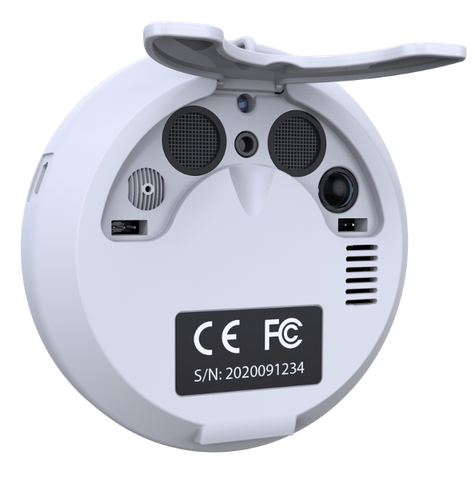
Xploris – ports and controls
4 sensors select keys
Full color
256 pixels display
Distance sensor
Temperature
probe input
USB-C port
Light
sensor
Sound
sensor
Speaker
Voltage sensor,
Voltage output source,
Dry contact switch
Voltage sensor,
Voltage output source,
Dry contact switch
2 Robotics
Servo engine
output
On/Off and
2 display keys

Slide 4
Hardware features
Sensing & Data logging
Coding
5 sensors: Light, Temperature, Sound, Distance, Voltage.
Displaying numeric sensor value and sensor bar graph.
Internal processor directly supporting Python and Blocks.
Art
Control
16x16 RGB LED matrix.
Using the full color pixel matrix for creating graphics and animations.
2 on/off outputs.
2 voltage output.
2 servo engine outputs.

Slide 5
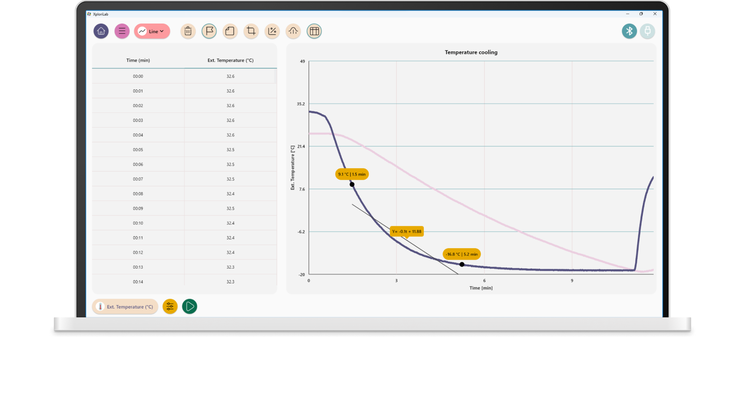
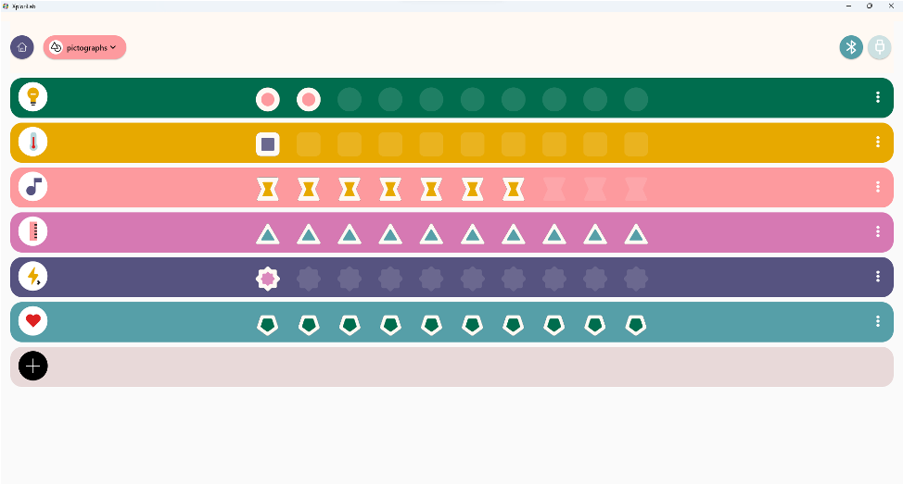
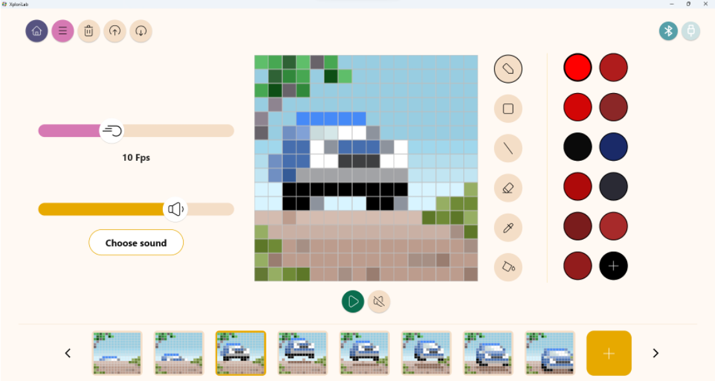
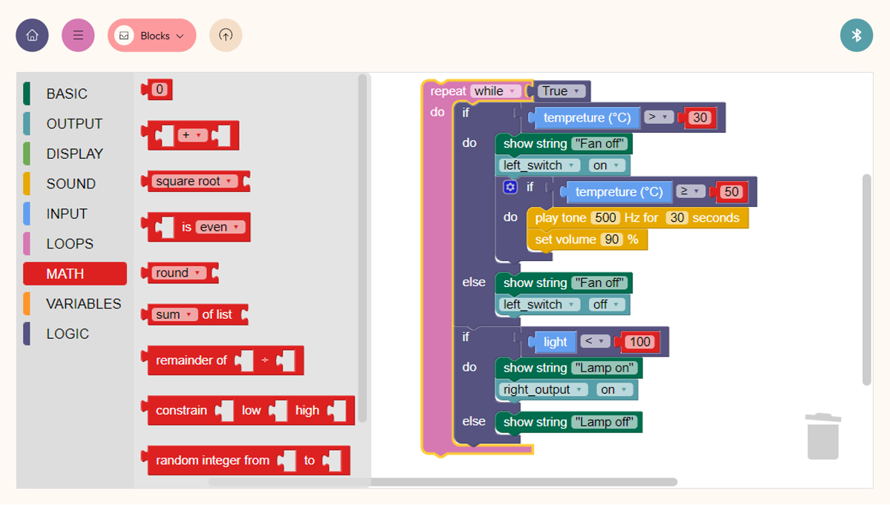
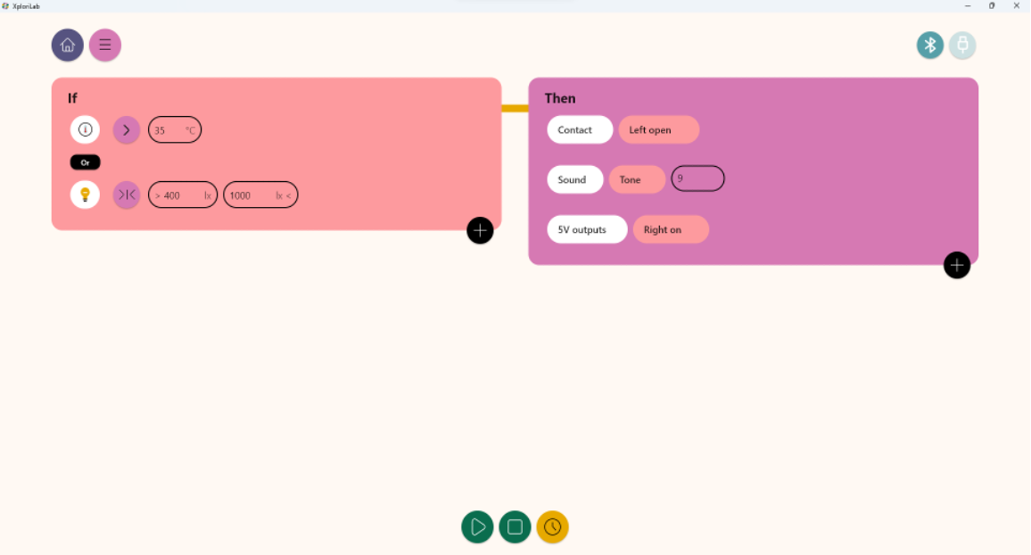
XploriLab - full suite of STEAM apps
Science sensing, datalogging, coding, control and art.

Slide 6
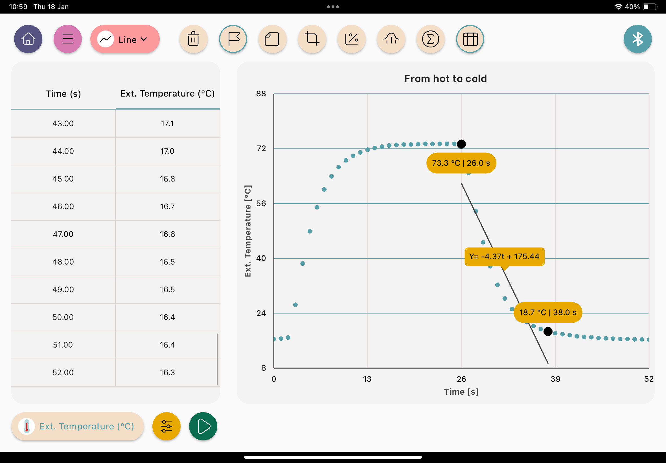
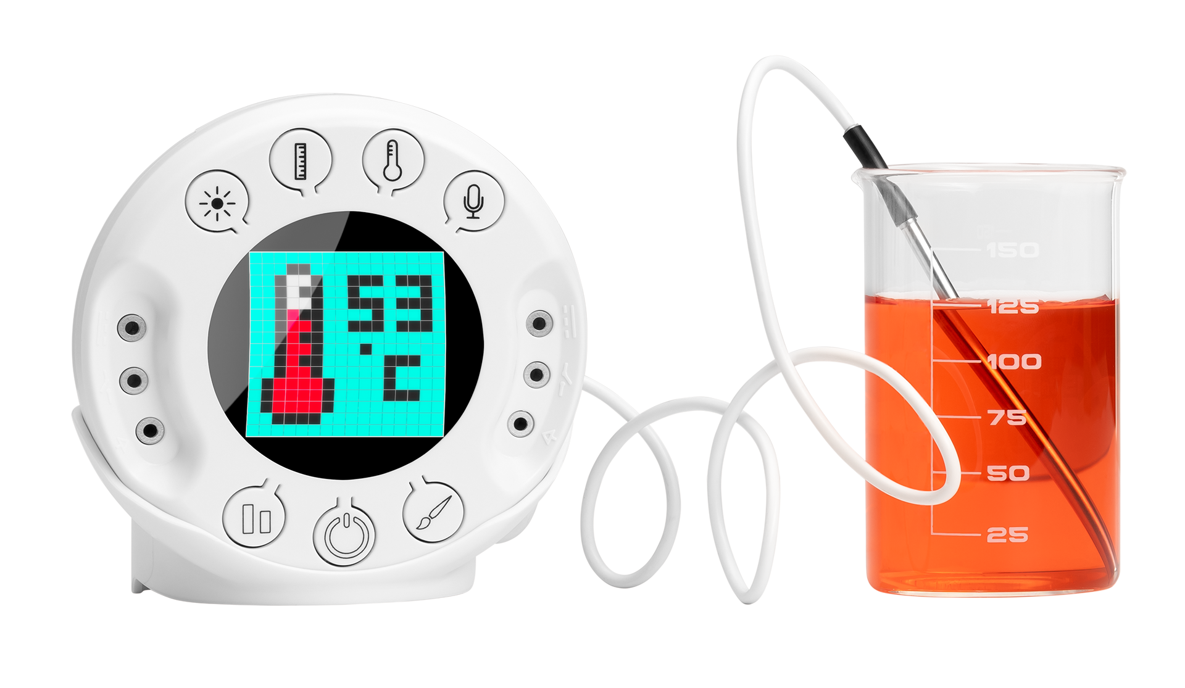
For science & math

Slide 7
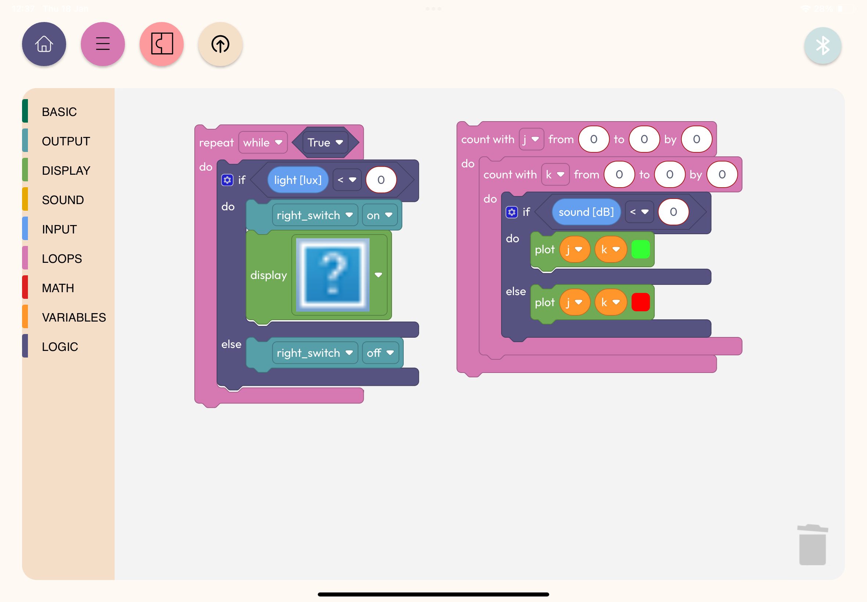
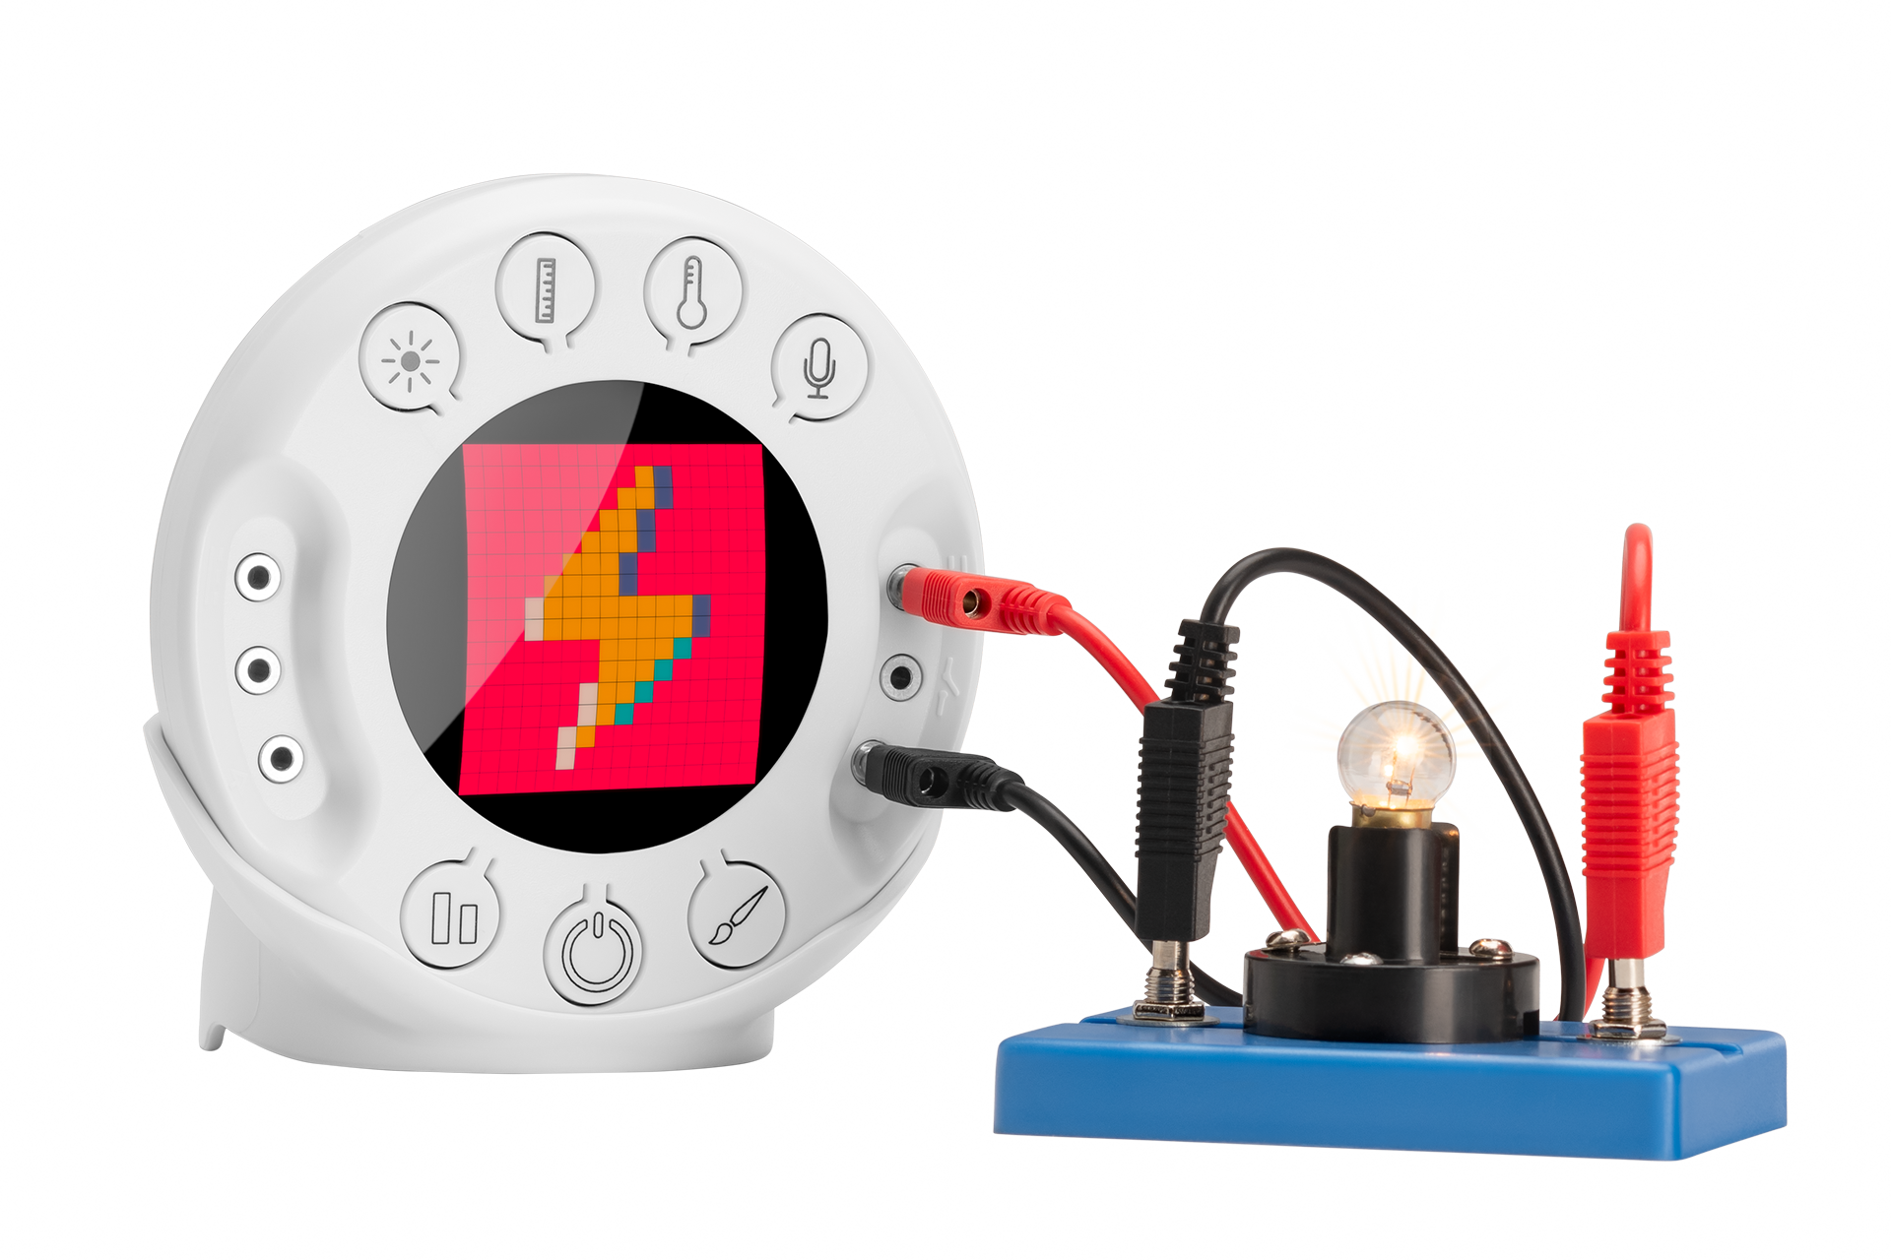
For coding
0
15
1
300
0
15
1
75

Slide 8
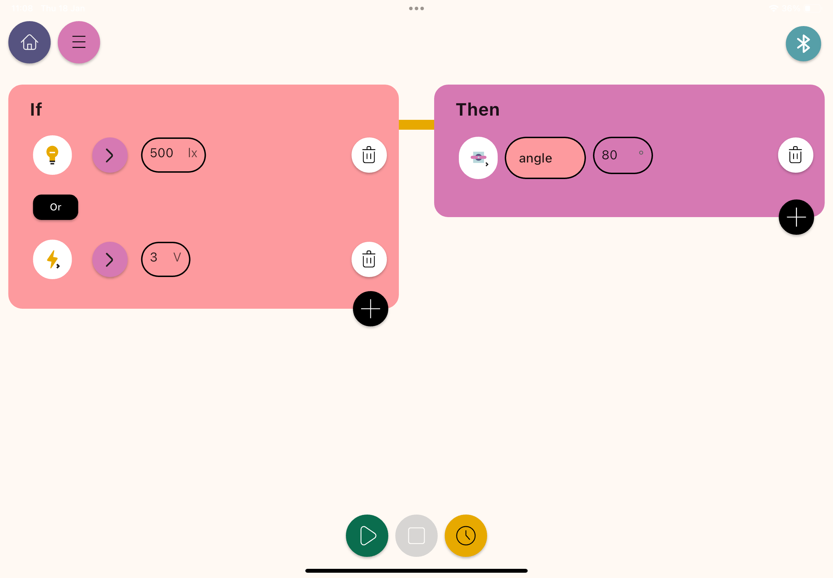
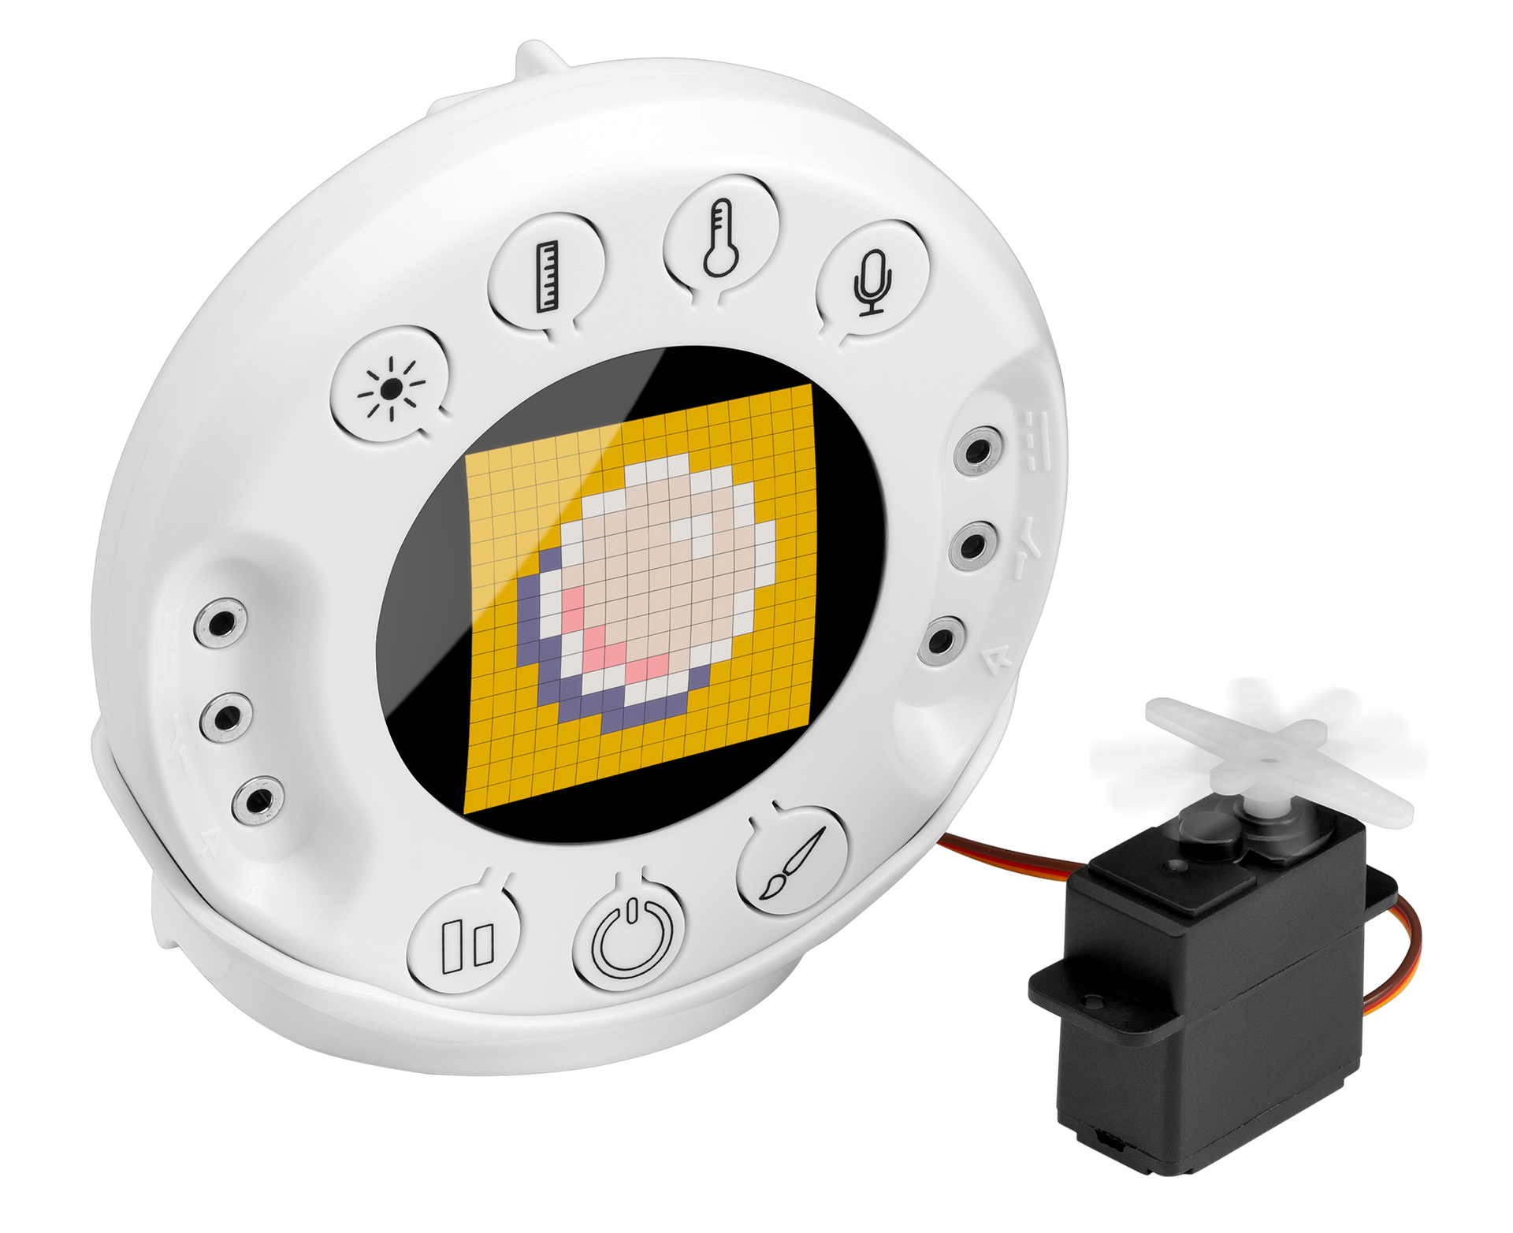
For control & engineering

Slide 9
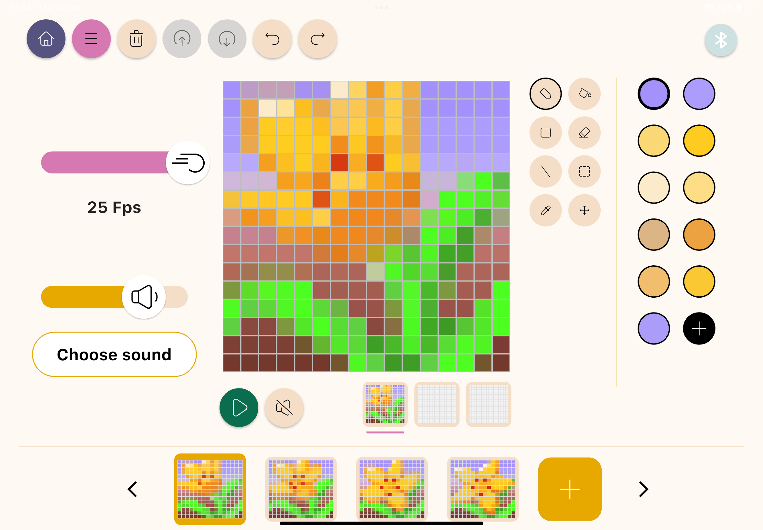
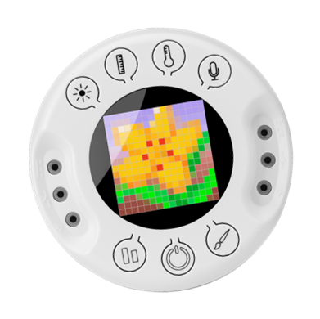
For art

Slide 10
Pedagogic coverage
Full integration of all STEAM subjects
Science & Math
Coding
Data visualization: gauges, pictographs, bar graphs, tables, line graphs.
Data analysis: markers, annotations, linear regressions, Export to EXCEL.
Platforms: Blockly, and Python editor.
Covering: data types, variables, logical operators, If/else conditions, loops, Input and output operations.
Art
Control
Introduction to: colors, drawing, pixel art and character creation.
Covering: frame by frame animation, shapes and geometry, sensors and code controlled animation.
Method: sensors based output levels.
Controlling: animation speed, servo speed, servo angle, contact open/close, 5V output on/off.

Slide 11
Xploris offers students an integrated end-to-end STEAM experience, from creating a pixel art flower animation to apply coding that opens the flower’s leaves when sunlight is projected on a light sensor”

Slide 12
Thank you!

