Slide 1
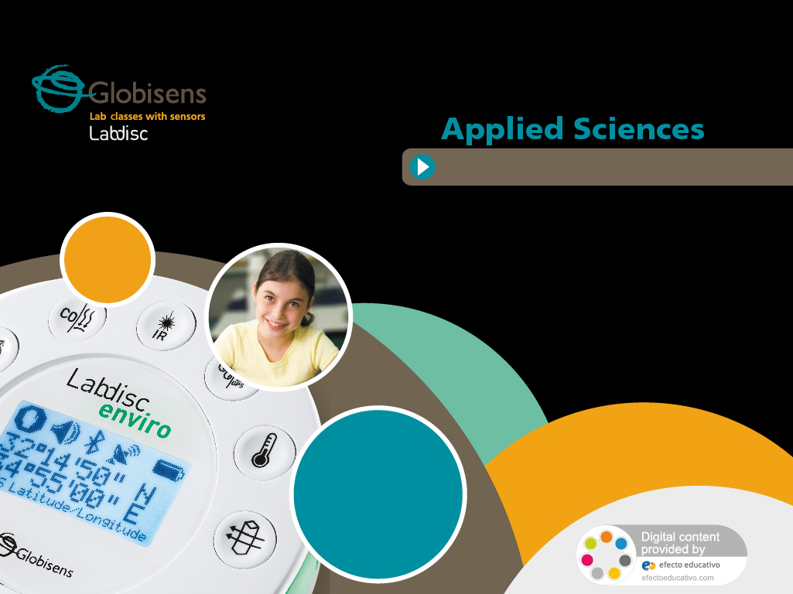

How acidic are the things we drink?
Measuring the pH of common drinks

Slide 2
How acidic are the things we drink?
Measuring the pH of common drinks
^{USA Standards Correlation}
FRAMEWORK FOR K-12 SCIENCE EDUCATION © 2012
The Dimension I practices listed below are called out as bold words throughout the activity.
Dimension 1 Science and Engineering Practices | ü | Asking questions (for science) and defining problems (for engineering) |  | Use mathematics and computational thinking
 | ü | Developing and using models | ü | Constructing explanations (for science) and designing solutions (for engineering)
 | ü | Planning and carrying out investigations | ü | Engaging in argument from evidence
 | ü | Analyzing and interpreting data | ü | Obtaining, evaluating, and communicating information
Dimension 2 Cross Cutting Concepts | ü | Patterns |  | Energy and matter: Flows, cycles, and conservation
 |  | Cause and effect: Mechanism and explanation | ü | Structure and function
 | ü | Scale, proportion, and quantity |  | Stability and change
 |  | Systems and system models

Slide 3
How acidic are the things we drink?
Measuring the pH of common drinks
^{USA Standards Correlation}
Dimension 3 Core Concepts | Discipline | Core Idea Focus
 | Physical Science | PS1: Matter and Its Interactions
 |  | PS1.A: Structure and Properties of Matter
NGSS Standards | Middle School Standards Covered | High School Standards Covered
 | MS.PS-SPM: Structure and Properties of Matter | HS.PS-SPM: Structure and Properties of Matter

Slide 4
How acidic are the things we drink?
Measuring the pH of common drinks
^{USA Standards Correlation}
NATIONAL SCIENCE EDUCATION STANDARDS © 2002
Content Standards (K-12)
ü | Systems, order, and organization | ü | Evolution and equilibrium
ü | Evidence, models, and explanation | ü | Form and Function
ü | Constancy, change, and measurement
Physical Science Standards Middle School |  | Physical Science Standards High School
ü | Properties and Changes of Properties in Matter | ü | Structure of Atoms
 | Motion and Forces | ü | Structure and Properties of Matter
 | Transfer of Energy |  | Chemical Reactions
 |  |  | Motion and Forces
 |  |  | Conservation of Energy and Increase in Disorder
 |  |  | Interactions of Energy and Matter

Slide 5
How acidic are the things we drink?
Measuring the pH of common drinks
^{USA Standards Correlation}
LEARNING OBJECTIVES
Core Objectives (National Standards):
Develop the ability to refine ill-defined questions and direct to phenomena that can be described, explained, or predicted through scientific means.
Develop the ability to observe, measure accurately, identify and control variables.
Decide what evidence can be used to support or refute a hypothesis.
Gather, store, retrieve, and analyze data.
Become confident at communicating methods, instructions, observations, and results with others.
Activity Objectives:
The objective of this activity is to compare the pH of carbonated drinks, juices, and other drinks, formulate a hypothesis and proceed to check it using the Globisens Labdisc pH sensor.
Time Requirement:
45-60 minutes

Slide 6
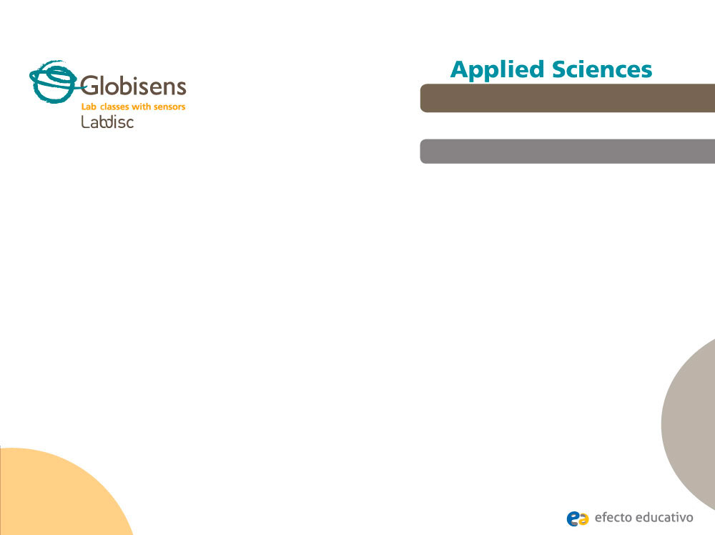
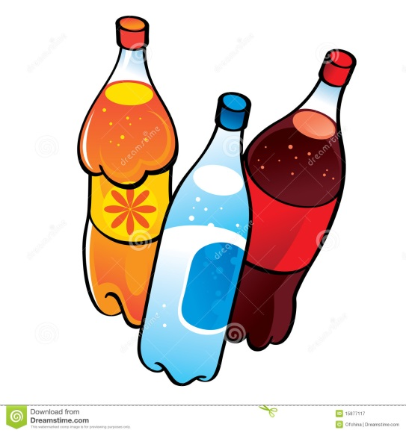
How acidic are the things we drink?
Measuring the pH of common drinks
^{Objective}
The objective of this activity is to compare the pH of fizzy drinks and alcoholic beverages, formulating a hypothesis and proceeding to check it using the Labdisc pH sensor.

Slide 7


How acidic are the things we drink?
Measuring the pH of common drinks
^{Introduction and theory}
The aim of the introduction is to focus students on the lesson subject by refreshing acquired knowledge and asking questions which encourage research development. Key concepts from the theoretical framework, applied by the students during the lesson, are taught.
^{Introduction}
Have you ever felt a burning sensation at the top of your stomach after eating a large meal, or having a specific food or beverage? It could even happen with something healthy like a seasoned lettuce with lemon juice. This feeling is known as heartburn. Heartburn is caused by excessive consumption of certain substances that can change the normal acidity of our stomach. Do you know exactly what the concept “acidity” means? In this class we invite you to discover the true meaning of this word, and to measure how acidic different beverages that we often drink really are.
Can you name some popular drinks that people consume on a regular basis? Try to
organize them according to their degree of acidity.

Slide 8
How acidic are the things we drink?
Measuring the pH of common drinks
^{Introduction and theory}
Have you ever heard about the term “pH”? What do you think it refers to?
Carry out the experiment activity with your class so that at the end you’ll be able to answer the following question:
How acidic are common beverages?

Slide 9
How acidic are the things we drink?
Measuring the pH of common drinks
^{Introduction and theory}
^{Theoretical}
When we talk about acid and alkaline, we are referring to the amount of hydrogen present in a solution. Acid raises the concentration of hydrogen, while an alkali lowers the hydrogen concentration. To know if a substance is acid or alkaline we measure the pH (potential of hydrogen), with a pH meter and probe. The pH is measured on a scale of 1 to 14. The higher the pH, the more alkaline (or base) the solution. 1 is the most acidic and 14 the most alkaline. If the pH is 7 it is considered neutral, below this value it is considered acidic and above basic. Inside our stomach we can find a pH 1 (extremely acidic), wine has a pH of 3.5, blood of 7.35, sea water of 8.5, etc.

Slide 10
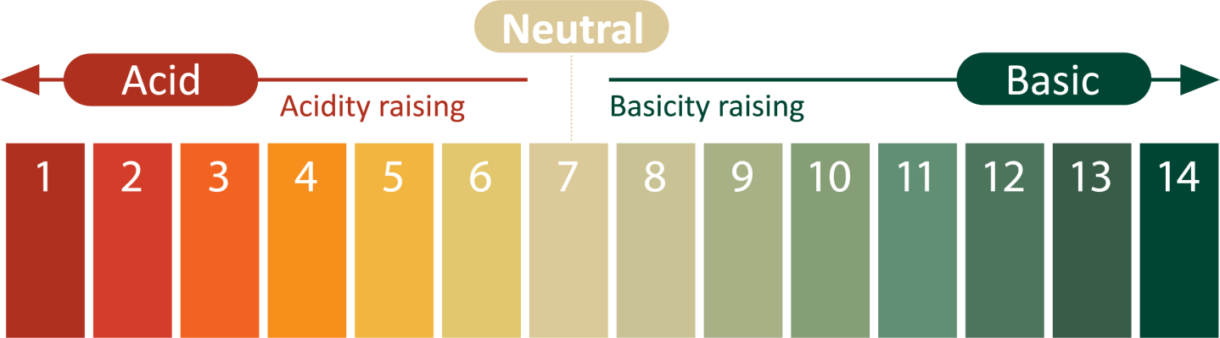
How acidic are the things we drink?
Measuring the pH of common drinks
^{Introduction and theory}
Every solution inside or outside the human body is acid, alkali or neutral. This means that blood, gastric juice, wine, coffee and so on each have a specific pH.
Inside the human body under ideal conditions we should find an acidity degree between 7.35 and 7.45, this means slightly basic.
Inside our organism it is vital to maintain a certain acid-basic balance, because a lot of metabolic reactions that perform fundamental roles inside our body can only happen at precise levels of acidity or basicity. A small change in the pH of the solution can affect the rate of important chemical reactions that our metabolism depends on, so risking the natural processes that occur in our body.

Slide 11
How acidic are the things we drink?
Measuring the pH of common drinks
^{Introduction and theory}
For example, during exercise the acidity of the muscles rises because of the generation of lactic acid. This causes pain and a decrease of voluntary muscle contraction.
Now students are encouraged to raise a hypothesis which must be tested with an experiment.
f you have a fizzy drink and alcoholic beverage, do you think there is a difference in
their pH? Which one do you expect to be more acidic and which one more basic?

Slide 12
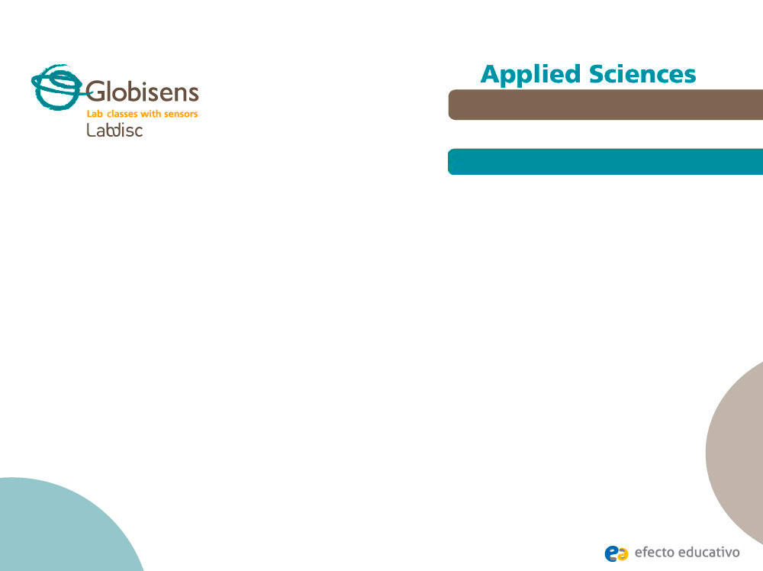
How acidic are the things we drink?
Measuring the pH of common drinks
^{Activity description}
During the following activity students will measure the pH of different kinds of fizzy and alcoholic beverages, using the Labdisc pH sensor. The results will then be arranged in order from lowest to highest pH. In conclusion, students should relate the excessive consumption of acidic substances to physical symptoms that people experience.

Slide 13
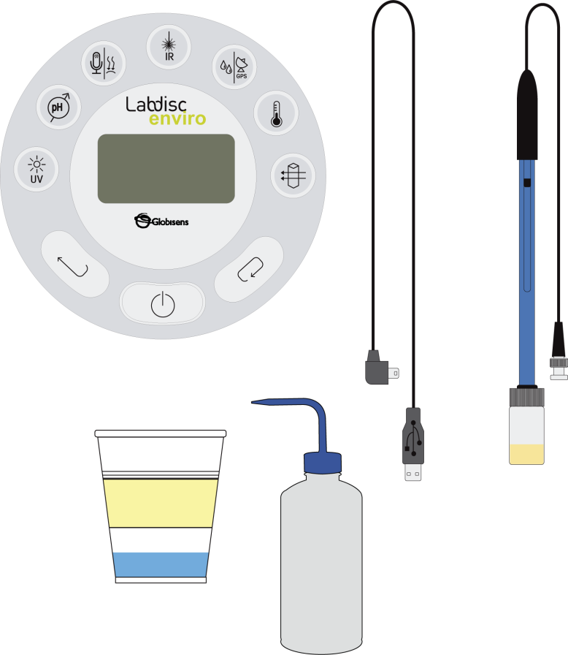
How acidic are the things we drink?
Measuring the pH of common drinks
Labdisc
^{Resources and materials}
USB connector cable
pH sensor
Tape to mark the glasses
Wash bottle
Tap water
Beaker or some other glass
Lemon
Coca Cola

Slide 14



How acidic are the things we drink?
Measuring the pH of common drinks
^{Using the Labdisc and sensor}
^{a. Using the Labdisc}
To collect measurements with the Labdisc pH sensor, the Labdisc must be configured according to the following steps:
Turn on the Labdisc by pressing
Press and select “SETUP” by pressing
Now select option “SET SENSORS” with
Select only the pH sensor and then push
Once you have done that you will return to setup, press
Select “10/sec” with and then press
Press and select “NUMBER OF SAMPLES” with
Select “10000” with and then press

Slide 15

How acidic are the things we drink?
Measuring the pH of common drinks
^{Using the Labdisc and sensor}
To go back to the measurements press three times.
Open the GlobiLab software and connect the Labdisc to the computer, using the USB cable, or through the Bluetooth connection. When you are ready - press from the software, or press to start measuring.
Once you have finished measuring stop the Labdisc by pressing (you will see the instruction “Press SCROLL key to STOP”) and press

Slide 16
How acidic are the things we drink?
Measuring the pH of common drinks
^{Using the Labdisc}
b. Care and cleaning of the sensor
The pH sensor is very sensitive, and requires certain treatment. Please consider that:
After each measurement the pH probe should be cleaned with distilled water. Always keep the wash bottle and distilled water close at hand. If you don’t have a wash bottle you will need a syringe of at least 10 ml in order to clean the
sensor properly.
Following each time the sensor is washed, ensure it is dried with absorbent paper, without touching the transparent ball at the tip of the sensor.

Slide 17
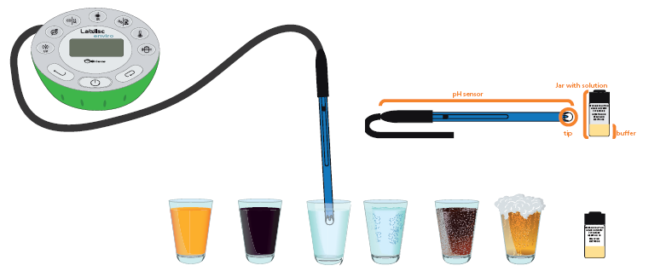
How acidic are the things we drink?
Measuring the pH of common drinks
^{Using the Labdisc}
Whenever the sensor is not used it must stay inside the buffer solution inside the jar. Ensure the sensor is always cleaned and dried properly before inserting the tip of the sensor into the solution (see steps 1 and 2).

Slide 18
How acidic are the things we drink?
Measuring the pH of common drinks
^{Experiment}
The following steps explain how to perform the experiment:
Take the 3 plastic glasses and mark each of them with the name of the substance you will analyze (e.g. Coca Cola).
Put a small amount of the drink inside the glass, about 50 ml (you should be able to completely insert the tip of the sensor into the solution).
To start measuring remove the electrode from the buffer and clean it with plenty of distilled water. Dry it with absorbent paper.
Measure the pH of the different substances inside the glasses according to the following order: Water, Lemon juice, Water (to wash the electrode), Coca Cola.
To collect data put the electrode inside the sample without touching the sides of the plastic glass.

Slide 19
How acidic are the things we drink?
Measuring the pH of common drinks
^{Experiment}
Press the button of the Labdisc.
Observe the pH variation displayed on the Labdisc screen.
Wait until the pH value you are measuring stabilizes. It is ready when the first decimal displayed on the screen varies between +/- 1.
Move the pH electrode between the 3 cups: Water, Lemon juice, Water and Coca Cola.
Once you have finished measuring turn the Labdisc off.
Remember to wash the electrode at the end of measurement with plenty of tap water, rinsing well the tip of the electrode.
Once you have finished remember to place the sensor back inside the buffer solution.

Slide 20


How acidic are the things we drink?
Measuring the pH of common drinks
^{Results and analysis}
The following steps explain how to analyze the experiment results:
Observe the graph displayed on the screen.
Press the button to write notes and add pictures on the graph specifying your observations.
Press to select data points on the graph and pick one representative point for each of the solutions (the representative points are the ones achieved once the
measurement reaches a plateau).
You can “lock” the marker at each of the 3 pH levels. Right click on the marker text box will allow you to lock it and have it as a label on the graph.

Slide 21

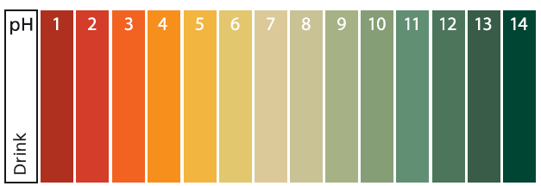
How acidic are the things we drink?
Measuring the pH of common drinks
^{Results and analysis}
How do your results relate to your initial hypothesis? Explain.
Which was the most acidic substance you analyzed? Which one was the most basic?
Locate each substance on the pH scale displayed on the theoretical background,
according to the data you collected.

Slide 22
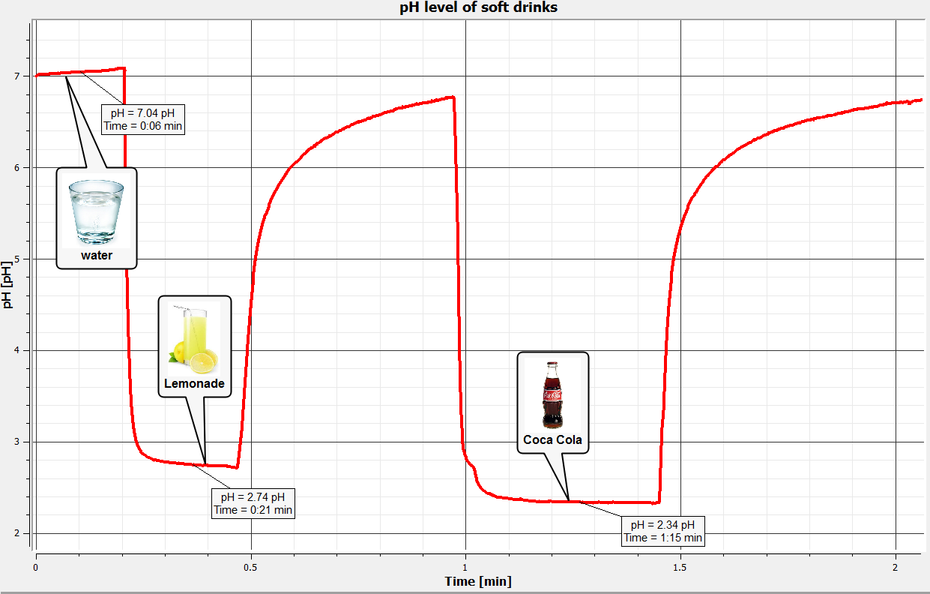
How acidic are the things we drink?
Measuring the pH of common drinks
^{Results and analysis}
Students should come up with a graph similar to the one below:

Slide 23


How acidic are the things we drink?
Measuring the pH of common drinks
^{Conclusions}
Following are some questions and answers which should be developed by students in order to elaborate on their conclusions.
How does the proton (hydrogen) concentration of the Cola-based drink compare to the distilled beverage?
Students should explain that the proton concentration of cola soda is higher than that of the distilled beverage, because it has a lower pH value (therefore, it is more acidic).
Students should reach the following conclusions:
Students will be more familiar with fizzy drinks, realizing that despite their sweet flavor this type of drink is more acidic than an water or even lemon juice. The most acidic soda is cola, which means that it has a higher hydrogen concentration than the other analyzed substances.

Slide 24
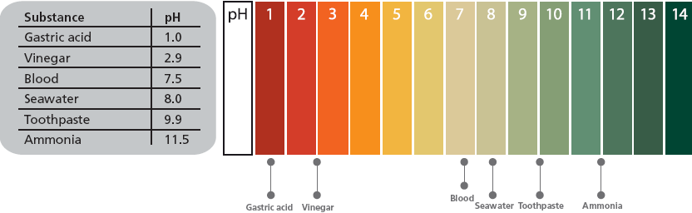
How acidic are the things we drink?
Measuring the pH of common drinks
Activities for further application
The aim of this section is for students to extrapolate the acquired knowledge during this class through its application in different contexts and situations. Furthermore, it is intended that students question and present possible explanations to the experimentally observed phenomena.
Further questions:
The following substances are arranged on the chart according to their pH.

Slide 25

How acidic are the things we drink?
Measuring the pH of common drinks
Activities for further application
Explain the symptomatology we experience when our gastric acid becomes more acidic or basic.
Students should establish the negative effects of an abrupt pH variation in the stomach, knowing it normally is in a range of 1.0 – 2.0. Students should understand that a sudden drop of this value may cause heartburn and a sudden rise may cause a “heavy” feeling in our stomach.
How are our teeth affected by the excessive consumption of acidic substances?
Students should establish that excessive consumption of acidic beverages causes dental erosion. This means the tooth enamel (the hard, protective coating of the tooth) is lost because of the acid attack. Sometimes the enamel is worn away and the dentine underneath is exposed. In extreme cases erosion may even reach the nerve. This can cause tooth decay, together with weakening and demineralization, which causes dental sensibility.

Slide 26


