Slide 1


Our Heart Rate
Measuring our heart rate at rest and after physical exercise

Slide 2
Our Heart Rate
Measuring our heart rate at rest and after
physical exercise
^{USA Standards Correlation}
FRAMEWORK FOR K-12 SCIENCE EDUCATION © 2012
The Dimension I practices listed below are called out as bold words throughout the activity.
Dimension 1 Science and Engineering Practices | ü | Asking questions (for science) and defining problems (for engineering) |  | Use mathematics and computational thinking
 |  | Developing and using models | ü | Constructing explanations (for science) and designing solutions (for engineering)
 | ü | Planning and carrying out investigations |  | Engaging in argument from evidence
 | ü | Analyzing and interpreting data | ü | Obtaining, evaluating, and communicating information
Dimension 2 Cross Cutting Concepts |  | Patterns |  | Energy and matter: Flows, cycles, and conservation
 |  | Cause and effect: Mechanism and explanation | ü | Structure and function
 |  | Scale, proportion, and quantity |  | Stability and change
 | ü | Systems and system models

Slide 3
Our Heart Rate
Measuring our heart rate at rest and after
physical exercise
^{USA Standards Correlation}
Dimension 3 Core Concepts | Discipline | Core Idea Focus
 | Life Science | LS1: From Molecules to Organisms: Structures and Processes
 |  | LS1.A: Structure and Function
 |  | LS1.B: Growth and Development of Organisms
NGSS Standards | Middle School Standards Covered | High School Standards Covered
 | MS.LS-SFIP: Structure, Function, and Information Processing | HS.LS-SFIP: Structure, Function, and Information Processing
 | MS.LS-GDRO: Growth, Development and Reproduction of Organisms | HS.LS-IVT: Inheritance and Variation of Traits

Slide 4
Our Heart Rate
Measuring our heart rate at rest and after
physical exercise
^{USA Standards Correlation}
NATIONAL SCIENCE EDUCATION STANDARDS © 2002
Content Standards (K-12)
ü | Systems, order, and organization |  | Evolution and equilibrium
ü | Evidence, models, and explanation |  | Form and Function
ü | Constancy, change, and measurement
Life Science Standards Middle School |  | Life Science Standards High School
ü | Structure and Function in Living Systems |  | The Cell
 | Reproduction and Heredity |  | Molecular Basis of Heredity
ü | Regulation and Behavior |  | Biological Evolution
 | Populations and Ecosystems |  | Interdependence of Organisms
ü | Diversity and Adaptations of Organisms | ü | Matter, Energy, and Organization in Living Systems
 |  | ü | Behavior of Organisms

Slide 5
Our Heart Rate
Measuring our heart rate at rest and after
physical exercise
^{USA Standards Correlation}
LEARNING OBJECTIVES
Core Objectives (National Standards):
Develop the ability to refine ill-defined questions and direct to phenomena that can be described, explained, or predicted through scientific means.
Develop the ability to observe, measure accurately, identify and control variables.
Decide what evidence can be used to support or refute a hypothesis.
Gather, store, retrieve, and analyze data.
Become confident at communicating methods, instructions, observations and results with others.
Activity Objectives:
The objective of this activity is to study our heart rate at rest and after physical exercise. Students will create a hypothesis and proceed to test it, using the Globisens Labdisc heart rate sensor.
Time Requirement:
45 - 60 minutes

Slide 6
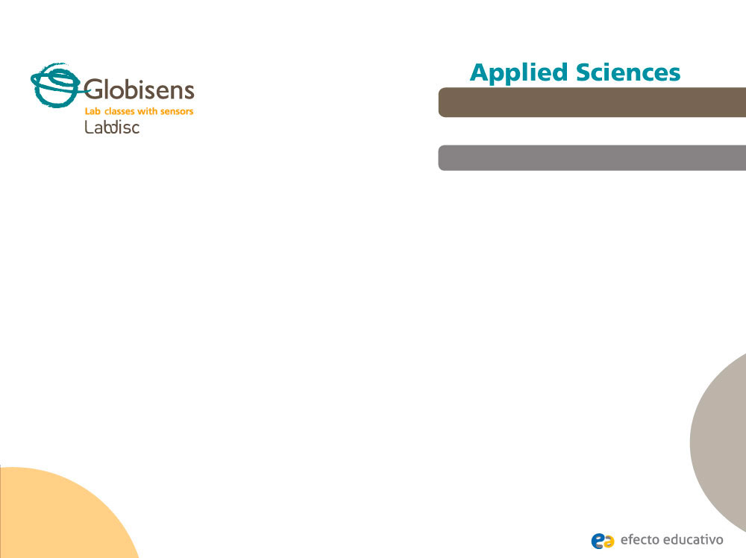
Our Heart Rate
Measuring our heart rate at rest and after
physical exercise
^{Objective}
Study our heart rate at rest and after physical exercise, creating a hypothesis and proceeding to test it, using the Labdisc heart rate sensor.

Slide 7


Our Heart Rate
Measuring our heart rate at rest and after
physical exercise
^{Introduction and theory}
The aim of the introduction is to focus students on the subject of the class by refreshing acquired knowledge and asking questions which can encourage research development. Then, key concepts of the theoretical framework, which will be used by the students during the class are taught.
^{Introduction}
Even though we know our heart beats throughout our entire life, we don’t usually notice it when we are resting or sitting. However, whenever we make a greater physical effort, we can feel our heart pounding strongly inside our chest.
What other situations do you think can cause your heart pulse to rise?
What do you think would happen if our heart didn´t have the ability to adapt?
Carry out the experiment activity with your class so that at the end you’ll be able to answer the following question:
In what type of situations does our heart rate rise? In what type of situations does
our heart rate slow down?

Slide 8
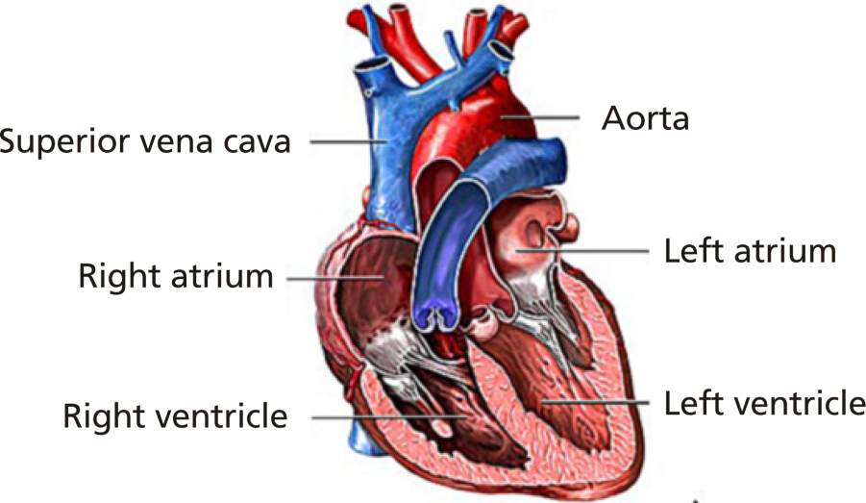
Our Heart Rate
Measuring our heart rate at rest and after
physical exercise
^{Introduction and theory}
^{Theoretical}
One of our vital functions is to provide each part of our body with gases, hormones and nutrients. This is performed by our circulatory system. The fundamental organ in this system is the heart, a very special muscle which has the ability to control itself. It works like a pump, receiving blood from the veins and ejecting it through the arteries.
The blood arrives into the atria and then flows into the ventricles. From here, the ventricles pump the blood out of the heart, carrying it throughout our body.

Slide 9
Our Heart Rate
Measuring our heart rate at rest and after
physical exercise
^{Introduction and theory}
Every cardiac cycle has two phases: Contraction (systole phase) and relaxation (diastole phase). These movements don’t happen at the same time, but we can explain the cycle with three events:
Atrial systole: Both atria contract, ejecting the blood into the ventricles.
Ventricular systole: Both ventricles contract ejecting the blood outside the heart. Meanwhile, the atria are still in systole. The right ventricle contains the blood collected by the veins from all over the body. This blood has a high concentration of CO2 and a low concentration of O2. From the right ventricle the blood is pumped to the lungs, where oxygenation takes place. The left ventricle expulses the blood that comes from the lungs, meaning this blood is rich with O2 and contains only a little amount of CO2.
General diastole: Atria and ventricles relax, letting the blood enter inside the atria again.

Slide 10
Our Heart Rate
Measuring our heart rate at rest and after
physical exercise
^{Introduction and theory}
Now students are encouraged to raise a hypothesis which must be tested with an experiment.
If you were to measure your heart rate at rest and then again after performing
physical exercise, how much do you think it would rise?

Slide 11
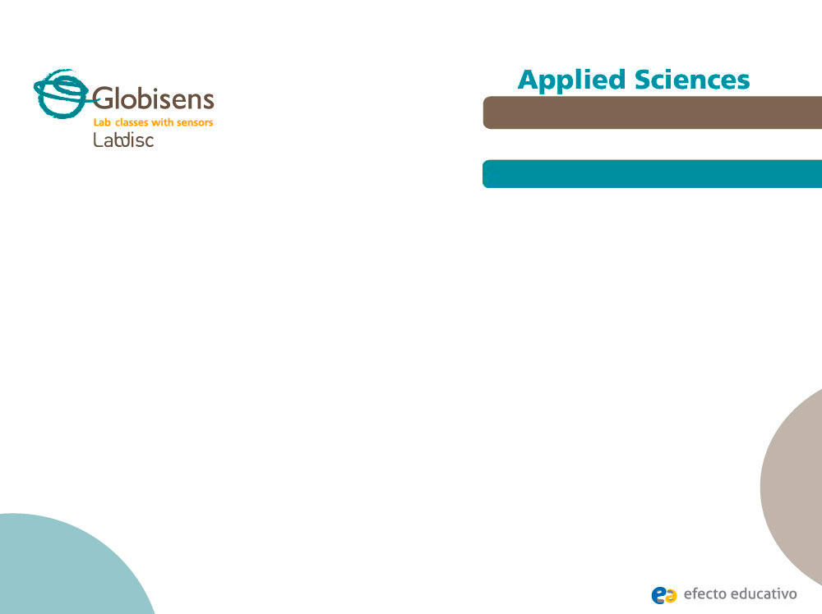
Our Heart Rate
Measuring our heart rate at rest and after
physical exercise
^{Activity description}
Students will measure their heart rhythm at two different times (during rest and after physical exercise) using the Labdisc heart rate sensor, to discover how these two data are related. After this activity they will construct two graphs and observe the differences in order to compare the results with their initial hypothesis.

Slide 12
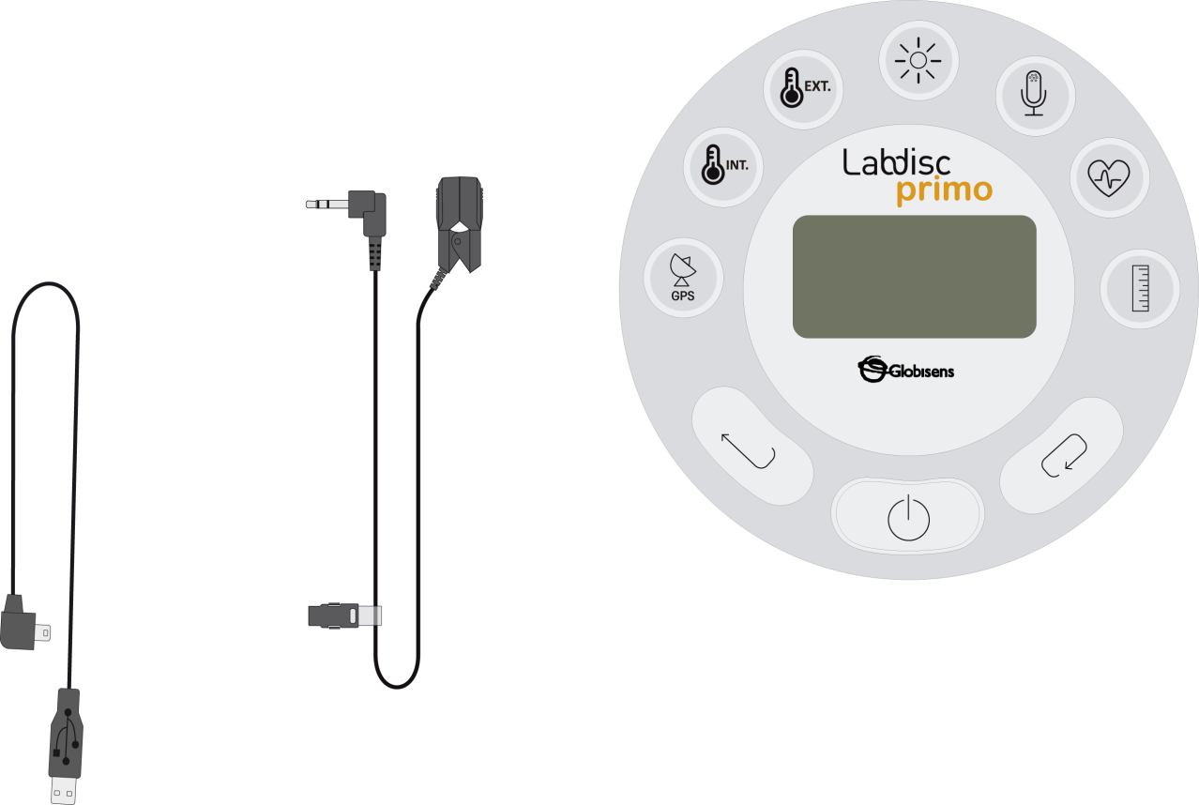
Our Heart Rate
Measuring our heart rate at rest and after
physical exercise
^{Resources and materials}
Labdisc
Ear clip
USB connector cable

Slide 13



Our Heart Rate
Measuring our heart rate at rest and after
physical exercise
^{Using the Labdisc}
^{a. Using the Labdisc}
To collect measurements with the Labdisc heart rate sensor, the Labdisc must be configured according to the following steps:
Turn on the Labdisc pressing
Press , and select “SETUP” by pressing
Now select option “SET SENSORS” with
Select only the heart rate sensor and then press
Once you have done that, you will return to setup, press
Select “10/sec” with and then press

Slide 14
Our Heart Rate
Measuring our heart rate at rest and after
physical exercise
^{Using the Labdisc}
Press and select “NUMBER OF SAMPLES” with
Select “1000” with and then press
To return to the measurements press two times.
Then press to start measuring.
Once you have finished measuring stop the Labdisc by pressing (you will see the instruction “Press SCROLL key to STOP”) and press

Slide 15
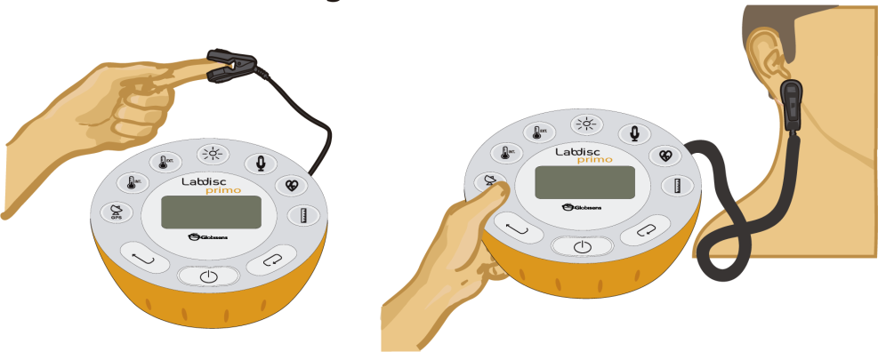
Our Heart Rate
Measuring our heart rate at rest and after
physical exercise
^{Experiment}
The following steps explain how to perform the experiment:
Put the ear clip on the index finger of a student and start recording with the Labdisc, as the image shows. After a few seconds the Labdisc should produce a “beeping” sound for every heart beat. If this does not happen, put the ear clip on the student`s ear lobe, as the image shows.
The student should stay sitting calmly, and without talking for a minute. Then stop the Labdisc.

Slide 16
Our Heart Rate
Measuring our heart rate at rest and after
physical exercise
^{Experiment}
Following the first minute, the student should then stand up and start jumping for another minute. After that, put the ear clip on the student`s index finger and start recording with the Labdisc for another minute.
Once you`ve finishing measuring, stop the Labdisc.
Repeat the same procedure with other classmates who want to participate.

Slide 17




Our Heart Rate
Measuring our heart rate at rest and after
physical exercise
^{Results and analysis}
The following steps explain how to analyze the experiment results:
Connect the Labdisc to the computer using the Bluetooth wireless communication channel.
In the top menu click in the button and select the button.
Select the last experiment from the list if you measured the heart rate of a single student. If you collected data from more students, proceed to analyze the graphs one-by-one. Remember that there are two graphs per student.
Observe the graph displayed on the screen.
Press the button and write notes on the graph specifying at what range you found the data for rest and physical exercise.
Press to select data points on the graph and pick one representative point for each activity.

Slide 18

Our Heart Rate
Measuring our heart rate at rest and after
physical exercise
^{Results and analysis}
Did you find differences between your hypothesis and the results recorded with the sensor? Explain.
What can cause the rise in the heart rate during physical exercise?
What other factors could relate to heart rate variations in a person?

Slide 19
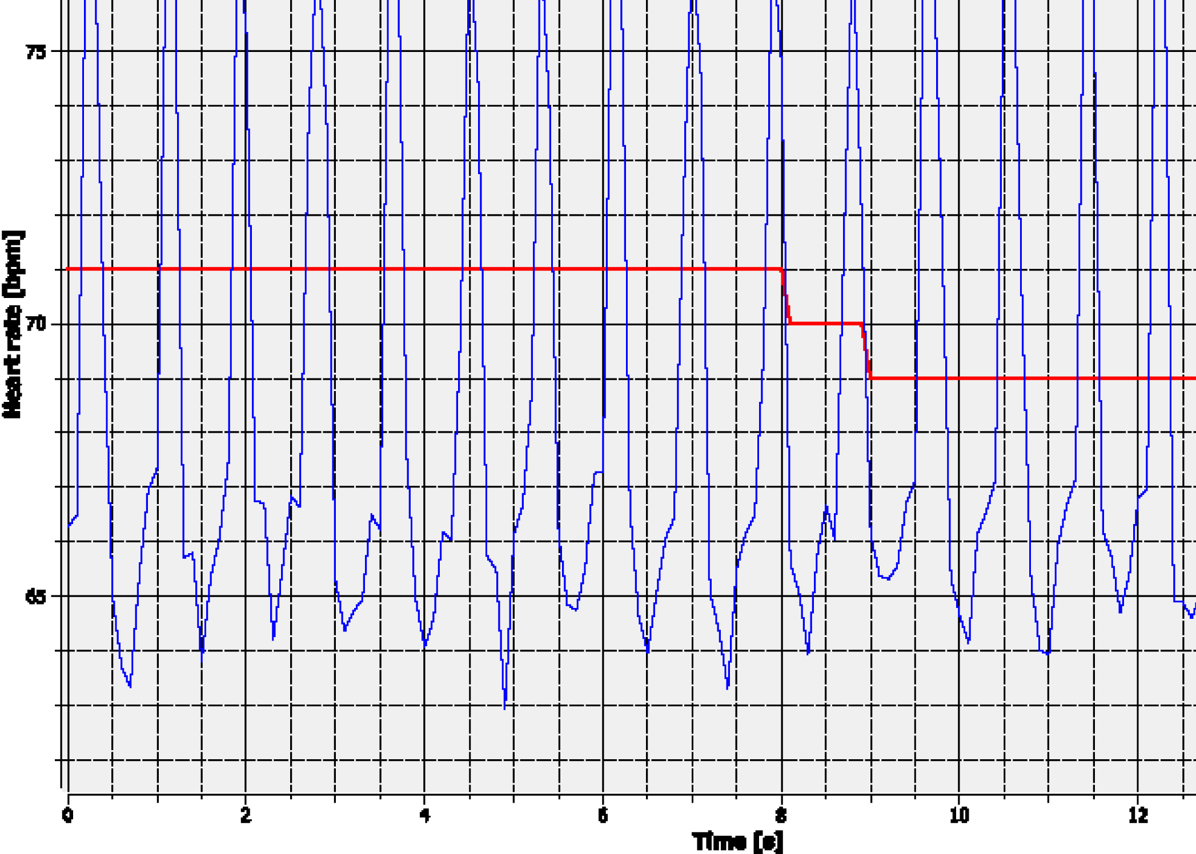
Our Heart Rate
Measuring our heart rate at rest and after
physical exercise
^{Results and analysis}
The graph below should be similar to the one the students came up with.

Slide 20
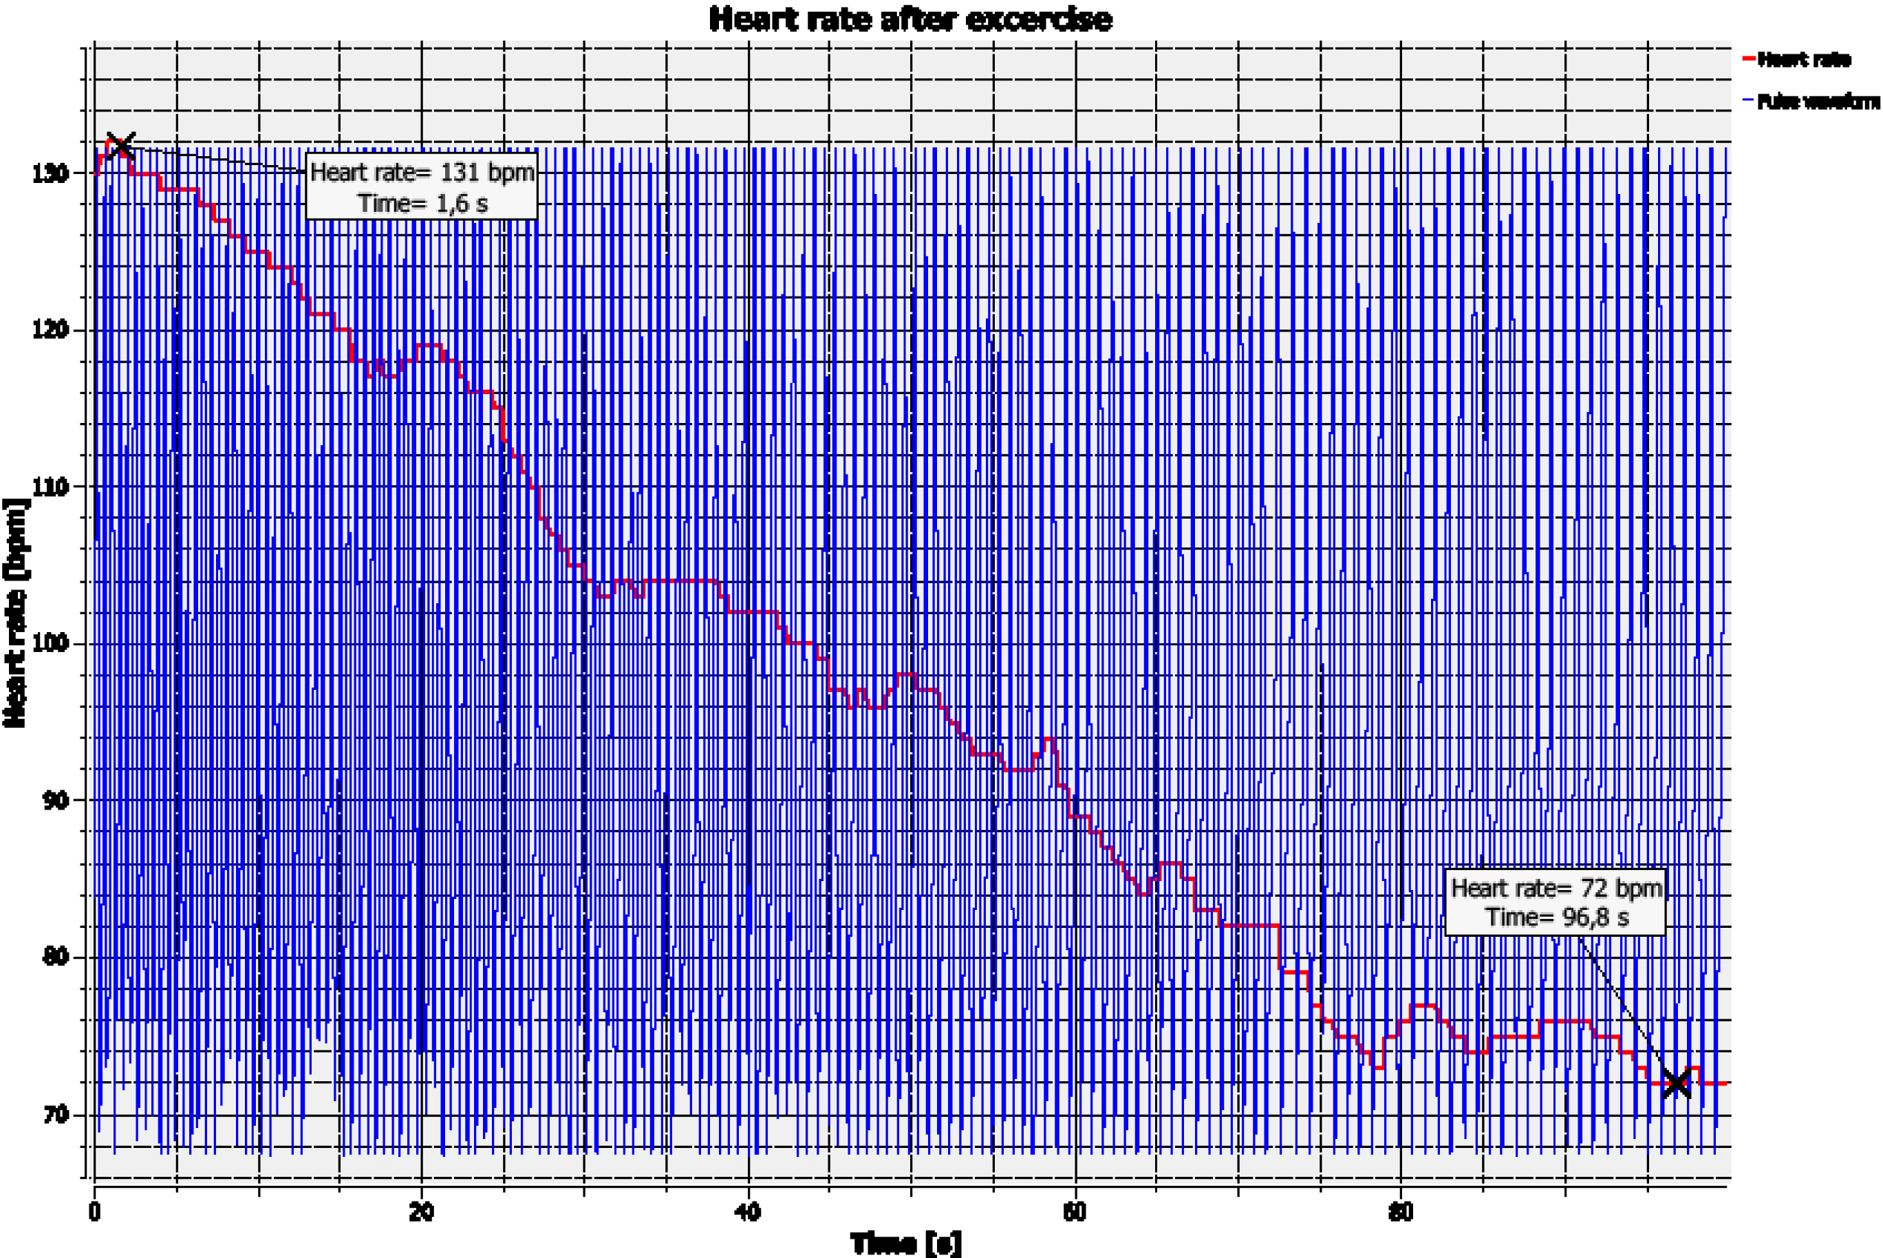
Our Heart Rate
Measuring our heart rate at rest and after
physical exercise
^{Results and analysis}

Slide 21

Our Heart Rate
Measuring our heart rate at rest and after
physical exercise
^{Conclusions}
Following are some questions and answers which should be developed by the students in order to elaborate on their conclusions.
Did you find a correlation between the activity of the person and the heart rate you recorded?
The students should point out that the heart rate rises with physical exercise,
compared to the heart rate during a period of rest.
Do all people have the same heart rate during a period of rest? Why?
Students should compare the graphs of two or more classmates, and establish that
two people don´t have the same heart rate, even if both are resting.
If you compare both graphs, how does the pulse vary at rest, after exercise and
when returning to rest?
Students should compare the graphs and say that the pulse remains constant when resting, increases during exercise and returns to the initial value.

Slide 22

Our Heart Rate
Measuring our heart rate at rest and after
physical exercise
^{Conclusions}
Students should reach following conclusions:
The heart rate is a physiological parameter that varies depending on the condition (at rest or performing physical exercise), and that it is also variable between different people in the same condition. They should also understand that heart rate is related to the individual person’s health condition.

Slide 23

Our Heart Rate
Measuring our heart rate at rest and after
physical exercise
Activities for further application
The aim of this section is for students to extrapolate the acquired knowledge during this class through its application in different contexts and situations. Furthermore, it is intended that students question and present possible explanations to the experimentally observed phenomena.
Further questions:
Whenever we exercise, our muscles consume a lot of oxygen and in turn start releasing more CO2 than when we are resting. How do you think these two actions are related to our heart rate?
Students should understand that the heart rate rises during exercise, because we need to pump more oxygenated blood towards the muscles, so that they can keep performing well. Additionally, an increased blood flow removes the large amount of CO2 that is released during muscle activity, transporting it to the lungs.

Slide 24
Our Heart Rate
Measuring our heart rate at rest and after
physical exercise
Activities for further application
Do you think the heart rate varies with age? (Think of a fetus, babies, kids, adults and elderly people).
Students should find out that as we get older, our heart rate slows down. Maybe some of the students have felt the heartbeat of a newborn and noticed its heart rate is much higher.
Why do you think it is important to know someone’s heart rate?
Students should understand that the heart rate is an important variable to consider in determining if someone is sick or healthy, because it will change often during some illnesses or in relation to symptoms (such as fever).

Slide 25
Our Heart Rate
Measuring our heart rate at rest and after
physical exercise
Activities for further application
Do you know how our daily diet, particularly the amount of fat consumed, can relate to our heart rate?
Students should establish that fat consumption causes blood vessel blockages, and therefore changes the heart rate.
Surely you have noticed that your heart rate rises when you are scared or feeling strong emotions, do you know why this happens? If you don’t, investigate the reason.
Student should establish that the heart rate changes because of different hormones which are released into the blood stream. For example, adrenaline is a heart rate rising hormone that is
released during physical activity and in stress situations.
When you compare both graphs obtained, how do you explain that the pulse value
returned to the same value as before doing exercise?
Students should point out that during exercise, the body needs more oxygen than when in a resting state. As a result, the heart pumps more blood to the tissues that are working and the pulse increases, but at rest the blood flux decreases, so the heart pumps less and the pulse returns to the initial state.

Slide 26


