Slide 1


Concentrations that absorb
Measuring percentage transmittance of solutions at different concentrations

Slide 2
Concentrations that absorb
Measuring percentage transmittance of solutions at different concentrations
^{USA Standards Correlation}
FRAMEWORK FOR K-12 SCIENCE EDUCATION © 2012
The Dimension I practices listed below are called out as bold words throughout the activity.
Dimension 1 Science and Engineering Practices | ü | Asking questions (for science) and defining problems (for engineering) | ü | Use mathematics and computational thinking
 | ü | Developing and using models | ü | Constructing explanations (for science) and designing solutions (for engineering)
 | ü | Planning and carrying out investigations | ü | Engaging in argument from evidence
 | ü | Analyzing and interpreting data | ü | Obtaining, evaluating, and communicating information
Dimension 2 Cross Cutting Concepts | ü | Patterns | ü | Energy and matter: Flows, cycles, and conservation
 | ü | Cause and effect: Mechanism and explanation |  | Structure and function
 | ü | Scale, proportion, and quantity |  | Stability and change
 | ü | Systems and system models

Slide 3
Concentrations that absorb
Measuring percentage transmittance of solutions at different concentrations
^{USA Standards Correlation}
Dimension 3 Core Concepts | Discipline | Core Idea Focus
 | Physical Science | PS1: Matter and Its Interactions
 |  | PS1.A: Structure and Properties of Matter
NGSS Standards | Middle School Standards Covered | High School Standards Covered
 | MS.PS-SPM: Structure and Properties of Matter | HS.PS-SPM: Structure and Properties of Matter

Slide 4
Concentrations that absorb
Measuring percentage transmittance of solutions at different concentrations
^{USA Standards Correlation}
NATIONAL SCIENCE EDUCATION STANDARDS © 2002
Content Standards (K-12)
ü | Systems, order, and organization |  | Evolution and equilibrium
ü | Evidence, models, and explanation | ü | Form and Function
ü | Constancy, change, and measurement
Physical Science Standards Middle School |  | Physical Science Standards High School
ü | Properties and Changes of Properties in Matter |  | Structure of Atoms
 | Motions and Forces | ü | Structure and Properties of Matter
 | Transfer of Energy |  | Chemical Reactions
 |  |  | Motions and Forces
 |  |  | Conservation of Energy and Increase in Disorder
 |  |  | Interactions of Energy and Matter

Slide 5
Concentrations that absorb
Measuring percentage transmittance of solutions at different concentrations
^{USA Standards Correlation}
LEARNING OBJECTIVES
Core Objectives (National Standards):
Develop the ability to refine ill-defined questions and direct to phenomena that can be described, explained, or predicted through scientific means.
Develop the ability to observe, measure accurately, identify and control variables.
Decide what evidence can be used to support or refute a hypothesis.
Gather, store, retrieve, and analyze data.
Become confident at communicating methods, instructions, observations, and results with others.
Activity Objectives:
The purpose of this activity is to relate light absorbance and transmittance in solutions with different concentrations, create a hypothesis and proceed to test it using the Globisens Labdisc colorimeter sensor.
Time Requirement:
60 - 90 Minutes

Slide 6
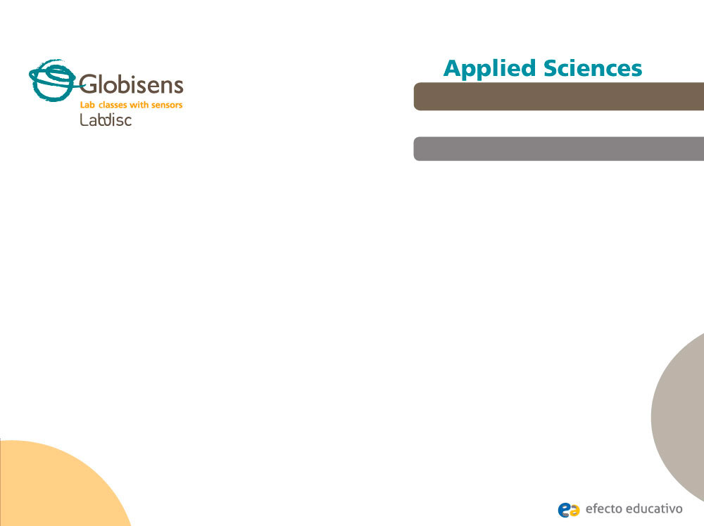
Concentrations that absorb
Measuring percentage transmittance of solutions at different concentrations
^{Objective}
The purpose of this activity is to relate light absorbance and transmittance in solutions with different concentrations, create a hypothesis and proceed to test it using the Labidsc colorimeter sensor.

Slide 7

Concentrations that absorb
Measuring percentage transmittance of solutions at different concentrations
^{Introduction and theory}
The aim of the introduction is to focus students on the lesson subject by refreshing acquired knowledge and asking questions which encourage research development. Key concepts from the theoretical framework, applied by the students during the lesson, are taught.
^{Introduction}
As part of our everyday life we prepare and use different solutions. Each one is
composed of two parts: The solvent (most of the time water), i.e. the substance
into which the solute is dissolved; and the solute, which is the substance that is
dissolved in the solvent. A common example of a solution may be salt water for
cooking pasta, which becomes more salty the more concentrated the solution is.
When you are doing scientific work, particularly in chemistry, biology or medical
sciences, it is very important to know exactly the concentration of the solutions
you are working with. To measure concentration, several techniques can be used.

Slide 8

Concentrations that absorb
Measuring percentage transmittance of solutions at different concentrations
^{Introduction and theory}
Can you think of some different solutions you have prepared at school or at home?
When you are making tea, how do you know when it is ready? Describe.
Carry out the experiment activity with your class so that at the end you’ll be able to
answer the following question:
How can a light beam that passes through a sample of a given solution help determine
its concentration?

Slide 9
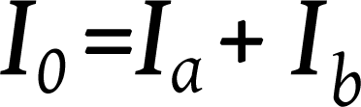
Concentrations that absorb
Measuring percentage transmittance of solutions at different concentrations
^{Introduction and theory}
^{Theoretical}
A solution is a homogeneous mixture of two or more substances that exist in a single concentration. To determine the concentration of a given solution you can apply the Beer-Lambert law. This law states that the concentration of a solute is proportional to the absorbance.
The colorimeter allows light to pass through a cuvette containing a sample of the solution which absorbs some of the incoming beam. When the ray of light of a given wavelength and intensity I comes perpendicularly into contact with the solution of a tinted chemical compound, the compound will absorb part of the radiation (Ia). The remaining part of the solution (Ib) will strike a detector. As such the following equation is demonstrated:

Slide 10
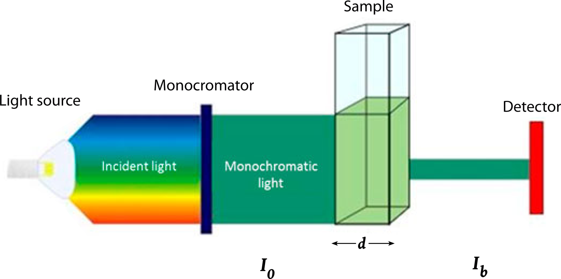
Concentrations that absorb
Measuring percentage transmittance of solutions at different concentrations
^{Introduction and theory}
The absorption of light is related to the number of molecules present in the solution
(concentration of the solution).

Slide 11


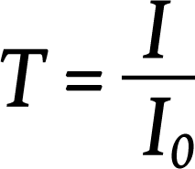
Concentrations that absorb
Measuring percentage transmittance of solutions at different concentrations
^{Introduction and theory}
The Beer-Lambert law defines the relationship between the concentration of a solution and the amount of light absorbed by the solution:
Where:
A = Absorbance
= Molar absorptivity [L mol cm ]
d = Path length of the cuvette containing the sample [cm]
C = Concentration of the compound in solution [mol L ]
Transmittance is the relationship between the amount of light that is transmitted to the
detector once it has passed through the sample (I) and the original amount of light (I0). This is expressed in following formula:
-1
-1
-1

Slide 12
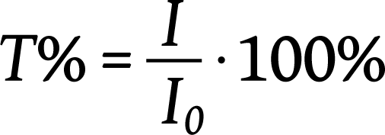
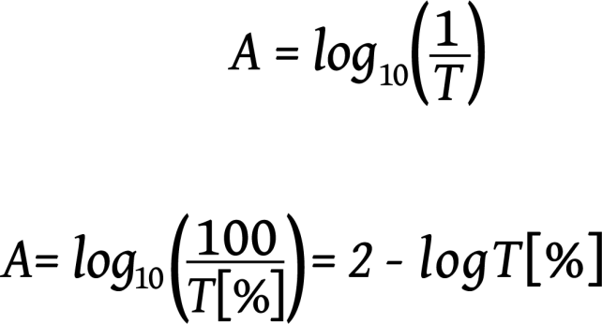
Concentrations that absorb
Measuring percentage transmittance of solutions at different concentrations
^{Introduction and theory}
Where I0 is the intensity of the incident light beam and I is the intensity of the light coming out of the sample. Transmittance is the relative percent of light passed through the sample. Thus, if half the light is transmitted, we can say that the solution has a 50% transmittance.
The relations between transmittance (T) and absorbance (A) can be expressed by following:

Slide 13
Concentrations that absorb
Measuring percentage transmittance of solutions at different concentrations
^{Introduction and theory}
Now students are encouraged to raise a hypothesis which must be tested with
an experiment.
If you have one solution of different concentrations, how do you expect the
transmittance percentages to change when you measure from the lowest to
the highest concentration? Why?

Slide 14
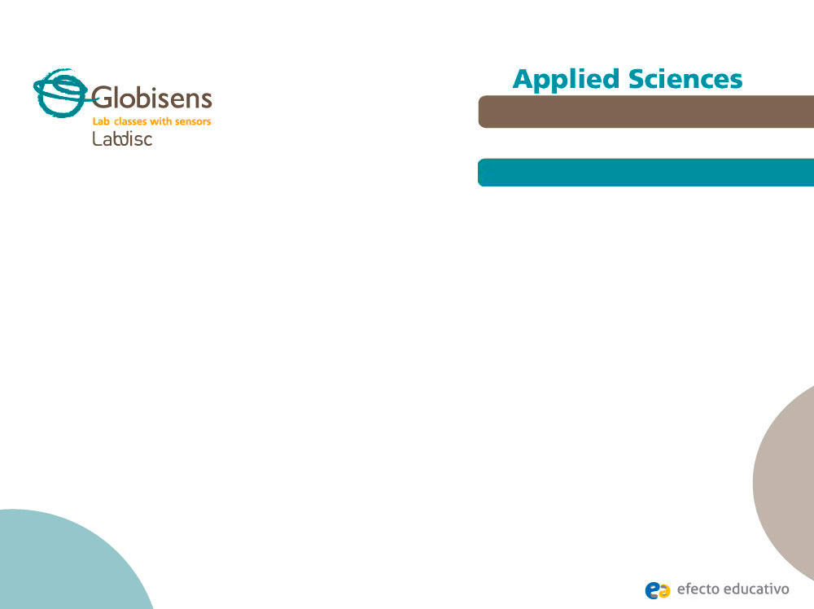
Concentrations that absorb
Measuring percentage transmittance of solutions at different concentrations
^{Activity description}
Students will study the relationship between transmittance, absorbance
and concentration of one solution using the Lambert-Beer law. They will
calculate the concentration of a sample using mathematical tools for
graph analysis.

Slide 15
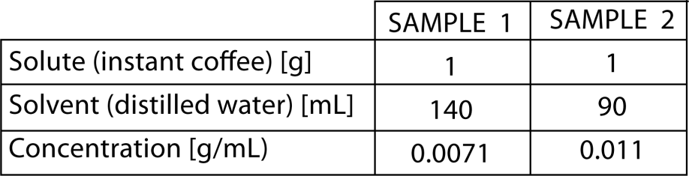
Concentrations that absorb
Measuring percentage transmittance of solutions at different concentrations
^{Activity description}
Preparation of the samples
The teacher will prepare two samples of solution for the students. The students will obtain the concentrations of the samples through the experiment.
The instructions to prepare the samples are as follows:
The teacher will give 3 mL. of one of the samples to each work group. The students will be told that they have to obtain the concentration. At the end of the class they will compare their results with the theoretical value.

Slide 16
Concentrations that absorb
Measuring percentage transmittance of solutions at different concentrations
^{Activity description}
Students will read a graph to obtain the concentration. To understand it they have to know the slope-interception form for the equation of a line.
Y = mX + n
Where
m = slope
X = x coordinate
Y = y coordinate
n = y intercept (where the line crosses the y axis)
Students must:
1. Obtain the transmittance percentage by using the colorimeter.
2. Divide the transmittance percentage by 100 to obtain transmittance (T) of the sample.
3. Calculate absorbance (A) using the following formula: A = LOG10T.
4. Obtain X by solving the slope-interception equation, substituting the y coordinate for
the activity description absorbance value.

Slide 17
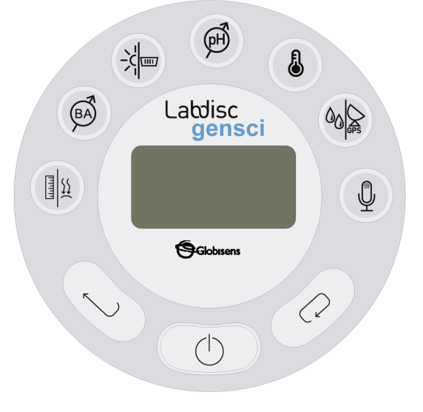
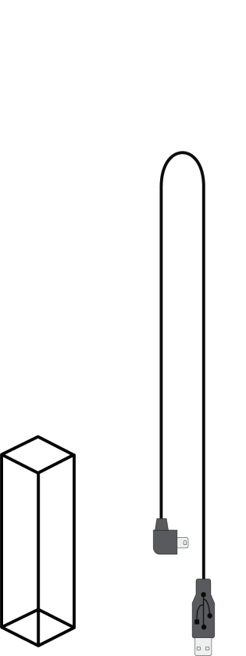
Concentrations that absorb
Measuring percentage transmittance of solutions at different concentrations
^{Resources and materials}
Labdisc
USB connector cable
Cuvette for the colorimeter
Distilled water
100 mL beaker
Instant coffee
Paper towel
4 test tubes
Wash bottle
Stirrer bar
Balance

Slide 18


Concentrations that absorb
Measuring percentage transmittance of solutions at different concentrations
^{Using the Labdisc}
^{a. Labdisc Configuration}
To collect measurements with the microphone sensor, the Labdisc must be set up according to the following steps:
Open the GlobiLab software and turn on the Labdisc.
Click on the Bluetooth icon in the bottom right corner of the GlobiLab screen. Select the
Labdisc you are using currently. Once the Labdisc has been recognized by the software,
the icon will change from a grey to blue color . If you prefer a USB connection follow the previous instruction clicking on the USB icon. You will see the same color change when the Labdisc is recognized .

Slide 19

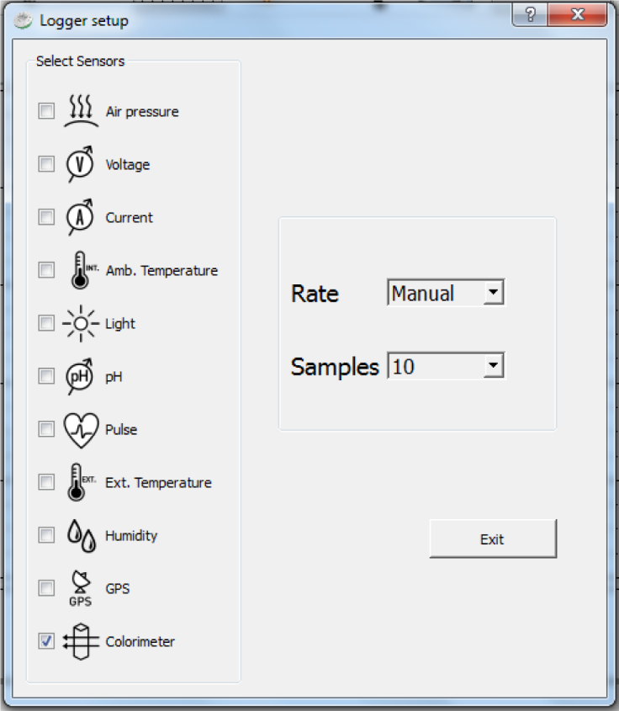
Concentrations that absorb
Measuring percentage transmittance of solutions at different concentrations
^{Using the Labdisc}
Click on to configure the Labdisc. Select colorimeter in the “Logger Setup” window.
Enter “Manual” for the sample frequency and the number of samples.

Slide 20


Concentrations that absorb
Measuring percentage transmittance of solutions at different concentrations
^{Using the Labdisc}
Once you have finished the sensor configuration start measuring by clicking .
Once you have finished measuring stop the Labdisc by clicking .

Slide 21
Concentrations that absorb
Measuring percentage transmittance of solutions at different concentrations
^{Experiment}
The following steps explain how to perform the experiment:
Note: Before you start recording, calibrate the colorimeter with the solvent you will
use during the experiment. This step is important to minimize the experimental error
of the measurement. To calibrate, add some solvent (in this case, distilled water),
filling ¾ of the sensor’s cuvette and place the cuvette in the output. Then, press the
button on the colorimeter until you hear the Labdisc’s signal. Once you have finished
the calibration remove the cuvette from the colorimeter.
Mark each beaker with the number of the sample (1 to 6).
Place distilled water in beaker 1.

Slide 22
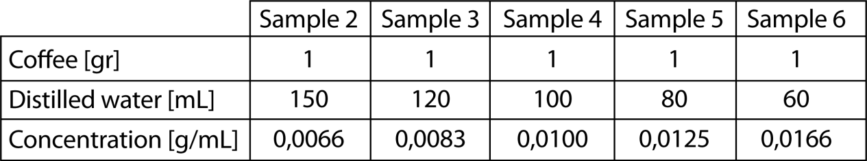
Concentrations that absorb
Measuring percentage transmittance of solutions at different concentrations
^{Experiment}
Prepare samples 2 to 6 as shown in the table below by measuring the amount of distilled water (solvent) and adding 1 gram of coffee (solute) to each glass.
Use the stirrer bar to mix the coffee until it dissolves completely.
Measure the transmittance of the solution. To take a data reading, fill the cuvette until it is ¾ full with solution from sample 1. ALWAYS hold the upper part of the cuvette to ensure the sides remain clean from fingerprints.
Clean and dry the cuvette with paper towels.

Slide 23
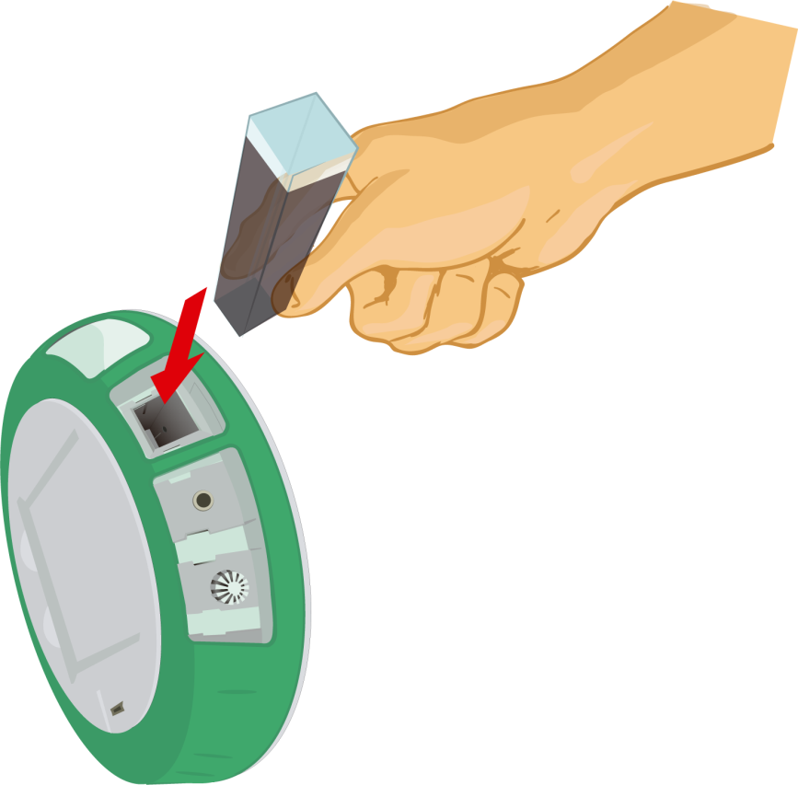
Concentrations that absorb
Measuring percentage transmittance of solutions at different concentrations
^{Experiment}
Place the cuvette in the output of the colorimeter. Cover the cuvette moving the edge of the Labdisc and start measuring.

Slide 24
Concentrations that absorb
Measuring percentage transmittance of solutions at different concentrations
^{Experiment}
Record the transmittance percentage. Take the sample out of the sensor and clean the cuvette with distilled water. Repeat the steps with the other samples.
Once you have finished measuring stop the Labdisc.

Slide 25
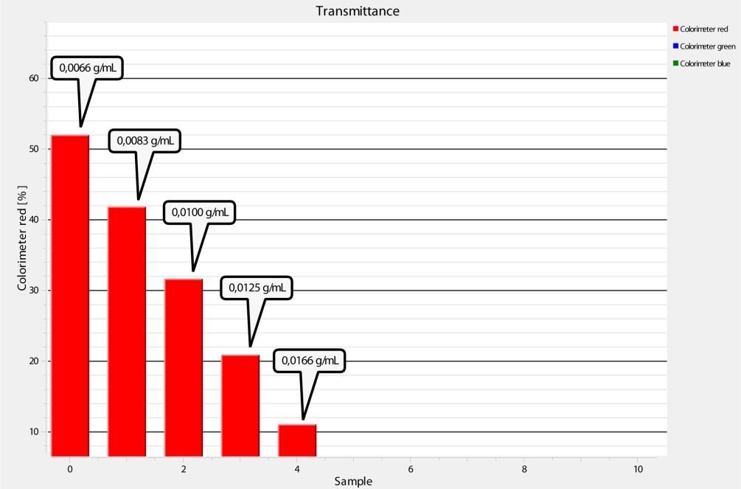
Concentrations that absorb
Measuring percentage transmittance of solutions at different concentrations
^{Experiment}
The graph below should be similar to the one the students came up with. The decreasing order of percentages can also be observed in both green and blue colorimeters.
Transmittance percentage as a function of concentration:

Slide 26
Concentrations that absorb
Measuring percentage transmittance of solutions at different concentrations
^{Results and analysis}
The following steps explain how to analyze the experiment results:
Export the data to Excel clicking on . Save the data on your computer.
Observe the percentage transmittance values obtained when we illuminate the samples with different light beam colors (different wavelengths: Red, green and blue).

Slide 27
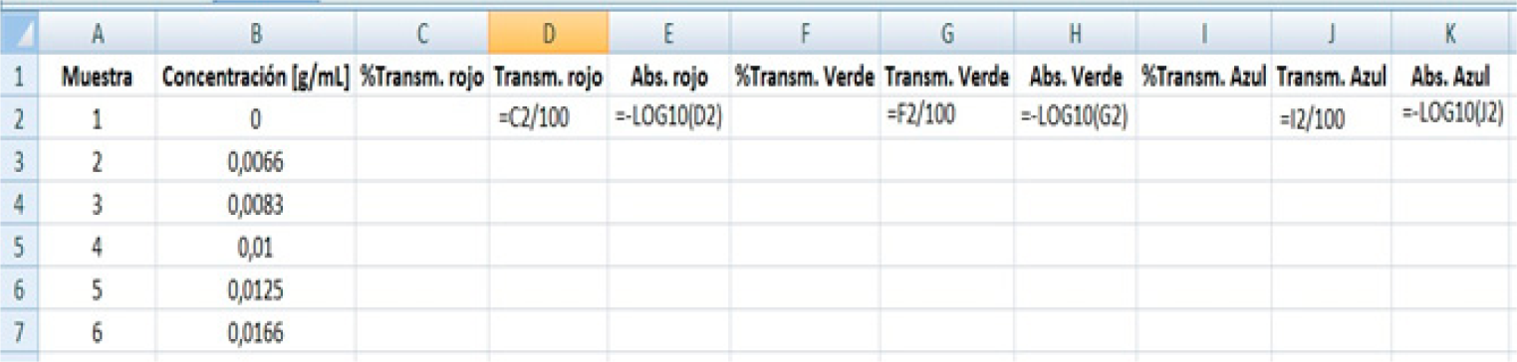
Concentrations that absorb
Measuring percentage transmittance of solutions at different concentrations
^{Results and analysis}
Organize the data and calculate transmittance and absorbance values starting from the
transmittance percentage given by the Labdisc. Data should be organized as shown in the
following table:
Sample – Concentration [gr/mL] - %Transmittance red – Transmittance red – Absorbance red - %Transmittance green – Transmittance green – Absorbance green - %Transmittance blue – Transmittance blue – Absorbance blue

Slide 28

Concentrations that absorb
Measuring percentage transmittance of solutions at different concentrations
^{Results and analysis}
Label column C as percentage transmittance of red, column F as percentage transmittance of green and column I as percentage transmittance of blue. Use the formula of the table to calculate the transmittance (columns D, G and J) and absorbance (columns E, H and K) of each sample.
Observe and compare the transmittance values for each sample. Remember that the Lambert-
Beer law can be used for absorbance values between 0 and 1. Therefore, select the color where you
obtained most results within this absorbance range.
Create a line graph of absorbance as a function of concentration. To do this, first create a scatter
plot by clicking on the button.
Select the Data Range. Select the concentrations value for the x axis and absorbance values for the
y axis.
Add a regressing line to the graph by right-clicking on the points and selecting “Add Trendline”.
Select the linear regression type. Choose the options chart and select “Display equations on chart”.
Press Ok to finish.

Slide 29

Concentrations that absorb
Measuring percentage transmittance of solutions at different concentrations
^{Results and analysis}
How do the results relate to your initial hypothesis? Explain.
What was the relationship between the transmittance and concentration of the
solutions?
What was the relationship between the absorbance and concentration of the
solutions?

Slide 30
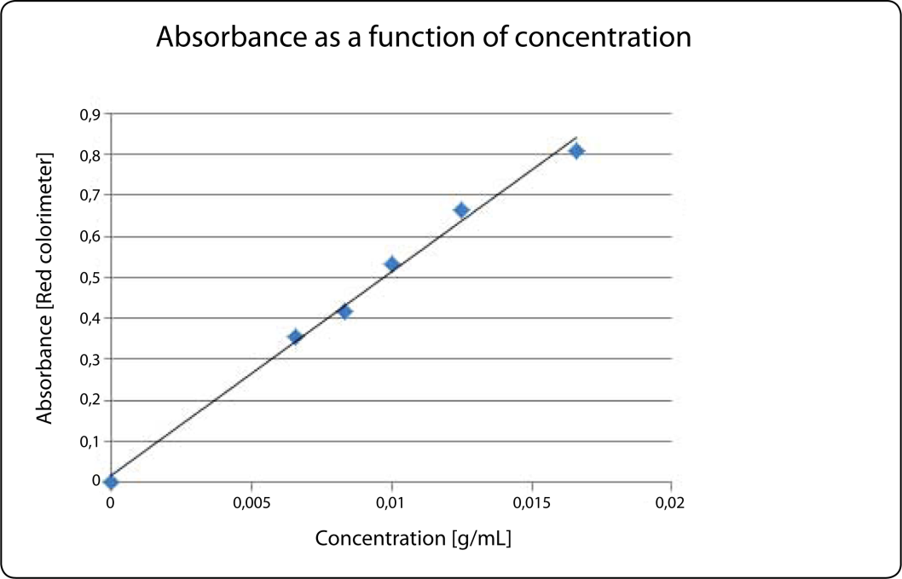
Concentrations that absorb
Measuring percentage transmittance of solutions at different concentrations
^{Results and analysis}
The graph below should be similar to the one the students came up with.
Concentration as a function of absorbance: Y axis: Absorbance [red colorimeter]
X axis: Concentration [gr/mL]

Slide 31

Concentrations that absorb
Measuring percentage transmittance of solutions at different concentrations
^{Conclusions}
Following are some questions and answers which should be developed by students in order to elaborate on their conclusions.
What variables are related in the Lambert-Beer law?
Students should point out that the Lambert-Beer law relates absorbance of a solution to its concentration.
If you have a solution and samples of it with different concentrations; in which range of absorbance can we use the Lambert-Beer law?
Students should go over the information given in the theoretical framework and point out that the Lambert-Beer law is only valid for absorbance values between 0 and 1.

Slide 32
Concentrations that absorb
Measuring percentage transmittance of solutions at different concentrations
^{Conclusions}
Suppose the equation on the Excel graph of absorbance as a function of concentration is a straight line. What is the relationship between the expression and the variables related in the Lambert-Beer law?
Students should understand the meaning of the equation of the graph. In this case, the y
coordinate represent absorbance and the x coordinate concentration. Therefore, we can
understand the equation as following expression:
Absorbance = m * Concentration + n
If you have a sample of unknown concentration, how would the Lambert-Beer law
be useful?
Students should point out that you can obtain the concentration of an unknown sample by measuring
absorbance and using the Lambert-Beer´s law to compare its absorbance to a known solution as an
absorbance reference.

Slide 33

Concentrations that absorb
Measuring percentage transmittance of solutions at different concentrations
Activities for further application
The aim of this section is for students to extrapolate the acquired knowledge during this class through its application in different contexts and situations. Furthermore, it is intended that students question and present possible explanations to the experimentally observed phenomena.
Further questions:
Suppose you have an instant coffee solution of an unknown concentration which you want to calculate using the Lambert-Beer law. However, your absorbance is higher than one - how can you calculate concentration?
Students should point out that they will have to decrease the absorbance value to use the Lambert-Beer law, diluting the initial sample to obtain an absorbance value between 0 and 1. Starting from that point, they could calculate the concentration of the diluted solution and then the concentration of the original sample.

Slide 34
Concentrations that absorb
Measuring percentage transmittance of solutions at different concentrations
Activities for further application
What was the concentration of the sample prepared by your teacher?
Students should use the knowledge obtained during the class to calculate the concentration of the work sample and obtain 0.0071 [gr/mL] or 0.011 [gr/mL] approximately, depending on the sample they worked with.

Slide 35


