Slide 1



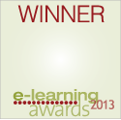

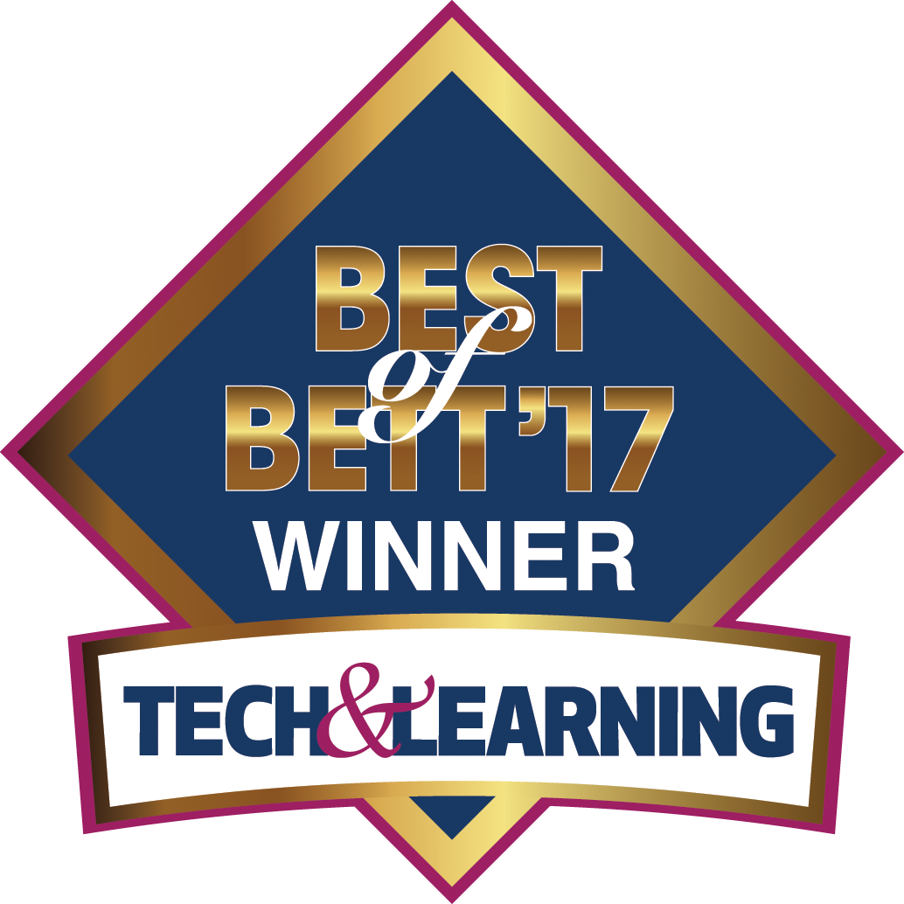
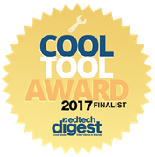
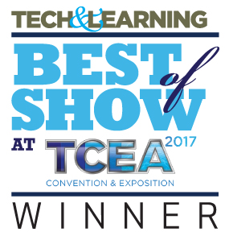

Полномасштабное лабораторное
обеспечение учебного процесса
Notes:
Revolutionizing the school science Labs
Today we will show you the Labdisc – a computer based science Laboratory which revolutionized Science Labs in terms of performance, ease of use and cost.
Launched in late 2011,
Won 7 international GOLD medals, including the latest BEST of BETT 2017 in London out of 700 companies.
Today we are proud of having over 90,000 Labdisc in over 30 countries and in 22 languages.

Slide 2
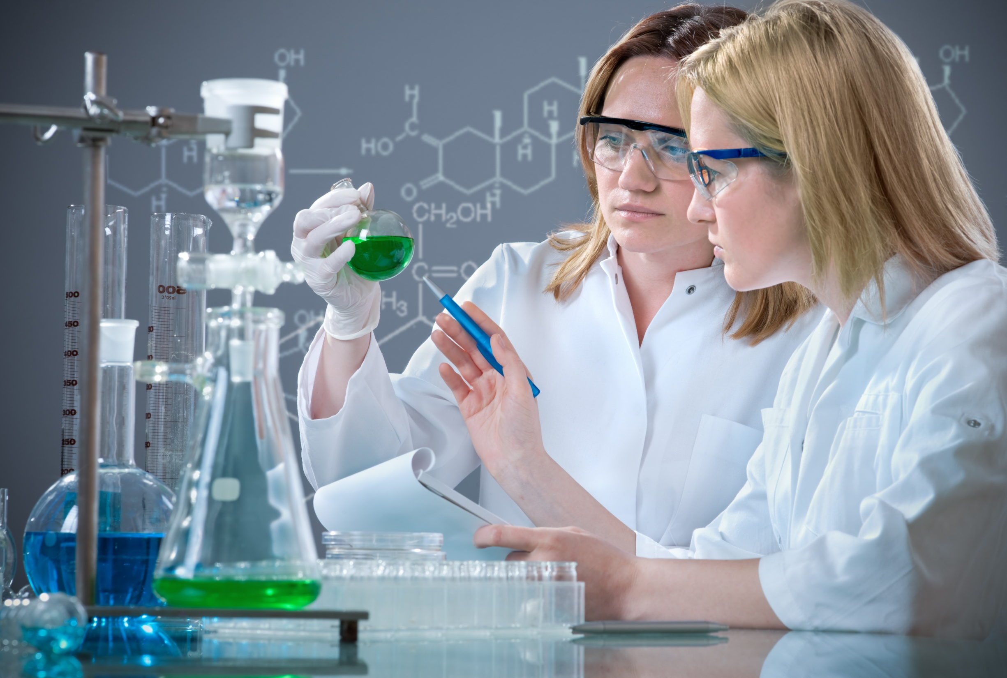
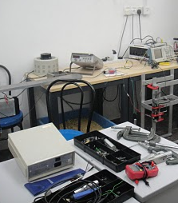
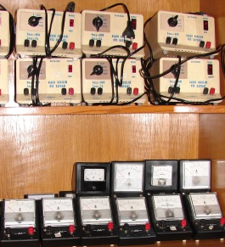


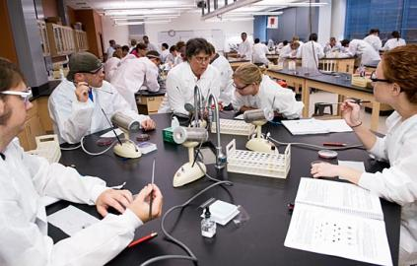
Главные проблемы:
Время и бюджет!
Для типичной лабораторной работы
на 15 рабочих мест в классе из 30 учеников
надо подключить и настроить до
90 отдельных устройств!
Notes:
Time consuming - Even simple experiments in typical classes of 30 students require at least 90 separate items to be tested, calibrated, setup and put away. As a result teachers were becoming technology shy.
Data logging manufacturers missed the point - Instead of understanding this, the data logging industry kept producing increasingly complicated and cumbersome technology that was too difficult and time-consuming to use.
Research shows that only 6% of teachers actually use computerized
laboratory tools for hands-on science, most of them don't use what they have, or only very rarely 3 to 4 times per year.
In addition, invariably throughout the semester, as all the various items (data loggers, sensors, cables, adaptors etc.) are collected after each lesson, a large number get lost.

Slide 3
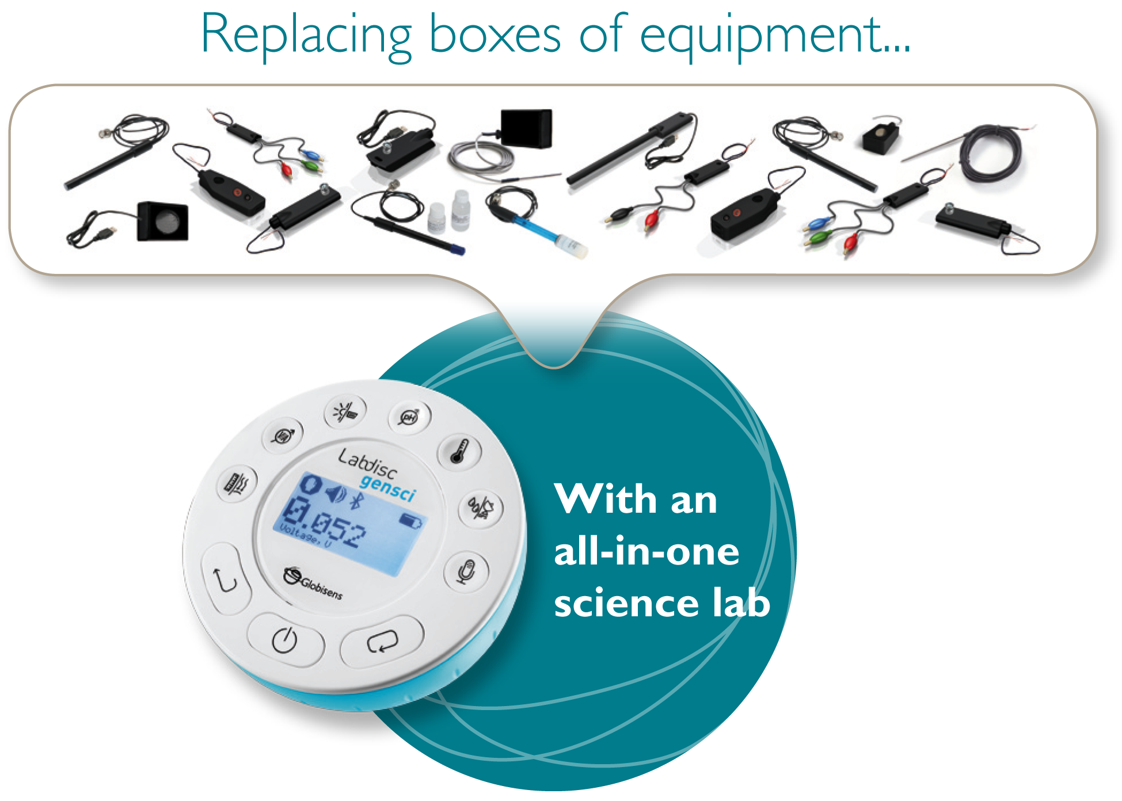
Естественно-научные опыты
еще никогда не были такими простыми!
Меняем все коробки cо множеством датчиков...
На
компактный лабораторный диск:
ВСЕ-в-ОДНОМ!
Notes:
Easy for teachers - Labdisc inquiry-based learning is simple and headache-free for teachers in the classroom or in the field.
Easy for students - Globisens packed everything (data loggers, sensors, sensor & communication cables) into a single disc that fits into the palm of a student’s hand.
The Labdisc is an all-in-one self contained data logging unit with up
to 12 built-in (auto-calibrated) sensors – immediately turning any interactive classroom into a 21st century science laboratory.
Easy for sales – The compact, small Labdisc means easy stocking and distribution. No bulky, high volume science equipment hardware

Slide 4

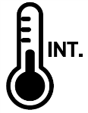
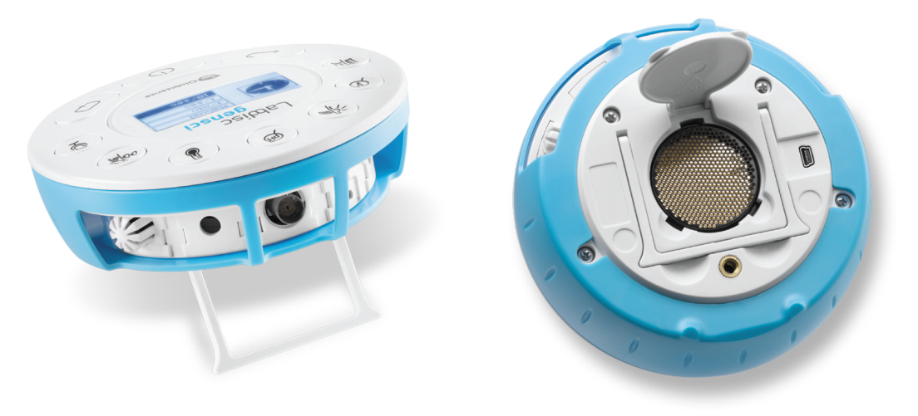








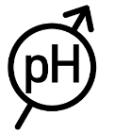
Вся лаборатория на ладони
Gensci – Основы научных знаний
Встроенные датчики
Давление газа, температура окружающей среды и температура объекта, напряжение и ток, расстояние, GPS, освещенность, рН, относительная влажность, микрофон и уровень звука, а также универсальный порт датчиков.
Notes:
The Labdisc Gensci - Supports middle to high school general science. It has a 128k sample memory and 24k/sec sampling rate, plus 12-bit resolution, 150 hour charge-life and large graphical LCD.
Built-in sensors include - Air Pressure, Ambient Temperature, Current, Distance, GPS, Light, Microphone, pH, Relative Humidity, Sound Level, Temperature, Voltage, plus Universal Input.
Typical activities include - Travelling speed with GPS, Newton’s Laws, sound waves, electrical currents, pH titration, endothermic and exothermic reactions, Boyle’s Law, specific heat and microclimate.

Slide 5
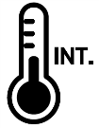
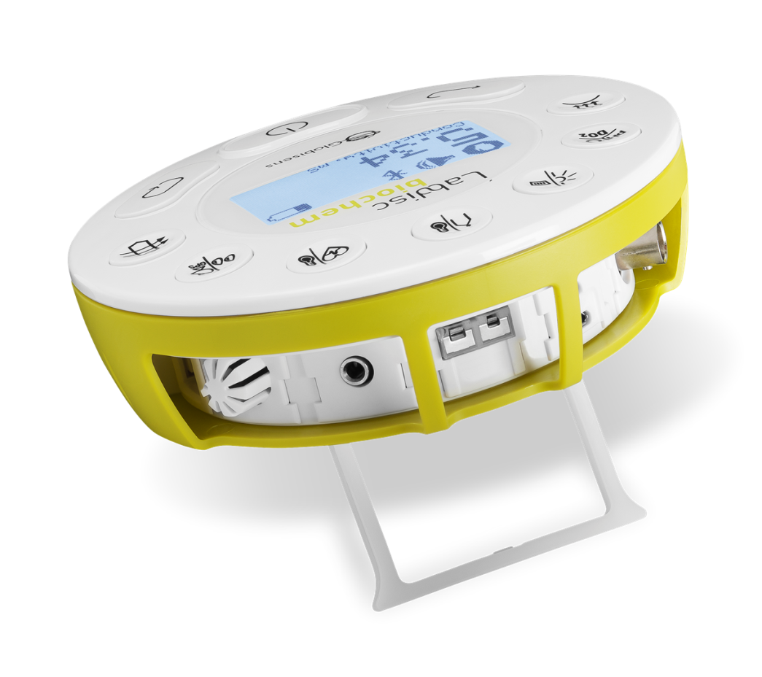

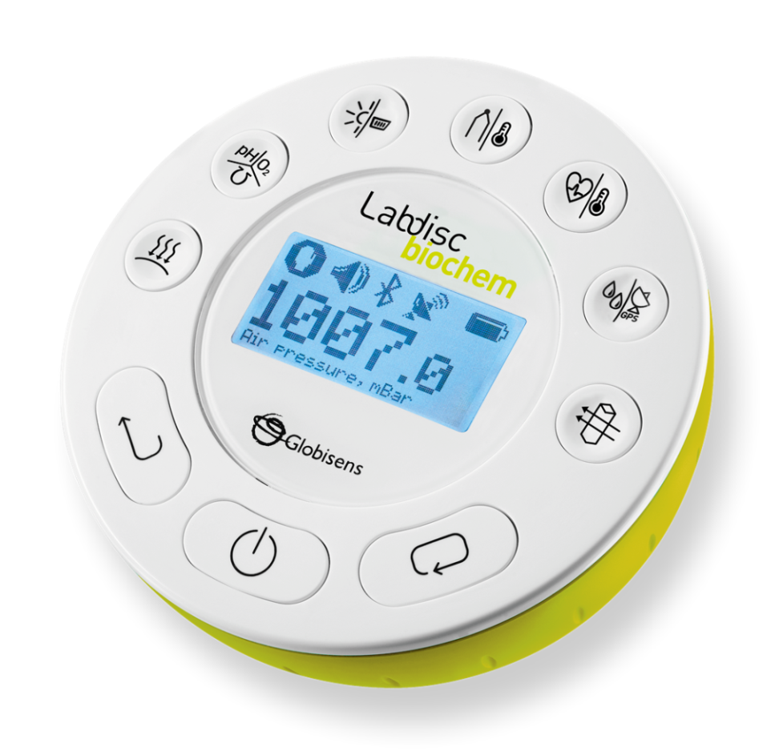


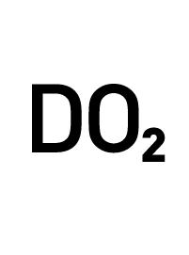






Вся лаборатория на ладони
Biochem – Биология и Химия
Встроенные датчики
Давление газа, температура окружающей среды и температура объекта, барометр, электропроводимость, рН, DO2 (уровень растворенного кислорода), освещенность, термопары, частота сердечных сокращений, относительная влажность, GPS, колориметр, турбидиметр и универсальный порт датчиков.
Notes:
The Labdisc Biochem – 150 hours battery life, 128k-sample memory and 12-bit resolution enable students to explore fast or long acting chemical, biochemical and biological phenomena in a clean and hazardous free science lab environment.
Built-in sensors include - Air Pressure, Ambient Temperature, Barometric Pressure, Colorimeter, Conductivity, Dissolved Oxygen, External Temperature, GPS, Heart Rate, Light, pH, Relative Humidity, Thermocouple, Turbidity and Universal Input.
Typical activities include - Skin temperature, pulse rates before and after activity, sweat production and photosynthesis, solid, liquid and gas phase changes and pH titration.

Slide 6
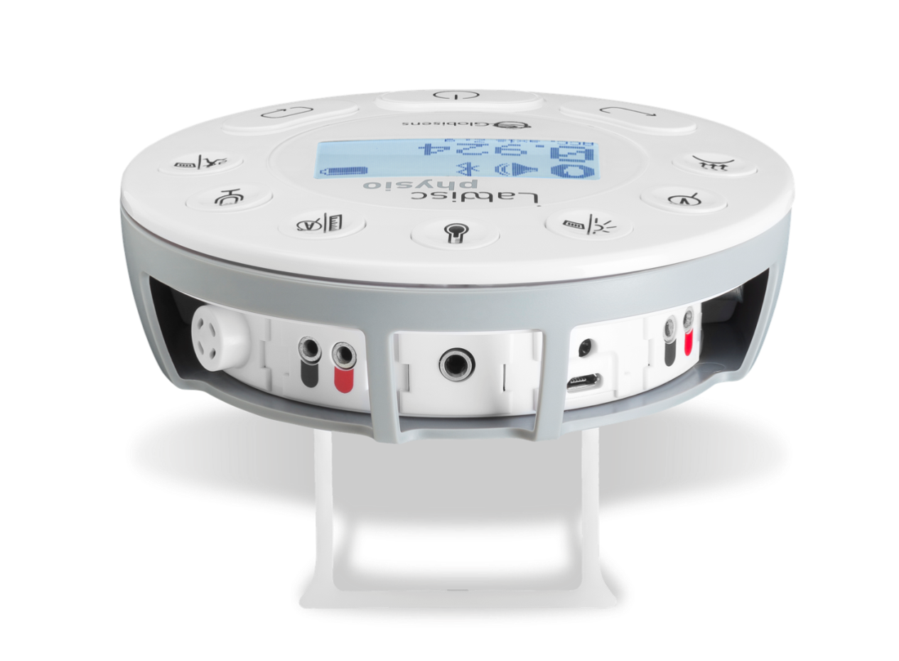
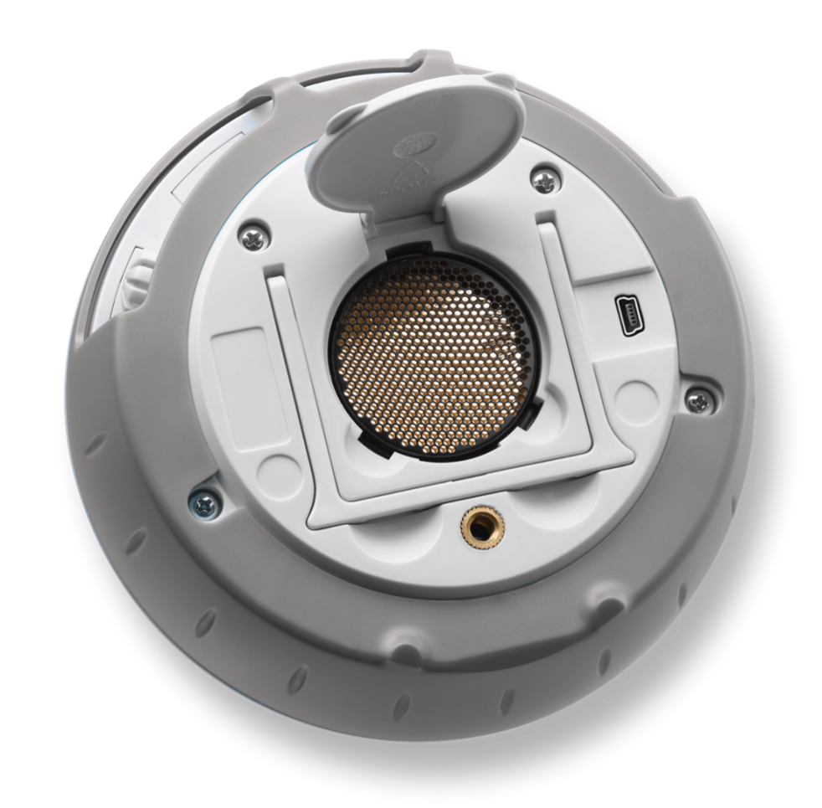




Вся лаборатория на ладони
Physio – Физика
Встроенные датчики
Давление газа, ток, напряжение и низкое напряжение, освещенность, температура окружающей среды и температура объекта, микрофон, расстояние, ускорение, и универсальный порт датчиков.
Notes:
The Labdisc Physio – Wireless data logging with 12-bit resolution, large 128k samples memory and high sampling rate of 24k/sec sampling rate. The Labdisc Physio comes with a wireless add-on, the small and lightweight force/acceleration sensor, easily attaching to portable Lab trolleys.
Built-in sensors include - Accelerometer, Air Pressure, Ambient Temperature, Current, Distance (Motion), External Temperature, Light, Microphone, Universal Input, Voltage
Typical activities include - Lenz and Boyle’s Laws, resistor networks, light source efficiency, light vs. distance, sound beat and wave superposition, Newton’s Second Law and free fall acceleration.

Slide 7
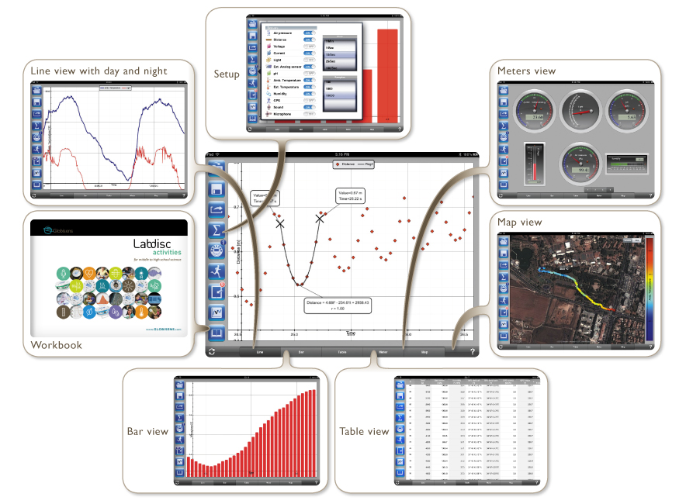
Программное обеспечения для анализа
Простое использование, обильный дисплей, все ОС, для всех возрастов
Notes:
Our Analysis software operates on all computer platforms:
Windows, Mac, iOS, Android, Linux and Chromebook
Like the Labdisc the software is rich with display type and analysis tool, yet it is very easy to us.
The Above picture shows the iOS version, its vivid data display including: graph, table, Bar graph and the beautiful Map view!

Slide 8
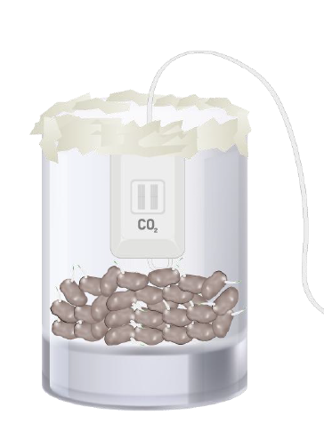
Учебные программы
Более 1000 страниц, полный охват программы
Горение
Человеческий
организм
Электричество
Парниковый эффект
Фотосинтез
Излучение
Магнетизм
Дыхание
Notes:
To complete our Labdisc package we offer 1000 pages of experiment guides covering practically all science topics in: Physics, Biology, Chemistry and Environmental science.
When received a list of the local science syllabus we offer a correlation of our experiment guides to the syllabus – showing 80-90% of syllabus coverage with a single Labdisc!
This makes the Labdisc a great value-for-money as it is being used throughout the science syllabus, and not just for few science topics.

Slide 9
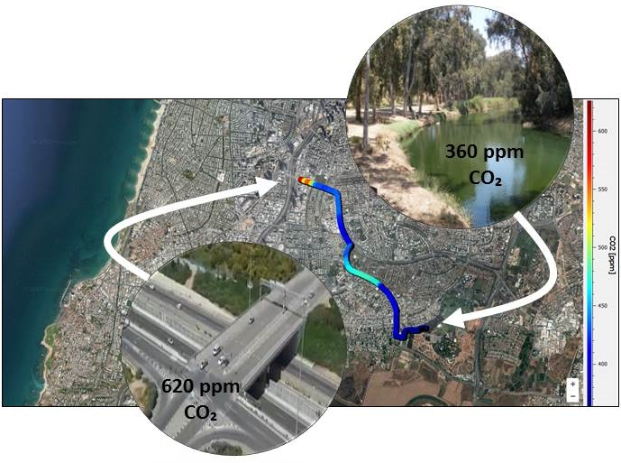
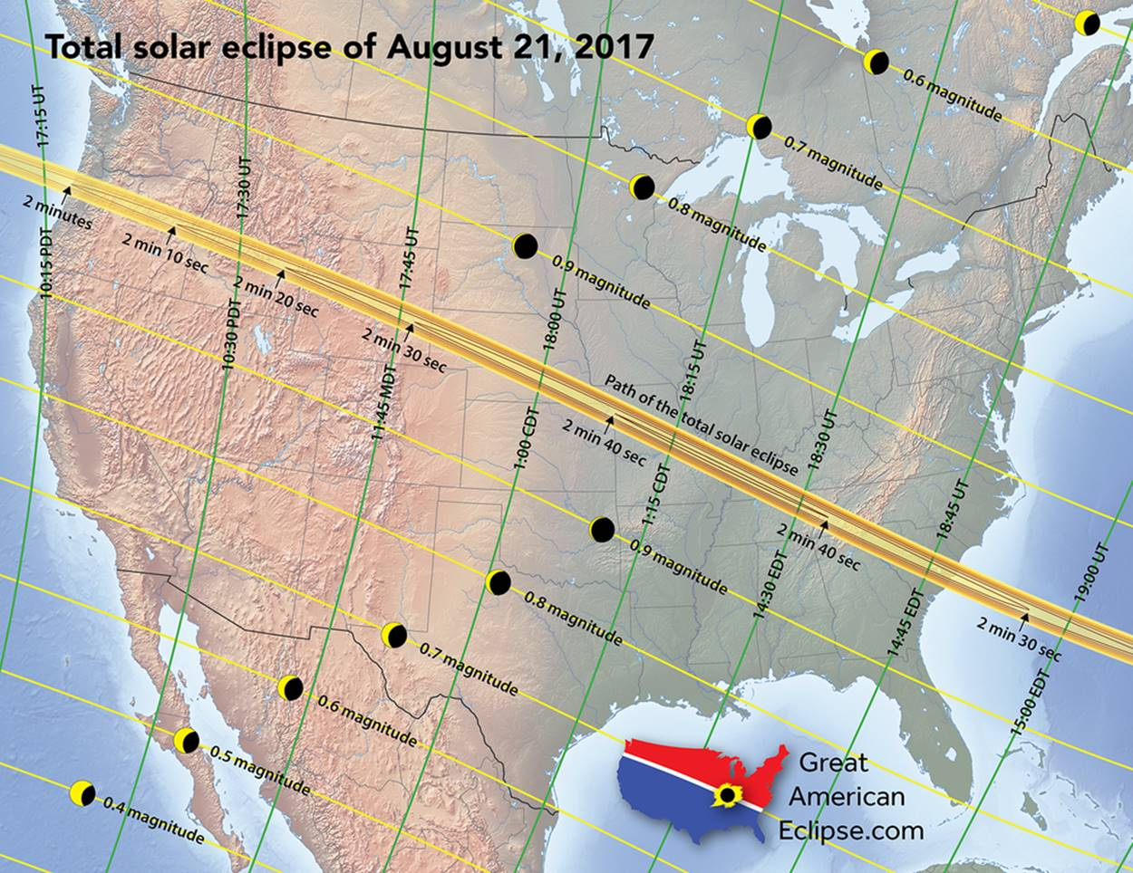
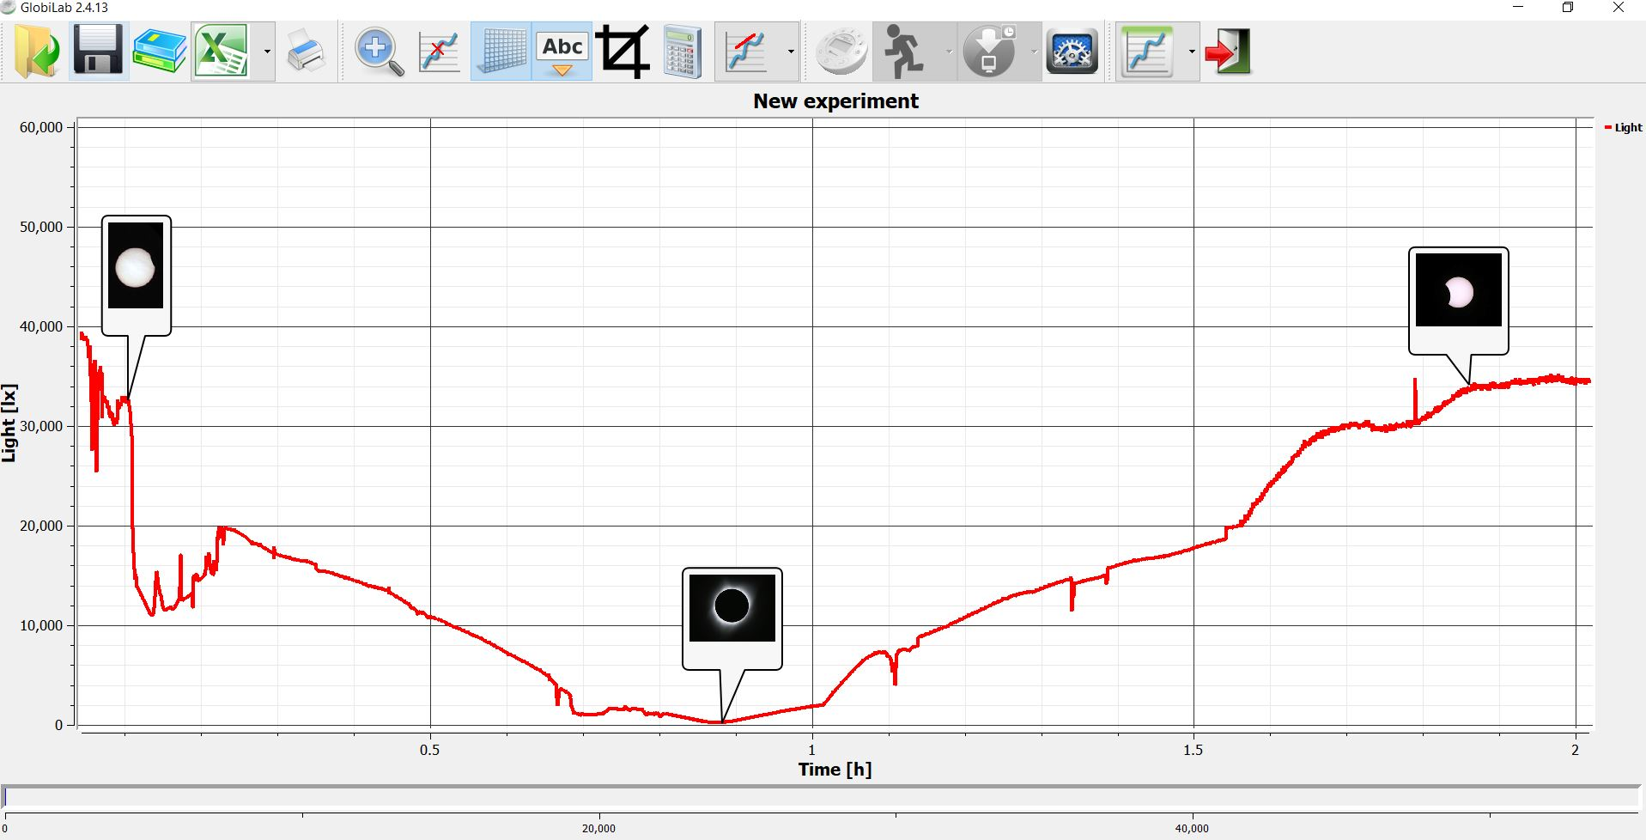
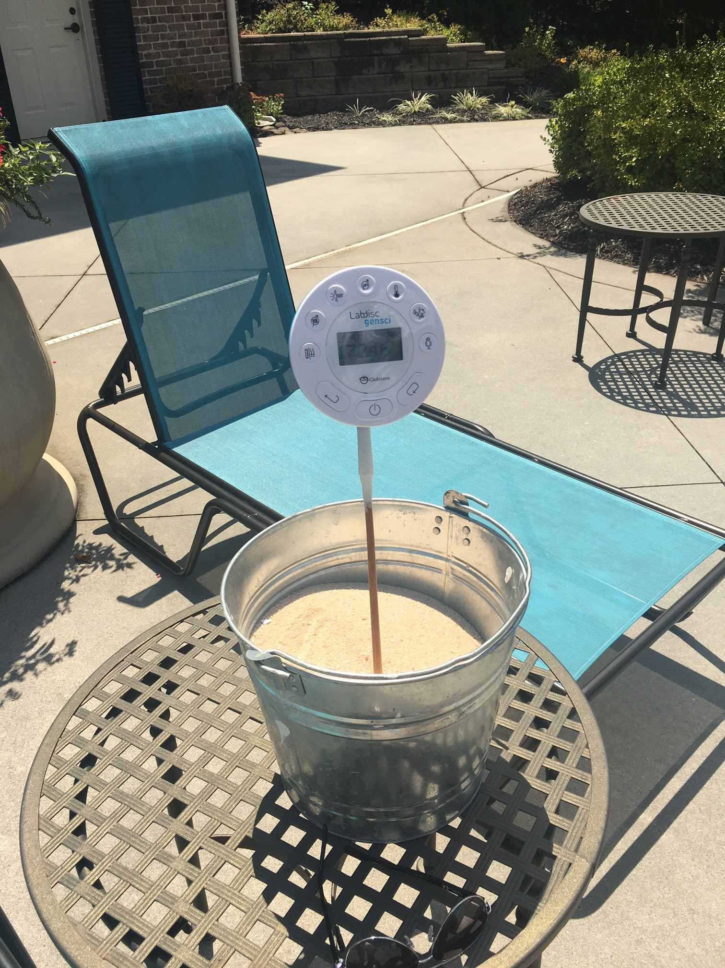
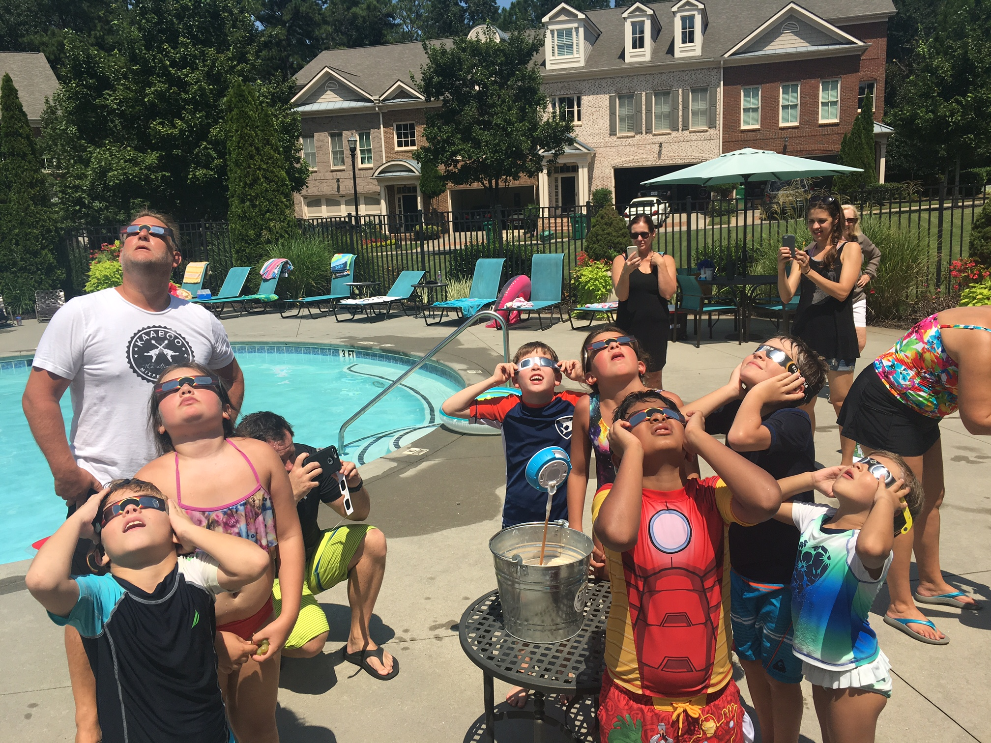
Labdisc в действии
Узнайте, каким может быть процесс изучения наук
Траектория солнечного
затмения 21 августа
Уровень CO2
в городе
Юные
исследователи
Атланты
Солнечное
затмение
В США в 2017 г.
Notes:
The Labdisc opens the door for RELEVANT SCIENCE
Here are two “cool” examples:
On the left is the beautiful Eclipse in America occurring in Aug 2017 recorded with the Labdisc by a group of kids in Atlanta. During the Eclipse - the Light level goes down from 40,000 lux to nearly zero and then back to 35,00 lux.
On the right we are using our CO2 sensor together with the GPS to record CO2 levels going from a small forest to a nearby highway. Using the Map View of the GlobiLab software we can clearly see the CO2 level starting at 360ppm in the forest and going up to 620ppm near the highway.
Cool, Relevant and beautiful!

Slide 10
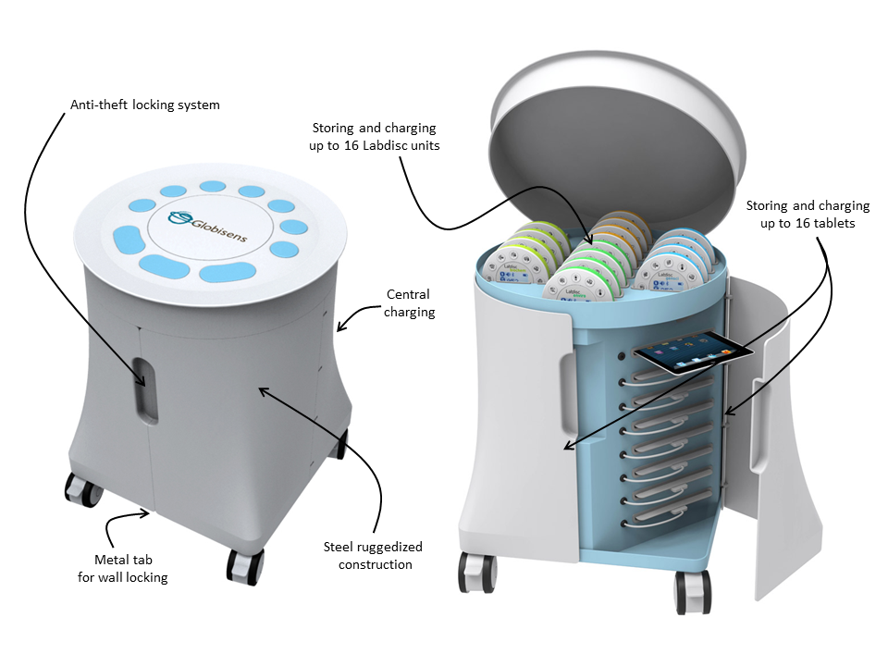
Передвижная тележка для лабораторных дисков
Комплексное решение для класса
Противокражная система
Хранение и подзарядка 16-ти Лабдисков одновременно
Хранение и подзарядка 16-ти планшетных компьютеров одновременно
Основная подзарядка
тележки
Конструкция из стали повышенной прочности
Металлическая вкладка для настенного крепления
Notes:
This solution is a mobile science laboratory with re-chargeable trolley containing 16 tablets and Labdiscs for an entire class
It is unique in the ability to mobilize the science lab to bring real inquiry-led experimentation via a fully functioning science lab to every class throughout the school. This removes the problem of mobilizing the students to a room devoted to a cluttered science lab that has to be outfitted with thousands of dollars worth of equipment.
The Labdisc wireless environment provides organized and centralized storage and charging facilities for up to 16 Labdisc units and tablet computers, as well accommodating any table computer.
The ruggedized steel framed trolley allows all equipment to be stored away – with an anti-theft locking system, as well as metal tab for wall locking.

Slide 11
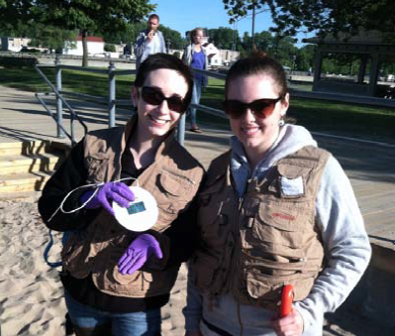
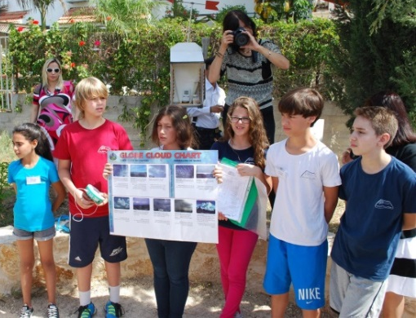
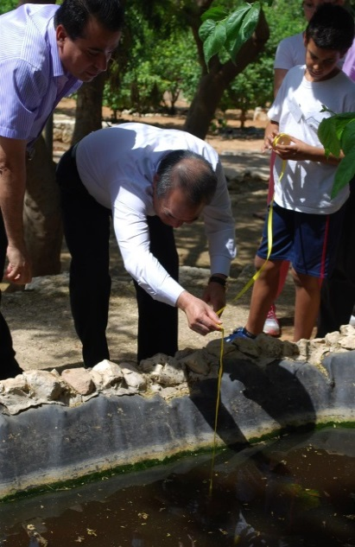
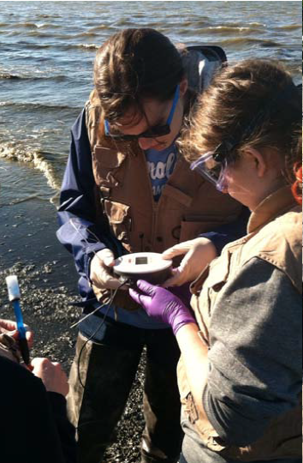
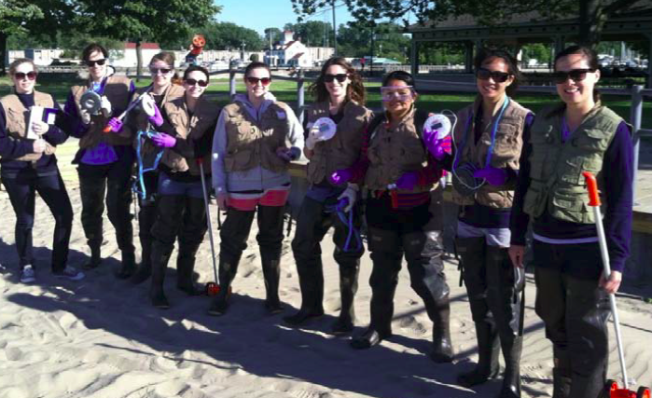
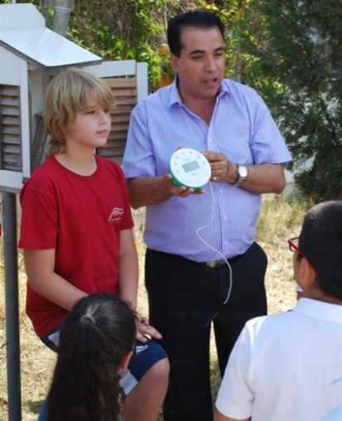

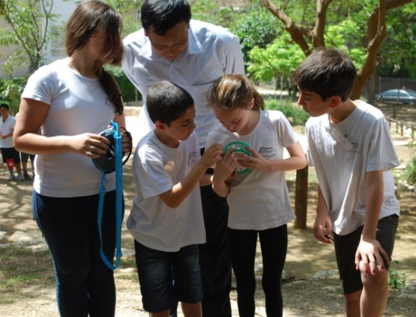
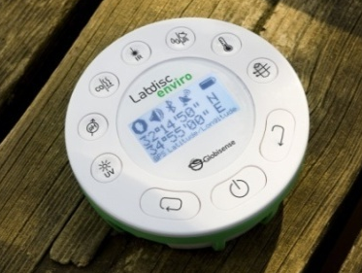
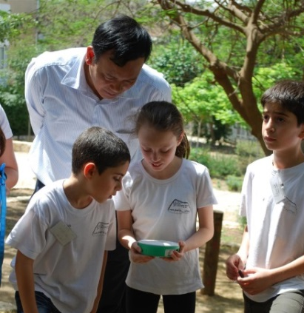
Изучение окружающей среды
Notes:
Environmental studies with the Labdisc
Being compact, with long battery life of 150 hours and with up to 15 sensors,
The Labdisc is all what you need for outdoor experiments
In this slide you can see High school students from USA experimenting in Marine Science, while the elementary kids are doing weather monitoring and water quality in a small pond.

Slide 12
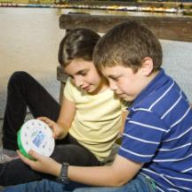
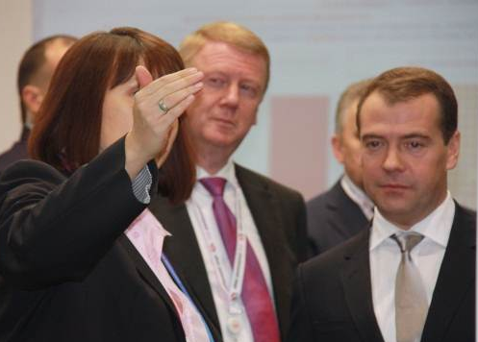
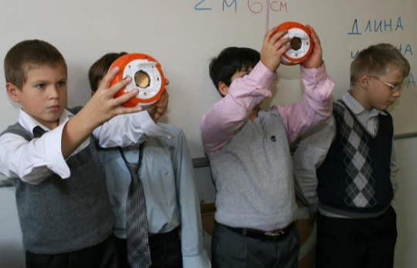
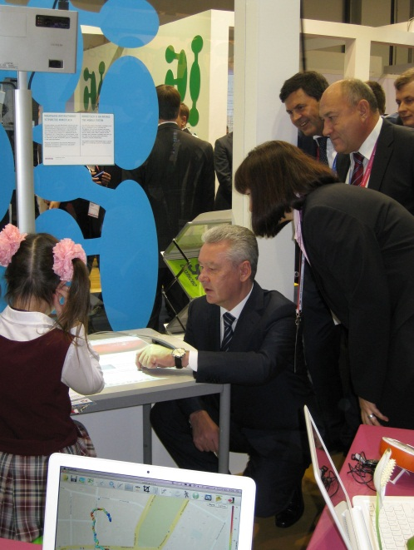
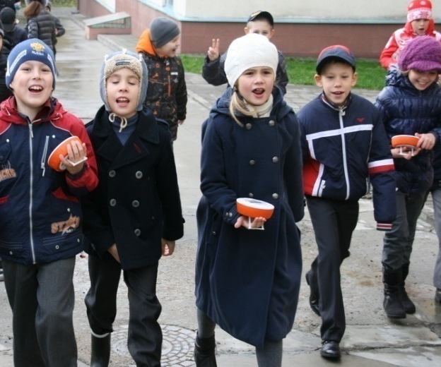
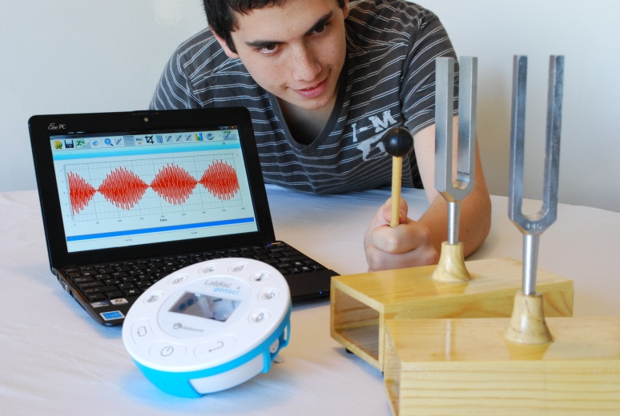
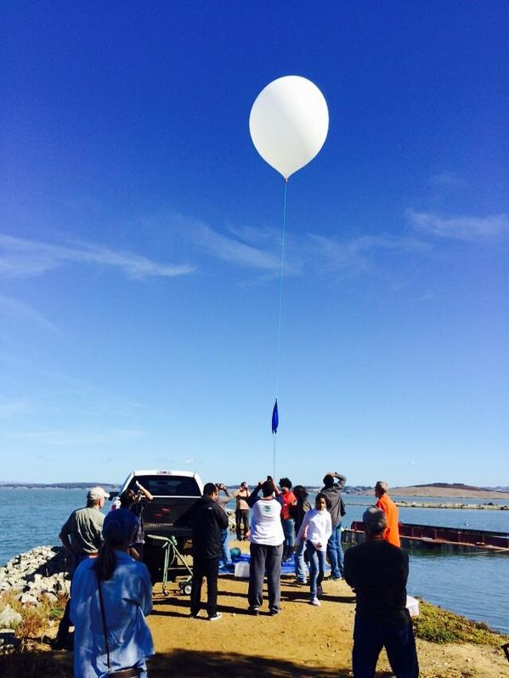
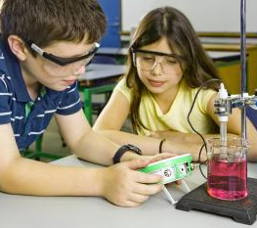
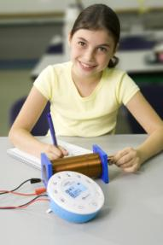
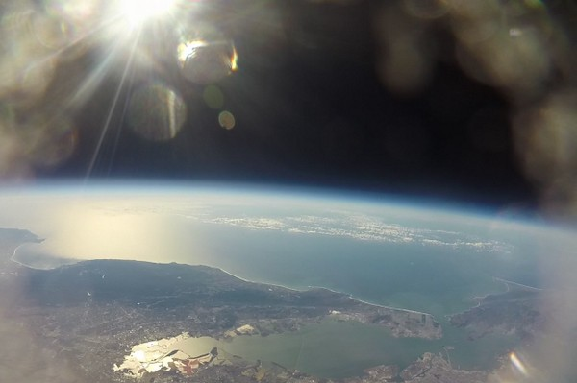
Внедрение лучшей педагогики
Notes:
To summarize make the following points:
The Labdisc system is very easy to demonstrate and operate whether for students of all ages, elementary schools teachers or sales people with zero science background.
Despite its ease-of-use the Labdisc is still a very modern and sophisticated piece of equipment with advanced features including high accuracy, resolution, very fast sampling rate (up to 25,000 samples per second), a long battery life 150 hours and clear LCD panel with back light.
The Labdisc is the first of its kind regard the number of built-in sensors and wireless clean operability… it really is a complete lab in the palm of the students hand.

Slide 13
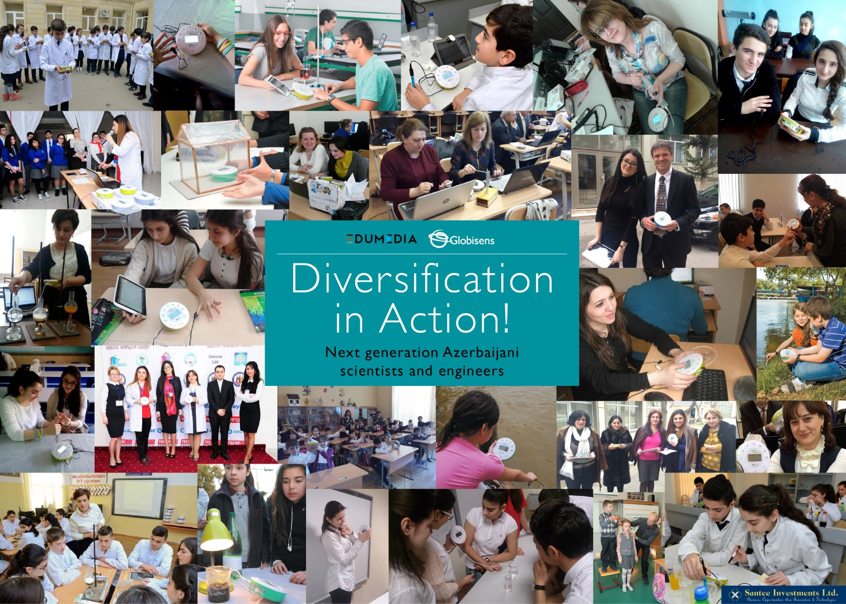
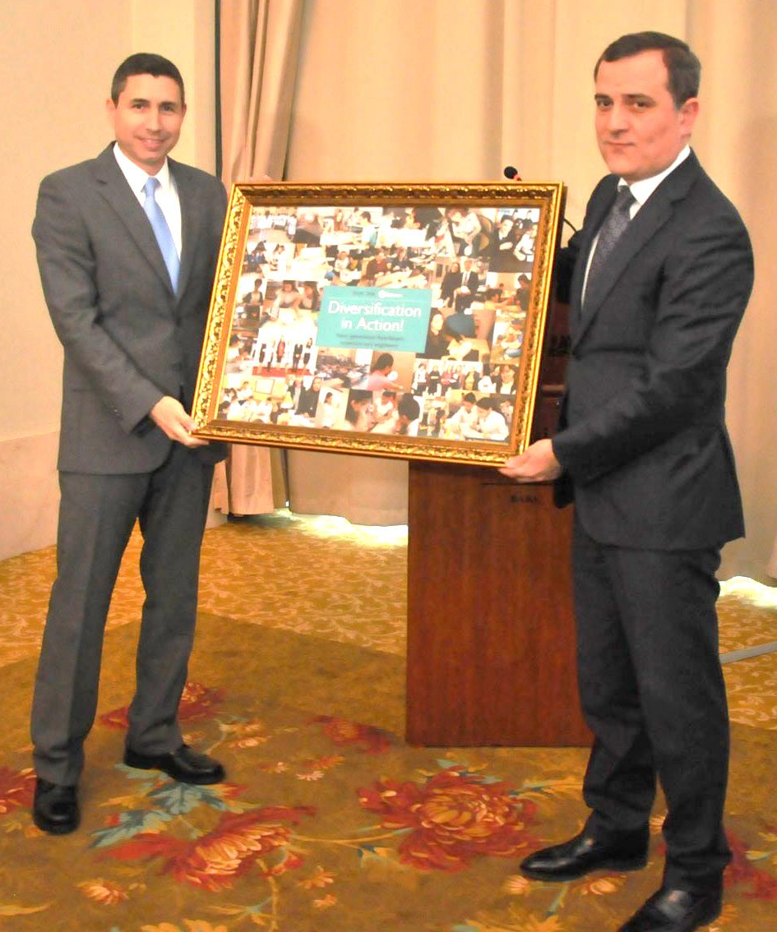
Notes:
Labdisc Pilot project – Azerbaijan case Study
“A picture is worth a thousand words”
This photomontage was made out of the thousands of photos, sent to us by teachers participating in our science project in Baku.
Pilot project included:
50 high schools – each equipped with 2 full science carts (16 Biochem, 16 Physio and Android tablets).
Localization phase - Translation of our software and experiment books to the local language. Correlate our experiment guides with the local science syllabus.
Teacher training - 3 days local teacher training.
Teacher Community - open teacher’s user group on Facebook.
Ongoing 6 months support - employing a project moderator who engages teachers on conducting different science experiments each week.
Weekly activities - have teachers and student upload their weekly work – lab reports, graphs, photos and video clips to our Facebook group.
School competition - Conduct competition between schools for the “Best experiment of the week”.

Slide 14
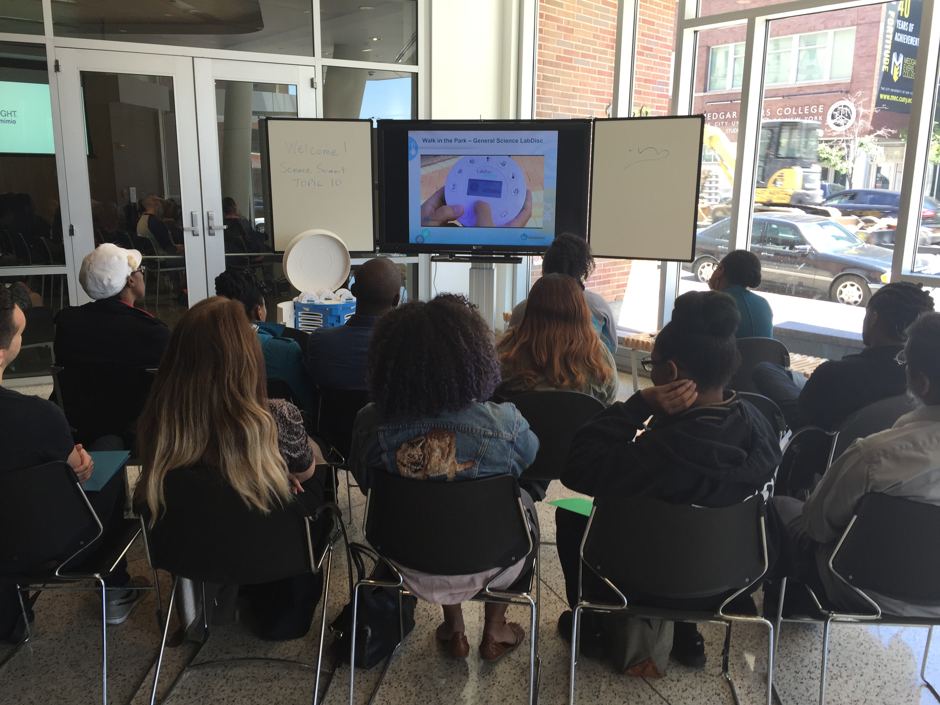
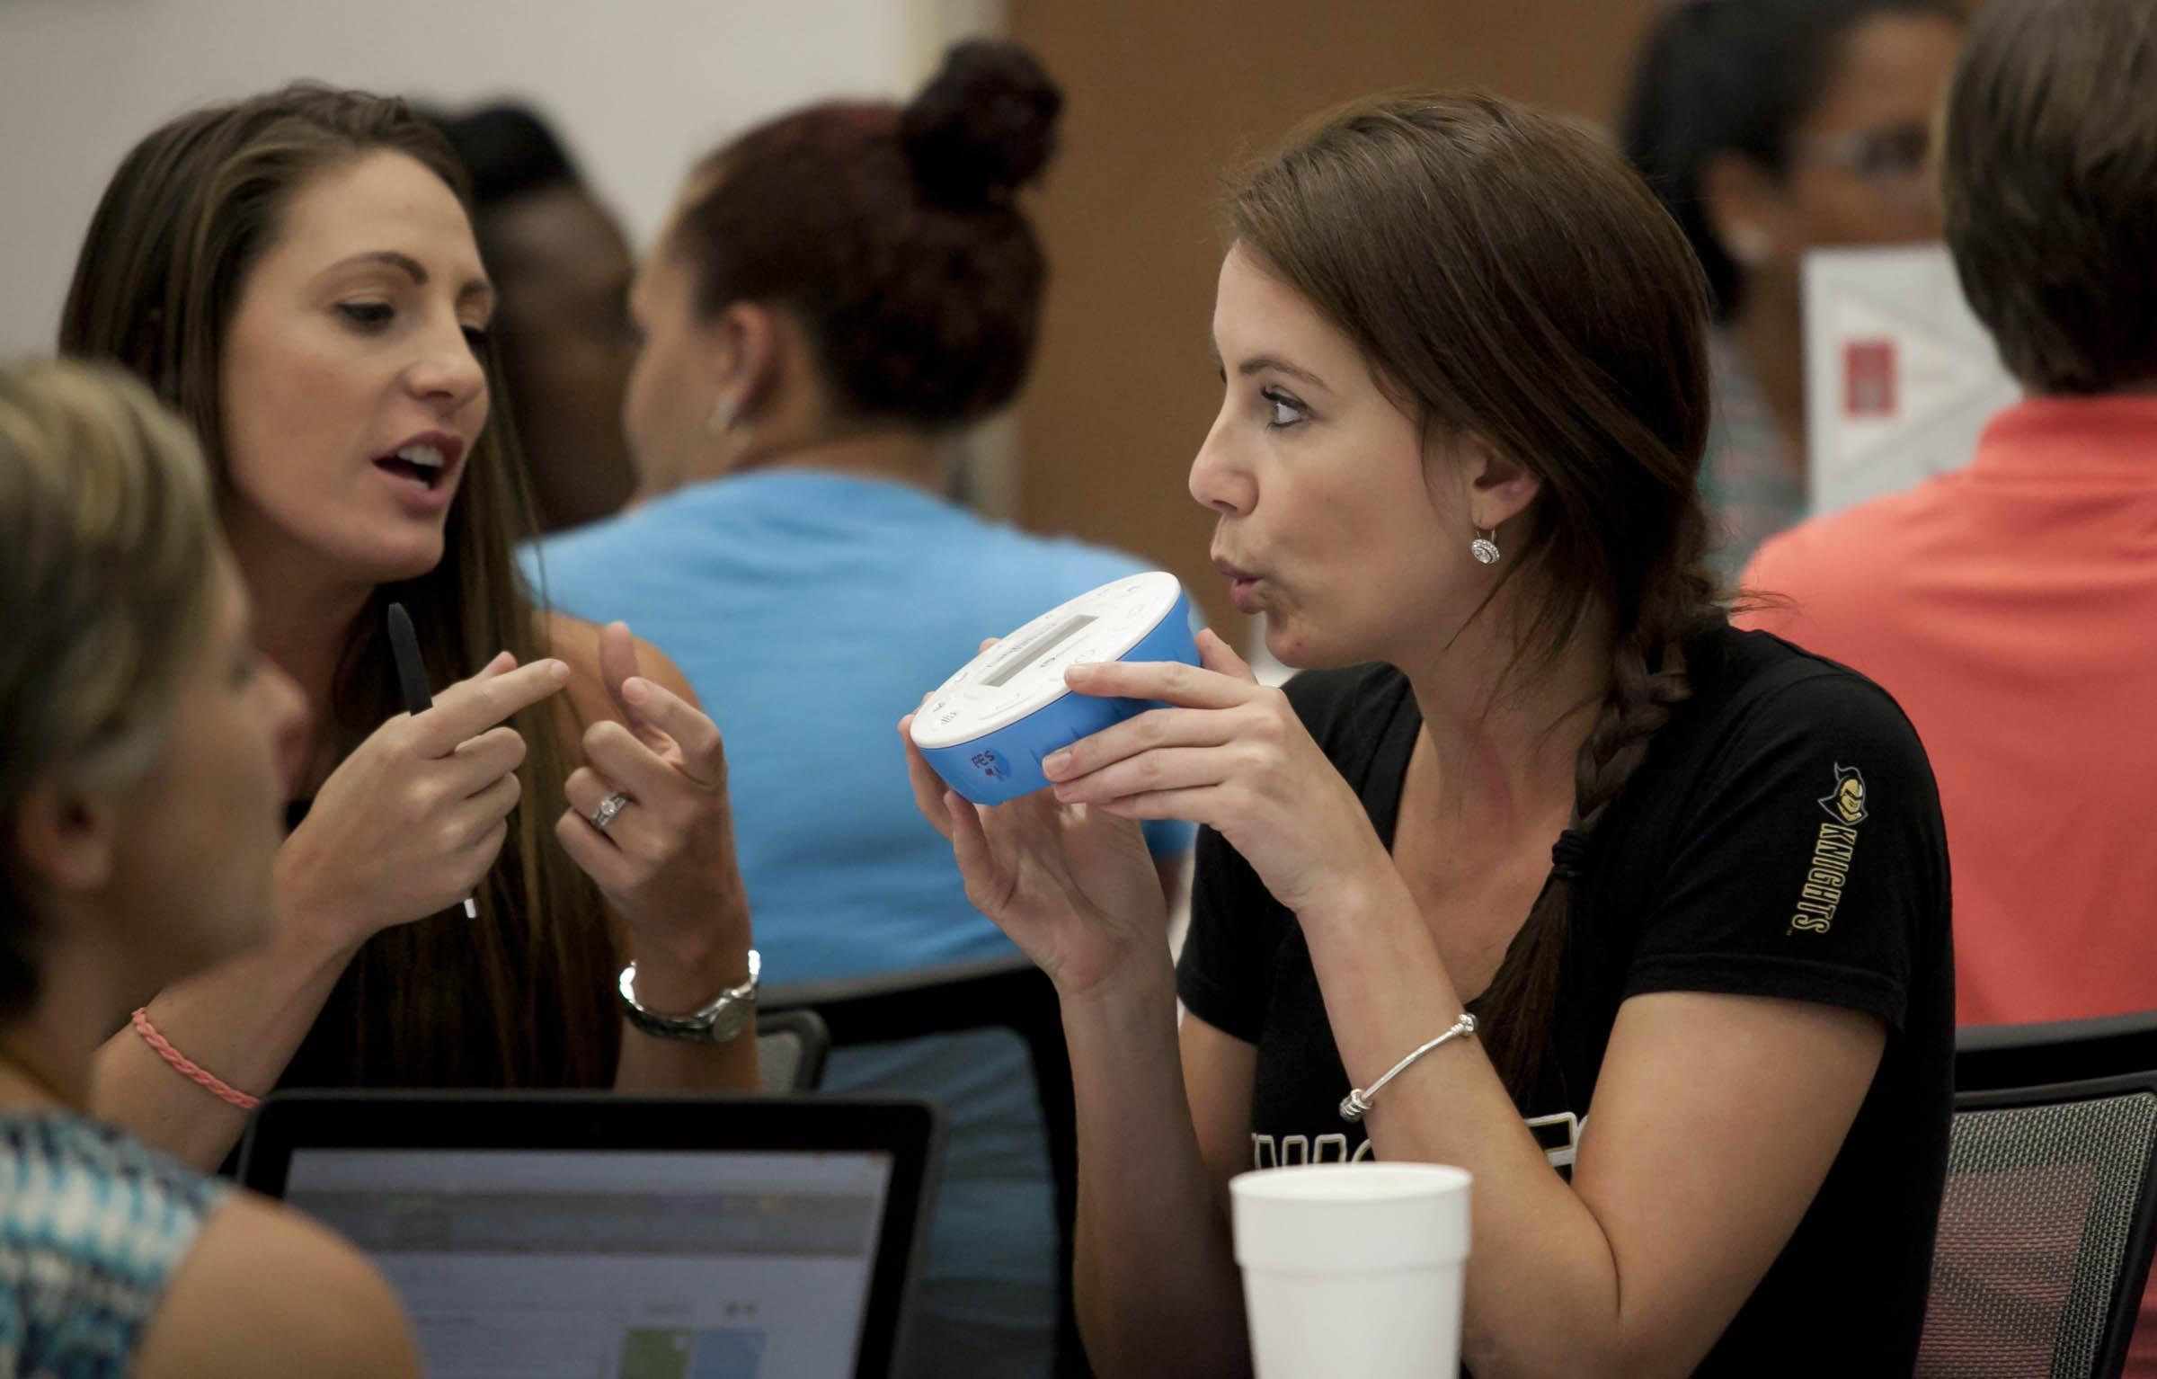
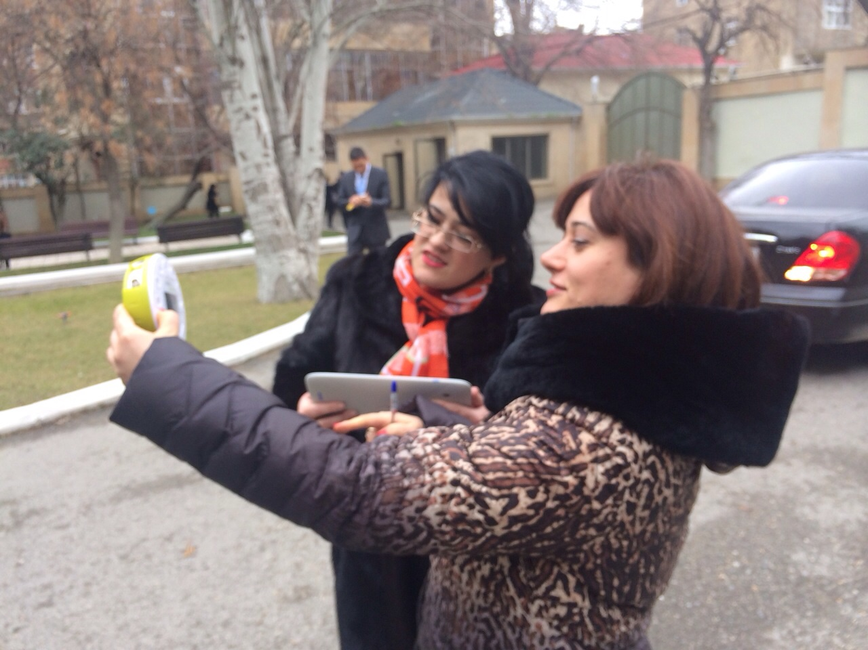

Повышение квалификации
Фронтальное, в оффлайне и в социальных сетях
Групповое обучение (1-3 дня)
Бесплатная загрузка обучающих материалов
Краткие руководства доступны онлайн
Учебные программы доступны онлайн
Видеозаписи с примерами доступны онлайн
Дневные STEM-мероприятия
Сообщества в Facebook
Научные соревнования среди школ
Notes:
A collection of teacher training packages that we offer:
Standard frontal teacher training courses where we send a trainer to work with the teachers for between 1-3 days.
In large projects we open a Facebook group for all teachers in the project and manage the project for up to 1 full year. During this time we conduct competition between the teachers for the “Best Experiment of the months” and give ongoing support.

Slide 15

Что говорят исследования?
Ученики должны использовать практические методы
не менее чем в половине учебных занятий, посвященных наукам!
Отчет GATSBY (Великобритания), 2015 г.
Ученики, использующие компьютеры и научные лаборатории, показали значительный прирост объема новых знаний.
Национальная научная организация TEEMSS, 2007 г.
Научные лаборатории воодушевляют учеников, позволяя сэкономить время на измерении температуры. Освободившееся время можно использовать для отрисовки и изучения графиков.
Журнал "Evaluation Horizons", номер 15, стр. 12-16, 2001 г.
Страны, как Япония и Корея (где науки изучают с малых лет), показывают более выдающиеся результаты в сфере математики и точных наук, чем другие страны первого эшелона.
Международная программа по оценке образовательных достижений учащихся, результаты по математике и точным наукам за 2007 г.
Notes:
Pedagogic justification
Here you can find quotes from pedagogic research done in the USA.
It shows the advantages of Probeware (usage of sensors in science laboratories):
They replace manual measurement and manual graph plotting
This leaves time for student to focus on true learning, which take place at:
The design of the experiment.
The analysis of the results.

Slide 16



Компания Globisens Ltd
  35 сотрудников
  Высокотехнологичное производство
  Учреждена в апреле 2009 года
  Первая партия ЛабДисков – октябрь 2011 года
  Почти 90,000 проданных ЛабДисков в течение первых 3 лет
  Возвращаются <0.2%
Notes:
Some corporate facts:
Reliable production - all products are produced by automatic robots in a modern and sophisticated hi-tech facility in Israel.
Very little returns – only 200 units out of 90,000 sold

