Slide 1
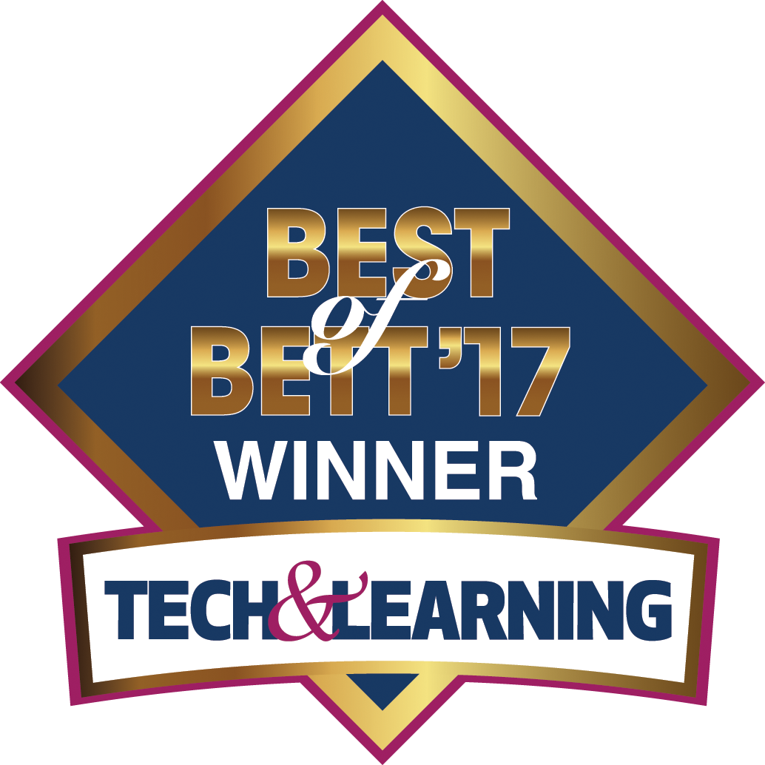
All-in-one K-12 modern science labs

Slide 2
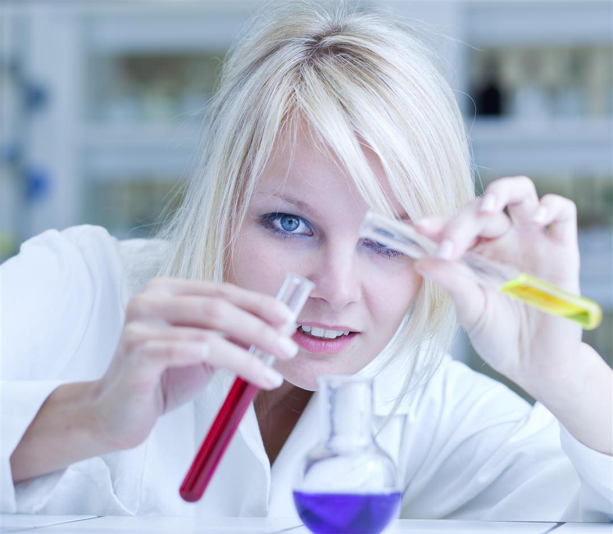
Science and STEM education
Challenges
Science is abstract.
Science has a special language.
Fewer science majors & more drop outs.
Pedagogic research show
“You hear – you forget”,
“you see – you remember”,
“you do – you understand”
Students should “do science” to understand science.
Hands-on & inquiry-based works.
Notes:
Core curriculum - Science, Math and English are the key subjects in schools on a national level worldwide and therefore receive the highest budgets.
Learning science challenges – An abstract subject, science must be visualized. What’s more science is like a language, to be fully mastered it must be started and regularly practiced from a young age.
Currently, there are fewer students choosing to learn science, making fewer feeders to universities and as a result fewer scientists and engineers.
Lessons learnt - Technology helps visualize abstract concepts with hands-on enquiry-based learning replacing text book oriented lessons.
Furthermore, the use of technology attracts students to learn science, with best results when started early. Effectively this increases the number of graduating scientists into the future workforce.
Activity-based learning solidifies science concepts… “What you do, you remember” (Chinese proverb).

Slide 3
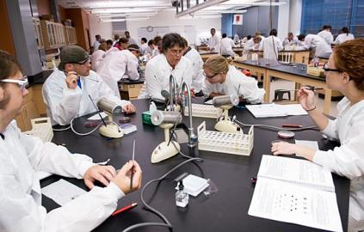
The Challenge:
Time, Budget!
A typical lab session requires 90 items to setup and calibrate!
Notes:
Time consuming - Even simple experiments in typical classes of 30 students require at least 90 separate items to be tested, calibrated, setup and put away. As a result teachers were becoming technology shy.
Data logging manufacturers missed the point - Instead of understanding this, the data logging industry kept producing increasingly complicated and cumbersome technology that was too difficult and time-consuming to use.
Research shows that only 6% of teachers actually use computerized laboratory tools for hands-on science, most of them don't use what they have, or only very rarely 3 to 4 times per year.
In addition, invariably throughout the semester, as all the various items (data loggers, sensors, cables, adaptors etc.) are collected after each lesson, a large number get lost.

Slide 4
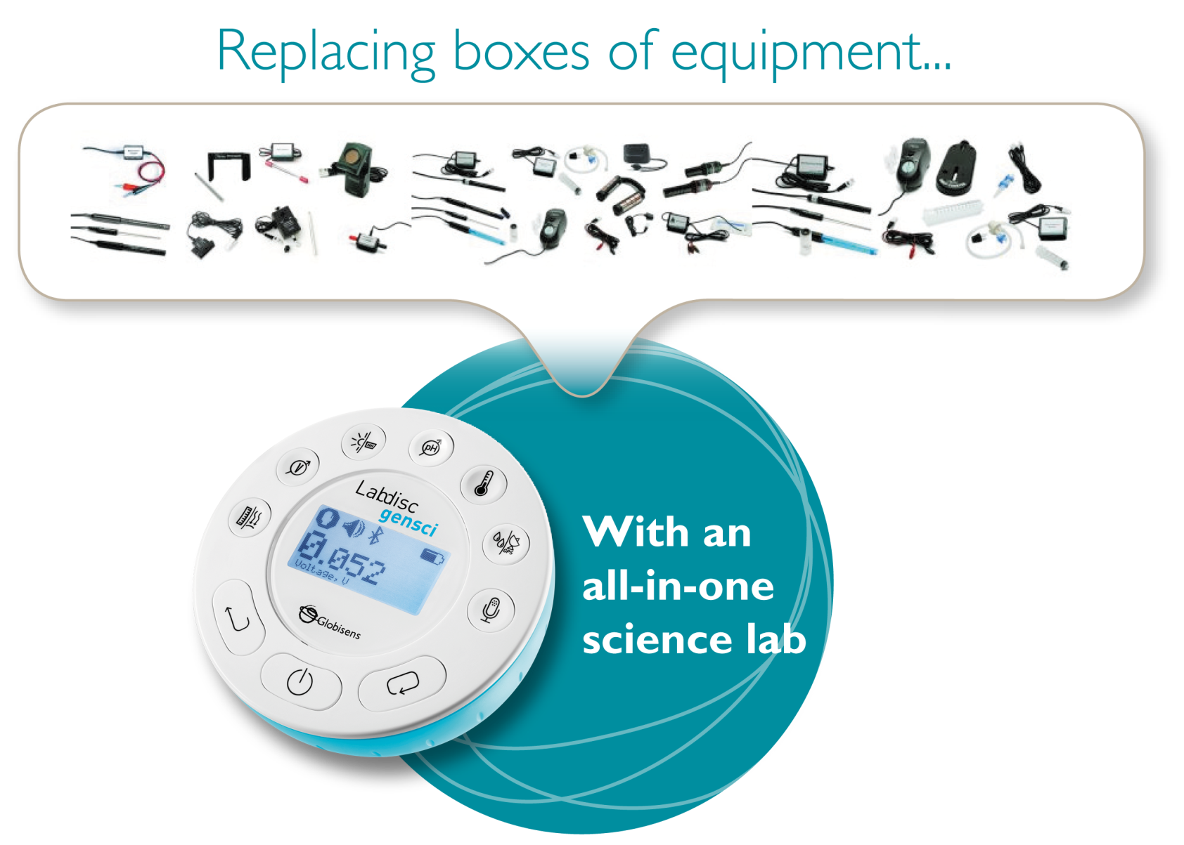
Science experimenting
was never so easy!
Notes:
Easy for teachers - Labdisc inquiry-based learning is simple and headache-free for teachers in the classroom or in the field.
Easy for students - Globisens packed everything (data loggers, sensors, sensor & communication cables) into a single disc that fits into the palm of a student’s hand.
The Labdisc is an all-in-one self contained data logging unit with up to 12 built-in (auto-calibrated) sensors – immediately turning any interactive classroom into a 21st century science laboratory.
Easy for sales – The compact, small Labdisc means easy stocking and distribution. No bulky, high volume science equipment hardware

Slide 5
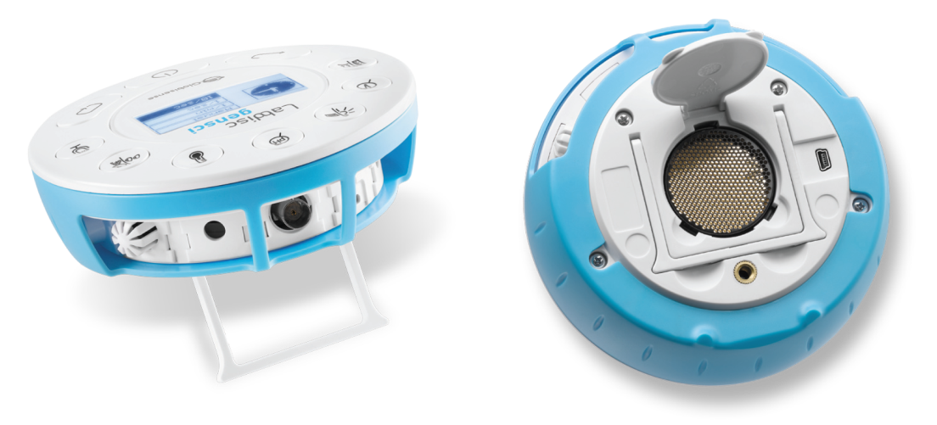
A Complete Lab on a Disc General Science Unit
Built-in Sensors
Air Pressure, Ambient Temperature, Current, Distance, GPS, Light, Microphone, pH, Relative Humidity, Sound Level, Temperature, Voltage, Universal Input
Notes:
The Labdisc Gensci - Supports middle to high school general science. It has a 128k sample memory and 24k/sec sampling rate, plus 12-bit resolution, 150 hour charge-life and large graphical LCD.
Built-in sensors include - Air Pressure, Ambient Temperature, Current, Distance, GPS, Light, Microphone, pH, Relative Humidity, Sound Level, Temperature, Voltage, plus Universal Input.
Typical activities include - Travelling speed with GPS, Newton’s Laws, sound waves, electrical currents, pH titration, endothermic and exothermic reactions, Boyle’s Law, specific heat and microclimate.

Slide 6
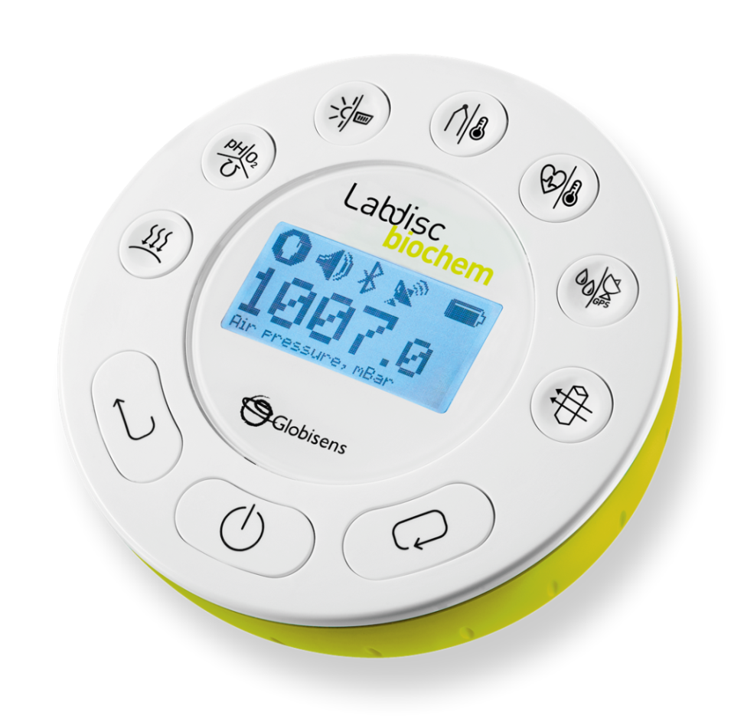
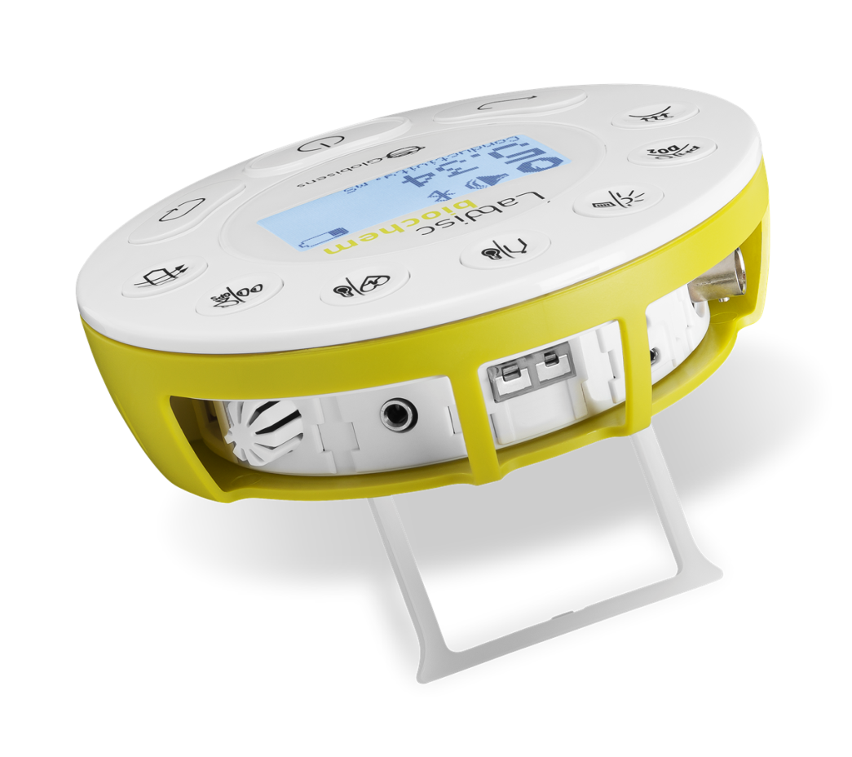
A Complete Lab on a Disc Biology and Chemistry Unit
Built-in Sensors
Air Pressure, Barometer, Conductivity, pH, DO2, Light, Universal Input, Thermocouple,
Ambient Temperature, Heart rate, Temperature, Humidity, GPS, Colorimeter, Turbidity
Notes:
The Labdisc Biochem – 150 hours battery life, 128k-sample memory and 12-bit resolution enable students to explore fast or long acting chemical, biochemical and biological phenomena in a clean and hazardous free science lab environment.
Built-in sensors include - Air Pressure, Ambient Temperature, Barometric Pressure, Colorimeter, Conductivity, Dissolved Oxygen, External Temperature, GPS, Heart Rate, Light, pH, Relative Humidity, Thermocouple, Turbidity and Universal Input.
Typical activities include - Skin temperature, pulse rates before and after activity, sweat production and photosynthesis, solid, liquid and gas phase changes and pH titration.

Slide 7
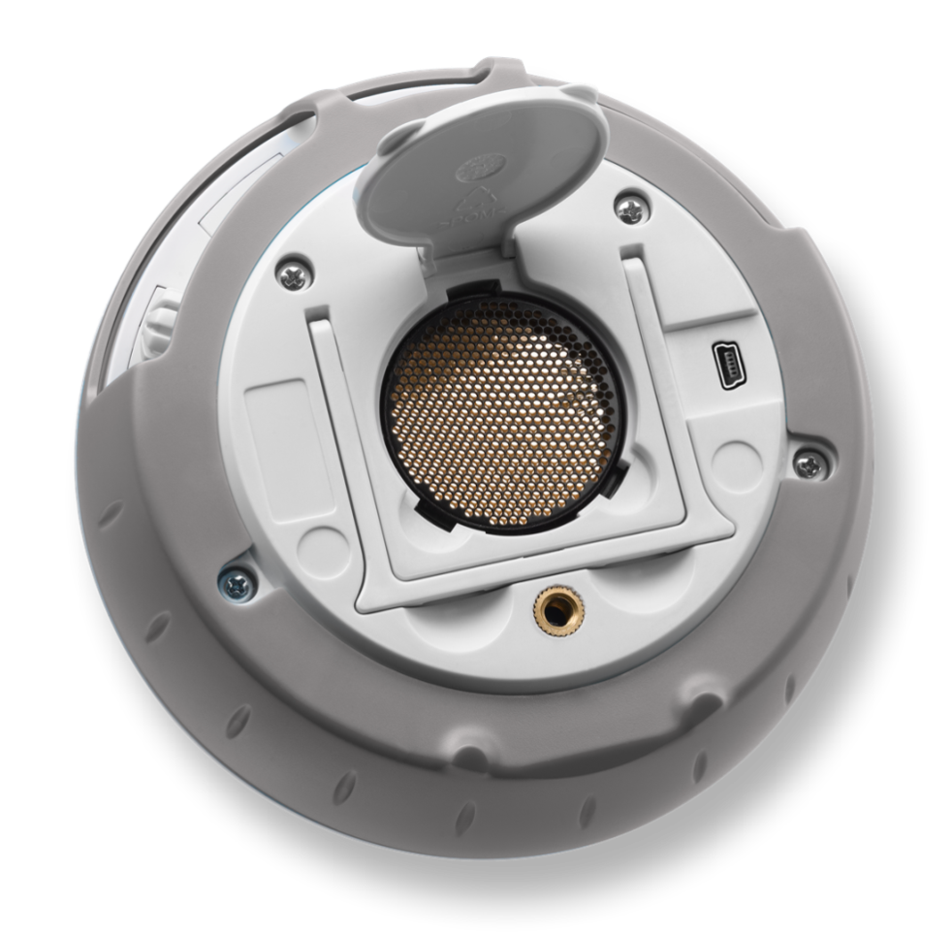
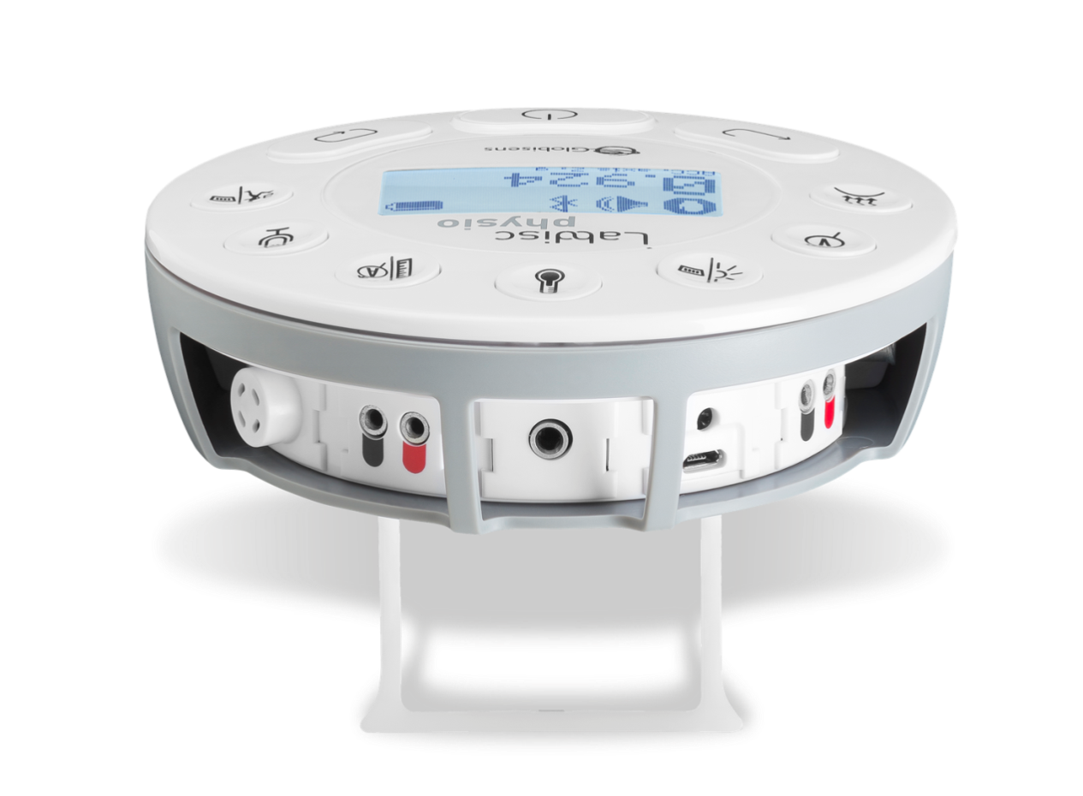
A Complete Lab on a Disc Physics Unit
Built-in Sensors
Air Pressure, Voltage, Low Voltage, Light, Universal Input, Ambient Temperature, Temperature, Current,
Distance, Microphone, Accelerometer
Notes:
The Labdisc Physio – Wireless data logging with 12-bit resolution, large 128k samples memory and high sampling rate of 24k/sec sampling rate. The Labdisc Physio comes with a wireless add-on, the small and lightweight force/acceleration sensor, easily attaching to portable Lab trolleys.
Built-in sensors include - Accelerometer, Air Pressure, Ambient Temperature, Current, Distance (Motion), External Temperature, Light, Microphone, Universal Input, Voltage
Typical activities include - Lenz and Boyle’s Laws, resistor networks, light source efficiency, light vs. distance, sound beat and wave superposition, Newton’s Second Law and free fall acceleration.

Slide 8
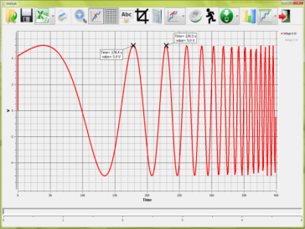
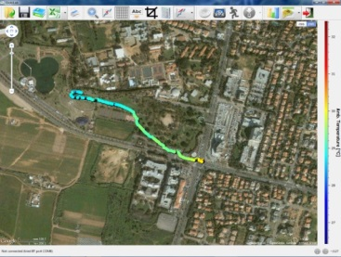
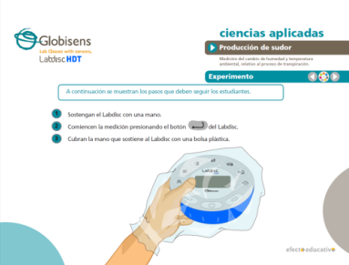
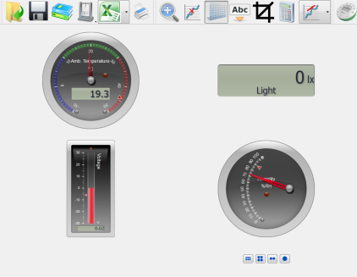
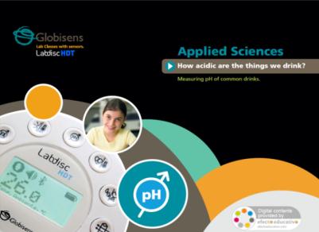
Globisens Science Content Analysis software, Experiment guides, Simulations
Over 100 learning units and science simulations
Cross platform analysis software
1300 pages of experiment guides in Physics, Biology and Chemistry
Notes:
GlobiLab analysis software for PC and MAC - For middle to high school science, with sophisticated data analysis, lab reporting tools, plus wireless communication for full setup and control of the Labdisc and built-in sensors.
Integrating GPS data logging - This not only plots real Labdisc collected data over a Google map with Google Maps functionality such as zoom and pan, but it also allows students to share their data with other students from all over the world.
Advanced functions and graphical tools - Include crop, markers, zoom and graph annotation. In addition, data analysis functions enable users to perform derivative and regression functions, as well as view comprehensive statistics.
Multiple meter displays - Updated five times every second and include analog gauge, digital bar, thermometer, digital value and color change.
Curriculum workbooks - In interactive PDF format, each including definitions of the experiment objective, theory, activity, resources, how to use the sensor, perform the experiment, analyze the results and conclusions, with some suggested activities for further application.

Slide 9
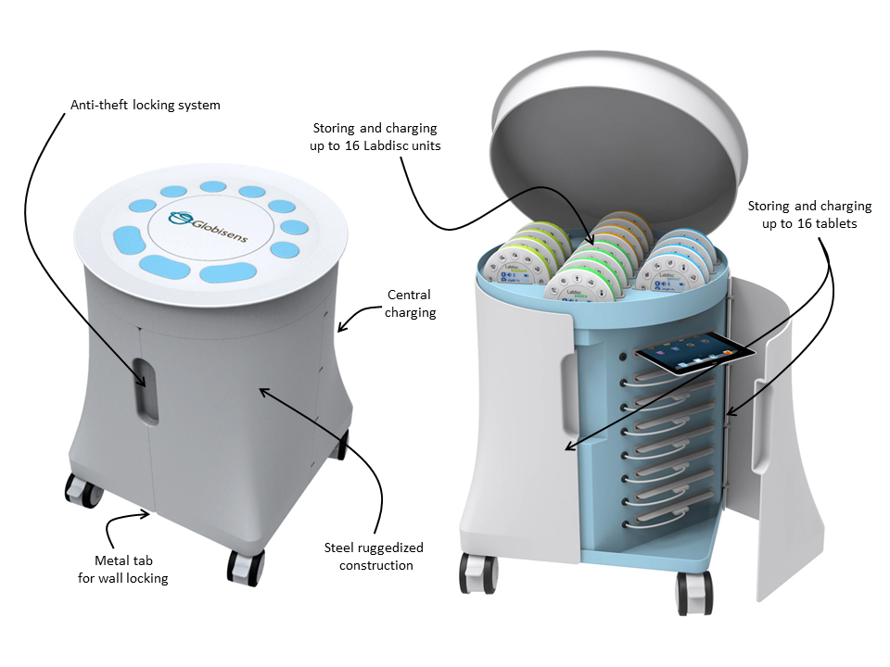
Labdisc Mobile Science Cart Complete classroom solution
Notes:
This solution is a mobile science laboratory with re-chargeable trolley containing 16 tablets and Labdiscs for an entire class
It is unique in the ability to mobilize the science lab to bring real inquiry-led experimentation via a fully functioning science lab to every class throughout the school. This removes the problem of mobilizing the students to a room devoted to a cluttered science lab that has to be outfitted with thousands of dollars worth of equipment.
The Labdisc wireless environment provides organized and centralized storage and charging facilities for up to 16 Labdisc units and tablet computers, as well accommodating any table computer.
The ruggedized steel framed trolley allows all equipment to be stored away – with an anti-theft locking system, as well as metal tab for wall locking.

Slide 10
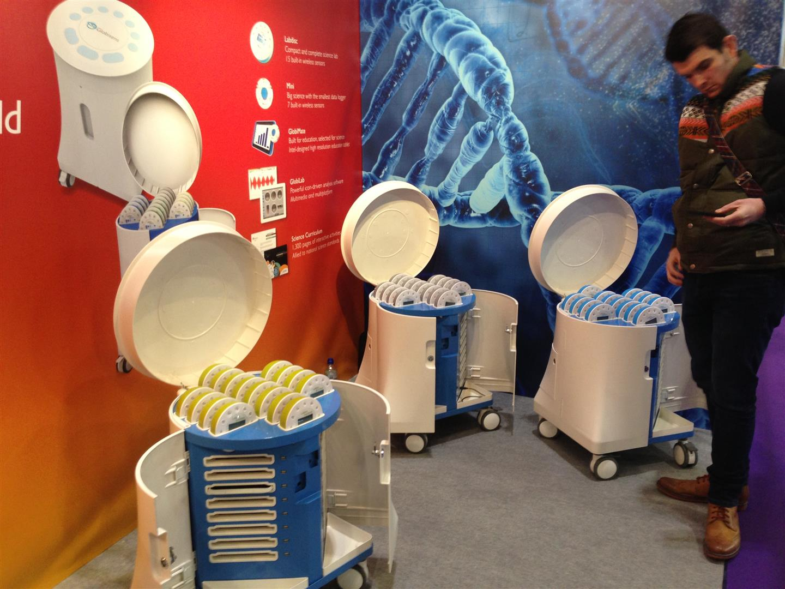

Slide 11
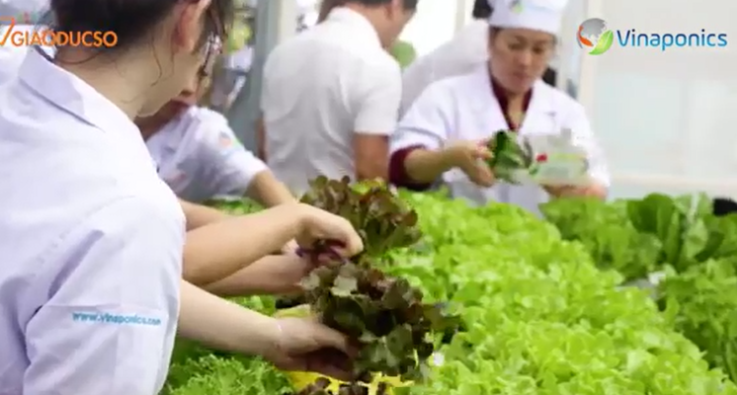
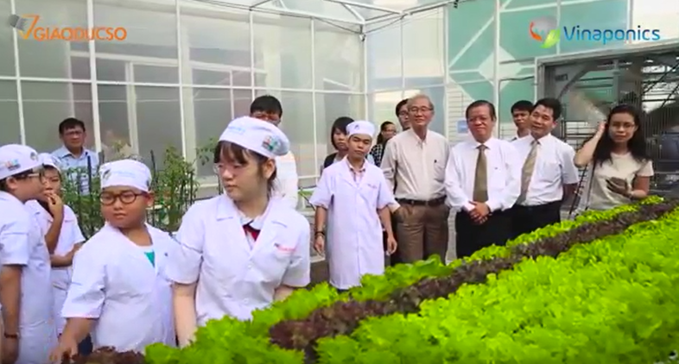
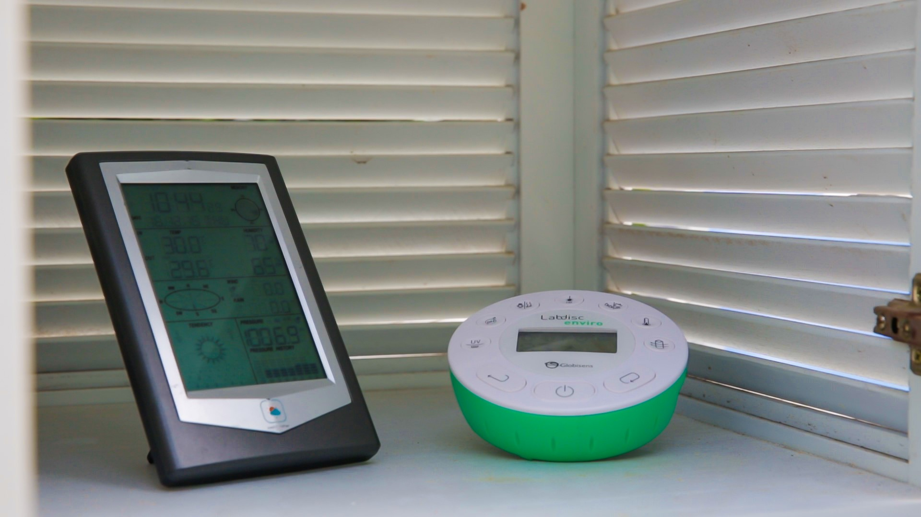
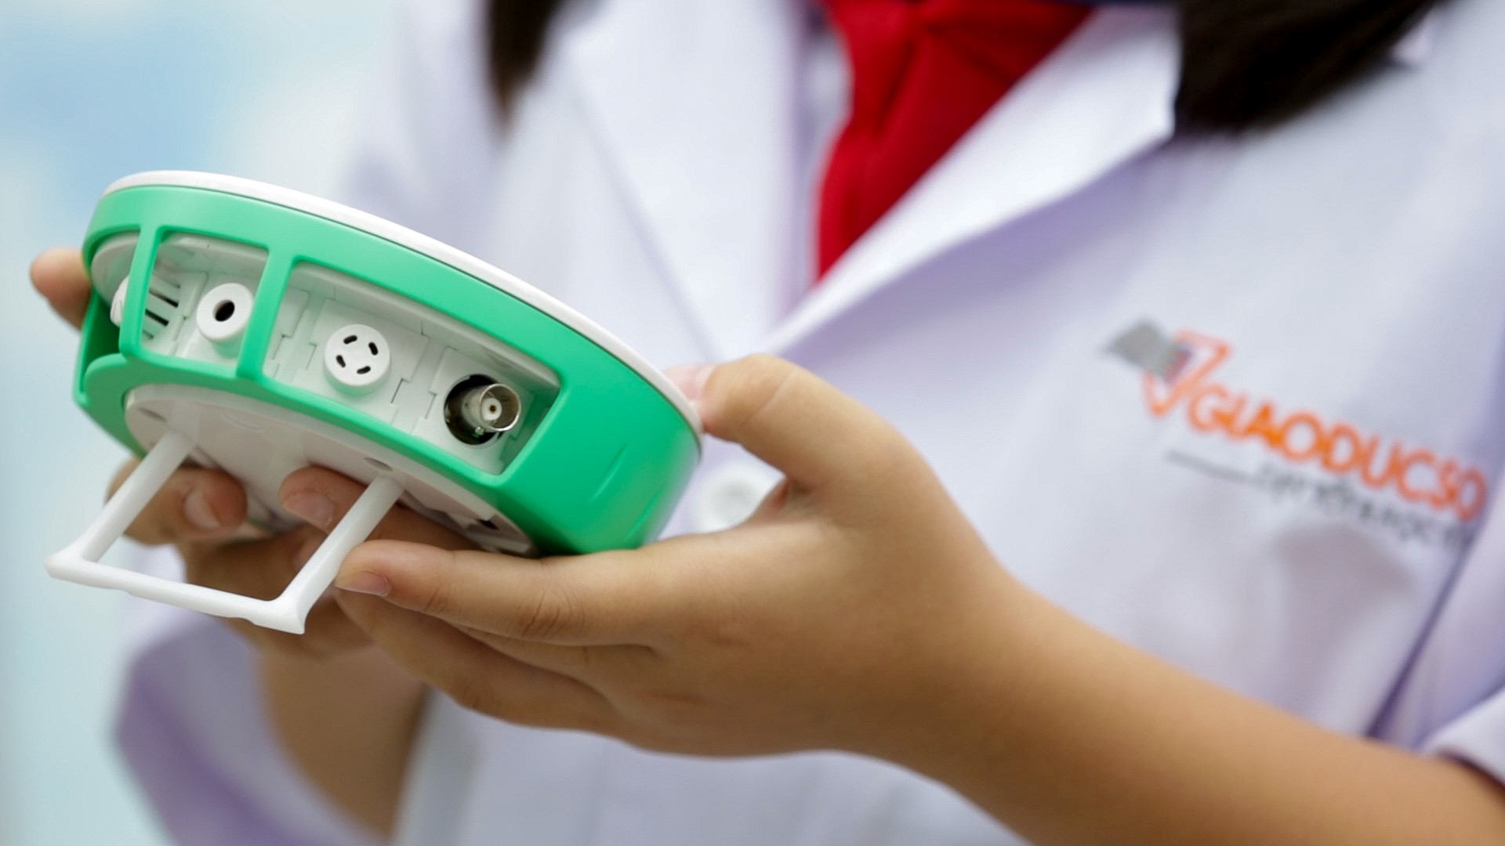
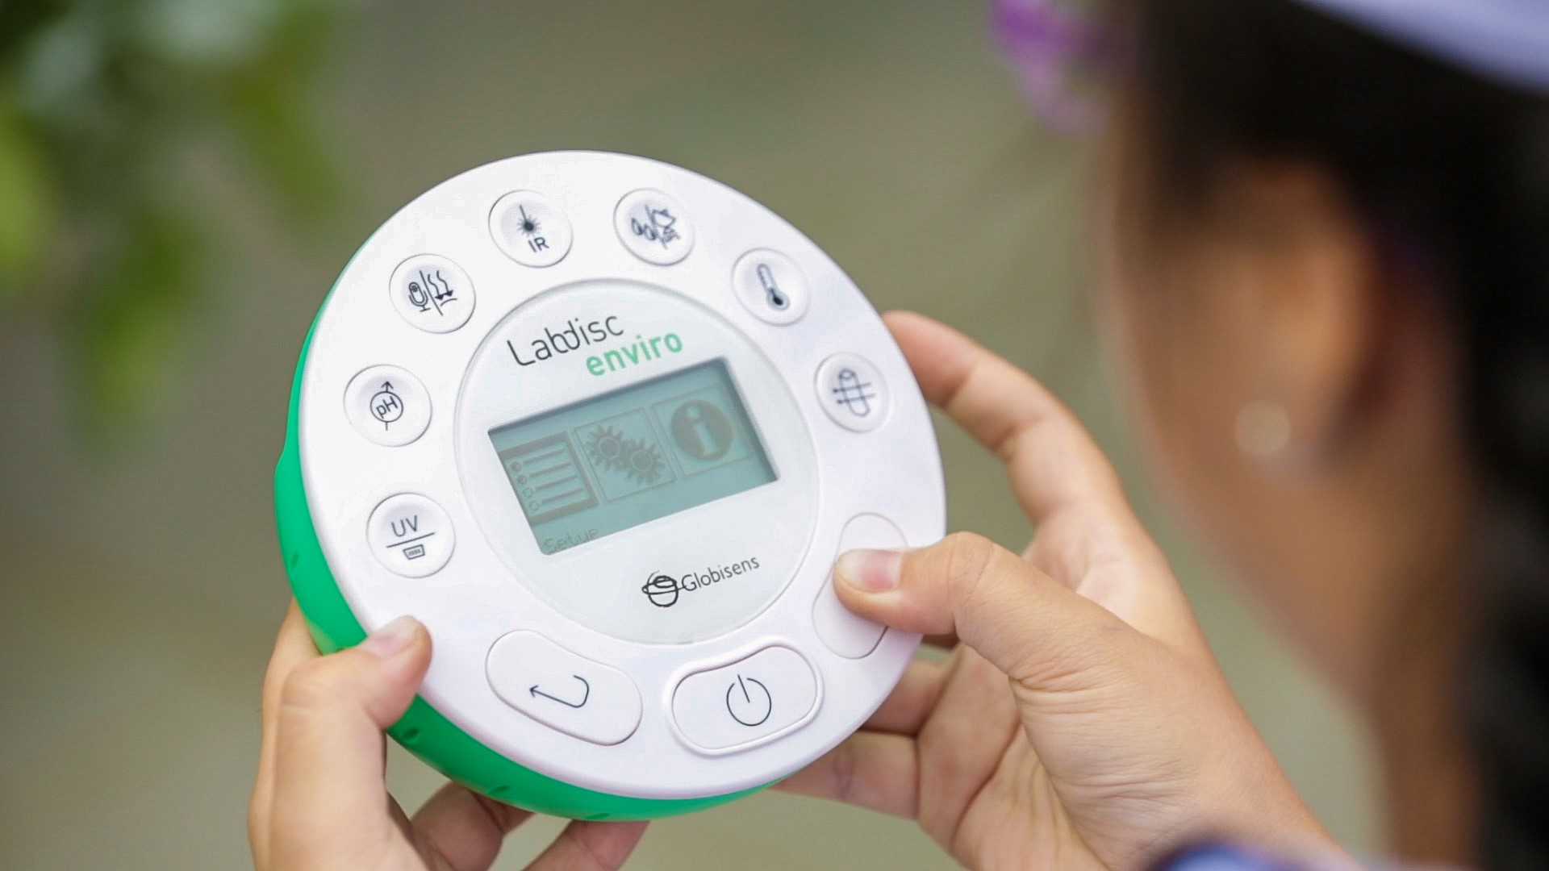
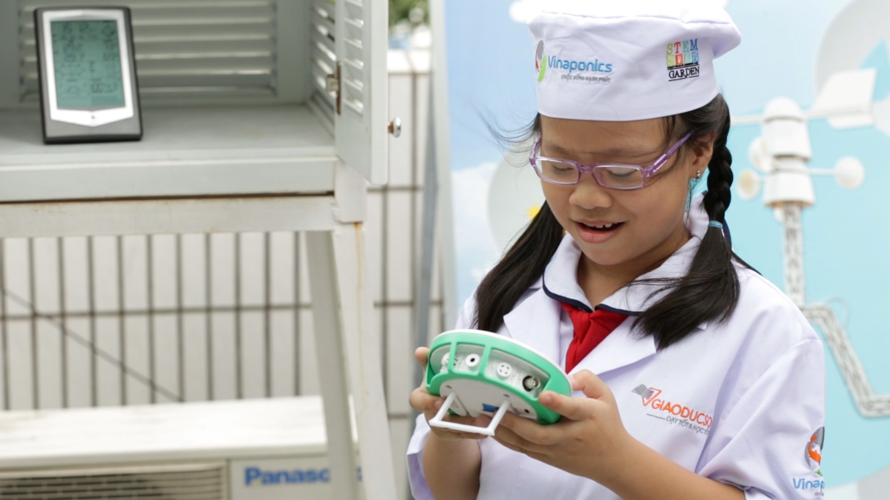
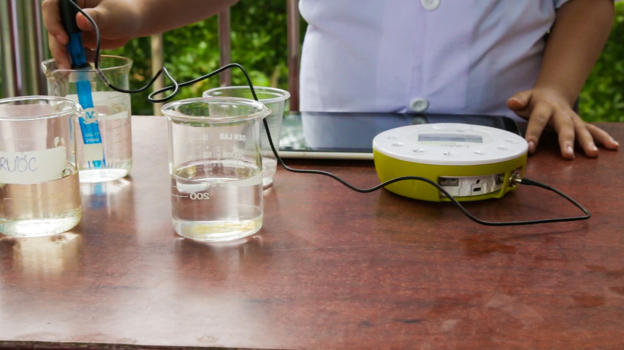
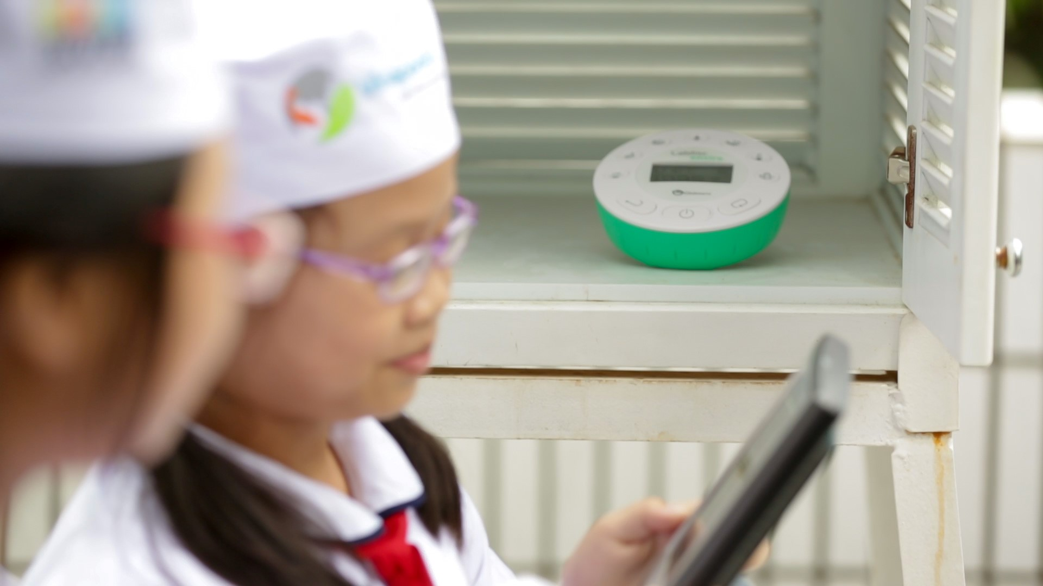
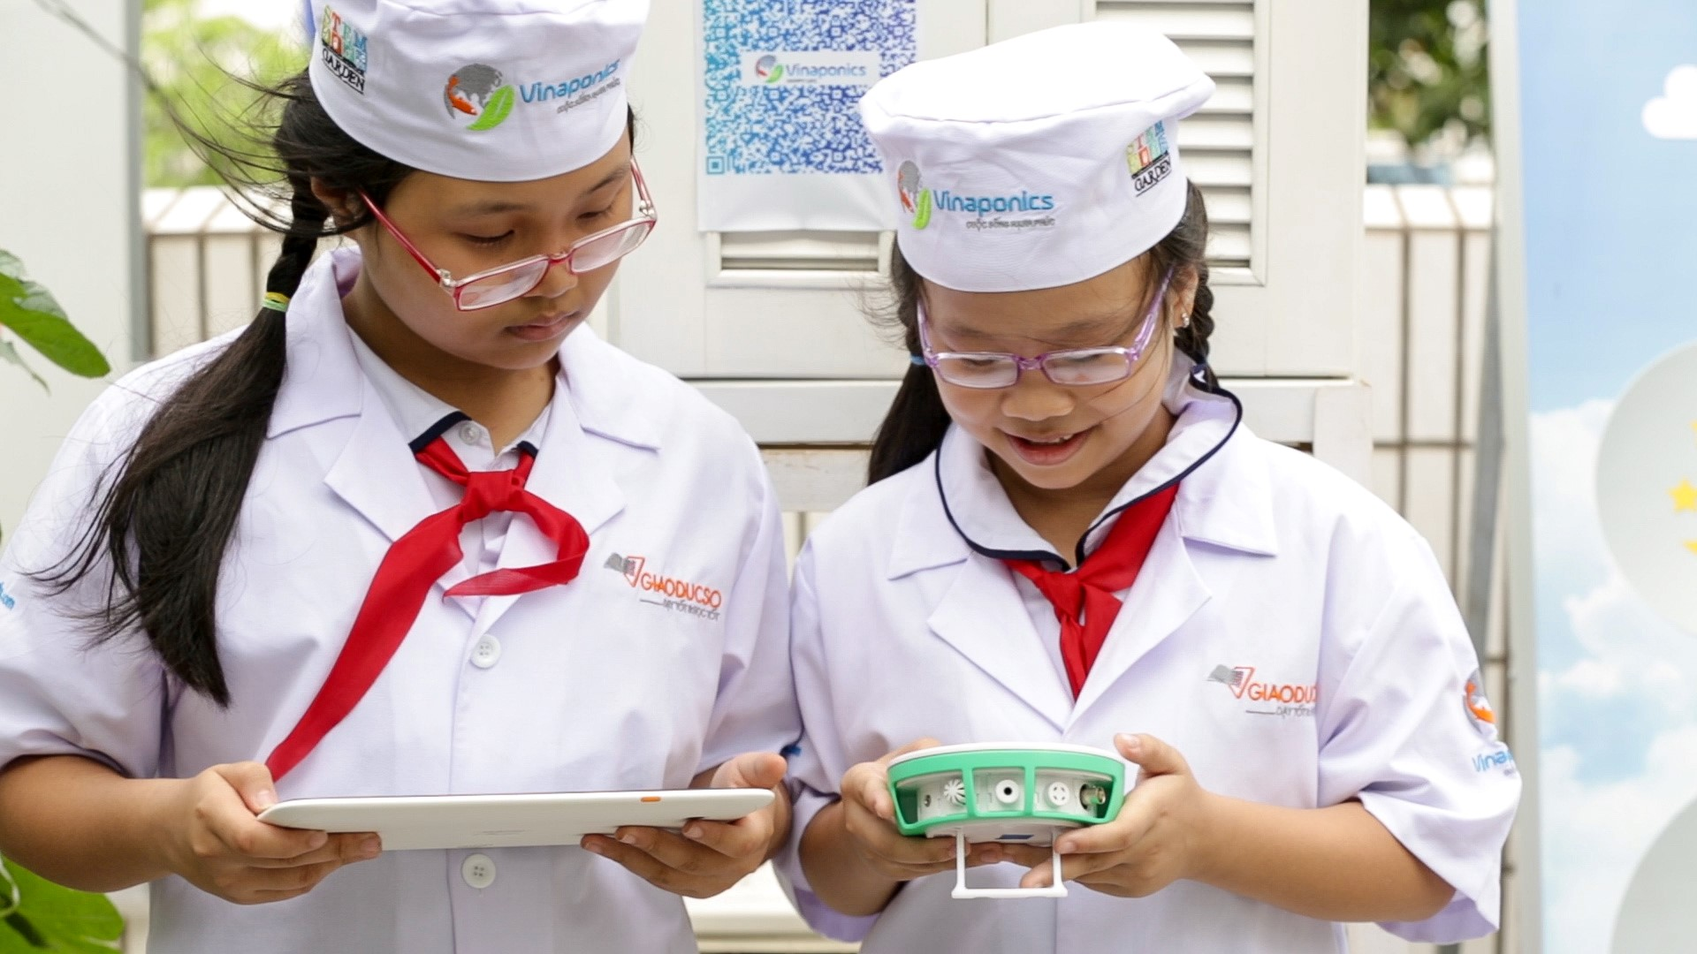
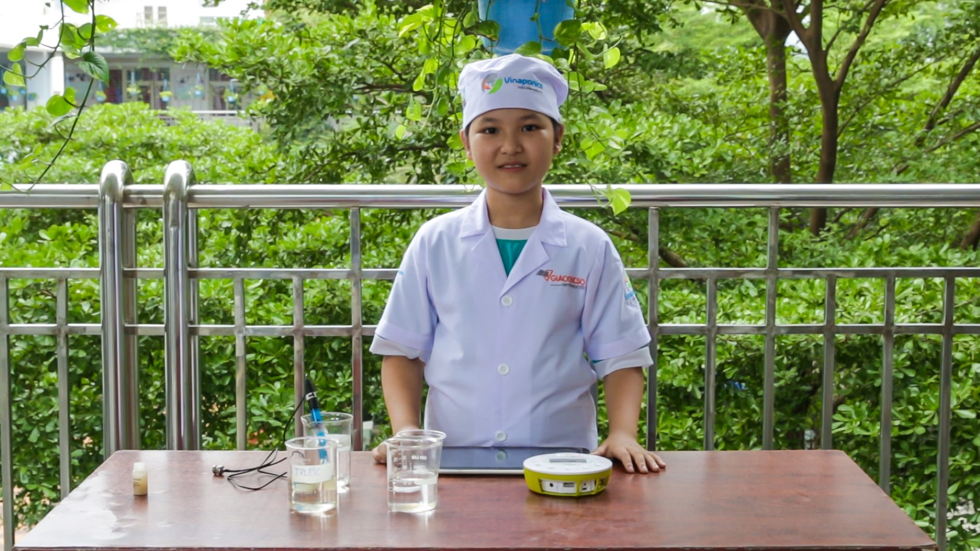
Aquaponics
STEM Agriculture
Vietnam

Slide 12
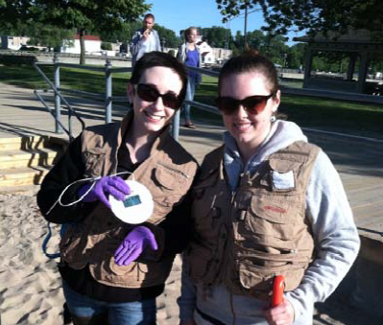
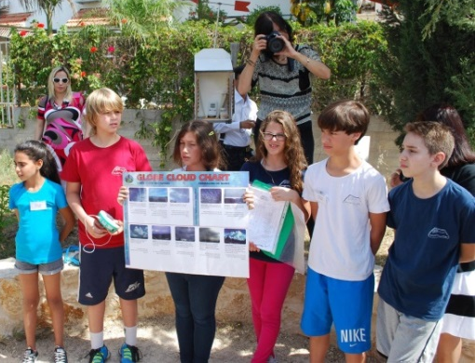
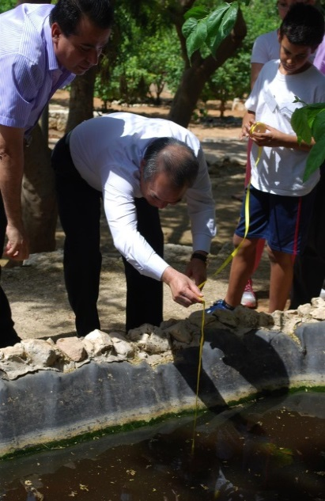
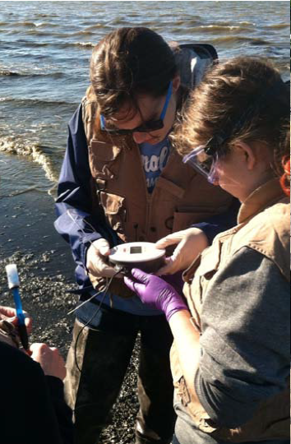
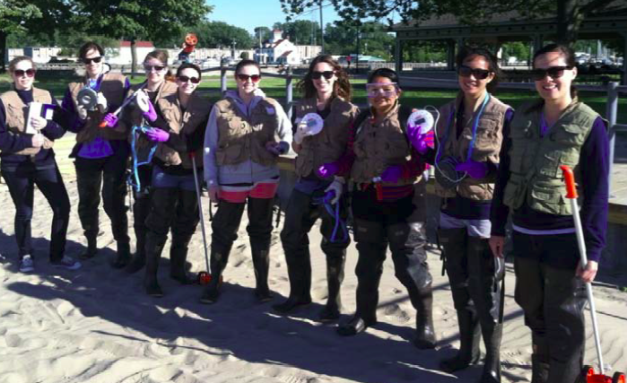
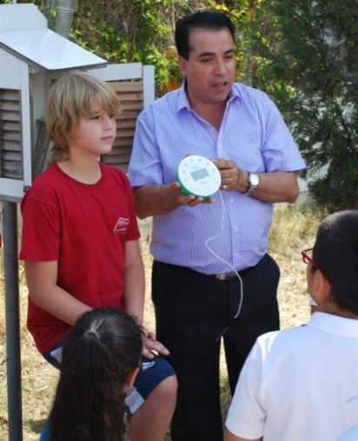
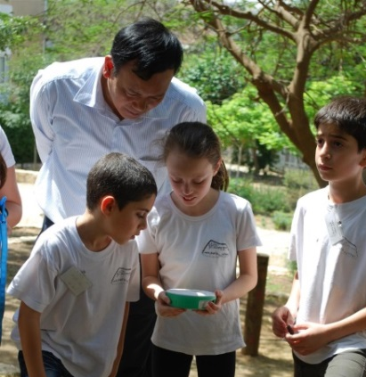
Exploring our Environment

Slide 13
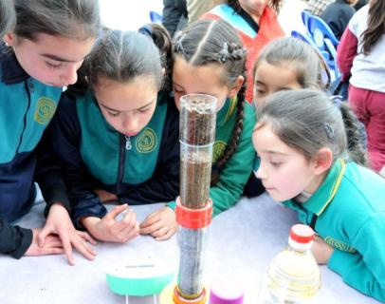
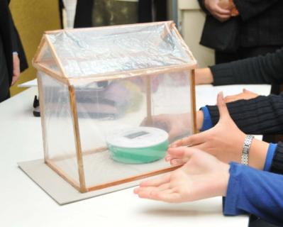
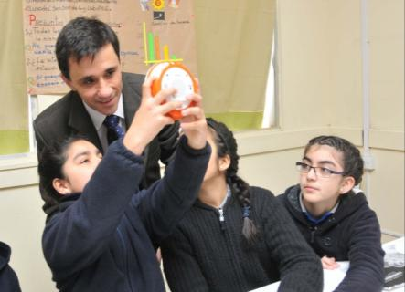
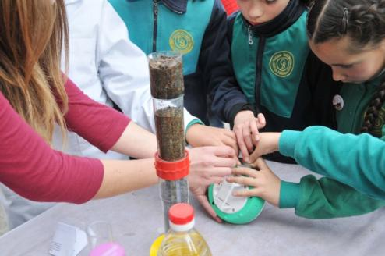
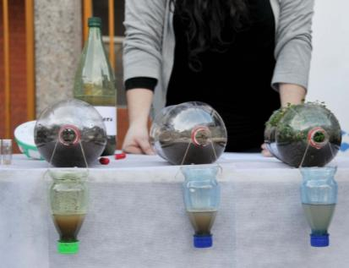
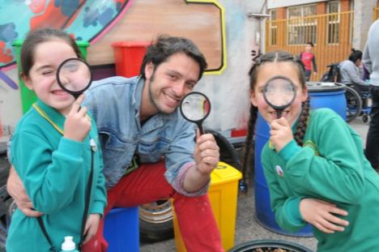
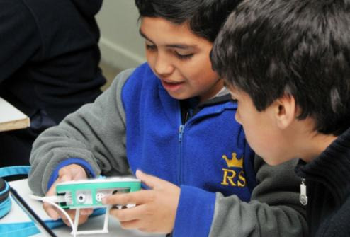
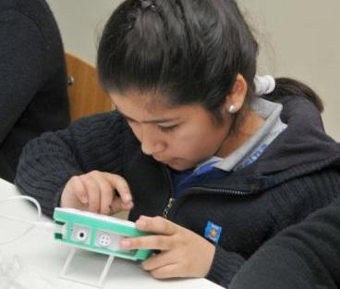
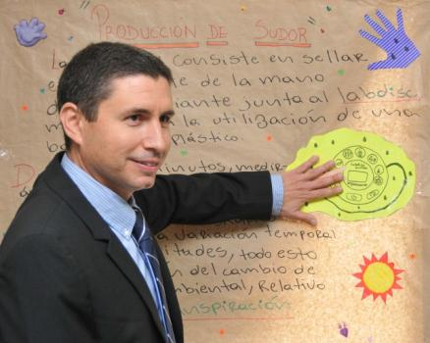
2nd graders Chile
Notes:
The Chilean national curriculum has started to introduce science from a much younger age in schools.
In this picture students, some as young as 2nd grade, are motivated and fully concentrated as they use Labdiscs in their very remotely located elementary school.
The students only received their Labdiscs two weeks earlier and are already able to perform sophisticated science experiments, while their teachers have found a solid channel to deliver inquiry-based learning and meet national standards.

Slide 14
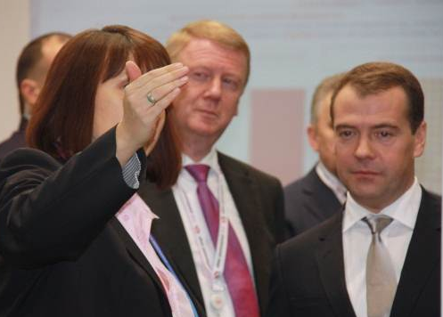
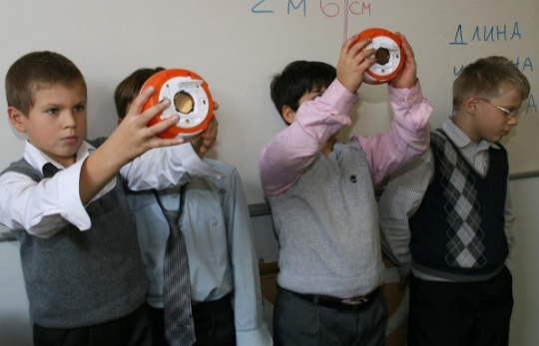
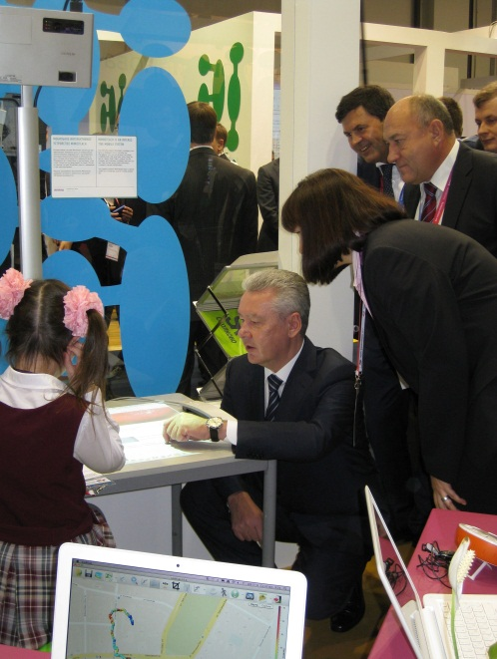
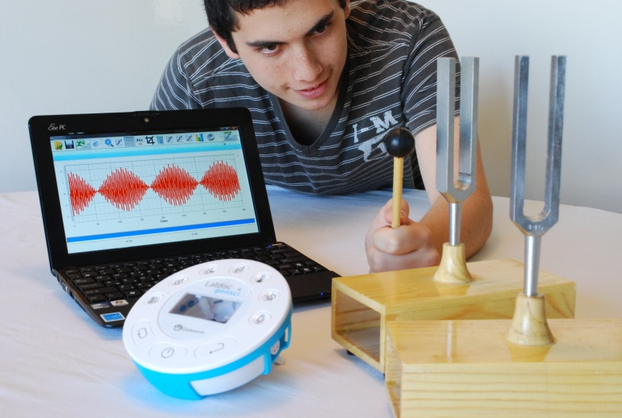
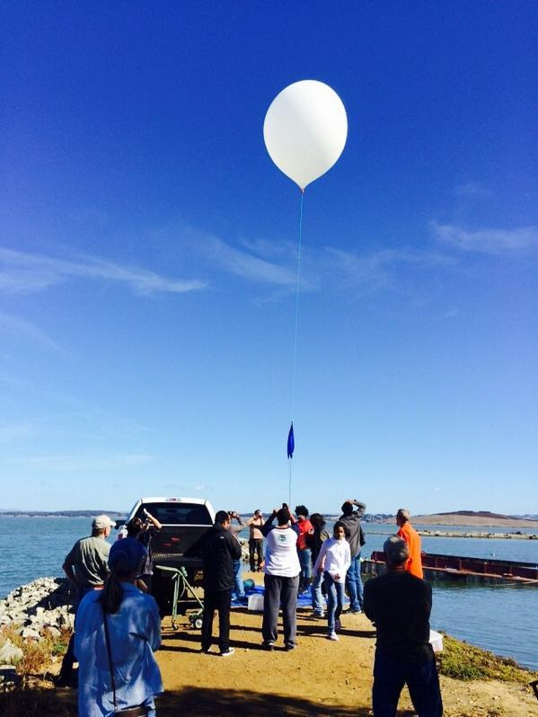
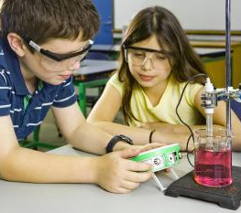
Bringing real change
Notes:
To summarize make the following points:
The Labdisc system is very easy to demonstrate and operate whether for students of all ages, elementary schools teachers or sales people with zero science background.
Despite its ease-of-use the Labdisc is still a very modern and sophisticated piece of equipment with advanced features including high accuracy, resolution, very fast sampling rate (up to 25,000 samples per second), a long battery life 150 hours and clear LCD panel with back light.
The Labdisc is the first of its kind regard the number of built-in sensors and wireless clean operability… it really is a complete lab in the palm of the students hand.

Slide 16
What does the research say?
Students who used computers and probeware showed significant learning gains. TEEMSS, National science Foundation, 2007
Students who had been exposed to hands-on science in pre-school performed higher than the national average. Plank (2000, USA)
Probeware excite pupils and saved them time recording temperature readings. That time could be used to produce and interpret graphs An Evaluation Horizons, n15 p12-16 Aut 2001
Countries like Japan and Korea (with early science learning) scored highly in science and math as compared with other 1st world countries PISA results of student science and math scores, 2007

Slide 17
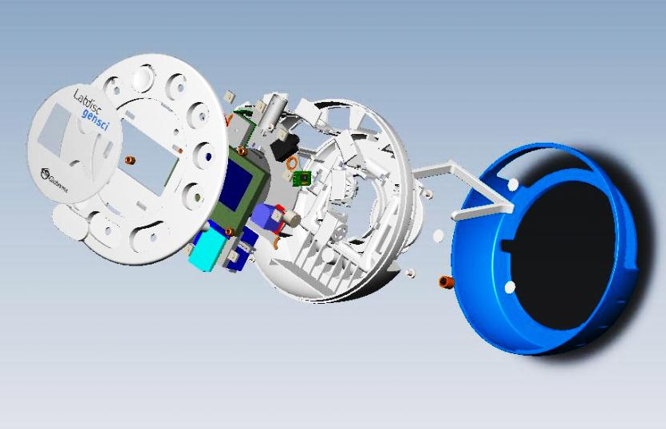
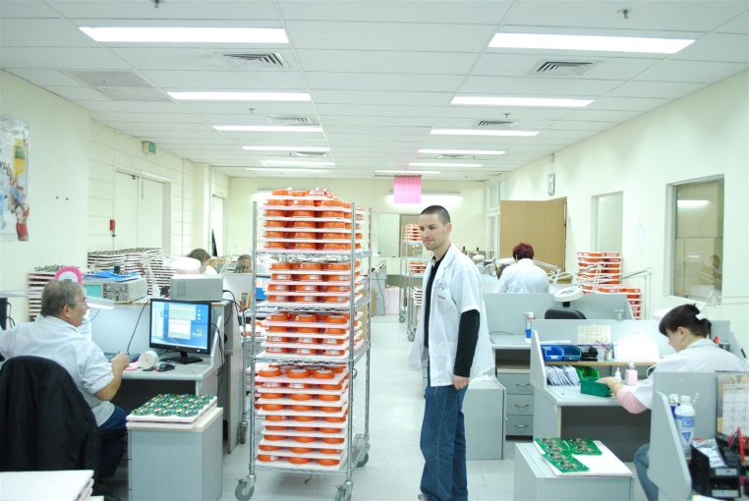
Globisens Ltd
35 employees
Production via a modern hi-tech facility
Labdisc product-line first launched in October 2011
Nearly 80,000 units shipped.
Returns < 0.2%
Notes:
Some corporate facts:
Globisens was established in April 2009 and today has 35 employees.
28 employees work in production, which is performed at a modern and
sophisticated hi-tech facility in Israel.
The Labdisc product-line was first launched in October 2011.
13,000 units were already shipped within the first 4 months for use in 300
schools internationally.

