Slide 1
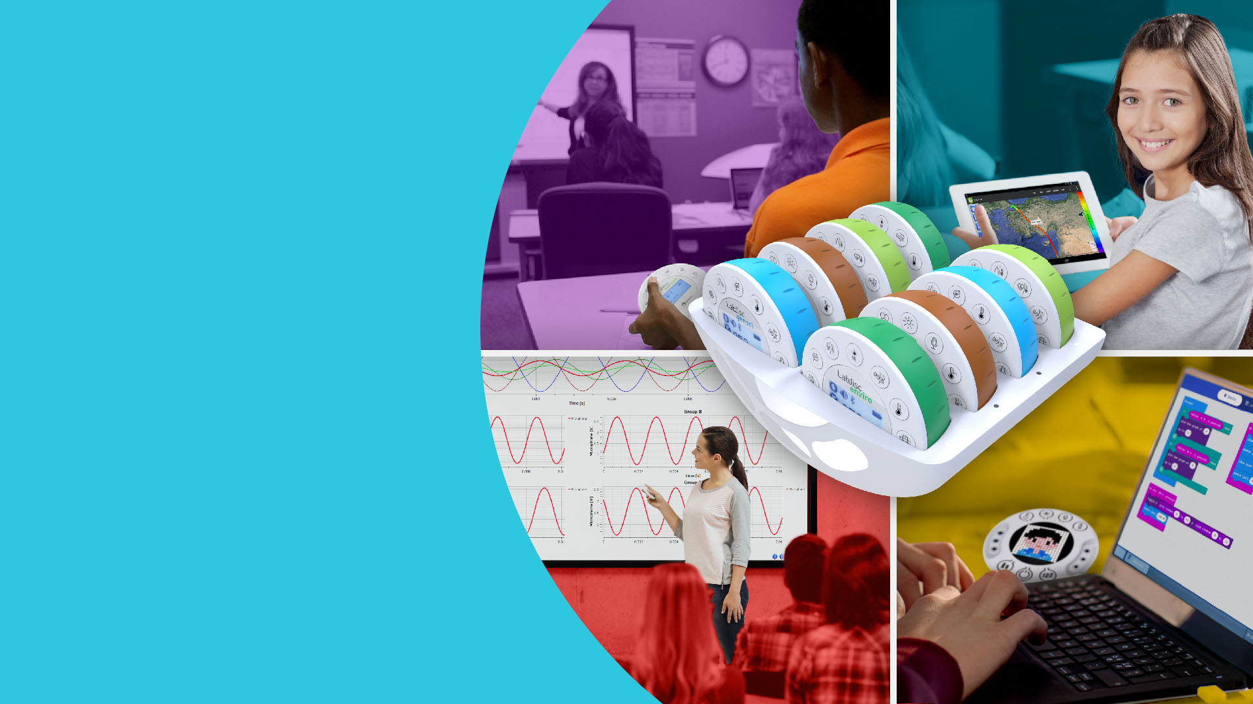





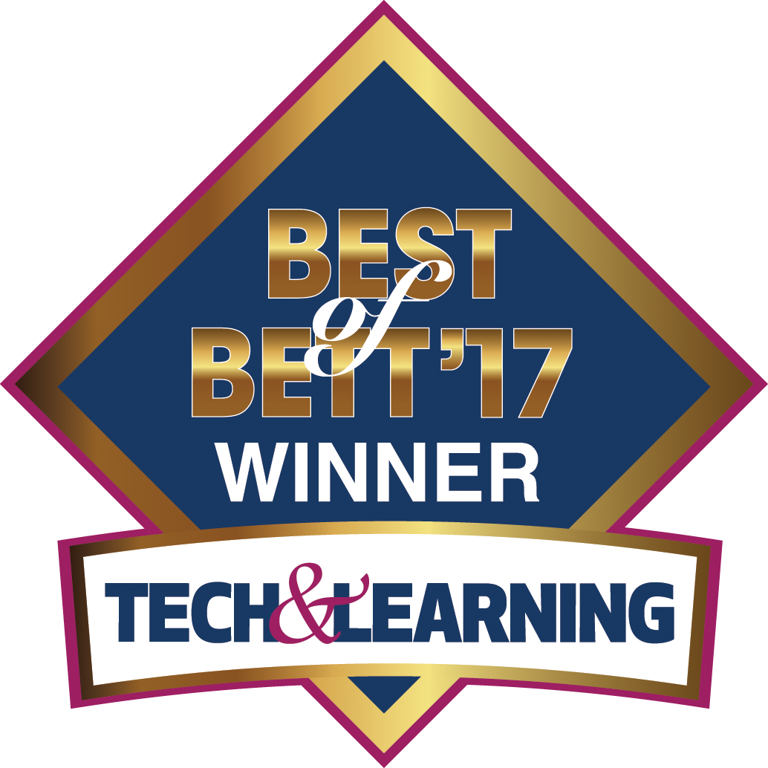
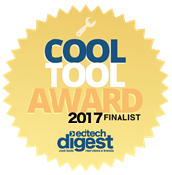
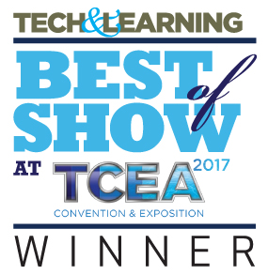

Modern STEM solutions
Notes:
Revolutionizing the school science Labs
Today we will show you the Labdisc – a computer based science Laboratory which revolutionized Science Labs in terms of performance, ease of use and cost.
Launched in late 2011,
Won 5 international GOLD medals, including the latest BEST of BETT 2017 in London out of 700 companies.
Today we are proud of having over 80,000 Labdisc in over 30 countries and in 22 languages.

Slide 2
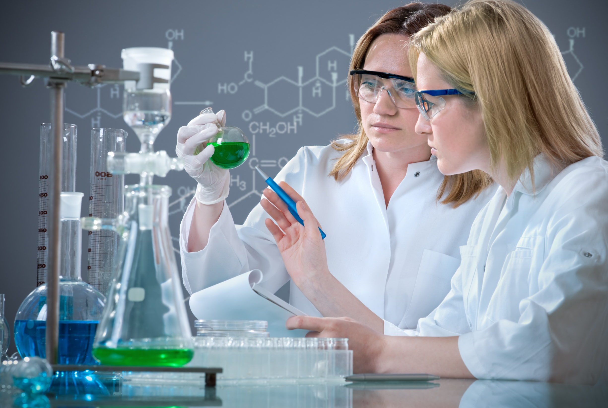
THE CHALLENGE:
Making Science & Math attractive, hands-on
and Easy
Notes:
Time consuming
A typical classes of 30 students require the preparations of about 90 separate items.
This is because every 2 students needs a working station with typically 2 meters, 2-3 cables, computer etc.
Multiply these 5-6 items by 15 stations and you have 90 items for the teacher to setup, calibrate and collect back at the end of the class…
This is extra 90 minutes of work for our already very busy teachers…
As a result the school Labs are not been used as often as they should have been.
Irrelevant
Student find the traditional Labs using “Pre-historic” analog meters – to be irrelevant in the 21st century school environment

Slide 3
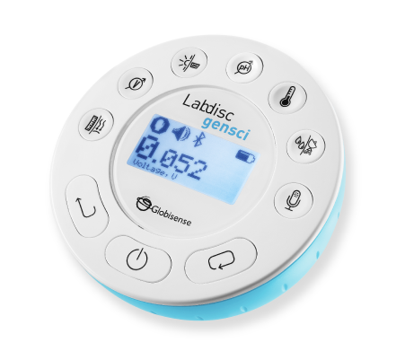
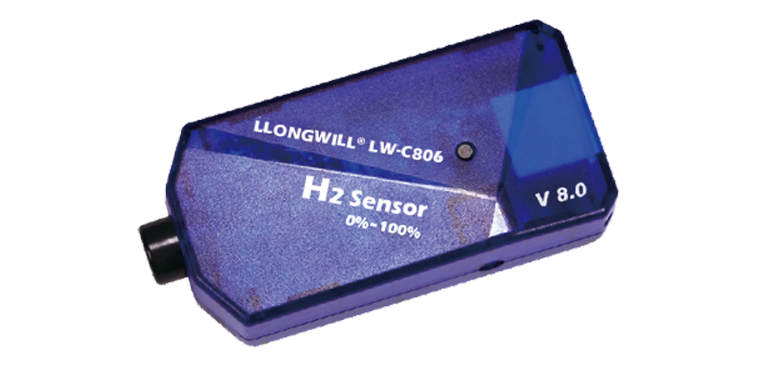
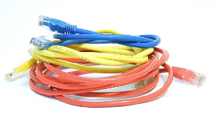
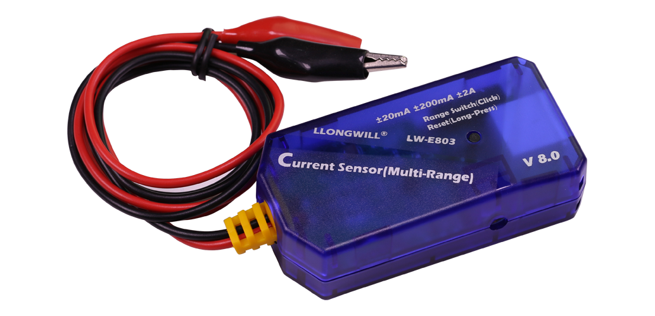
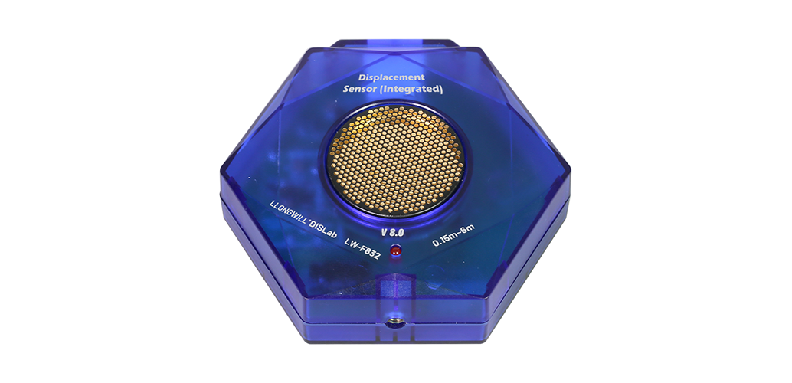
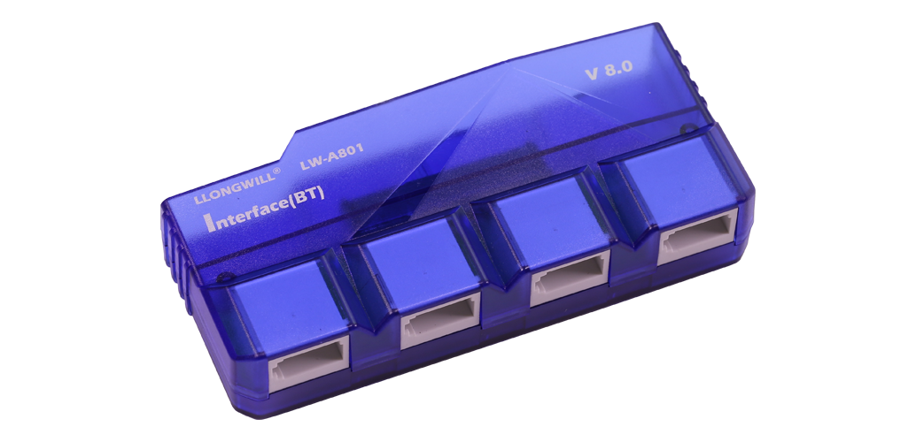
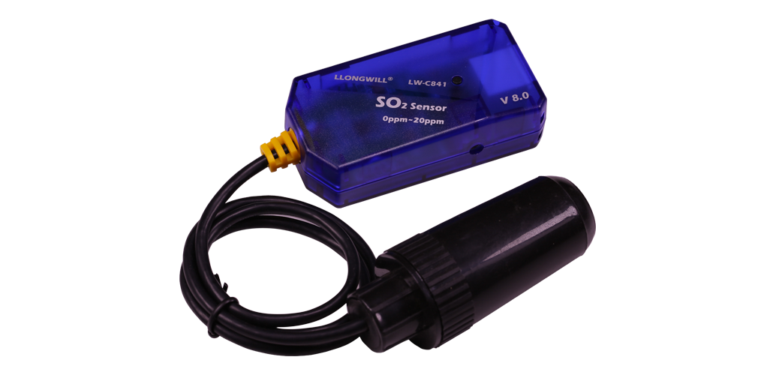
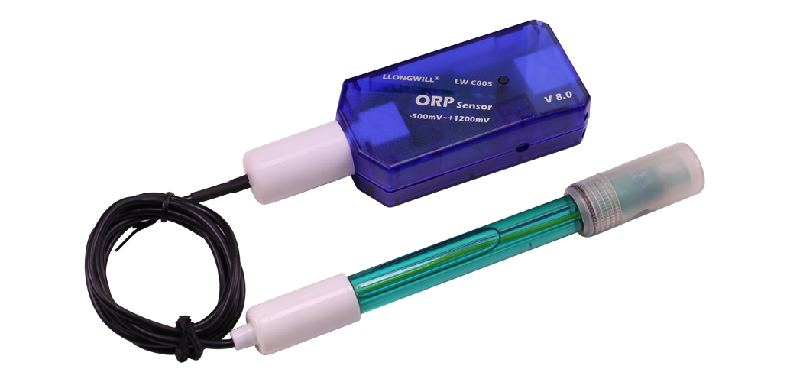
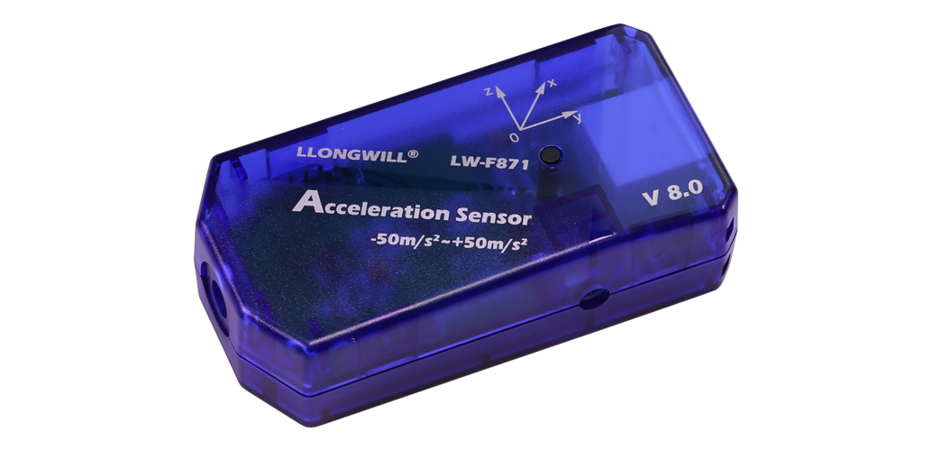
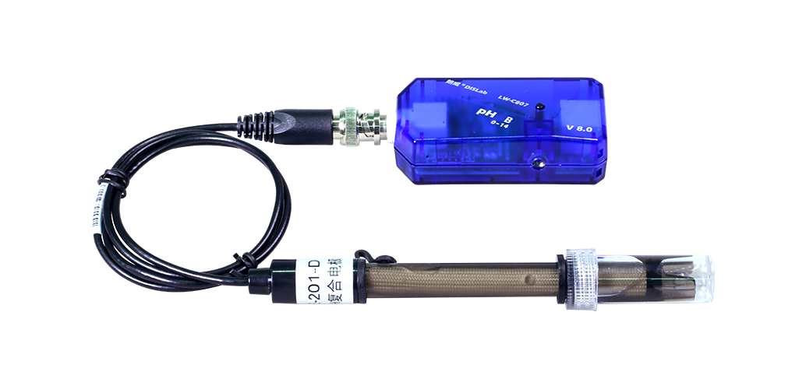
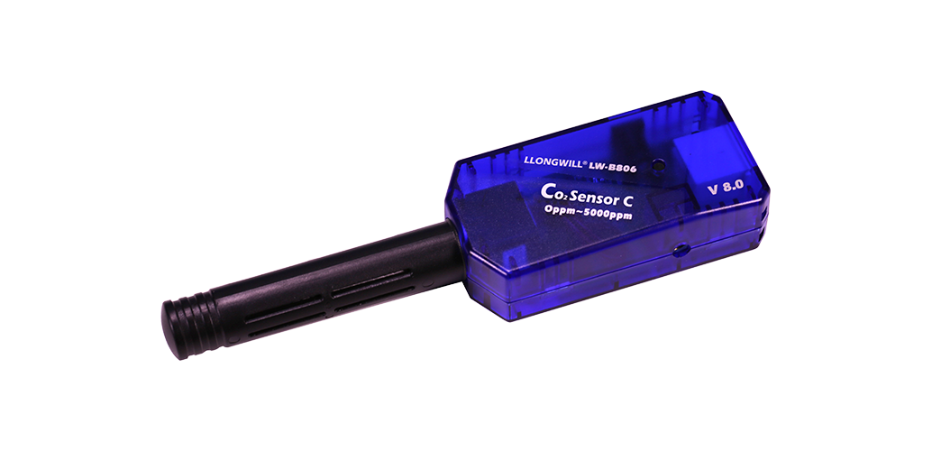
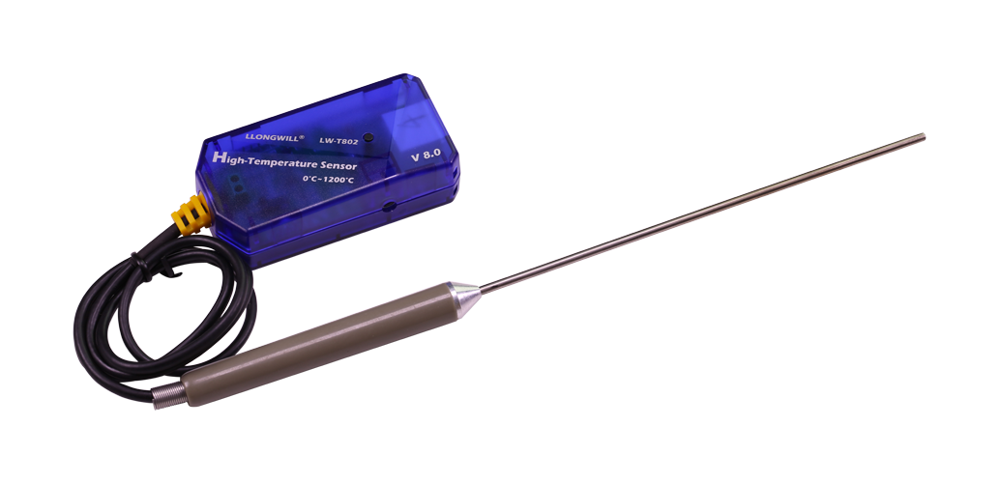
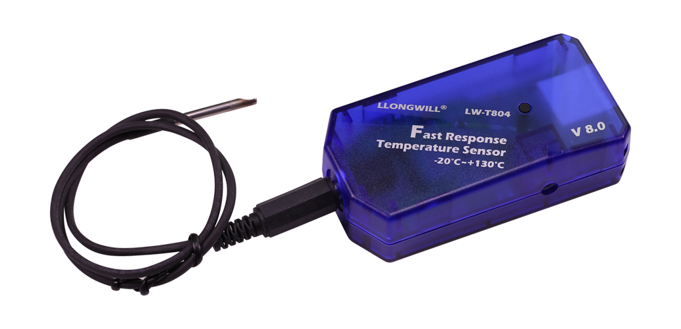
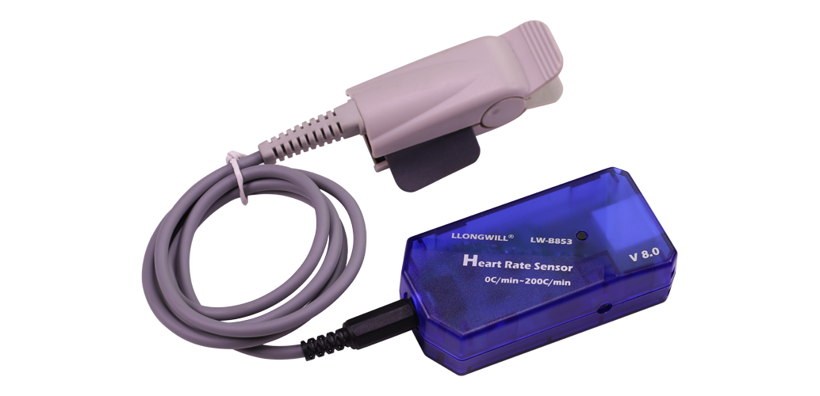
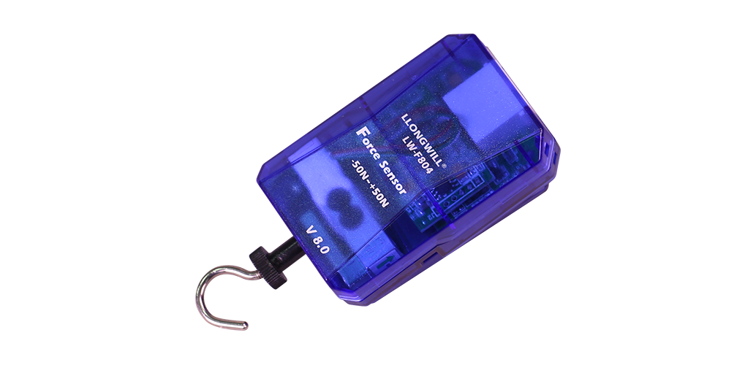

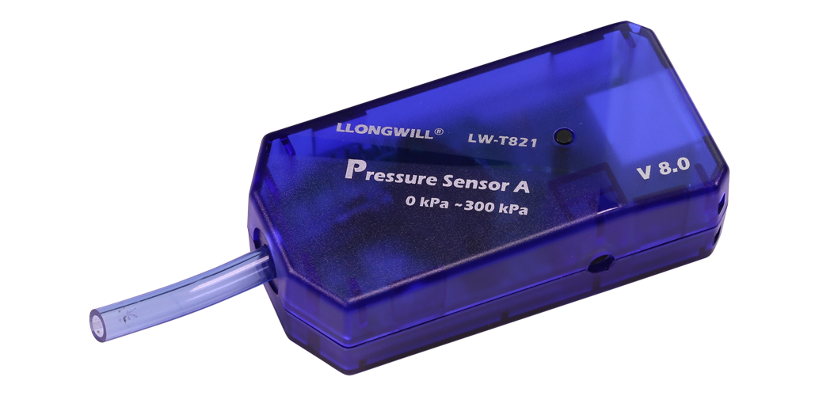
SCIENCE EXPERIMENTING WAS NEVER SO EASY!
Replacing boxes of sensors…
With an all-in-one science lab
FROM 60 PER CLASS TO ONE PER TABLE | SAVING 90 MINUTES OF PREPARATION TIME
Notes:
We solve this problem!
Consolidation - combining 12-15 meters into a single disc.
Less items - from 90 items in the laboratory –> to only 1 per table.
Easy, with no calibration - all sensors are automatically calibrated when the Labdisc is turned on.
SAVING HUGE PREPARATION TIME FOR THE TEACHER.

Slide 4

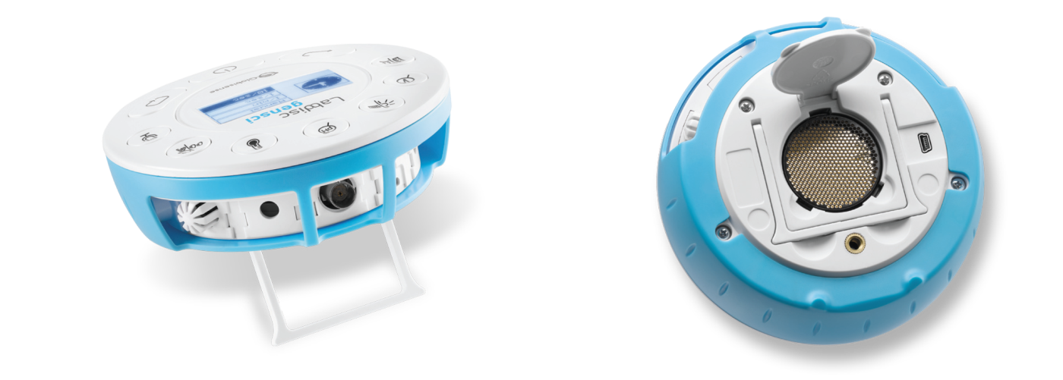
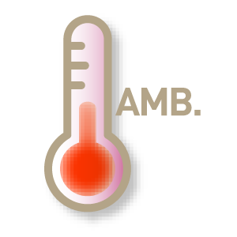




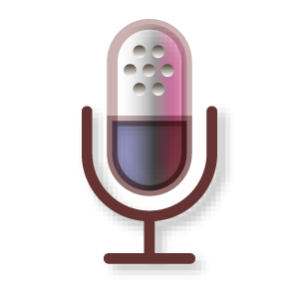

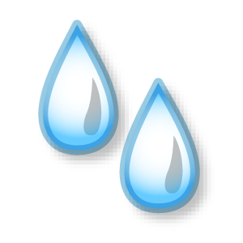
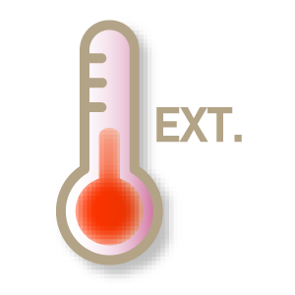
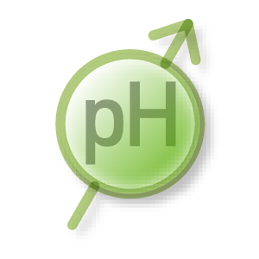

GENSCI: GENERAL SCIENCE UNIT
A Complete Lab on a Disc
12 built-in Sensors
Air Pressure, Ambient Temperature, Current, Distance, GPS, Light, Microphone, pH,
Relative Humidity, Sound Level, Temperature, Voltage, Universal Input
Notes:
The Labdisc Gensci – For General science.
Combining the most needed sensors for all 3 science subject – Physics, Biology band Chemistry
Ideal for Elementary and Middle school
Built-in sensors include - Air Pressure, Ambient Temperature, Current, Distance, GPS, Light, Microphone, pH, Relative Humidity, Sound Level, Temperature, Voltage, plus Universal Input.
Typical activities include - Travelling speed with GPS, Newton’s Laws, sound waves, electrical currents, pH titration, endothermic and exothermic reactions, Boyle’s Law, specific heat and microclimate.

Slide 5
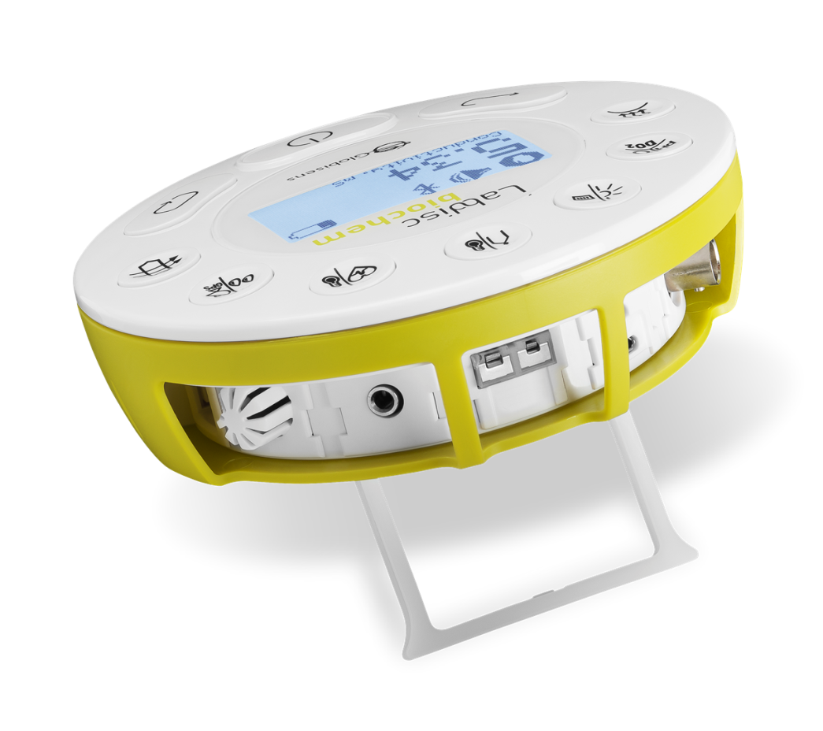
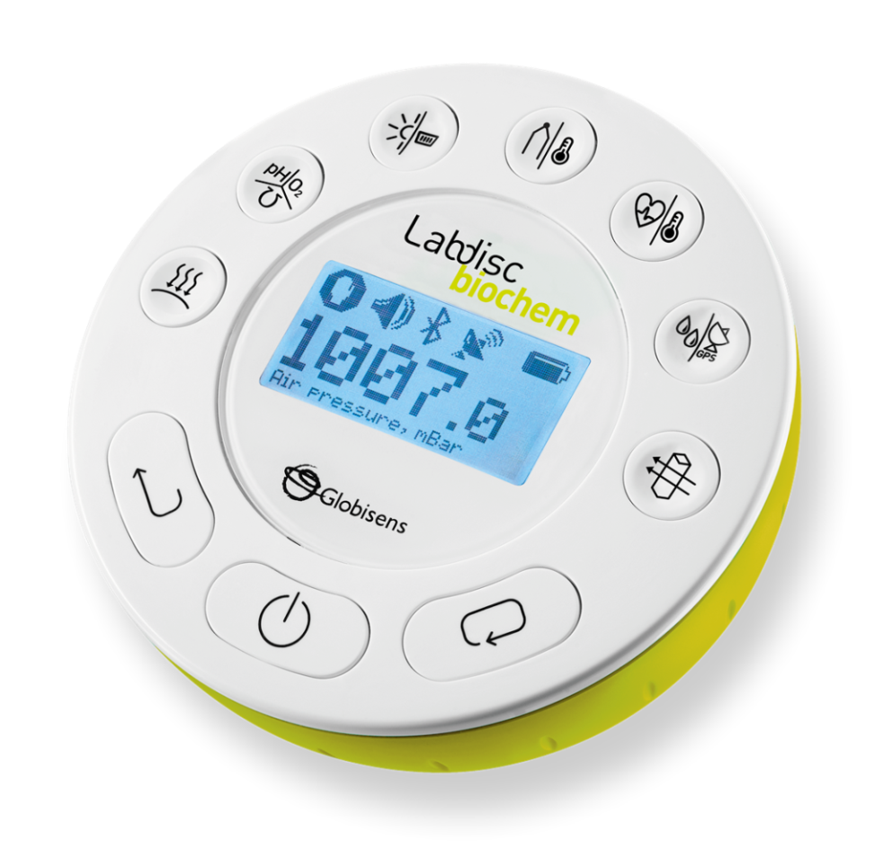
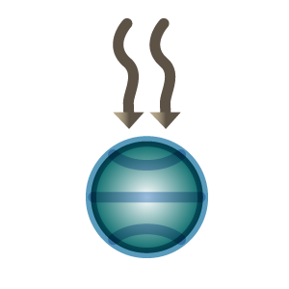

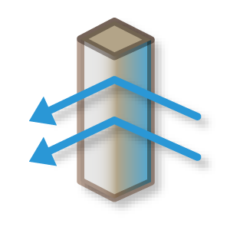

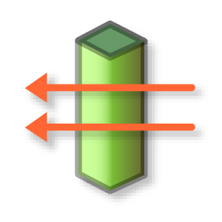

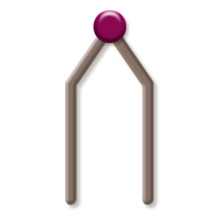
BIOCHEM: BIOLOGY AND CHEMISTRY UNIT
A Complete Lab on a Disc
14 built-in Sensors
Air Pressure, Barometer, Conductivity, pH, DO2, Light, Universal Input, Thermocouple,
Ambient Temperature, Heart rate, Temperature, Humidity, GPS, Colorimeter, Turbidity
Notes:
The Labdisc Biochem – with 15 built in sensors for High school Biology and Chemistry
Built-in sensors include - Air Pressure, Ambient Temperature, Barometric Pressure, Colorimeter, Conductivity, Dissolved Oxygen, External Temperature, GPS, Heart Rate, Light, pH, Relative Humidity, Thermocouple, Turbidity and Universal Input.
Typical activities include - Skin temperature, pulse rates before and after activity, sweat production and photosynthesis, solid, liquid and gas phase changes and pH titration.

Slide 6
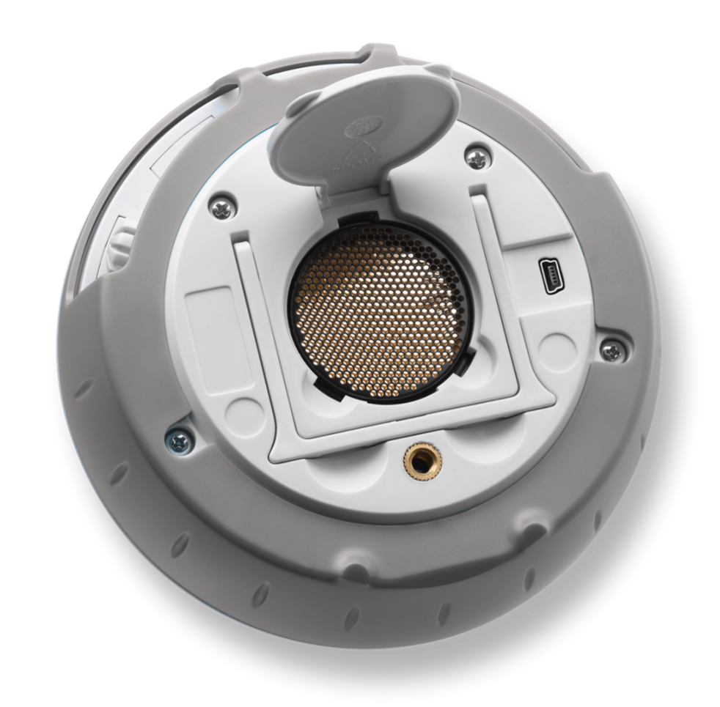
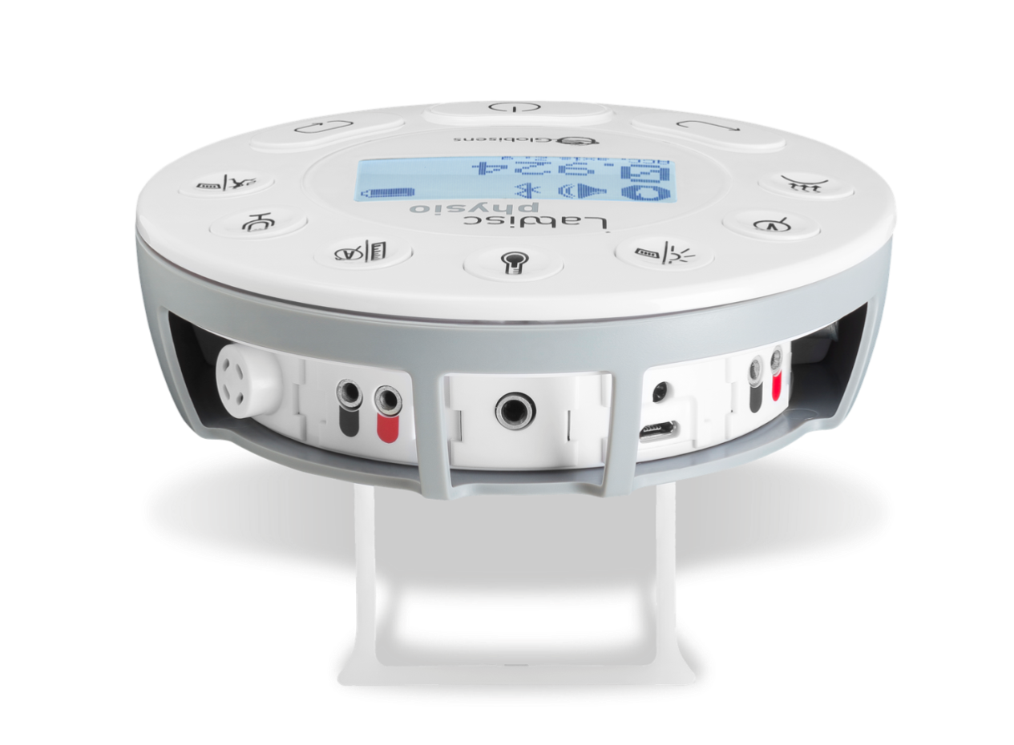


PHYSIO: GENERAL SCIENCE UNIT
A Complete Lab on a Disc
10 built-in Sensors
Air Pressure, Voltage, Low Voltage, Light, 2 x Universal Input, Ambient Temperature,
Temperature, Current, Distance, Microphone, Accelerometer
Notes:
The Labdisc Physio – with 12 built in sensors for High school Physics
Built-in sensors include - Accelerometer, Air Pressure, Ambient Temperature, Current, Distance (Motion), External Temperature, Light, Microphone, Universal Input, Voltage
Typical activities include - Lenz and Boyle’s Laws, resistor networks, light source efficiency, light vs. distance, sound beat and wave superposition, Newton’s Second Law and free fall acceleration.

Slide 7
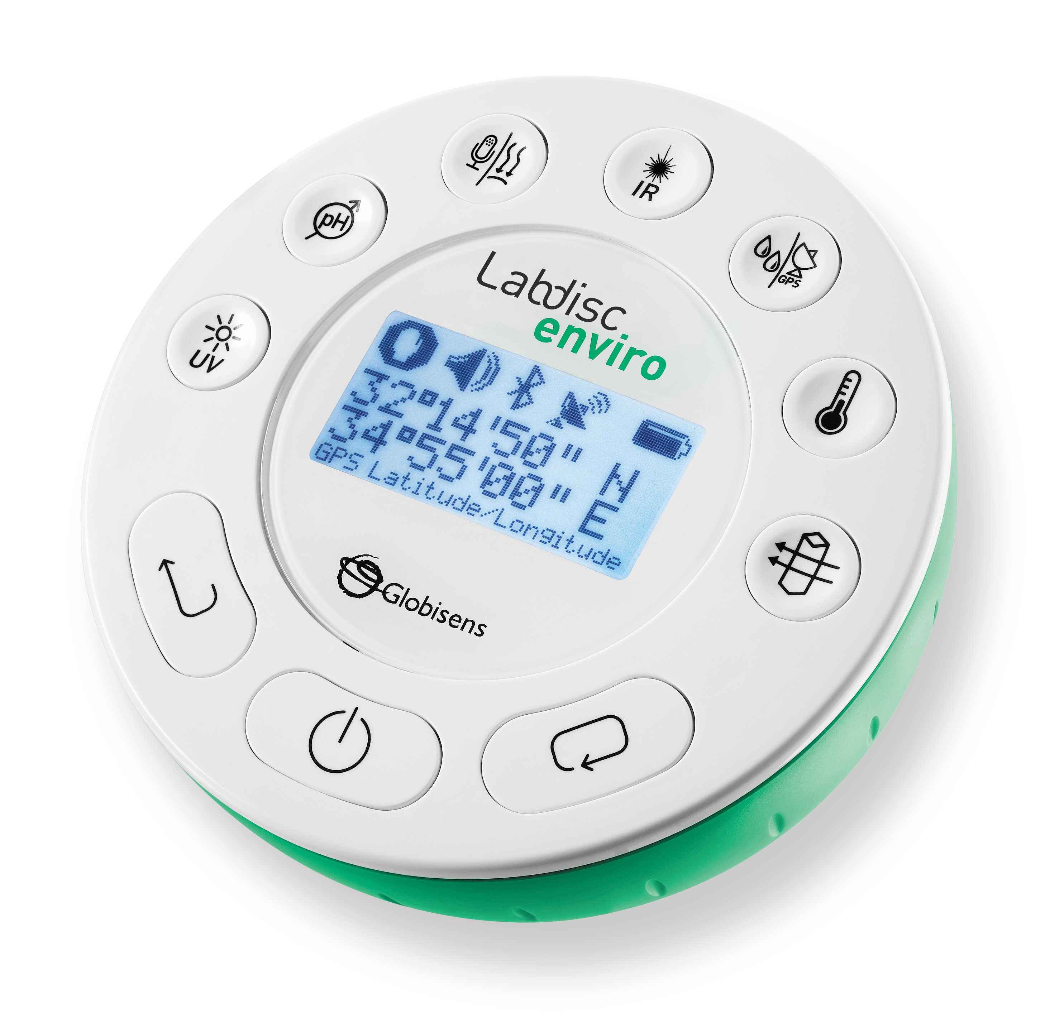
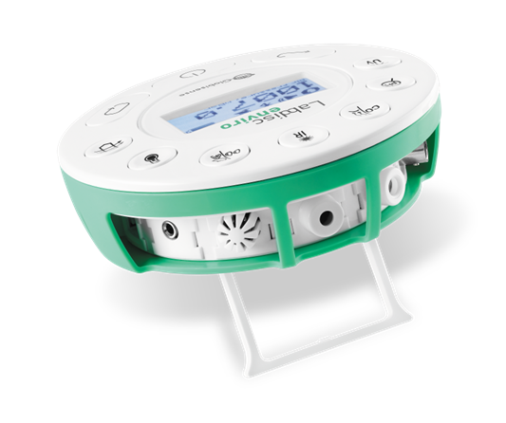

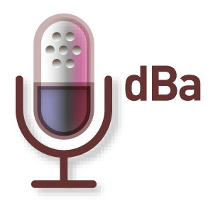

ENVIRO: ENVIRONMENTAL SCIENCE UNIT
A Complete Lab on a Disc
12 built-in Sensors
Ambient Temperature, Barometric Pressure, Colorimeter, DO2 (electrode not included), GPS, IR Temperature,
pH, Relative Humidity, Sound Level, Temperature, Turbidity, UV, Universal input,

Slide 8
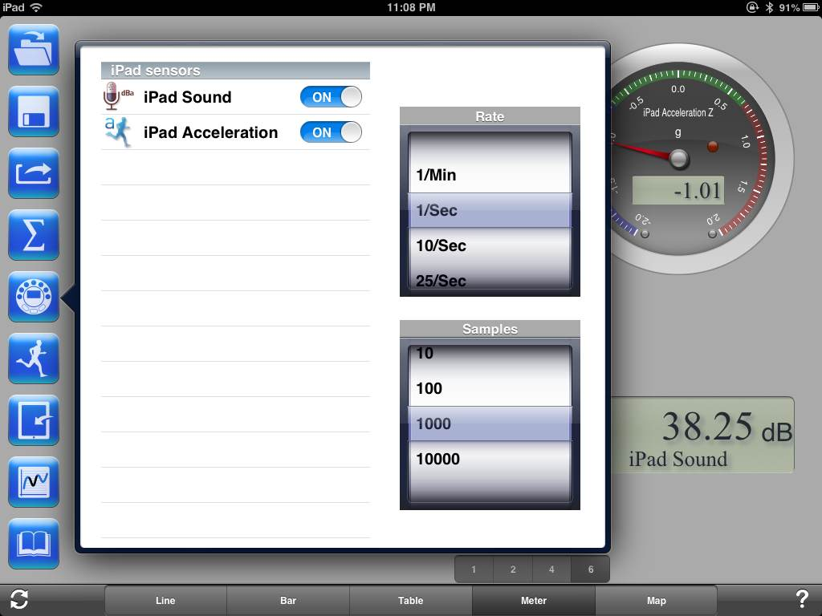
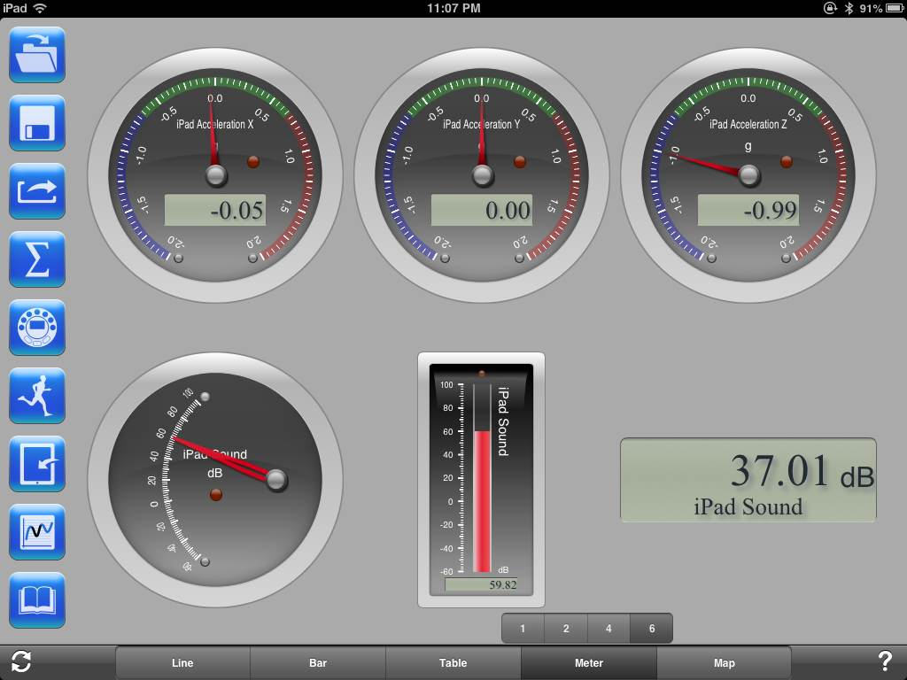
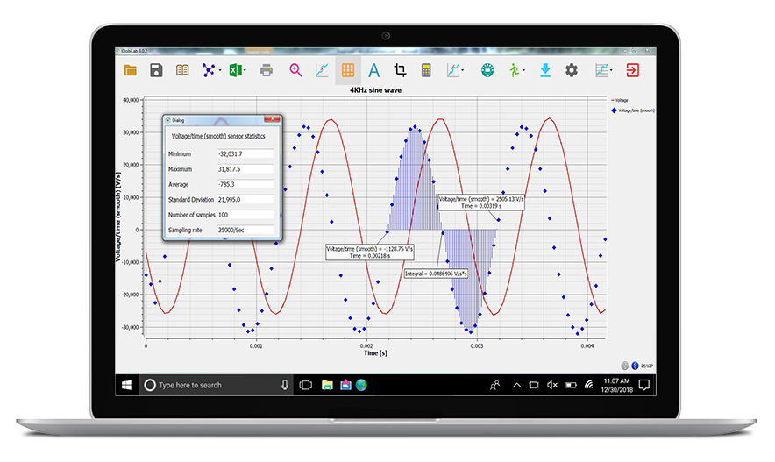
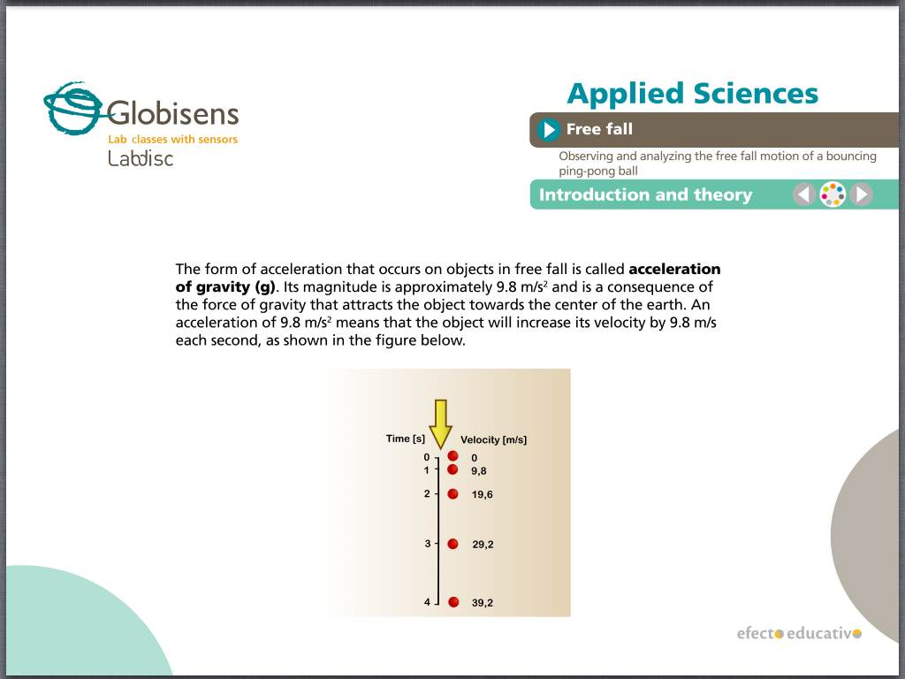
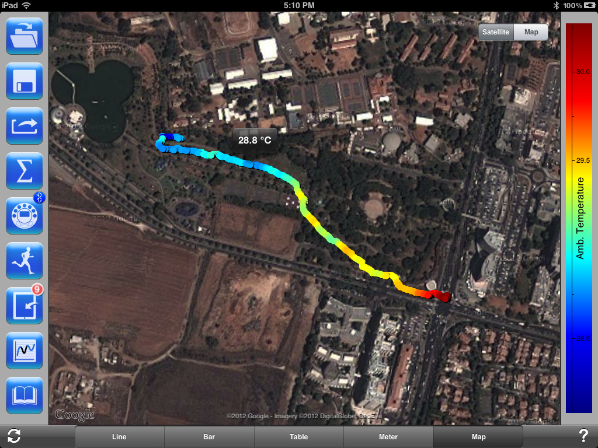
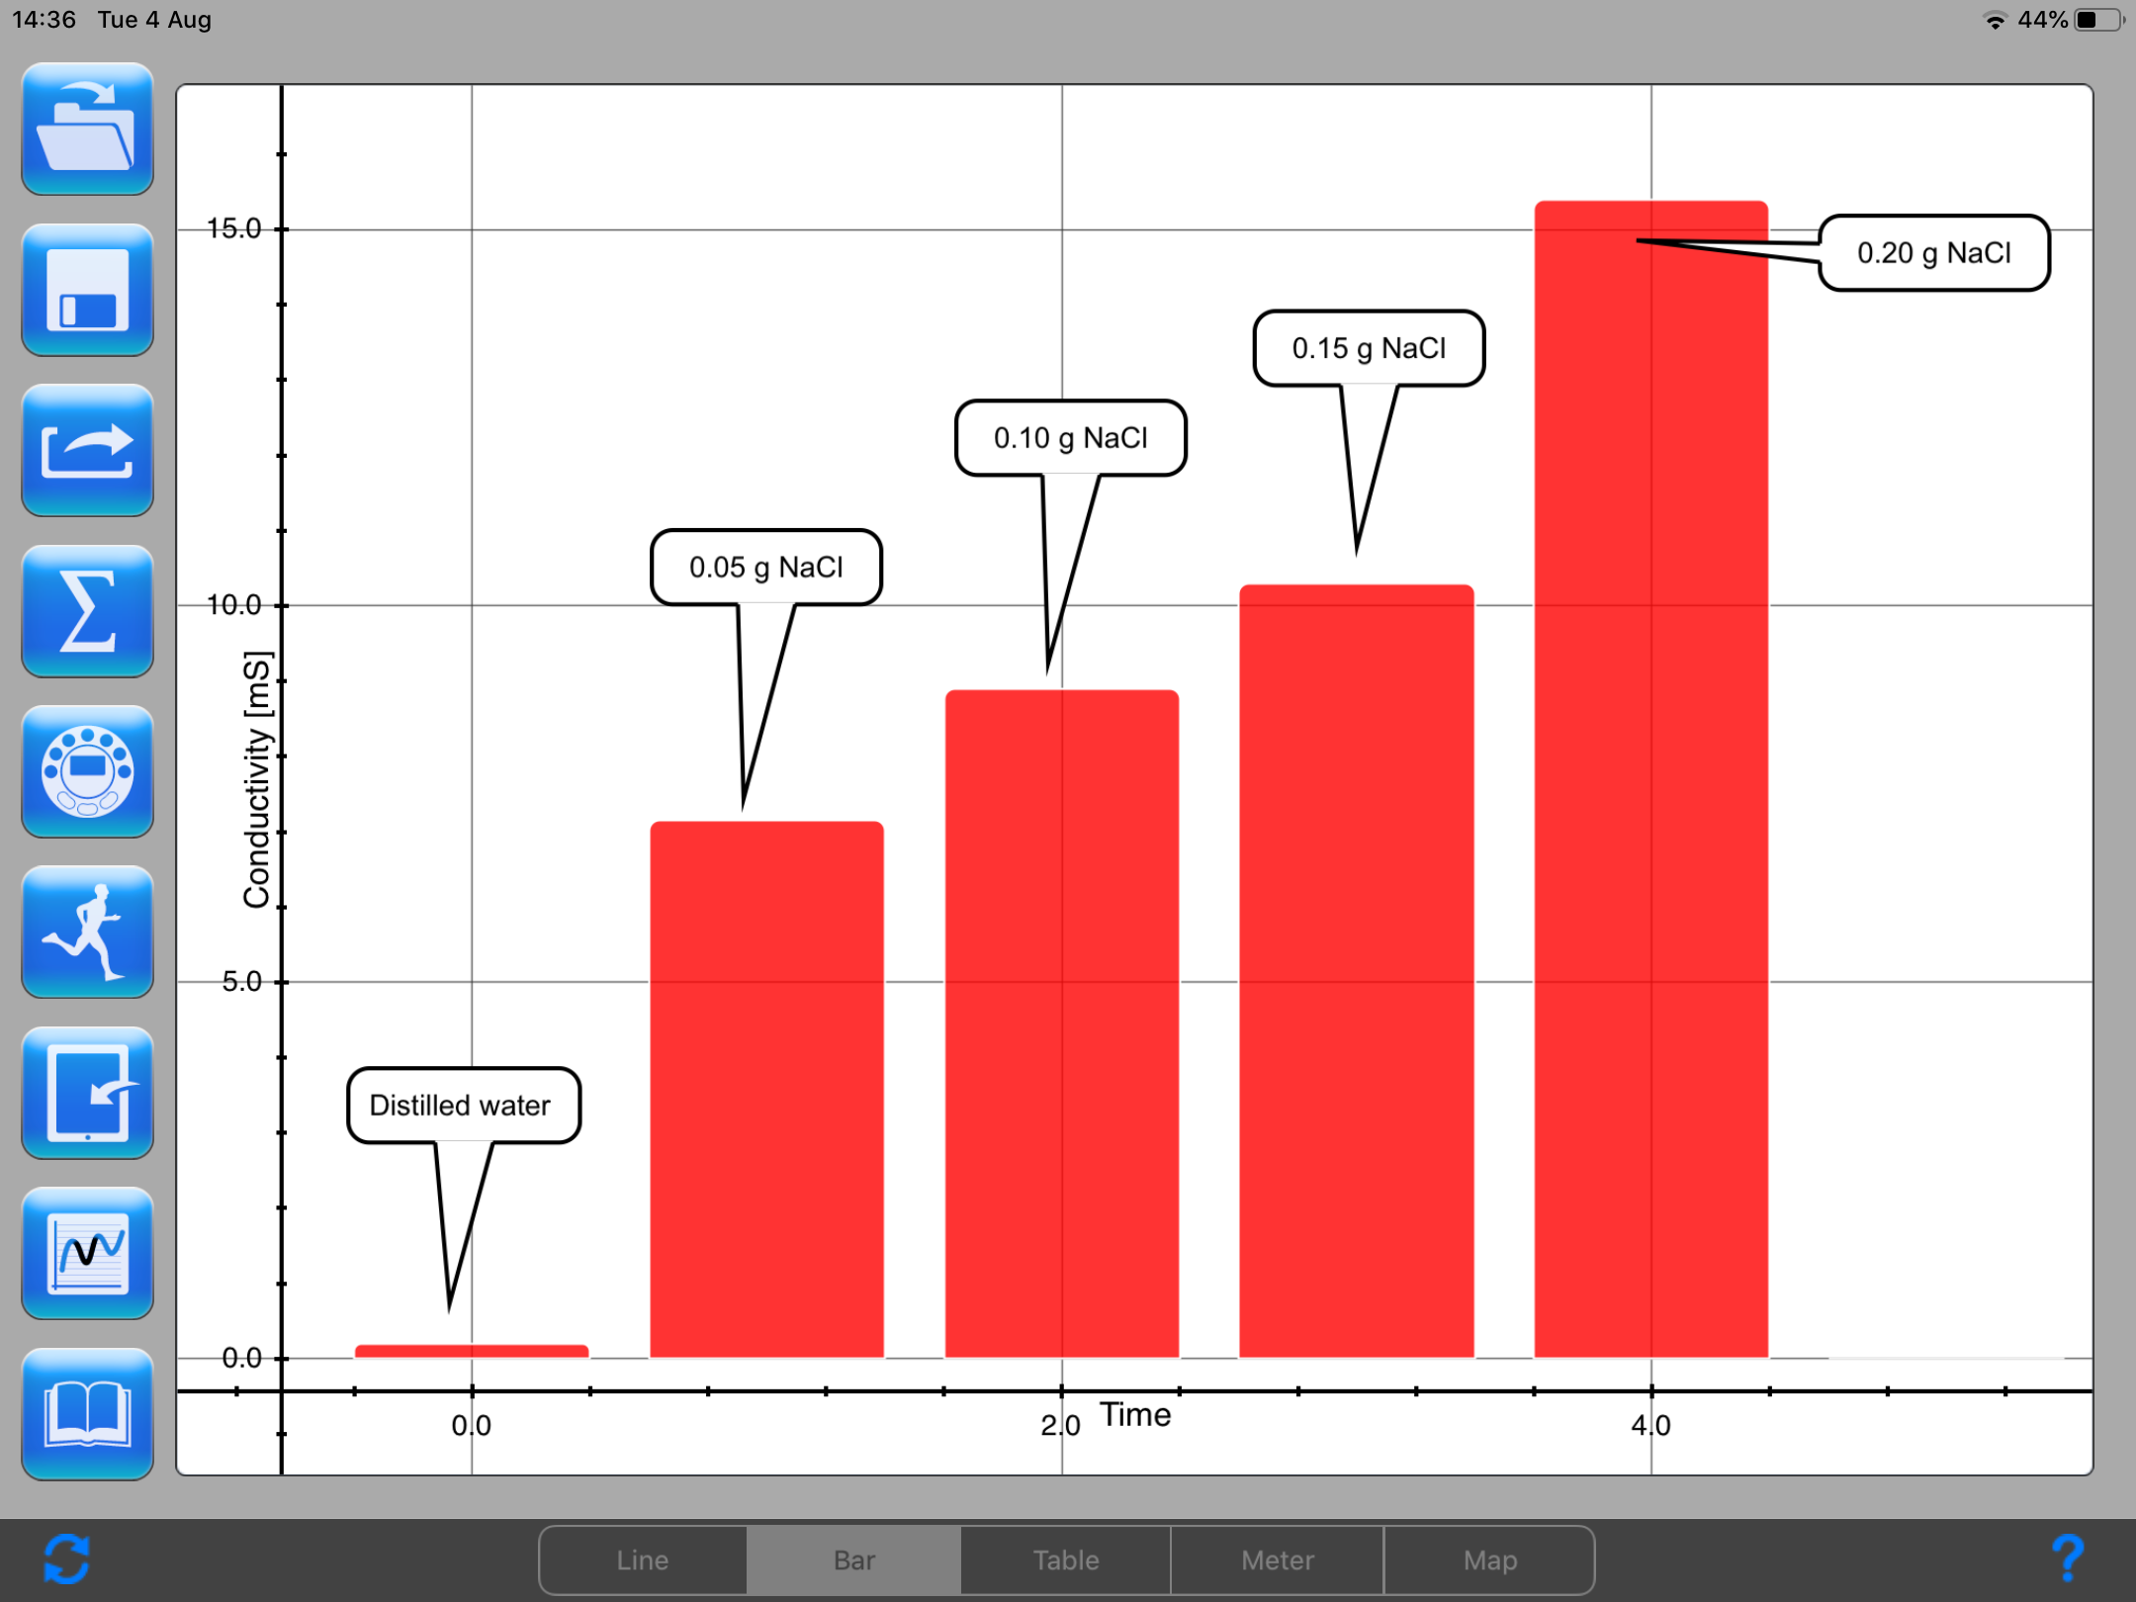
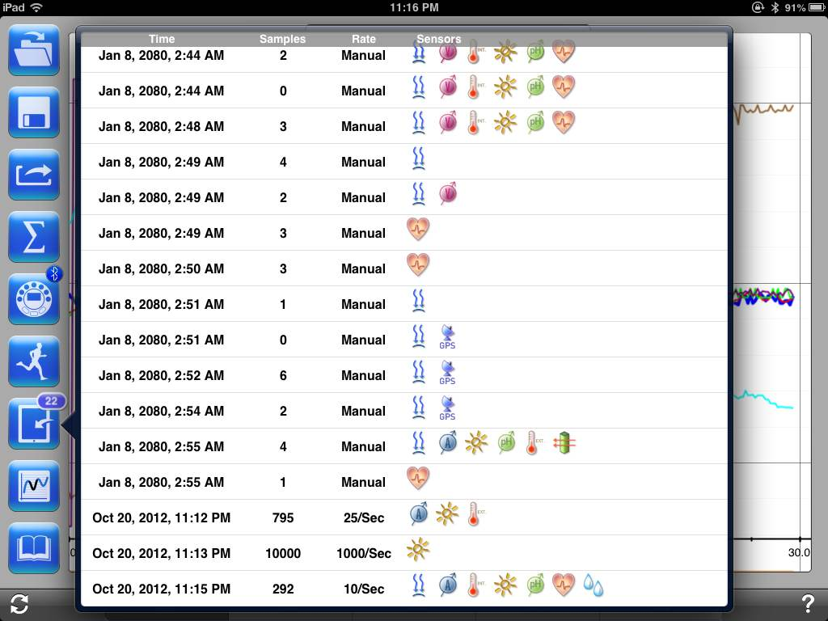
ANALYSIS SOFTWARE
Easy to use, rich display, supporting all OS, for all ages
Setup
Meters view
Workbook
Map view
Bar view
Table view
Notes:
Our Analysis software operates on all computer platforms:
Windows, Mac, iOS, Android, Linux and Chromebook
Like the Labdisc the software is rich with display type and analysis tool, yet it is very easy to us.
The Above picture shows the iOS version, its vivid data display including: graph, table, Bar graph and the beautiful Map view!

Slide 9
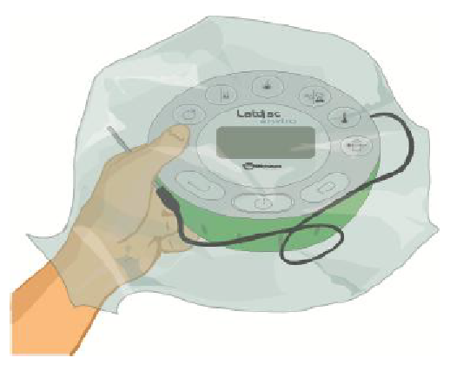
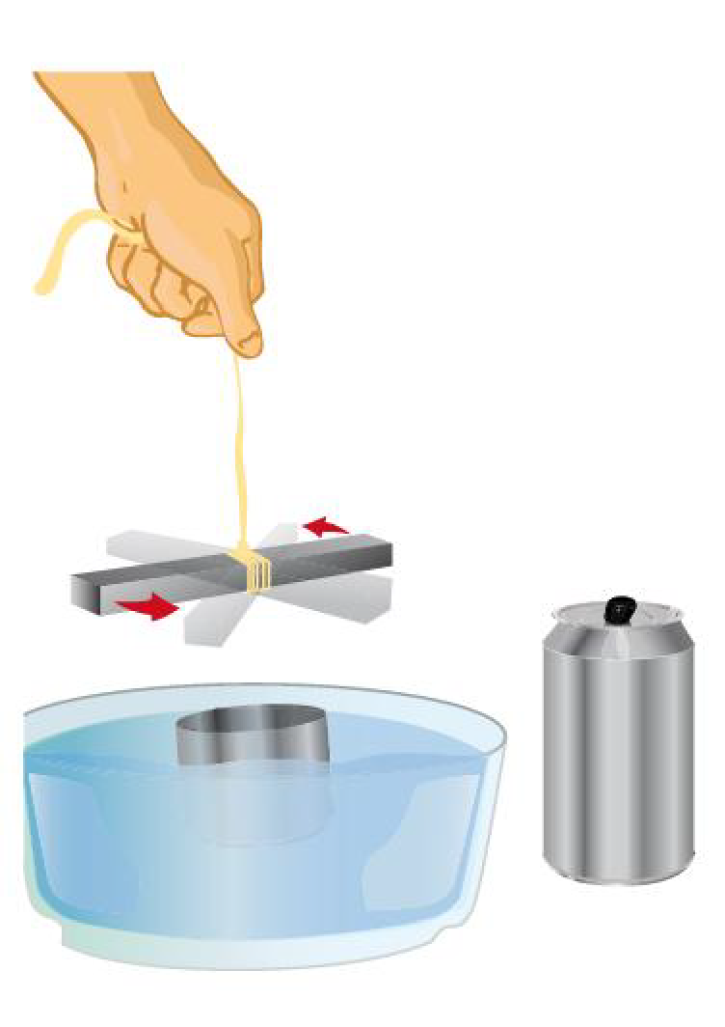
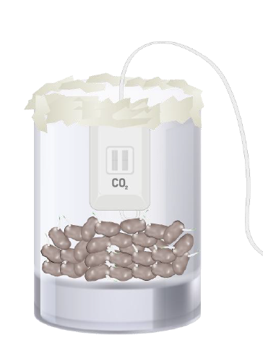
LESSON PLANS
Over 1000 pages, full syllabus coverage
Combustion
Electricity
Greenhouse effect
Human body
Magnetics
Respiration
Radiation
Photosynthesis
Notes:
To complete our Labdisc package we offer 1000 pages of experiment guides covering practically all science topics in: Physics, Biology, Chemistry and Environmental science.
When received a list of the local science syllabus we offer a correlation of our experiment guides to the syllabus – showing 80-90% of syllabus coverage with a single Labdisc!
This makes the Labdisc a great value-for-money as it is being used throughout the science syllabus, and not just for few science topics.

Slide 10
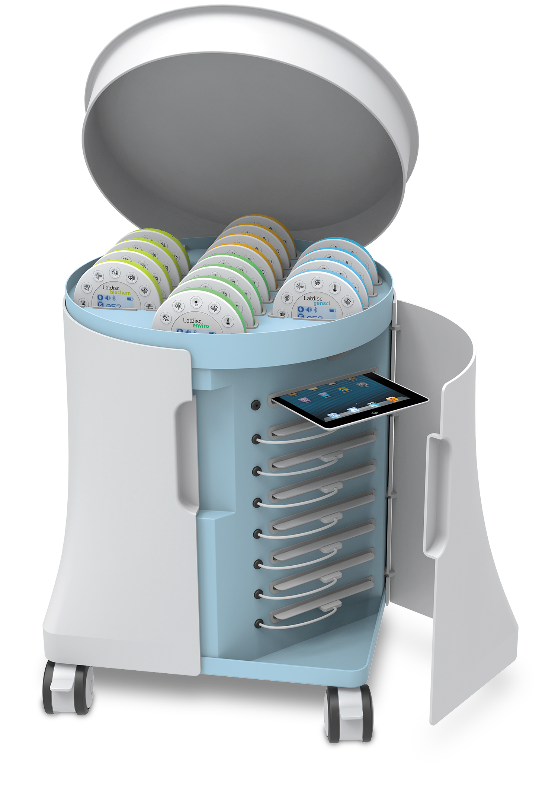
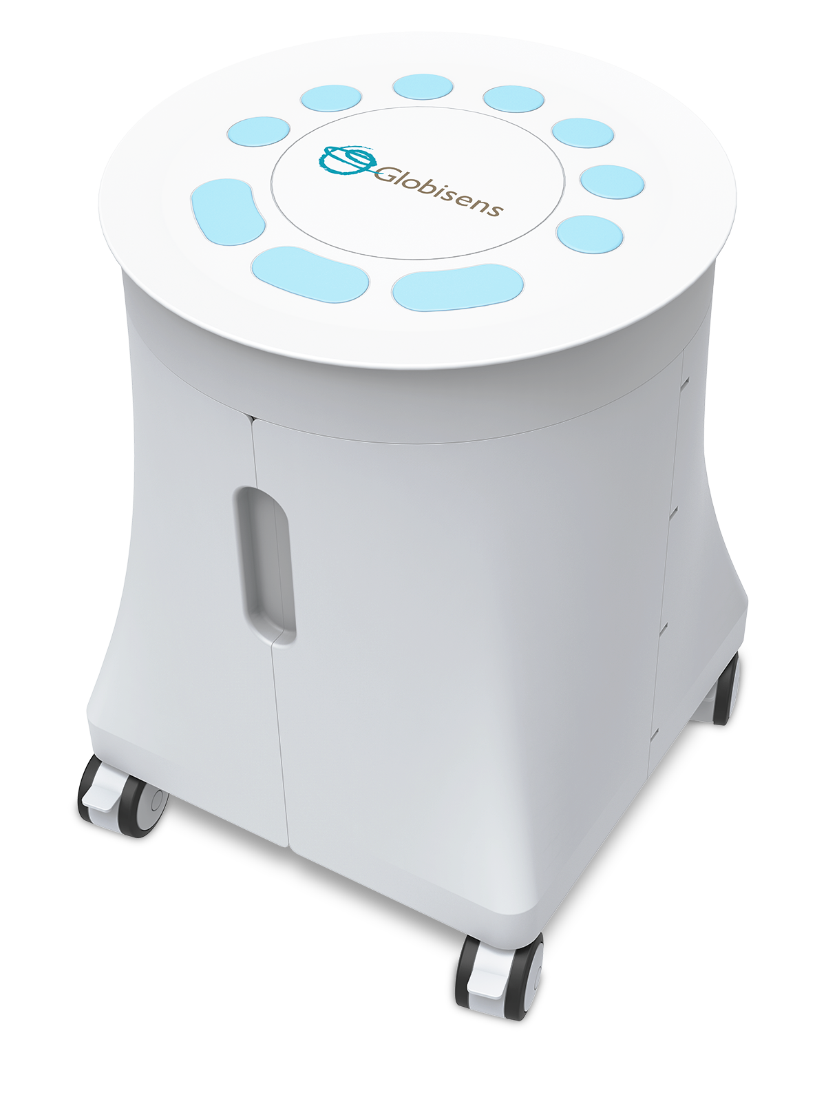
LABDISC MOBILE SCIENCE CART
Storing and charging up to 16 Labdisc units
Storing and charging up to 16 tablets
Anti-theft locking system
Complete classroom solution
Central charging
Metal tab for wall locking
Steel ruggedized construction
Notes:
Labdisc class solution – Mobile Science cart
A mobile cart for mobilizing, storing and charging 16 Labdisc and 16 Tablets (Android or iPads)
Providing a Labdisc – computer set for every 2 students
No need for investing in a special large room for a school Laboratory. Now we can “bring science” to the classroom instead of sending students to the school Lab

Slide 11

LABDISC CHARGING STATION

Slide 12

GETTING
AN EARLY START ON SCIENCE
2nd graders in Chile
Page 12
Notes:
Doing Science in very early age
The Labdisc ease of use, with built in sensor, no cables and no need for calibration
It is the ONLY laboratory suitable for Elementary school teachers which usually are not technology savvy
In this slide you can see 8 years old Chilean students building a small greenhouse and measuring the temperature inside and outside - showing the greenhouse effect.
Another group is doing water quality experimenting of filtering water through soil.
Look at their eyes and body language – they are totally engaged. Not very typical in science lessons!

Slide 13

DIVERSITY
IN ACTION
Next generation Azerbaijani scientists and engineers
Notes:
Labdisc Pilot project – Azerbaijan case Study
“A picture is worth a thousand words”
This photomontage was made out of the thousands of photos, sent to us by teachers participating in our science project in Baku.
Pilot project included:
50 high schools – each equipped with 2 full science carts (16 Biochem, 16 Physio and Android tablets).
Localization phase - Translation of our software and experiment books to the local language. Correlate our experiment guides with the local science syllabus.
Teacher training - 3 days local teacher training.
Teacher Community - open teacher’s user group on Facebook.
Ongoing 6 months support - employing a project moderator who engages teachers on conducting different science experiments each week.
Weekly activities - have teachers and student upload their weekly work – lab reports, graphs, photos and video clips to our Facebook group.
School competition - Conduct competition between schools for the “Best experiment of the week”.

Slide 14

EXPLORING OUR ENVIRONMENT
Page 14
Notes:
Environmental studies with the Labdisc
Being compact, with long battery life and with up to 15 sensors,
The Labdisc is all what you need for outdoor experiments
In this slide you can see High school students from USA experimenting in Marine Science, while the elementary kids are doing weather monitoring and water quality in a small pond.

Slide 15

BRINGING REAL CHANGE
Curriculum coverage and Project based learning
Notes:
Curriculum coverage and Project based learning
The Labdisc replaces most to all Lab meters
70-80% of science curriculum can be covered with a single Labdisc – making it a great value for money.
In the slide center you can see a Physics wave experiment while left down you can see experiments in Electricity and Chemistry.
But our real goal is to have students come with their own research project!
Moscow - Researching the noise level of an urban area
On the 2nd top picture from the left you can see Russia Prime Minister Mr. Dmitry Medvedev. He came to see our research project in Moscow, where the kids on the center left picture were walking Moscow streets with the Labdisc in their hands measuring both GPS location and noise level. Later, using our software they plot a layer of noise level over Google Maps – complaining to the Major of Moscow that the city is Noisy. It was extremely impressive to see young Elementary students doing practical science with municipal implication – that the Prime Minister came to see it!
San Francisco – Environmental conditions in near space
Bottom right picture show kids who bought a weather balloon on Amazon and launched the Labdisc to 100,000 feet above San Francisco bay, as they were curious to learn the Temperature, Sound level, Air pressure and other conditions at near-space. The Labdisc parachuted back 40km away from launch location and student retrieve all data. Click on the picture to show a movie of a similar experiment done in the UK. All data and graphs can be found on the CASE STUDY section under RESOUCES on our WEB.

Slide 16

AQUAPONICS
STEM AGRICULTURE
VIETNAM
Notes:
Reviewing some of our worldwide projects - Agriculture
The Labdisc being a compact, battery operated , having large selection of sensors is ideal for experimenting in Agriculture.
In this aquaponics green house in Vietnam, the students are growing lattice using water coming from fish tanks. The fish waste is used as fertilizers for the lattice while the lattice filters the water and enrich it with oxygen.
The Labdisc is helping students to monitor all conditions of the aquaponics fish-plants ecosystem, by measuring parameters such as Temperature, Humidity, Oxygen level, pH etc.

Slide 17

GLOBISENS LTD
10 employees
Hi-tech production facility
in Israel
Labdisc first launched Oct 2011
Nearly 150,000 units shipped
Returns < 0.2%
Notes:
Revolutionizing the school science Labs
Today we will show you the Labdisc – a computer based science Laboratory which revolutionized Science Labs in terms of performance, ease of use and cost.
Launched in late 2011,
Won 5 international GOLD medals, including the latest BEST of BETT 2017 in London out of 700 companies.
Today we are proud of having over 80,000 Labdisc in over 30 countries and in 22 languages.

