Slide 1
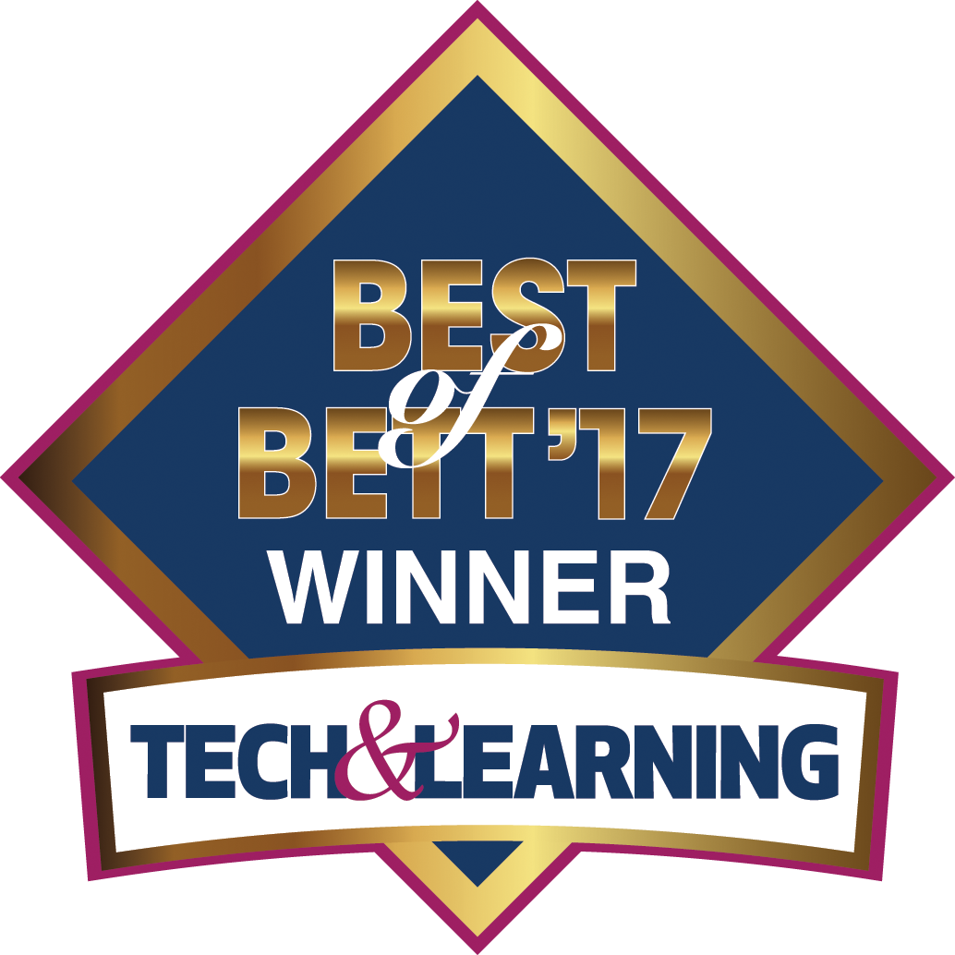
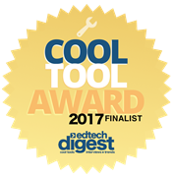
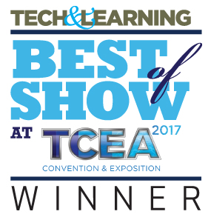
Laboratorio de ciencias para o Ensino
fundamental e medio
Notes:
Revolutionizing the school science Labs
Today we will show you the Labdisc – a computer based science Laboratory which revolutionized Science Labs in terms of performance, ease of use and cost.
Launched in late 2011,
Won 5 international GOLD medals, including the latest BEST of BETT 2017 in London out of 700 companies.
Today we are proud of having over 80,000 Labdisc in over 30 countries and in 22 languages.

Slide 2
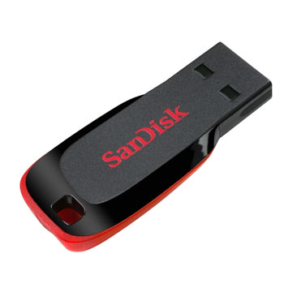
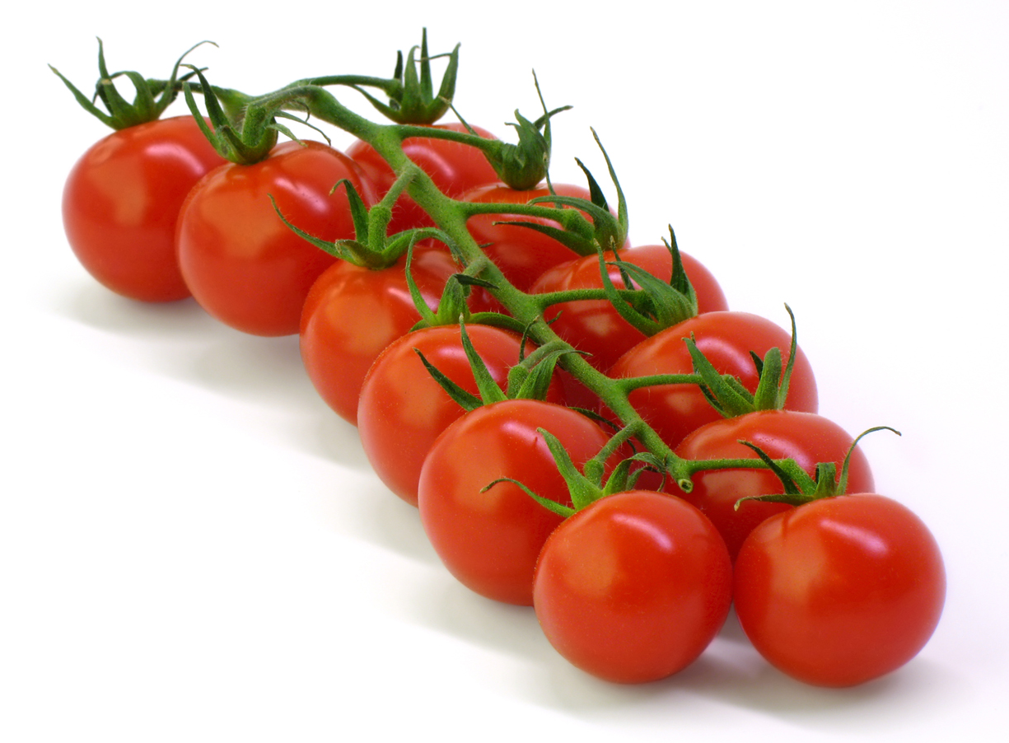
Porque Ciencias? Porque STEM?
O que há de comum nessas duas imagens?
Ambas foram inventadas em Israel…
Por:
3000 empresas start–up de tecnologia de ponta
960 centros de P&D de empresas como INTEL, Google, Microsoft…
Mais de $20b de exportação de tecnologia por ano
Notes:
But why do we need to have our kids learn science?
Why do we need our kids to major in STEM (Science, Technology, Engineering and Math)?
Try to answer the question of What’s common to: Cherry tomato, Memory stick and Intel Pentium processor?
The answer is ISRAEL, as all these technologies were invented in Israel.
Israel is a great example of a STEM country – with a Hi-Tech economy.
From 1970’s the ministry of education is pushing students to major in Science and Math – assuring that in 10 years time the will be the next generation of Engineers and Scientist and help the country build a very strong economy!
What you do today in your schools – will be crucial for your country economy in the near future.

Slide 3
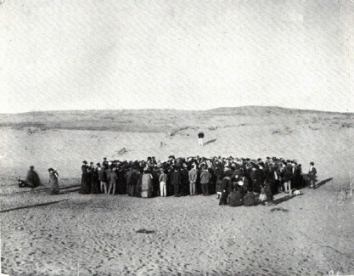
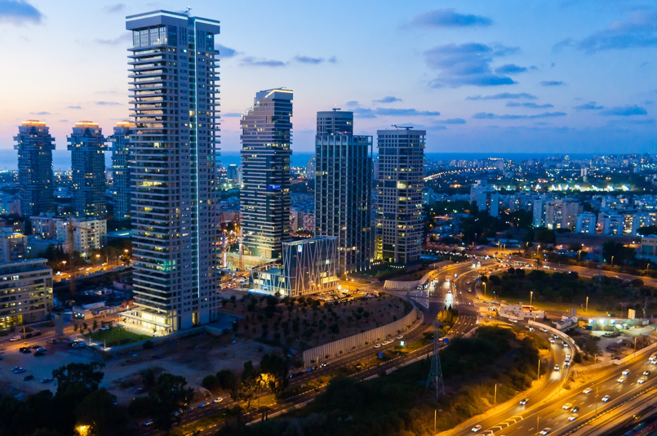
Impressionante progresso em apenas 70 anos
Tel Aviv hoje
Tel-Aviv no passado…

Slide 4
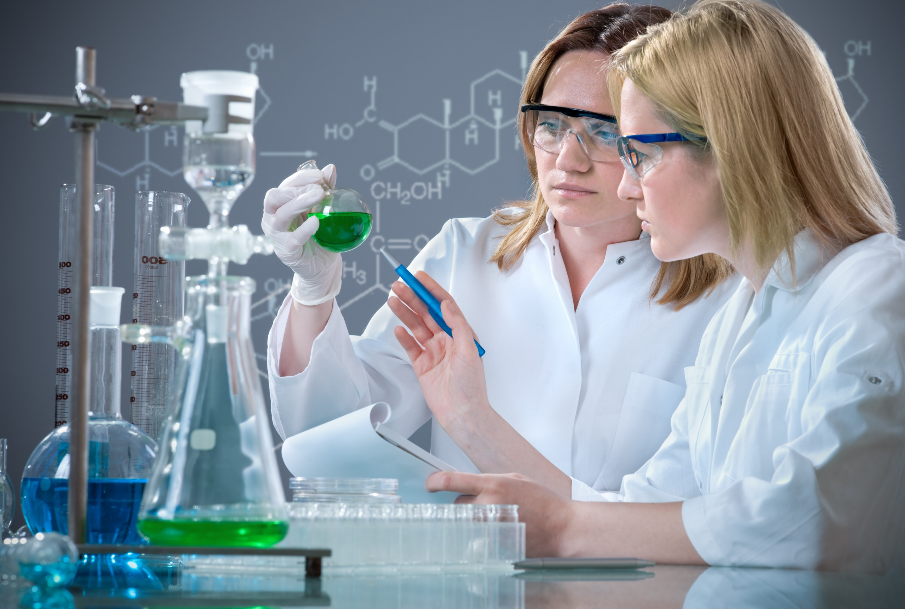
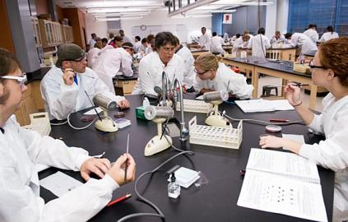
O desafio:
Tempo, Orçamento!
Uma tipica aula de laboratorio requer a preparação e calibração de 90 items!
Notes:
Time consuming
A typical classes of 30 students require the preparations of about 90 separate items.
This is because every 2 students needs a working station with typically 2 meters, 2-3 cables, computer etc.
Multiply these 5-6 items by 15 stations and you have 90 items for the teacher to setup, calibrate and collect back at the end of the class…
This is extra 90 minutes of work for our already very busy teachers…
As a result the school Labs are not been used as often as they should have been.
Irrelevant
Student find the traditional Labs using “Pre-historic” analog meters – to be irrelevant in the 21st century school environment

Slide 5
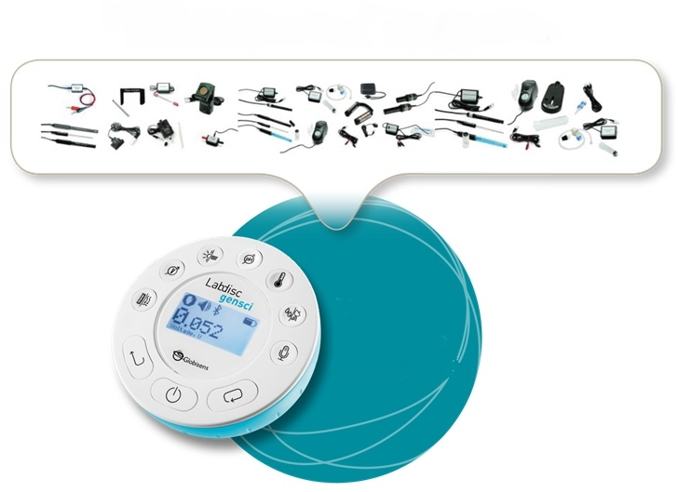
Experimentação em Ciencias
Nunca foi tão facil!
Trocando caixas de equipamentos…
Por um laboratorio de ciencias completo, tudo-em-um
Notes:
We solve this problem!
Consolidation - combining 12-15 meters into a single disc.
Less items - from 90 items in the laboratory –> to only 1 per table.
Easy, with no calibration - all sensors are automatically calibrated when the Labdisc is turned on.
SAVING HUGE PREPARATION TIME FOR THE TEACHER.

Slide 6
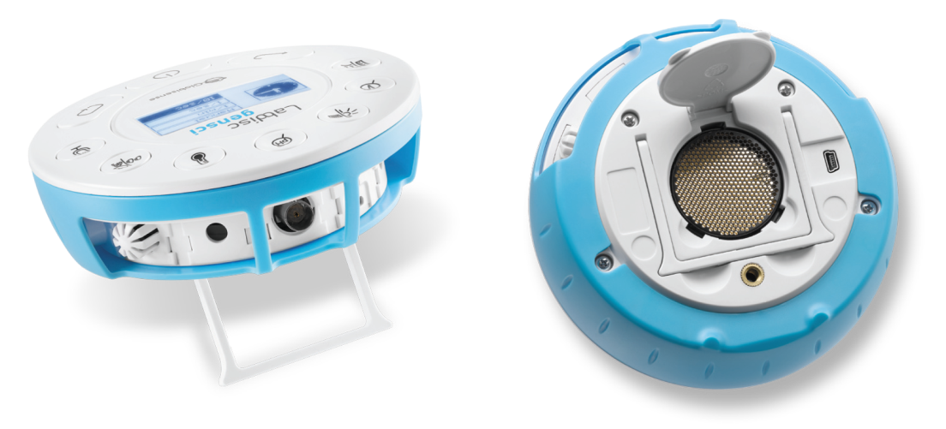
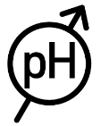
O laboratorio completo em um disco Unidade de Ciencias Gerais
Sensores embarcados
Pressao do ar, Temperatura ambiente, Corrente, Distancia, GPS, Luz, Microfone, pH, Umidade relativa, Nivel de som, Temperatura, Tensão, plug Universal
Notes:
The Labdisc Gensci – For General science.
Combining the most needed sensors for all 3 science subject – Physics, Biology band Chemistry
Ideal for Elementary and Middle school
Built-in sensors include - Air Pressure, Ambient Temperature, Current, Distance, GPS, Light, Microphone, pH, Relative Humidity, Sound Level, Temperature, Voltage, plus Universal Input.
Typical activities include - Travelling speed with GPS, Newton’s Laws, sound waves, electrical currents, pH titration, endothermic and exothermic reactions, Boyle’s Law, specific heat and microclimate.

Slide 7
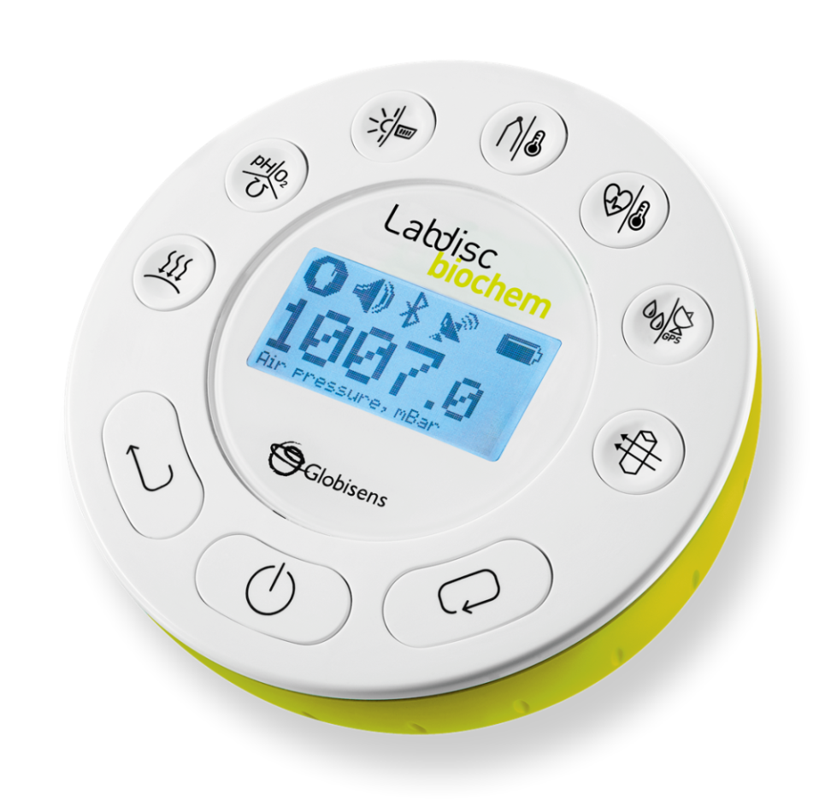
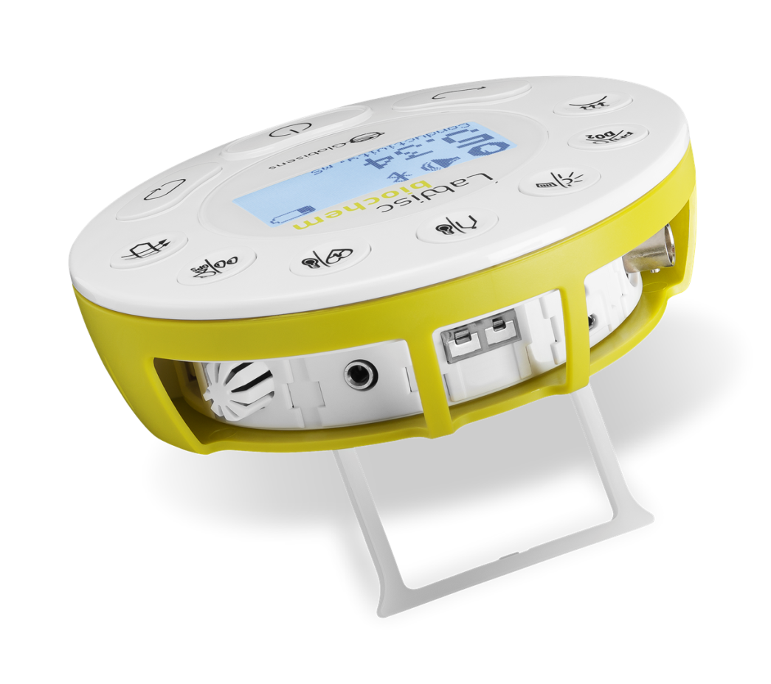
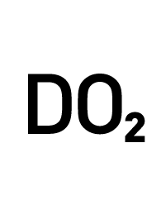
Um Laboratório Completo em um Disco Unidade de Biologia e Química
Sensores Incorporados
Pressão do Ar, Barômetro, Condutividade, pH, DO2, Luz, Entrada Universal, Par Termoelétrico,
Temperatura Ambiente, Frequência Cardíaca, Temperatura, Umidade, GPS, Colorímetro, Turvação
Notes:
The Labdisc Biochem – with 15 built in sensors for High school Biology and Chemistry
Built-in sensors include - Air Pressure, Ambient Temperature, Barometric Pressure, Colorimeter, Conductivity, Dissolved Oxygen, External Temperature, GPS, Heart Rate, Light, pH, Relative Humidity, Thermocouple, Turbidity and Universal Input.
Typical activities include - Skin temperature, pulse rates before and after activity, sweat production and photosynthesis, solid, liquid and gas phase changes and pH titration.

Slide 8
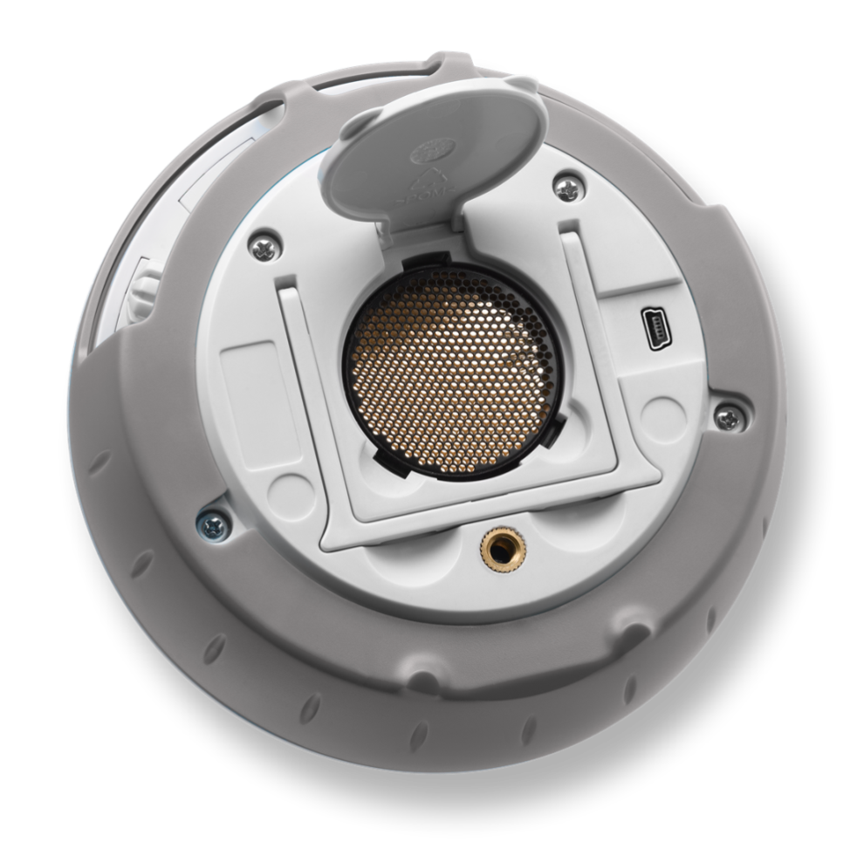
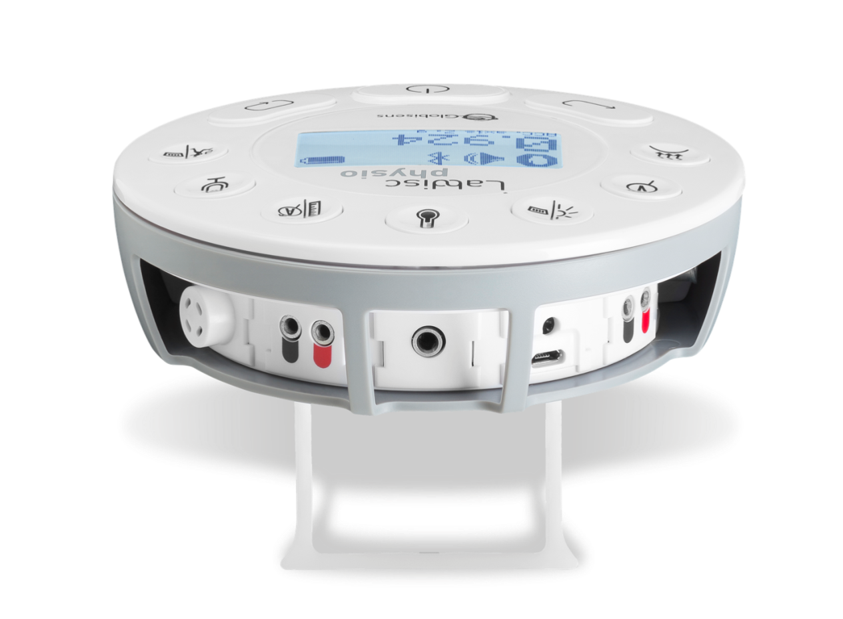
Um Laboratório Completo em um Disco Unidade de Física
Sensores Incorporados
Pressão do Ar, Voltagem, Baixo Voltagem, Luz, Entrada Universal, Temperatura do Ambiente, Temperatura, Corrente, Distância, Microfone, Acelerômetro
Notes:
The Labdisc Physio – with 12 built in sensors for High school Physics
Built-in sensors include - Accelerometer, Air Pressure, Ambient Temperature, Current, Distance (Motion), External Temperature, Light, Microphone, Universal Input, Voltage
Typical activities include - Lenz and Boyle’s Laws, resistor networks, light source efficiency, light vs. distance, sound beat and wave superposition, Newton’s Second Law and free fall acceleration.

Slide 9
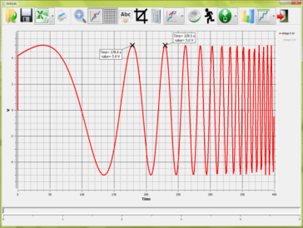
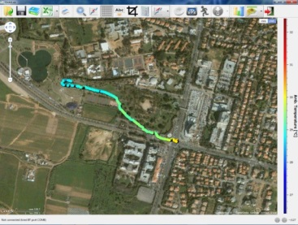
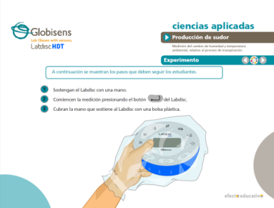
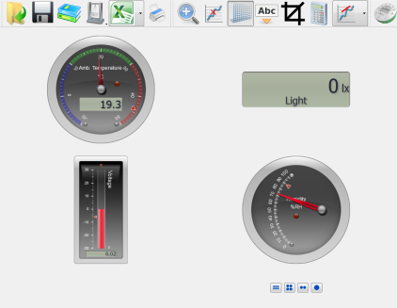
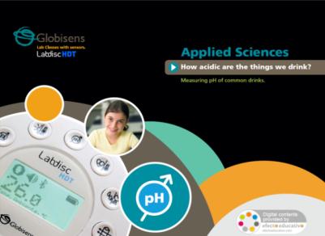
Conteúdo de Ciencias da Globisens Software de analise, Guia de Experimentos, Simulações
Mais de 100 unidades de Ensino e simulações em ciências
Software multiplataforma de análise
1300 guias de experimentos em Fisica, Quimica e Biologia
Notes:
Complete our Labdisc solution with analysis software and curriculum Material
GlobiLab analysis software
Running on all platforms: Windows, MAC, iOS, Android, Linux and Chromebook.
Communicating wirelessly (or through USB) with the Labdisc
Plotting all Labdisc measurements as Graphs, Tables, Gauges and even as sensor layers over Google Maps.
Curriculum workbooks
Over 1300 pages of “cook books” on how to use and set the Labdisc for various experiments in Biology, Chemistry, Physics and Environmental sciences.

Slide 10
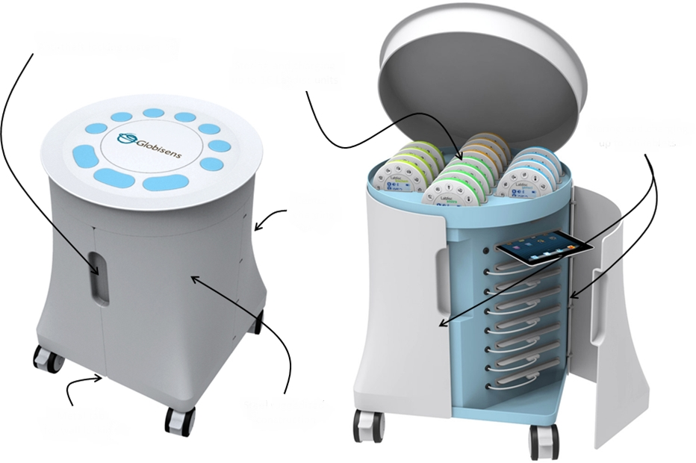
Carrinho de transporte Labdisc Solução completa para a sala de aula
sistema de protecao anti-robo
Armazena e recarrega ate
16 unidades Labdisc
Armazena e recarrega ate
16 unidades Tablet
Carga central
Contruido com material rigido
Bloqueador metalico de parede
Notes:
Labdisc class solution – Mobile Science cart
A mobile cart for mobilizing, storing and charging 16 Labdisc and 16 Tablets (Android or iPads)
Providing a Labdisc – computer set for every 2 students
No need for investing in a special large room for a school Laboratory. Now we can “bring science” to the classroom instead of sending students to the school Lab

Slide 11
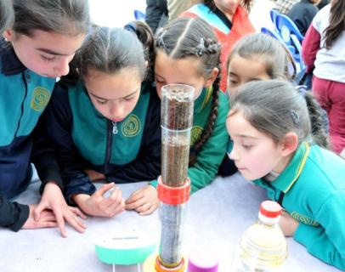
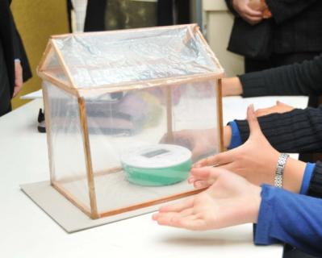
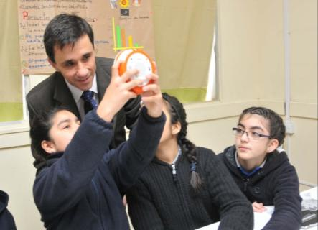
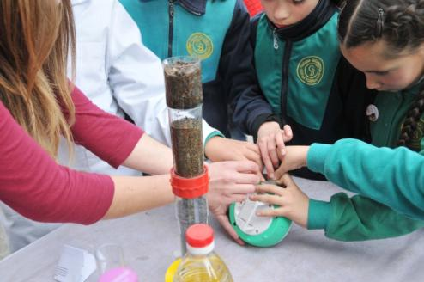
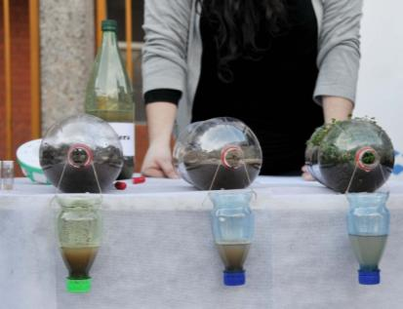
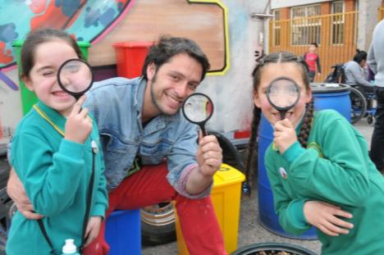
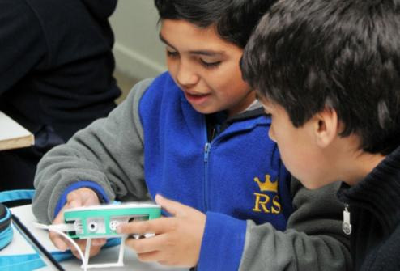
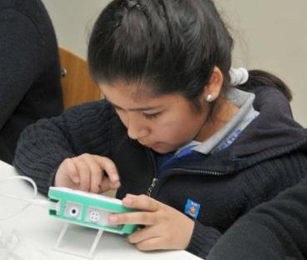
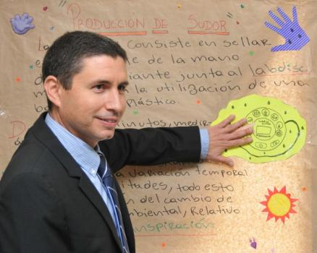
Ensino Medio Chile
Notes:
Doing Science in very early age
The Labdisc ease of use, with built in sensor, no cables and no need for calibration
It is the ONLY laboratory suitable for Elementary school teachers which usually are not technology savvy
In this slide you can see 8 years old Chilean students building a small greenhouse and measuring the temperature inside and outside - showing the greenhouse effect.
Another group is doing water quality experimenting of filtering water through soil.
Look at their eyes and body language – they are totally engaged. Not very typical in science lessons!

Slide 12
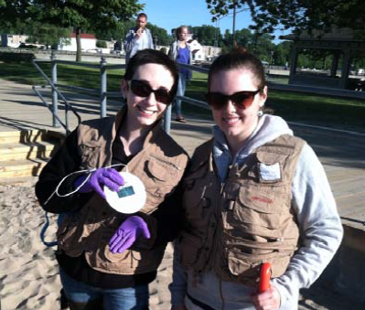
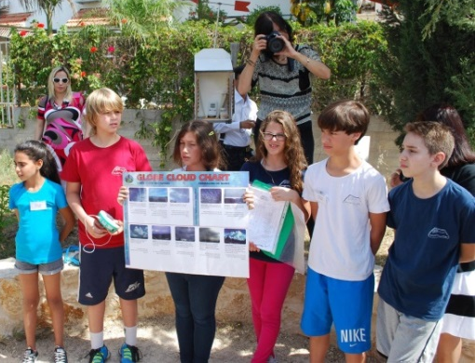
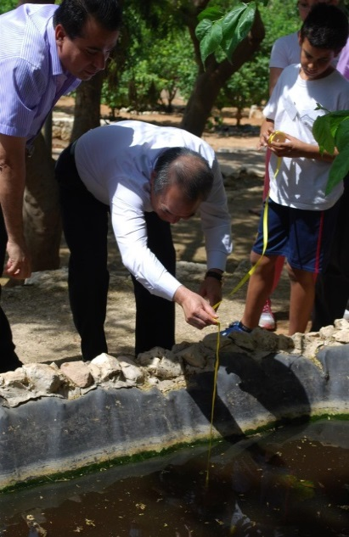
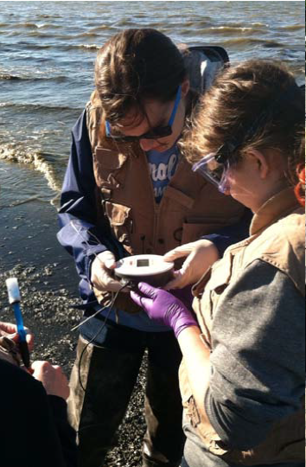
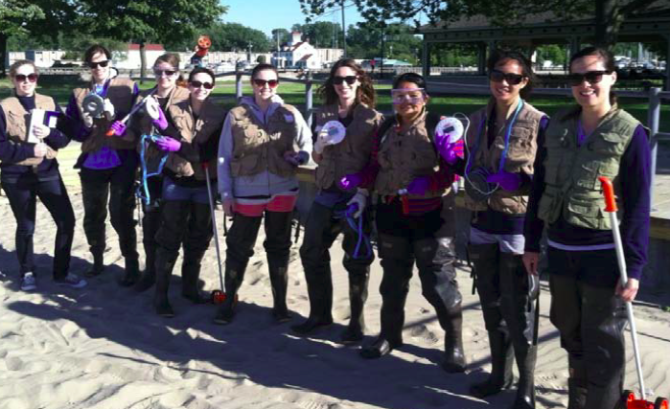
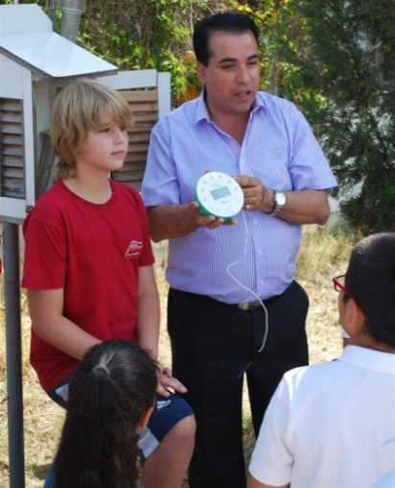
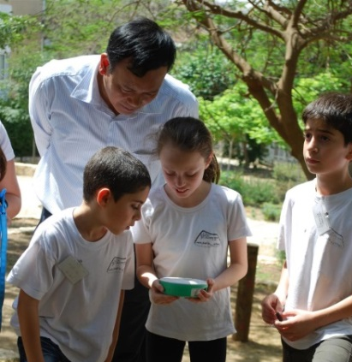
Explorando Nosso Ambiente
Notes:
Environmental studies with the Labdisc
Being compact, with long battery life and with up to 15 sensors,
The Labdisc is all what you need for outdoor experiments
In this slide you can see High school students from USA experimenting in Marine Science, while the elementary kids are doing weather monitoring and water quality in a small pond.

Slide 13
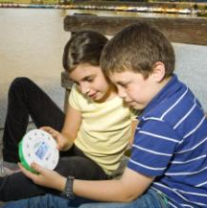
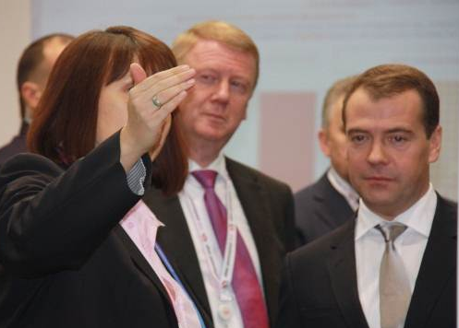
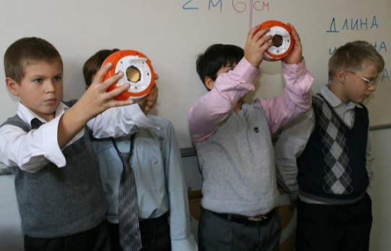
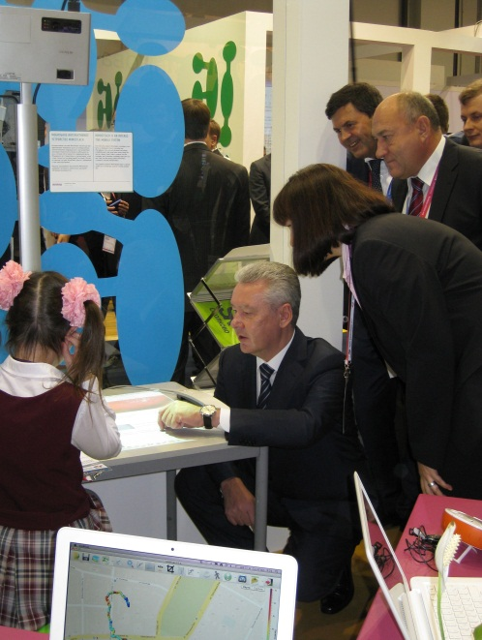
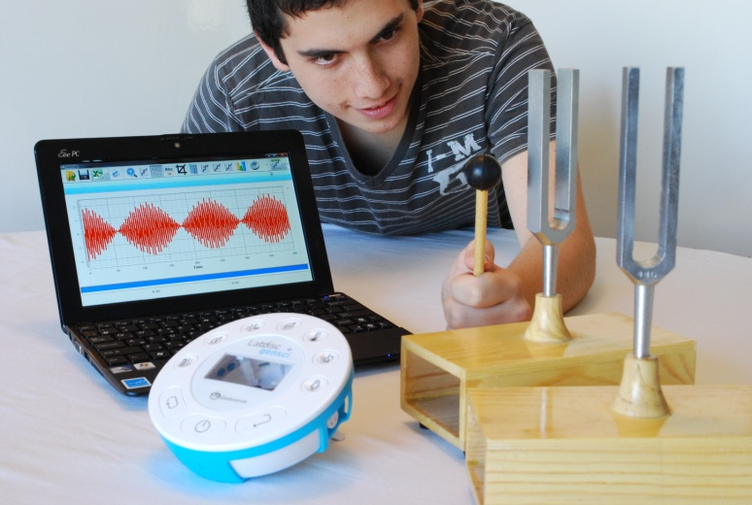
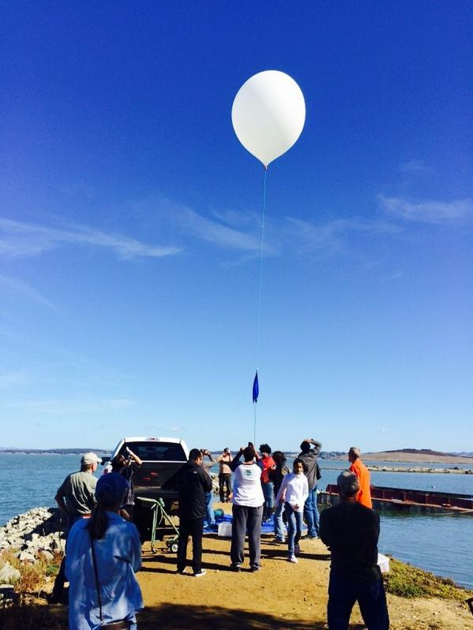
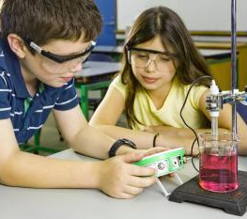
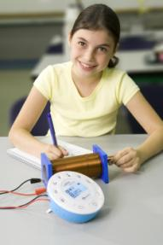
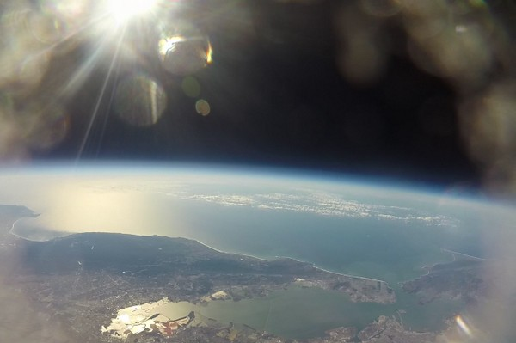
Uma mudança real
Notes:
Curriculum coverage and Project based learning
The Labdisc replaces most to all Lab meters
70-80% of science curriculum can be covered with a single Labdisc – making it a great value for money.
In the slide center you can see a Physics wave experiment while left down you can see experiments in Electricity and Chemistry.
But our real goal is to have students come with their own research project!
Moscow - Researching the noise level of an urban area
On the 2nd top picture from the left you can see Russia Prime Minister Mr. Dmitry Medvedev. He came to see our research project in Moscow, where the kids on the center left picture were walking Moscow streets with the Labdisc in their hands measuring both GPS location and noise level. Later, using our software they plot a layer of noise level over Google Maps – complaining to the Major of Moscow that the city is Noisy. It was extremely impressive to see young Elementary students doing practical science with municipal implication – that the Prime Minister came to see it!
San Francisco – Environmental conditions in near space
Bottom right picture show kids who bought a weather balloon on Amazon and launched the Labdisc to 100,000 feet above San Francisco bay, as they were curious to learn the Temperature, Sound level, Air pressure and other conditions at near-space. The Labdisc parachuted back 40km away from launch location and student retrieve all data. Click on the picture to show a movie of a similar experiment done in the UK. All data and graphs can be found on the CASE STUDY section under RESOUCES on our WEB.

Slide 14
Notes:
Labdisc Pilot project – Azerbaijan case Study
“A picture is worth a thousand words”
This photomontage was made out of the thousands of photos, sent to us by teachers participating in our science project in Baku.
Pilot project included:
50 high schools – each equipped with 2 full science carts (16 Biochem, 16 Physio and Android tablets).
Localization phase - Translation of our software and experiment books to the local language. Correlate our experiment guides with the local science syllabus.
Teacher training - 3 days local teacher training.
Teacher Community - open teacher’s user group on Facebook.
Ongoing 6 months support - employing a project moderator who engages teachers on conducting different science experiments each week.
Weekly activities - have teachers and student upload their weekly work – lab reports, graphs, photos and video clips to our Facebook group.
School competition - Conduct competition between schools for the “Best experiment of the week”.

Slide 15
O que as pesquisas dizem?
Os alunos que usaram computadores e equipes de sondas mostraram ganhos significativos no aprendizagem. TEEMSS, National science Foundation, 2007
Os alunos envoltos na ciência prática no pré-escolar tiveram um maior desempenho do que a média nacional. Plank (2000, USA)
As equipes de sondas entusiasmam aos alunos e poupam-lhes tempo no registro de leituras de temperatura. Esse tempo pode ser usado para produzir e interpretar gráficos. An Evaluation Horizons, n15 p12-16 Aut 2001
Países como o Japão e a Coréia (com aprendizado científico precoce) obtiveram um maior desempenho em ciências e matemáticas em comparação com outros países do 1º mundo. PISA: resultado das pontuações de ciências e matemáticas, 2007
Notes:
Pedagogic justification
Here you can find quotes from pedagogic research done in the USA.
It shows the advantages of Probeware (usage of sensors in science laboratories):
They replace manual measurement and manual graph plotting
This leaves time for student to focus on true learning, which take place at:
The design of the experiment.
The analysis of the results.

Slide 16
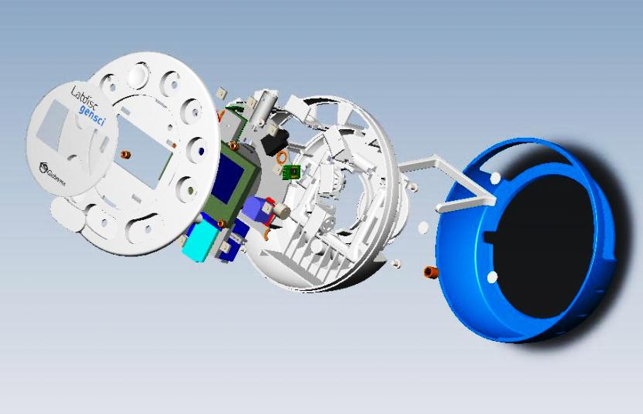
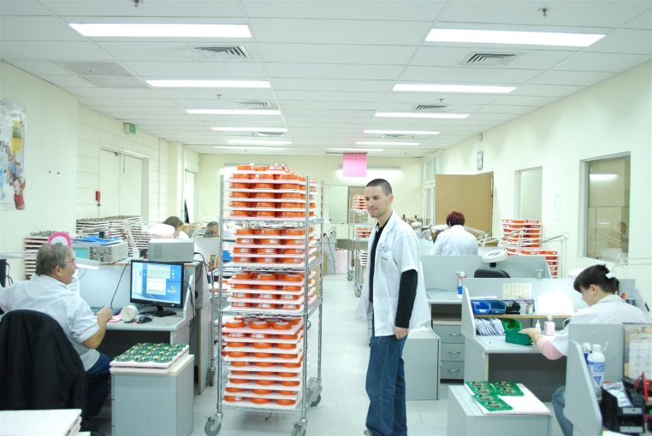
Globisens Ltd
35 empregados
Produção através de uma moderna instalação de alta tecnologia
Linha de produtos Labdisc lançada pela primeira vez em outubro de 2011
Cerca de 80.000 unidades enviadas.
Devoluções <0,2%
Notes:
Some corporate facts:
Reliable production - all products are produced by automatic robots in a modern and sophisticated hi-tech facility in Israel.
Very little returns – only 200 units out of 80,000 sold

