Slide 1
Temperature variation between day and night
Measuring thermal oscillation and luminosity during a full day

Slide 2
Temperature variation between day and night
Measuring thermal oscillation and luminosity during a full day
^{USA Standards Correlation}
FRAMEWORK FOR K-12 SCIENCE EDUCATION © 2012
The Dimension I practices listed below are called out as bold words throughout the activity.
Dimension 1 Science and Engineering Practices | ü | Asking questions (for science) and defining problems (for engineering) |  | Use mathematics and computational thinking
 | ü | Developing and using models |  | Constructing explanations (for science) and designing solutions (for engineering)
 | ü | Planning and carrying out investigations | ü | Engaging in argument from evidence
 | ü | Analyzing and interpreting data | ü | Obtaining, evaluating, and communicating information
Dimension 2 Cross Cutting Concepts | ü | Patterns | ü | Energy and matter: Flows, cycles, and conservation
 | ü | Cause and effect: Mechanism and explanation |  | Structure and function
 |  | Scale, proportion, and quantity |  | Stability and change
 | ü | Systems and system models

Slide 3
Temperature variation between day and night
Measuring thermal oscillation and luminosity during a full day
^{USA Standards Correlation}
Dimension 3 Core Concepts | Discipline | Core Idea Focus
 | Earth and Space Science | ESS1: Earth’s Place in the Universe
 |  | ESS1.B: Earth and the Solar System
 |  | ESS2: Earth’s Systems
 |  | ESS2.A: Earth Materials and Systems
 |  | ESS2.D: Weather and Climate
NGSS Standards | Middle School Standards Covered | High School Standards Covered
 | MS.ESS-SS: Space Systems | HS.ESS-SS: Space Systems
 | MS.ESS-HE: The History of Earth | HS.ESS-ES: Earth Systems
 | MS.ESS-EIP: Earth’s Interior Processes | HS.ESS-CC: Climate Change
 | MS.ESS-ESP: Earth’s Surface Processes
 | MS.ESS-WC: Weather and Climate Systems

Slide 4
Temperature variation between day and night
Measuring thermal oscillation and luminosity during a full day
^{USA Standards Correlation}
NATIONAL SCIENCE EDUCATION STANDARDS © 2002
Content Standards (K-12)
ü | Systems, order, and organization |  | Evolution and equilibrium
ü | Evidence, models, and explanation | ü | Form and Function
ü | Constancy, change, and measurement
Earth and Space Science Standards Middle School |  | Earth and Space Science Standards High School
ü | Structure of the Earth System | ü | Energy in the Earth System
 | Earth’s History |  | Geochemical Cycles
ü | Earth in the Solar System |  | Origin and Evolution of the Earth System
 |  |  | Origin and Evolution of the Universe

Slide 5
Temperature variation between day and night
Measuring thermal oscillation and luminosity during a full day
^{USA Standards Correlation}
LEARNING OBJECTIVES
Core Objectives (National Standards):
Develop the ability to refine ill-defined questions and direct to phenomena that can be described, explained, or predicted through scientific means.
Develop the ability to observe, measure accurately, identify and control variables.
Decide what evidence can be used to support or refute a hypothesis.
Gather, store, retrieve, and analyze data.
Become confident at communicating methods, instructions, observations and results with others.
Activity Objectives:
The purpose of this activity is to study the temperature and luminosity changes produced during the day and night in a given area, by formulating a hypothesis and proceeding to check it using the Globisens Labdisc light and temperature sensors.
Time Requirement: 20 – 30 minutes to set up, 24 hours to collect data, 30-45 minutes to analyze dataminutes

Slide 6
Temperature variation between day and night
Measuring thermal oscillation and luminosity during a full day
^{Objective}
To study the temperature and luminosity changes produced during the day and night in a given area, by formulating a hypothesis and proceeding to check it using the Labdisc light and temperature sensors.

Slide 7
Temperature variation between day and night
Measuring thermal oscillation and luminosity during a full day
^{Introduction and theory}
The aim of the introduction is to focus students on the lesson subject by refreshing acquired knowledge and asking questions which encourage research development. Key concepts from the theoretical framework, applied by the students during the lesson, are taught.
^{Introduction}
During the day we can observe different changes in the environment: humidity, atmospheric pressure, noise, luminosity and other factors are constantly changing as the hours pass, and we can even predict how some of them will change during a full day. Thus we can say, for example, that temperature at 7 am is lower than at 3 pm, and as night approaches, temperature falls again.
Why do you think fluctuations in temperature during a full day occur? Explain.
Thermal oscillations cause us to wrap up or uncover, according to how we feel, but
have you ever thought how animals and plants adapt to daily temperature
fluctuations? Explain.

Slide 8
Temperature variation between day and night
Measuring thermal oscillation and luminosity during a full day
^{Introduction and theory}
Carry out the experiment activity with your class so that at the end you’ll be able to answer the following question:
What differences in temperature and luminosity are produced between day and
night in the area where you live?

Slide 9
Temperature variation between day and night
Measuring thermal oscillation and luminosity during a full day
^{Introduction and theory}
^{Theoretical}
Thermal oscillation (or thermal range) is the difference between the highest and the lowest temperature registered in a place during a given period of time. Its value is given mainly by the geography of the place and its effect determines many of the activities that living organisms do in a certain territory.
An example is life in the desert, where few clouds are formed, the heat of the sun directly affects the soil, and therefore temperature can reach very high values. However, at night temperature falls abruptly even below 0 ºC, there are extremely big thermal oscillations. For example, in the Arizona desert located in the United States, there can be thermal oscillations of up to 56º C, meaning that the local species must present adaptations in order to withstand the weather.

Slide 10
Temperature variation between day and night
Measuring thermal oscillation and luminosity during a full day
^{Introduction and theory}
Some of the adaptations that plants have generated in order to live in the desert are very small leaves covered with wax, long roots and specialized tissues to accumulate water; all this in order to increase absorption, diminish perspiration and avoid dehydration. Animals also have adaptations which allow them to live in this kind of environment. For example, they increase their internal temperature to avoid losing water through perspiration; these animals excrete very concentrated urine to eliminate waste in the smallest possible volume. They also have habits adapted to weather conditions like hunting at night and hiding during the day.
Now students are encouraged to raise a hypothesis which must be tested with an experiment.
If you had to establish a temperature range variation during a complete day in the
place where you live, what do you think that variation would be?

Slide 11
Temperature variation between day and night
Measuring thermal oscillation and luminosity during a full day
^{Activity description}
Students will perform a measurement of room temperature and luminosity inside their schools over a 24 hour period, using the built-in Labdisc temperature and light sensors. They will then draw a graphic to observe the existing correlation between the thermal oscillation of their areas and the quantity of light in the environment, in order to compare the hypothesis with the results.

Slide 12
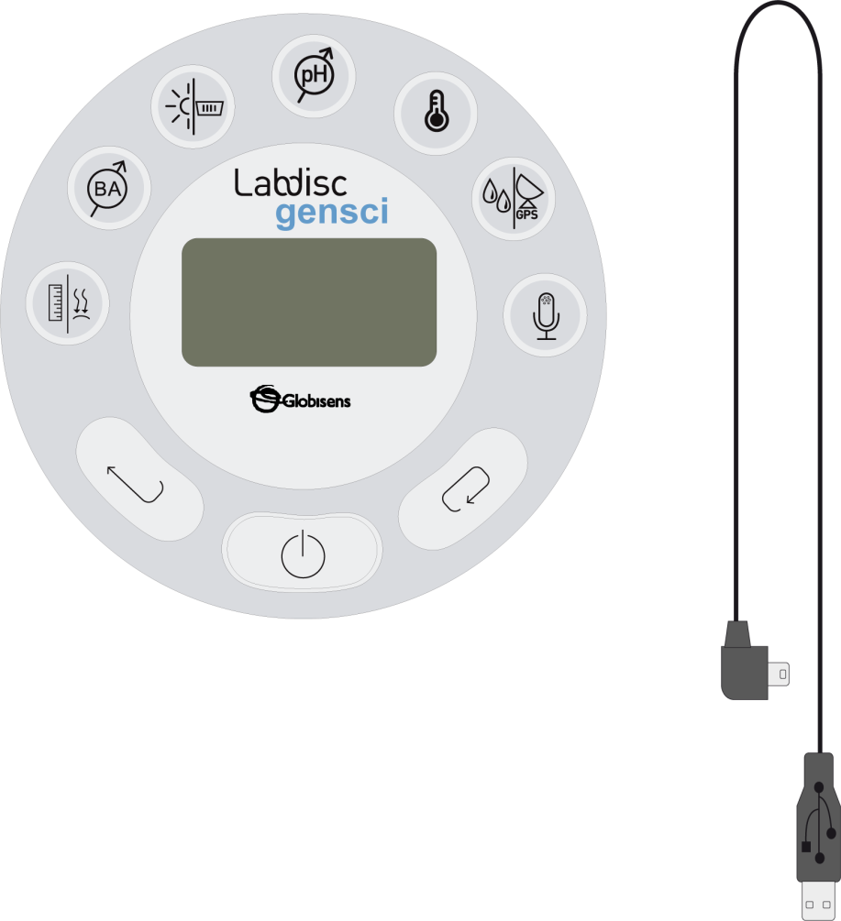
Temperature variation between day and night
Measuring thermal oscillation and luminosity during a full day
^{Resources and materials}
Labdisc
USB connector cable

Slide 13
Temperature variation between day and night
Measuring thermal oscillation and luminosity during a full day
^{Using the Labdisc}
^{a. Using the Labdisc}
To collect measurements with the Labdisc built-in temperature and light sensor, the Labdisc must be configured according to the following steps:
Turn on the Labdisc by pushing the button.
Push the button, and select “SETUP” with the button.
Select “SET SENSORS” option with the button.
Select only the room temperature and light sensors and then push
Once you have done this, push the button once and select “SAMPLING RATE” with the button.
Select “1/min” with the button then press the button.
Press the button and select “NUMBER OF SAMPLES” pushing

Slide 14
Temperature variation between day and night
Measuring thermal oscillation and luminosity during a full day
^{Using the Labdisc}
Select “10000” with the button and, then, push the button.
To go back to measuring press three times the button.
Then, push the Labdisc button to start measuring.
Once you have finished measuring, stop the Labdisc. To do this, push the button (the instruction “Press SCROLL key to STOP” will appear on the screen), then press the button.

Slide 15
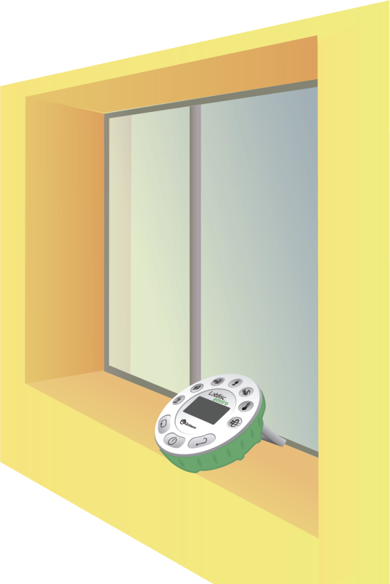
Temperature variation between day and night
Measuring thermal oscillation and luminosity during a full day
^{Experiment}
The following steps explain how to perform the experiment:
Find a location in your school where the Labdisc can be placed without danger of interference during a whole day.

Slide 16
Temperature variation between day and night
Measuring thermal oscillation and luminosity during a full day
^{Experiment}
Put the Labdisc in the previously selected location and activate it to register the temperature data.
Register the sensor activation time (be sure it is on the hour so for example, 9:00 am).
After measuring for a period of 24 hours stop the sensor.

Slide 17
Temperature variation between day and night
Measuring thermal oscillation and luminosity during a full day
^{Results and analysis}
The following steps explain how to analyze the experiment results:
Connect the Labdisc to the computer using the USB communication cable or via the Bluetooth wireless communication channel.
In the top menu click on the button and select the button.
From the measurements list that will appear, select the last experiment made.
Observe the graph building on the screen.
Push the button and put notes on the graph specifying the date and time of data taken.
Click on the button to select points within the graph and choose a representative point for each shift (morning, noon, afternoon, night, midnight, dawn).

Slide 18
Temperature variation between day and night
Measuring thermal oscillation and luminosity during a full day
^{Results and analysis}
Did you find differences between what you registered with the Labdisc and what you had predicted in the hypothesis? What were they?
If you compare the place where you live with a desert (like the Arizona desert), what
differences exist at the level of thermal range and luminosity? Explain.

Slide 19
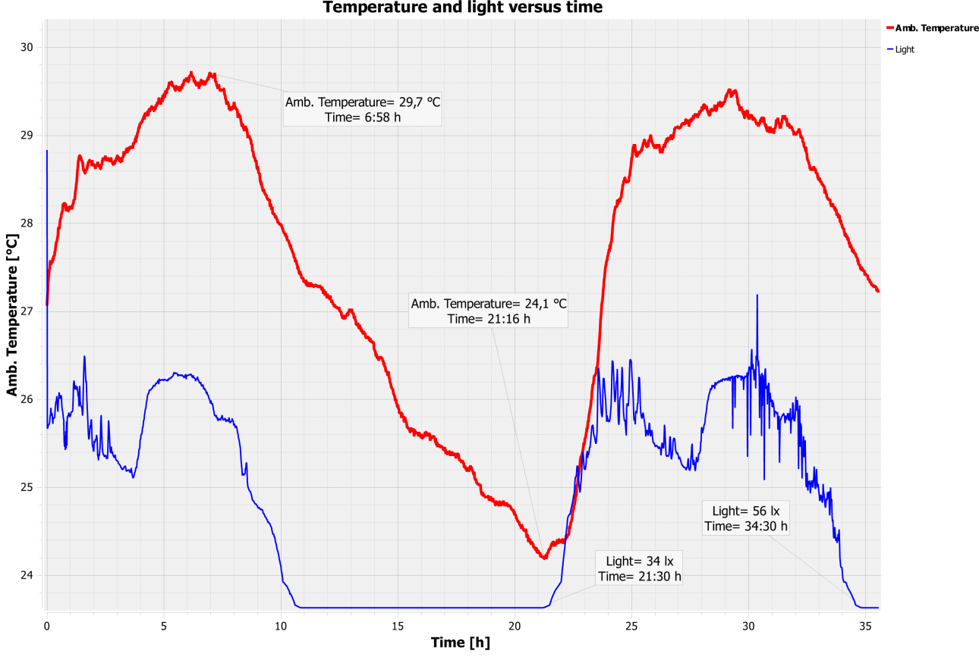
Temperature variation between day and night
Measuring thermal oscillation and luminosity during a full day
^{Results and analysis}
The graph below should be similar to the one the students came up with.

Slide 20
Temperature variation between day and night
Measuring thermal oscillation and luminosity during a full day
^{Conclusions}
Following are some questions and answers which should be developed by students in order to elaborate on their conclusions.
Did you observe temperature differences during the different shifts of the day?
Which ones?
It is intended that students interpret the graph and observe that in fact room
temperature changes as a full day passes.
Did you observe any relation between luminosity and room temperature?
What was it?
It is intended that students observe and analyze the graph, and from this establish that there is a correlation between luminosity and temperature, and that the higher luminosity, the higher temperature.

Slide 21
Temperature variation between day and night
Measuring thermal oscillation and luminosity during a full day
^{Conclusions}
If you had to classify the thermal oscillation of the place where you live into high, medium or low, how would you do it and why?
Students should classify the thermal oscillation obtained in their schools. They should indicate why and according to which factors they made this classification.
Do you think it is important to know the weather forecast of the highest and lowest temperature registered in a day? Why?
It is intended that students use their experience and indicate if at any moment they
have given importance to highest and lowest temperature predictions from their areas,
for example at the moment of choosing what to wear the following day.

Slide 22
Temperature variation between day and night
Measuring thermal oscillation and luminosity during a full day
^{Conclusions}
What environmental and geographical factors do you think are involved in the thermal variations found in your area?
Students should analyze the place where they are and mention the factors they believe could be important at the moment of establishing a thermal oscillation of a given place, like the presence of mountains or hills, water masses, clouds, etc.
It is intended that students achieve the following conclusions.
To establish that the difference between the highest and the lowest temperature registered in a full day corresponds to the thermal range and it is given by the geography of the place, season of the year, etc. Between day and night there are differences in temperature, thus, during the day the sunlight shines directly on the area, increasing the ambient temperature, while at night, when the sun rays fall on the opposite face of the earth, temperature is lower. Therefore, there is a correlation between the luminosity of a place and the temperature it presents.

Slide 23
Temperature variation between day and night
Measuring thermal oscillation and luminosity during a full day
Activities for further application
The aim of this section is for students to extrapolate the acquired knowledge during this class through its application in different contexts and situations. Furthermore, it is intended that students question and present possible explanations to the experimentally observed phenomena.
Further questions:
Do you believe that at the Poles there is a big thermal range? Justify.
It is intended that students understand that there should not be a big thermal range at the Poles, because there is not a big difference between the highest and the lowest temperature registered in a day, due to the earth’s positioning regarding the sun.

Slide 24
Temperature variation between day and night
Measuring thermal oscillation and luminosity during a full day
Activities for further application
If you had to forecast the weather, what factors would you consider to make
the prediction?
Students should point out that factors such as humidity, geography, height,
presence or absence of water, atmospheric pressure, season of the year, etc.,
should be considered.
Do you believe there are places on the earth where it is hotter at night than during the day?
It is intended that students answer that in general there should not be places on the earth where it is hotter at night than in the day, because during the day the sun heats the atmosphere.

