Slide 1

The Candle Flame
Measuring the temperature of a flame according to the “three zones model”

Slide 2
^{The Candle Flame}
Measuring the temperature of a flame according
to the “three zones model”
^{USA Standards Correlation}
FRAMEWORK FOR K-12 SCIENCE EDUCATION © 2012
The Dimension I practices listed below are called out as bold words throughout the activity.
Dimension 1 Science and Engineering Practices | ü | Asking questions (for science) and defining problems (for engineering) |  | Use mathematics and computational thinking
 | ü | Developing and using models |  | Constructing explanations (for science) and designing solutions (for engineering)
 | ü | Planning and carrying out investigations | ü | Engaging in argument from evidence
 | ü | Analyzing and interpreting data | ü | Obtaining, evaluating, and communicating information
Dimension 2 Cross Cutting Concepts | ü | Patterns | ü | Energy and matter: Flows, cycles, and conservation
 | ü | Cause and effect: Mechanism and explanation |  | Structure and function
 | ü | Scale, proportion, and quantity |  | Stability and change
 | ü | Systems and system models

Slide 3
^{The Candle Flame}
Measuring the temperature of a flame according
to the “three zones model”
^{USA Standards Correlation}
Dimension 3 Core Concepts | Discipline | Core Idea Focus
 | Physical Science | PS3: Energy
 |  | PS3.D: Energy in Chemical Processes and Everyday Life
NGSS Standards | Middle School Standards Covered | High School Standards Covered
 | MS.PS-E: Energy | HS.PS-E: Energy

Slide 4
^{The Candle Flame}
Measuring the temperature of a flame according
to the “three zones model”
^{USA Standards Correlation}
NATIONAL SCIENCE EDUCATION STANDARDS © 2002
Content Standards (K-12)
ü | Systems, order, and organization |  | Evolution and equilibrium
ü | Evidence, models, and explanation | ü | Form and Function
ü | Constancy, change, and measurement
Physical Science Standards Middle School |  | Physical Science Standards High School
 | Properties and Changes of Properties in Matter |  | Structure of Atoms
 | Motion and Forces |  | Structure and Properties of Matter
ü | Transfer of Energy | ü | Chemical Reactions
 |  |  | Motion and Forces
 |  |  | Conservation of Energy and Increase in Disorder
 |  | ü | Interactions of Energy and Matter

Slide 5
^{The Candle Flame}
Measuring the temperature of a flame according
to the “three zones model”
^{USA Standards Correlation}
LEARNING OBJECTIVES
Core Objectives (National Standards):
Develop the ability to refine ill-defined questions and direct to phenomena that can be described, explained, or predicted through scientific means.
Develop the ability to observe, measure accurately, identify and control variables.
Decide what evidence can be used to support or refute a hypothesis.
Gather, store, retrieve, and analyze data.
Become confident at communicating methods, instructions, observations, and results with others.
Activity Objectives:
The purpose of this activity is to relate temperature and color in a candle flame, create a hypothesis and proceed to test it using the Globisens Labdisc thermocouple sensor.
Time Requirement:
60 – 90 Minutes

Slide 6
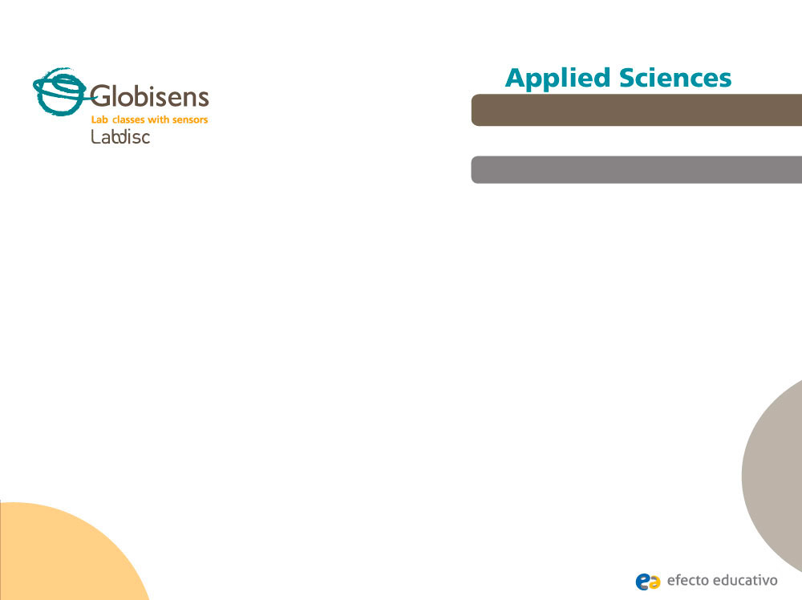
^{The Candle Flame}
Measuring the temperature of a flame according
to the “three zones model”
^{Objective}
The purpose of this activity is to relate temperature and color in a candle flame, create a hypothesis and proceed to test it using the Labidsc thermocouple sensor.

Slide 7

^{The Candle Flame}
Measuring the temperature of a flame according
to the “three zones model”
^{Introduction and theory}
Different materials change their appearance because of environmental influences. Heat is one of the most common environmental factors and it produces an easily recognizable change of color in matter when temperature is increased. An example of this phenomenon can be found in the metal industry where metals show a bright yellow color just before melting which is called incandescence. It is therefore clear that not only can we relate color to the temperature of matter, but also to its intensity.

Slide 8

^{The Candle Flame}
Measuring the temperature of a flame according
to the “three zones model”
^{Introduction and theory}
Why do you think we call some colors warm or cold? Think of examples.
Have you ever seen the different colors of a candle flame? Have you felt the irradiated heat from the flame?
According to what we’ve discussed so far, a simple candle flame can make an interesting scientific study object and in this experiment we’ll try to discover all its complexity.
Carry out the experiment activity with your class so that at the end you’ll be able to answer the following question:
Are the colors of a flame related to the temperature gradient along it?

Slide 9

^{The Candle Flame}
Measuring the temperature of a flame according
to the “three zones model”
^{Introduction and theory}
^{Theoretical}
A candle flame is produced by the combustion of wax, a hydrocarbon. Once the candle has been lit, the heat melts the wax which rises through the wick by capillarity and is vaporized.
The color gradient reveals the temperature increase from the base to the top of the flame, similar to the ignition of a metal. In this case, elemental carbon particles called soot are released from the incomplete combustion of the wax and are heated by the exothermic energy of this reaction – thus emitting light.

Slide 10
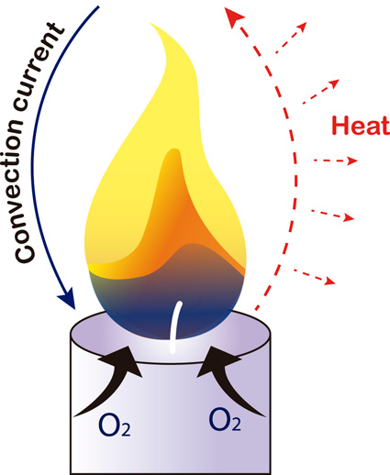
^{The Candle Flame}
Measuring the temperature of a flame according
to the “three zones model”
^{Introduction and theory}
The flame of a candle has a structure comprised of three areas, showing colors near to the infrared spectrum the higher the temperature is:
Blue area: Basal region of the flame where combustion is complete due to the richness of oxygen. Carbon particles are not present here.
Orange/brown area: The majority of oxygen is consumed in the blue area, therefore the combustion here is incomplete. Because of that, we can find a great concentration of carbon which is heated to temperatures ranging from 800 to 900 °C.
Yellow area: The chemical conditions here are similar to the previous area; however the carbon particles have now reached higher temperatures.

Slide 11

^{The Candle Flame}
Measuring the temperature of a flame according
to the “three zones model”
^{Introduction and theory}
Now students are encouraged to raise a hypothesis which must be tested with an experiment.
If you measure the temperature of different areas of a candle flame, how do you expect the results to change when you measure from the lowest to the highest zone? Why?

Slide 12
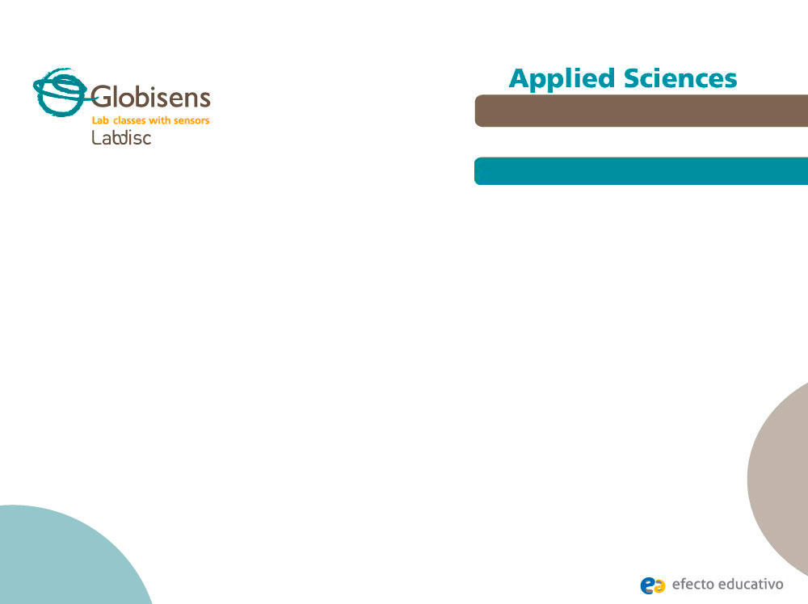
^{The Candle Flame}
Measuring the temperature of a flame according
to the “three zones model”
^{Activity description}
Students will study the relationship between the chromatic structure of a candle flame and the temperature of each area, calculating the magnitude differences quantitatively. They will use tools for graph analysis to find out the results.

Slide 13
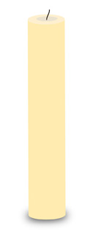
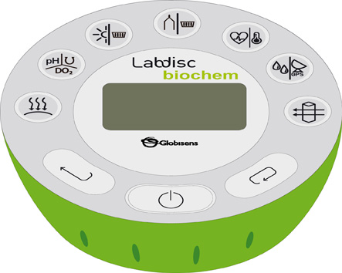
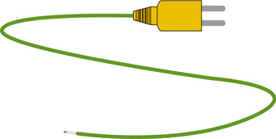
^{The Candle Flame}
Measuring the temperature of a flame according
to the “three zones model”
^{Resources and materials}
Labdisc
Thermocouple
Candle
Matches
3
1
1
2
3
2
4

Slide 14
^{The Candle Flame}
Measuring the temperature of a flame according
to the “three zones model”
^{Using the Labdisc}
^{Labdisc configuration}
To collect measurements with the Labdisc and thermocouple sensor, the Labdisc must be configured according to the following steps:
Open the GlobiLab software and turn on the Labdisc
Click on the Bluetooth icon in the bottom right corner of the GlobiLab screen. Select the Labdisc you are using currently. Once the Labdisc has been recognized by the software, the icon will change from a grey to blue color . If you prefer a USB connection follow the previous instruction clicking on the USB icon. You will see the same color change when the Labdisc is recognized .
1
2

Slide 15
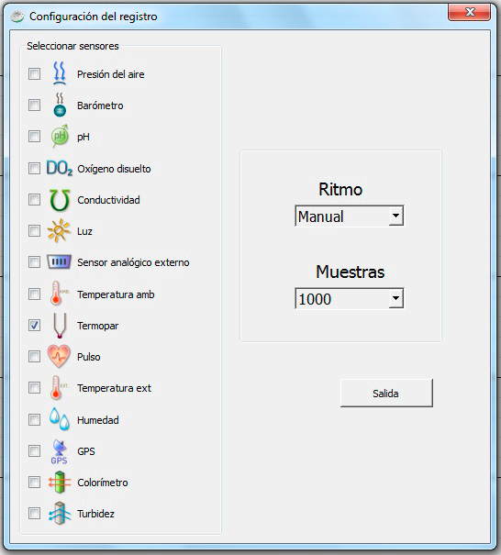
^{The Candle Flame}
Measuring the temperature of a flame according
to the “three zones model”
^{Using the Labdisc}
3
Click on to configure the Labdisc. Select thermocouple in the “Logger Setup” window. Enter “Manual” for the sampling rate.

Slide 16


^{The Candle Flame}
Measuring the temperature of a flame according
to the “three zones model”
^{Using the Labdisc}
4
Once you have finished the sensor configuration start measuring by clicking
Once you have finished measuring stop the Labdisc by clicking
5

Slide 17
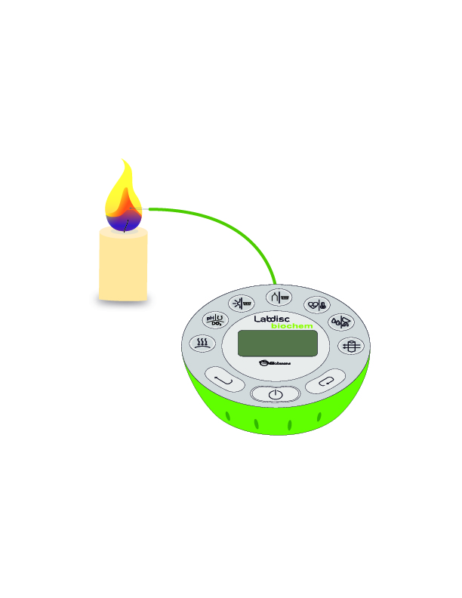
^{The Candle Flame}
Measuring the temperature of a flame according
to the “three zones model”
^{Experiment}
1
Light a candle and wait one to two minutes. After this period throw away the liquid wax and measure the flame height.
Identify the three separate areas in the flame. Start with the blue zone and move up the flame.
2

Slide 18
^{The Candle Flame}
Measuring the temperature of a flame according
to the “three zones model”
^{Experiment}
As you introduce the thermocouple to each of the three areas of the flame, measure the temperature. Before recording each new sample make sure the thermocouple tip is soot-free.
Be careful:
The thermocouple isolation is easily burnt when it is close to fire.
Once you have finished measuring stop the Labdisc
3
4

Slide 19




^{The Candle Flame}
Measuring the temperature of a flame according
to the “three zones model”
^{Results and analysis}
1
Select a bar graph from the GlobiLab menu to show the experiment results. Then, add pictures of each bar to indicate the measured areas by clicking ..
Get the average, maximum and minimum values of temperature using the statistics tool from the menu and calculate the difference between the
extreme temperatures.
Observe the table data by clicking on and compare the average value with the central temperature of the flame.
2
3

Slide 20

^{The Candle Flame}
Measuring the temperature of a flame according
to the “three zones model”
^{Results and analysis}
How do the results relate to your initial hypothesis? Explain.
What was the relationship between the color and temperature of the flame?
Where did you record the minimum and maximum temperature values? What was the average between these magnitudes? Was the average similar to the temperature in the second area (orange/brown)?
What was the magnitude of temperature range within the flame height? Did you expect this result?

Slide 21
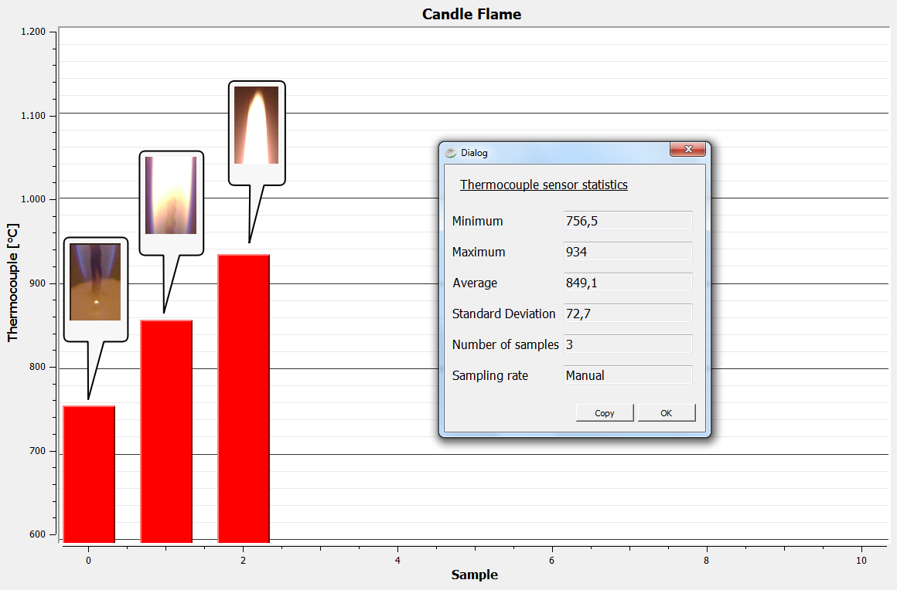
^{The Candle Flame}
Measuring the temperature of a flame according
to the “three zones model”
^{Results and analysis}
The graph below should be similar to the one the students came up with:

Slide 22

^{The Candle Flame}
Measuring the temperature of a flame according
to the “three zones model”
^{Conclusion}
What variables are correlated in this experiment?
Students should point out that the temperature increase is related to the spectral scale, namely “warmer colors” show the higher temperatures. Indirectly, the height of the flame could also be correlated with the temperature.
Why is the basal area of the flame blue?
Students should mainly consider two reasons: This area has the higher oxygen concentration since it is the starting point of the gas that determines the complete combustion. As a result the amount of carbon is not meaningful and therefore the ignition is practically nothing.

Slide 23
^{The Candle Flame}
Measuring the temperature of a flame according
to the “three zones model”
^{Conclusion}
How are warm colors produced in the upper and middle areas of the flame?
Students should remember from the theoretical background that the carbon particles are heated by the exothermic energy. The carbon then becomes incandescent and emits light near to the infrared spectrum.

Slide 24

^{The Candle Flame}
Measuring the temperature of a flame according
to the “three zones model”
Activities for further application
In what position should the ring of a Bunsen burner be located to heat a beaker with the least amount of soot? Why?
Students should point out that the most important condition is to allow the greatest possible amount of oxygen to enter. In this way a complete combustion reaction is reached which produces a low soot concentration.
If you wanted to know the approximate mean temperature of a steel nail heated at its tip, what zone would you measure?
Students should use the knowledge obtained during the class to suggest they could get an approximate value in the middle zone of the nail.

Slide 25


