Slide 1
Acid Rain
Demonstrating the acid rain phenomenon

Slide 2
^{Acid Rain}
Demonstrating the acid rain phenomenon
^{USA Standards Correlation}
FRAMEWORK FOR K-12 SCIENCE EDUCATION © 2012
The Dimension I practices listed below are called out as bold words throughout the activity.
Dimension 1 Science and Engineering Practices | ü | Asking questions (for science) and defining problems (for engineering) | ü | Use mathematics and computational thinking
 | ü | Developing and using models | ü | Constructing explanations (for science) and designing solutions (for engineering)
 | ü | Planning and carrying out investigations | ü | Engaging in argument from evidence
 | ü | Analyzing and interpreting data | ü | Obtaining, evaluating, and communicating information
Dimension 2 Cross Cutting Concepts | ü | Patterns | ü | Energy and matter: Flows, cycles, and conservation
 | ü | Cause and effect: Mechanism and explanation | ü | Structure and function
 | ü | Scale, proportion, and quantity | ü | Stability and change
 | ü | Systems and system models

Slide 3
^{Acid Rain}
Demonstrating the acid rain phenomenon
^{USA Standards Correlation}
Dimension 3 Core Concepts | Discipline | Core Idea Focus
 | Earth and Space Science | ESS2: Earth’s Systems
 |  | ESS2.D: Weather and Climate
 |  | ESS3: Earth and Human Activity
 |  | ESS3.C: Human Impacts on Earth Systems
NGSS Standards | Middle School Standards Covered | High School Standards Covered
 | MS.ESS-WC: Weather and Climate Systems | HS.ESS-CC: Climate Change
 | MS.ESS-HI: Human Impacts | HS.ESS-HS: Human Sustainability

Slide 4
^{Acid Rain}
Demonstrating the acid rain phenomenon
^{USA Standards Correlation}
NATIONAL SCIENCE EDUCATION STANDARDS © 2002
Content Standards (K-12)
ü | Systems, order, and organization |  | Evolution and equilibrium
ü | Evidence, models, and explanation | ü | Form and Function
ü | Constancy, change, and measurement
Earth and Space Science Standards Middle School |  | Earth and Space Science Standards High School
ü | Structure of the Earth System |  | Energy in the Earth System
 | Earth’s History | ü | Geochemical Cycles
 | Earth in the Solar System |  | Origin and Evolution of the Earth System
 |  |  | Origin and Evolution of the Universe

Slide 5
^{Acid Rain}
Demonstrating the acid rain phenomenon
^{USA Standards Correlation}
LEARNING OBJECTIVES
Core Objectives (National Standards):
Develop the ability to refine ill-defined questions and direct to phenomena that can be described, explained, or predicted through scientific means.
Develop the ability to observe, measure accurately, identify and control variables.
Decide what evidence can be used to support or refute a hypothesis.
Gather, store, retrieve, and analyze data.
Become confident at communicating methods, instructions, observations, and results with others.
Activity Objectives:
The purpose of this activity is to investigate the effects of acid rain as a forerunner to water acidity, create a hypothesis, and test the hypothesis, using the Globisens Labdisc pH-meter sensor.
Time Requirement: 30 – 45 Minutes

Slide 6
^{Acid Rain}
Demonstrating the acid rain phenomenon
^{Objective}
The purpose of this activity is to investigate the effect of acid rain forerunner on water acidity, create a hypothesis and proceed to test it using the Labidsc pH-meter sensor.

Slide 7
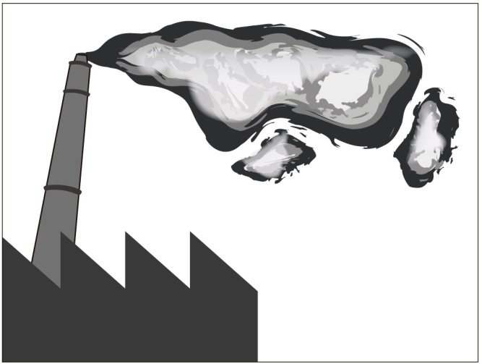
^{Acid Rain}
Demonstrating the acid rain phenomenon
^{Introduction and theory}
In our modern society we rely on the use of fossil fuels in numerous aspects of our daily life, for example to operate vehicles, produce electricity, heating, industry and much more. A large amount of particulate pollutants are released into the atmosphere because of the combustion of these types of fuels. This contamination can be transported long distances by wind or become concentrated in defined spaces.

Slide 8
^{Acid Rain}
^{Acid Rain}
Demonstrating the acid rain phenomenon
^{Introduction and theory}
Have you ever seen or heard about the grey layer above some cities called smog?
What environmental effects are produced by gas emission from fossil fuel combustion?
Carry out the experiment activity with your class so that at the end you’ll be able to answer the following question:
What directly determines the pH of acid rain?

Slide 9
^{Acid Rain}
Demonstrating the acid rain phenomenon
^{Introduction and theory}
^{Theoretical}
The gases (nitrogen oxides, sulfur dioxide and carbon dioxide) produced by fossil fuels burning mainly react in the atmosphere with water and oxygen. The result is an acid solution which when it falls as water is called acid rain. Deposition of these compounds also occurs in wet environments where fog is present.
Acid rain mainly affects watershed ecosystems. The majority of lakes and streams have a pH between six and eight, a range essential to sustain an appropriate habitat for plants and animals. Many water bodies are seriously affected because the basin soils are unable to neutralize new loads of acidity.
The addition of acidic compounds to ground and water has a direct impact on plants and animals.

Slide 10
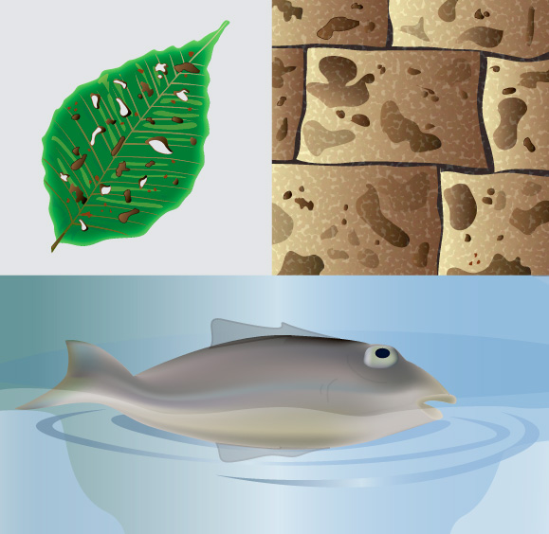
^{Acid Rain}
Demonstrating the acid rain phenomenon
^{Introduction and theory}
Many forests are highly sensitive to acid variation from soil and air humidity, resulting in detrimental effects such as the direct destruction of leaf tissue and even reduced growth of roots. Animals, fish and amphibians are affected mainly at the primary and juvenile stages with data showing that at pH 5 the majority of fish eggs cannot hatch and at lower pH adults die.
Acid rain also accelerates the decay of buildings of all types, which is of particular loss to mankind when culturally relevant sculptures and architectural monuments are affected.

Slide 11
^{Acid Rain}
Demonstrating the acid rain phenomenon
^{Introduction and theory}
Now students are encouraged to raise a hypothesis which must be tested with an experiment.
How will the water pH change by direct CO₂ exposure?

Slide 12
^{Acid Rain}
Demonstrating the acid rain phenomenon
^{Activity description}
Students will study the variation of water acidity due to carbon dioxide dissolution. They will blow into a volume of water with a straw and visualize their results in real time using GlobiLab software. After that, they will use tools for graph analysis to find out the results.

Slide 13
^{Acid Rain}
Demonstrating the acid rain phenomenon
^{Resources and materials}
Labdisc Biochem
Beaker
pH-meter
Straw
Distilled water
3
1
1
2
3
4
5
4
2

Slide 14
^{Acid Rain}
Demonstrating the acid rain phenomenon
^{Using the Labdisc}
^{Labdisc configuration}
To collect measurements with the Labdisc and pH sensor, the Labdisc must be configured according to the following steps:
Open the GlobiLab software and turn on the Labdisc
Click on the Bluetooth icon in the bottom right corner of the GlobiLab screen. Select the Labdisc you are using currently. Once the Labdisc has been recognized by the software, the icon will change from a grey to blue color . If you prefer a USB connection follow the previous instruction clicking on the USB icon. You will see the same color change when the Labdisc is recognized .
1
2

Slide 15
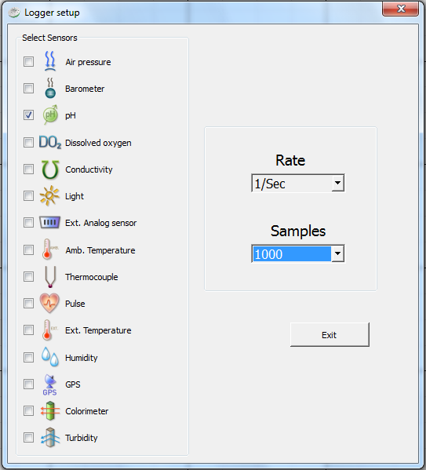
^{Acid Rain}
Demonstrating the acid rain phenomenon
^{Using the Labdisc}
3
Click on to configure the Labdisc. Select pH in the “Logger Setup” window. Enter “1/Sec” for the sampling Rate and “1000” for Samples.

Slide 16
^{Acid Rain}
Demonstrating the acid rain phenomenon
^{Using the Labdisc}
4
Once you have finished the sensor configuration start measuring by clicking
Once you have finished measuring stop the Labdisc by clicking
5

Slide 17
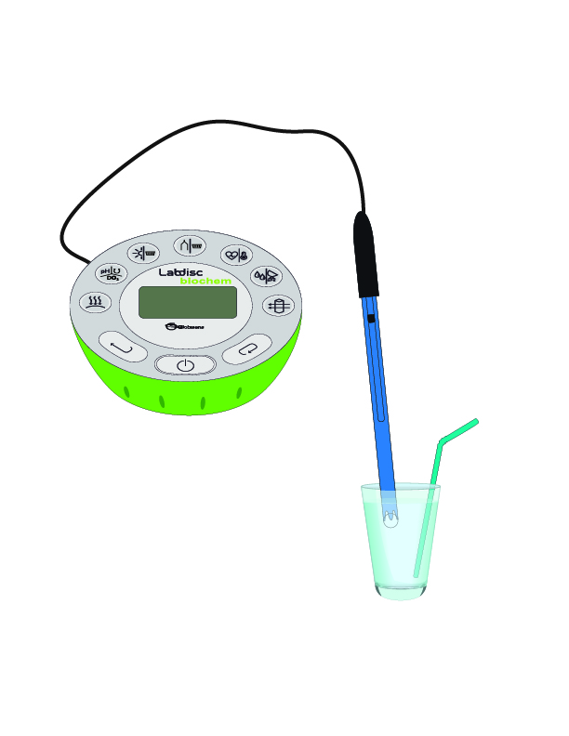
^{Acid Rain}
Demonstrating the acid rain phenomenon
^{Experiment}
1
Pour 50 mL. of distilled water in the beaker.
Enter the pH sensor without touching the sides or bottom of the beaker.
Start measurements and record the initial pH for a few seconds.
Blow into the water with the straw for one minute.
Continue measuring for one minute and then, stop Labdisc.
2
3
4
5

Slide 18
^{Acid Rain}
Demonstrating the acid rain phenomenon
^{Results and analysis}
1
Select a line graph from the GlobiLab menu to show the experiment results.
Then, label parts of the curve according to the experimental stages with the tool.
After that, show pH values from the initial and final states with the markers, by clicking on every section.
2
3

Slide 19
^{Acid Rain}
Demonstrating the acid rain phenomenon
^{Results and analysis}
Was your hypothesis proved? Explain.
What effect was caused by blowing air into the water?
What happened to the pH change when you stopped blowing?

Slide 20
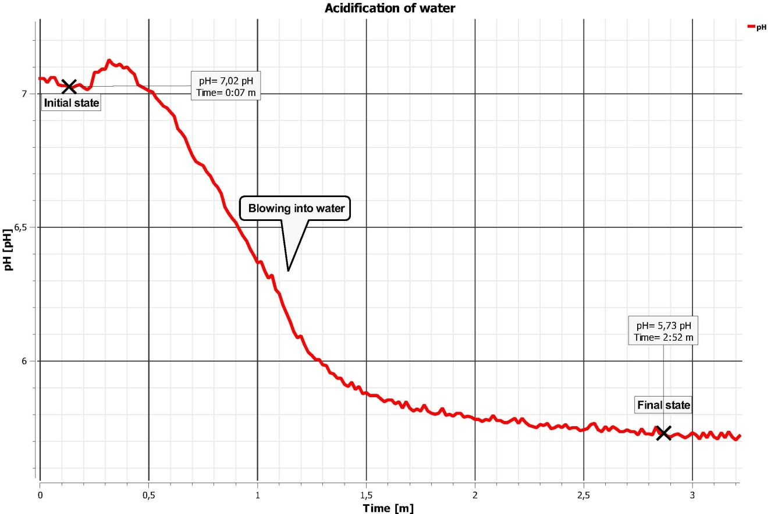
^{Acid Rain}
Demonstrating the acid rain phenomenon
^{Results and analysis}
The graph below should be similar to the one the students came up with:

Slide 21
^{Acid Rain}
Demonstrating the acid rain phenomenon
^{Conclusion}
What does the pH decrement depend on?
Students should point out that the pH decreases due to dissolution of carbon dioxide in water. The pH decrement is directly related to available CO₂ which depends on the time spent blowing into the water.
Why didn’t the pH reach the original value after the experiment?
Students should infer from the experiment that the dissolved carbon dioxide reacts to water and oxygen which comes from the blown air producing a carbonic acid solution. They could support their proposals by going over the theoretical background.

Slide 22
^{Acid Rain}
Demonstrating the acid rain phenomenon
^{Conclusion}
How can you relate this experiment to what happen on Earth?
Students should indicate that the acidification of water due to dissolved CO₂ as a result of the experiment is similar to atmospheric dissolution of industrial gases. It is important to relate the acidity degree to the concentration of this kind of pollution.

Slide 23
^{Acid Rain}
Demonstrating the acid rain phenomenon
Activities for further application
How would you evaluate the atmospheric contamination level in your city?
Students could propose to collect some samples of rain over winter in their city and measure the water acidity. They should plan to compare the pH values between the first rain after a long dry period and the next water samples.
What actions could help with the prevention of acid rain?
Students could suggest limiting the amount of industrial emissions and promote alternative energy sources. They also could indicate individual actions, such as cleaning smokestacks and pipes, turning devices off when they are not in use, better insulating homes to avoid excessive heating or cooling system use and more.

